Slide 1
Efficient Algorithms for the All-pairs Suffix-Prefix Problem and the All-pairs Substring-prefix Problem
Enno Ohlebusch, and Simon Gog,
Information Processing Letters, Vol. 110, No. 3, pp. 123-128, January 2010.
Presenter : Shie-Yan Lee
2018/5/15

Slide 2



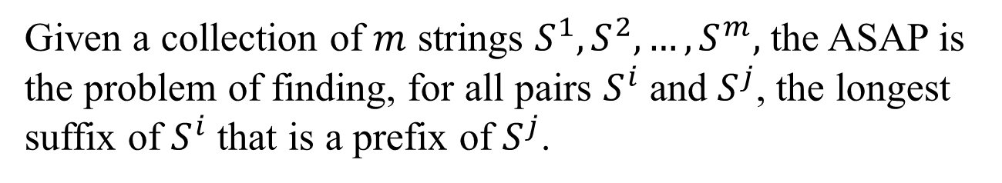




All-pairs suffix-prefix problem
Given a collection of $m$ strings $S^{1},S^{2},…,S^{m},$ the ASAP is the problem of finding, for all pairs $S^{i}$ and $S^{j}$, the longest suffix of $S^{i}$ that is a prefix of $S^{j}$.
$$S^{1}$$
$$S^{2}$$
$$S^{3}$$
$$S^{i}$$
$$S^{4}$$
$$S^{j}$$
......
$$S^{m}$$

Slide 3
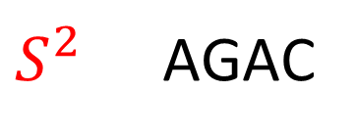
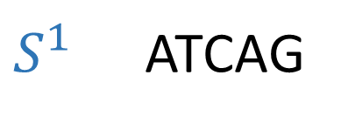
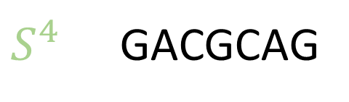
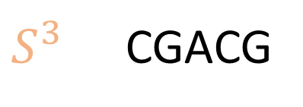
All-pairs suffix-prefix problem
Example :
$S^{1}$ ATCAG
$S^{2}$ AGAC
ATCAGACGACGCAG
$S^{3}$ CGACG
$S^{4}$ GACGCAG

Slide 4
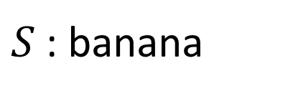
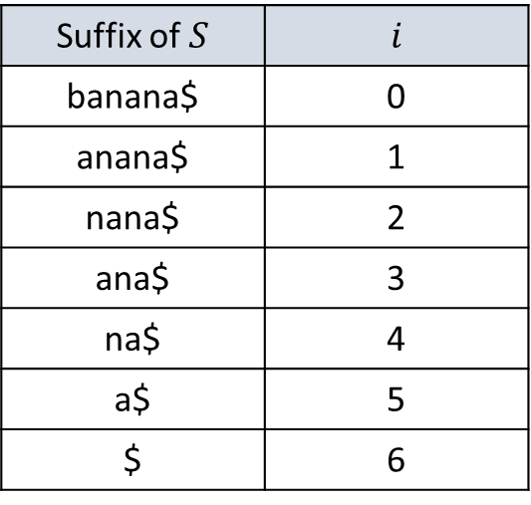
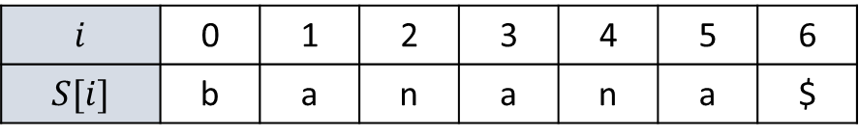
Suffix array (SA)
$S$ : banana
$$i$$ | 0 | 1 | 2 | 3 | 4 | 5 | 6
$$S[i]$$ | b | a | n | a | n | a | $
Suffix of $S$ | $$i$$
banana$ | 0
anana$ | 1
nana$ | 2
ana$ | 3
na$ | 4
a$ | 5
$ | 6

Slide 5
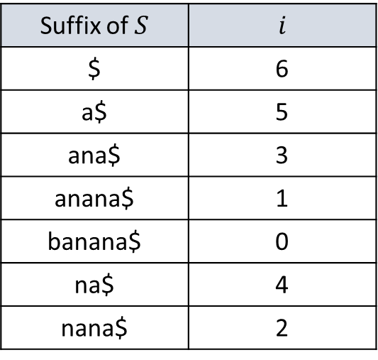
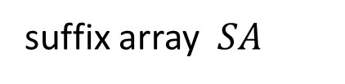
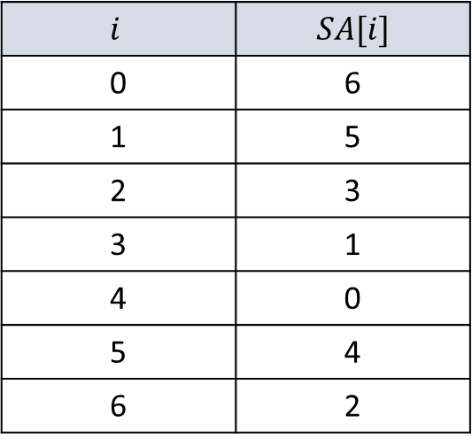
Suffix array (SA)
$S$ : banana
$$i$$ | 0 | 1 | 2 | 3 | 4 | 5 | 6
$$S[i]$$ | b | a | n | a | n | a | $
suffix array $SA$
Suffix of $S$ | $$i$$
$ | 6
a$ | 5
ana$ | 3
anana$ | 1
banana$ | 0
na$ | 4
nana$ | 2
$$i$$ | $$SA[i]$$
0 | 6
1 | 5
2 | 3
3 | 1
4 | 0
5 | 4
6 | 2

Slide 6
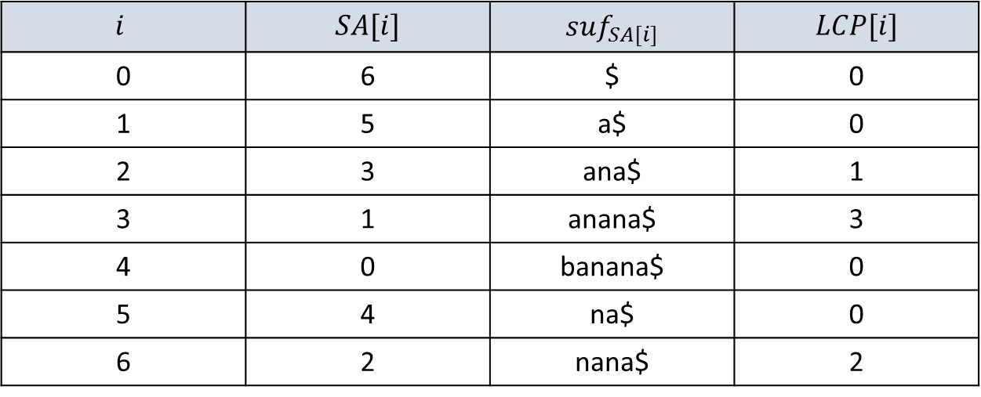
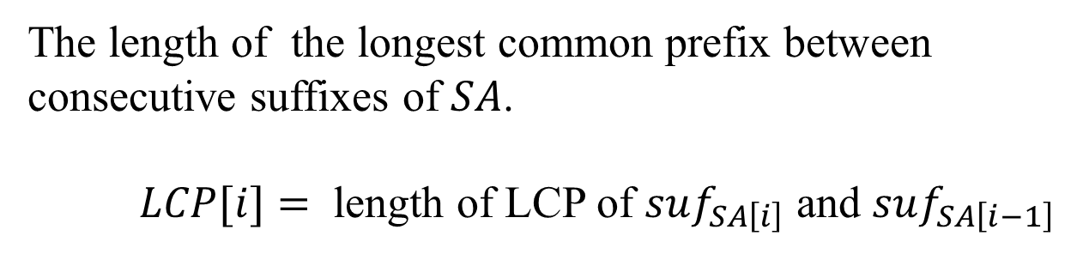
Longest common prefix (LCP)
The length of the longest common prefix between
consecutive suffixes of $SA$.
$LCP[i]=$ length of LCP of $suf_{SA\left[i\right]}$ and $suf_{SA\left[i−1\right]}$
$$i$$ | $$SA[i]$$ | $$suf_{SA[i]}$$ | $$LCP[i]$$
0 | 6 | $ | 0
1 | 5 | a$ | 0
2 | 3 | ana$ | 1
3 | 1 | anana$ | 3
4 | 0 | banana$ | 0
5 | 4 | na$ | 0
6 | 2 | nana$ | 2

Slide 7
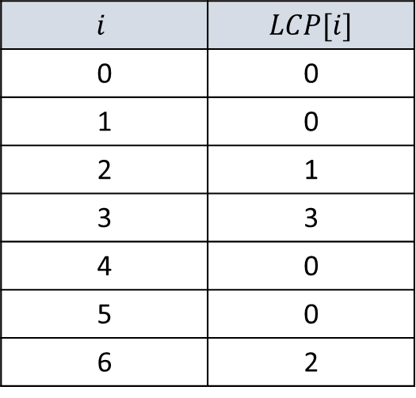
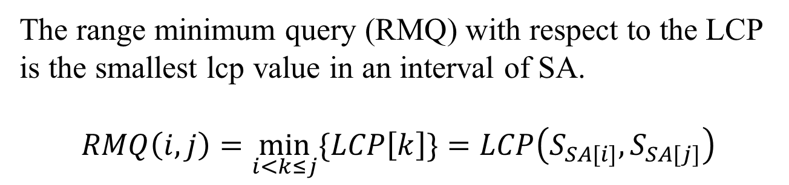
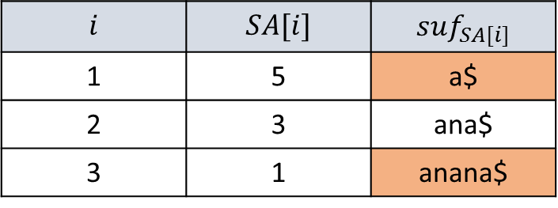
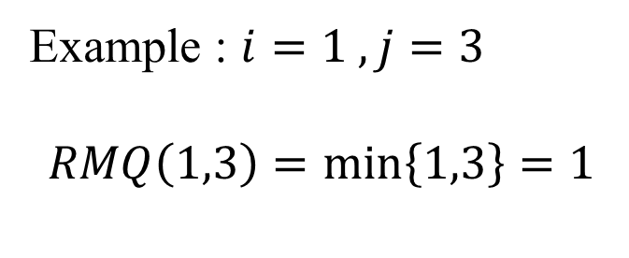
Range minimum query with LCP
The range minimum query (RMQ) with respect to the LCP
is the smallest lcp value in an interval of SA.
$$RMQ\left(i,j\right)=\min_{i<k≤j}{\{LCP\left[k\right]\}}=LCP\left(S_{SA[i]},S_{SA[j]}\right)$$
$$i$$ | $$LCP[i]$$
0 | 0
1 | 0
2 | 1
3 | 3
4 | 0
5 | 0
6 | 2
Example : $i=1 , j=3$
$$RMQ\left(1,3\right)=\min\left\{1,3\right\}=1$$
$$i$$ | $$SA[i]$$ | $$suf_{SA[i]}$$
1 | 5 | a$
2 | 3 | ana$
3 | 1 | anana$

Slide 8

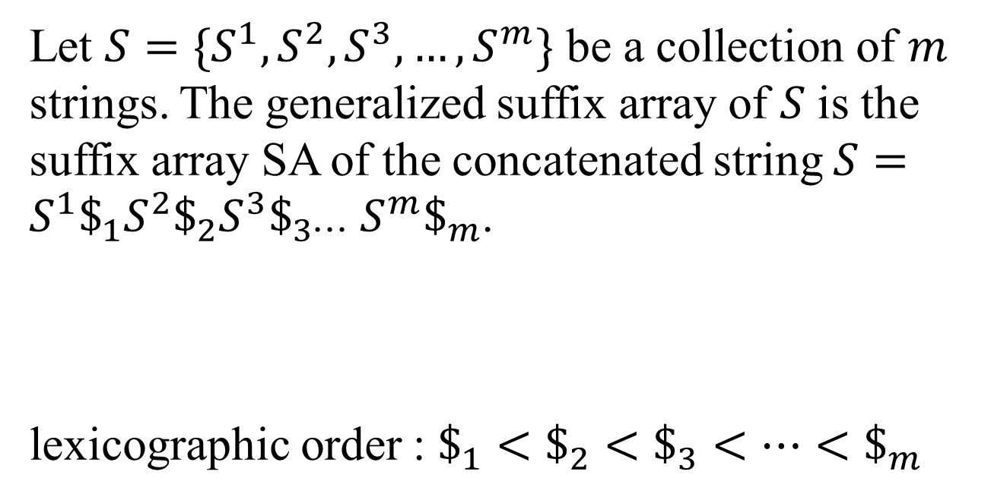



Generalized suffix array
Let $S=\{S^{1},S^{2},S^{3},…,S^{m}\}$ be a collection of $m$ strings. The generalized suffix array of $S$ is the suffix array SA of the concatenated string $S=S^{1}\$_{1}S^{2}\$_{2}S^{3}\$_{3}$... $S^{m}\$_{m}$.
lexicographic order : $\$_{1}<\$_{2}<\$_{3}<…<\$_{m}$
...
$$S^{1}$$
$$S^{2}$$
$$S^{3}$$
$$S^{m}$$

Slide 9
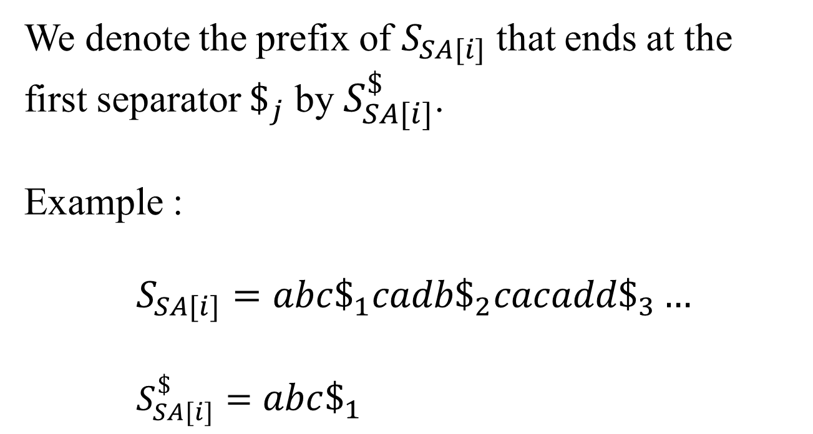
Generalized suffix array
We denote the prefix of $S_{SA[i]}$ that ends at the first separator $\$_{j}$ by $S_{SA[i]}^{\$}$.
Example :
$$S_{SA[i]}=abc\$_{1}cadb\$_{2}cacadd\$_{3}…$$
$S_{SA[i]}^{\$}=abc\$_{1}$

Slide 10
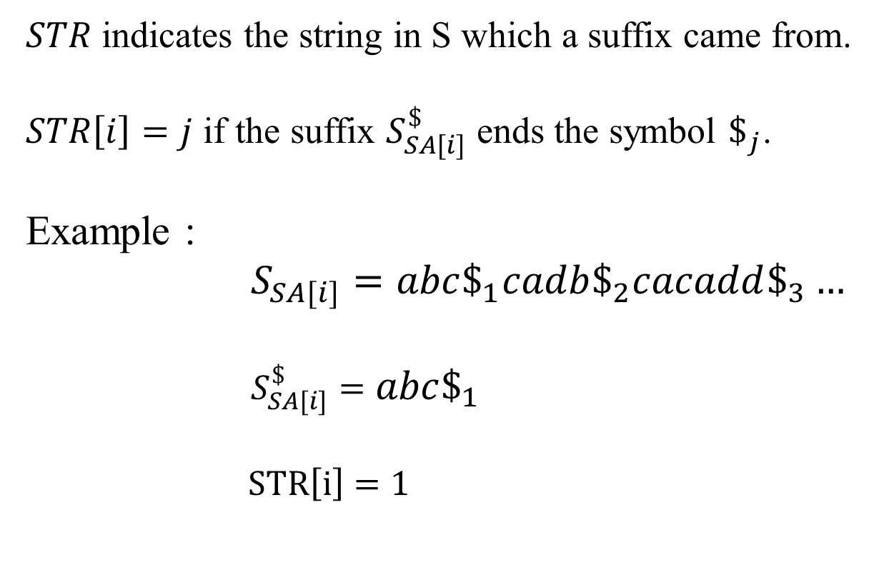
The STR array
$STR$ indicates the string in S which a suffix came from.
$STR\left[i\right]=j$ if the suffix $S_{SA[i]}^{\$}$ ends the symbol $\$_{j}$.
Example :
$S_{SA[i]}=abc\$_{1}cadb\$_{2}cacadd\$_{3}…$
$S_{SA[i]}^{\$}=abc\$_{1}$
$STR\left[i\right]=1$

Slide 11
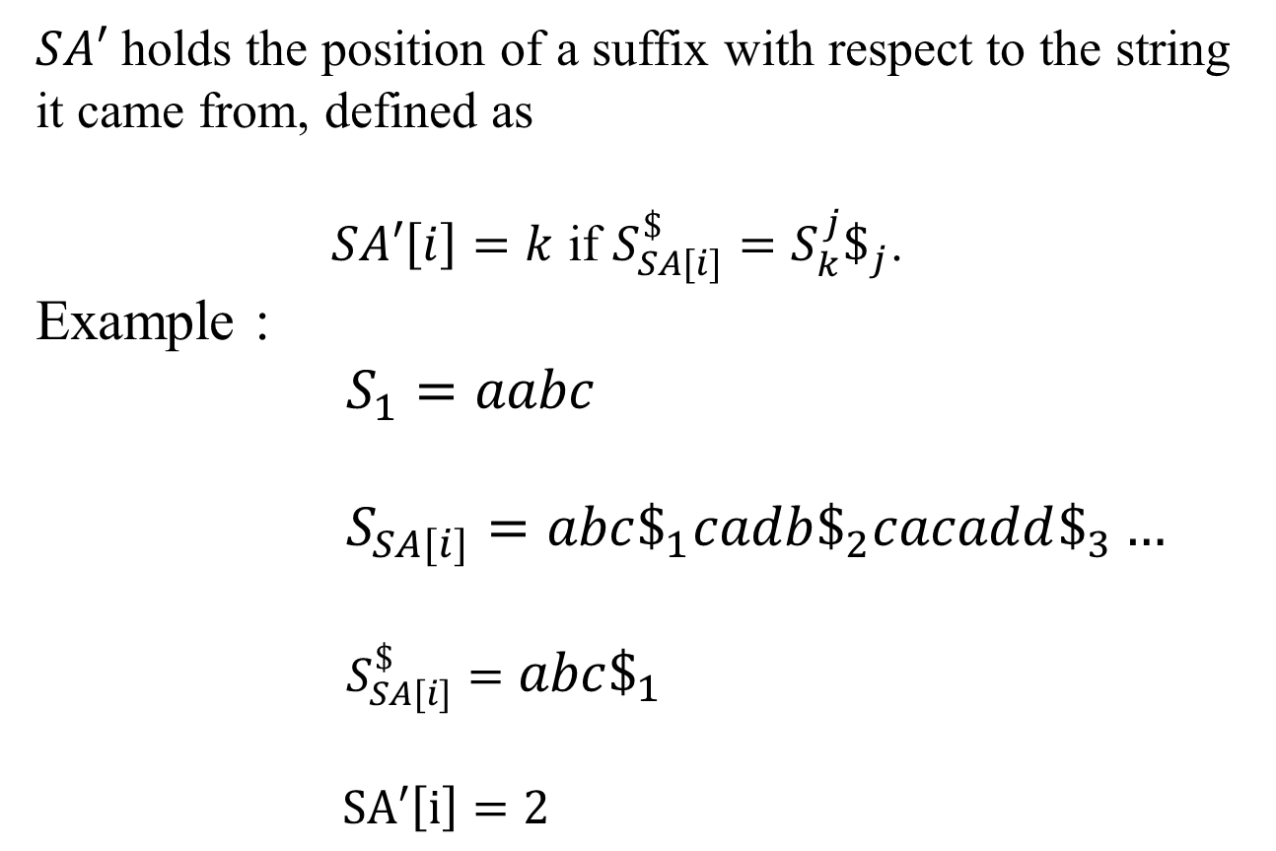
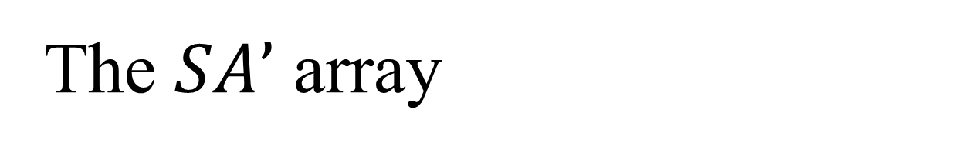
The $SA’$ array
$SA′$ holds the position of a suffix with respect to the string
it came from, defined as
$SA′\left[i\right]=k$ if $S_{SA[i]}^{\$}=S_{k}^{j}\$_{j}$.
Example :
$S_{1}=aabc$
$S_{SA[i]}=abc\$_{1}cadb\$_{2}cacadd\$_{3}…$
$S_{SA[i]}^{\$}=abc\$_{1}$
$SA′\left[i\right]=2$

Slide 12
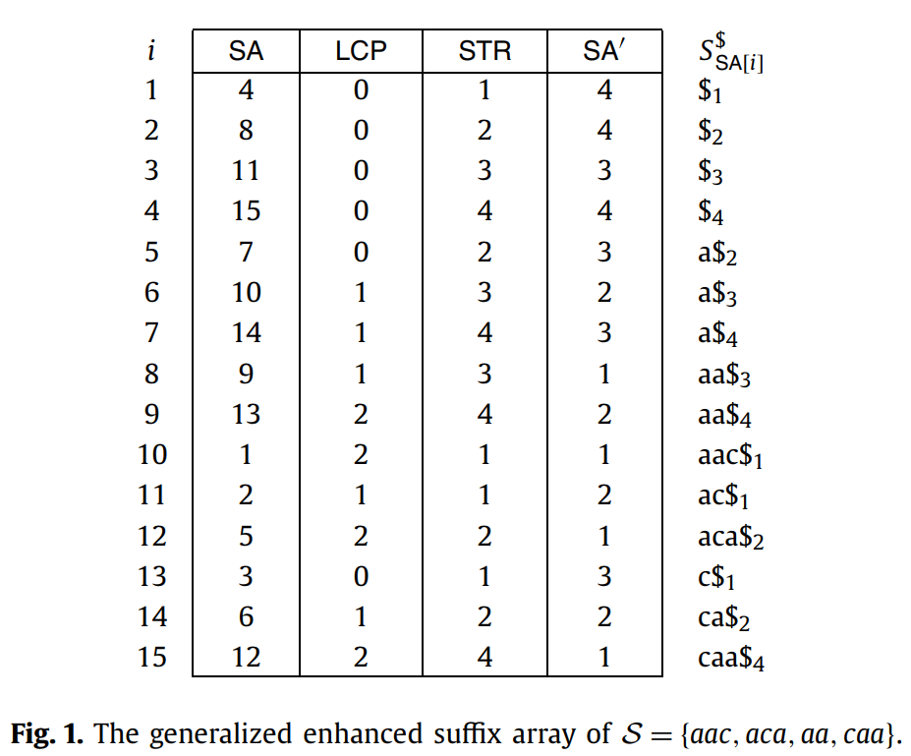
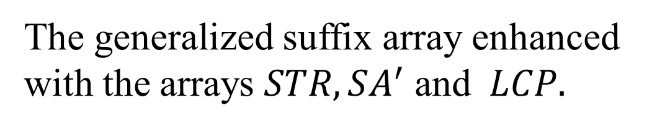
GESA
The generalized suffix array enhanced
with the arrays $STR, SA^{′}$ and $LCP.$

Slide 13
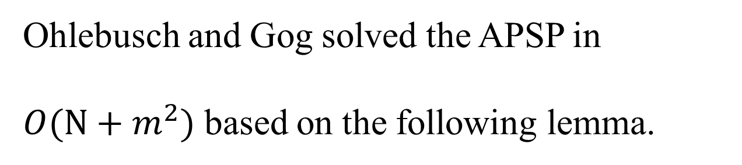
Algorithm by Ohlebusch and Gog
Ohlebusch and Gog solved the APSP in
$O(N+m^{2})$ based on the following lemma.

Slide 14
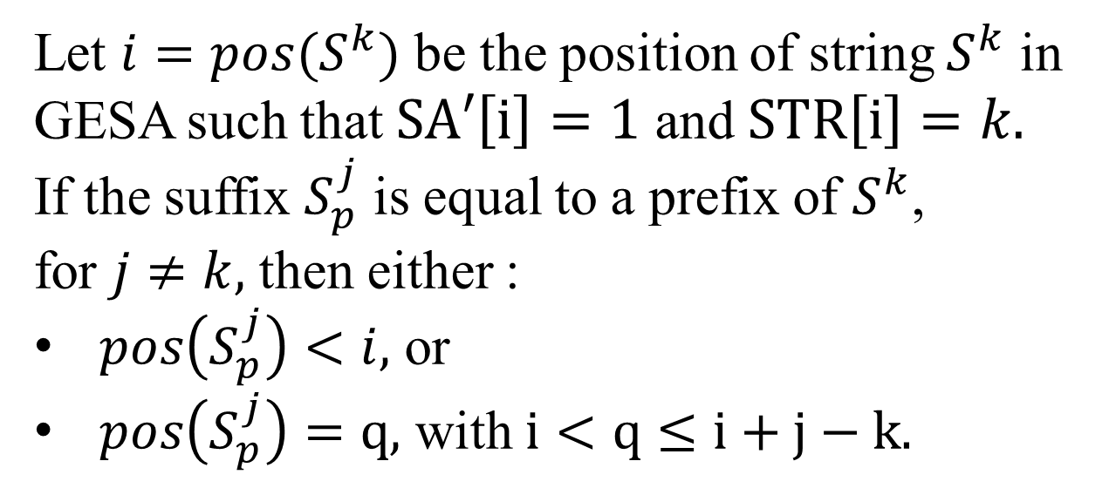
Let $i=pos(S^{k})$ be the position of string $S^{k}$ in GESA such that $SA′\left[i\right]=1$ and $STR\left[i\right]=k.$
If the suffix $S_{p}^{j}$ is equal to a prefix of $S^{k}$,
for $j≠k,$ then either :
$pos\left(S_{p}^{j}\right)<i,$ or
$pos\left(S_{p}^{j}\right)=q,$ with $i<q≤i+j−k.$

Slide 15



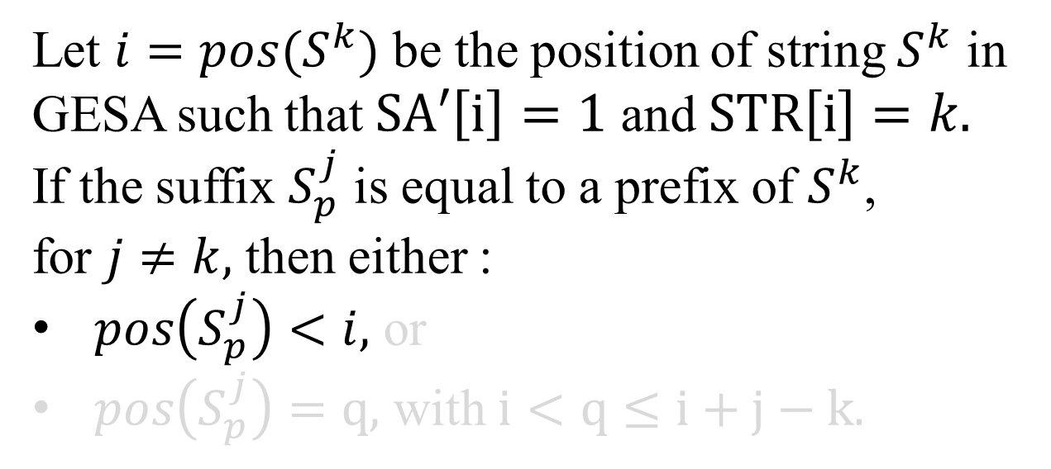





Let $i=pos(S^{k})$ be the position of string $S^{k}$ in GESA such that $SA′\left[i\right]=1$ and $STR\left[i\right]=k.$
If the suffix $S_{p}^{j}$ is equal to a prefix of $S^{k}$,
for $j≠k,$ then either :
$pos\left(S_{p}^{j}\right)<i,$ or
$pos\left(S_{p}^{j}\right)=q,$ with $i<q≤i+j−k.$
...
$$A$$
...
$$A$$
...
$$S^{1}$$
$$S^{k}$$
$$S^{j}$$
$$S^{m}$$
$$A$$
$$\$_{j}$$

Slide 16



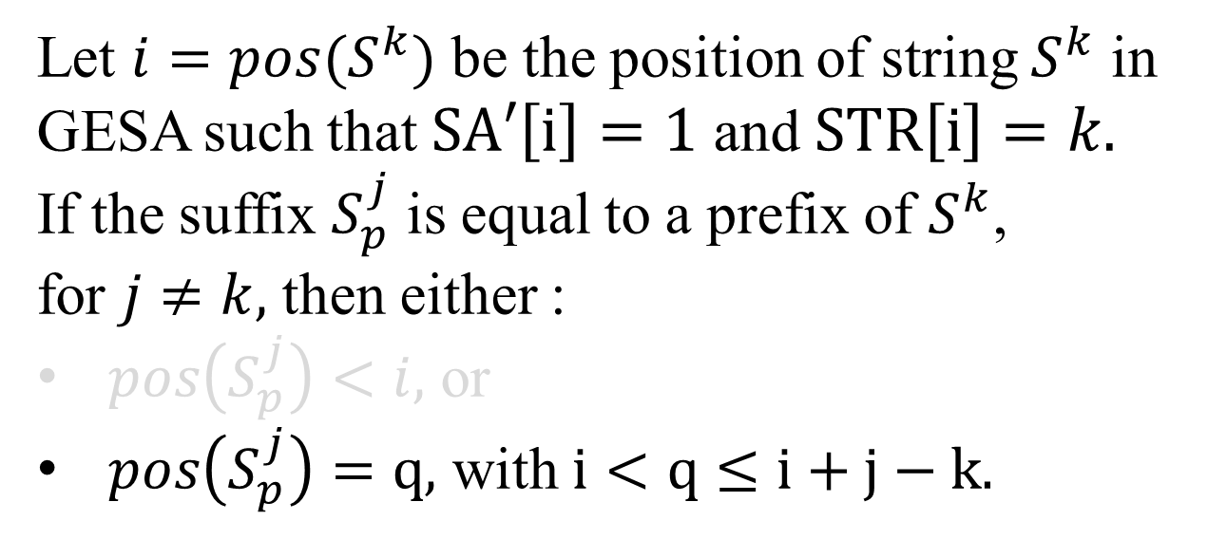





Let $i=pos(S^{k})$ be the position of string $S^{k}$ in GESA such that $SA′\left[i\right]=1$ and $STR\left[i\right]=k.$
If the suffix $S_{p}^{j}$ is equal to a prefix of $S^{k}$,
for $j≠k,$ then either :
$pos\left(S_{p}^{j}\right)<i,$ or
$pos\left(S_{p}^{j}\right)=q,$ with $i<q≤i+j−k.$
...
$$A$$
...
$$A$$
...
$$S^{1}$$
$$S^{k}$$
$$S^{j}$$
$$S^{m}$$
$$i$$
$$A$$
$$\$_{j}$$
$$S^{k}$$
...
...
$$q$$
$$S^{j}$$
...
...

Slide 17
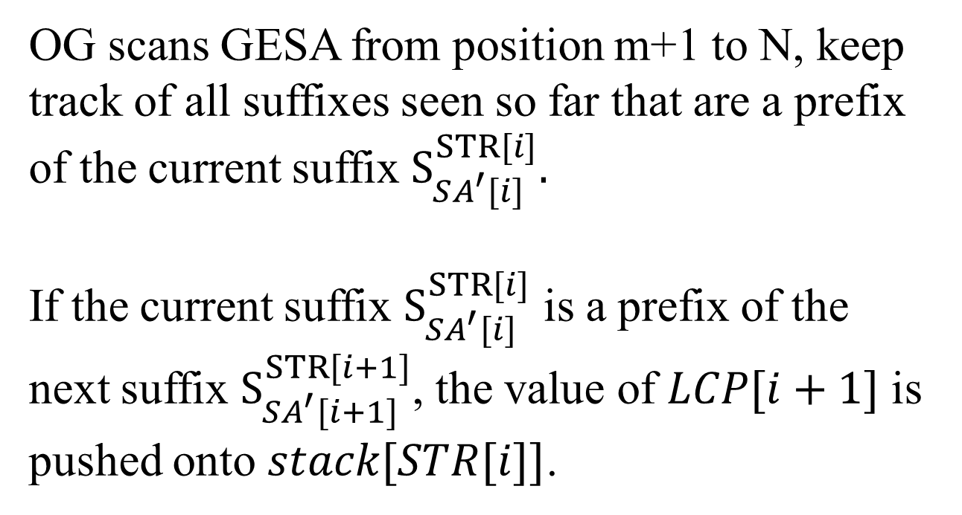

OG scans GESA from position m+1 to N, keep track of all suffixes seen so far that are a prefix of the current suffix $S_{SA^{′}[i]}^{STR[i]}.$
If the current suffix $S_{SA^{′}[i]}^{STR[i]}$ is a prefix of the next suffix $S_{SA^{′}[i+1]}^{STR[i+1]}$, the value of $LCP[i+1]$ is pushed onto $stack[STR[i]]$.
2
$$stack[4]$$

Slide 18
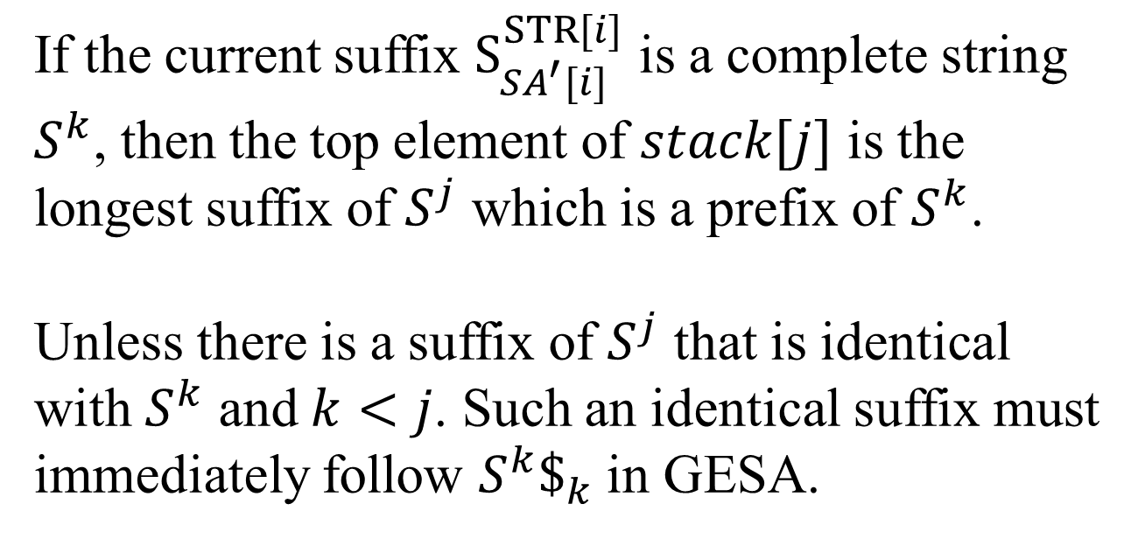


If the current suffix $S_{SA^{′}[i]}^{STR[i]}$ is a complete string $S^{k}$, then the top element of $stack[j]$ is the longest suffix of $S^{j}$ which is a prefix of $S^{k}$.
Unless there is a suffix of $S^{j}$ that is identical with $S^{k}$ and $k<j$. Such an identical suffix must immediately follow $S^{k}\$_{k}$ in GESA.
$$S^{1}=aac$$
2
$$S^{4}=caa$$
$$stack[4]$$

Slide 19




$Ov[i,j]$ represents the longest suffix of $S^{j}$ that is a prefix of $S^{i}$.
$$Ov\left[1,4\right]=2$$
$$S^{1}=aac$$
2
$$S^{4}=caa$$
$$stack[4]$$

Slide 20

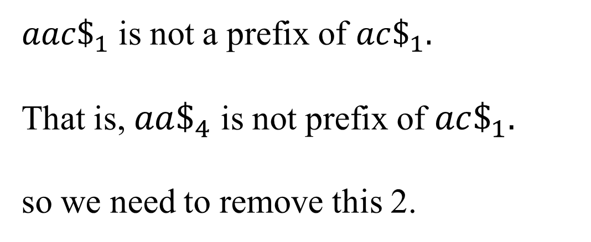
During the scan, all suffixes on the stacks that are not a prefix of the current suffix must be removed.
2
$$stack[4]$$
$aac\$_{1}$ is not a prefix of $ac\$_{1}.$
That is, $aa\$_{4}$ is not prefix of $ac\$_{1}.$
so we need to remove this 2.

Slide 21
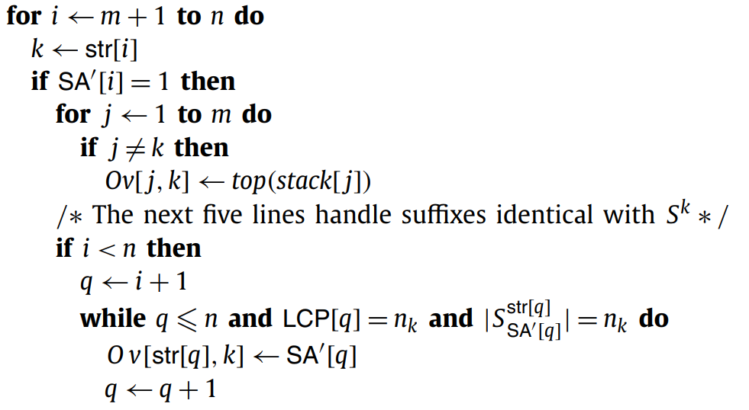
Time complexity

Slide 22
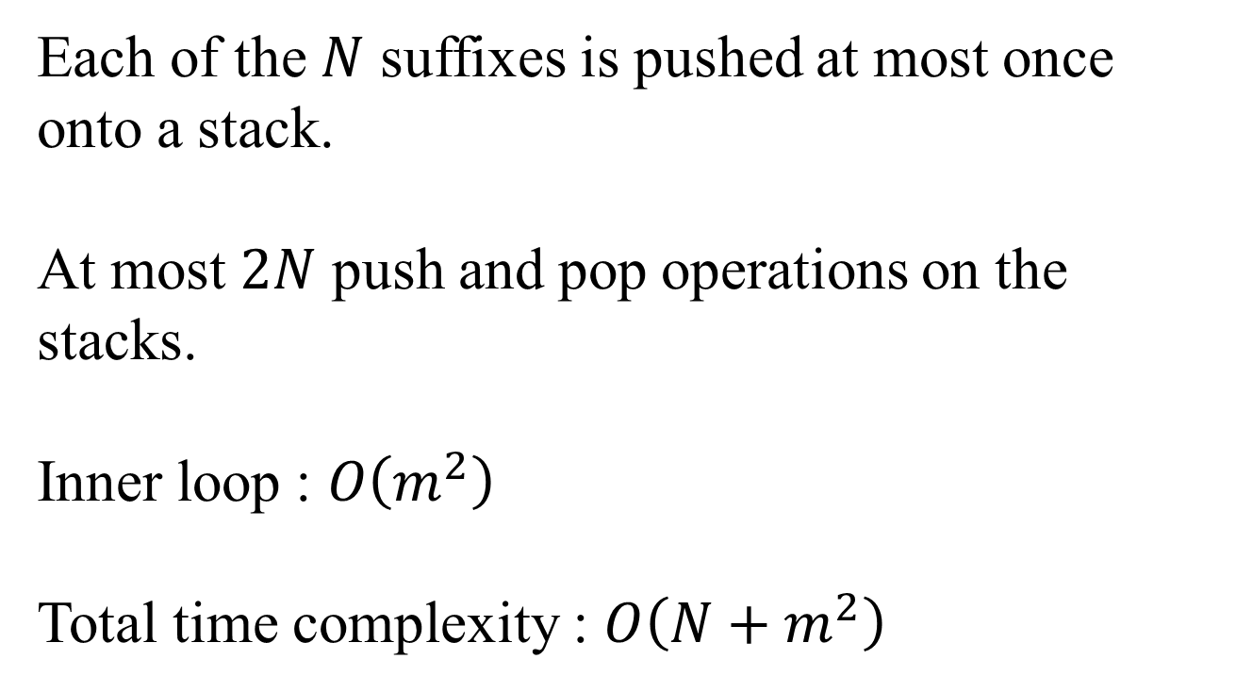
Time complexity
Each of the $N$ suffixes is pushed at most once onto a stack.
At most $2N$ push and pop operations on the stacks.
Inner loop : $O\left(m^{2}\right)$
Total time complexity : $O\left({N+m}^{2}\right)$

Slide 23
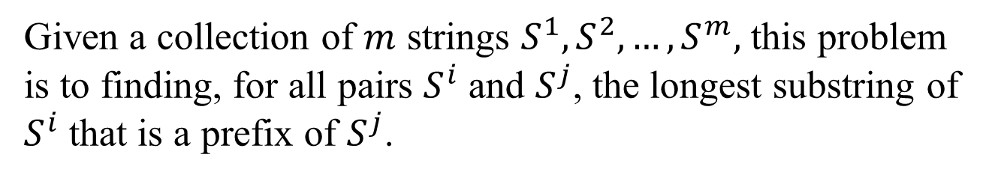
All-pairs substring-prefix problem
Given a collection of $m$ strings $S^{1},S^{2},…,S^{m},$ this problem is to finding, for all pairs $S^{i}$ and $S^{j}$, the longest substring of $S^{i}$ that is a prefix of $S^{j}$.
$$S^{1}$$
$$S^{2}$$
$$S^{3}$$
$$S^{i}$$
$$S^{4}$$
$$S^{j}$$
......
$$S^{m}$$

