Slide 1
Fuzzy clustering of time series data using dynamic time warping distance
Hesam Izakian, Witold Pedrycz, Iqbal Jamal
Engineering Applications of Artificial Intelligence
Vol. 39, 2015, Pages 235-244
Presenter: Shan-Ru Liu
Date: 2018/07/03

Slide 2
Abstract (1/2)
Clustering is a powerful vehicle to reveal and visualize structure of data. When dealing with time series, selecting a suitable measure to evaluate the similarities/dissimilarities within the data becomes necessary and subsequently it exhibits a significant impact on the results of clustering. This selection should be based upon the nature of time series and the application itself. When grouping time series based on their shape information is of interest (shape-based clustering), using a Dynamic Time Warping (DTW) distance is a desirable choice. Using stretching or compressing segments of temporal data, DTW determines an optimal match between any two time series. In this way, time series exhibiting similar patterns occurring at different time periods, are considered as being similar.

Slide 3
Abstract (2/2)
Although DTW is a suitable choice for comparing data with respect to their shape information, calculating the average of a collection of time series (which is required in clustering methods) based on this distance becomes a challenging problem. As the result, employing clustering techniques like K-Means and Fuzzy C-Means (where the cluster centers – prototypes are calculated through averaging the data) along with the DTW distance is a challenging task and may produce unsatisfactory results. In this study, three alternatives for fuzzy clustering of time series using DTW distance are proposed. In the first method, a DTW-based averaging technique proposed in the literature, has been applied to the Fuzzy C-Means clustering. The second method considers a Fuzzy C-Medoids clustering, while the third alternative comes as a hybrid technique, which exploits the advantages of both the Fuzzy C-Means and Fuzzy C-Medoids when clustering time series. Experimental studies are reported over a set of time series coming from the UCR time series database.

Slide 4

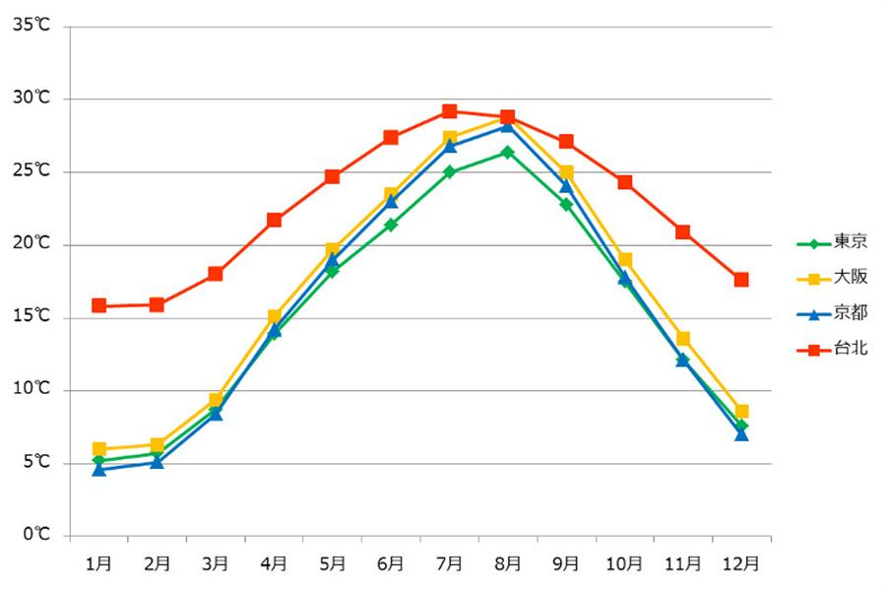
Time Series

Slide 5
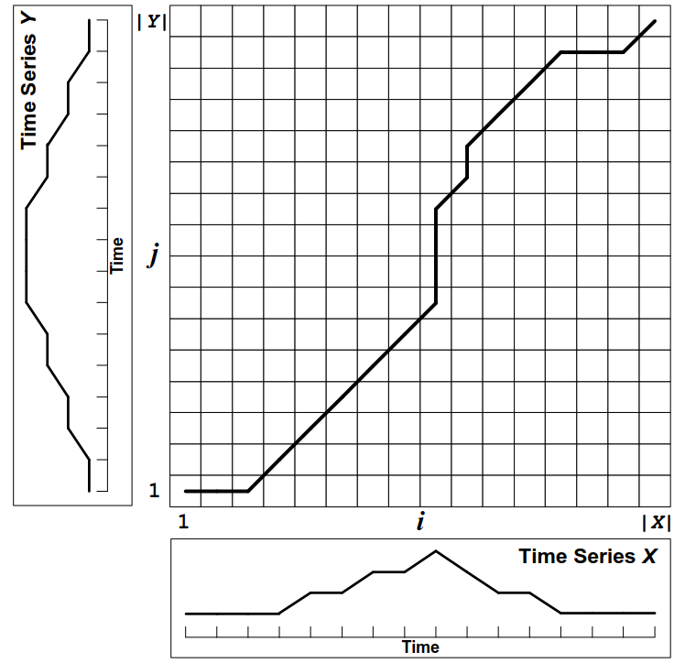
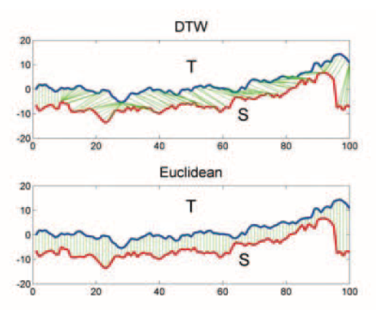
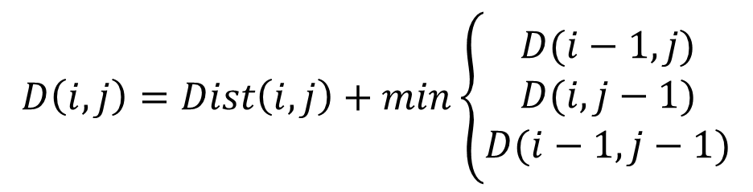
Dynamic Time Warping (1/2)
$$D\left(i,j\right)=Dist\left(i,j\right)+min\left\{\begin{aligned}D(i−1,j) \\ D(i,j−1) \\ D(i−1,j−1)\end{aligned}\right.$$

Slide 6
Dynamic Time Warping (2/2)
Two time series S₁: [2,1,2,1], S₂: [1,2,1]
S₁ S₂ | 2 | 1 | 2 | 1
1 | 0+1=1 | 0+1=1 | 1+1=2 | 2+0=2
2 | 1+0=1 | 1+1=2 | 0+1=1 | 1+1=2
1 | 1+1=2 | 0+1=1 | 1+1=2 | 0+1=1

Slide 7
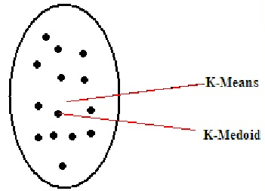
K-means & K-medoids
隨機選K個質心的值-K-means v.s. 隨機選K個點當質心-K-medoids
計算各點到質心的距離
將點依離它最近的質心，分成K群
依分好的群，在每個群中重新計算質心
重複做2~4值到滿足迭代次數或誤差小於指定值

Slide 8

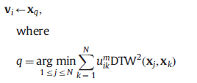


Fuzzy C-means & C-medodis of time series

Slide 9
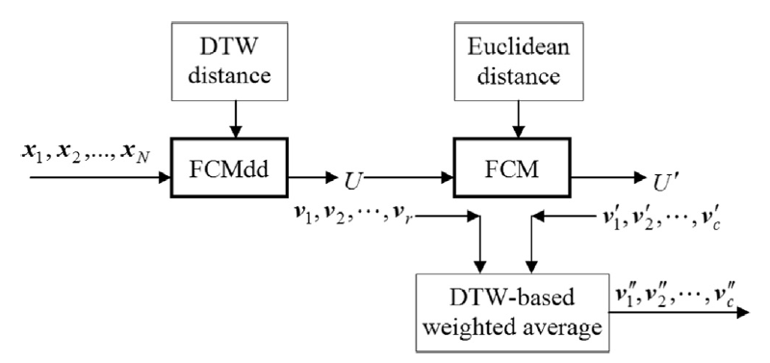
Hybrid FCM & FCMdd of time series

Slide 10
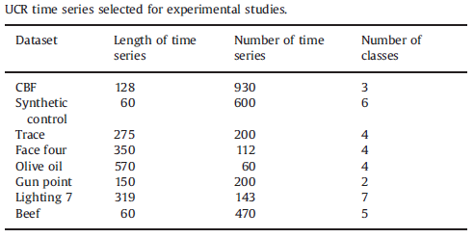
UCR time series selected for experimental studies

Slide 11
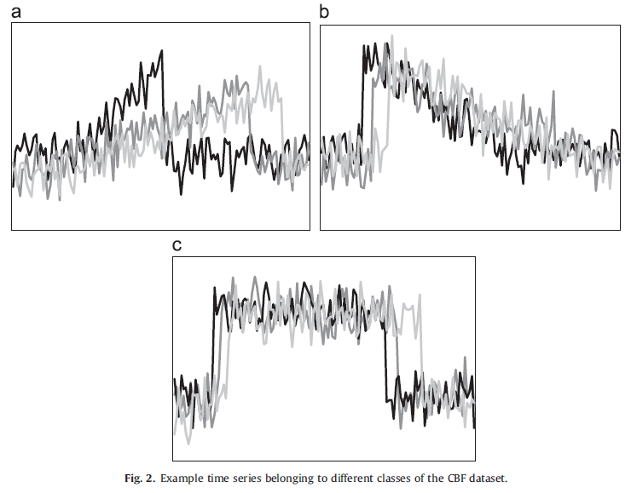
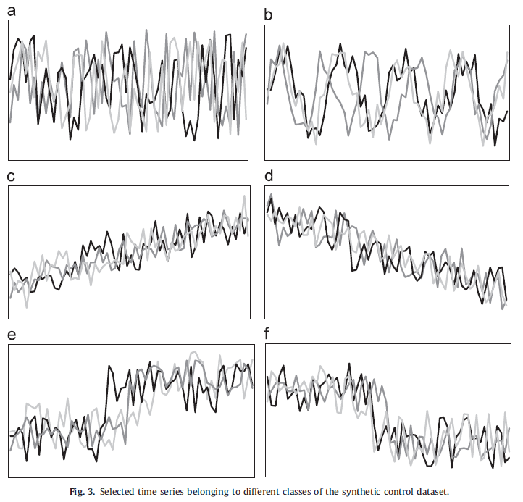
Example time series of CBF & synthetic control dataset

Slide 12
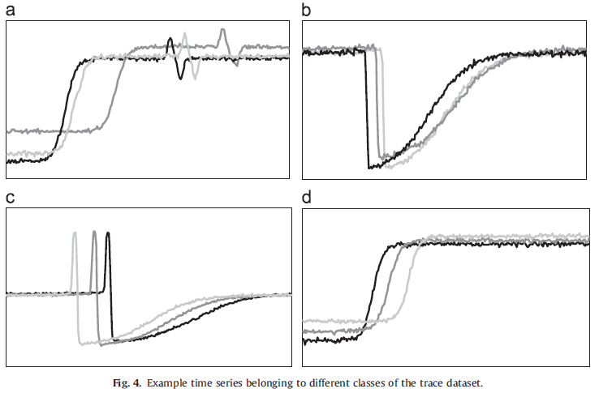
Example time series of trace dataset

Slide 13
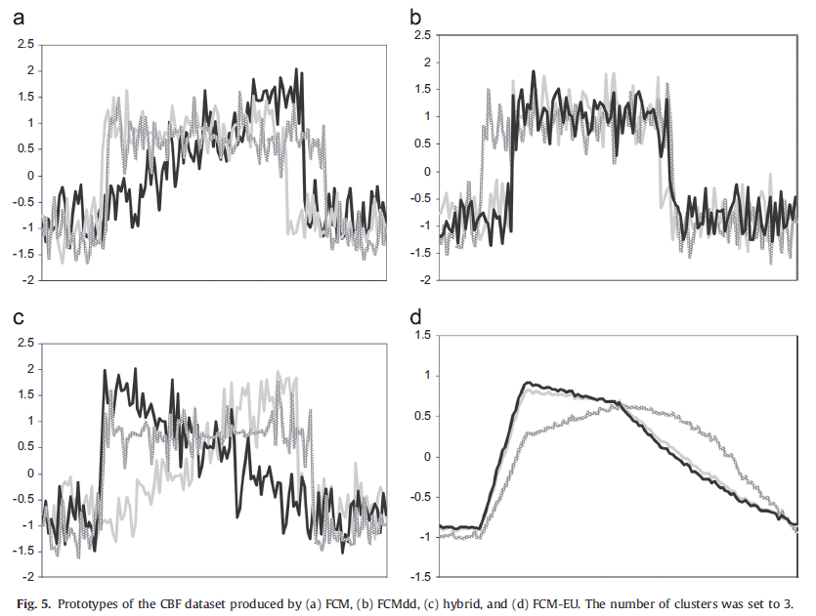
Prototypes of the CBF dataset

Slide 14
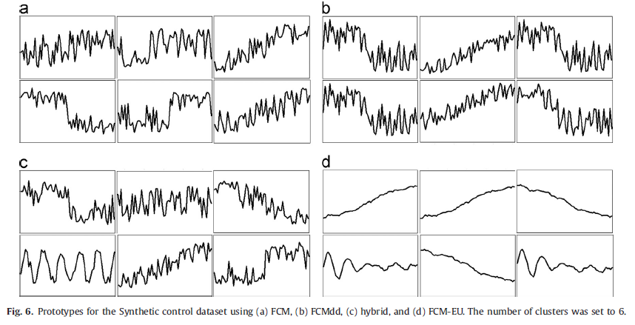
Prototypes of the Synthetic control dataset

Slide 15
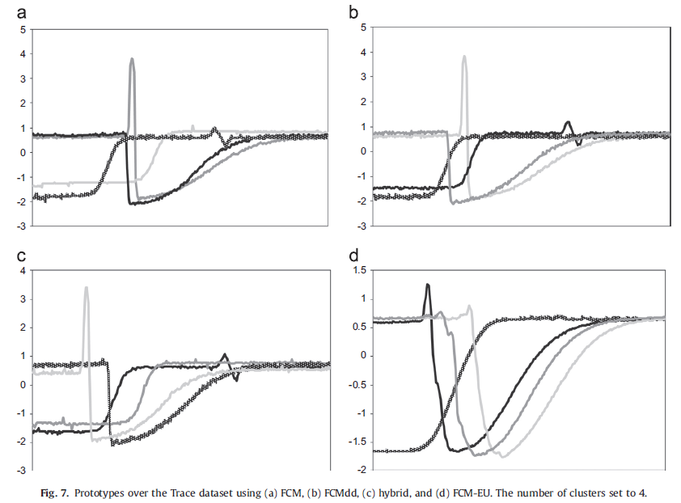
Prototypes of the Trace dataset

Slide 16
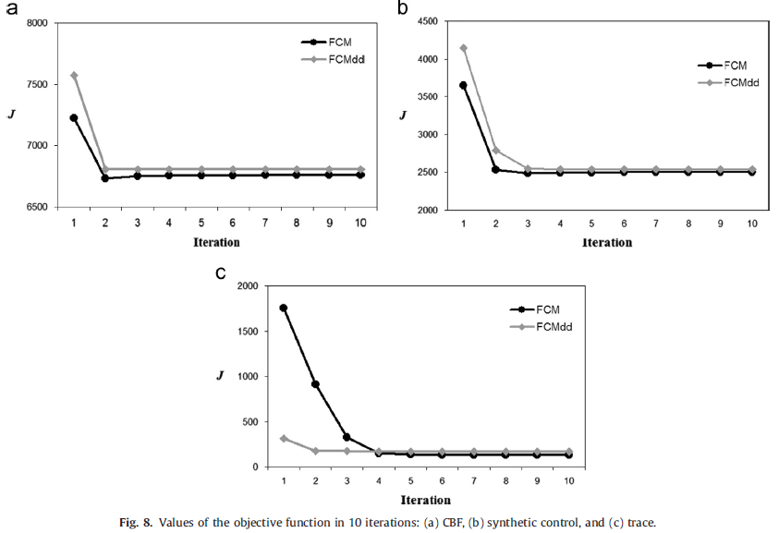
Values of the objective function in 10 iterations

Slide 17
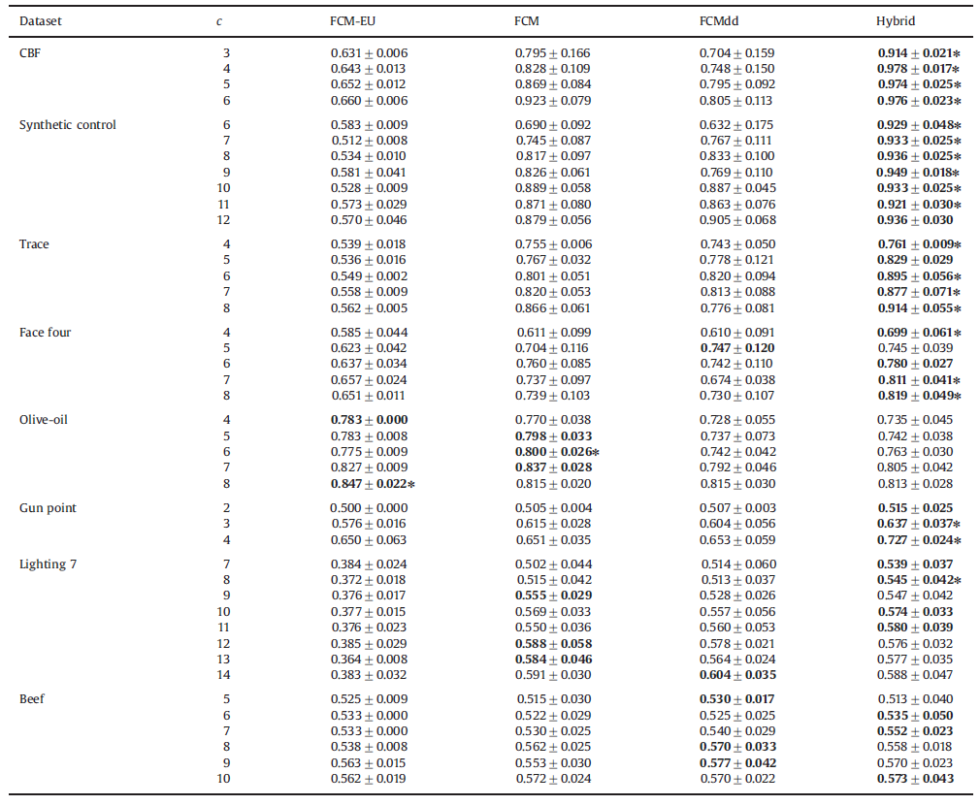
Experimental Results

Slide 18
Experimental Results

Slide 19
Conclusion
Compare to FCM-EU method, the proposed methods generate the better results.
Among the three proposed methods, the hybrid method produces superior results.

