Slide 1
Hybrid Optimization Algorithm Using N-Gram Based Edit Distance
M.Priya, Dr.R.Kalpana and T.Srisupriya
International Conference on Communication and Signal Processing, April 6 - April 8, 2017, Chennai, India
Speaker: Guan-Zhi Chen
Date: 2018.09.18

Slide 2
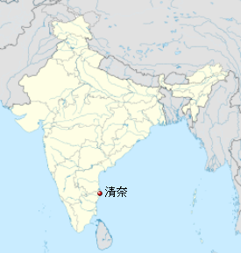

Slide 3
Abstract (1/2)
Spell-checking method is used to detect and correct the incorrect words which spelled in a document. To afford the best probable solution for corrected words first we should detect the incorrect words. The several spell correcting techniques are used after detecting the wrong words or misspelled words, to produces the best accurate correct or alternate words. Spell checking is used in word processing programs, cell phones, email programs and many other applications such as blogs and forums etc. Classification of Error correction and detection provide a better understanding of different types of techniques.

Slide 4
Abstract (2/2)
There are two basic approaches to correct the spelling called edit distance approach and N-gram approach. This paper deals with a new technique called N-Gram based Edit distance (NGE) for transformation of strings. For rule generation to estimate the probabilities using Log model. The proposed method is compared with the other two approaches: Edit distance and N-Gram. The proposed method yields better result than other two approaches and the hybrid algorithm outperforms both edit distance and n-gram algorithm in terms of efficiency and accuracy.

Slide 5
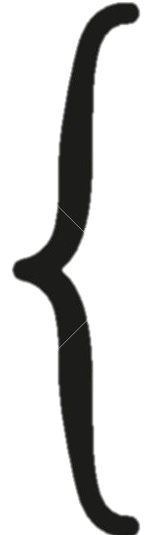
Spell errors
Real-word
Typographic error
Cognitive error
Phonetic error
Spell error
oan - on
Non-word
existance - existence
privelege - privilege

Slide 6
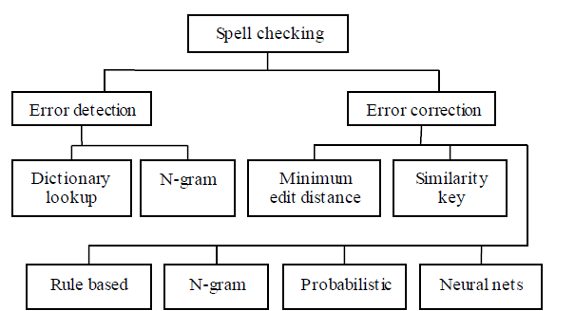
Classification of spell checking

Slide 7
Edit distance (1/3)
Operations: insertion, deletion, substitution, transposition…
S:
A A B A A A A
S:
A A A B C
T:
A B A A A C A
T:
A B C A A
Insertion
Substitution
Transposition
Deletion

Slide 8


Edit distance (2/3)
Operations: insertion, deletion, substitution, transposition…
S:
football
$$ED=0$$
T:
Football
S:
foetball
$$ED=1$$
T:
Football

Slide 9
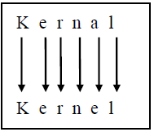
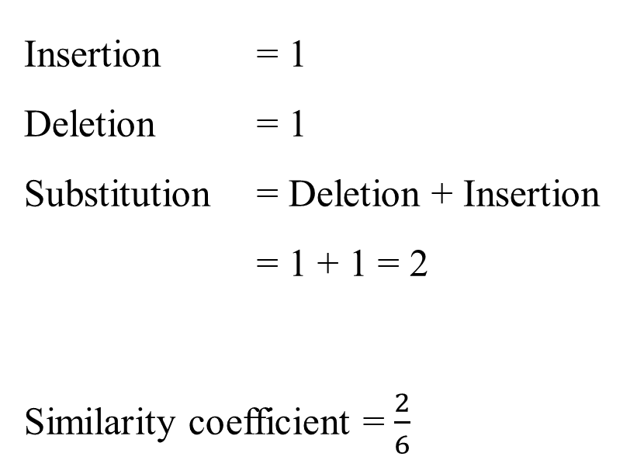
Edit distance (3/3)
S:
Kernal
Insertion = 1
Deletion = 1
Substitution = Deletion + Insertion
= 1 + 1 = 2
Similarity coefficient = $\frac{2}{6}$
T:
Kernel
different length of S & T: sequence or latent alignment

Slide 10
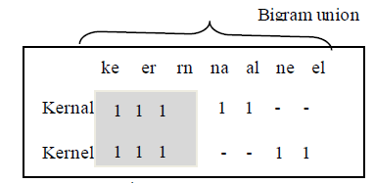
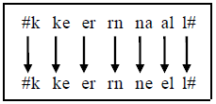
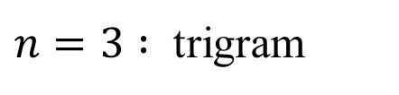
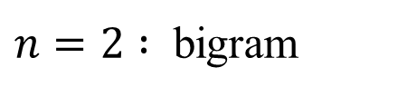
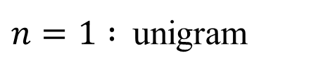
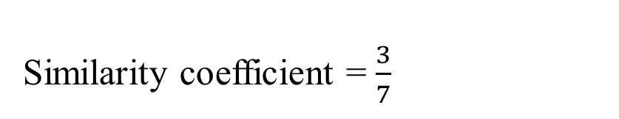
N-Gram
$n=1 :$unigram
$n=2 :$ bigram
$n=3 :$ trigram
S:
Kernal
T:
Kernel
Similarity coefficient = $\frac{3}{7}$

Slide 11
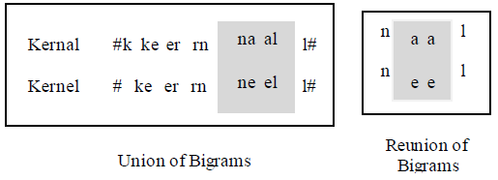
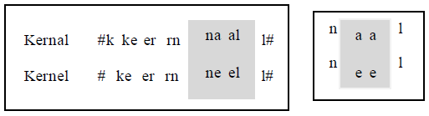
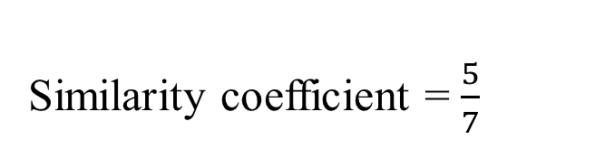
Hybrid algorithm (N-Gram + edit distance) (1/2)
Training data
error detection
Get the string pairs (si, ti)
Apply Bigram for the pairs (si, ti)
Common bigrams are predict from (si, ti)
Find the union of bigram from (si, ti)
Apply n-gram based edit distance and create transformation rule
End
error correction
k
Similarity coefficient = $\frac{5}{7}$

Slide 12
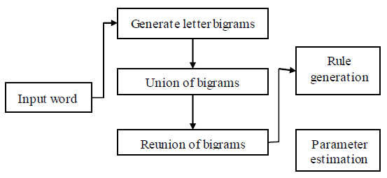

Hybrid algorithm (N-Gram + edit distance) (2/2)
Maximum likelihood estimation

Slide 13
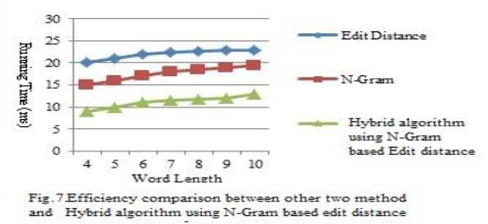
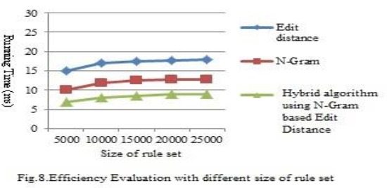
Experimental results

