Slide 1
Hybrid techniques based on solving reduced problem instances for a longest common subsequence problem
Christian Blum, Maria J. Blesa
Applied Soft Computing 62 (2018) pp. 15–28
Presenter: Kuo-Feng Huang
Date: 2018/09/18

Slide 2
Abstract (1/2)
Finding the longest common subsequence of a given set of input strings is a relevant problem arising in various practical settings. One of these problems is the so-called longest arc-preserving common subsequence problem. This NP-hard combinatorial optimization problem was introduced for the comparison of arc-annotated ribonucleic acid (RNA) sequences. In this work we present an integer linear programming (ILP) formulation of the problem. As even in the context of rather small problem instances the application of a general purpose ILP solver is not viable due to the size of the model,

Slide 3
Abstract (2/2)
we study alternative ways based on model reduction in order to take profit from this ILP model. First, we present a heuristic way for reducing the model, with the subsequent application of an ILP solver. Second, we propose the application of an iterative hybrid algorithm that makes use of an ILP solver for generating high quality solutions at each iteration. Experimental results concerning artificial and real problem instances show that the proposed techniques outperform an available technique from the literature.

Slide 4
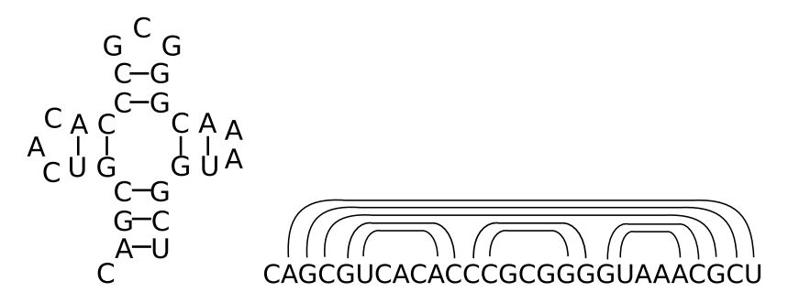
The longest arc-preserving common subsequence (LAPCS) problem

Slide 5
The longest arc-preserving common subsequence (LAPCS) problem
X: GCUAAG
Y: CGUAAG
LCS: GUAAG or CUAAG
LAPCS: GUAAG
a_{0,1} a_{2,2} a_{3,3} a_{4,4} a_{5,5}
(2,3) ∈ P_{x} (2,3) ∈ P_{x}

Slide 6
Existing heuristic for LAPCS
First find CS with the dynamic programming algorithm by Smith and Waterman
LCS: CUAAG
C
U A
G A
the maximum independent set (MIS) problem is solved in graph.

Slide 7
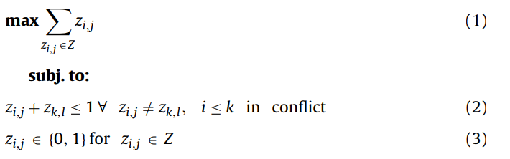
An ILP model for the LAPCS problem
lLP: integer linear programming
conflict

Slide 8
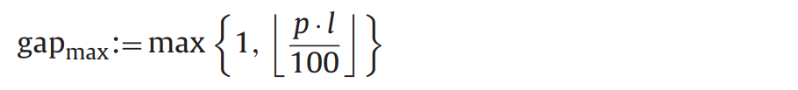
An ILP model for the LAPCS problem
0 ≤ p ≤ 100， l:= min{l_{x}, l_{y}}

Slide 9
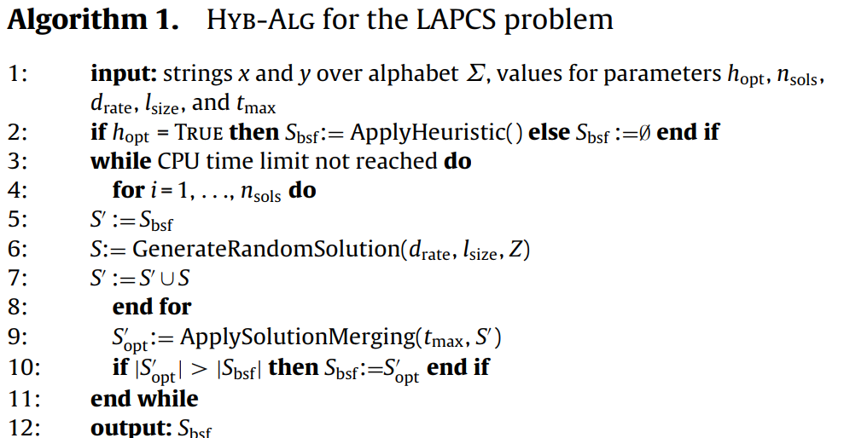
A hybrid algorithm based on solution merging

Slide 10
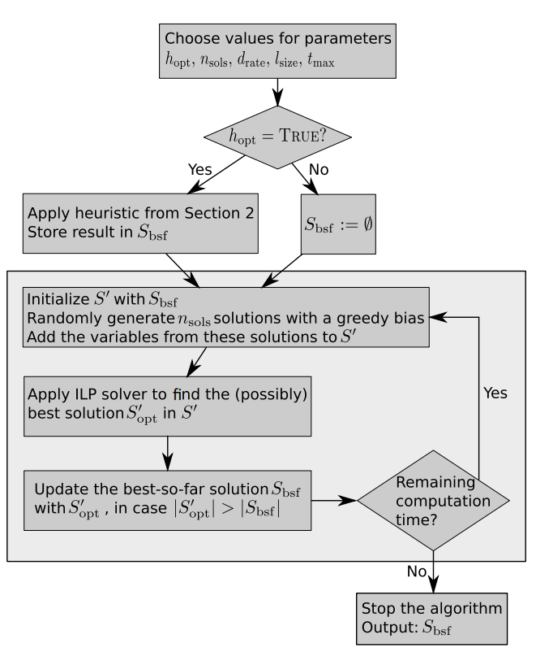
A hybrid algorithm based on solution merging

Slide 11

A hybrid algorithm based on solution merging
At each construction step, exactly one variable is chosen from C and added to S. For doing so, first, a value rand is chosen uniformly at random from [0, 1]. In case rand ≤ d_{rate}, where d_{rate} is a parameter of the algorithm, the variable z_{i,j} ∈ C with the smallest weight value is deterministically chosen. Otherwise, a candidate list L ⊆ C of size min{l_{size}, |C|} containing the options with the lowest weight values is generated and exactly one variable z_{i,j} ∈ L is then chosen uniformly at random and added to S.

Slide 12
Experiment environment
CPU: Intel(R) Xeon(R) CPU 5670 CPUs of 12 nuclei of 2933 MHz
RAM: 40 Gigabytes
ILP models: CPLEX

Slide 13
Instances
SET 1:
artificial problem instances.
length l_{x} = l_{y} ∈ {100, 200, . . ., 900, 1000}.
n_{arcs} ∈ {lx/10, lx/5, lx/2}
For each combination of l_{x} and n_{arcs} we randomly generated 30 problem instances. This makes a total of 900 problem instances.

Slide 14
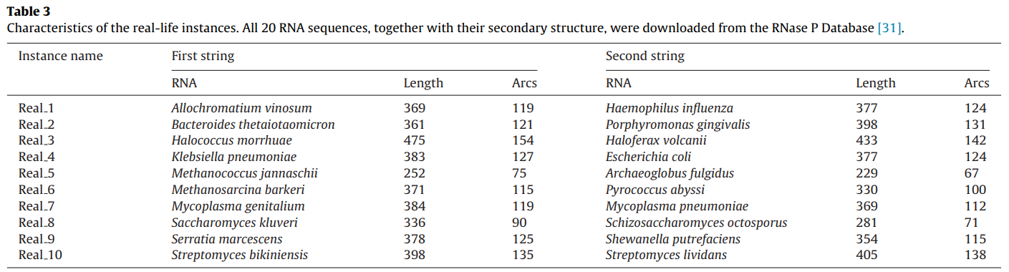
Instances
SET 2:
arcannotated RNA sequences from the RNase P Database.
In total we assembled 10 problem instances, whose characteristics

Slide 15
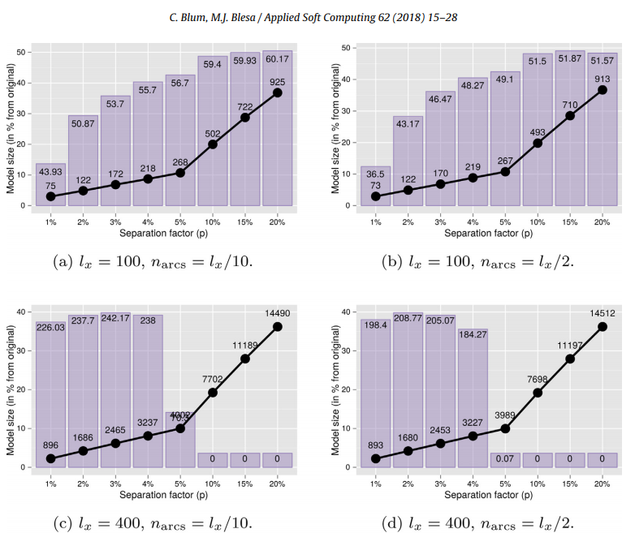
Experiment: set 1

Slide 16
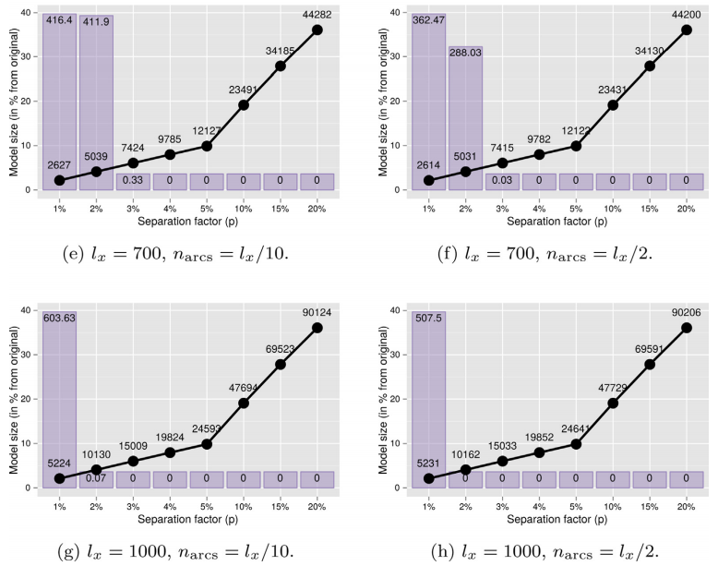
Experiment: set 1

Slide 17
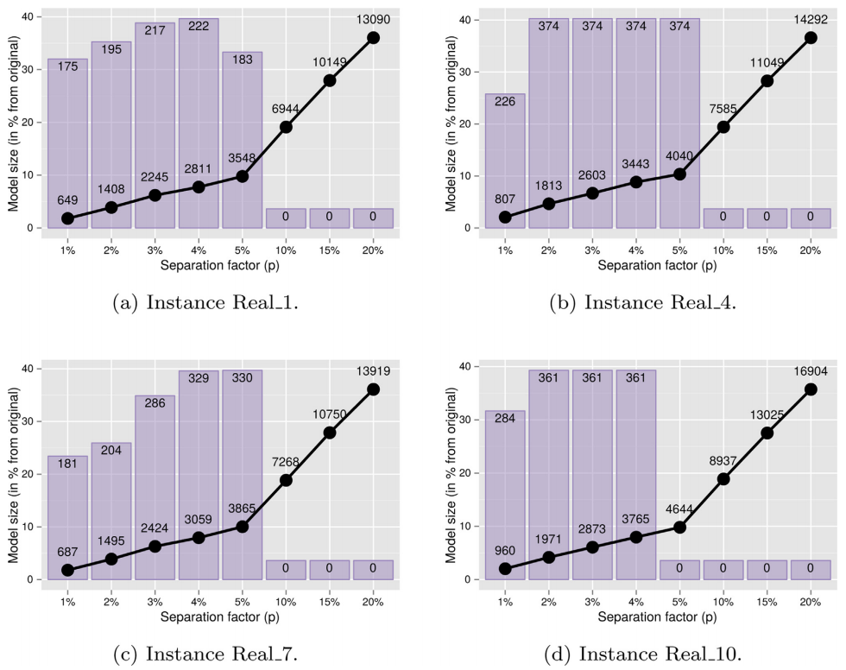
Experiment: set 2

Slide 18
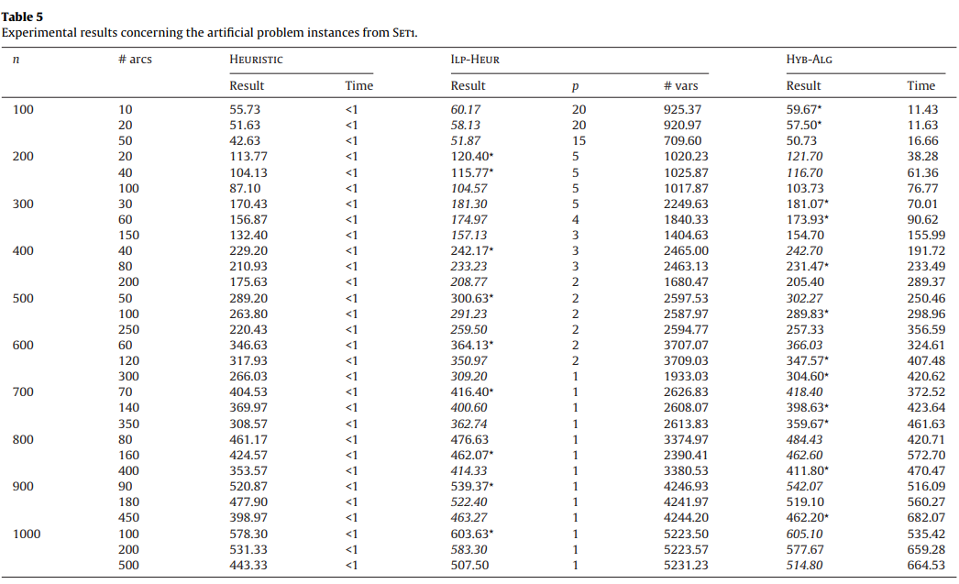
Experiment: set 1

Slide 19
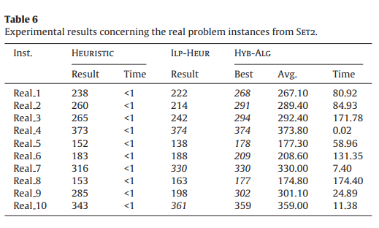
Experiment: set 2

