Slide 1
An Efficient Algorithm for the Longest Tandem Scattered Subsequence Problem
Adrian Kosowski
Department of Algorithms and System Modeling
Gda´nsk University of Technology, Poland
Proceeding of String Processing and Information Retrieval: 11th International Conference, SPIRE 2004, Padova, Italy, October 5-8, 2004.
Presenter: Ting-Wei Liang
Date:2018/09/18

Slide 2
Abstract
The paper deals with the problem of finding a tandem scattered subsequence of maximum length (LTS) for a given character sequence. A sequence is referred to as tandem if it can be split into two identical sequences. An efficient algorithm for the LTS problem is presented and is shown to have O(n²) computational complexity and linear memory complexity with respect to the length n of the analyzed sequence. A conjecture is put forward and discussed, stating that the complexity of the given algorithm may not be easily improved. Finally, the potential application of the solution to the LTS problem in approximate tandem substring matching in DNA sequences is discussed.

Slide 3
Longest Tandem Scattered (Square) Subsequence
S = ABCBBCABABAC
Tandem Subsequences = ABAB,ACAC,AA,…
Longest Tandem Subsequence (LTS)
= ABBCABBC

Slide 4
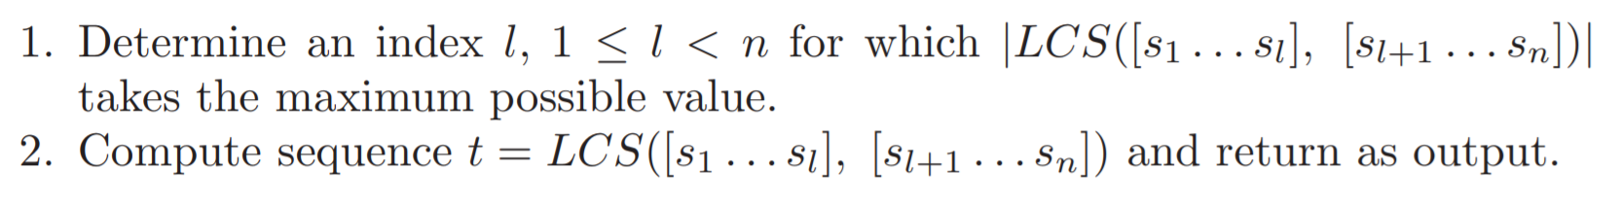

Algorithm for LTS
S = ABCBBC ABABAC
$$l=6$$
LCS(ABCBBC, ABABAC) = ABBCABBC = LTS

Slide 5
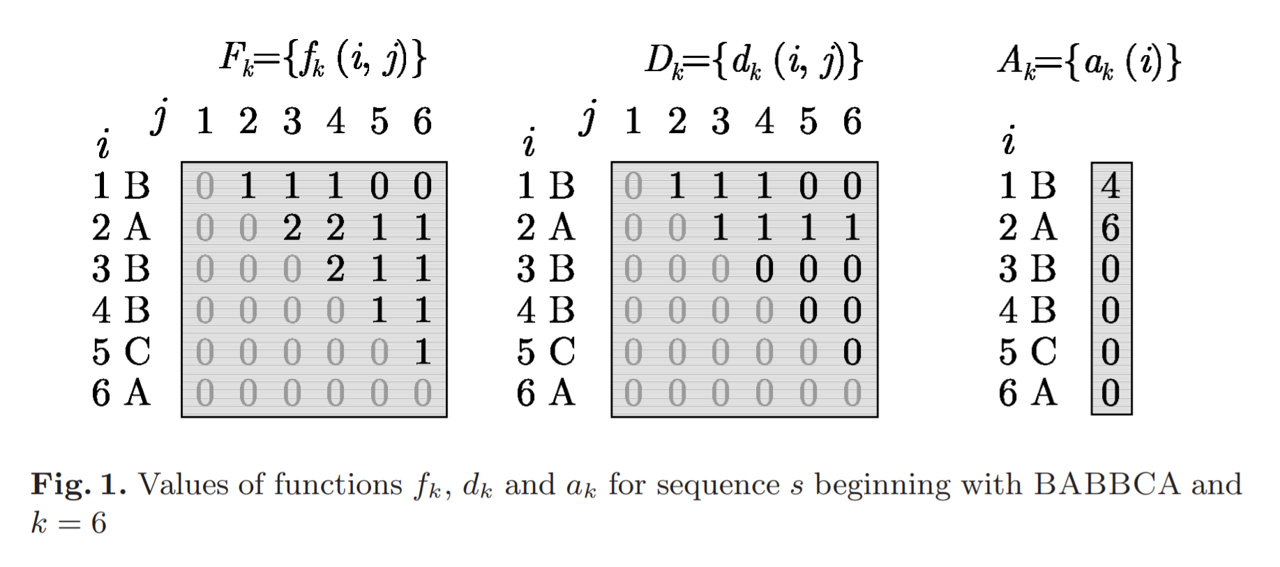
LTSsplit Problem

Slide 6
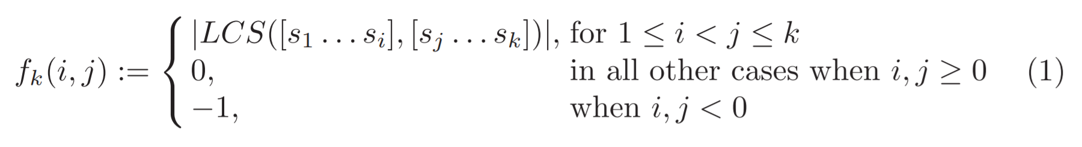
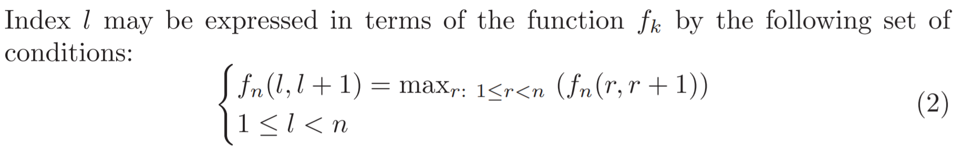
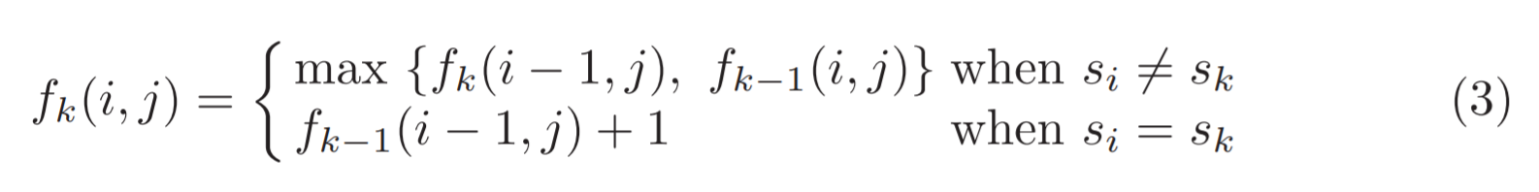
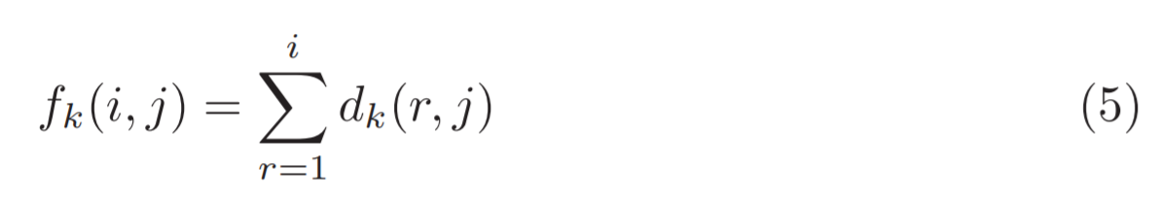
LTSsplit Problem

Slide 7
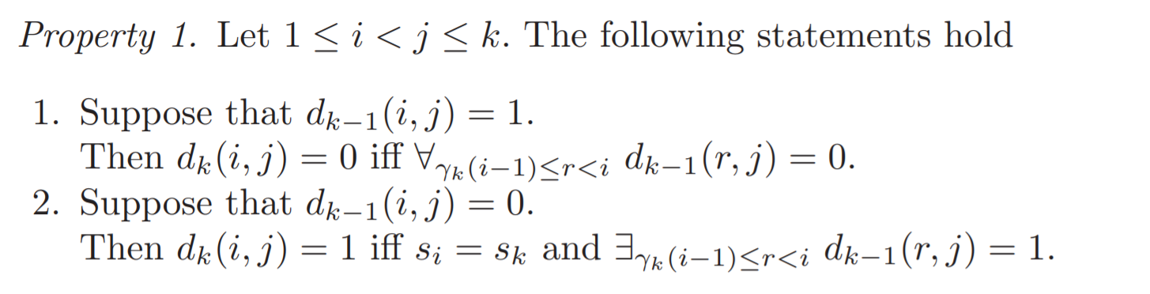
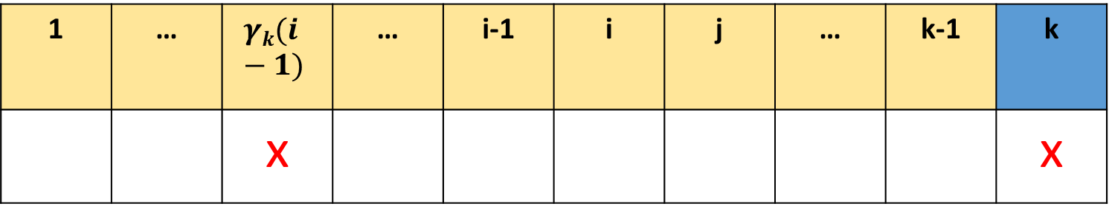
Property 1
1 | … | $$γk(i−1)$$ | … | i-1 | i | j | … | k-1 | k
 |  | x |  |  |  |  |  |  | x

Slide 8
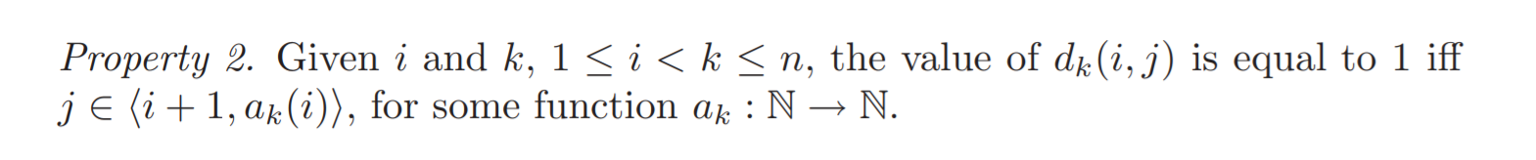
Property 2

Slide 9
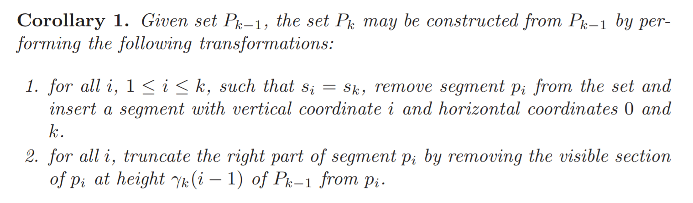
A_{k} constructed from A_{k-1}

Slide 10
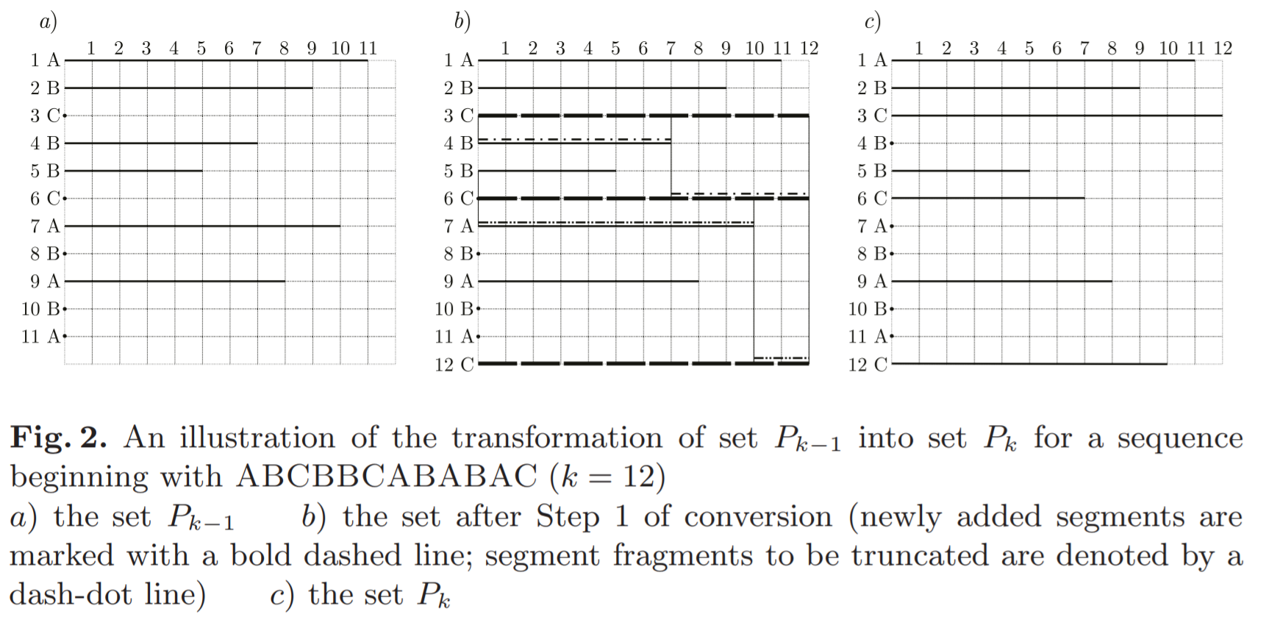
A_{k} constructed from A_{k-1}

Slide 11
A_{k} constructed from A_{k-1}
 | A_{k-1} | A_{k}
A | 11
B | 9
C | 0
B | 7
B | 5
C | 0
A | 10
B | 0
A | 8
B | 0
A | 0
C |  | 12
k = 12

Slide 12
A_{k} constructed from A_{k-1}
 | A_{k-1} | A_{k}
A | 11
B | 9
C | 0
B | 7
B | 5
C | 0
A | 10 | 0
B | 0
A | 8
B | 0
A | 0
C |  | 12
k = 12
t = 0
t = 10

Slide 13
A_{k} constructed from A_{k-1}
 | A_{k-1} | A_{k}
A | 11
B | 9
C | 0
B | 7
B | 5
C | 0
A | 10 | 0
B | 0 | 0
A | 8 | 8
B | 0 | 0
A | 0 | 0
C |  | 10
k = 12
t = 0
t = 10

Slide 14
A_{k} constructed from A_{k-1}
 | A_{k-1} | A_{k}
A | 11
B | 9
C | 0
B | 7
B | 5
C | 0 | 12
A | 10 | 0
B | 0 | 0
A | 8 | 8
B | 0 | 0
A | 0 | 0
C |  | 10
k = 12

Slide 15
A_{k} constructed from A_{k-1}
 | A_{k-1} | A_{k}
A | 11
B | 9
C | 0
B | 7 | 0
B | 5 | 5
C | 0 | 7
A | 10 | 0
B | 0 | 0
A | 8 | 8
B | 0 | 0
A | 0 | 0
C |  | 10
k = 12
t = 0
t = 7

Slide 16
A_{k} constructed from A_{k-1}
 | A_{k-1} | A_{k}
A | 11 | 11
B | 9 | 9
C | 0 | 12
B | 7 | 0
B | 5 | 5
C | 0 | 7
A | 10 | 0
B | 0 | 0
A | 8 | 8
B | 0 | 0
A | 0 | 0
C |  | 10
k = 12
t = 0
t = 7

Slide 17
Time Complexity
LTSsplit
Step1 : Compute A_{n} => O(n²)
Step2 : Determine the index to separate the string =>O(n)
Compute LCS => O(n²)

