Slide 1

Robust solutions of uncertain linear programs
Aharon Ben-Tal and Arkadi Nemirovski
Technion-Israel Institute of Technology (以色列理工學院), Faculty of Industrial Engineering and Management, Haifa, Israel
Operations Research Letters, Vol. 25, pp. 1-13, 1999
Presenter: Hung-Hsin Chen (陳紘昕)
Date: July 3, 2012

Slide 2
Abstract (1/2)
We treat in this paper linear programming (LP) problems with uncertain data. The focus is on uncertainty associated with hard constraints: those which must be satisfied, whatever is the actual realization of the data (within a prescribed uncertainty set). We suggest a modeling methodology whereas an uncertain LP is replaced by its robust counterpart (RC).

Slide 3
Abstract (2/2)
We then develop the analytical and computational optimization tools to obtain robust solutions of an uncertain LP program via solving the corresponding explicitly stated convex RC program. In particular, it is shown that the RC of an LP with ellipsoidal uncertainty set is computationally tractable, since it leads to a conic quadratic program, which can be solved in polynomial time.

Slide 4
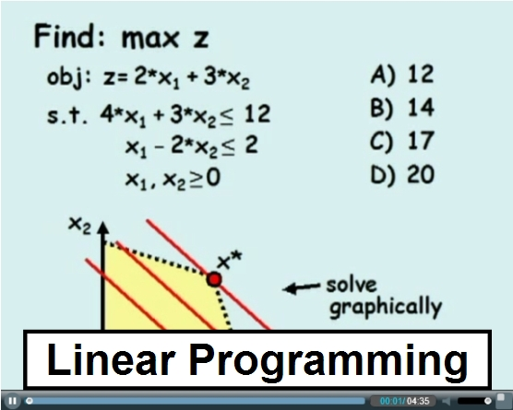
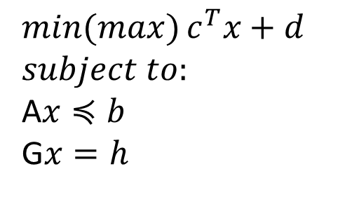
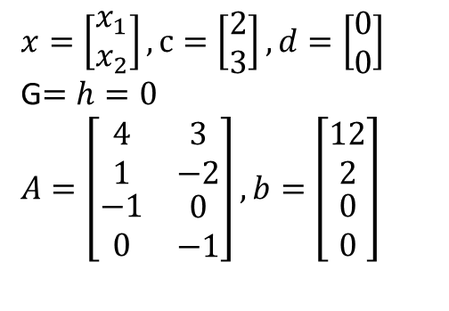
Linear programming (LP)
$$min(max){c^{T}x+d}$$
$$subject to:$$
A$x≼b$
G$x=h$
LP is a convex (concave) optimization problem.
$$x=\left[\begin{matrix}x_{1} \\ x_{2}\end{matrix}\right], c=\left[\begin{matrix}2 \\ 3\end{matrix}\right], d=\left[\begin{matrix}0 \\ 0\end{matrix}\right]$$
G$=h=0$
$$A=\left[\begin{matrix}4 & 3 \\ 1 & −2 \\ \begin{matrix}−1 \\ 0\end{matrix} & \begin{matrix}0 \\ −1\end{matrix}\end{matrix}\right], b=\left[\begin{matrix}12 \\ 2 \\ \begin{matrix}0 \\ 0\end{matrix}\end{matrix}\right]$$

Slide 5
LP with uncertainty
製藥廠的決策問題：
One active agent (活性試劑) A for treating a disease.
Two possible drugs: D₁, D₂
Two possible raw material: R₁, R₂
1K packs | D₁ | D₂
售價($) | 6200 | 6900
試劑A (grams) | 0.5 | 0.6
人力成本(hours) | 90 | 100
裝備成本(hours) | 40 | 50
操作成本($) | 700 | 800
Kg | R₁ | R₂
成本($) | 100 | 199
Content of A(g) | 0.01 | 0.02
constraints | 總預算($) | 人力(hours) | 裝備(hours) | 儲存量(kg)
 | 100000 | 2000 | 800 | 1000

Slide 6
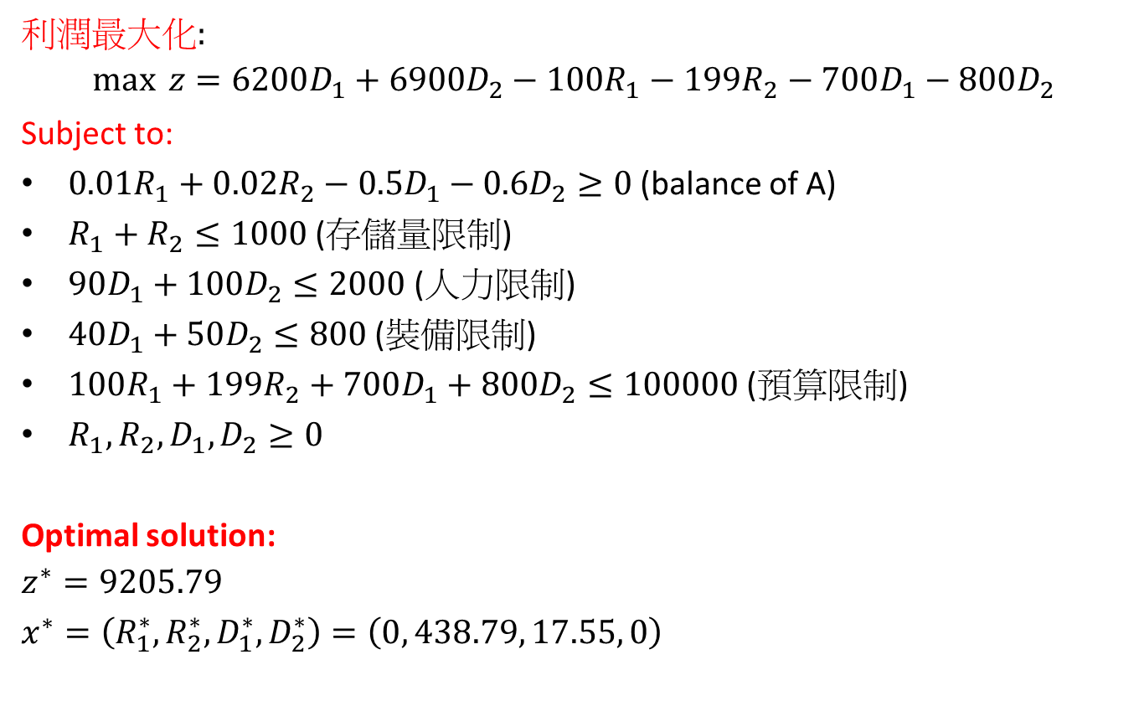
LP formulation
利潤最大化:
$$\max{ z=6200D_{1}+6900D_{2}−100R_{1}−199R_{2}−700D_{1}−800D_{2}}$$
Subject to:
$0.01R_{1}+0.02R_{2}−0.5D_{1}−0.6D_{2}≥0$(balance of A)
$R_{1}+R_{2}≤1000$ (存儲量限制)
$90D_{1}+100D_{2}≤2000$(人力限制)
$40D_{1}+50D_{2}≤800$ (裝備限制)
$100R_{1}+199R_{2}+700D_{1}+800D_{2}≤100000$ (預算限制)
$R_{1}, R_{2}, D_{1}, D_{2}≥0$
Optimal solution:
$$z^{∗}=9205.79$$
$$x^{∗}=\left(R_{1}^{∗}, R_{2}^{∗}, D_{1}^{∗},D_{2}^{∗}\right)=\left(0, 438.79, 17.55, 0\right)$$

Slide 7
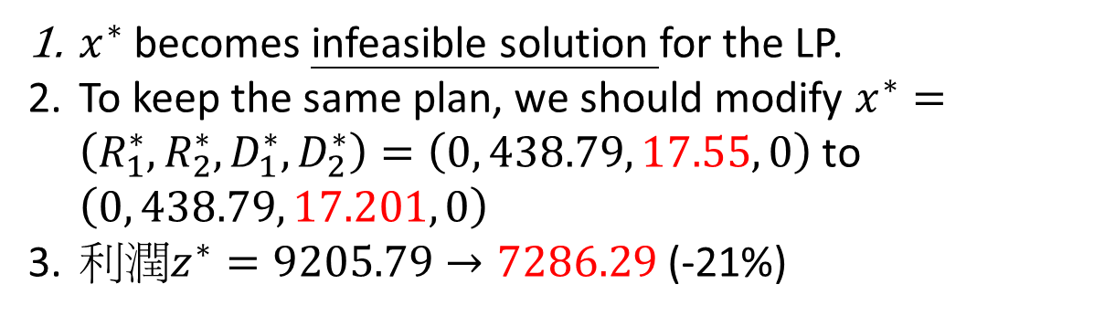
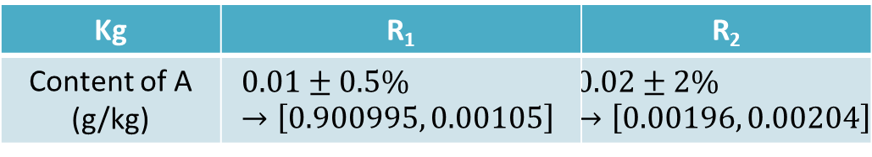
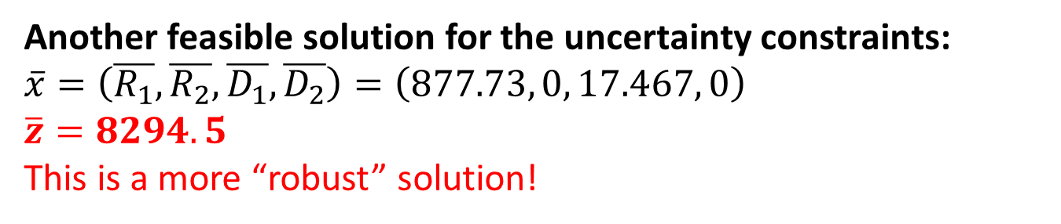
LP formulation with uncertainty
Kg | R₁ | R₂
Content of A (g/kg) | $$0.01±0.5\%→\left[0.900995, 0.00105\right]$$ | $$0.02±2\%→\left[0.00196, 0.00204\right]$$
$x^{∗}$ becomes infeasible solution for the LP.
To keep the same plan, we should modify $x^{∗}=\left(R_{1}^{∗}, R_{2}^{∗}, D_{1}^{∗},D_{2}^{∗}\right)=\left(0, 438.79, 17.55, 0\right)$ to $\left(0, 438.79, 17.201, 0\right)$
利潤$z^{∗}=9205.79→7286.29$ (-21%)
Another feasible solution for the uncertainty constraints:
$$\overline{x}=\left(\overline{R_{1}}, \overline{R_{2}}, \overline{D_{1}}, \overline{D_{2}}\right)=\left(877.73, 0, 17.467, 0\right)$$
$$\overline{z}=8294.5$$
This is a more “robust” solution!

Slide 8
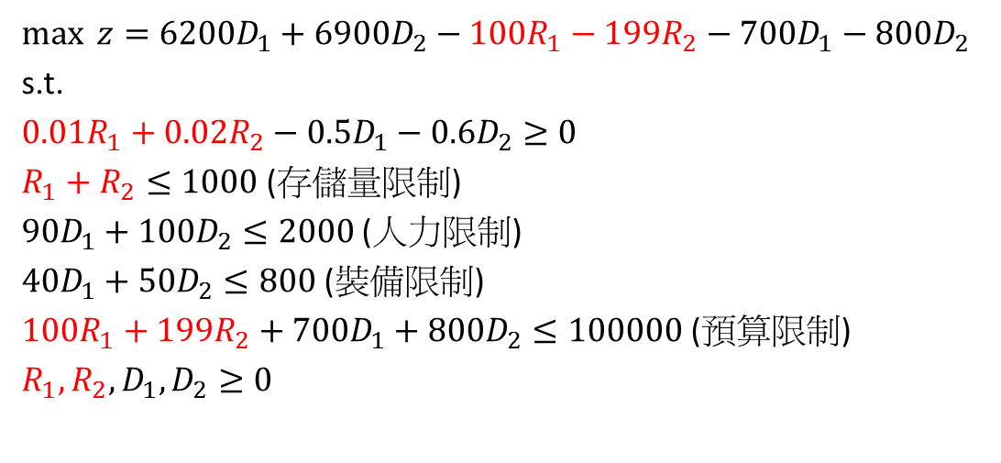
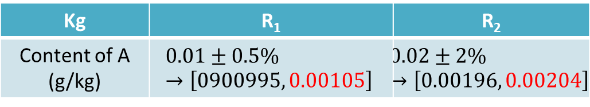
Conservative way to get a solution
Soyster (73)
Considering the worst values in the uncertainty set to get the solution.
$$\max{ z=6200D_{1}+6900D_{2}−100R_{1}−199R_{2}−700D_{1}−800D_{2}}$$
s.t.
$$0.01R_{1}+0.02R_{2}−0.5D_{1}−0.6D_{2}≥0$$
$R_{1}+R_{2}≤1000$ (存儲量限制)
$90D_{1}+100D_{2}≤2000$(人力限制)
$40D_{1}+50D_{2}≤800$ (裝備限制)
$100R_{1}+199R_{2}+700D_{1}+800D_{2}≤100000$ (預算限制)
$R_{1}, R_{2}, D_{1}, D_{2}≥0$
Kg | R₁ | R₂
Content of A (g/kg) | $$0.01±0.5\%→\left[0900995, 0.00105\right]$$ | $$0.02±2\%→\left[0.00196, 0.00204\right]$$

Slide 9
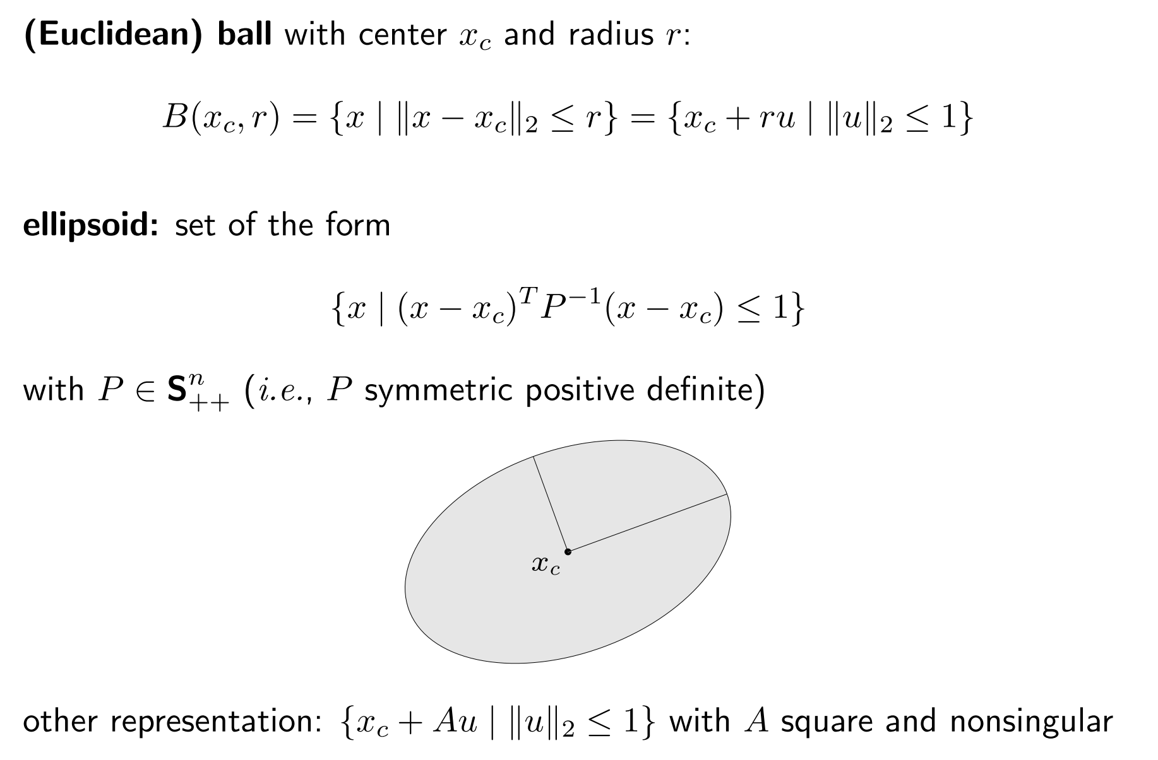
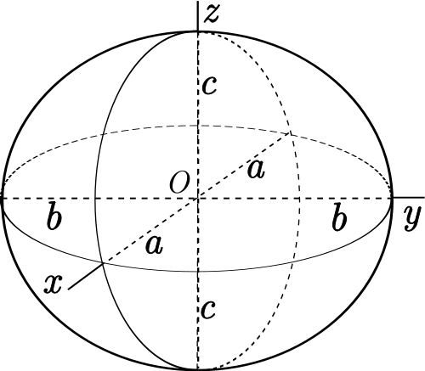

Ellipsoid
$\left\{x| {\left(x−x_{c}\right)}^{T}P^{−1}\left(x−x_{c}\right)≤1\right\}, P∈S_{++}^{n} (P is symmetric positive definite)$
Or $\left\{x_{c}+Au | {\left\|u\right\|}_{2}≤1\right\}, A square and nonsingular$
$$Example:$$
$$x={\left[\begin{matrix}x_{1} & x_{2} & x_{3}\end{matrix}\right]}^{T},x_{c}={\left[x_{1}^{c}, x_{2}^{c}, x_{3}^{c}\right]}^{T}$$
$$P^{−1}=\left[\begin{matrix}\frac{1}{a^{2}} & 0 & 0 \\ 0 & \frac{1}{b^{2}} & 0 \\ 0 & 0 & \frac{1}{c^{2}}\end{matrix}\right], A=\left[\begin{matrix}a & 0 & 0 \\ 0 & b & 0 \\ 0 & 0 & c\end{matrix}\right]$$
$$⟹{\left(x−x_{c}\right)}^{T}P^{−1}\left(x−x_{c}\right)=\frac{{\left(x_{1}−x_{1}^{c}\right)}^{2}}{a^{2}}+\frac{{\left(x_{2}−x_{2}^{c}\right)}^{2}}{b^{2}}+\frac{{\left(x_{3}−x_{3}^{c}\right)}^{2}}{c^{2}}≤1$$

Slide 10
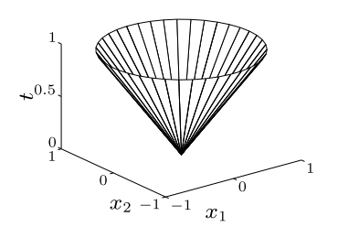

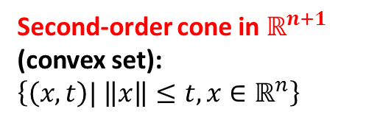
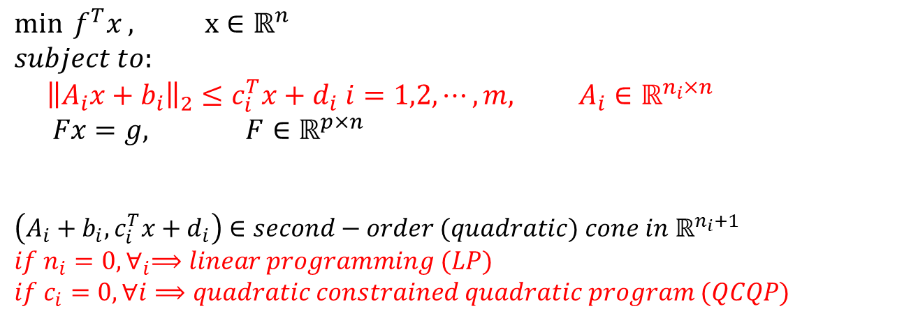
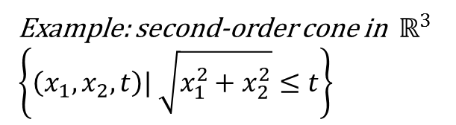
Second-order cone programming (SOCP)
$$\min{ f^{T}x}, x∈ℝ^{n}$$
$$subject to:$$
$${\left\|A_{i}x+b_{i}\right\|}_{2}≤c_{i}^{T}x+d_{i} i=1,2,⋯,m, A_{i}∈ℝ^{n_{i}×n}$$
$$Fx=g, F∈ℝ^{p×n}$$
$$\left(A_{i}+b_{i}, c_{i}^{T}x+d_{i}\right)∈second−order (quadratic) cone in ℝ^{n_{i}+1}$$
$$if n_{i}=0, ∀_{i}⟹linear programming (LP)$$
$$if c_{i}=0, ∀i⟹quadratic constrained quadratic program (QCQP)$$
Second-order cone in $ℝ^{n+1}$ (convex set):
$$\left\{\left(x, t\right)| \left\|x\right\|≤t, x∈ℝ^{n}\right\}$$
Example: second-order cone in $ℝ^{3}$
$$\left\{\left(x_{1}, x_{2}, t\right)| \sqrt{x_{1}^{2}+x_{2}^{2}}≤t\right\}$$

Slide 11
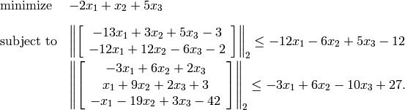
SOCP Example
http://abel.ee.ucla.edu/cvxopt/userguide/coneprog.html#second-order-cone-programming

Slide 12
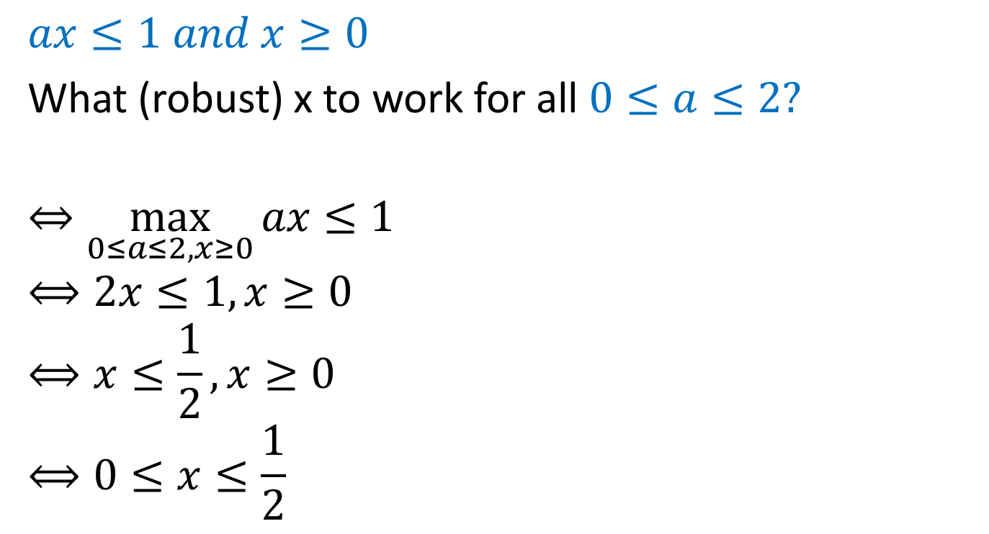
Simple linear constraint
$$ax≤1 and x≥0$$
What (robust) x to work for all $0≤a≤2?$
$$⇔\max_{0≤a≤2, x≥0}{ax≤1}$$
$$⟺2x≤1, x≥0$$
$$⟺x≤\frac{1}{2}, x≥0$$
$$⟺0≤x≤\frac{1}{2}$$

Slide 13
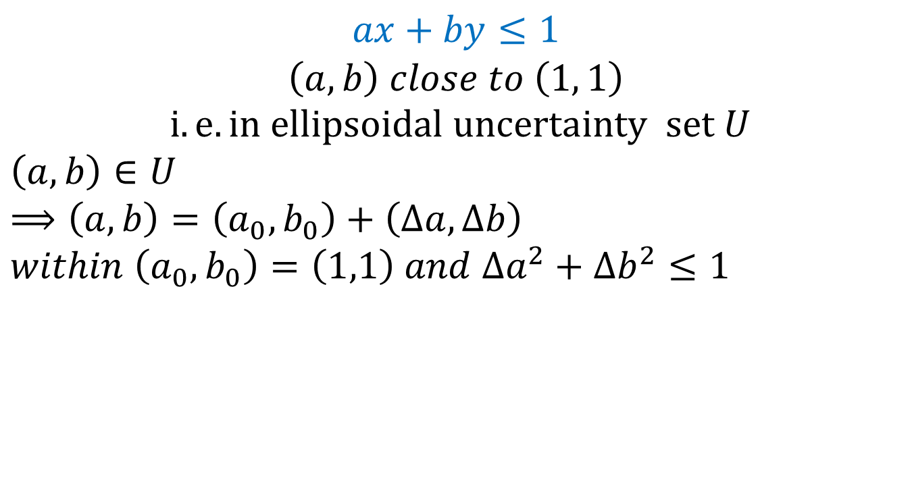
Slightly more involved example
$$ax+by≤1$$
$$\left(a, b\right) close to \left(1, 1\right)$$
$$i.e. in ellipsoidal uncertainty set U$$
$$\left(a,b\right)∈U$$
$$⟹\left(a,b\right)=\left(a_{0}, b_{0}\right)+\left(Δa,Δb\right)$$
$$within \left(a_{0}, b_{0}\right)=\left(1,1\right) and Δa^{2}+Δb^{2}≤1$$
U
Want (x, y) to satisfy
a x + b y≤ 1,
for all (a, b) from U
(a₀, b₀)

Slide 14
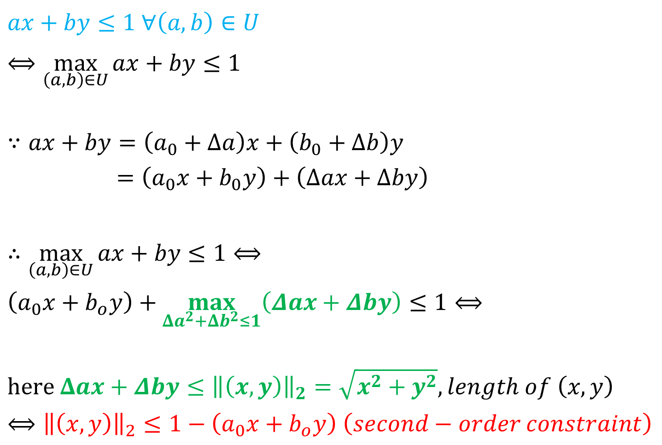
$$ax+by≤1 ∀\left(a,b\right)∈U$$
$$⟺\max_{\left(a,b\right)∈U}{ax+by≤1}$$
$$∵ax+by=\left(a_{0}+Δa\right)x+\left(b_{0}+Δb\right)y$$
$=\left(a_{0}x+b_{0}y\right)+\left(Δax+Δby\right)$
$$∴\max_{\left(a,b\right)∈U}{ax+by≤1}⟺$$
$$\left(a_{0}x+b_{o}y\right)+\max_{Δa^{2}+Δb^{2}≤1}\left(Δax+Δby\right)≤1⟺$$
$$here Δax+Δby≤{\left\|\left(x,y\right)\right\|}_{2}=\sqrt{x^{2}+y^{2}}, length of \left(x,y\right)$$
$⟺{\left\|\left(x,y\right)\right\|}_{2}≤1−\left(a_{0}x+b_{o}y\right)$ $\left(second−order constraint\right)$

Slide 15
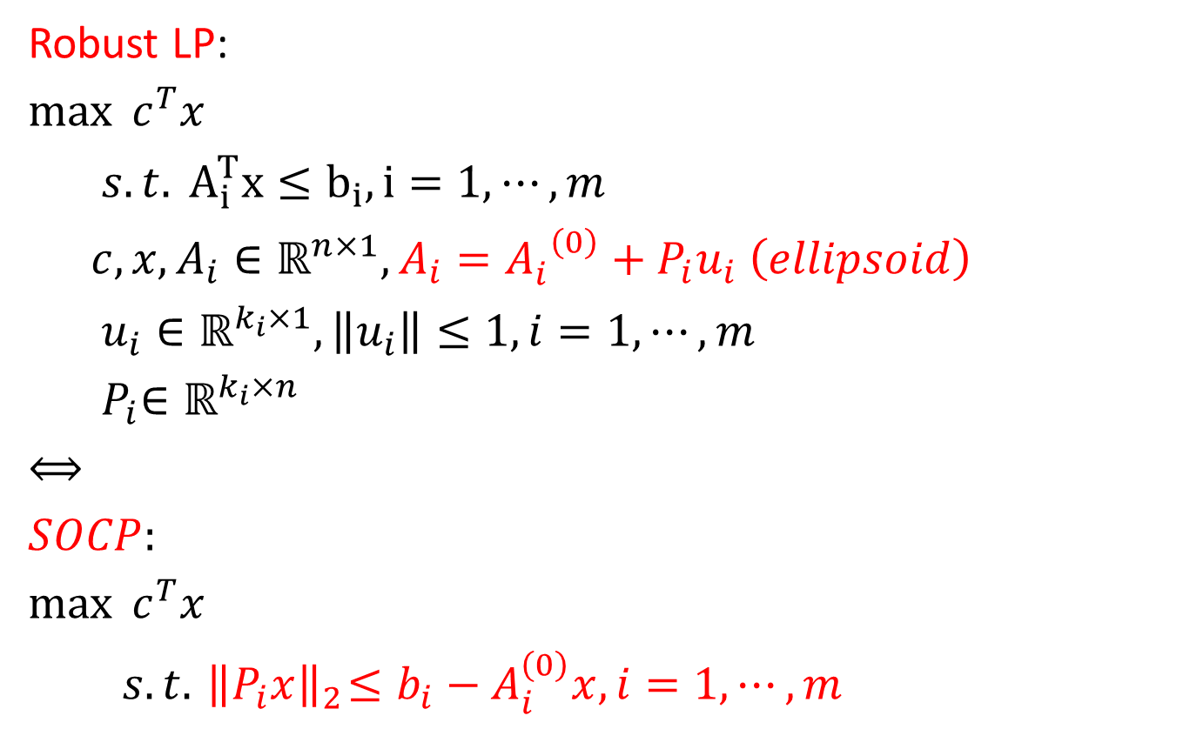
General robust LP formulation
Robust LP:
$$\max{ c^{T}x}$$
$$s.t. A_{i}^{T}x≤b_{i}, i=1,⋯,m$$
$$c,x,A_{i}∈ℝ^{n×1}, A_{i}={A_{i}^{}}^{\left(0\right)}+P_{i}u_{i} \left(ellipsoid\right)$$
$$u_{i}∈ℝ^{k_{i}×1}, \left\|u_{i}\right\|≤1, i=1,⋯,m$$
$${ P}_{i}∈ℝ^{k_{i}×n}$$
$$⟺$$
$$SOCP:$$
$$\max{{ c}^{T}x}$$
$$s.t. { \left\|P_{i}x\right\|}_{2}≤b_{i}−A_{i}^{\left(0\right)}x, i=1,⋯,m$$

Slide 16
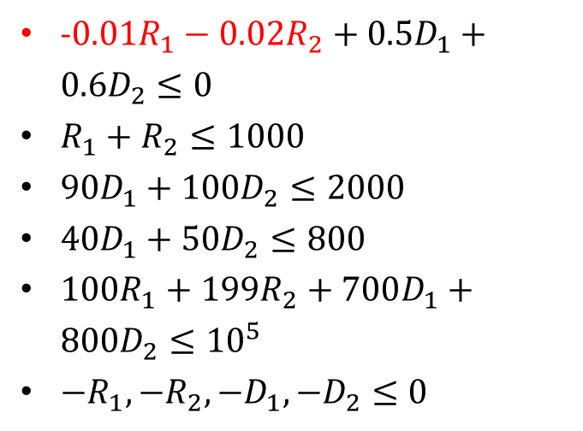
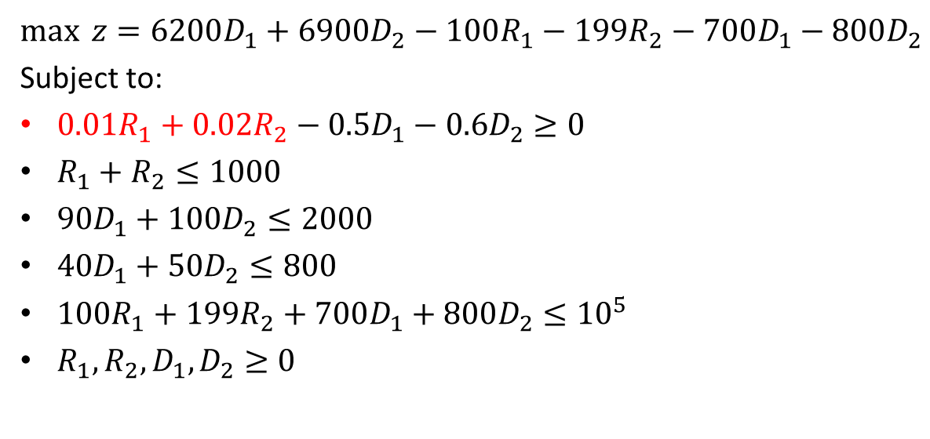
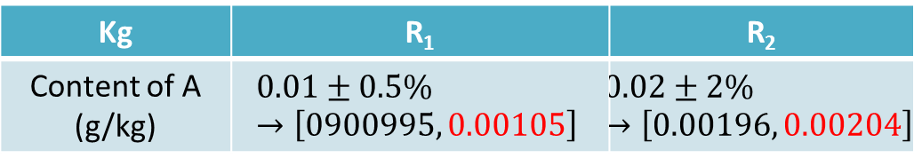
Pharmaceutics example
$$\max{ z=6200D_{1}+6900D_{2}−100R_{1}−199R_{2}−700D_{1}−800D_{2}}$$
Subject to:
$0.01R_{1}+0.02R_{2}−0.5D_{1}−0.6D_{2}≥0$
$R_{1}+R_{2}≤1000$
$90D_{1}+100D_{2}≤2000$
$40D_{1}+50D_{2}≤800$
$100R_{1}+199R_{2}+700D_{1}+800D_{2}≤{10}^{5}$
$R_{1}, R_{2}, D_{1}, D_{2}≥0$
-$0.01R_{1}−0.02R_{2}+0.5D_{1}+0.6D_{2}≤0$
$R_{1}+R_{2}≤1000$
$90D_{1}+100D_{2}≤2000$
$40D_{1}+50D_{2}≤800$
$100R_{1}+199R_{2}+700D_{1}+800D_{2}≤{10}^{5}$
$−R_{1}, {−R}_{2}, {−D}_{1}, −D_{2}≤0$
Kg | R₁ | R₂
Content of A (g/kg) | $$0.01±0.5\%→\left[0900995, 0.00105\right]$$ | $$0.02±2\%→\left[0.00196, 0.00204\right]$$

Slide 17
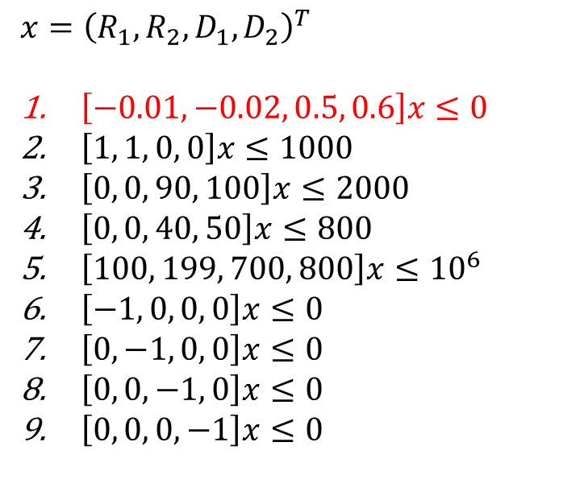
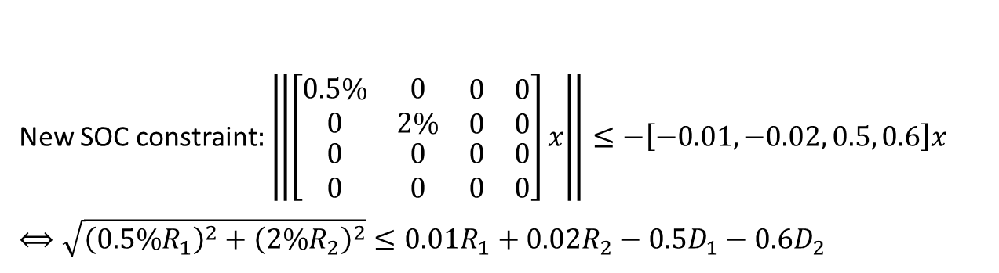

Uncertainty to SOC constraints
$$x={\left(R_{1}, R_{2}, D_{1}, D_{2}\right)}^{T}$$
$\left[−0.01, −0.02, 0.5, 0.6\right]x≤0$
$\left[1, 1, 0, 0\right]x≤1000$
$\left[0, 0, 90, 100\right]x≤2000$
$\left[0, 0, 40, 50\right]x≤800$
$\left[100, 199, 700, 800\right]x≤{10}^{6}$
$\left[−1, 0, 0, 0\right]x≤0$
$\left[0, −1, 0, 0\right]x≤0$
$\left[0, 0, −1, 0\right]x≤0$
$\left[0, 0, 0, −1\right]x≤0$
$\left[−0.01±0.5\%, −0.02±2\%, 0.5, 0.6\right]x≤0$
$$A_{1}=\left[\begin{matrix}−0.01±0.5\% \\ −0.02±2\% \\ \begin{matrix}0.5 \\ 0.6\end{matrix}\end{matrix}\right]≈\left[\begin{matrix}−0.01 \\ −0.02 \\ \begin{matrix}0.5 \\ 0.6\end{matrix}\end{matrix}\right]+\left[\begin{matrix}0.5\% & 0 & \begin{matrix}0 & 0\end{matrix} \\ 0 & 2\% & \begin{matrix}0 & 0\end{matrix} \\ \begin{matrix}0 \\ 0\end{matrix} & \begin{matrix}0 \\ 0\end{matrix} & \begin{matrix}\begin{matrix}0 \\ 0\end{matrix} & \begin{matrix}0 \\ 0\end{matrix}\end{matrix}\end{matrix}\right]u$$
New SOC constraint$:\left\|\left[\begin{matrix}0.5\% & 0 & \begin{matrix}0 & 0\end{matrix} \\ 0 & 2\% & \begin{matrix}0 & 0\end{matrix} \\ \begin{matrix}0 \\ 0\end{matrix} & \begin{matrix}0 \\ 0\end{matrix} & \begin{matrix}\begin{matrix}0 \\ 0\end{matrix} & \begin{matrix}0 \\ 0\end{matrix}\end{matrix}\end{matrix}\right]x\right\|≤−\left[−0.01, −0.02, 0.5, 0.6\right]x$
$$⟺\sqrt{{\left(0.5\%R_{1}\right)}^{2}+{\left(2\%R_{2}\right)}^{2}}≤0.01R_{1}+0.02R_{2}−0.5D_{1}−0.6D_{2}$$

Slide 18
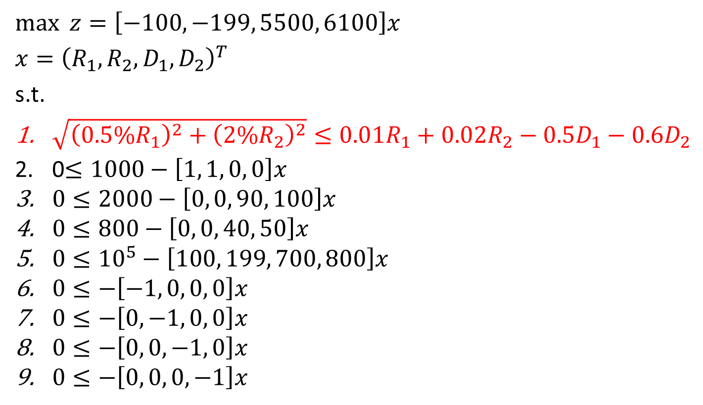
Corresponding SOCP
$$\max{ z=\left[−100, −199, 5500, 6100\right]x}$$
$$x={\left(R_{1}, R_{2}, D_{1}, D_{2}\right)}^{T}$$
s.t.
$\sqrt{{\left(0.5\%R_{1}\right)}^{2}+{\left(2\%R_{2}\right)}^{2}}≤0.01R_{1}+0.02R_{2}−0.5D_{1}−0.6D_{2}$
0$≤1000−\left[1, 1, 0, 0\right]x$
$0≤2000−\left[0, 0, 90, 100\right]x$
$0≤800−\left[0, 0, 40, 50\right]x$
$0≤{10}^{5}−\left[100, 199, 700, 800\right]x$
$0≤−\left[−1, 0, 0, 0\right]x$
$0≤−\left[0, −1, 0, 0\right]x$
$0≤−\left[0, 0, −1, 0\right]x$
$0≤−\left[0, 0, 0, −1\right]x$

Slide 19
How to decide ellipse?
Expert opinion
Statistics: average live in ellipsoids
Does not have to be an ellipse. Can be some other shape (e.g. boxes)

Slide 20
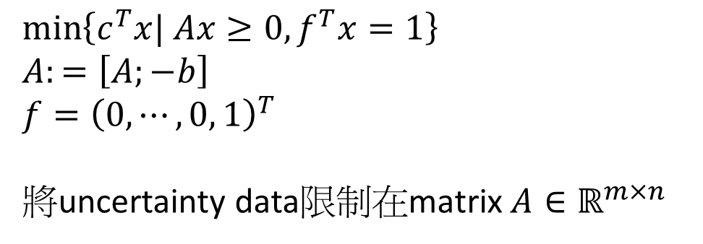
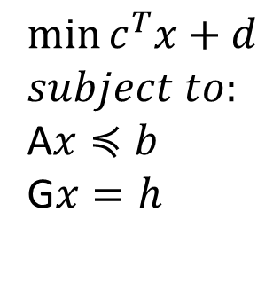
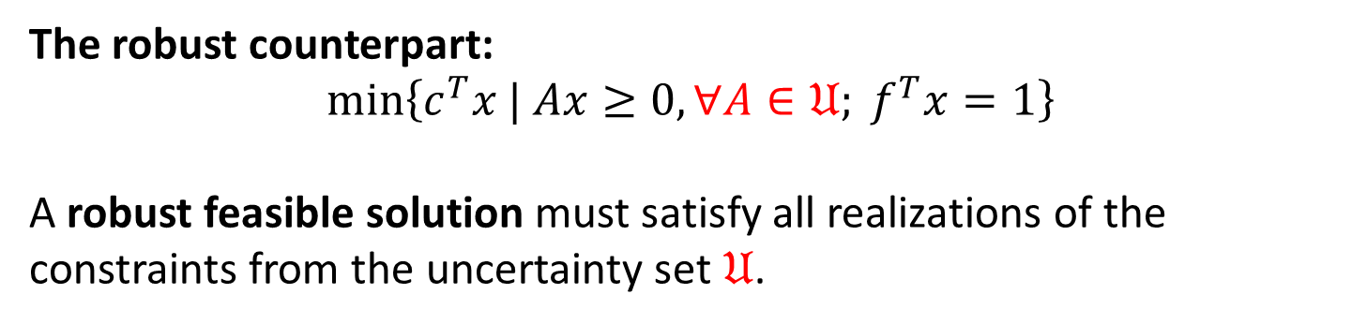
Robust counterpart construction
$$\min{c^{T}x+d}$$
$$subject to:$$
A$x≼b$
G$x=h$
$$\min\left\{c^{T}x| Ax≥0, f^{T}x=1\right\}$$
$$A:=\left[A;−b\right]$$
$$f={\left(0, ⋯,0, 1\right)}^{T}$$
將uncertainty data限制在matrix $A∈ℝ^{m×n}$
The robust counterpart:
$$\min\left\{c^{T}x | Ax≥0, ∀A∈𝔘; f^{T}x=1\right\}$$
A robust feasible solution must satisfy all realizations of the constraints from the uncertainty set $𝔘$.

Slide 21
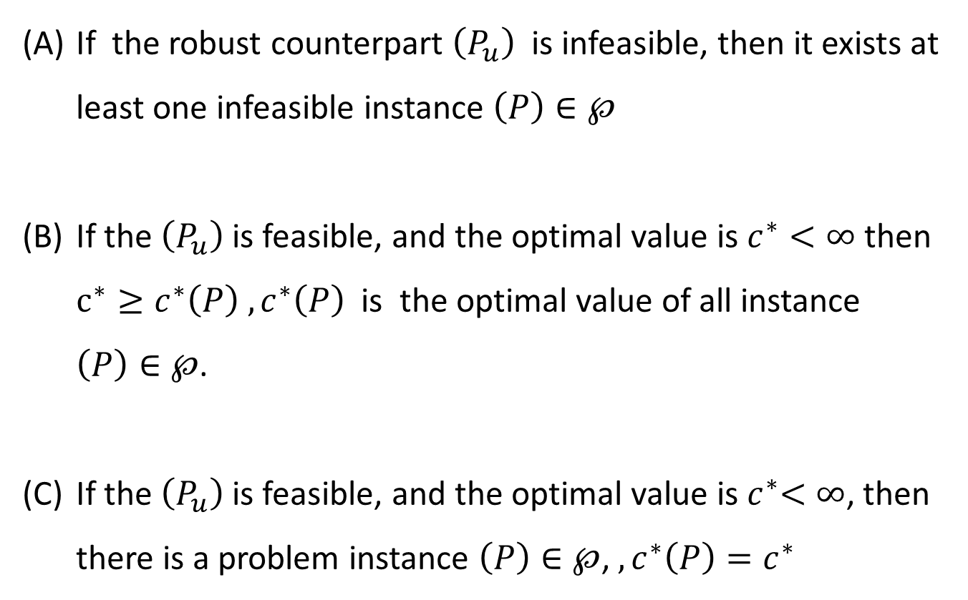
Robust counterpart and the uncertain LP
If the robust counterpart $\left(P_{u}\right)$ is infeasible, then it exists at least one infeasible instance $\left(P\right)∈℘$
If the $\left(P_{u}\right)$is feasible, and the optimal value is $c^{∗}<∞$ then $c^{∗}≥c^{∗}\left(P\right) , c^{∗}\left(P\right)$ is the optimal value of all instance $\left(P\right)∈℘$.
If the $\left(P_{u}\right)$is feasible, and the optimal value is${ c}^{∗}<∞$, then there is a problem instance $\left(P\right)∈℘$, $, c^{∗}\left(P\right)=c^{∗}$

Slide 22
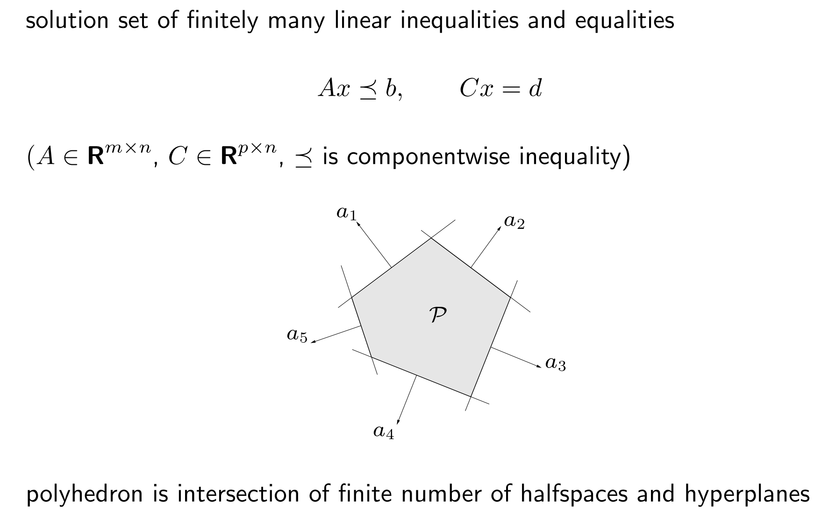
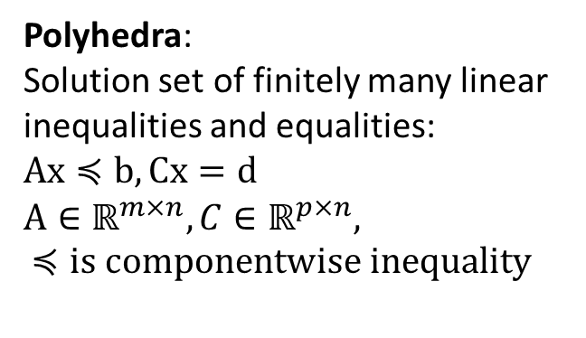
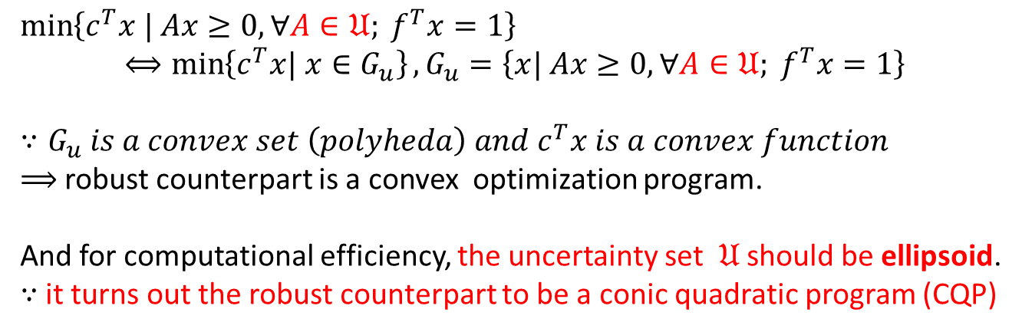
Robust counterpart is a convex optimization program
$$\min\left\{c^{T}x | Ax≥0, ∀A∈𝔘; f^{T}x=1\right\}$$
$$⟺\min\left\{c^{T}x| x∈G_{u}\right\}, G_{u}=\left\{x| Ax≥0,∀A∈𝔘; f^{T}x=1\right\}$$
$$∵G_{u} is a convex set \left(polyheda\right) and c^{T}x is a convex function$$
$⟹$ robust counterpart is a convex optimization program.
And for computational efficiency, the uncertainty set $𝔘$ should be ellipsoid.
$∵$ it turns out the robust counterpart to be a conic quadratic program (CQP)
Polyhedra:
Solution set of finitely many linear inequalities and equalities:
$$Ax≼b, Cx=d$$
$$A∈ℝ^{m×n}, C∈ℝ^{p×n}, \\ ≼is componentwise inequality$$

Slide 23
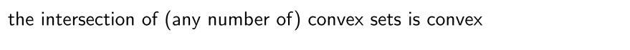
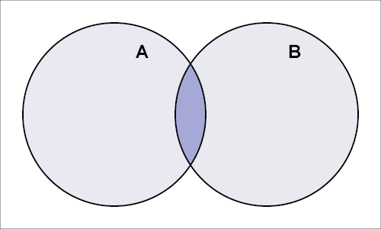
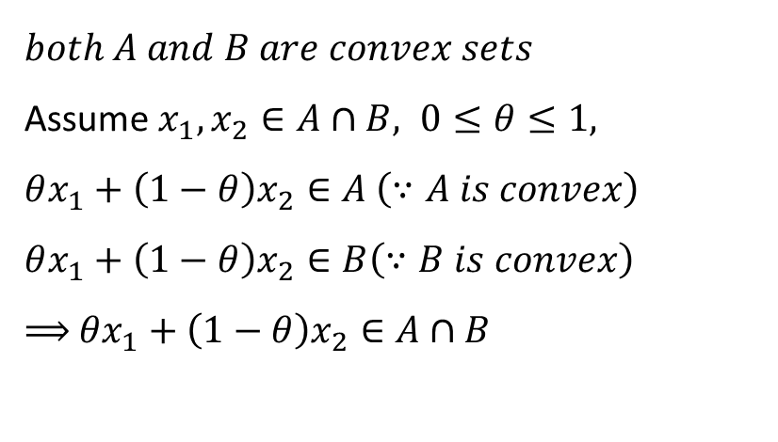
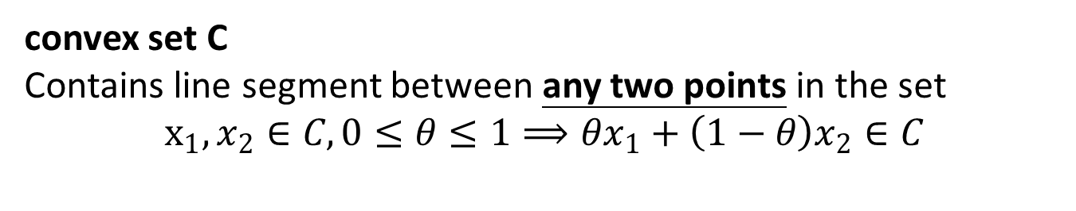
Intersection of convex sets
convex set C
Contains line segment between any two points in the set
$$x_{1}, x_{2}∈C, 0≤θ≤1⟹θx_{1}+\left(1−θ\right)x_{2}∈C$$
$$both A and B are convex sets$$
Assume $x_{1}, x_{2}∈A∩B, 0≤θ≤1,$
$$θx_{1}+\left(1−θ\right)x_{2}∈A \left(∵A is convex\right)$$
$$θx_{1}+\left(1−θ\right)x_{2}∈B\left(∵B is convex\right)$$
$⟹$ $θx_{1}+\left(1−θ\right)x_{2}∈$ $A∩B$

Slide 24
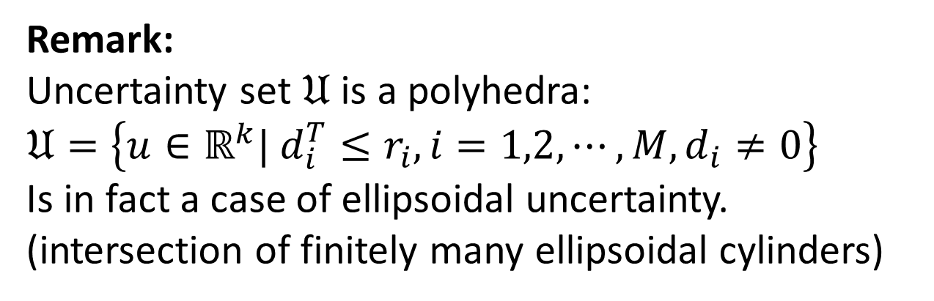
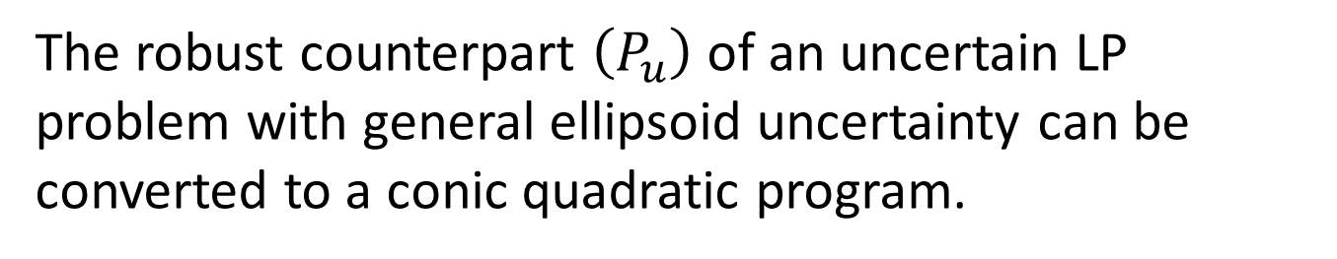
Theorem 3.1
The robust counterpart $\left(P_{u}\right)$ of an uncertain LP problem with general ellipsoid uncertainty can be converted to a conic quadratic program.
Remark:
Uncertainty set $𝔘$ is a polyhedra:
$$𝔘=\left\{u∈ℝ^{k}| d_{i}^{T}≤r_{i}, i=1,2,⋯,M, d_{i}≠0\right\}$$
Is in fact a case of ellipsoidal uncertainty.
(intersection of finitely many ellipsoidal cylinders)

Slide 25
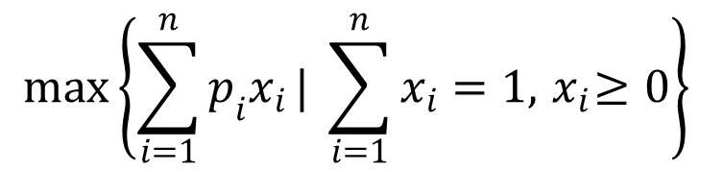

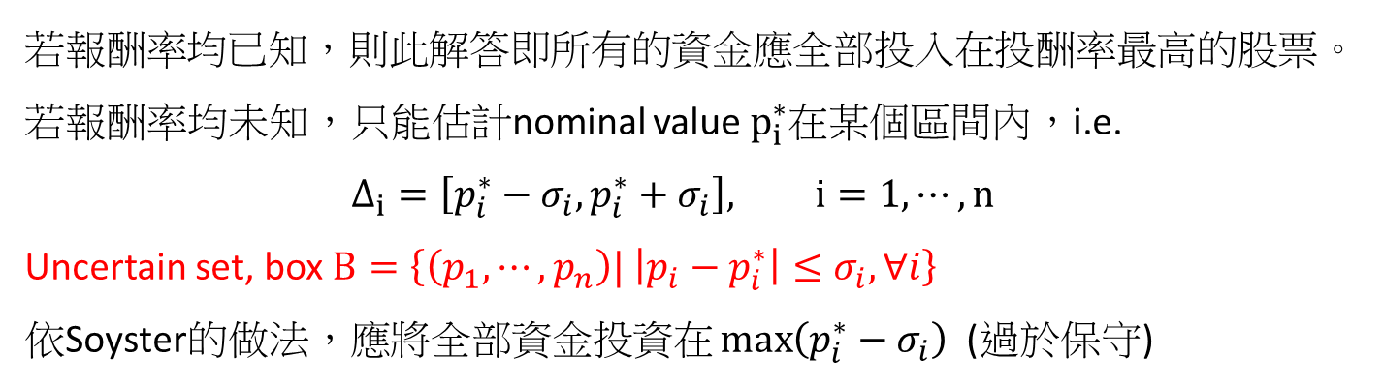
Portfolio problem
年初投資1元在n種股票的投資組合當中。
年底時，n種股票的報酬率為$p_{i}, i=1,⋯,n$，且在年底時賣出投資組合。
Goal: 決定分配到此n支股票的資金$x_{I}, i=1,⋯,n$
$$\max\left\{\sum_{i=1}^{n}{p_{i}x_{i}}| \sum_{i=1}^{n}{x_{i}}=1, { x}_{i}≥0\right\}$$
若報酬率均已知，則此解答即所有的資金應全部投入在投酬率最高的股票。
若報酬率均未知，只能估計nominal value $p_{i}^{∗}$在某個區間內，i.e.
$$Δ_{i}=\left[p_{i}^{∗}−σ_{i}, p_{i}^{∗}+σ_{i}\right], i=1,⋯,n$$
Uncertain set, box $B=\left\{\left(p_{1},⋯,p_{n}\right)| \left|p_{i}−p_{i}^{∗}\right|≤σ_{i}, ∀i\right\}$
依Soyster的做法，應將全部資金投資在 $\max\left(p_{i}^{∗}−σ_{i}\right)$ (過於保守)

Slide 26
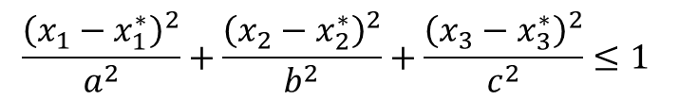
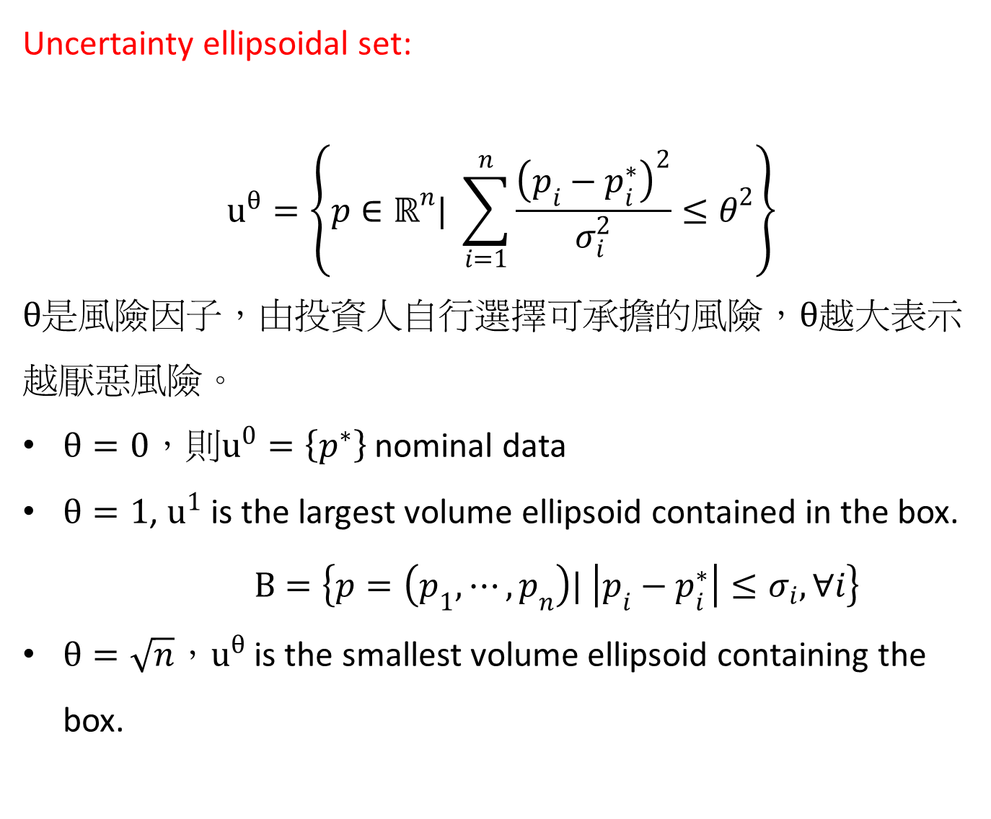
Uncertainty ellipsoidal set:
$$u^{θ}=\left\{p∈ℝ^{n}| \sum_{i=1}^{n}{\frac{{\left(p_{i}−p_{i}^{∗}\right)}^{2}}{σ_{i}^{2}}}≤θ^{2}\right\}$$
$θ$是風險因子，由投資人自行選擇可承擔的風險，$θ$越大表示越厭惡風險。
$θ=0$，則$u^{0}=\left\{p^{∗}\right\}$ nominal data
$θ=1$, $u^{1}$ is the largest volume ellipsoid contained in the box. $B=\left\{p=\left(p_{1},⋯,p_{n}\right)| \left|p_{i}−p_{i}^{∗}\right|≤σ_{i}, ∀i\right\}$
$θ=\sqrt{n}，u^{θ}$ is the smallest volume ellipsoid containing the box.
$$\frac{{\left(x_{1}−x_{1}^{∗}\right)}^{2}}{a^{2}}+\frac{{\left(x_{2}−x_{2}^{∗}\right)}^{2}}{b^{2}}+\frac{{\left(x_{3}−x_{3}^{∗}\right)}^{2}}{c^{2}}≤1$$

Slide 27
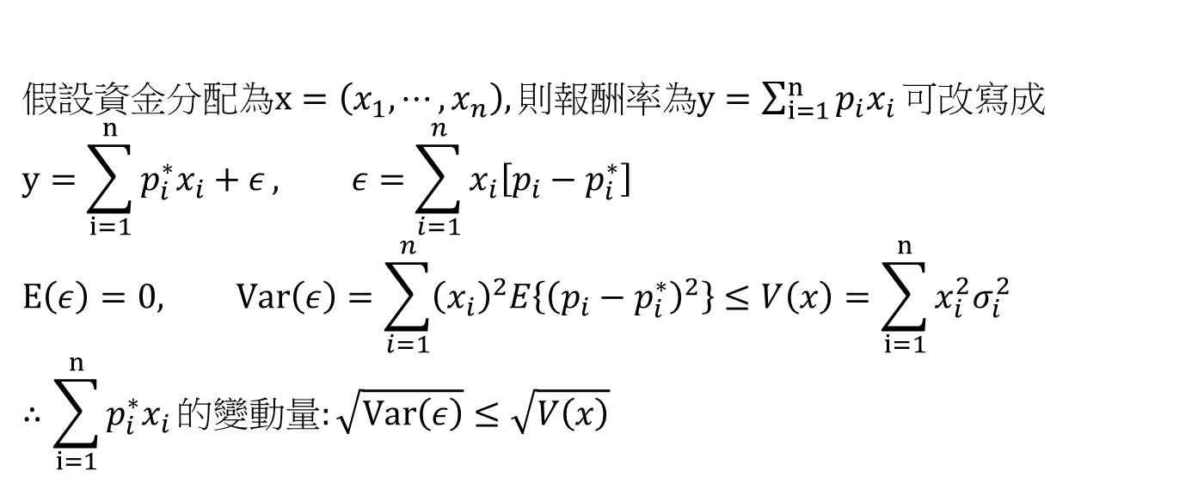
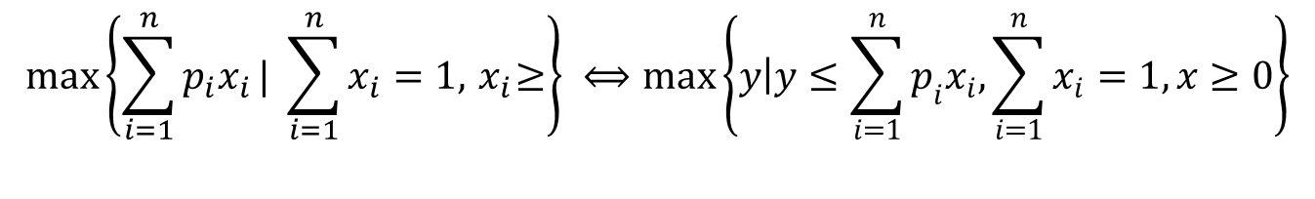
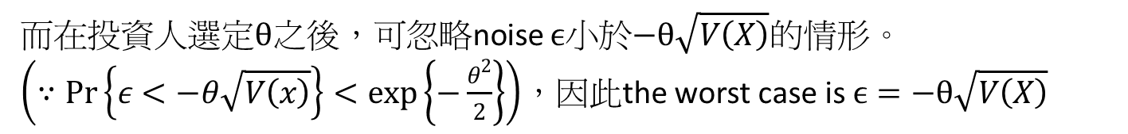
$$\max\left\{\sum_{i=1}^{n}{p_{i}x_{i}}| \sum_{i=1}^{n}{x_{i}}=1, { x}_{i}≥\right\} ⟺\max\left\{\left.y\right|y≤\sum_{i=1}^{n}{p_{i}x_{i}, \sum_{i=1}^{n}{x_{i}}=1, x≥0}\right\}$$
假設資金分配為$x=\left(x_{1},⋯, x_{n}\right), 則報酬率為y=\sum_{i=1}^{n}{p_{i}x_{i}}可改寫成$
$$y=\sum_{i=1}^{n}{p_{i}^{∗}x_{i}+ε}, ε=\sum_{i=1}^{n}{x_{i}\left[p_{i}−p_{i}^{∗}\right]}$$
$$E\left(ε\right)=0, Var\left(ε\right)=\sum_{i=1}^{n}{{\left(x_{i}\right)}^{2}E\left\{{\left(p_{i}−p_{i}^{∗}\right)}^{2}\right\}}≤V\left(x\right)=\sum_{i=1}^{n}{x_{i}^{2}σ_{i}^{2}}$$
$$∴\sum_{i=1}^{n}{p_{i}^{∗}x_{i}}的變動量:\sqrt{Var\left(ε\right)}≤\sqrt{V\left(x\right)}$$
而在投資人選定$θ$之後，可忽略noise $ϵ$小於$−θ\sqrt{V\left(X\right)}$的情形。
$\left(∵\operatorname{Pr}\left\{ε<−θ\sqrt{V\left(x\right)}\right\}<\exp\left\{−\frac{θ^{2}}{2}\right\}\right)$，因此the worst case is $ϵ=−θ\sqrt{V\left(X\right)}$

Slide 28
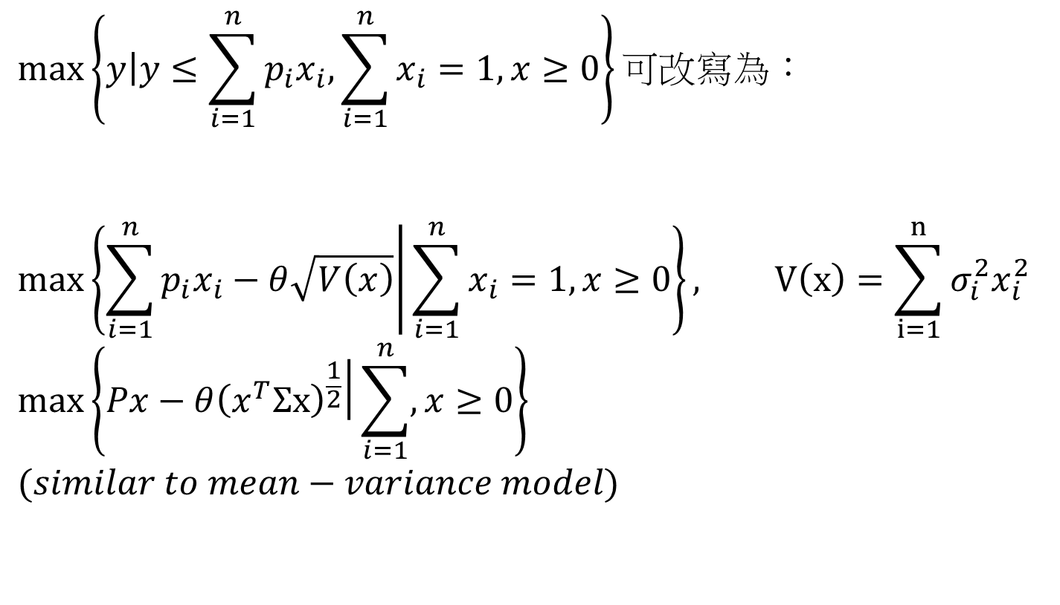
$$\max\left\{\left.y\right|y≤\sum_{i=1}^{n}{p_{i}x_{i}, \sum_{i=1}^{n}{x_{i}}=1, x≥0}\right\}可改寫為：$$
$$\max\left\{\left.\sum_{i=1}^{n}{p_{i}x_{i}}−θ\sqrt{V\left(x\right)}\right|\sum_{i=1}^{n}{x_{i}=1, x≥0}\right\}, V\left(x\right)=\sum_{i=1}^{n}{σ_{i}^{2}x_{i}^{2}}$$
$$\max\left\{\left.Px−θ{\left(x^{T}Σx\right)}^{\frac{1}{2}}\right|\sum_{i=1}^{n}{, x≥0}\right\}$$
$$(similar to mean−variance model)$$

Slide 29
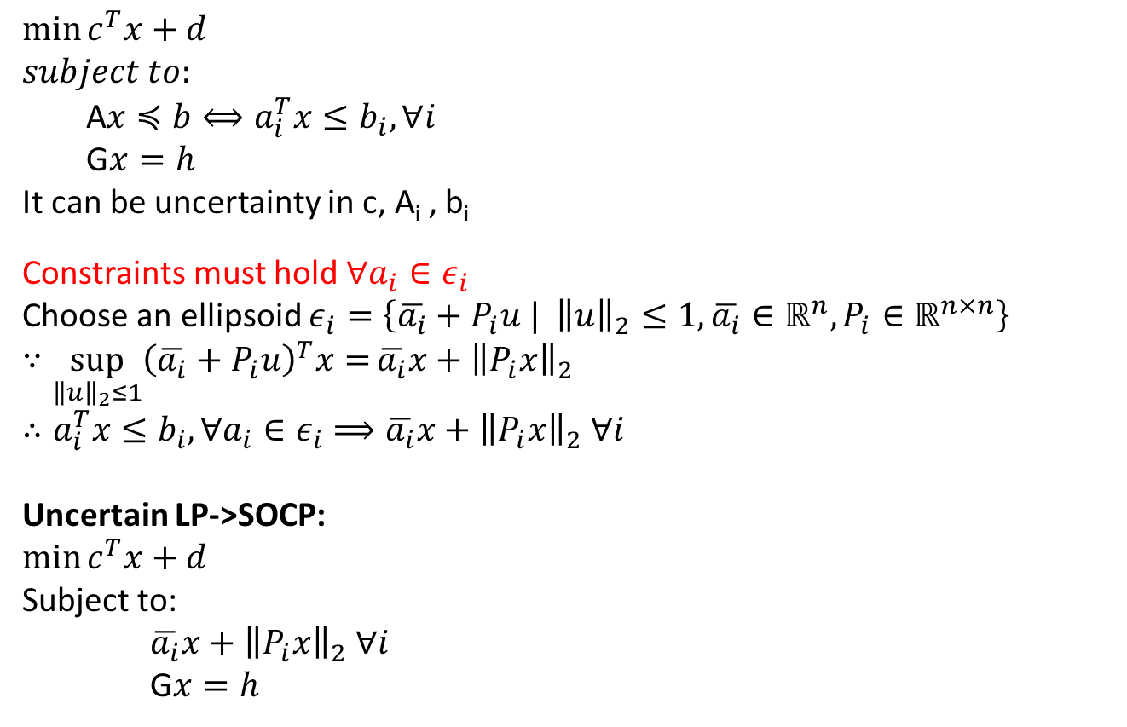
Robust linear programming
$$\min{c^{T}x+d}$$
$$subject to:$$
A$x≼b⟺a_{i}^{T}x≤b_{i}, ∀i$
G$x=h$
It can be uncertainty in c, A_{i} , b_{i}
Constraints must hold $∀a_{i}∈ε_{i}$
Choose an ellipsoid $ε_{i}=\left\{\overline{a_{i}}+P_{i}u | {\left\|u\right\|}_{2}≤1, \overline{a_{i}}∈ℝ^{n}, P_{i}∈ℝ^{n×n}\right\}$
$$∵\sup_{{\left\|u\right\|}_{2}≤1}{{\left(\overline{a_{i}}+P_{i}u\right)}^{T}x=}\overline{a_{i}}x+{\left\|P_{i}x\right\|}_{2}$$
$$∴a_{i}^{T}x≤b_{i}, ∀a_{i}∈ε_{i}⟹\overline{a_{i}}x+{\left\|P_{i}x\right\|}_{2} ∀i$$
Uncertain LP->SOCP:
$$\min{c^{T}x+d}$$
Subject to:
$\overline{a_{i}}x+{\left\|P_{i}x\right\|}_{2} ∀i$
G$x=h$

Slide 30
Resource
Stephen P. Boyd, Stanford University:
EE364A: Convex Optimization I
EE364B: Convex Optimization II
http://www.stanford.edu/~boyd/cvxbook/
Software:
*ROME(MATLAB)
*CVXOPT (Python)

Slide 31

Thank you!!

