Slide 1
Predicting the State of Cysteines Based on Sequence Information
Xuanmin Guang(光宣敏), Yanzhi Guo(郭研芝), Jiamin Xiao(肖嘉敏), Xia Wang, Jing Sun, Wenjia Xiong(熊文佳), Menglong Li(李夢龍) Journal of Theoretical Biology, Volume 267, Issue 3, 7 December 2010, Pages 312-318.
Presenter: Chun-Chieh Tai
Date: July 3, 2012

Slide 2
Abstract(1/2)
A three-stage support vector machine (SVM) was constructed to predict the state of cysteines by fusing sequence information, evolution information and annotation information of protein sequences. The first and second stages were for predicting whether the protein sequences contain disulfide bonds and whether all of the cysteines are involved in disulfide bonds. In the last stage, one SVM was constructed for predicting which cysteines are involved in disulfide bonds, among all these cysteines in proteins. The three SVMs give a good performance and the overall prediction accuracy are 90.05%, 96.36% and 80.00%, respectively, which indicates that the features selected in this work are effective for predicting the state of cysteines.

Slide 3
Abstract(2/2)
In addition, current methods only paid too much attention to the prediction performance and never showed us how much important the roles of these features played in the prediction. As a result a feature importance measurement designated as F-score function was used to evaluate these features. The result shows that among these protein descriptors; evolution information is the most important feature for representing the disulfide-containing proteins. The prediction software and data sets used in this article are freely available at http://cic.scu.edu.cn/bioinformatics/Predict_Cys.zip.

Slide 4
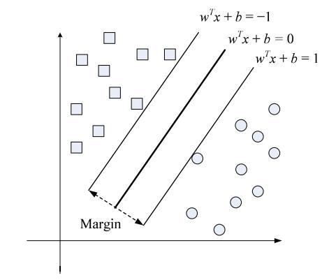
Support Vector Machine (SVM)
Hyperplan
maximizing

Slide 5
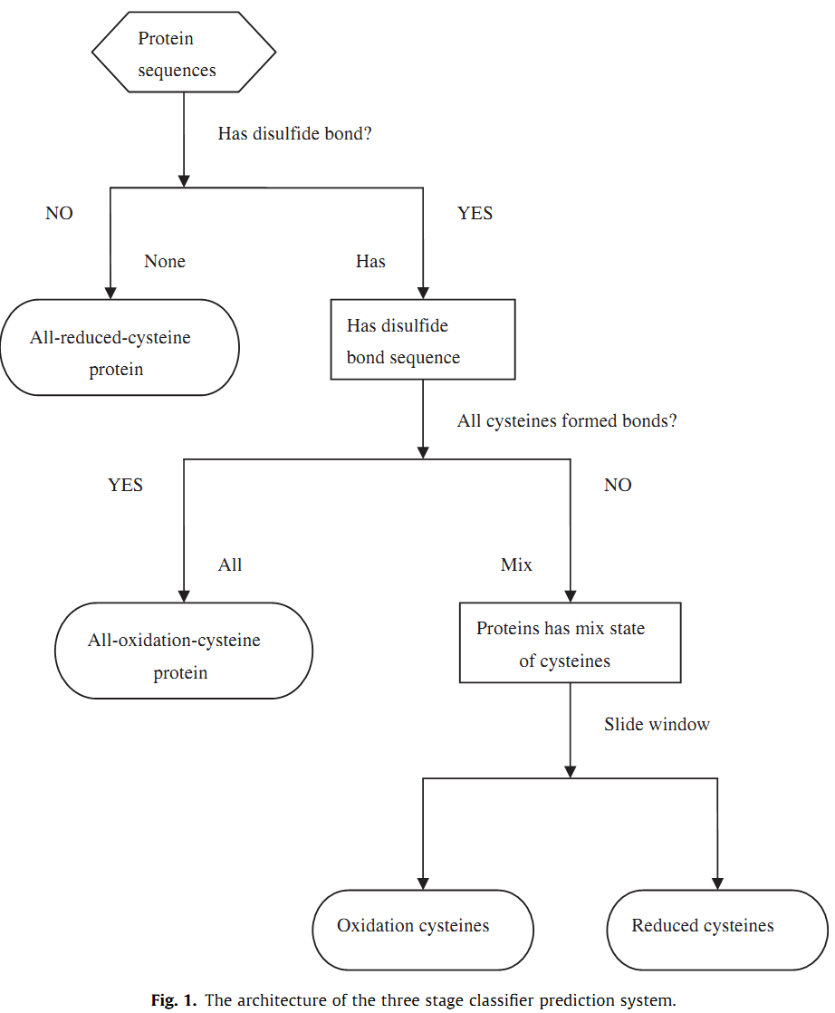

Slide 6
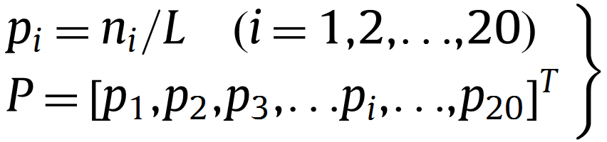
Amino Acid Composition

Slide 7
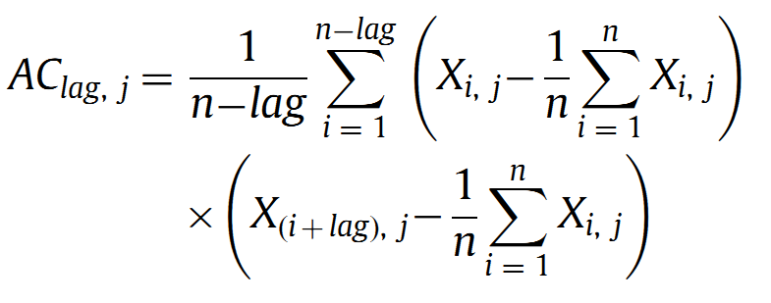
Auto Convariance Variables
lag: the distance between an amino acid residue and its neighbor a certain number of residues away, lag = 1, 2, …, lg
J: descriptor(hydrophobicity and polarity)
Number of AC: 2*lg

Slide 8
Position Speciﬁc Scoring Matrix(PSSM)
A R N D C Q E G H I L K M F P S T W Y V
Y -2 -2 -2 -3 -3 -2 -2 -3 2 -1 -1 -2 -1 3 -3 -2 -2 2 7 -1
V 0 -3 -3 -3 -1 -2 -3 -3 -3 3 1 -2 1 -1 -3 -2 0 -3 -1 4
I -1 -3 -4 -3 -1 -3 -3 -4 -4 4 2 -3 1 0 -3 -3 -1 -3 -1 3
C 0 -4 -3 -4 9 -3 -4 -3 -3 -1 -1 -3 -2 -3 -3 -1 -1 -3 -3 -1
F -2 -3 -3 -4 -3 -3 -3 -3 -1 0 0 -3 0 7 -4 -3 -2 1 3 -1
F -2 -3 -3 -4 -3 -3 -3 -3 -1 0 0 -3 0 7 -4 -3 -2 1 3 -1
T 0 -1 0 -1 -1 -1 -1 -2 -2 -1 -1 -1 -1 -2 -1 2 5 -3 -2 0
V 0 -3 -3 -3 -1 -2 -3 -3 -3 3 1 -2 1 -1 -3 -2 0 -3 -1 4
L -2 -2 -4 -4 -1 -2 -3 -4 -3 2 4 -3 2 0 -3 -3 -1 -2 -1 1
C 0 -4 -3 -4 9 -3 -4 -3 -3 -1 -1 -3 -2 -3 -3 -1 -1 -3 -3 -1
F -2 -3 -3 -4 -3 -3 -3 -3 -1 0 0 -3 0 7 -4 -3 -2 1 3 -1
C 0 -4 -3 -4 9 -3 -4 -3 -3 -1 -1 -3 -2 -3 -3 -1 -1 -3 -3 -1
L -2 -2 -4 -4 -1 -2 -3 -4 -3 2 4 -3 2 0 -3 -3 -1 -2 -1 1
A R N D C Q E G H I L K M F P S T W Y V
…
…
…
…
…
…
…
…
…
…
…
…
…
…
…
…
…
…
…
…
…
PSSM was created by using PSI-BLAST to search the Swiss-Prot for multiple sequence alignment against the protein samples.
每個位置 每種protein出現都會有一個分數，基本上跟training set中這個位置這個protein出現的次數正相關。

Slide 9
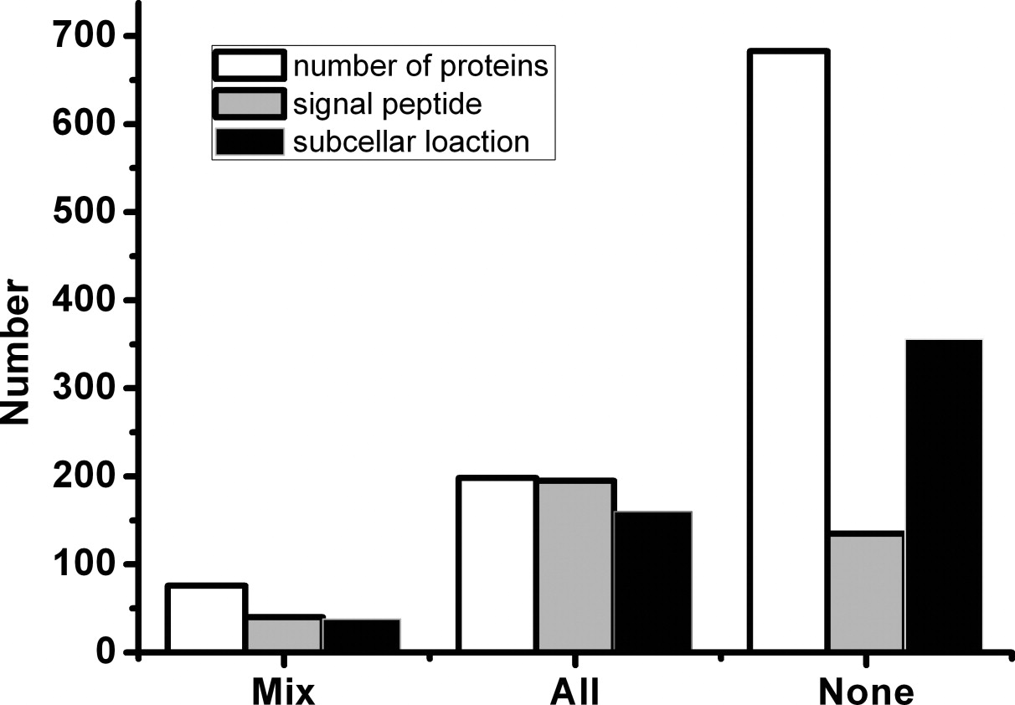
Annotation Information and the Number of Cysteines

Slide 10
Performance Measures
Sensitivity = TP/(TP+FN)
Specificity = TN/(TN+FP)
Accuracy = (TP+ TN)/N
N: total # of cases
真陽性 (true positive, TP)表示在真正有病的族群中，檢驗的結果也真的是陽性。
真陰性 (true negative, TN)表示在沒病的族群中，檢驗的結果也是陰性。
偽陽性 (false positive, FP)表示在沒病的族群中，檢驗的結果卻是陽性。
偽陰性 (false negative, FN) 表示在真正有病的族群中，檢驗的結果卻是陰性。

Slide 11
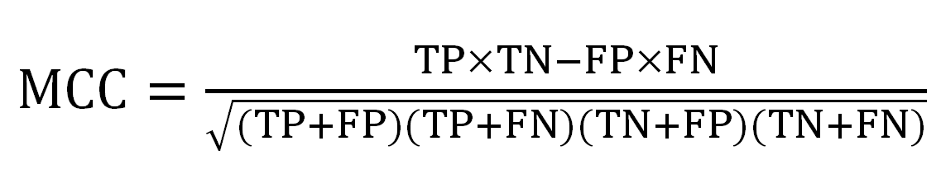
Matthews Correlation Coefﬁcient
 |  | prediction outcome
actual value |  | P | N
 | P’ | True Positive | False Negative
 | N’ | False Positive | True Negative

Slide 12
F-score
F-score就是Precision與Recall的調和平均數(Harmonic Mean)
F= 2*(TP+FP)*(TN+FN)/(TP+FP+TN+FN)

Slide 13
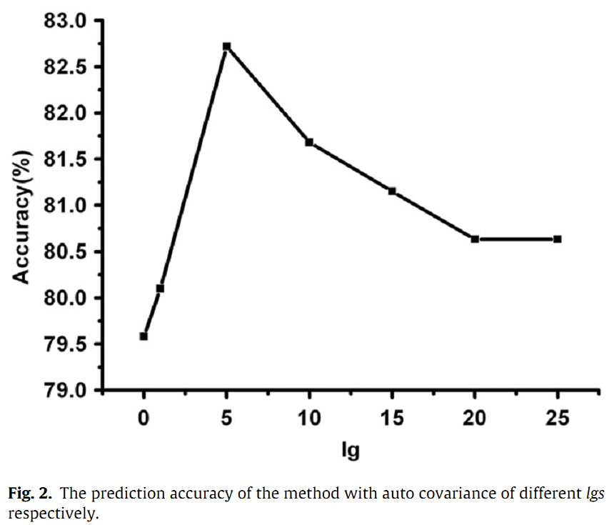
Result(1/5)

Slide 14
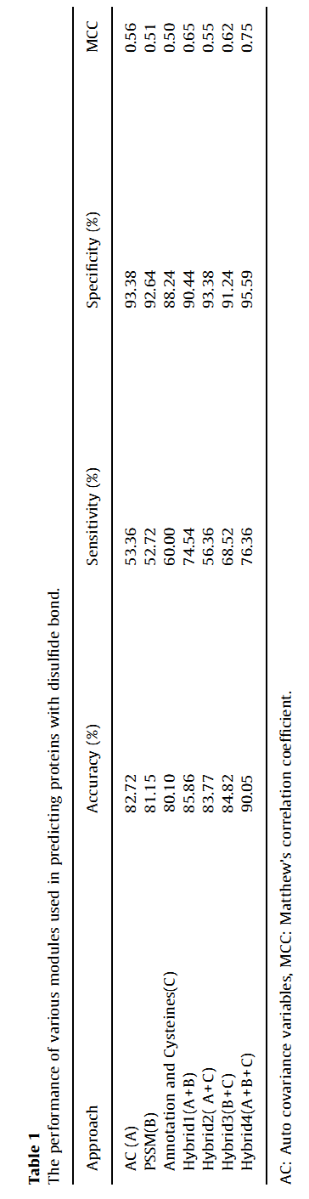
Result(2/5)

Slide 15
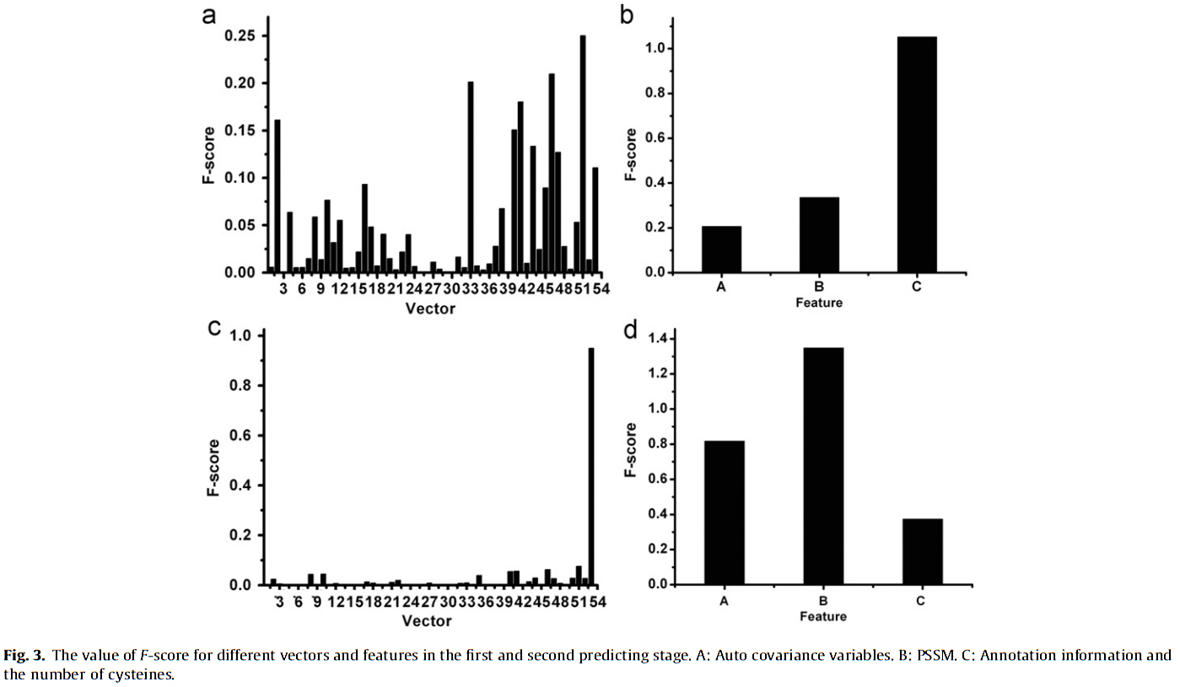
Result(3/5)

Slide 16
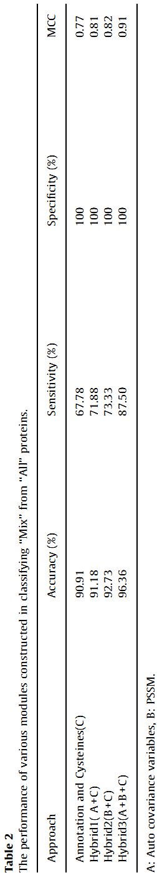
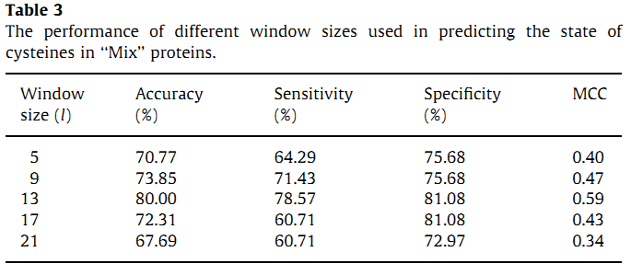
Result(4/5)

Slide 17
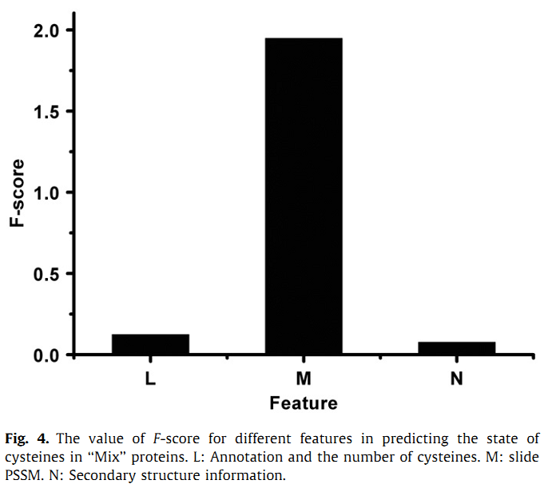
Result(5/5)

Slide 18
Thanks for your listening.

