Slide 1
A New Filtration Method Based on the Locality Property for Approximate String Matching
Chia Wei Lu (呂嘉維) and R. C. T. Lee (李家同)
The 29th Workshop on Combinatorial Mathematics and Computation Theory
Presenter: Yi-Pu Guo
2012-07-17

Slide 2
Abstract
In this paper, we consider the approximate string matching problem. We give a method to eliminate candidate locations in text T as there can be no substring S ending at those locations such that the edit distance between S and pattern P is smaller than or equal to a specified error bound k. Our method is simple to implement. Experimental results show that our method is effective. For instance, for a DNA type data, when the text is 10M characters long, patterns are 10 characters long and k=1, in average, 99% of locations are eliminated by our method. We have also performed comparisons with other algorithms, and the results showed that our algorithm can eliminate more parts than most of the others.

Slide 3
Edit distance
kitten
sitten
sittin
sitting
ED(A,B)=3
每次
插入 (insertion)、
刪除 (deletion) 或
取代 (substitution)
一個字元，從字串 A 到 B 所需的步驟數。

Slide 4
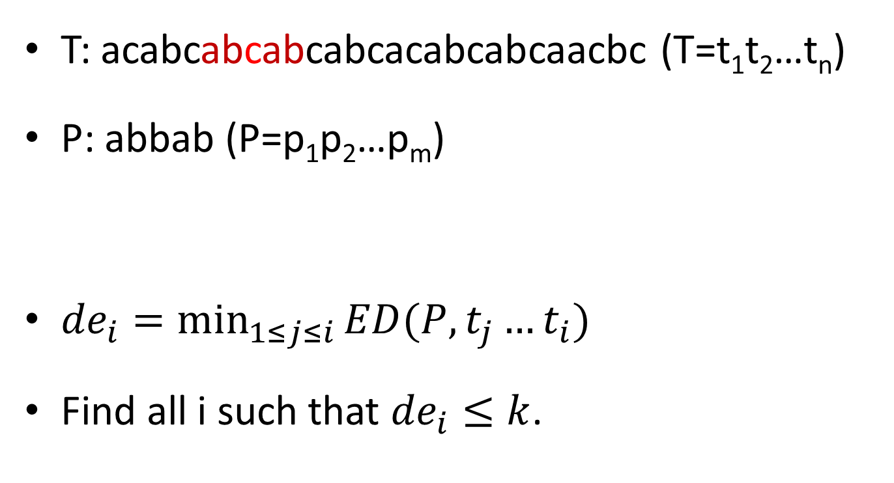
k differences problem
T: acabcabcabcabcacabcabcaacbc (T=t₁t₂…t_{n})
P: abbab (P=p₁p₂…p_{m})
${de}_{i}=\min_{1≤j≤i}{ED(P,t_{j}…t_{i})}$
Find all i such that ${de}_{i}≤k$.

Slide 5
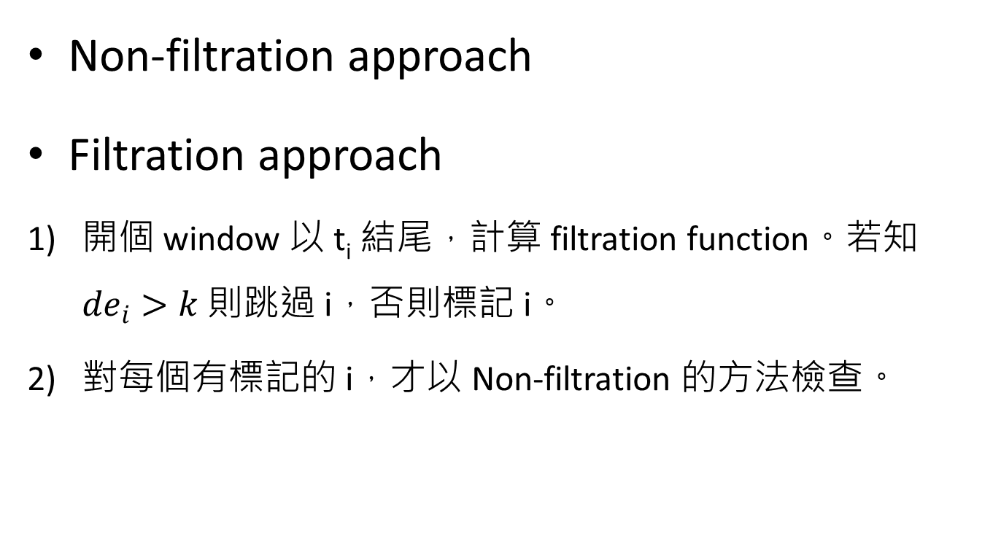
Non-filtration & Filtration approach
Non-filtration approach
Filtration approach
開個 window 以 t_{i} 結尾，計算 filtration function。若知 ${de}_{i}>k$ 則跳過 i，否則標記 i。
對每個有標記的 i，才以 Non-filtration 的方法檢查。

Slide 6
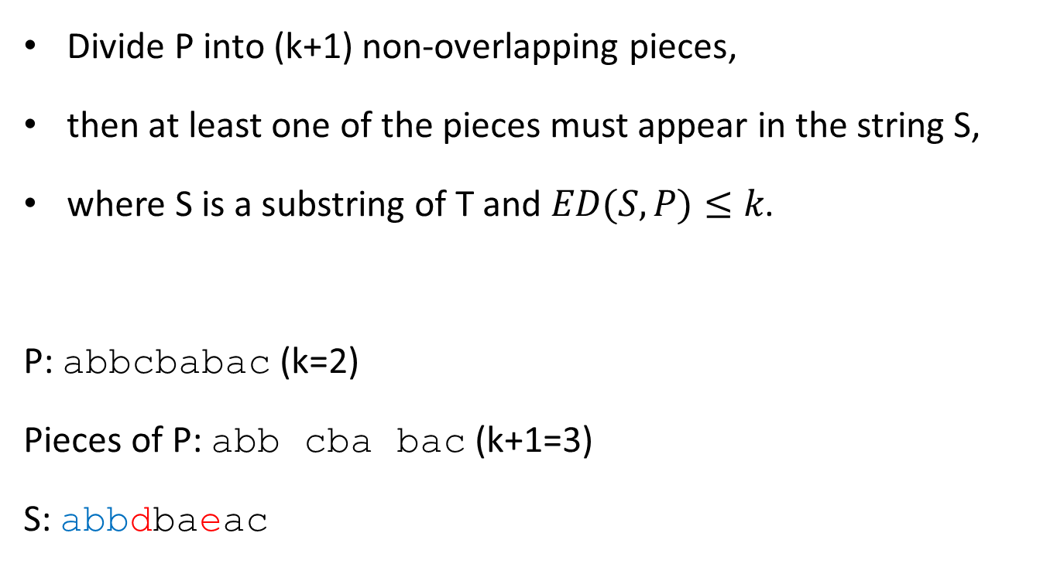
The Partial Exact Matching
Divide P into (k+1) non-overlapping pieces,
then at least one of the pieces must appear in the string S,
where S is a substring of T and $ED(S,P)≤k$.
P: abbcbabac (k=2)
Pieces of P: abb cba bac (k+1=3)
S: abbdbaeac

Slide 7
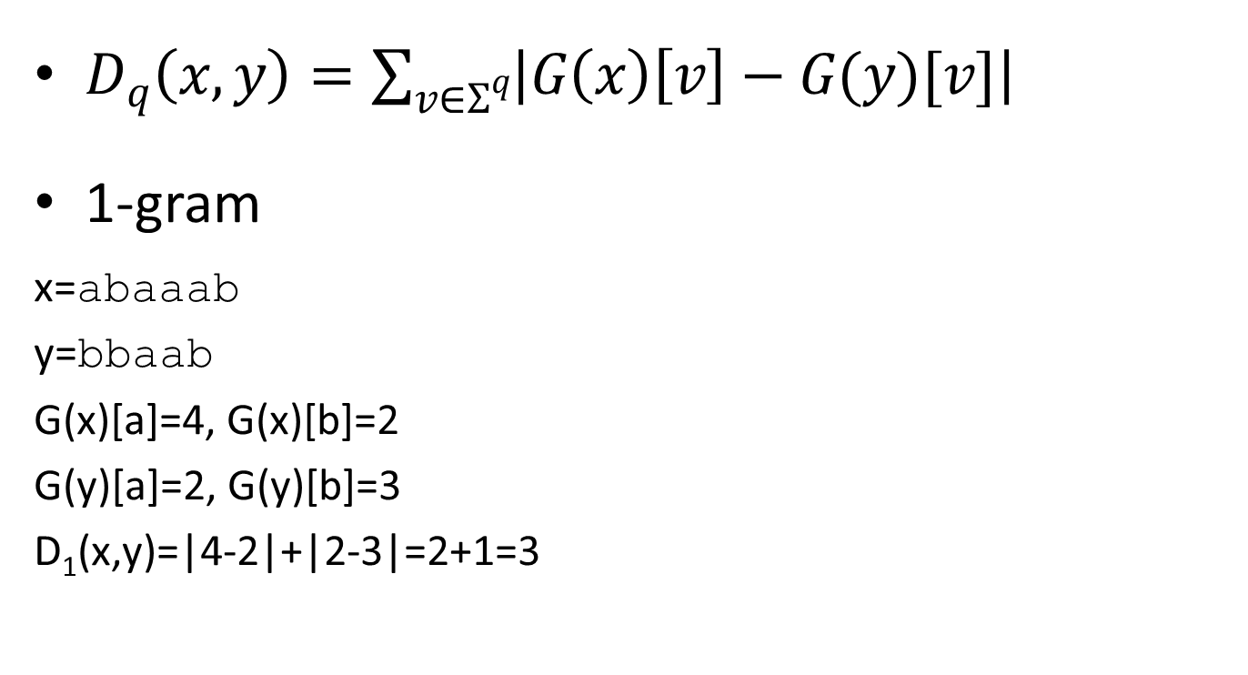
q-gram (1/2)
$D_{q}\left(x,y\right)=\sum_{v∈Σ^{q}}{\left|G\left(x\right)\left[v\right]−G(y)[v]\right|}$
1-gram
x=abaaab
y=bbaab
G(x)[a]=4, G(x)[b]=2
G(y)[a]=2, G(y)[b]=3
D₁(x,y)=|4-2|+|2-3|=2+1=3

Slide 8
q-gram (2/2)
2-gram
x=abaaab
y=bbaab
G(x)[aa]=2, G(x)[ab]=2, G(x)[ba]=1, G(x)[bb]=0
G(y)[aa]=1, G(y)[ab]=1, G(y)[ba]=1, G(y)[bb]=1
D₂(x,y)=|2-1|+|2-1|+|1-1|+|0-1|=1+1+0+1=3

Slide 9
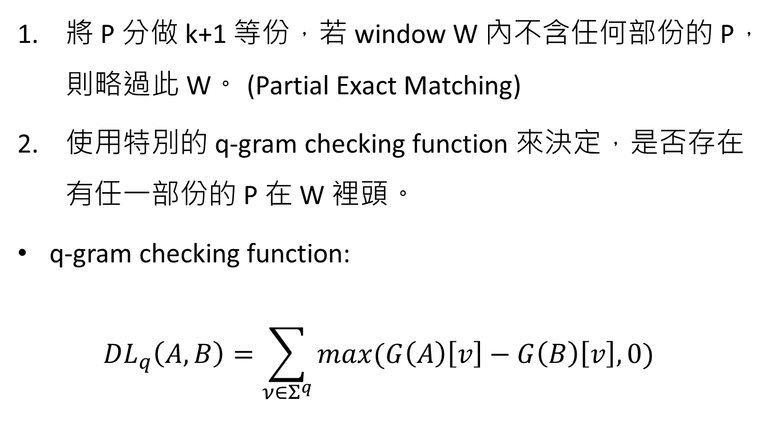
This Algorithm
將 P 分做 k+1 等份，若 window W 內不含任何部份的 P，則略過此 W。 (Partial Exact Matching)
使用特別的 q-gram checking function 來決定，是否存在有任一部份的 P 在 W 裡頭。
q-gram checking function: ${DL}_{q}\left(A,B\right)=\sum_{ν∈Σ^{q}}{\max{(G\left(A\right)\left[v\right]−G\left(B\right)\left[v\right],0)}}$

Slide 10
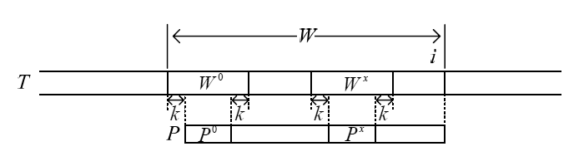
Proof
Lemma 1 If String A exactly appears in string B, DL_{q}(A,B)=0.
P_{i} must appear in the corresponding segment W_{i}.
…
Theorem 3 If for some i, W=T(i-m-k+1,i), and there is no one piece P_{x} of P such that DL_{q}(P_{x},W_{x})=0, then de_{i}>k.

Slide 11
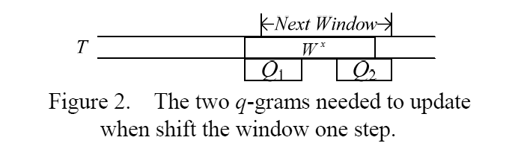
Shifting window
When position i needs to be checked
T
W
t_{i}
W'
t_{i+1}
If Position i+1 also needs to be checked
more efficient to apply DP to the whole blue part

Slide 12
Experiments
P: m={10,20,50}
T: n=10M, Σ={a,c,g,t} (randomly generate)
1≤k≤10
Parameter q: 1≤q≤5 (the best performance one).

Slide 13
Experiments (m=10)
k | 1 | 2 | 3
CL90_LET | 48.71 | 98.97 | 100
CL90_SET | 99.11 | 100 | 100
CM94 | 100 | 100 | 100
FN04 | 0.87 | 33.02 | 97.76
NR00 | 0.98 | 43.5 | 99.89
WM92 | 2.32 | 47.95 | 98.47
U92 | 1.48 | 49.43 | 93.51
Our | 0.47 | 30.29 | 91.94
Our+NR00 | 0.23 | 18.08 | 90.76
The percentage of positions needed to check

Slide 14
Experiments (m=20)
k | 1 | 2 | 3 | 4 | 5
CL90_LET | 0.02 | 2.68 | 52.38 | 98.36 | 100
CL90_SET | 9.6 | 88.87 | 100 | 100 | 100
CM94 | 8.86 | 70.27 | 100 | 100 | 100
FN04 | 0 | 0 | 0.89 | 26.42 | 91.62
NR00 | 0 | 0 | 0.1 | 4.7 | 59.03
WM92 | 0 | 1.74 | 9.66 | 42.23 | 94.09
U92 | 0 | 0.03 | 5.46 | 54.54 | 95.86
Our | 0 | 0.01 | 2.02 | 32.25 | 90.74
Our+NR00 | 0 | 0 | 0.05 | 2.87 | 49.03
The percentage of positions needed to check

Slide 15
Experiments (m=50)
k | 1 | 2 | 3 | 4 | 5 | 6 | 7 | 8 | 9 | 10
CL90_LET | 0 | 0 | 0 | 0 | 0 | 0.02 | 1.32 | 23.64 | 80.09 | 98.89
CL90_SET | 0 | 0 | 0.16 | 8.94 | 84.79 | 99.7 | 100 | 100 | 100 | 100
CM94 | 0 | 0.02 | 0.38 | 4.42 | 82.93 | 98.76 | 99.99 | 100 | 100 | 100
FN04 | 0 | 0 | 0 | 0 | 0 | 0 | 0 | 0.01 | 0.45 | 11.59
NR00 | 0 | 0 | 0 | 0 | 0 | 0 | 0 | 0 | 0 | 0
WM92 | 0 | 0 | 0 | 0.03 | 0.55 | 2.61 | 11.8 | 44.07 | 48.57 | 94.76
U92_Qgram | 0 | 0 | 0 | 0 | 0 | 0 | 0.21 | 6.22 | 42.72 | 91.55
Our | 0 | 0 | 0 | 0 | 0 | 0 | 0.09 | 3.29 | 24.65 | 83.98
Our+NR00 | 0 | 0 | 0 | 0 | 0 | 0 | 0 | 0 | 0 | 0
The percentage of positions needed to check

Slide 16
The End
Thank you for listening.

