Slide 1
Computing the Longest Common Subsequence of Multiple RLE Strings
Ling-Chih Yao and Kuan-Yu Chen(陳冠宇)
Proceedings of the 29th Workshop on Combinatorial Mathematics and Computation Theory, pp. 228-234
Presenter: Chiou-Ting Tseng
Date: July 17, 2012

Slide 2
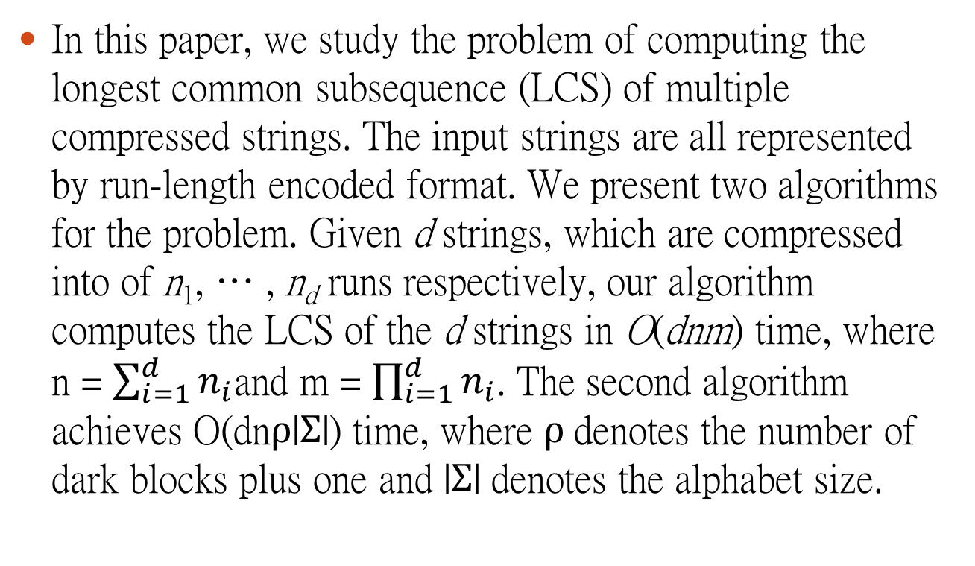
Abstract
In this paper, we study the problem of computing the longest common subsequence (LCS) of multiple compressed strings. The input strings are all represented by run-length encoded format. We present two algorithms for the problem. Given d strings, which are compressed into of n₁, … , n_{d} runs respectively, our algorithm computes the LCS of the d strings in O(dnm) time, where n = $\sum_{i=1}^{d}{n_{i}}$and m = $\prod_{i=1}^{d}{n_{i}}$. The second algorithm achieves O(dnρ|Σ|) time, where ρ denotes the number of dark blocks plus one and |Σ| denotes the alphabet size.

Slide 3
Longest Common Subsequence (LCS)
沒有特別強調的話input是兩條字串
Given two strings A = a₁a₂a₃…a_{m} and B = b₁b₂b₃…b_{n}, find the longest common part of A and B by deleting zero or more characters from A and B.
For example, A = AGACTGTC, B = AAGTCACG, LCS(A, B) = AGACG

Slide 4
LCS by Dynamic Programming
-
A
G
A
C
T
G
T
C
-
0
0
0
0
0
0
0
0
0
T
0
0
0
0
0
1
1
1
1
A
0
1
1
1
1
1
1
1
1
G
0
1
2
2
2
2
2
2
2
T
0
1
2
2
2
3
3
3
3
C
0
1
2
2
3
3
3
3
4
A
0
1
2
3
3
3
3
3
4
C
0
1
2
3
4
4
4
4
4
G
0
1
2
3
4
4
5
5
5
Notes:
The computation can be done in a tabular form. After the computation, we can trace back the answer of the longest common subsequence.

Slide 5

d -LCS
給d 條長度是n_{i} 的字串，這個LCS必須要是所有字串的common subsequence中最長的
Time complexity: O($\prod_{i=1}^{d}{n_{i} }$).

Slide 6
Run-length Encoding
aaaabbbaacc ➔ a⁴b³a²c²
bbbbcccaaaaaa ➔ b⁴c³a⁶

Slide 7
RLE-LCS by Dynamic Programming
 | - | a | a | a | a | b | b | b | a | a | c | c
- | 0 | 0 | 0 | 0 | 0 | 0 | 0 | 0 | 0 | 0 | 0 | 0
b | 0 | 0 | 0 | 0 | 0 | 1 | 1 | 1 | 1 | 1 | 1 | 1
b | 0 | 0 | 0 | 0 | 0 | 1 | 2 | 2 | 2 | 2 | 2 | 2
b | 0 | 0 | 0 | 0 | 0 | 1 | 2 | 3 | 3 | 3 | 3 | 3
b | 0 | 0 | 0 | 0 | 0 | 1 | 2 | 3 | 3 | 3 | 3 | 3
c | 0 | 0 | 0 | 0 | 0 | 1 | 2 | 3 | 3 | 3 | 4 | 4
c | 0 | 0 | 0 | 0 | 0 | 1 | 2 | 3 | 3 | 3 | 4 | 5
c | 0 | 0 | 0 | 0 | 0 | 1 | 2 | 3 | 3 | 3 | 4 | 5
a | 0 | 1 | 1 | 1 | 1 | 1 | 2 | 3 | 3 | 3 | 4 | 5
a | 0 | 1 | 2 | 2 | 2 | 2 | 2 | 3 | 3 | 4 | 4 | 5
a | 0 | 1 | 2 | 3 | 3 | 3 | 3 | 3 | 3 | 4 | 4 | 5
a | 0 | 1 | 2 | 3 | 4 | 4 | 4 | 4 | 4 | 4 | 4 | 5
a | 0 | 1 | 2 | 3 | 4 | 4 | 4 | 4 | 5 | 5 | 5 | 5
a | 0 | 1 | 2 | 3 | 4 | 4 | 4 | 4 | 5 | 6 | 6 | 6

Slide 8
RLE-LCS by Dynamic Programming
[Bunke and Csirik, 1995] [Liu et al., 2008] [Ann et al., 2008]

Slide 9
Lemma 1
Let S₁ and S₂ be two strings and e^{r} be a run encoding symbol e. Let S₁e^{r} and S₂e^{r} denote the strings obtained by appending the run e^{r} to S₁ and S₂. We have that LCS(S₁e^{r}, S₂e^{r}) = LCS(S₁, S₂) + r.

Slide 10
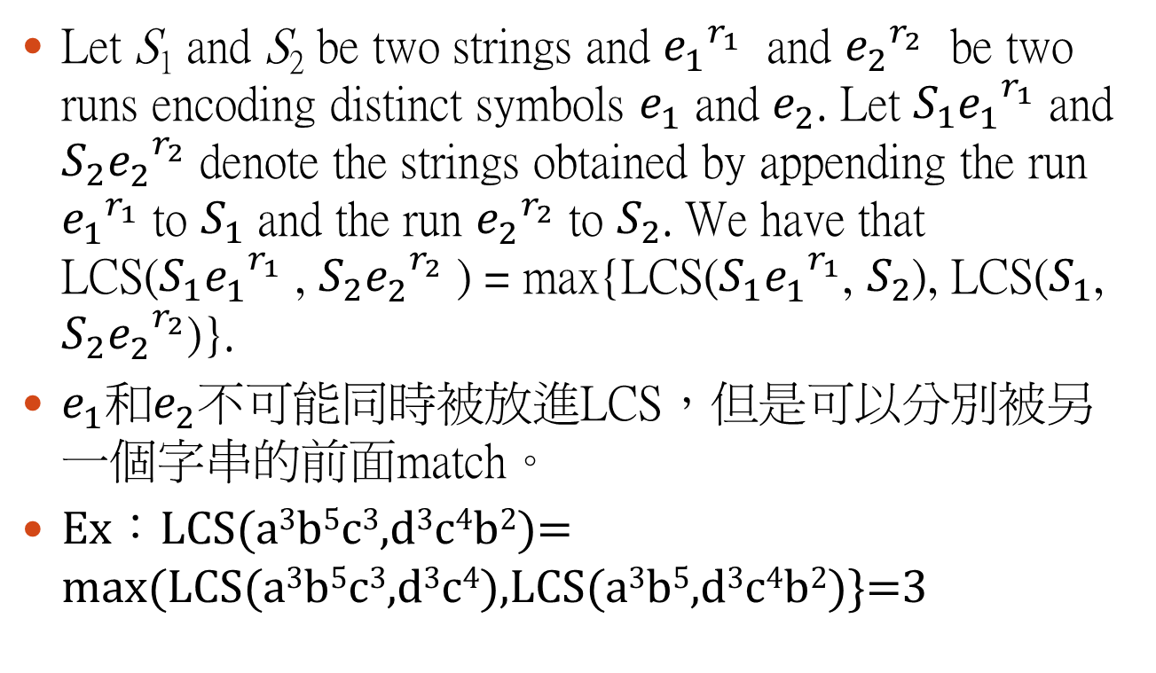
Lemma 2
Let S₁ and S₂ be two strings and ${e_{1}^{}}^{r_{1}}$ and ${e_{2}^{}}^{r_{2}}$ be two runs encoding distinct symbols $e_{1}^{}$ and $e_{2}^{}$. Let ${{S_{1}e}_{1}^{}}^{r_{1}}$ and ${{S_{2}e}_{2}^{}}^{r_{2}}$ denote the strings obtained by appending the run ${e_{1}^{}}^{r_{1}}$ to $S_{1}$ and the run ${e_{2}^{}}^{r_{2}}$ to $S_{2}$. We have that LCS(${{S_{1}e}_{1}^{}}^{r_{1}}$ , ${{S_{2}e}_{2}^{}}^{r_{2}}$ ) = max{LCS(${{S_{1}e}_{1}^{}}^{r_{1}}$, $S_{2}$), LCS($S_{1}$, ${{S_{2}e}_{2}^{}}^{r_{2}}$)}.
$e_{1}^{}$和$e_{2}^{}$不可能同時被放進LCS，但是可以分別被另一個字串的前面match。
Ex：LCS(a³b⁵c³,d³c⁴b²)= max(LCS(a³b⁵c³,d³c⁴),LCS(a³b⁵,d³c⁴b²)}=3

Slide 11
主菜
前面都是說兩條字串的RLE-LCS
下面開始進入多條的
這個LCS必須要是所有字串的common subsequence
Ex:
S₁=a⁶c⁶b³a⁸
S₂=a⁸c²b³a⁶
S₃=a⁴c¹⁰b²a⁴
LCS=a⁴c²b²a⁴

Slide 12
Lemma 3
Let S₁, S₂, … , S_{d} be d strings and e^{r} be a run. Let S₁e^{r}, S₂e^{r}, … , S_{d}e^{r} denote the strings obtained by appending run e^{r} to S₁, S₂, … , S_{d} , respectively. We have that LCS(S₁e^{r}, S₂e^{r}, … , S_{d}e^{r} ) = LCS(S₁, S₂, … , S_{d} ) + r.

Slide 13
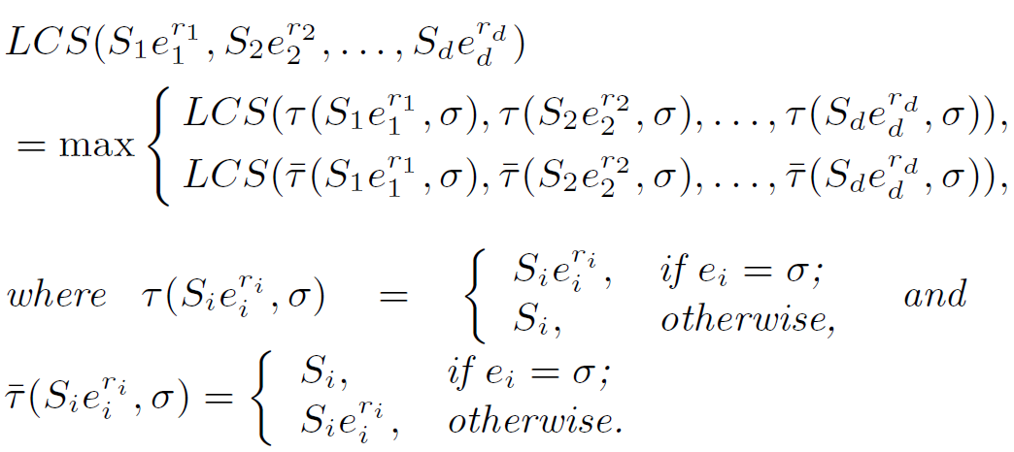
Lemma 4
Let S₁, S₂, … , S_{d} be d strings and let e₁, e₂, …, e_{d} be d symbols which are not all the same, i.e. e₁ = e₂ = … = e_{d} cannot hold. We have that for any σ ∈ {e₁, e₂, …, e_{d} },

Slide 14
Lemma 4
對每個字母σ，LCS可以分成用σ結尾和不是用σ結尾兩種
若是用σ結尾，那不是σ的e_{i}就要拿掉
若不是用σ結尾，那是σ的e_{i}就要拿掉

Slide 15
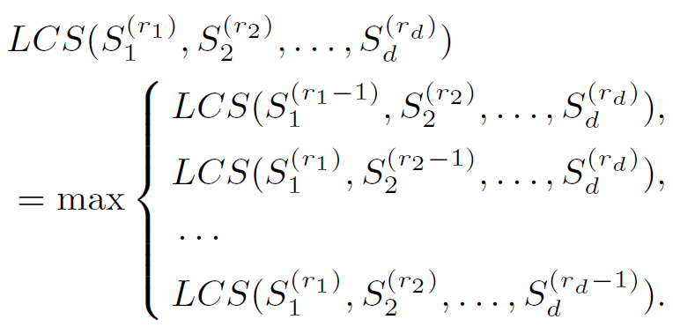
Lemma 5
Suppose that runs S₁(r₁), S₂(r₂), … , S_{d}(r_{d}) do not encode the same symbol, i.e. symbol(S₁(r₁))=symbol(S₂(r₂))=… =symbol(S_{d}(r_{d})) cannot hold. We have that

Slide 16
Example
S₁=a⁶c⁶b³a⁸
S₂=a⁸c²b³a⁶
S₃=a⁴c¹⁰b²a⁴
By Lemma 3, LCS (S₁, S₂, S₃) = LCS(a⁶c⁶b³a⁴, a⁸c²b³a², a⁴c¹⁰b²) + 4
By Lemma 4, LCS(a⁶c⁶b³a⁴, a⁸c²b³a², a⁴c¹⁰b²) = max {LCS(a⁶c⁶b³, a⁸c²b³, a⁴c¹⁰b²), LCS(a⁶c⁶b³a⁴, a⁸c²b³a², a⁴c¹⁰)} (前面是不含a, 後面是含a)
假設之前的block都已經算完，LCS(a⁶c⁶b³, a⁸c²b³, a⁴c¹⁰b²) = 8

Slide 17
Example
By Lemma 4, LCS(a⁶c⁶b³a⁴, a⁸c²b³a², a⁴c¹⁰) = max {LCS(a⁶c⁶b³, a⁸c²b³, a⁴c¹⁰), LCS(a⁶c⁶b³a⁴, a⁸c²b³a², a⁴)} (前面是不含a, 後面是含a)
LCS(a⁶c⁶b³, a⁸c²b³, a⁴c¹⁰) = 6
By Lemma 3, LCS(a⁶c⁶b³a⁴, a⁸c²b³a², a⁴) = LCS(a⁶c⁶b³a², a⁸c²b³, a²) + 2
By Lemma 4, LCS(a⁶c⁶b³a², a⁸c²b³, a²) =max{LCS(a⁶c⁶b³, a⁸c²b³, ε), LCS(a⁶c⁶b³a², a⁸c², a²)} (前面是不含a, 後面是含a)
……

Slide 18
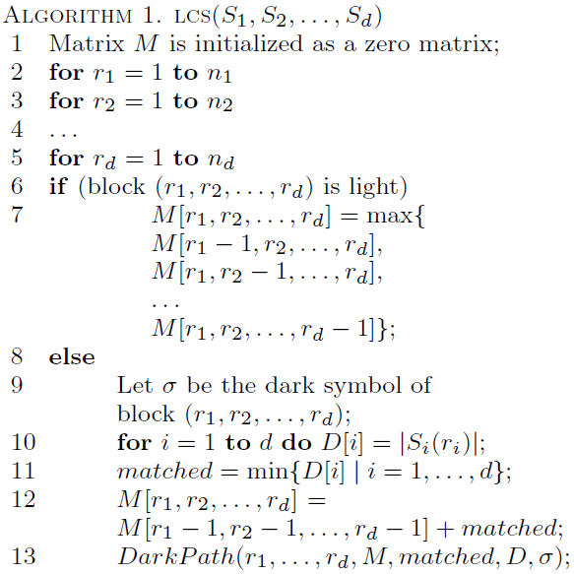
Algorithm 1 - Main

Slide 19
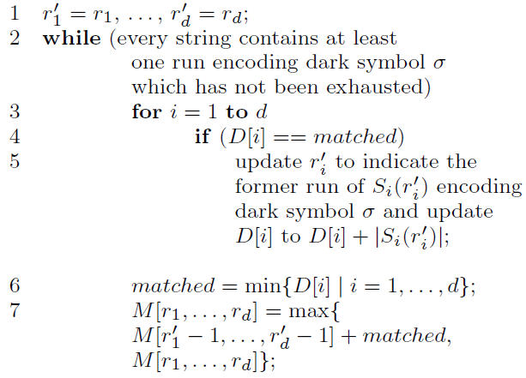
Algorithm 1 – DarkPath

Slide 20
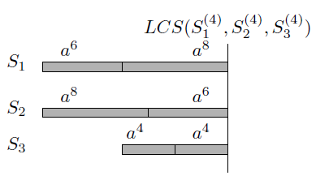
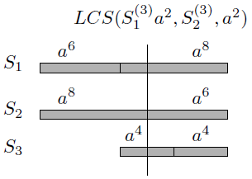
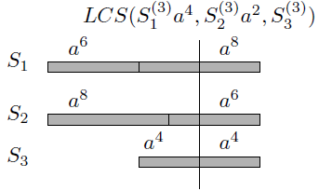
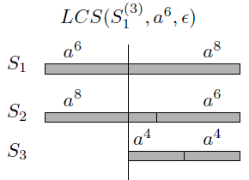
Example

Slide 21
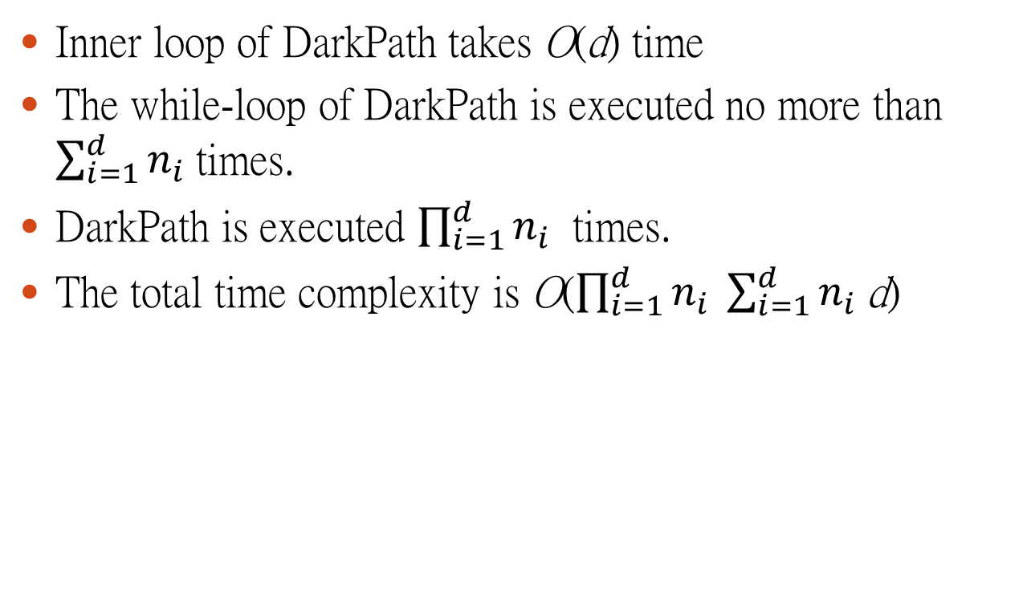
Time Complexity
Inner loop of DarkPath takes O(d) time
The while-loop of DarkPath is executed no more than $\sum_{i=1}^{d}{n_{i} }$times.
DarkPath is executed $\prod_{i=1}^{d}{n_{i} }$ times.
The total time complexity is O($\prod_{i=1}^{d}{n_{i} }\sum_{i=1}^{d}{n_{i} }$d)

Slide 22
Algorithm 2
Exploiting the sparsity inherent in the LCS computation, only store values of dark blocks.
We propose Lemma 6 when we need a value of an light block by comparing the values of dark blocks

Slide 23
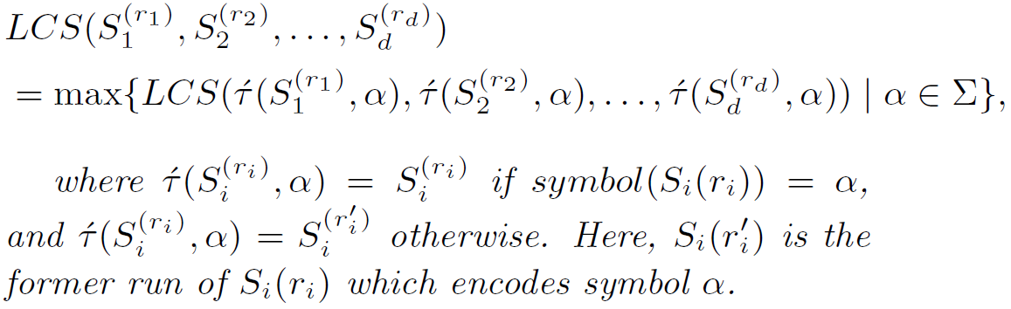
Lemma 6
Suppose that runs S₁(r₁), S₂(r₂), … , S_{d}(r_{d}) do not encode the same symbol, i.e. symbol(S₁(r₁))=symbol(S₂(r₂))=… =symbol(S_{d}(r_{d})) cannot hold. We have that

Slide 24
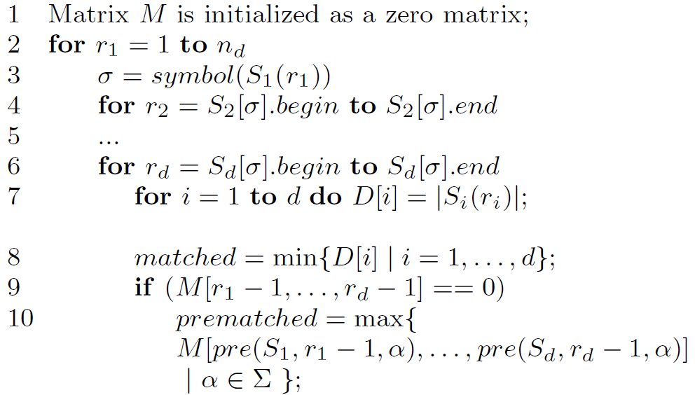
Algorithm 2 - Main

Slide 25
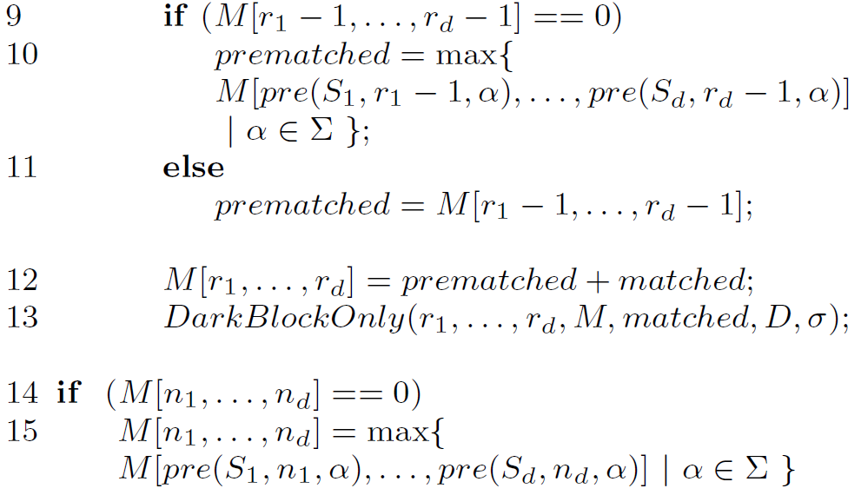
Algorithm 2 - Main

Slide 26
pre(S, r, σ) Example
For string S = a⁵b⁴c⁷b³a⁴c³, pre(S, 6, a) = 5, pre(S, 3, c) = 3 and pre(S, 1, b) = 0.

Slide 27
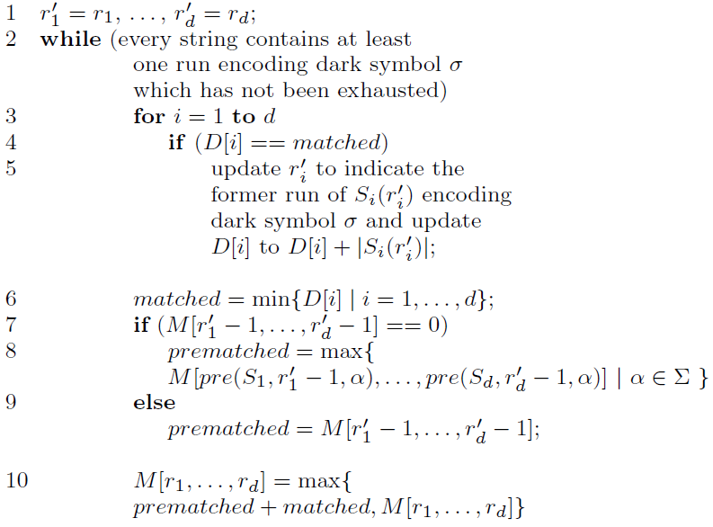
Algorithm 2 – DarkBlockOnly

Slide 28
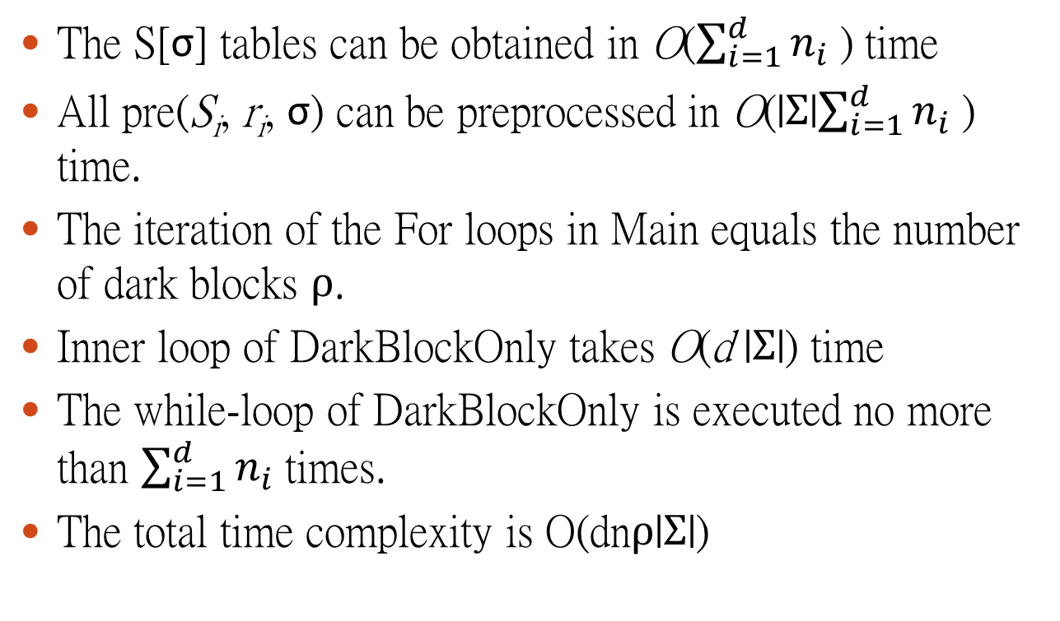
Time Complexity
The S[σ] tables can be obtained in O($\sum_{i=1}^{d}{n_{i} }$) time
All pre(S_{i}, r_{i}, σ) can be preprocessed in O(|Σ|$\sum_{i=1}^{d}{n_{i} }$) time.
The iteration of the For loops in Main equals the number of dark blocks ρ.
Inner loop of DarkBlockOnly takes O(d |Σ|) time
The while-loop of DarkBlockOnly is executed no more than $\sum_{i=1}^{d}{n_{i} }$times.
The total time complexity is O(dnρ|Σ|)

Slide 29
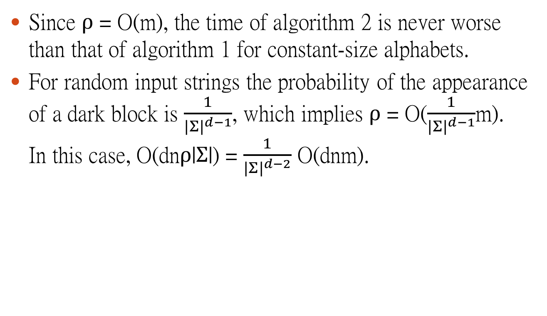
Comparison
Since ρ = O(m), the time of algorithm 2 is never worse than that of algorithm 1 for constant-size alphabets.
For random input strings the probability of the appearance of a dark block is $\frac{1}{{|Σ|}^{d−1}}$, which implies ρ = O($\frac{1}{{|Σ|}^{d−1}}$m). In this case, O(dnρ|Σ|) = $\frac{1}{{|Σ|}^{d−2}}$ O(dnm).

Slide 30
End

