Slide 1
高爐風口影像識別技術開發
Development of Raceway Monitoring System Based on Image Analysis
技術與訓練36 卷2 期
民國100 年6 月27~34

Slide 2
摘要
高爐風徑區焦炭與粉煤之燃燒反應，可供應煉鐵所需的熱與還原氣體，故其穩定性影響高爐作業甚劇。高爐風口若發生停止噴煤、浮渣或大塊落料等異況，將導致設備損壞，甚至釀成重大事故。因此中鋼公司各高爐均於風口裝置了監視攝影系統，讓現場人員可以即時了解風口噴煤是否有異況發生。然而由於每一座高爐均有30個以上的風口，現場人員很難隨時盯著每一風口的監視畫面，以致無法即時掌握各風口的狀況。因此，本研究乃利用風口的監視畫面，發展影像識別技術，並開發出異況自動判別及預警系統，以即時提醒現場人員，避免製程異況造成設備損壞及事故發生。

Slide 3
Abstract
Raceway of a blast furnace is the space where the formation of the reducing gas takes place and consequent thermal energy is generated for iron-making. The operation of the blast furnace is affected adversely by the interruption of pulverised coal injection, burden chunk blockage, slag over flow etc, which would further lead to equipment damage or other safety issues. Thus, China Steel decided to install a CCD camera on each raceway to let its operators monitor the combustion in real time. However, since each blast furnace is equipped with more than 30 raceways, it is extremely labor-intensive to watch the images throughout the operation. Therefore, a system which incorporates the image processing and classification techniques was developed to facilitate on-line monitoring and warning of anomaly states.

Slide 4
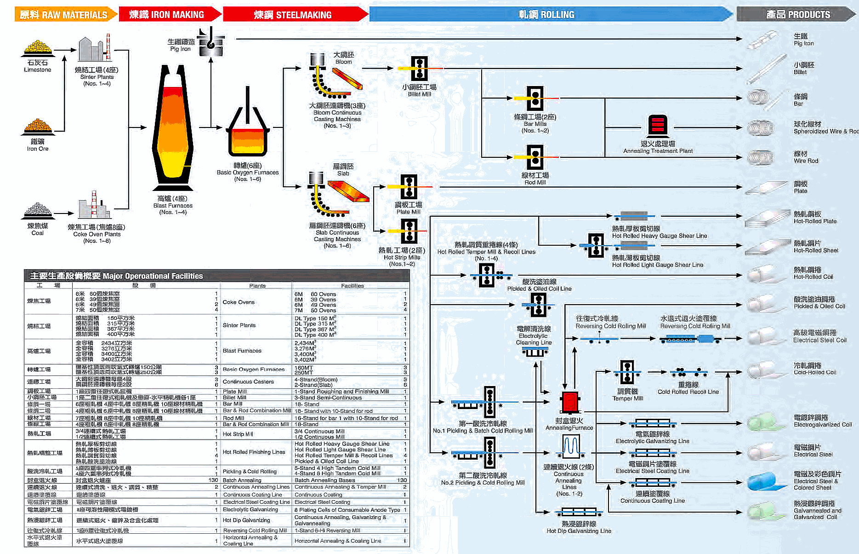
鋼品生產流程
資料來源：綠野鋼莊

Slide 5
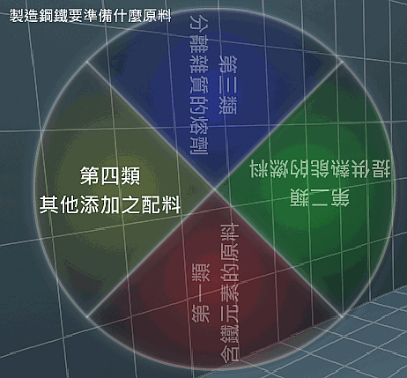
原料
鋼和鐵都是以鐵元素為主要成份，只是其中含碳量有所差異，純粹的鐵元素稱做純鐵，自然裡不存在也沒人使用。通常含碳量2﹪以上的稱為「生鐵」，低於此數值的稱為「鋼」。冶煉鋼鐵時含鐵的礦石先在鼓風爐(Blast Furnace又稱高爐)中，被冶煉成熔融的生鐵，接著再把熔融生鐵置於煉鋼爐(Steel Making Furnace)中精煉成鋼。
煉製鋼鐵所需的原料可分為四大類：第一類是含有鐵質元素的礦石原料，第二類是煤和焦炭，第三類為冶煉過程中以產生爐渣(Slag)方式來分離雜質的熔劑或助熔劑(Flux)，第四類是各種的配合原料，如廢鋼(Scrap)、氧氣、脫氧劑及製程回收料等。
資料來源：綠野鋼莊

Slide 6
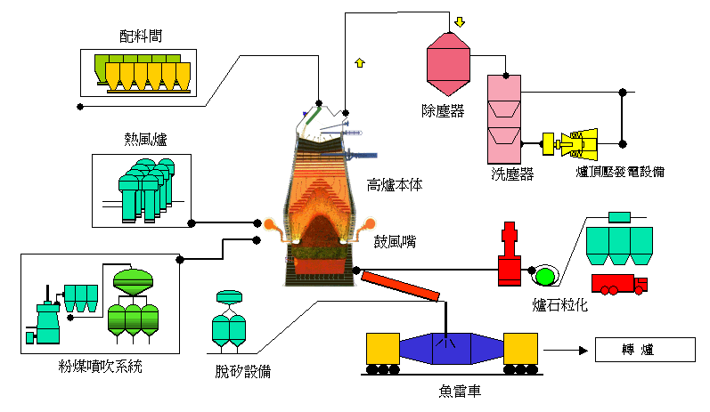
煉鐵
高爐作業是將鐵礦石、焦炭及助熔劑由高爐頂部加入爐內，再由爐下部鼓風嘴 鼓入高溫熱風，產生還原氣体，還原鐵礦石，產生熔融鐵水與熔渣之煉鐵製程。
資料來源：綠野鋼莊

Slide 7
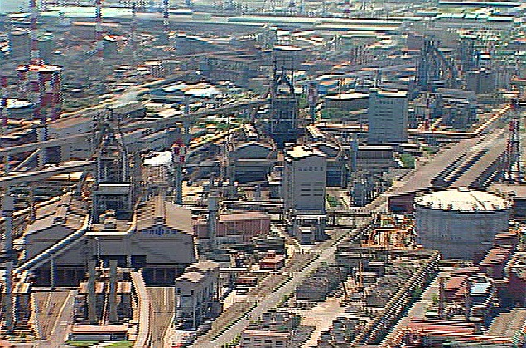
燃燒狀況觀測
監控燃燒狀況
判斷鏡頭失焦、歪斜及粉煤噴射狀況

Slide 8
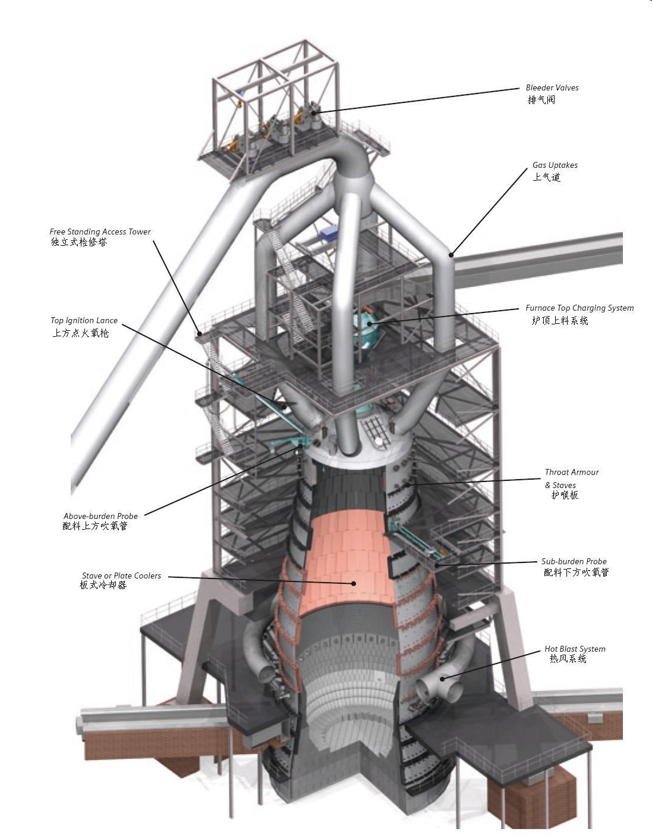
http://photo.hanyu.iciba.com/upload/encyclopedia/e0/aa/bk_e0aa01d52b11f2345dba9f0207fea560_DpMYTJ.jpg

Slide 9
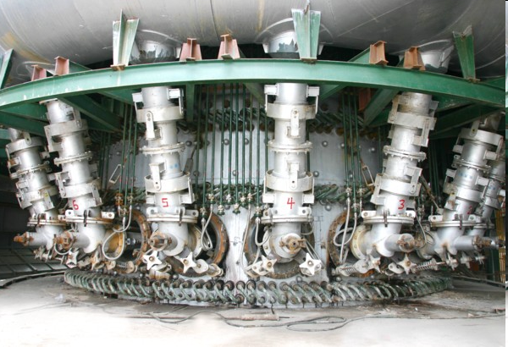
http://image.cn.made-in-china.com/2f0j01OBMEILcPsTrf/高炉风口设备.jpg

Slide 10
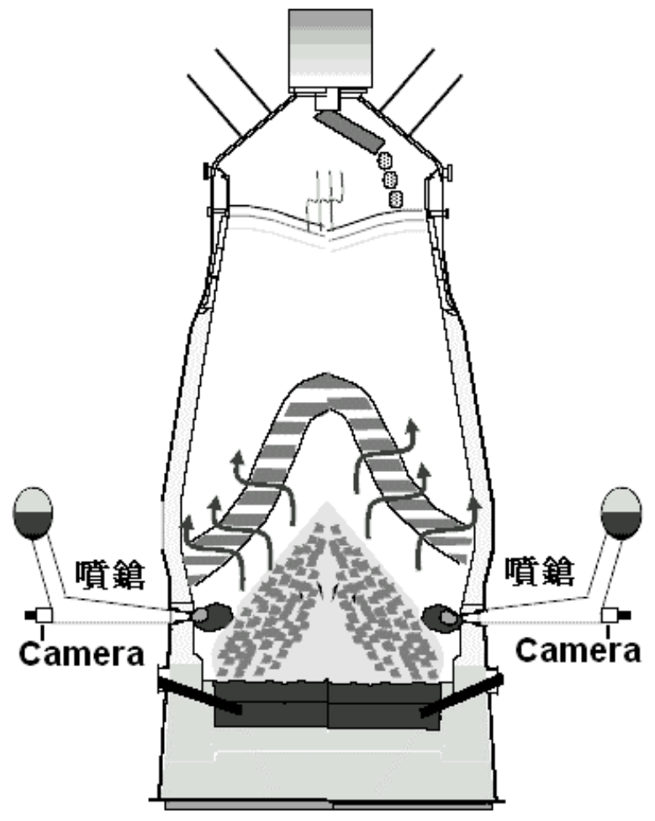
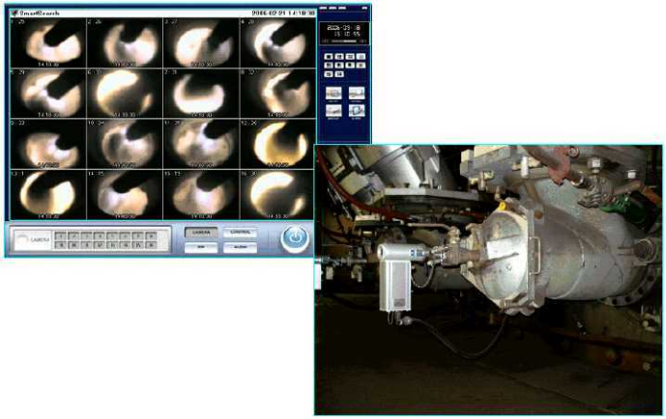
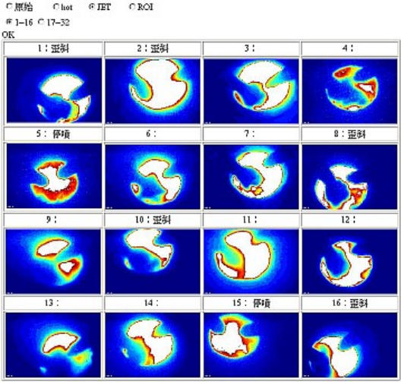
燃燒狀況觀測
監控燃燒狀況與鑑別異況

Slide 11
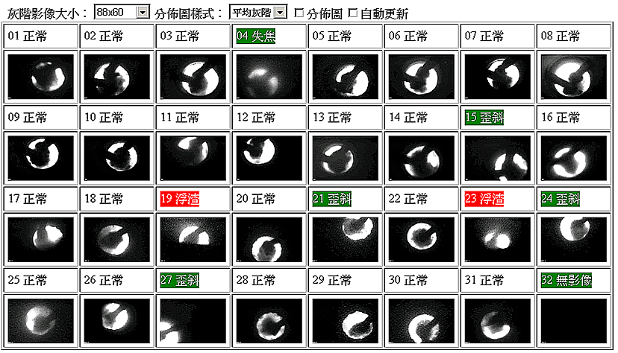

Slide 12
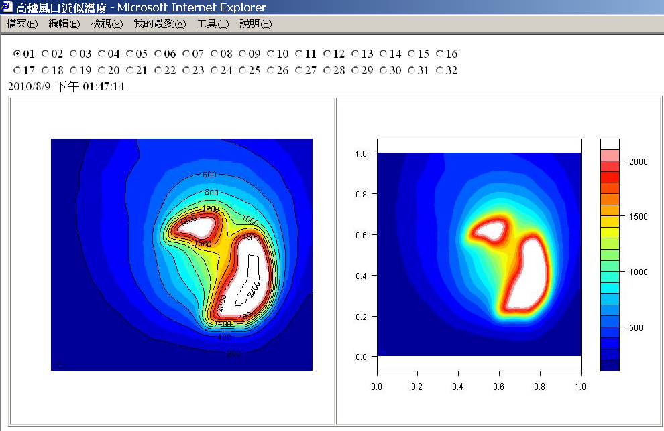

Slide 13
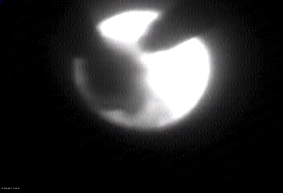
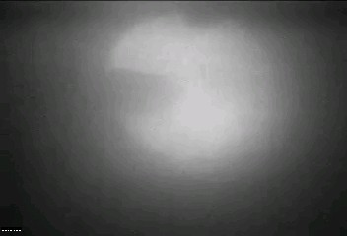
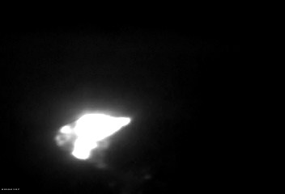
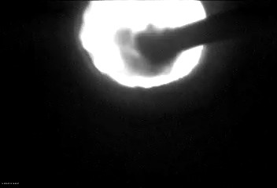
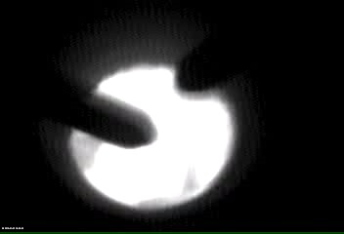
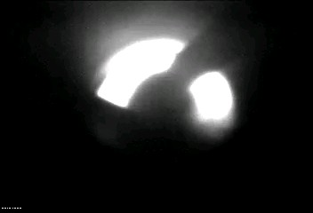
影像狀態分類
正常
模糊
大塊落料
歪斜
停止噴煤
浮渣

Slide 14
問題定義
Input: an image
Output: the status of the image, including 1.interruption of pulverised coal injection, 2.burden chunk blockage, 3.slag over flow, 4. fuzzy, 5. skew, 6. normal

Slide 15
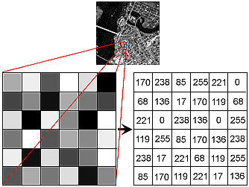
Image and Pixel
x=0,y=0,影像原點
I(x,y)
假設x為水平軸， y為垂直軸，均相對於影像原點
http://hosting.soonet.ca/eliris/remotesensing/bl130lec10.html

Slide 16
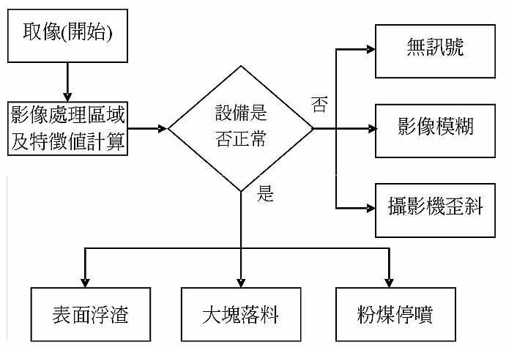
影像處理流程

Slide 17
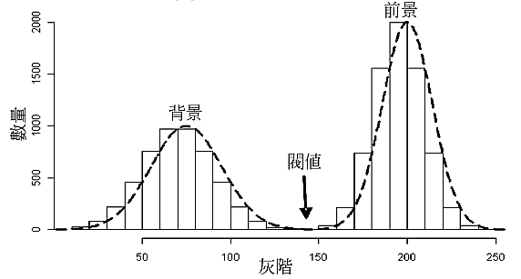
前景與背景影像分離

Slide 18
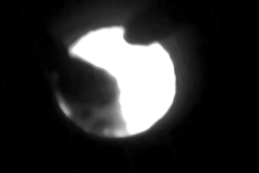
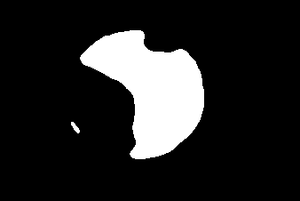
前景與背景影像分離(二值化)
gray level statistics:
mean = 46
standard deviation = 85
threshold = 46 + 85
原來灰階小於threshold
原來灰階大於threshold
Notes:
filename = r'D:\\temp\\PJ97075\\exp_fig\\allsorted\\normal\\20100817105243_image30.jpg'

Slide 19
輪廓點擷取
Contour 1: 15 points
CvPoint(x=80,y=137)
CvPoint(x=80,y=140)
CvPoint(x=82,y=142)
CvPoint(x=82,y=143)
CvPoint(x=83,y=144)
CvPoint(x=83,y=145)
CvPoint(x=87,y=149)
CvPoint(x=88,y=149)
CvPoint(x=89,y=148)
CvPoint(x=89,y=146)
CvPoint(x=88,y=145)
CvPoint(x=88,y=144)
CvPoint(x=84,y=140)
...
CvPoint(x=82,y=137)
Contour 2: 197 points
CvPoint(x=146,y=34)
CvPoint(x=145,y=35)
CvPoint(x=140,y=35)
CvPoint(x=139,y=36)
CvPoint(x=133,y=36)
CvPoint(x=132,y=37)
CvPoint(x=129,y=37)
CvPoint(x=128,y=38)
CvPoint(x=126,y=38)
CvPoint(x=125,y=39)
CvPoint(x=124,y=39)
...
CvPoint(x=160,y=35)
CvPoint(x=159,y=35)
CvPoint(x=158,y=34)

Slide 20
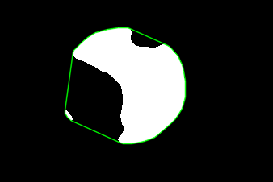
Convexhull計算
CvPoint(x=80,y=137),
CvPoint(x=80,y=140),
CvPoint(x=83,y=145),
CvPoint(x=87,y=149),
CvPoint(x=149,y=177)
CvPoint(x=152,y=178)
...
CvPoint(x=205,y=55),
CvPoint(x=158,y=34),
CvPoint(x=146,y=34),
CvPoint(x=133,y=36),
CvPoint(x=129,y=37),
CvPoint(x=118,y=40),
CvPoint(x=116,y=41),
CvPoint(x=108,y=46),
CvPoint(x=102,y=51),
CvPoint(x=91,y=62),
CvPoint(x=90,y=64)]
Contiur1: 15 pts, Contour2:197 pts, 共計212 pts, 計算convexhull後剩40 pts

Slide 21
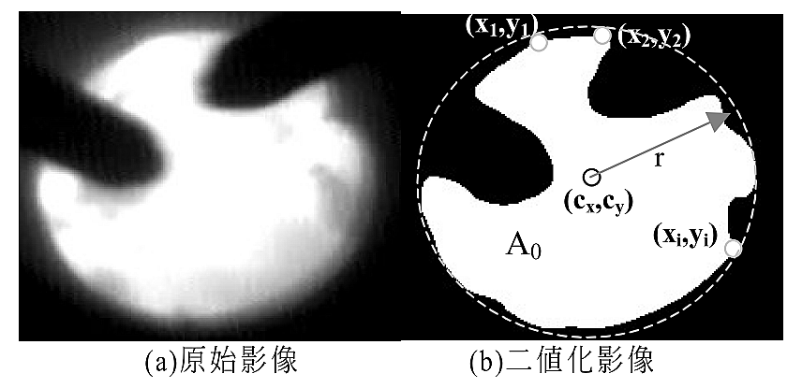

圓心與半徑迴歸
xi,yi為convexhull上的點

Slide 22

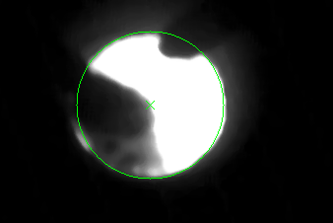
圓心與半徑迴歸
xi,yi為convexhull上的點

Slide 23
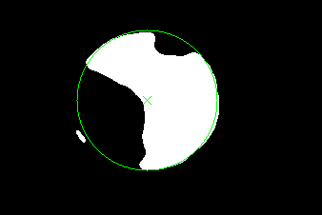
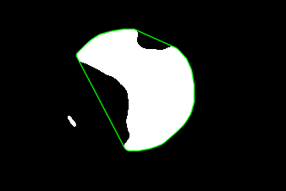
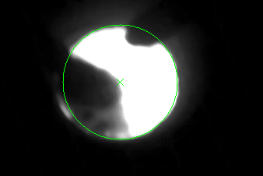
圓心與半徑迴歸
xi,yi為convexhull上的點

Slide 24

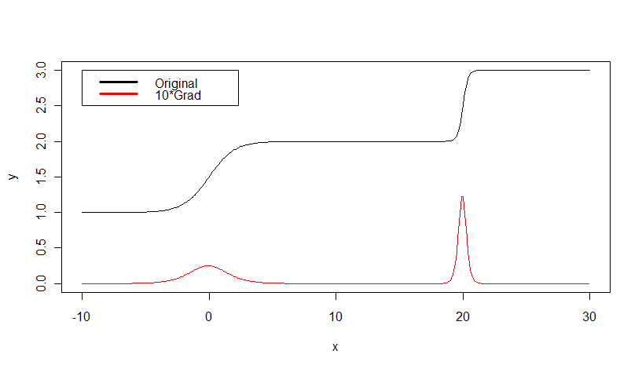
Gradient
http://en.wikipedia.org/wiki/Gradient
Notes:
x1=seq(-10,10,0.1)
x2=seq(10,30,0.1)
y1=1/(1+exp(-1*x1))+1
y2=1/(1+exp(-5*x1))+2
x=c(x1,x2); y=c(y1,y2)
f=10
yd=diff(y)*f
ylim=c(min(y,yd),max(y,yd))
plot(x,y,type='l',ylim=ylim)
lines(x[-length(x)],yd,type='l',col=2)
legend( -10, 3, c('Original signal',paste(f,'*Grad signal',sep='')), lwd=3, col=c(1,2))

Slide 25
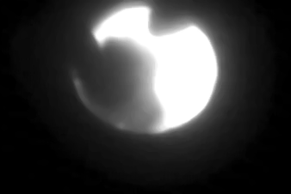
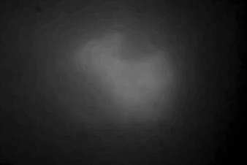
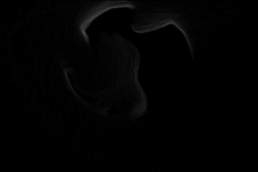
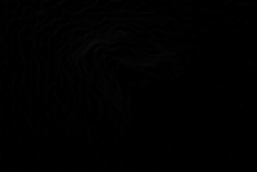
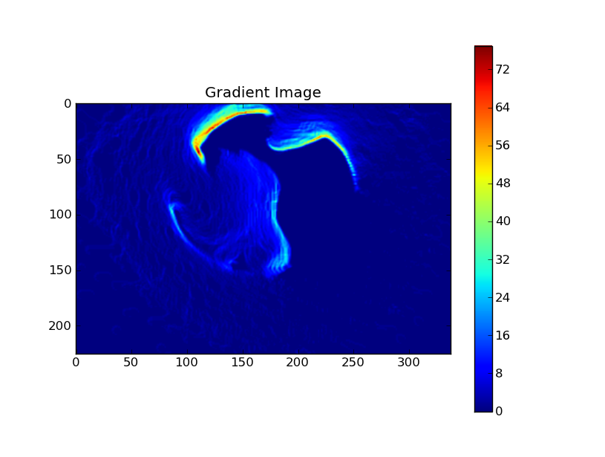
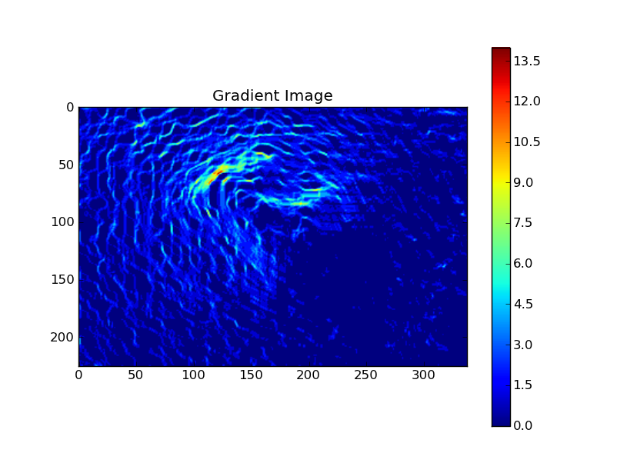
Gradient
Notes:
filename='D:\\temp\\PJ97075\\exp_fig\\allsorted\\normal\\20100817105243_image13.jpg'
filename='D:\\temp\\PJ97075\\exp_fig\\allsorted\\fuzzy\\20100817122243_image23.jpg'
image_org = LoadImage_BDRMV(filename,7)
Img_proc_org = cvCloneImage(image_org)
cvSmooth(image_org,Img_proc_org,CV_MEDIAN,7)
img1 = my_Sobel_xy_from_gray(Img_proc_org)
p = plt.imshow(img1.as_numpy_array())
fig = plt.gcf()
plt.clim() # clamp the color limits
plt.title("Gradient Image")
plt.colorbar()
plt.show()

Slide 26
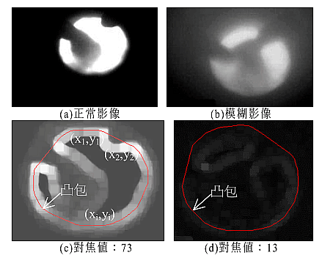
Gradient

Slide 27
Projection
[1,] 42 3 8 3 4 3 6 10 2 3 0
[2,] 44 5 10 8 2 0 4 0 1 9 5
[3,] 50 0 1 8 1 1 7 8 10 6 8
[4,] 49 8 2 0 9 8 8 2 9 2 1
[5,] 42 2 2 9 5 6 5 7 4 2 0
[6,] 44 1 3 7 4 1 7 3 7 8 3
[7,] 34 2 1 1 9 2 5 5 3 1 5
[8,] 51 5 6 7 0 8 1 8 3 9 4
[9,] 54 2 9 7 6 7 7 1 5 10 0
[10,] 41 8 0 5 3 4 2 6 4 1 8
[11,] 0 36 42 55 43 40 52 50 48 51 34

Slide 28
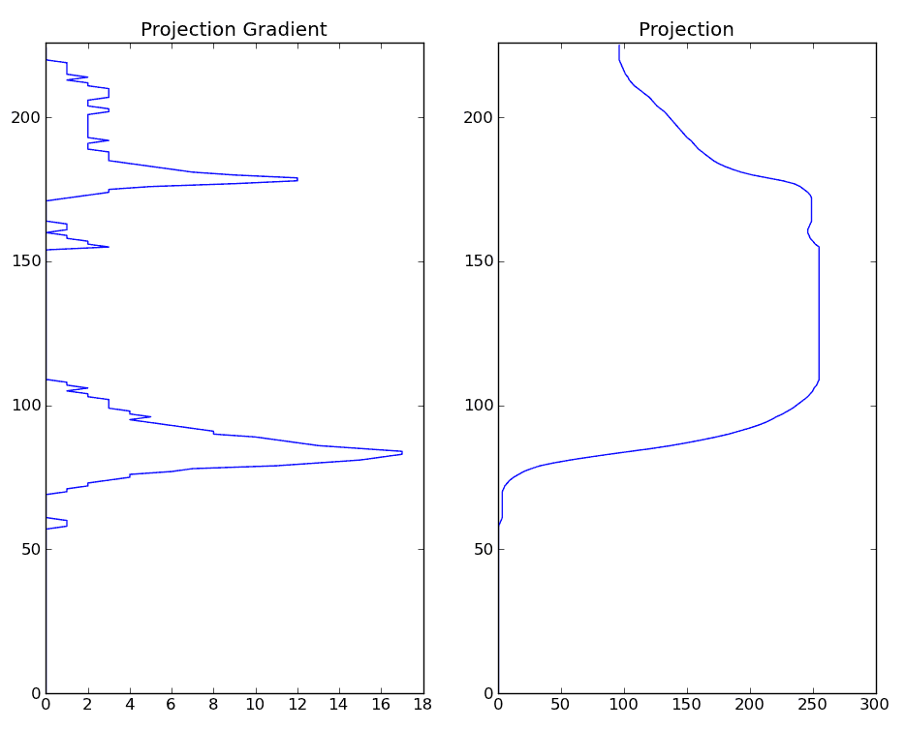
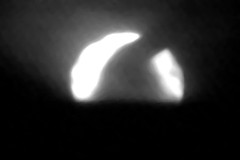
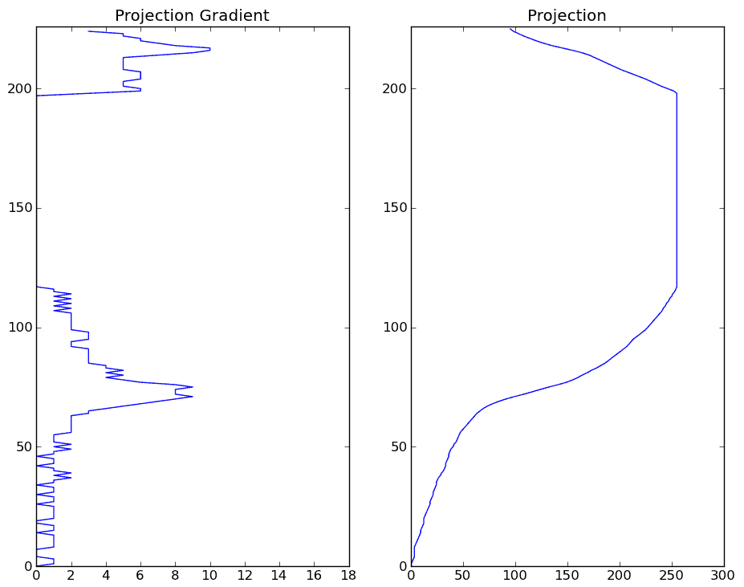
Projection
Notes:
import os
import numpy as np
import matplotlib.pyplot as plt
os.chdir(r'D:\temp\PJ97075\py')
from ut_20110510 import *
filename='D:\\temp\\PJ97075\\exp_fig\\allsorted\\normal\\20100817105243_image13.jpg'
filename=r'D:\temp\PJ97075\exp_fig\allsorted\slag\20100719161809_image19.jpg'
image_org = LoadImage_BDRMV(filename,7)
Img_proc_org = cvCloneImage(image_org)
cvSmooth(image_org,Img_proc_org,CV_MEDIAN,7)
#image = rotateImage(Img_proc_org,90)
hor_prj = get_hor_proj(Img_proc_org)
hor_prj.reverse()
hor_prj_dif = [abs(hor_prj[i+1]-hor_prj[i]) for i in range(len(hor_prj)-1)]
plt.subplot(131)
plt.plot(hor_prj_dif,range(len(hor_prj_dif)))
plt.ylim(0,len(hor_prj))
plt.title('Projection Gradient')
subplot(132)
plt.plot(hor_prj,range(len(hor_prj)))
plt.ylim(0,len(hor_prj))
plt.title('Projection')
subplot(133)
plt.imshow(Img_proc_org.as_numpy_array())
plt.show()

Slide 29
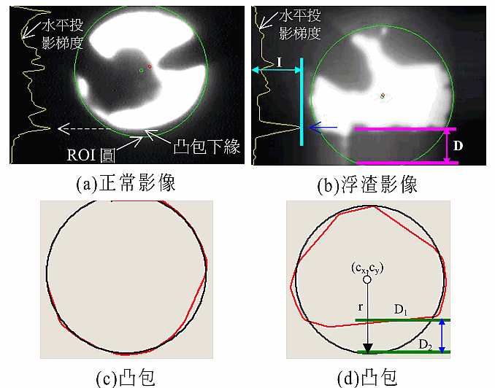
Slag detection

Slide 30
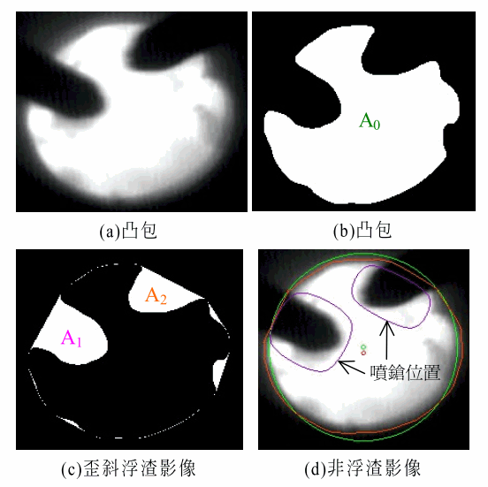
Stop detection

Slide 31
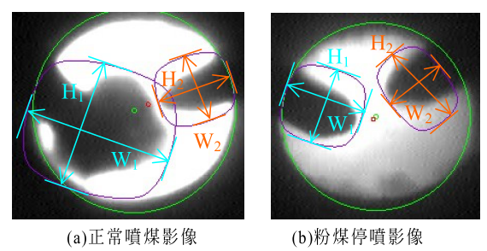
Stop detection

Slide 32
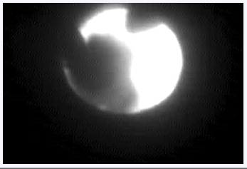
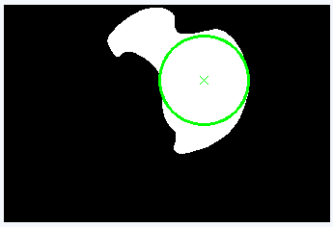
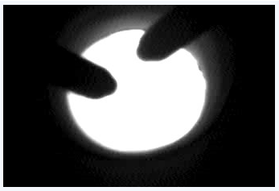
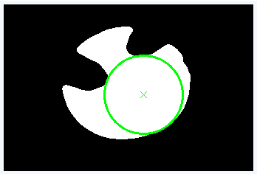
Maximal inscribed circle
Notes:
filename='D:\\temp\\PJ97075\\exp_fig\\allsorted\\normal\\20100817105243_image13.jpg'
filename=r'D:\temp\PJ97075\exp_fig\allsorted\stop\2010-01-23-16-02-11140_image17.jpg'

Slide 33
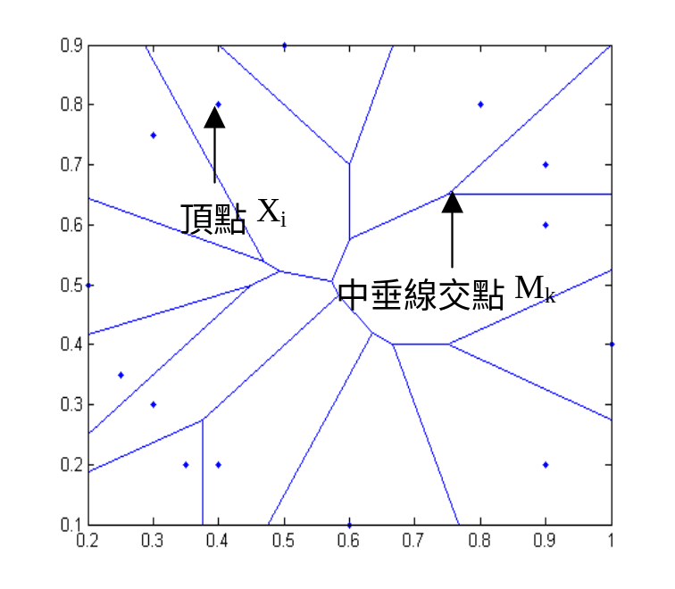
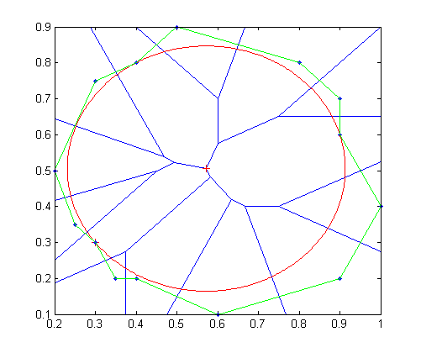
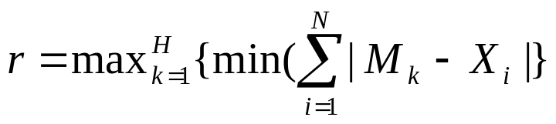
By Vornoroi diagram
Notes:
filename='D:\\temp\\PJ97075\\exp_fig\\allsorted\\normal\\20100817105243_image13.jpg'
filename=r'D:\temp\PJ97075\exp_fig\allsorted\stop\2010-01-23-16-02-11140_image17.jpg'

Slide 34
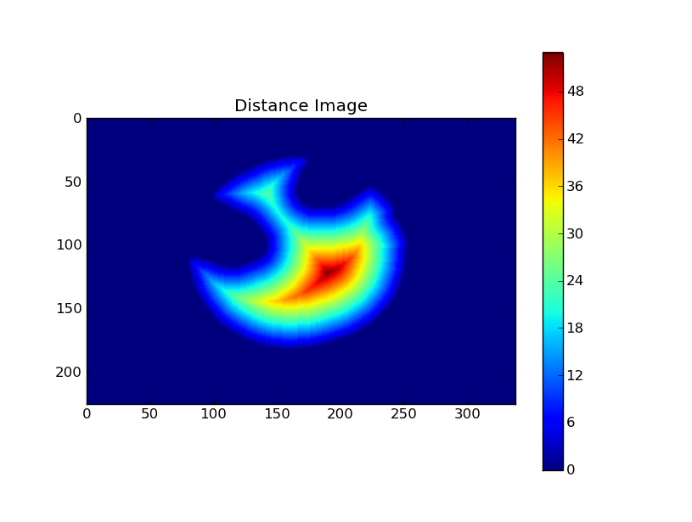

By distance transformation
Notes:
import os
import numpy as np
import matplotlib.pyplot as plt
os.chdir(r'D:\temp\PJ97075\py')
from ut_20110510 import *
filename='D:\\temp\\PJ97075\\exp_fig\\allsorted\\normal\\20100817105243_image13.jpg'
filename=r'D:\temp\PJ97075\exp_fig\allsorted\stop\2010-01-23-16-02-11140_image17.jpg'
image_org = LoadImage_BDRMV(filename,7)
mean = CvScalar(0)
std = CvScalar(0)
cvAvgSdv(image_org,mean,std)
mean = mean.val[0]
std = std.val[0]
Img_proc_org = cvCloneImage(image_org)
cvSmooth(image_org,Img_proc_org,CV_MEDIAN,7)
Img_proc_ada_thr = cvCreateImage(cvSize(image_org.width,image_org.height),image_org.depth,1)
threshold = max(mean+std,50)
cvThreshold(Img_proc_org,Img_proc_ada_thr,threshold,255,CV_THRESH_BINARY)
# Create the output image
dist32s = cvCreateImage( cvSize(image_org.width,image_org.height), IPL_DEPTH_32F, 1 );
#Distance transform
cvDistTransform( Img_proc_ada_thr, dist32s, CV_DIST_L2, CV_DIST_MASK_5, None, None );
dist8u1 = cvCreateImage( cvSize(image_org.width,image_org.height), IPL_DEPTH_8U, 1 );
cvConvertScale( dist32s, dist8u1, 1, 0 );
plt.imshow(dist8u1.as_numpy_array())
plt.clim() # clamp the color limits
plt.title("Distance Image")
plt.colorbar()
plt.show()

Slide 35

By distance transformation
Center
Notes:
import os
import numpy as np
import matplotlib.pyplot as plt
os.chdir(r'D:\temp\PJ97075\py')
from ut_20110510 import *
filename='D:\\temp\\PJ97075\\exp_fig\\allsorted\\normal\\20100817105243_image13.jpg'
filename=r'D:\temp\PJ97075\exp_fig\allsorted\stop\2010-01-23-16-02-11140_image17.jpg'
image_org = LoadImage_BDRMV(filename,7)
mean = CvScalar(0)
std = CvScalar(0)
cvAvgSdv(image_org,mean,std)
mean = mean.val[0]
std = std.val[0]
Img_proc_org = cvCloneImage(image_org)
cvSmooth(image_org,Img_proc_org,CV_MEDIAN,7)
Img_proc_ada_thr = cvCreateImage(cvSize(image_org.width,image_org.height),image_org.depth,1)
threshold = max(mean+std,50)
cvThreshold(Img_proc_org,Img_proc_ada_thr,threshold,255,CV_THRESH_BINARY)
# Create the output image
dist32s = cvCreateImage( cvSize(image_org.width,image_org.height), IPL_DEPTH_32F, 1 );
#Distance transform
cvDistTransform( Img_proc_ada_thr, dist32s, CV_DIST_L2, CV_DIST_MASK_5, None, None );
dist8u1 = cvCreateImage( cvSize(image_org.width,image_org.height), IPL_DEPTH_8U, 1 );
cvConvertScale( dist32s, dist8u1, 1, 0 );
plt.imshow(dist8u1.as_numpy_array())
plt.clim() # clamp the color limits
plt.title("Distance Image")
plt.colorbar()
plt.show()

Slide 36




Out-of-range detection
假設原始影像的大小為
ROI的半徑r與圓心分別為

Slide 37

The blockage detection

Slide 38

Fourier (discrete) transformation (FT)
http://fourier.eng.hmc.edu/e101/lectures/Image_Processing/node6.html

Slide 39

Fourier (discrete) transformation
Original signal:
0.0 2.0 7.0 9.0 6.0 8.0 1.0 8.0 9.0 8.0 10.0 1.0 2.0 4.0 1.0 8.0 2.0 8.0 6.0 2.0
FT signal:
[1] -4.7- 2.3i 23.8- 3.6i -7.8+ 2.0i -2.9+ 2.4i -6.0+ 2.0i
[6] -9.8-12.2i -23.2+12.5i -5.1-10.3i -8.3+14.7i 102.0+ 0.0i
[11] -8.3-14.7i -5.1+10.3i -23.2-12.5i -9.8+12.2i -6.0- 2.0i
[16] -2.9- 2.4i -7.8- 2.0i 23.8+ 3.6i -4.7+ 2.3i -14.0+ 0.0i
Notes:
a=c(0,2,7,9,6,8,1,8,9,8,10,1,2,4,1,8,2,8,6,2)
#a=round(runif(20)*10)
cat(sprintf('%.1f',a)); cat('\n')
b0=fft(a)
b = round(b0,1)
op=par(mfrow=c(1,2))
plot(a,type='l',xlab='x',ylab='Intensity',main='Original signal')
plot(-9:10,abs(c(b[(length(b)/2+2):length(b)],b[1:(length(b)/2+1)])),type='l',xlab='Frequency',ylab='Intensity',main='Fourier transform')
par(op)

Slide 40
Fourier (discrete) transformation
Original signal:
0.0 2.0 7.0 9.0 6.0 8.0 1.0 8.0 9.0 8.0 10.0 1.0 2.0 4.0 1.0 8.0 2.0 8.0 6.0 2.0
Reduced FT signal:
[1] -4.7- 2.3i 23.8- 3.6i -7.8+ 2.0i -2.9+ 2.4i -6.0+ 2.0i
[6] -9.8-12.2i -23.2+12.5i -5.1-10.3i -8.3+14.7i 102.0+ 0.0i
[11] -8.3-14.7i -5.1+10.3i -23.2-12.5i -9.8+12.2i -6.0- 2.0i
[16] -2.9- 2.4i -7.8- 2.0i 23.8+ 3.6i -4.7+ 2.3i -14.0+ 0.0i
Notes:
a=c(0,2,7,9,6,8,1,8,9,8,10,1,2,4,1,8,2,8,6,2)
#a=round(runif(20)*10)
cat(sprintf('%.1f',a)); cat('\n')
b0=fft(a)
b = round(b0,1)
for(i in 0:9){
b = b0
b[(length(a)/2-i):(length(a)/2+i)] = 0
ap = fft(b,inverse=T) / length(a)
print(round(abs(ap),1))
}
op=par(mfrow=c(1,2))
plot(a,type='l',xlab='x',ylab='Intensity',main='Original signal')
plot(abs(c(b[(length(b)/2+2):length(b)],b[1:(length(b)/2+1)])),type='l',xlab='Frequency',ylab='Intensity',main='Fourier transform')
par(op)

Slide 41

Fourier (discrete) transformation
Notes:
a=c(0,2,7,9,6,8,1,8,9,8,10,1,2,4,1,8,2,8,6,2)
#a=round(runif(20)*10)
cat(sprintf('%.1f',a)); cat('\n')
b0=fft(a)
b = round(b0,1) x11()
op=par(mfrow=c(2,2))
plot(a,type='l',xlab='x',ylab='Intensity',main='Original signal')
b0=fft(a)
b=b0
plot(-9:10,abs(c(b[(length(b)/2+2):length(b)],b[1:(length(b)/2+1)])),type='l',xlab='Frequency',ylab='Intensity',main='Fourier transform')
i=0;
b[(length(a)/2+1-i):(length(a)/2+1+i)] = 0
ap = fft(b,inverse=T) / length(a)
plot(round(abs(ap),1),type='l',xlab='x',ylab='Intensity',main='Reconstructed signal')
plot(-9:10,abs(c(b[(length(b)/2+2):length(b)],b[1:(length(b)/2+1)])),type='l',xlab='Frequency',ylab='Intensity',main='Reduced Fourier transform')
par(op)

Slide 42

Fourier (discrete) transformation
Notes:
a=c(0,2,7,9,6,8,1,8,9,8,10,1,2,4,1,8,2,8,6,2)
#a=round(runif(20)*10)
cat(sprintf('%.1f',a)); cat('\n')
b0=fft(a)
b = round(b0,1)
N=3
op=par(mfrow=c(N,2))
plot(a,type='l',xlab='x',ylab='Intensity',main='Original signal')
b0=fft(a)
b=b0
plot(abs(c(b[(length(b)/2+2):length(b)],b[1:(length(b)/2+1)])),type='l',xlab='Frequency',ylab='Intensity',main='Fourier transform')
for(j in 0:(N-2)){
b = b0
i = 2 * (j+1)
b[(length(a)/2+1-i):(length(a)/2+1+i)] = 0
ap = fft(b,inverse=T) / length(a)
plot(round(abs(ap),1),type='l',xlab='x',ylab='Intensity',main='Reconstructed signal')
plot(-9:10,abs(c(b[(length(b)/2+2):length(b)],b[1:(length(b)/2+1)])),type='l',xlab='Frequency',ylab='Intensity',main='Reduced Fourier transform')
}
par(op)

Slide 43




FT and reconstruction
Notes:
import os
import numpy as np
import matplotlib.pyplot as plt
os.chdir(r'D:\temp\PJ97075\py')
from ut_20110510 import *
filename='D:\\temp\\PJ97075\\exp_fig\\allsorted\\normal\\20100817105243_image13.jpg'
image_org = LoadImage_BDRMV(filename,7)
mean = CvScalar(0)
std = CvScalar(0)
cvAvgSdv(image_org,mean,std)
mean = mean.val[0]
std = std.val[0]
Img_proc_org = cvCloneImage(image_org)
cvSmooth(image_org,Img_proc_org,CV_MEDIAN,7)
fft_test(Img_proc_org)

Slide 44


Discrete Cosine transformation (DCT)
A discrete cosine transform (DCT) expresses a sequence of finitely many data points in terms of a sum of cosine functions oscillating at different frequencies. DCTs are important to numerous applications in science and engineering, from lossy compression of audio (e.g. MP3) and images (e.g. JPEG) (where small high-frequency components can be discarded), to spectral methods for the numerical solution of partial differential equations.
http://en.wikipedia.org/wiki/Discrete_cosine_transform

Slide 45

DCT and reconstruction
Notes:
import os
import numpy as np
import matplotlib.pyplot as plt
os.chdir(r'D:\temp\PJ97075\py')
from ut_20110510 import *
filename='D:\\temp\\PJ97075\\exp_fig\\allsorted\\normal\\20100817105243_image13.jpg'
image_org = LoadImage_BDRMV(filename,7)
mean = CvScalar(0)
std = CvScalar(0)
cvAvgSdv(image_org,mean,std)
mean = mean.val[0]
std = std.val[0]
Img_proc_org = cvCloneImage(image_org)
cvSmooth(image_org,Img_proc_org,CV_MEDIAN,7)
dct_test(Img_proc_org)

Slide 46

Wavelet transform
In numerical analysis and functional analysis, a discrete wavelet transform (DWT) is any wavelet transform for which the wavelets are discretely sampled. As with other wavelet transforms, a key advantage it has over Fourier transforms is temporal resolution: it captures both frequency and location information (location in time).
http://en.wikipedia.org/wiki/Discrete_wavelet_transform

Slide 47




Reconstruction from wavelet coefficients
Notes:
import os
import numpy as np
import matplotlib.pyplot as plt
os.chdir(r'D:\temp\PJ97075\py')
from ut_20110510 import *
filename='D:\\temp\\PJ97075\\exp_fig\\allsorted\\normal\\20100817105243_image13.jpg'
image_org = LoadImage_BDRMV(filename,7)
mean = CvScalar(0)
std = CvScalar(0)
cvAvgSdv(image_org,mean,std)
mean = mean.val[0]
std = std.val[0]
Img_proc_org = cvCloneImage(image_org)
cvSmooth(image_org,Img_proc_org,CV_MEDIAN,7)

Slide 48

Moments
http://en.wikipedia.org/wiki/Image_moment

Slide 49


Moments
i=j=1
M11=0+0+0+0+3+4+8
M21=0+0+0+0+3+4+16
M22=0+0+0+0+9+16+64
http://en.wikipedia.org/wiki/Image_moment

Slide 50

Central moments
http://en.wikipedia.org/wiki/Image_moment

Slide 51

Central Moments
Center coordinates: 0.4 2.7
Centralized coordinates
x -0.4 -0.4 -0.4 -0.4 0.6 0.6 1.6
y -1.7 -0.7 0.3 1.3 0.3 1.3 1.3
i=j=1
μ22=0.4624*2+0.0784*2+0.0144*2+0.2704+0.0324+0.6084+4.3264
μ12=-1.156*2-0.196*2-0.036*2-0.676+0.054+1.014+2.704
http://en.wikipedia.org/wiki/Image_moment

Slide 52

Properties from central Moments
http://en.wikipedia.org/wiki/Image_moment

Slide 53


Scale and rotation invariant moments
http://en.wikipedia.org/wiki/Image_moment

Slide 54



Scale invariant moments
n00 1.00000 1.00000 1.00000
n10 0.00000 0.00000 0.00000
n20 0.09381 0.09353 0.11165
n30 -0.00947 -0.00925 -0.00874
n01 0.00000 0.00000 0.00000
n11 0.04505 0.04467 -0.04340
n21 -0.01330 -0.01293 -0.00636
n02 0.11401 0.11335 0.09270
n12 -0.00734 -0.00697 0.01225
Notes:
import os
import numpy as np
import matplotlib.pyplot as plt
os.chdir(r'D:\temp\PJ97075\py')
from ut_20120720 import *
filename='D:\\temp\\PJ97075\\exp_fig\\allsorted\\normal\\20100817105243_image13.jpg'
image_org = LoadImage_BDRMV(filename,7)
mean = CvScalar(0)
std = CvScalar(0)
cvAvgSdv(image_org,mean,std)
mean = mean.val[0]
std = std.val[0]
Img_proc_org = cvCloneImage(image_org)
cvSmooth(image_org,Img_proc_org,CV_MEDIAN,7)
Img_proc_ada_thr = cvCreateImage(cvSize(image_org.width,image_org.height),image_org.depth,1)
threshold = max(mean+std,50)
cvThreshold(Img_proc_org,Img_proc_ada_thr,threshold,255,CV_THRESH_BINARY)
image = image1 = Img_proc_ada_thr
ratio = 0.5
image2 = cvCreateImage(cvSize(int(image.width*ratio),\
int(image.height*ratio)),image.depth,image.nChannels)
cvResize(image,image2)
image3 = rotateImage(image2,90)
#1
moment = CvMoments()
hmoment = CvHuMoments()
cvMoments(image1,moment,1)
cm=[]
for y in range(0,3):
for x in range(0,4-y):
cm.append(cvGetNormalizedCentralMoment(moment,x,y))
cvGetHuMoments(moment,hmoment)
cm = ['%1.5f' % v for v in cm]
hmoment=['%1.9f' % getattr(hmoment,a) for a in dir(hmoment) if 'hu' in a]
cm1=cm;hm1=hmoment
#2
moment = CvMoments()
hmoment = CvHuMoments()
cvMoments(image2,moment,1)
cm=[]
for y in range(0,3):
for x in range(0,4-y):
cm.append(cvGetNormalizedCentralMoment(moment,x,y))
cvGetHuMoments(moment,hmoment)
cm = ['%1.5f' % v for v in cm]
hmoment=['%1.9f' % getattr(hmoment,a) for a in dir(hmoment) if 'hu' in a]
cm2=cm;hm2=hmoment
#3
moment = CvMoments()
hmoment = CvHuMoments()
cvMoments(image3,moment,1)
cm=[]
for y in range(0,3):
for x in range(0,4-y):
cm.append(cvGetNormalizedCentralMoment(moment,x,y))
cvGetHuMoments(moment,hmoment)
cm = ['%1.5f' % v for v in cm]
v=[a for a in dir(hmoment) if 'hu' in a]
hmoment=['%1.9f' % getattr(hmoment,a) for a in dir(hmoment) if 'hu' in a]
cm3=cm;hm3=hmoment
u=[]
for y in range(0,3):
for x in range(0,4-y):
u.append('u%d%d' % (x,y))
numpy.column_stack((u,cm1,cm2,cm3))
numpy.column_stack((v,hm1,hm2,hm3))

Slide 55
Scale and rotation invariant moments
['I1', '0.207829074', '0.206877967', '0.204348878']
['I2', '0.008525327', '0.008374403', '0.007891892']
['I3', '0.002516910', '0.002392851', '0.002177346']
['I4', '0.000303655', '0.000280815', '0.000240196']
['I5', '0.000000139', '0.000000115', '0.000000077']
['I6', '0.000008693', '0.000007339', '0.000005106']
['I7', '0.000000226', '0.000000200', '0.000000156']
Notes:
import os
import numpy as np
import matplotlib.pyplot as plt
os.chdir(r'D:\temp\PJ97075\py')
from ut_20120720 import *
filename='D:\\temp\\PJ97075\\exp_fig\\allsorted\\normal\\20100817105243_image13.jpg'
image_org = LoadImage_BDRMV(filename,7)
mean = CvScalar(0)
std = CvScalar(0)
cvAvgSdv(image_org,mean,std)
mean = mean.val[0]
std = std.val[0]
Img_proc_org = cvCloneImage(image_org)
cvSmooth(image_org,Img_proc_org,CV_MEDIAN,7)
Img_proc_ada_thr = cvCreateImage(cvSize(image_org.width,image_org.height),image_org.depth,1)
threshold = max(mean+std,50)
cvThreshold(Img_proc_org,Img_proc_ada_thr,threshold,255,CV_THRESH_BINARY)
image = image1 = Img_proc_ada_thr
ratio = 0.5
image2 = cvCreateImage(cvSize(int(image.width*ratio),\
int(image.height*ratio)),image.depth,image.nChannels)
cvResize(image,image2)
image3 = rotateImage(image2,90)
#1
moment = CvMoments()
hmoment = CvHuMoments()
cvMoments(image1,moment,1)
cm=[]
for y in range(0,3):
for x in range(0,4-y):
cm.append(cvGetNormalizedCentralMoment(moment,x,y))
cvGetHuMoments(moment,hmoment)
cm = ['%1.5f' % v for v in cm]
hmoment=['%1.9f' % getattr(hmoment,a) for a in dir(hmoment) if 'hu' in a]
cm1=cm;hm1=hmoment
#2
moment = CvMoments()
hmoment = CvHuMoments()
cvMoments(image2,moment,1)
cm=[]
for y in range(0,3):
for x in range(0,4-y):
cm.append(cvGetNormalizedCentralMoment(moment,x,y))
cvGetHuMoments(moment,hmoment)
cm = ['%1.5f' % v for v in cm]
hmoment=['%1.9f' % getattr(hmoment,a) for a in dir(hmoment) if 'hu' in a]
cm2=cm;hm2=hmoment
#3
moment = CvMoments()
hmoment = CvHuMoments()
cvMoments(image3,moment,1)
cm=[]
for y in range(0,3):
for x in range(0,4-y):
cm.append(cvGetNormalizedCentralMoment(moment,x,y))
cvGetHuMoments(moment,hmoment)
cm = ['%1.5f' % v for v in cm]
v=[a for a in dir(hmoment) if 'hu' in a]
hmoment=['%1.9f' % getattr(hmoment,a) for a in dir(hmoment) if 'hu' in a]
cm3=cm;hm3=hmoment
u=[]
for y in range(0,3):
for x in range(0,4-y):
u.append('u%d%d' % (x,y))
numpy.column_stack((u,cm1,cm2,cm3))
numpy.column_stack((v,hm1,hm2,hm3))

Slide 56

Chain code
Gary Bradski and Adrian Kaehler," Learning OpenCV"

Slide 57

Chain code
Gary Bradski and Adrian Kaehler," Learning OpenCV"

Slide 58
Chain code histogram
['0', 50, 26, 39]
['1', 47, 23, 19]
['2', 76, 38, 38]
['3', 38, 20, 18]
['4', 74, 35, 38]
['5', 37, 20, 25]
['6', 72, 35, 27]
['7', 52, 26, 23]
Notes:
import os
import numpy as np
import matplotlib.pyplot as plt
os.chdir(r'D:\temp\PJ97075\py')
from ut_20120720 import *
filename='D:\\temp\\PJ97075\\exp_fig\\allsorted\\normal\\20100817105243_image13.jpg'
image_org = LoadImage_BDRMV(filename,7)
mean = CvScalar(0)
std = CvScalar(0)
cvAvgSdv(image_org,mean,std)
mean = mean.val[0]
std = std.val[0]
Img_proc_org = cvCloneImage(image_org)
cvSmooth(image_org,Img_proc_org,CV_MEDIAN,7)
Img_proc_ada_thr = cvCreateImage(cvSize(image_org.width,image_org.height),image_org.depth,1)
threshold = max(mean+std,50)
cvThreshold(Img_proc_org,Img_proc_ada_thr,threshold,255,CV_THRESH_BINARY)
image = image1 = Img_proc_ada_thr
ratio = 0.5
image2 = cvCreateImage(cvSize(int(image.width*ratio),\
int(image.height*ratio)),image.depth,image.nChannels)
cvResize(image,image2)
image3 = rotateImage(image2,90)
#create the storage area
storage = cvCreateMemStorage(0)
#1
Tmpimg = image1
#find the contours
nb_contours, contours0 = cvFindContours(Tmpimg, storage, None, header_size=sizeof(CvChain), method=CV_CHAIN_CODE,mode=CV_RETR_LIST)
contours = contours0
ccodes = []
for contour in contours.hrange():
ccodes.append([i.contents.value for i in contour.asarrayptr(c_int8_p)])
hist1 = numpy.histogram(ccodes,bins=8)[0]
#2
Tmpimg = image2
#find the contours
nb_contours, contours0 = cvFindContours(Tmpimg, storage, None, header_size=sizeof(CvChain), method=CV_CHAIN_CODE,mode=CV_RETR_LIST)
contours = contours0
ccodes = []
for contour in contours.hrange():
ccodes.append([i.contents.value for i in contour.asarrayptr(c_int8_p)])
hist2 = numpy.histogram(ccodes,bins=8)[0]
#1
Tmpimg = image3
#find the contours
nb_contours, contours0 = cvFindContours(Tmpimg, storage, None, header_size=sizeof(CvChain), method=CV_CHAIN_CODE,mode=CV_RETR_LIST)
contours = contours0
ccodes = []
for contour in contours.hrange():
ccodes.append([i.contents.value for i in contour.asarrayptr(c_int8_p)])
hist3 = numpy.histogram(ccodes,bins=8)[0]
v=[str(a) for a in range(0,8)]
numpy.row_stack((array(v),hist1,hist2,hist3))

Slide 59

Image processing library

Slide 60

Parts of features
*Do not include Maximal inscribed circle, Fourier, cosine, wavelet and moment features.

Slide 61






Support Vector Machines
SVM seeks a maximal margin separating hyper-plane to separate two groups of data.
Taken from the textbook: Introduction to Data Mining

Slide 62

Mutual information
H(•): the entropy
H(X,Y): the joint entropy of X and Y
X, Y: one feature and class label
I(X,Y): the relevance measure between X and Y

Slide 63

mRMR
(minimal redundancy and maximal relevance)
mRMR combines both the maximal relevance and the minimal redundancy criterion.
relevance
redundancy

Slide 64

mRMR
http://penglab.janelia.org/proj/mRMR/

Slide 65

Sequential backward feature selection
mRMR
Feature
Ranking

Slide 66

Prediction

