Slide 1
Memetic programming with adaptive local search using tree data structures
CSTST '08 Proceedings of the 5th international conference on Soft computing as transdisciplinary science and technology, pages 258-264
Presenter : Cheng-Han Lee
Date : 2012/07/31

Slide 2
Abstract
Meta-heuristics are general frameworks of heuristics methods for solving combinatorial optimization problems, where exploring the exact solutions for these problems becomes very hard due to some limitations like extremely large running time. In this paper, new local searches over tree space are defined. Using these local searches, various meta-heuristics can be generalized to deal with tree data structures to introduce a more general framework of meta-heuristics called Meta-Heuristics Programming (MHP) as general machine learning tools. As an alternative to Genetic Programming (GP) algorithm, Memetic Programming (MP) algorithm is proposed as a new outcome of the MHP framework. The efficiency of the proposed MP Algorithm is examined through comparative numerical experiments.

Slide 3
Memetic algorithms(MA)
Meme(文化基因)
The term “Memetic Algorithm” (MA) was first introduced by Moscato in his technical report in 1989.
It combines global search and local search

Slide 4
Pseudo code
Initialize: Population
while Stopping conditions are not satisfied do
Evaluate fitness function
Evolve a new population
Local search
end while

Slide 5
Example : Solving MAX Clique
Coding
a b c d e f
[0 1 1 1 0 0]
Crossover
[0 1 1 | 1 0 0] [0 1 1 0 1 1]
[1 0 1 | 0 1 1] [1 0 1 1 0 0]
Mutation
[0 1 1 | 1 0 0] [0 1 1 | 1 1 0]
c
e
a
d
b
f

Slide 6
Example : Solving MAX Clique
Local Search
Add neighbor nodes
or Remove nodes without any connection
c
e
c
e
a
a
d
d
b
b
f
f
c
e
c
e
a
a
d
d
b
b
f
f

Slide 7
In this paper …
Local Search Over Tree Space
Shaking
Grafting
Pruning

Slide 8
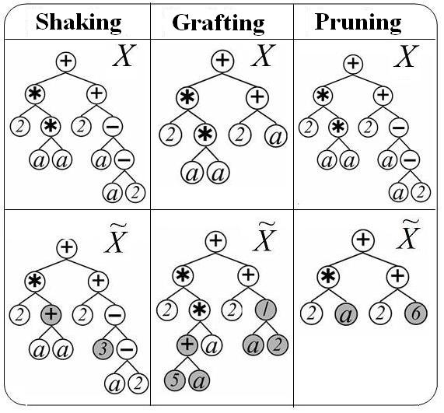
Local Search Over Tree Space

Slide 9
Experiments
Symbolic Regression Problem
6-Bit Multiplexer Problem

Slide 10
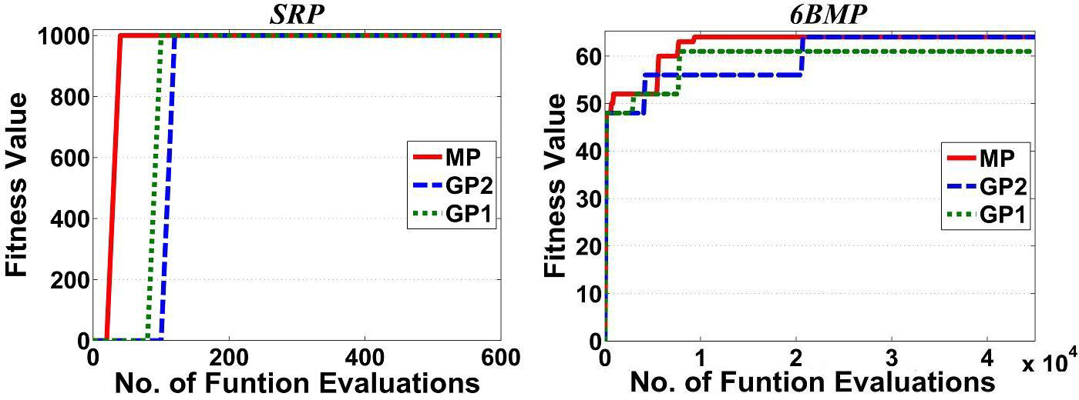
Best Solution in the Best Run

Slide 11
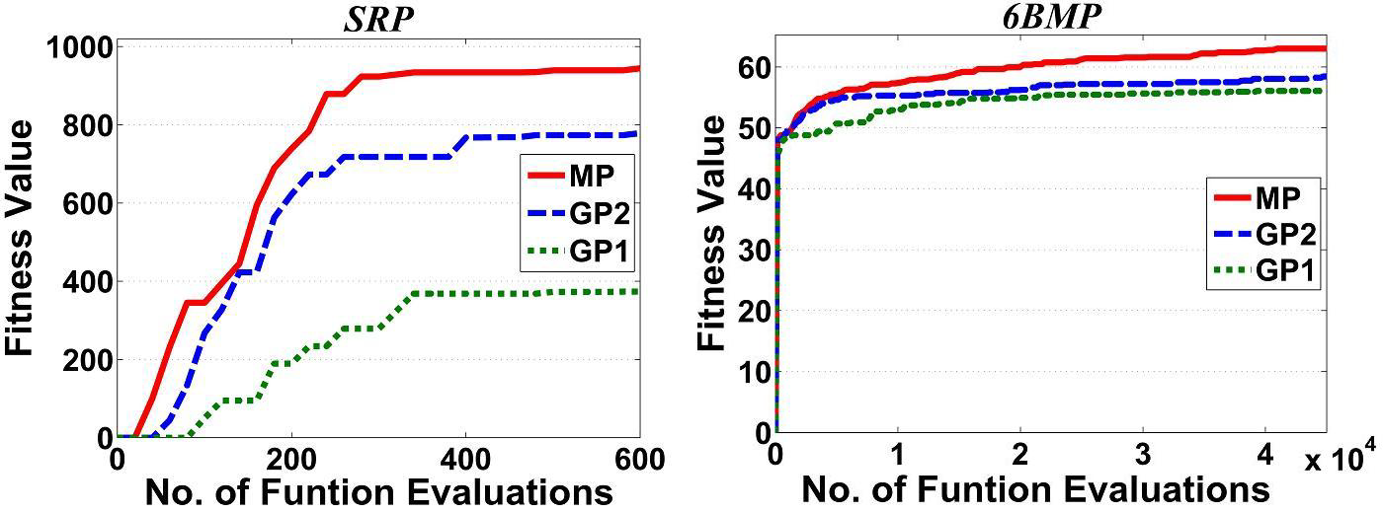
Average of all Best Solutions in all Runs

Slide 12
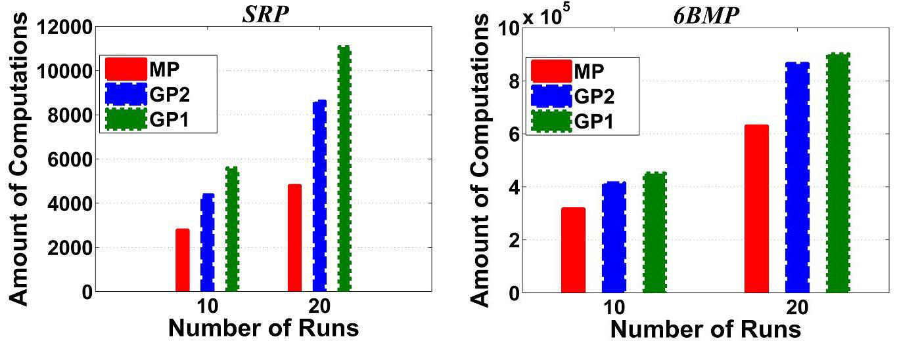
Amount of the Computations

Slide 13
THE END

