Slide 1
Using Support Vector Machine Combined with Auto Covariance to Predict Protein–protein Interactions from Protein Sequences
Yanzhi Guo(郭研芝), Lezheng Yu(余樂正), Zhining Wen(文志寧) and Menglong Li(李夢龍) Nucleic Acids Research, Volume 36, No. 9, Pages 3025-3030, April 2008.
Presenter: Chun-Chieh Tai
Date: August 7, 2012

Slide 2
Abstract(1/2)
Compared to the available protein sequences of different organisms, the number of revealed protein–protein interactions (PPIs) is still very limited. So many computational methods have been developed to facilitate the identification of novel PPIs. However, the methods only using the information of protein sequences are more universal than those that depend on some additional information or predictions about the proteins. In this article, a sequence-based method is proposed by combining a new feature representation using auto covariance (AC) and support vector machine (SVM).

Slide 3
Abstract(2/2)
AC accounts for the interactions between residues a certain distance apart in the sequence, so this method adequately takes the neighbouring effect into account. When performed on the PPI data of yeast Saccharomyces cerevisiae(釀酒酵母), the method achieved a very promising prediction result. An independent data set of 11474 yeast PPIs was used to evaluate this prediction model and the prediction accuracy is 88.09%. The performance of this method is superior to those of the existing sequence-based methods, so it can be a useful supplementary tool for future proteomics studies.
The prediction software and all data sets used in this article are freely available at http://www.scucic.cn/Predict_PPI/index.htm.

Slide 4
Seven Physicochemical Properties of Amino Acids
Hydrophobicity
疏水性
Hydrophicility
Volumes of side chains of amino acids
氨基酸側鏈卷
Polarity
極性
Polarizability
極化
solvent-accessiblesurfacearea(SASA)
溶劑可接近表面面積
Net charge index (NCI) of side chains of amino acids
淨電荷指數（NCI）的側鏈氨基酸

Slide 5
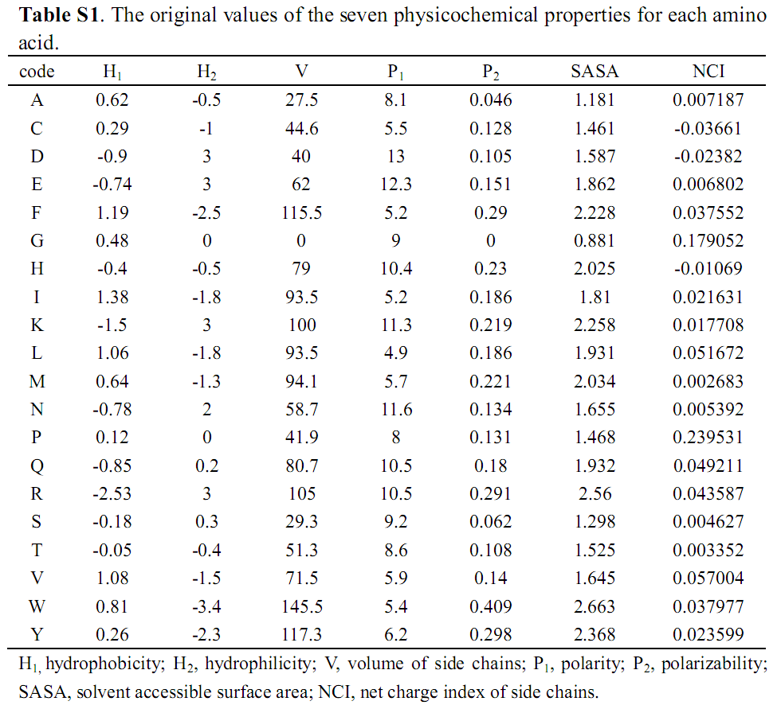

Slide 6
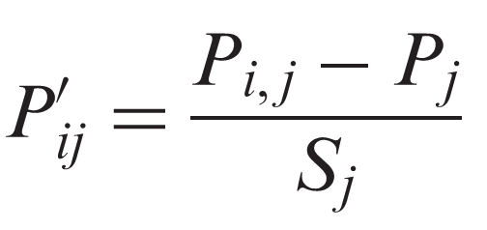
Normalized
To Zero mean and unit standard deviation
P_{i,j}: the j-th descriptor value for i-th amino acid
P_{j}: the mean of j-th descriptor over the 20 amino acids
S_{j}: the corresponding standard deviation

Slide 7
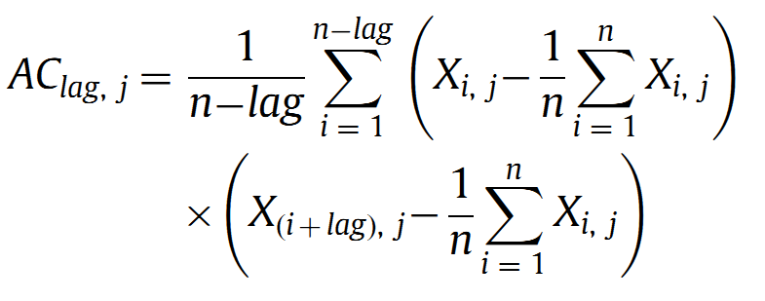
Auto Convariance Variables
lag: the distance between an amino acid residue and its neighbor a certain number of residues away, lag = 1, 2, …, lg
J: descriptor(hydrophobicity and polarity)
Number of AC: 2*lg

Slide 8
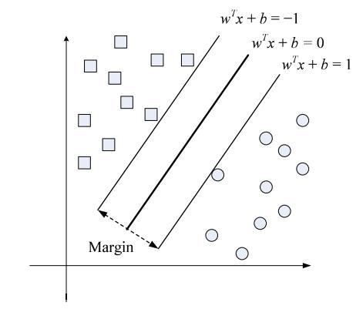
Support Vector Machine (SVM)
Hyperplan
maximizing

Slide 9
Performance Measures
Sensitivity = TP/(TP+FN)
Specificity = TN/(TN+FP)
Accuracy = (TP+ TN)/N
N: total # of cases
真陽性 (true positive, TP)表示在真正有病的族群中，檢驗的結果也真的是陽性。
真陰性 (true negative, TN)表示在沒病的族群中，檢驗的結果也是陰性。
偽陽性 (false positive, FP)表示在沒病的族群中，檢驗的結果卻是陽性。
偽陰性 (false negative, FN) 表示在真正有病的族群中，檢驗的結果卻是陰性。

Slide 10
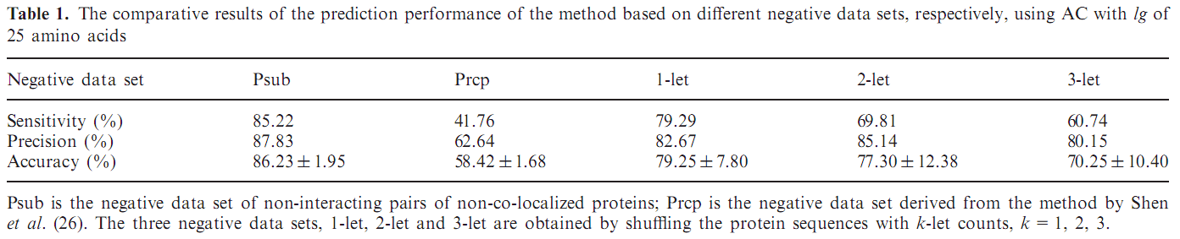
Result(1/3)

Slide 11
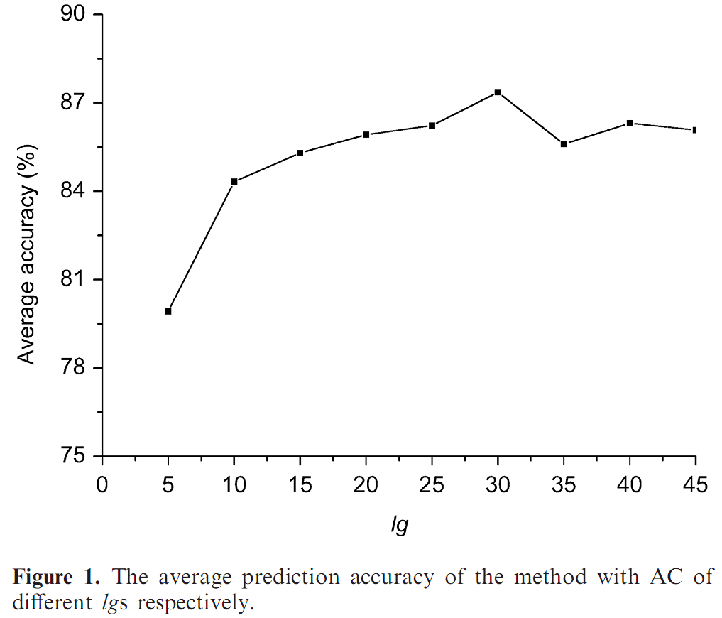
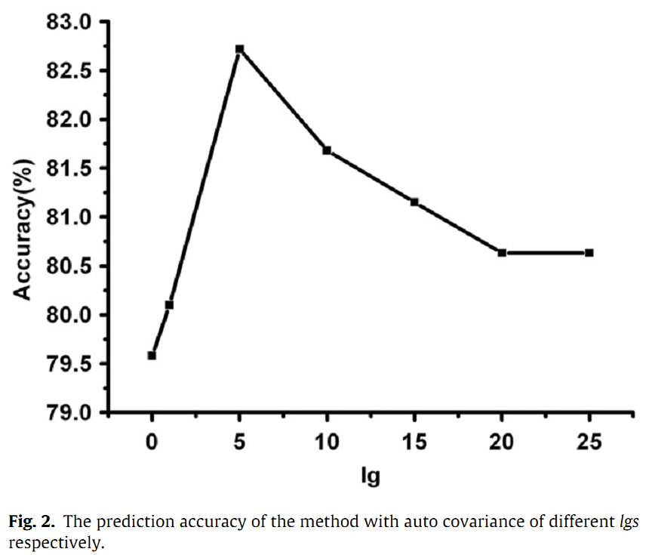
Result(2/3)

Slide 12
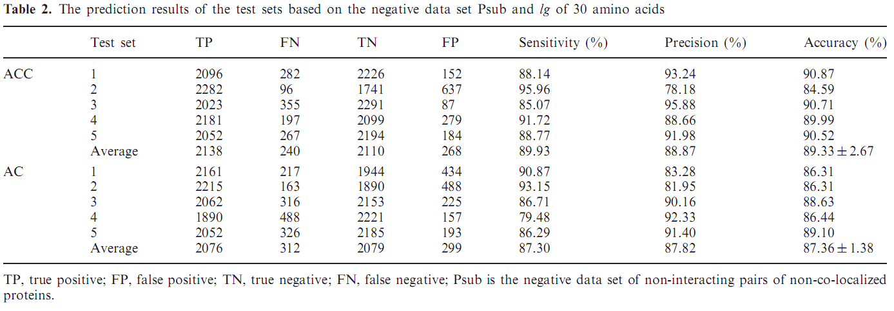
Result(3/3)
ACC : 2940-dimensional (2x30x7x7) vector
AC : 420-dimensional (2x30x7) vector

Slide 13
Thanks for your listening.

