Slide 1

Dynamic Multiobjective Optimization Problems: Test Cases, Approximations, and Applications
Marco Farina, Kalyanmoy Deb, and Paolo Amato
IEEE TRANSACTION ON EVOLUTIONARY COMPUTATION, VOL. 8, NO.5 PP. 425-442, 2004
Presenter: Hung-Hsin Chen (陳紘昕)
Date: Aug. 21, 2012

Slide 2
Abstract (1/2)
After demonstrating adequately the usefulness of evolutionary multiobjective optimization (EMO) algorithms in finding multiple Pareto-optimal solutions for static multiobjective optimization problems, there is now a growing need for solving dynamic multiobjective optimization problems in a similar manner. In this paper, we focus on addressing this issue by developing a number of test problems and by suggesting a baseline algorithm. Since in a dynamic multiobjective optimization problem, the resulting Pareto-optimal set is expected to change with time (or, iteration of the optimization process), a suite of five test problems offering different patterns of such changes and different difficulties in tracking the dynamic Pareto-optimal front by a multiobjective optimization algorithm is presented.

Slide 3
Abstract (2/2)
Moreover, a simple example of a dynamic multiobjective optimization problem arising from a dynamic control loop is presented. An extension to a previously proposed direction-based search method is proposed for solving such problems and tested on the proposed test problems. The test problems introduced in this paper should encourage researchers interested in multiobjective optimization and dynamic optimization problems to develop more efficient algorithms in the near future.

Slide 4
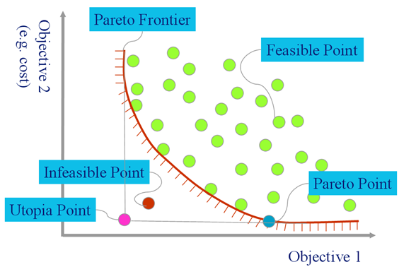
Pareto front (static)

Slide 5
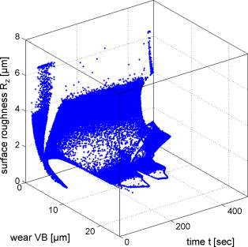
Pareto front (dynamic)
Front changes with time

Slide 6
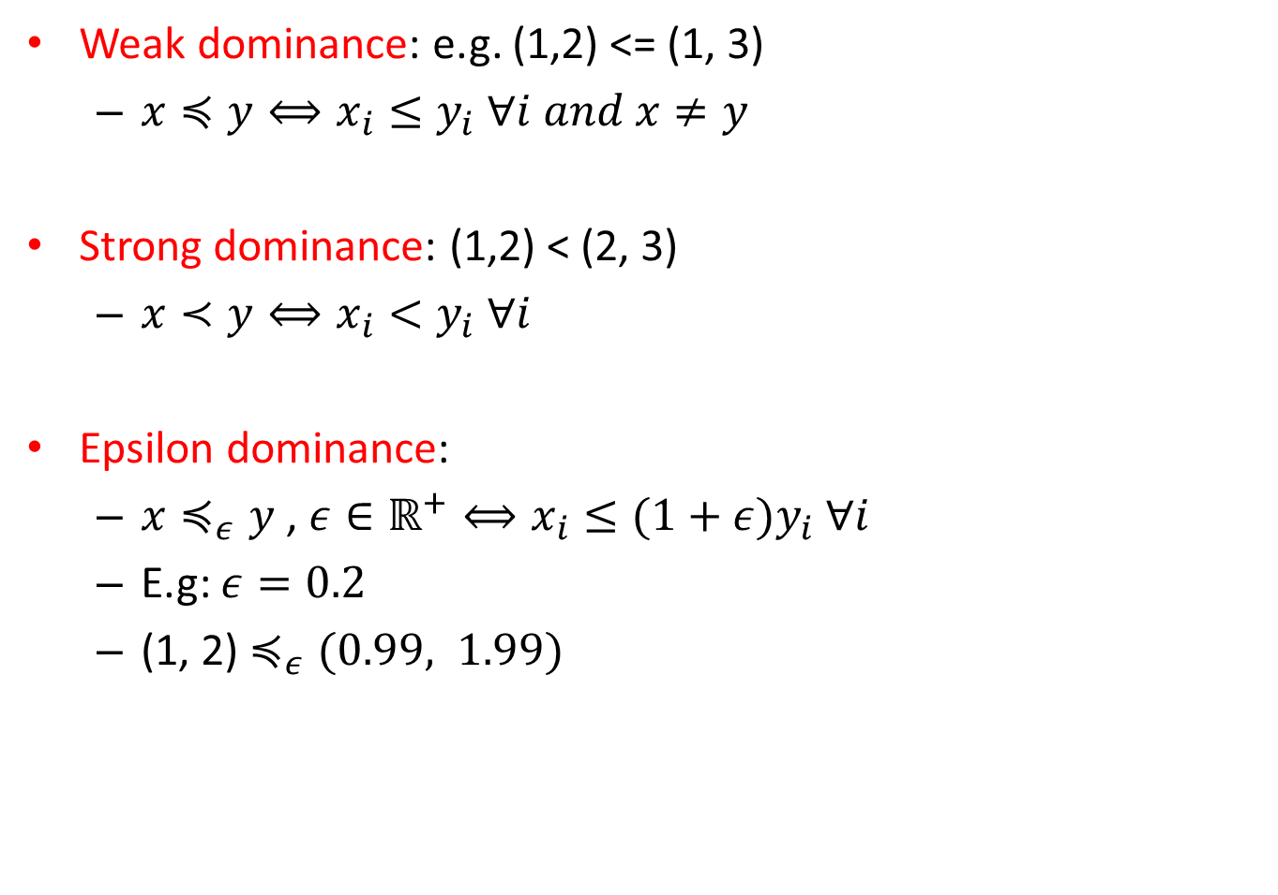
Dominance definition
Weak dominance: e.g. (1,2) <= (1, 3)
$x≼y⟺x_{i}≤y_{i} ∀i and x≠y$
Strong dominance: (1,2) < (2, 3)
$x≺y⟺x_{i}<y_{i} ∀i$
Epsilon dominance:
$x≼_{ε}y$, $ε∈ℝ^{+}⟺x_{i}≤(1+ε)y_{i} ∀i$
E.g: $ε=0.2$
(1, 2) $≼_{ε}(0.99, 1.99)$

Slide 7
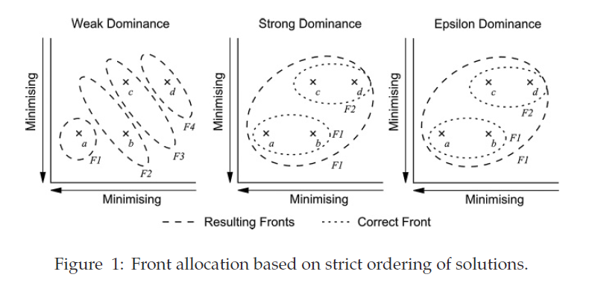
Dominance

Slide 8
Introduction of dynamic optimization
Lack of test problems for dynamic evolutionary multiobjective optimization.
GA for time-dependent fitness landscape, the operators requires reaction for balance between convergence and exploration.
Artificial life paradigm and hybridization of it with evolutionary are suitable for the problems.

Slide 9
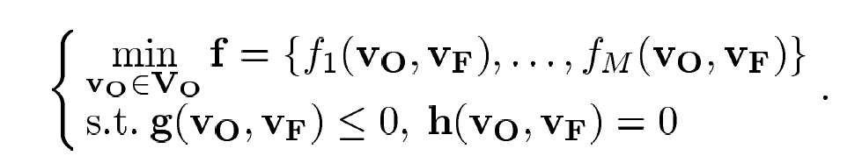
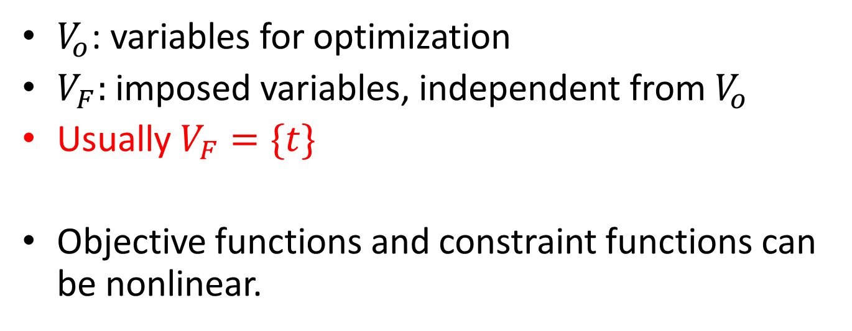
Problem definition (general)
$V_{o}$: variables for optimization
$V_{F}:$imposed variables, independent from $V_{o}$
Usually $V_{F}=\{t\}$
Objective functions and constraint functions can be nonlinear.

Slide 10
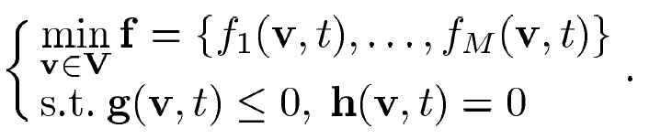
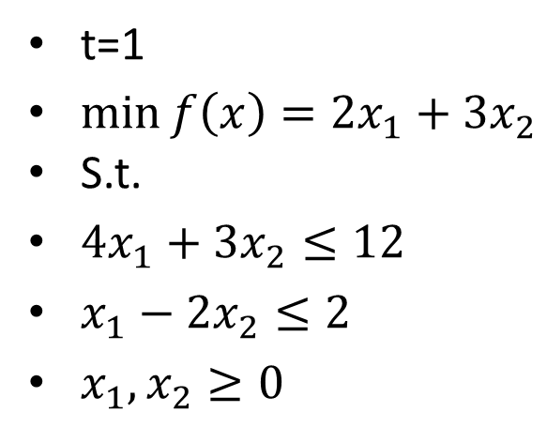
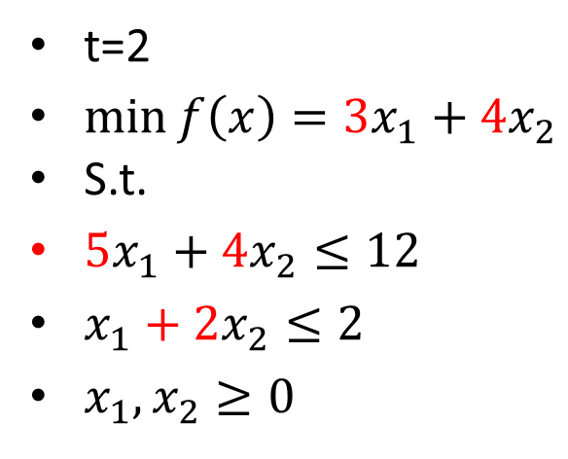
Dynamic multiobjective minimization problem of M objectives
t=1
$\min{f\left(x\right)=2x_{1}+3x_{2}}$
S.t.
$4x_{1}+3x_{2}≤12$
$x_{1}−2x_{2}≤2$
$x_{1}, x_{2}≥0$
t=2
$\min{f\left(x\right)=3x_{1}+4x_{2}}$
S.t.
$5x_{1}+4x_{2}≤12$
$x_{1}+2x_{2}≤2$
$x_{1}, x_{2}≥0$

Slide 11
F_{p}(t): Pareto front at time t
Ω(t): feasible set at time t
S_{p}(t): Pareto-opt. set at time t
U(t): Utopia point at time t
Utopia point: feasible set中，每一維度都只考慮單一objective的最佳值

Slide 12
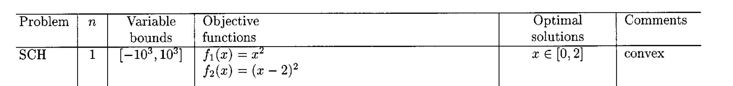
Example
Ω(t): feasible set
S_{p}(t): Pareto-opt. set
Optimal decision variables, Sp | Optimal objective values, Fp
X=0 | Objectives: (0, 4)
X=1 | Objectives: (1, 1)
X=2 | Objectives: (4, 0)

Slide 13
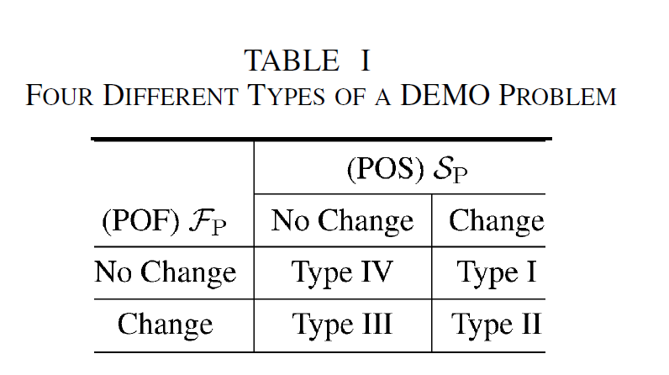
Test problems
No attention to the decision maker’s preference.
The rate of change of the problem with time (slowly or suddenly change)

Slide 14
SCH problem
Type | Objective functions | Opt. Pareto fronts, Fp | Opt.soltions, Sp
static | F1(x)=x² F2(x)=(x-2)² | (0,4), …,(1, 1), …,(4,0) | x in [0, 2]
Only Sp changes | F1(x, t)=(x-t)² F2(x, t)=(x-2-t)² | (0,4), …,(1, 1), …,(4,0) | X in [t, t+2]
Only Fp changes | F1(x, t)=x²+t F2(x, t)=(x-2)²+t | [t, 4+t],…,[t, t+1], …[4+t, t] | X in [0, 2]
Both changes | Trivial

Slide 15
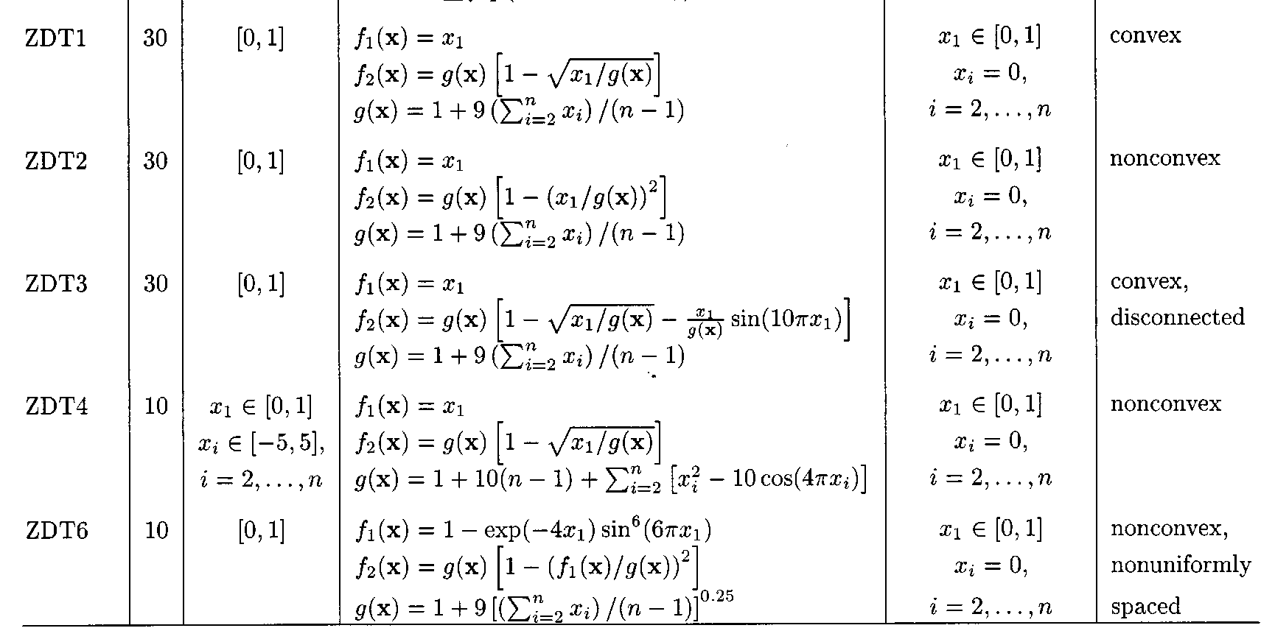
Static ZDT problem
K. Deb, A. Pratap, S. Agarwal, and T. Meyarivan, “A Fast and Elitist Multiobjective Genetic Algorithm: NSGA-II,” IEEE transaction on evolutionary computation, Vol. 6, No. 2, 2002.

Slide 16
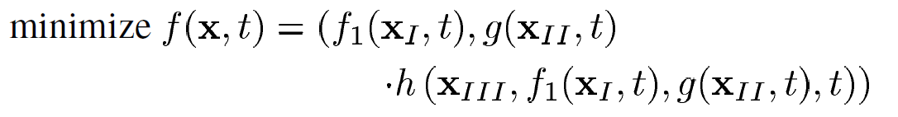
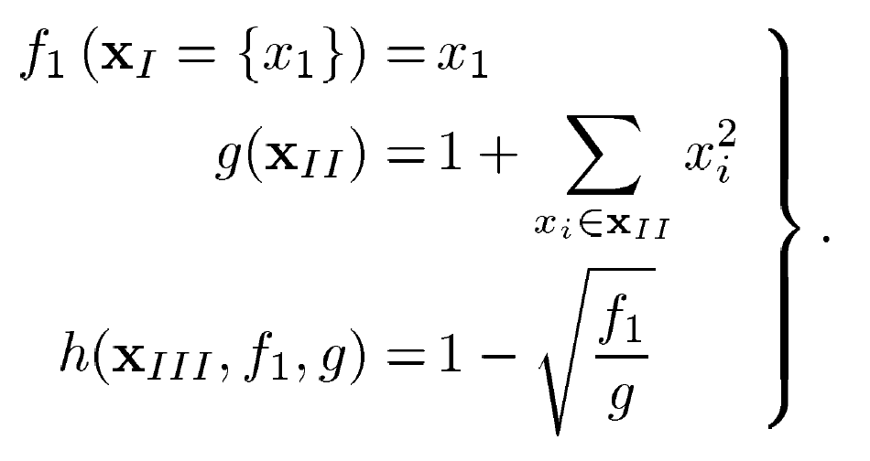
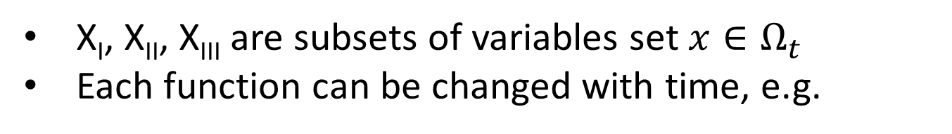
Dynamic ZDT problems (two-objective)
X_{I}, X_{II}, X_{III} are subsets of variables set $x∈Ω_{t}$
Each function can be changed with time, e.g.

Slide 17
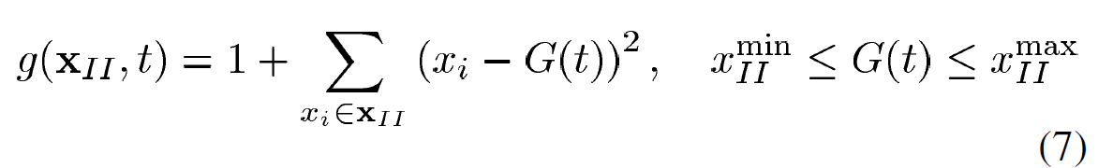
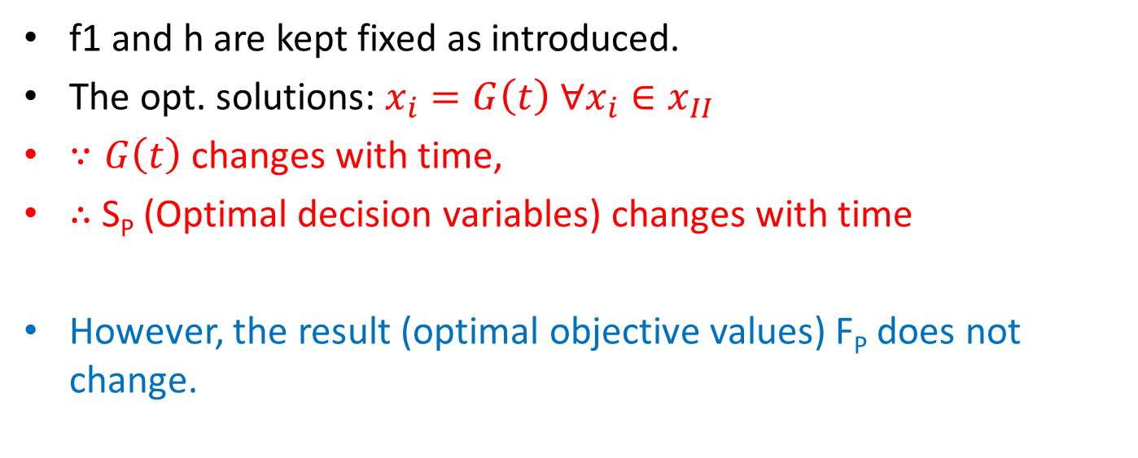
Scenario 1 (type I, only S_{P} changes)
f1 and h are kept fixed as introduced.
The opt. solutions: $x_{i}=G\left(t\right) ∀x_{i}∈x_{II}$
$∵G\left(t\right)$changes with time,
$∴$S_{P} (Optimal decision variables) changes with time
However, the result (optimal objective values) F_{P} does not change.

Slide 18
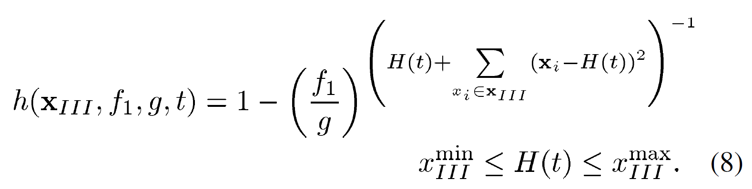
Scenario 2 (Type II, both S_{P} and F_{P} change)
f1 and g are kept fixed as introduced.
the result (optimal objective values) F_{P} changes with X_{III} (S_{P}).

Slide 19
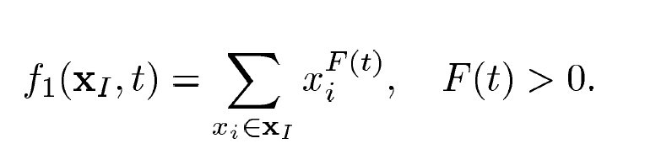
Scenario 3(Type III, only F_{p} changes)
the result (optimal objective values) F_{P} change with F(t).
S_{P} (Optimal decision variables) do not change.

Slide 20
Scenario 4 (complex situation)
Varying G(t), H(t), F(t), the F_{P} and S_{P} will change.

Slide 21
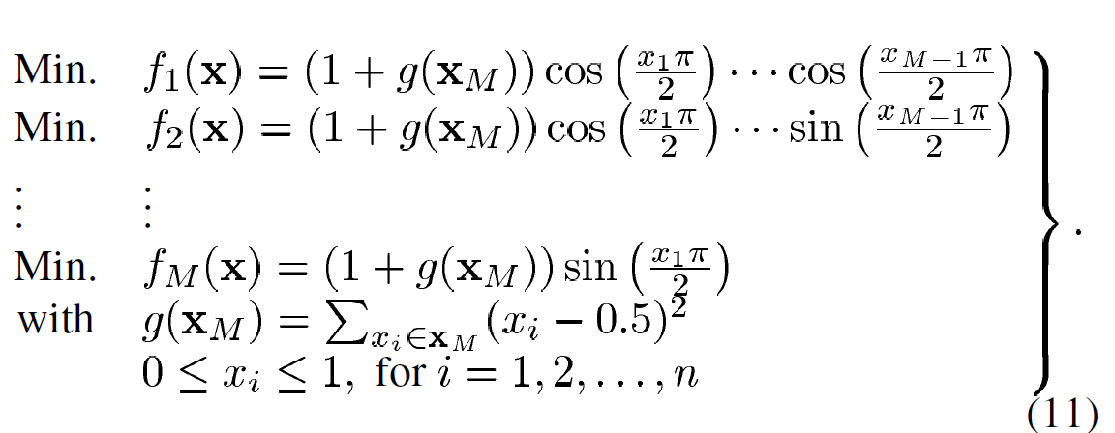
Static DTLZ-2 problem
M-objective, n-variable problem

Slide 22
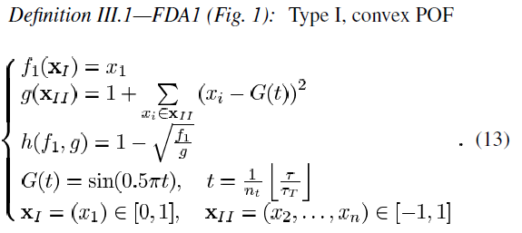
Test suite for continuous search space
Test suite of five test problems.
only S_{P} changes with time

Slide 23
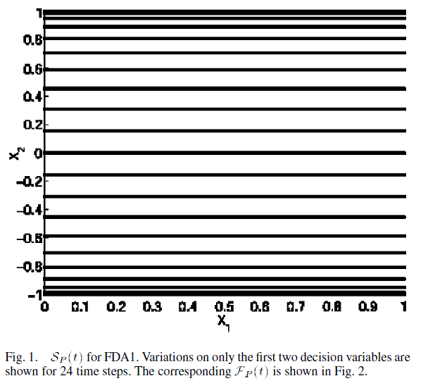
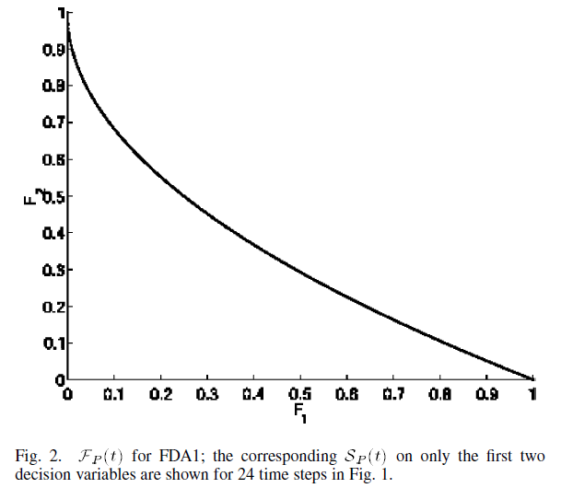
FDA1-Sp and Fp figures
only S_{P} changes with time

Slide 24
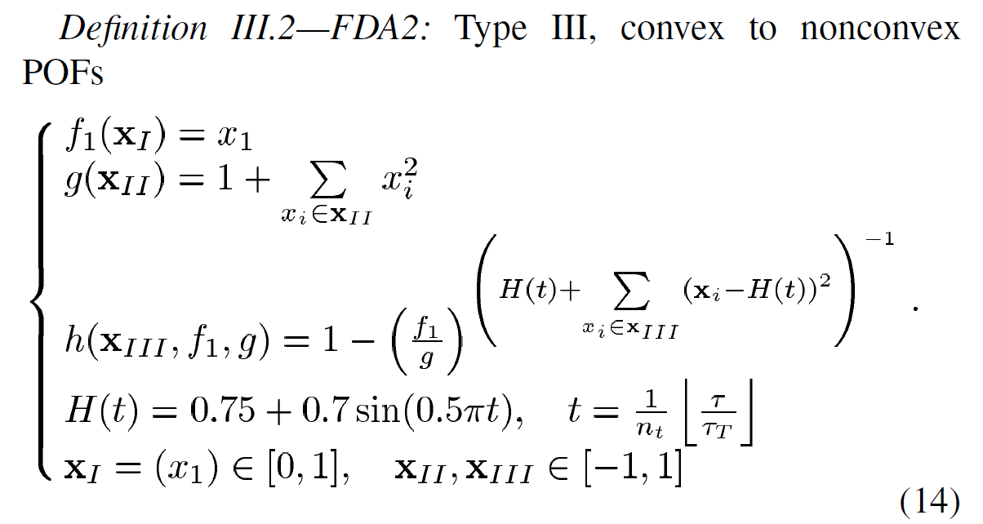
FDA2
only F_{P} changes with time

Slide 25
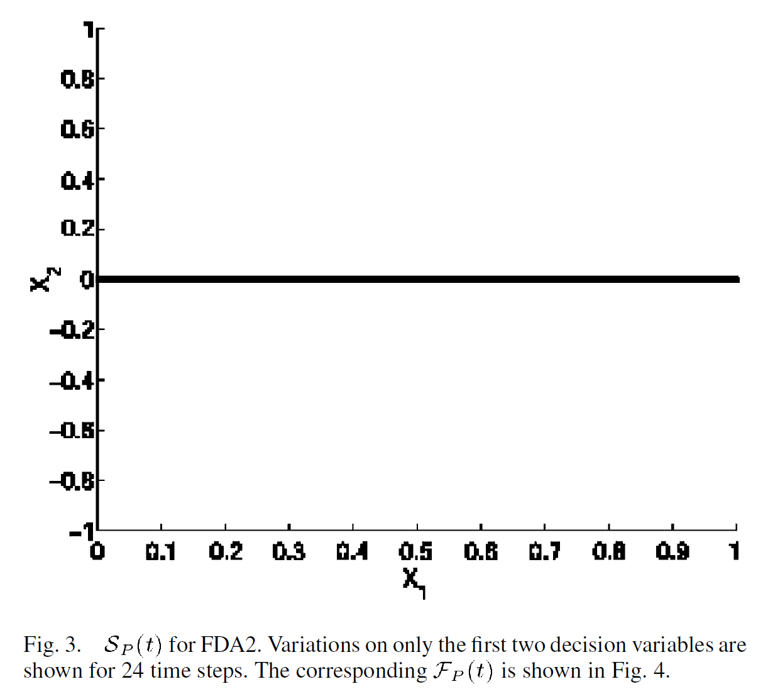
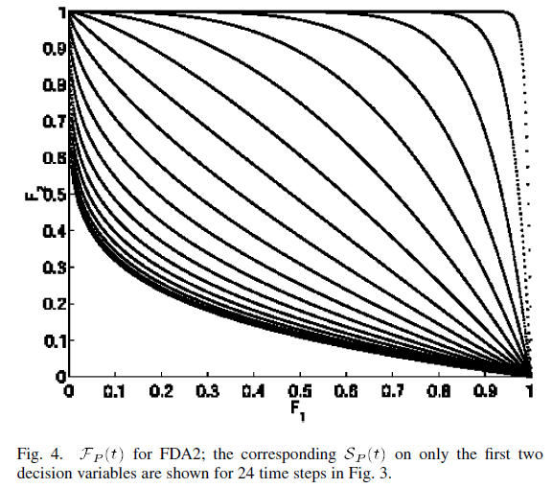
FDA2-Sp and Fp figures
only F_{P} changes with time

Slide 26
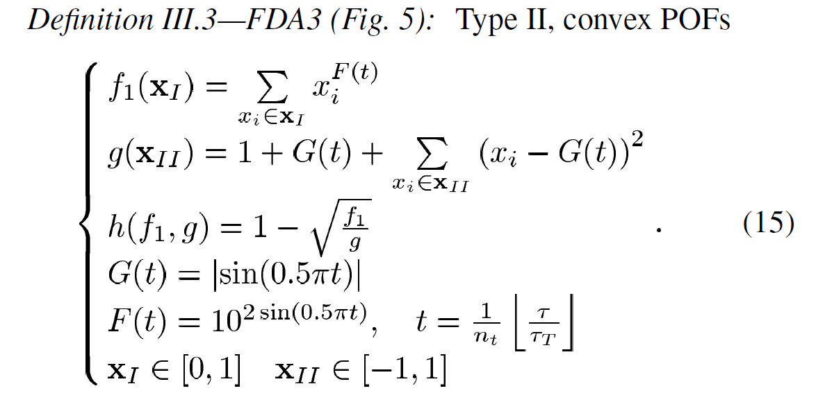
FDA3
Both S_{p} and F_{P} change with time

Slide 27
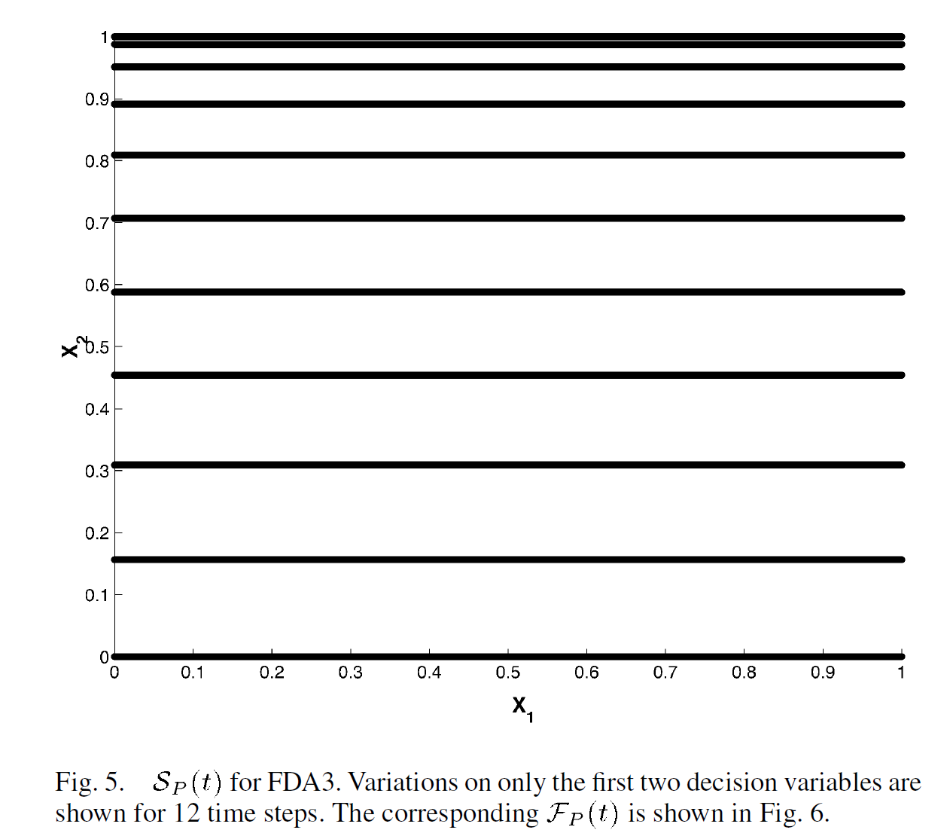
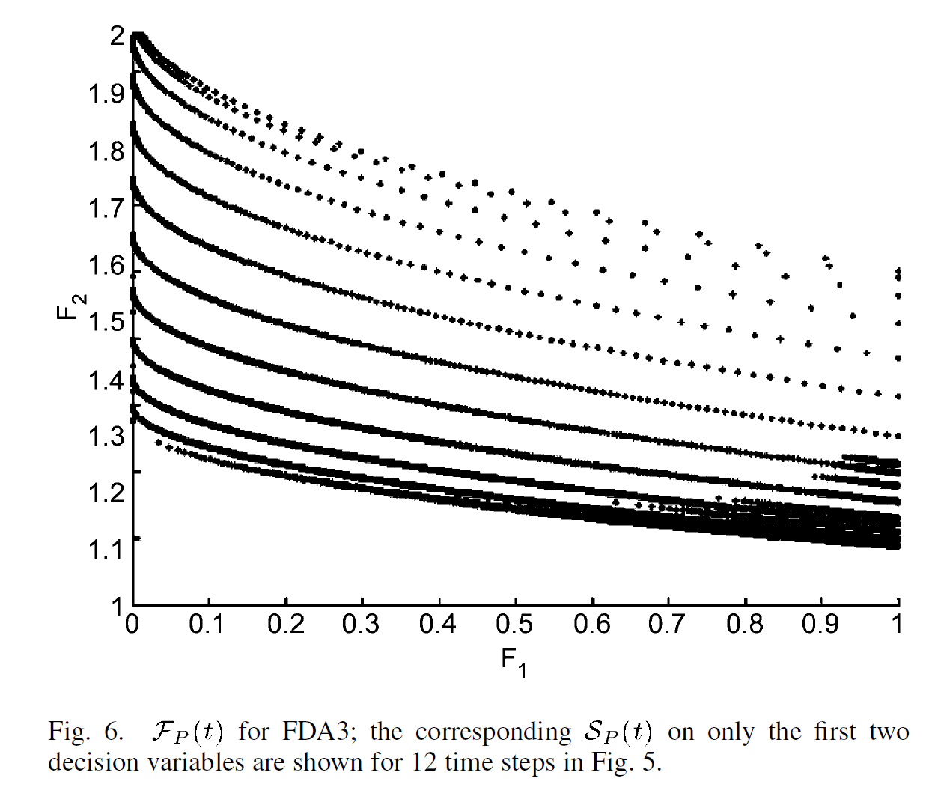
FDA3-Sp and Fp figures
Both S_{p} and F_{P} change with time

Slide 28
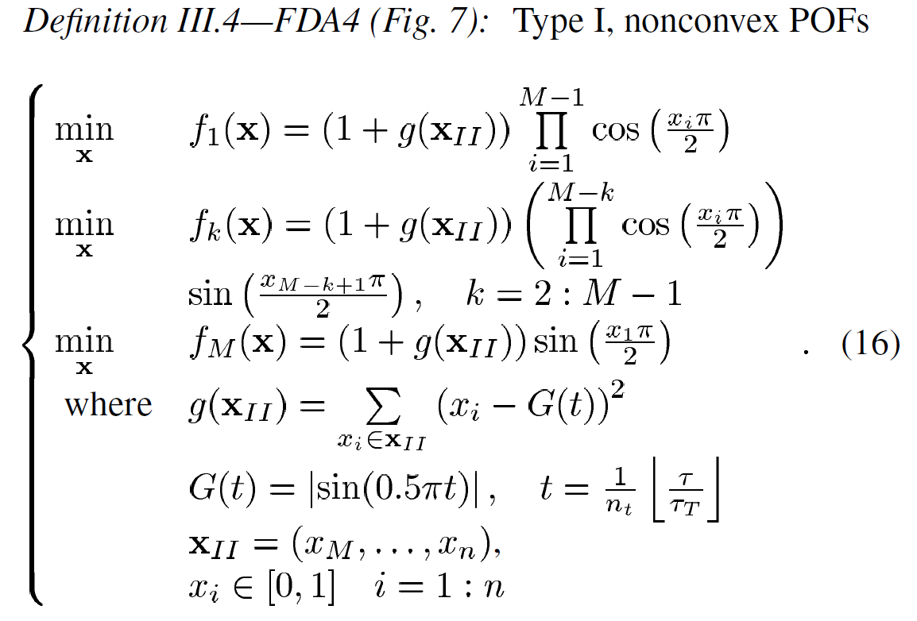
FDA4
only S_{p} changes with time

Slide 29
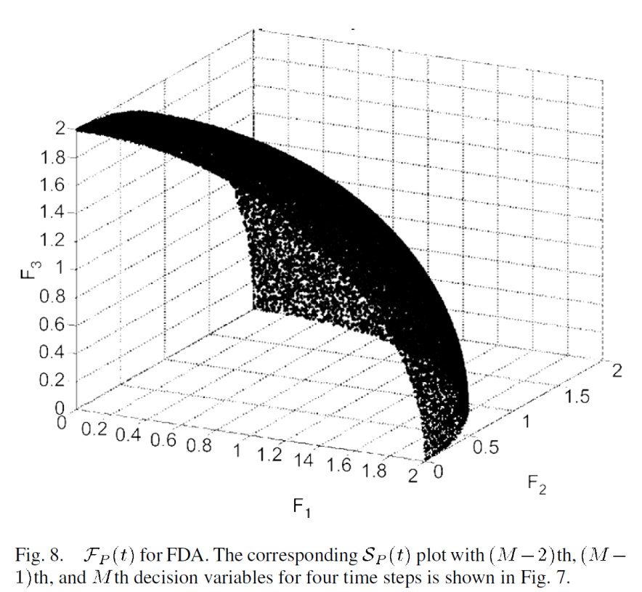
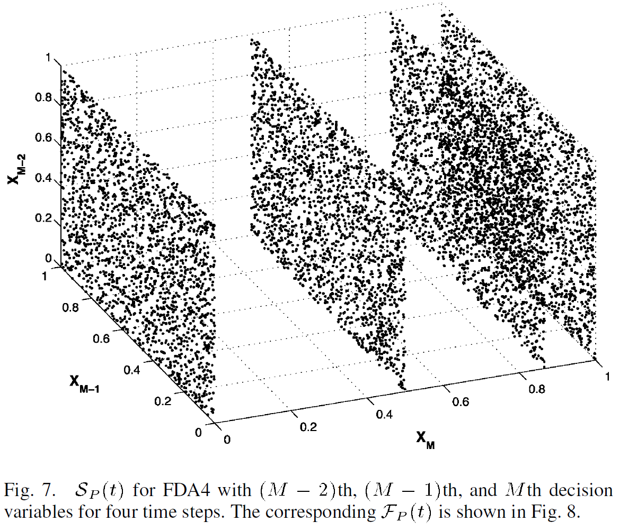
FDA4-Sp and Fp figures
only S_{p} changes with time

Slide 30
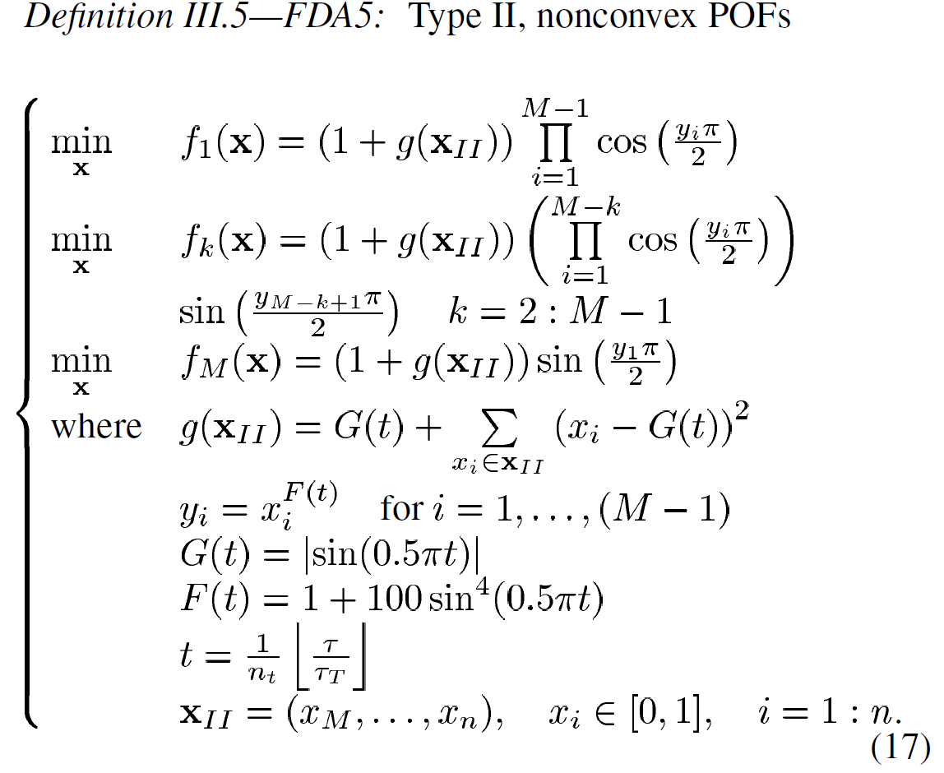
FDA5

Slide 31
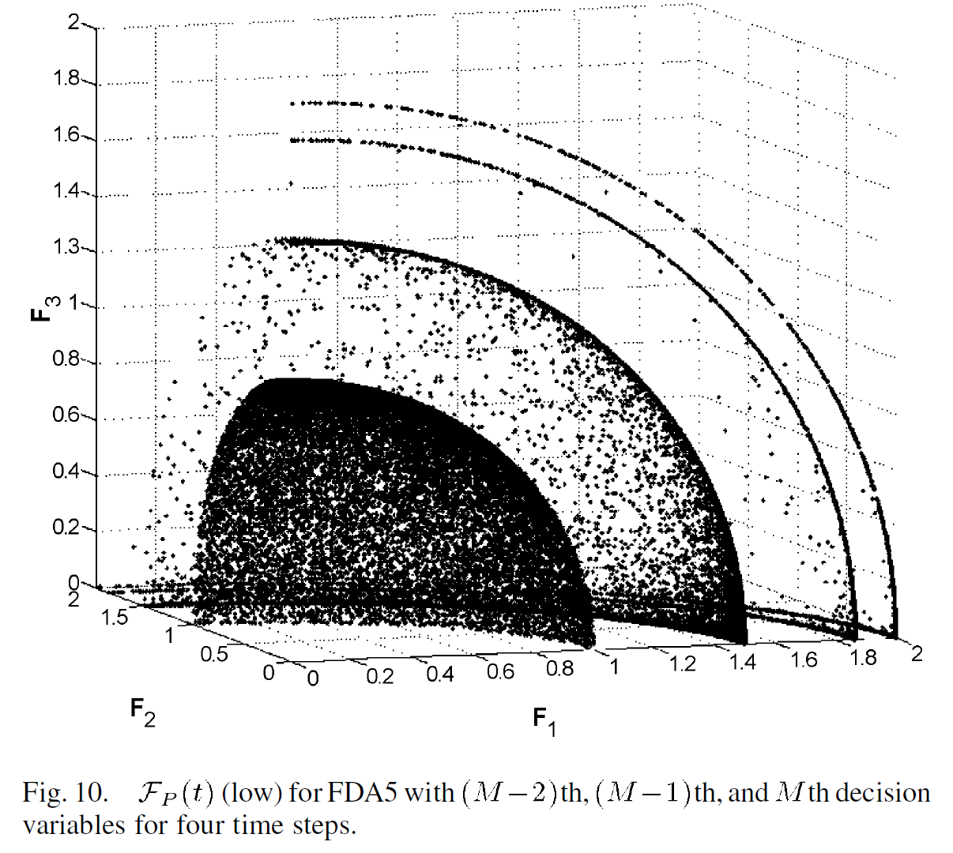
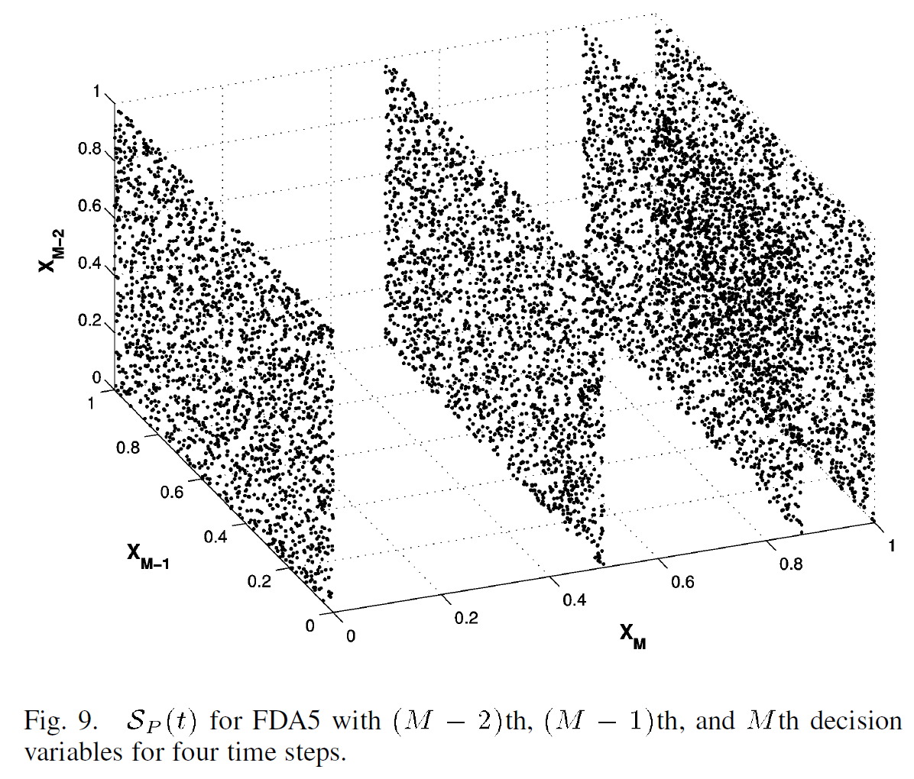
FDA5-Sp and Fp figures
Both S_{p} and F_{P} change with time

Slide 32
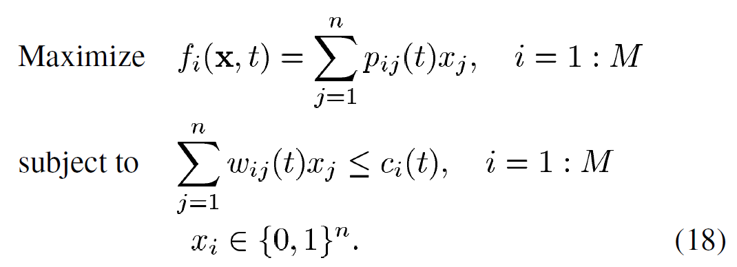
Discrete search space test problems
Dynamic knapsack problem having M knapsacks.

Slide 33
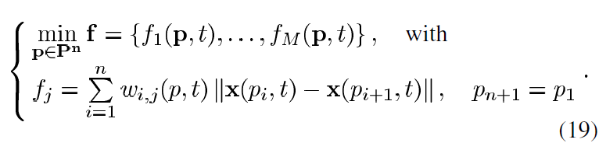
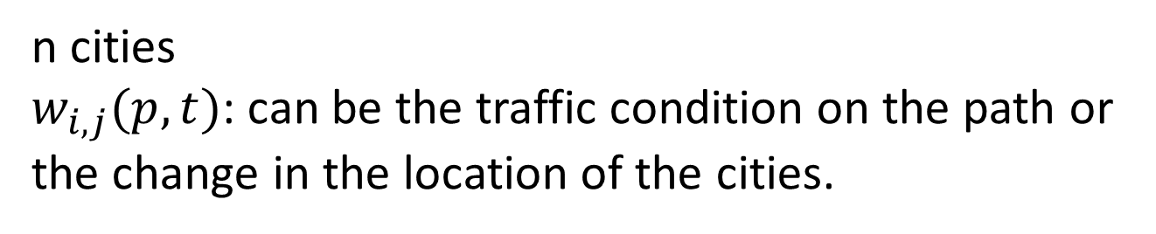
Dynamic traveling salesman problem
P is a permutation of the cities.
n cities
$w_{i,j}(p, t)$: can be the traffic condition on the path or the change in the location of the cities.

Slide 34
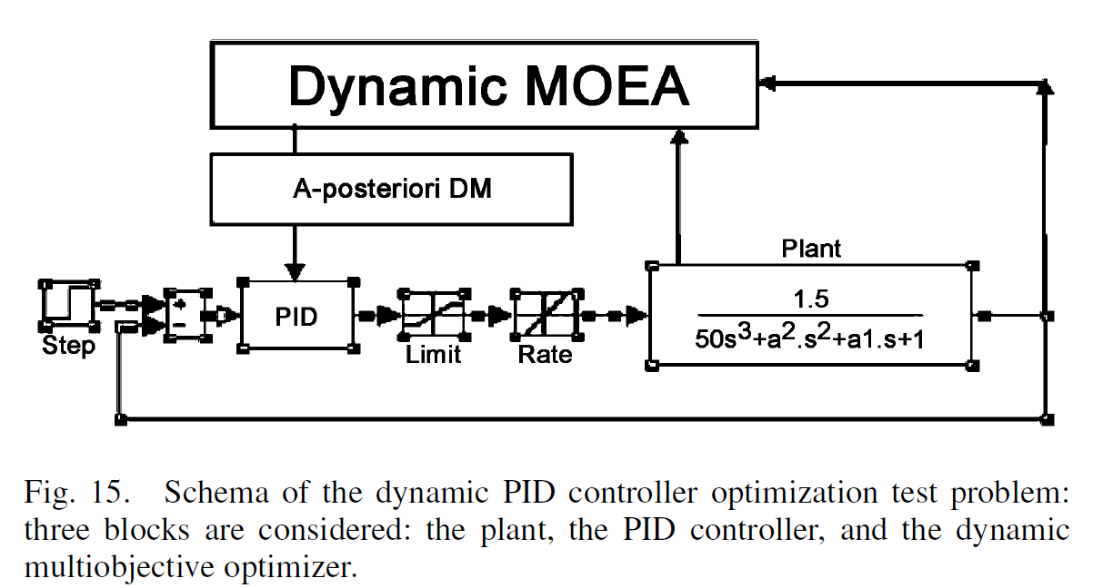
Dynamic multiobjective optimal control problems

Slide 35
Dynamic EMO algorithm, a directed-based approach
The following conditions will happen in solving problem:
The time dependence is slow but continuous (mode A).
The time dependence is seldom but sudden and random (mode B).
[considering a sudden random time-dependent change.]

Slide 36
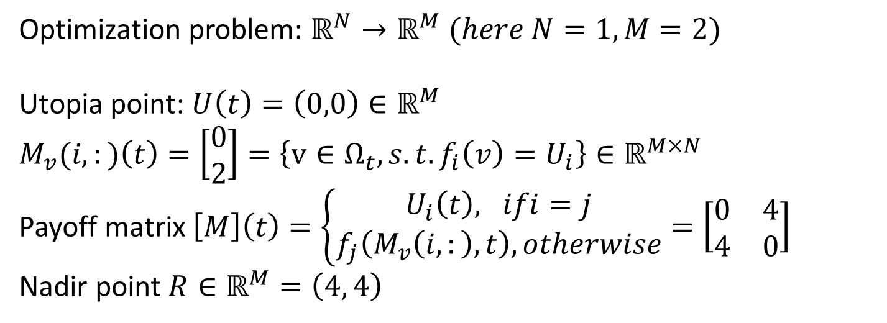
SCH problem
Objective functions | Opt. Pareto fronts, Fp | Opt.soltions, Sp
F1(x)=x² F2(x)=(x-2)² | (0,4), …,(1, 1), …,(4,0) | x in [0, 2]
Optimization problem: $ℝ^{N}→ℝ^{M} (here N=1, M=2)$
Utopia point: $U\left(t\right)=\left(0,0\right)∈ℝ^{M}$
$$M_{v}(i,:)\left(t\right)=\left[\begin{matrix}0 \\ 2\end{matrix}\right]=\left\{v∈Ω_{t}, s.t. f_{i}\left(v\right)=U_{i}\right\}∈ℝ^{M×N}$$
Payoff matrix $\left[M\right]\left(t\right)=\left\{\begin{aligned}U_{i}\left(t\right), ifi=j \\ f_{j}\left(M_{v}\left(i,:\right), t\right), otherwise\end{aligned}\right.=\left[\begin{matrix}0 & 4 \\ 4 & 0\end{matrix}\right]$
Nadir point $R∈ℝ^{M}=\left(4, 4\right)$

Slide 37
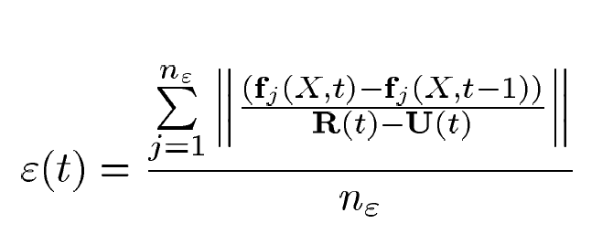
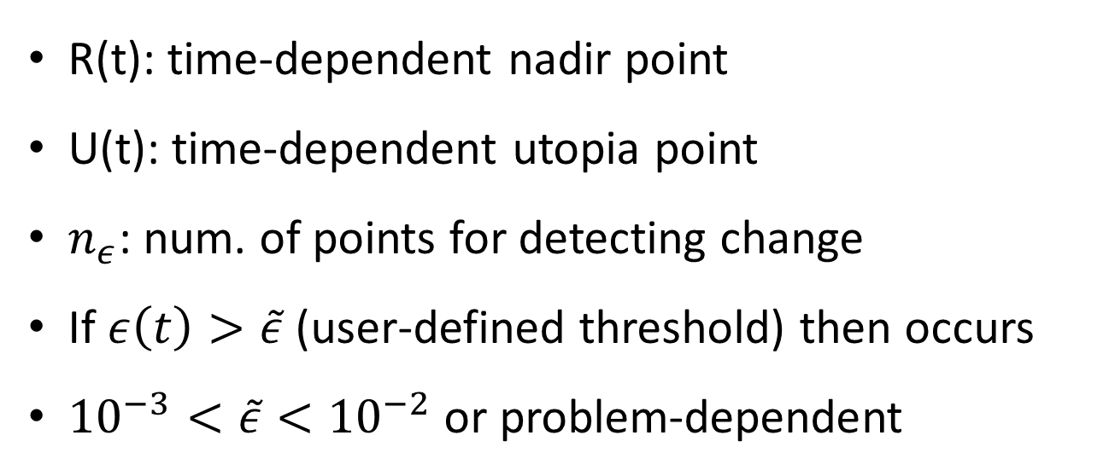
Checking the suddenly change
R(t): time-dependent nadir point
U(t): time-dependent utopia point
$n_{ε}$: num. of points for detecting change
If $ε\left(t\right)>\tilde{ε}$(user-defined threshold) then occurs
${10}^{−3}<\tilde{ε}<{10}^{−2}$or problem-dependent

Slide 38
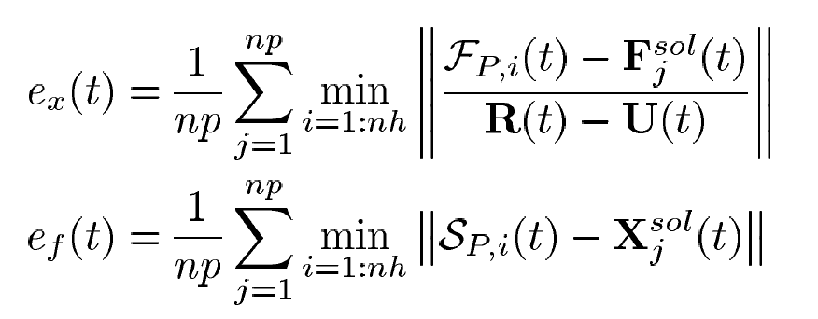
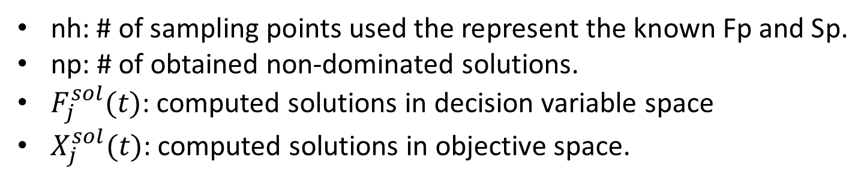
Convergence measure (in decision space and objective space)
nh: # of sampling points used the represent the known Fp and Sp.
np: # of obtained non-dominated solutions.
$F_{j}^{sol}(t)$: computed solutions in decision variable space
$X_{j}^{sol}(t)$: computed solutions in objective space.

Slide 39
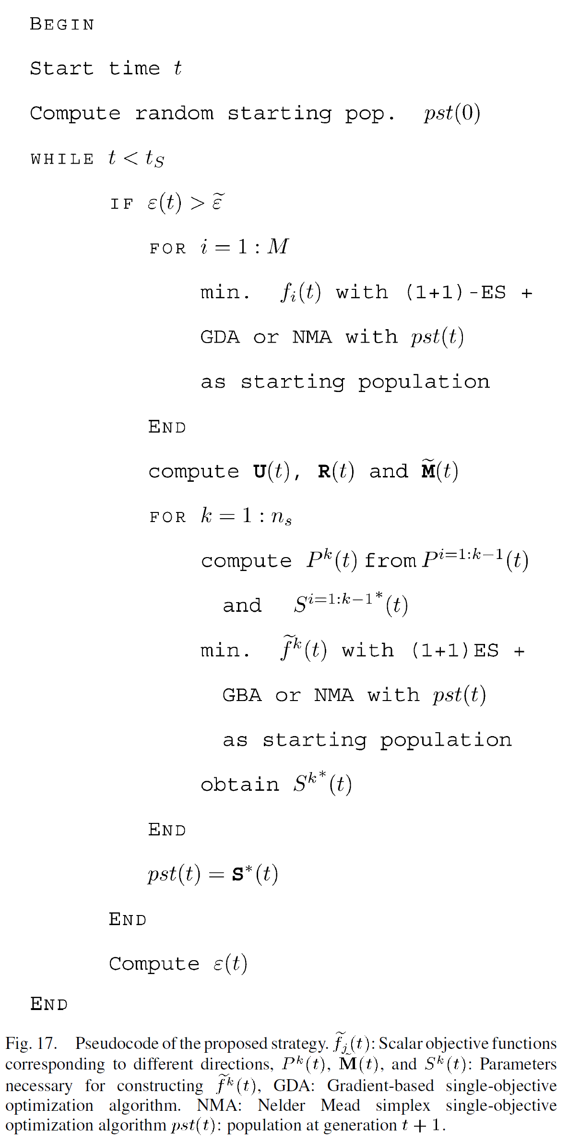
t_{s}: stop time
Suddenly change occurs
找出單一目標的最佳值
在新的估計區間產生chromosome重新演化

Slide 41
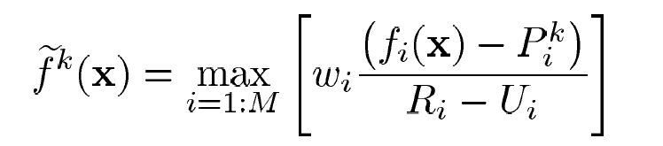
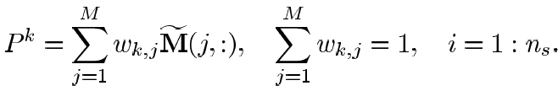
Pareto front

Slide 42
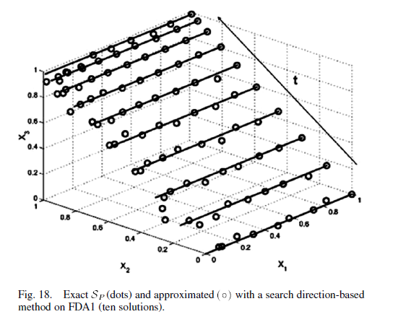
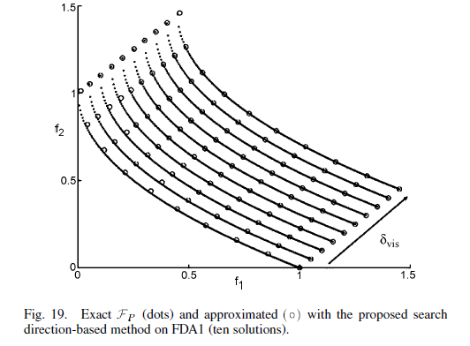
FDA1

Slide 43
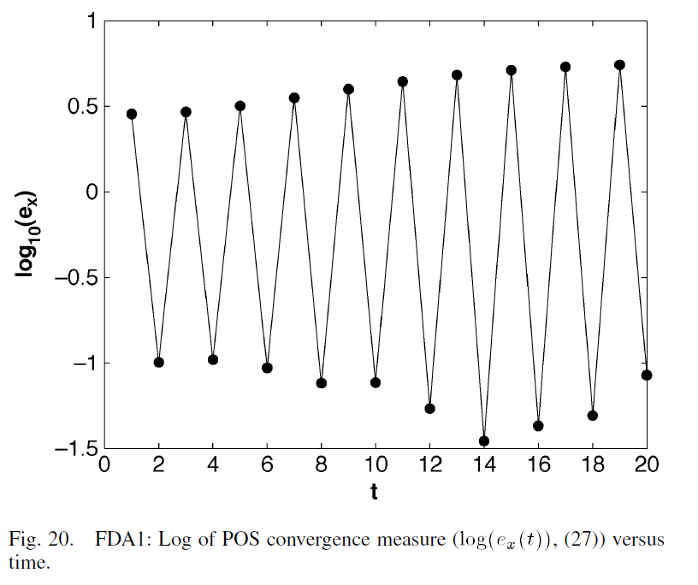

FDA1

Slide 44


FDA2

Slide 45


FDA2

Slide 46


FDA3

Slide 47


FDA3

Slide 48

FDA4

Slide 49

FDA4

Slide 50

FDA4

Slide 51

FDA5

Slide 52

FDA5

Slide 53


FDA5

Slide 54


Thank you!!

