Slide 1
Fast Computation of a Longest Increasing Subsequence and Application
M. Crochemore, E. Porat,
Information and Computation, Vol. 208, 2010, pp. 1054~1059
Presenter: Guan-Ting Chen
Date: Oct. 4, 2022

Slide 2
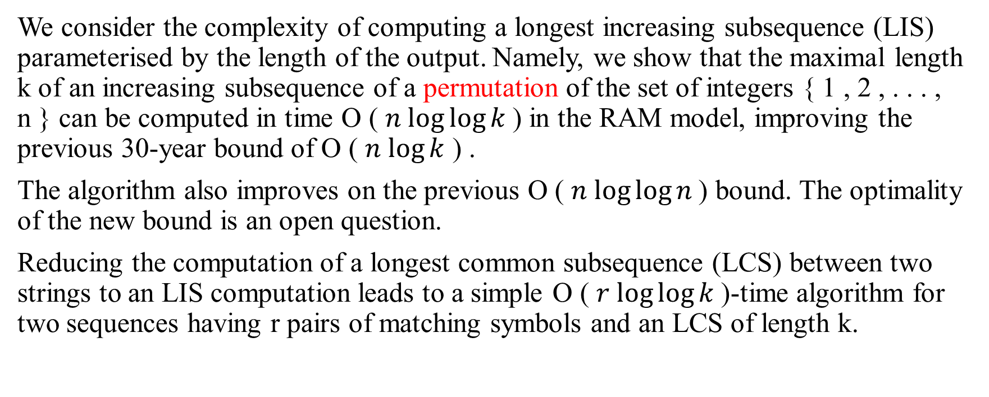
Abstract
We consider the complexity of computing a longest increasing subsequence (LIS) parameterised by the length of the output. Namely, we show that the maximal length k of an increasing subsequence of a permutation of the set of integers { 1 , 2 , . . . , n } can be computed in time O ( $n log⁡log⁡k$) in the RAM model, improving the previous 30-year bound of O ( $n log⁡k$ ) .
The algorithm also improves on the previous O ( $n log⁡log⁡n$) bound. The optimality of the new bound is an open question.
Reducing the computation of a longest common subsequence (LCS) between two strings to an LIS computation leads to a simple O ( $r log⁡log⁡k$)-time algorithm for two sequences having r pairs of matching symbols and an LCS of length k.

Slide 3
Longest Increasing Subsequence
 | B
S | 1 | 2 | 3 | 4
12 | 12
8 | 8
9 | 8 | 9
1 | 1 | 9
11 | 1 | 9 | 11
6 | 1 | 6 | 11
7 | 1 | 6 | 7
2 | 1 | 2 | 7
10 | 1 | 2 | 7 | 10
4 | 1 | 2 | 4 | 10
5 | 1 | 2 | 4 | 5
3 | 1 | 2 | 3 | 5

Slide 4
Sort
12 | 10 | 01
08 | 01 | 02
09 | 11 | 03
01 | 12 | 04
11 | 02 | 05
06 | 03 | 06
07 | 04 | 07
02 | 05 | 08
10 | 06 | 09
04 | 07 | 10
05 | 08 | 11
03 | 09 | 12
Radix Sort
{12, 8, 9, 1, 11, 6, 7, 2, 10, 4, 5, 3}
Pair ?
{(1, 12), (1, 8), (1, 9), (1, 1), (2, 11), (2, 6), (2, 7), (2, 2), (3, 10), (3, 4), (3, 5), (3, 3)}

Slide 5
Algorithm
Split S into blocks
{(12, 8, 9, 1), (11, 6, 7, 2), (10, 4, 5, 3)}
Sort the blocks
{(1, 8, 9, 12), (2, 6, 7, 11), (3, 4, 5, 10)}
Process the blocks one by one

Slide 6
Processing a block
Assign a key to elements
(12, 8, 9, 1) → (d, b, c, a)
Get B
(a, c) → (1, 9)
Merge B with next blocks
Reassign B
(1, 9) + (11, 6, 7, 2) → (1, 2, 6, 7, 9, 11) → (a, b, c, d, e, f)
(1, 9) → (a, e), (11, 6, 7, 2) → (f, c, d, b)
Update B
(a, b, d) → (1, 2, 7)

Slide 7
Processing a block (cont.)
Merge B with next blocks
Reassign B
(1, 2, 7) → (a, b, f), (10, 4, 5, 3) → (g, d, e, c)
Update B
(a, b, c, e) → (1, 2, 3, 5)
LIS Length: 4

Slide 8

Size of the blocks
不斷執行上述演算法，直到 B 的 size > $m_{i}$便終止
$m_{0}= 4$
$m_{i}= m_{i−1}^{log{ m}_{i−1}}$

Slide 9

Time Complexity
$O(n\log{\log{k )}}$
Permutation
Radix Sort
van Emde Boas trees

Slide 10
Longest Common Subsequence
p(x[1]) = p(a) = (5, 2, 1)
p(x[2]) = p(b) = (4, 3)
 | 1 | 2 | 3 | 4 | 5
x | a | b | a | b | a
y | a | a | b | b | a

Slide 11
Longest Common Subsequence (cont.)
x = a b a b a
y = a a b b a
S(x, y) | p(x[1]) | p(x[2]) | p(x[3]) | p(x[4]) | p(x[5])
 | 5, 2, 1 | 4, 3 | 5, 2, 1 | 4, 3 | 5, 2, 1
LCS(x, y) = LIS(S(x, y))

Slide 12
Longest Common Subsequence (cont.)
S(x, y) | (5, 3) | (2, 3) | (1, 3) | (4, 2) | (3, 2) | (5, 2) | (2, 2) | (1, 2) | (4, 1) | (3, 1) | (5, 1) | (2, 1) | (1, 1)
Order | 13 | 6 | 3 | 10 | 8 | 12 | 5 | 2 | 9 | 7 | 11 | 4 | 1
x = a b a b a
y = a a b b a
3 | 5 | 7 | 11
(1, 1) | (3, 2) | (4, 3) | (5, 5)

