Slide 1
Computing Longest Previous Factor in linear time and applications
Maxime Crochemore, Lucian Ilie
Information Processing Letters 106 (2008) 75–80
Presenter: Cheng-Han Ho
Date: Oct. 4, 2022

Slide 2
Abstract
We give two optimal linear-time algorithms for computing the Longest Previous Factor (LPF) array corresponding to a string w. For any position i in w, LPF[i] gives the length of the longest factor of w starting at position i that occurs previously in w. Several properties and applications of LPF are investigated. They include computing the Lempel–Ziv factorization of a string and detecting all repetitions (runs) in a string in linear time independently of the integer alphabet size.

Slide 3
LPF (Longest Previous Factor)
W = abbaabbbaaaabab
i | 0 | 1 | 2 | 3 | 4 | 5 | 6 | 7 | 8 | 9 | 10 | 11 | 12 | 13
w | a | b | b | a | a | b | b | b | a | a | a | b | a | b
LPF | 0 | 0 | 1 | 1 | 3 | 2 | 4 | 3 | 2 | 3 | 2 | 2 | 2 | 1

Slide 4
Computing Longest Previous Factor
Algorithm-1: 用 Suffix Array
Algorithm-2: 用 LCP

Slide 5
Suffix Array (1/3)
W = abbaabbbaaabab
SA[0] = abbaabbbaaabab SA[7] = baaabab
SA[1] = bbaabbbaaabab SA[8] = aaabab
SA[2] = baabbbaaabab SA[9] = aabab
SA[3] = aabbbaaabab SA[10] = baba
SA[4] = abbbaaabab SA[11] = bab
SA[5] = bbbaaabab SA[12] = ab
SA[6] = bbaaabab SA[13] = b

Slide 6
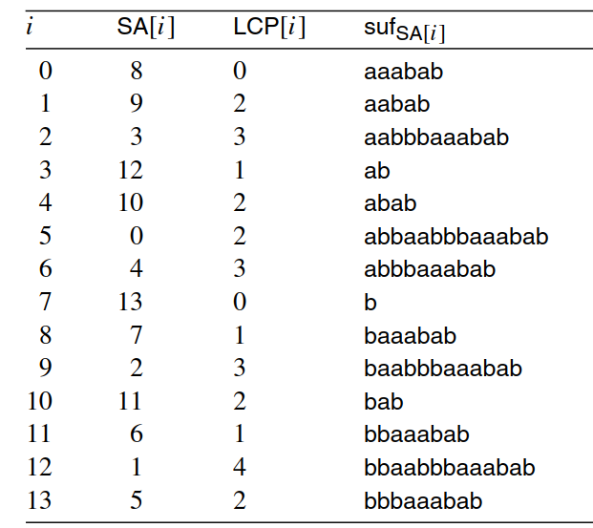
Suffix Array (2/3)
W = abbaabbbaaabab
根據字典序排序

Slide 7
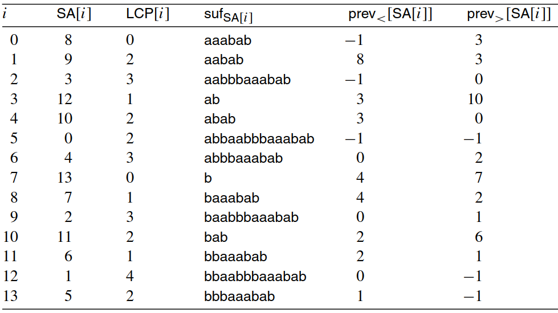
Suffix Array (3/3)

Slide 8
LPF property
LPF[i] ≧ LPF[i-1] -1
i | 0 | 1 | 2 | 3 | 4 | 5 | 6 | 7 | 8 | 9 | 10 | 11 | 12 | 13
w | a | b | b | a | a | b | b | b | a | a | a | b | a | b
LPF | 0 | 0 | 1 | 1 | 3 | 2 | 4 | 3 | 2 | 3 | 2 | 2 | 2 | 1

Slide 9
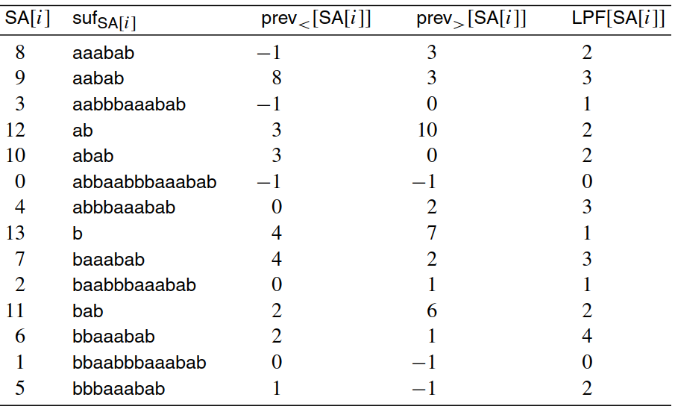
Algorithm-1
LPF[i] ≧ LPF[i-1] -1
LPF<[i] ≧ LPF<[i-1] -1
LPF>[i] ≧ LPF>[i-1] -1
i | 0 | 1 | 2 | 3 | 4 | 5 | 6 | 7 | 8 | 9 | 10 | 11 | 12 | 13
W | a | b | b | a | a | b | b | b | a | a | a | b | a | b
LPF< | 0 | 0 | 0 | 0 | 3 | 2 | 1 | 0 | 0 | 2 | 1 | 2 | 1 | 0
LPF> | 0 | 0 | 1 | 1 | 0 | 0 | 4 | 3 | 2 | 3 | 2 | 1 | 2 | 1
LPF | 0 | 0 | 1 | 1 | 3 | 2 | 4 | 3 | 2 | 3 | 2 | 2 | 2 | 1

Slide 10
LCP (Longest Common Preﬁx)

Slide 11
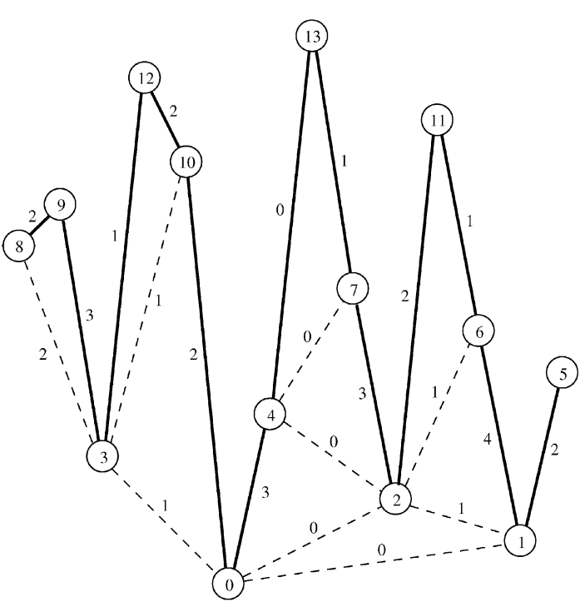
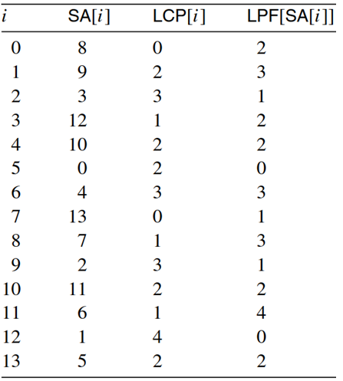
Algorithm-2

Slide 12
Computing Longest Previous Factor
Algorithm-1: 用 Suffix Array
Algorithm-2: 用 LCP
Linear time

