Slide 1
Contract Bridge Bidding by Learning
Chun-Yen Ho and Hsuan-Tien Lin Workshops at the Twenty-Ninth AAAI Conference on Artificial Intelligence, 2015
Presenter: Yun-An Chen
Date: Nov. 1, 2022

Slide 2
Abstract(1/2)
Contract bridge is an example of an incomplete information game for which computers typically do not perform better than expert human bridge players. In particular, the typical bidding decisions of human bridge players are difficult to mimic with a computer program, and thus automatic bridge bidding remains to be a challenging research problem. Currently, the possibility of automatic bidding without mimicking human players has not been fully studied.

Slide 3
Abstract(2/2)
In this work, we take an initiative to study such a possibility for the specific problem of bidding without competition. We propose a novel learning framework to let a computer program learn its own bidding decisions. The framework transforms the bidding problem into a learning problem, and then solves the problem with a carefully designed model that consists of cost-sensitive classifiers and upper-confidence-bound algorithms. We validate the proposed model and find that it performs competitively to the champion computer bridge program that mimics human bidding decisions.

Slide 4
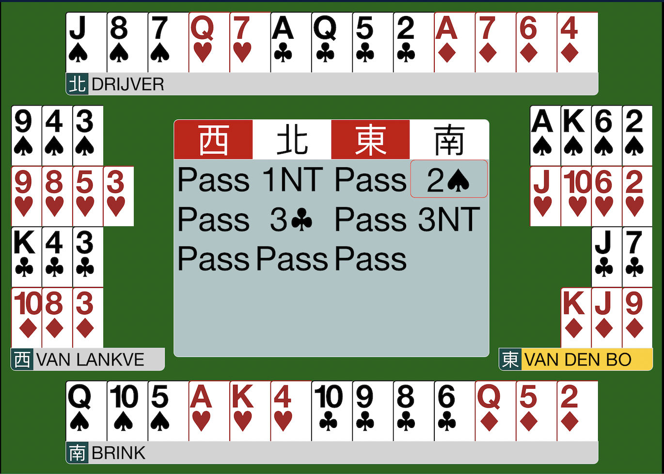
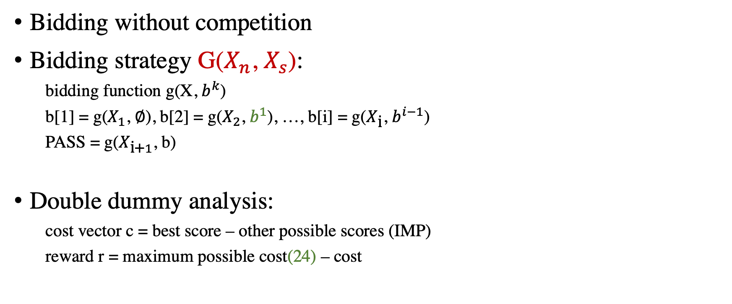


Problem Setup
Bidding without competition
Bidding strategy G($X_{n}$, $X_{s}$):
bidding function g(X, $b^{k}$)
b[1] = g($X_{1}$, ∅), b[2] = g($X_{2}$, $b^{1}$), …, b[i] = g($X_{\text{i}}$, $b^{i−1}$)
PASS = g($X_{\text{i}\text{+}1}$, b)
Double dummy analysis:
cost vector c = best score – other possible scores (IMP)
reward r = maximum possible cost(24) – cost
b[1] = g($X_{n}$, ∅) = 1NT
b[2] = g($X_{s}$, 1NT) = 2S

Slide 5
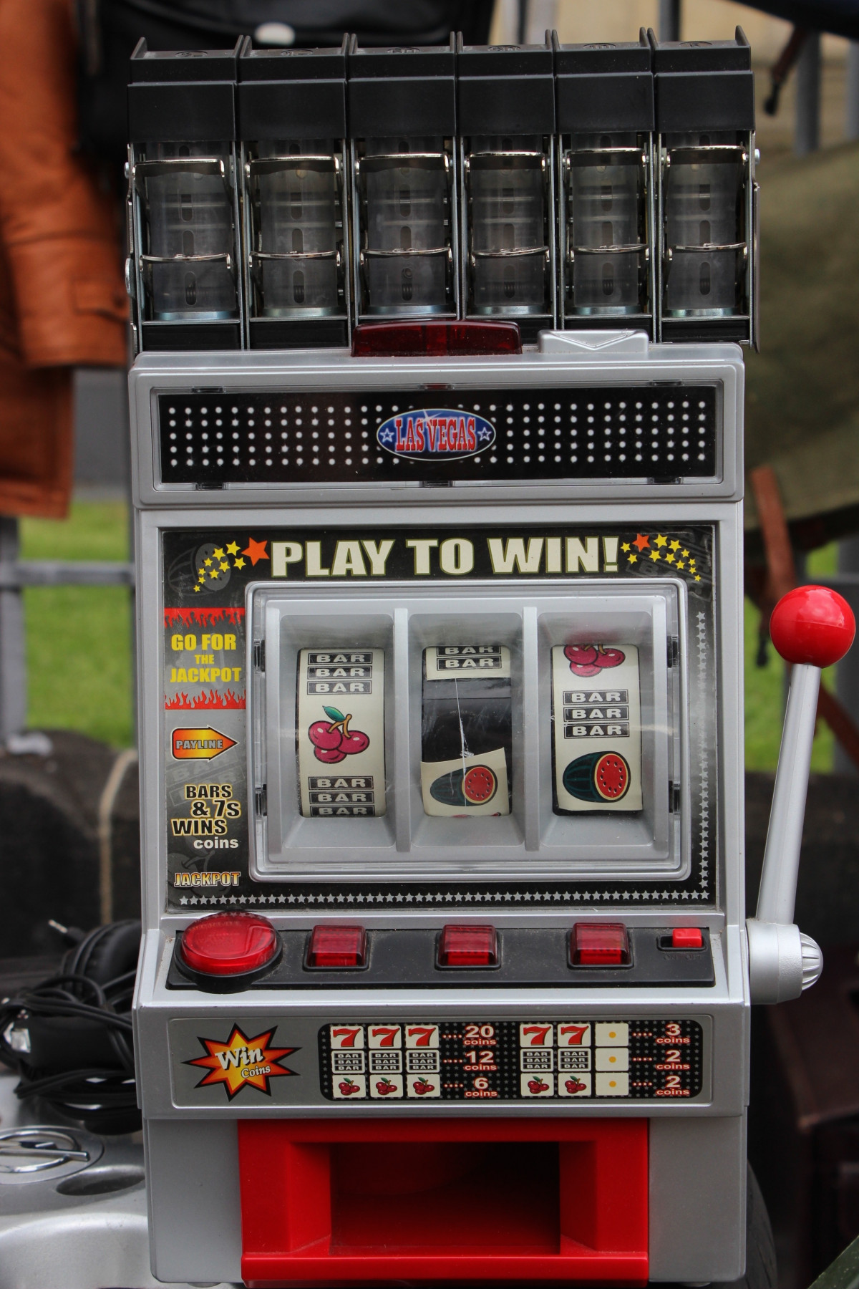



Contextual bandit problem
Multi-armed bandit
exploration
exploitation
M=4

Slide 6
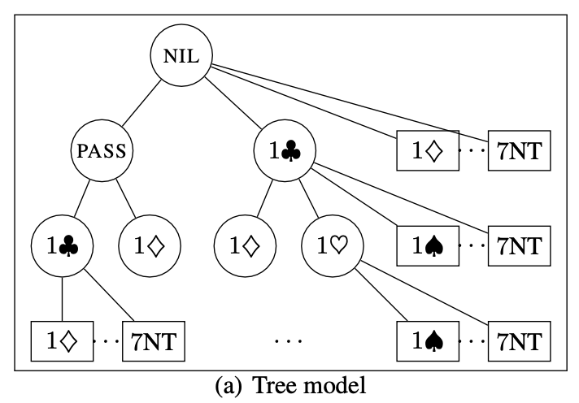



Multi-layer bandit model
root node: g($X_{n}$, ∅)
Input $x_{n}$ to g
bidding node V(b, g)
the prediction of g = b[1]
M=2, $ℓ$=3

Slide 7

Multi-layer bandit model
Input $x_{n}$ to g
bidding node V(b, g)
(pass, g)
Input $x_{s}$ to g
b[2]
(1C, g)
M=2, $ℓ$=3

Slide 8
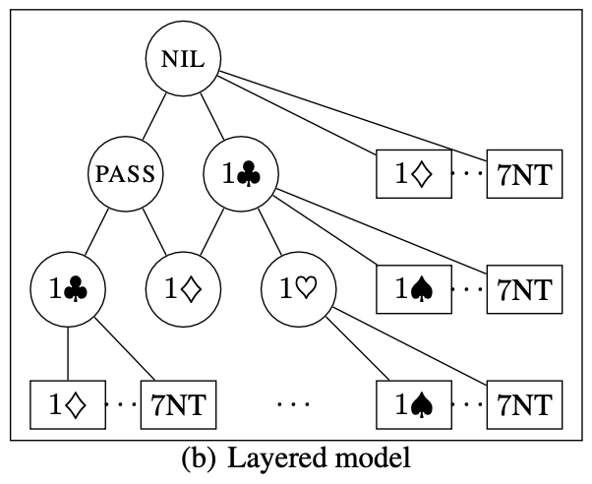
Multi-layer bandit model(Layered model)
Combining the non-terminal nodes

Slide 9
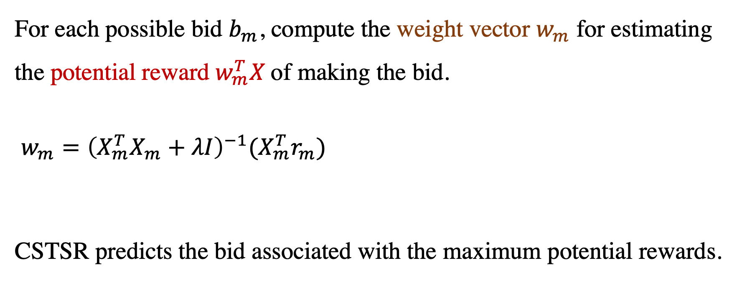


CSTSR - ridge regression
For each possible bid $b_{m}$, compute the weight vector $w_{m}$ for estimating the potential reward $w_{m}^{T}X$of making the bid.
$w_{m}={\left(X_{m}^{T}X_{m}+λI\right)}^{−1}(X_{m}^{T}r_{m})$
CSTSR predicts the bid associated with the maximum potential rewards.
$r_{m}$ : all the rewards gathered when $b_{m}$is made
$X_{m}$: all the x associated with those rewards

Slide 10
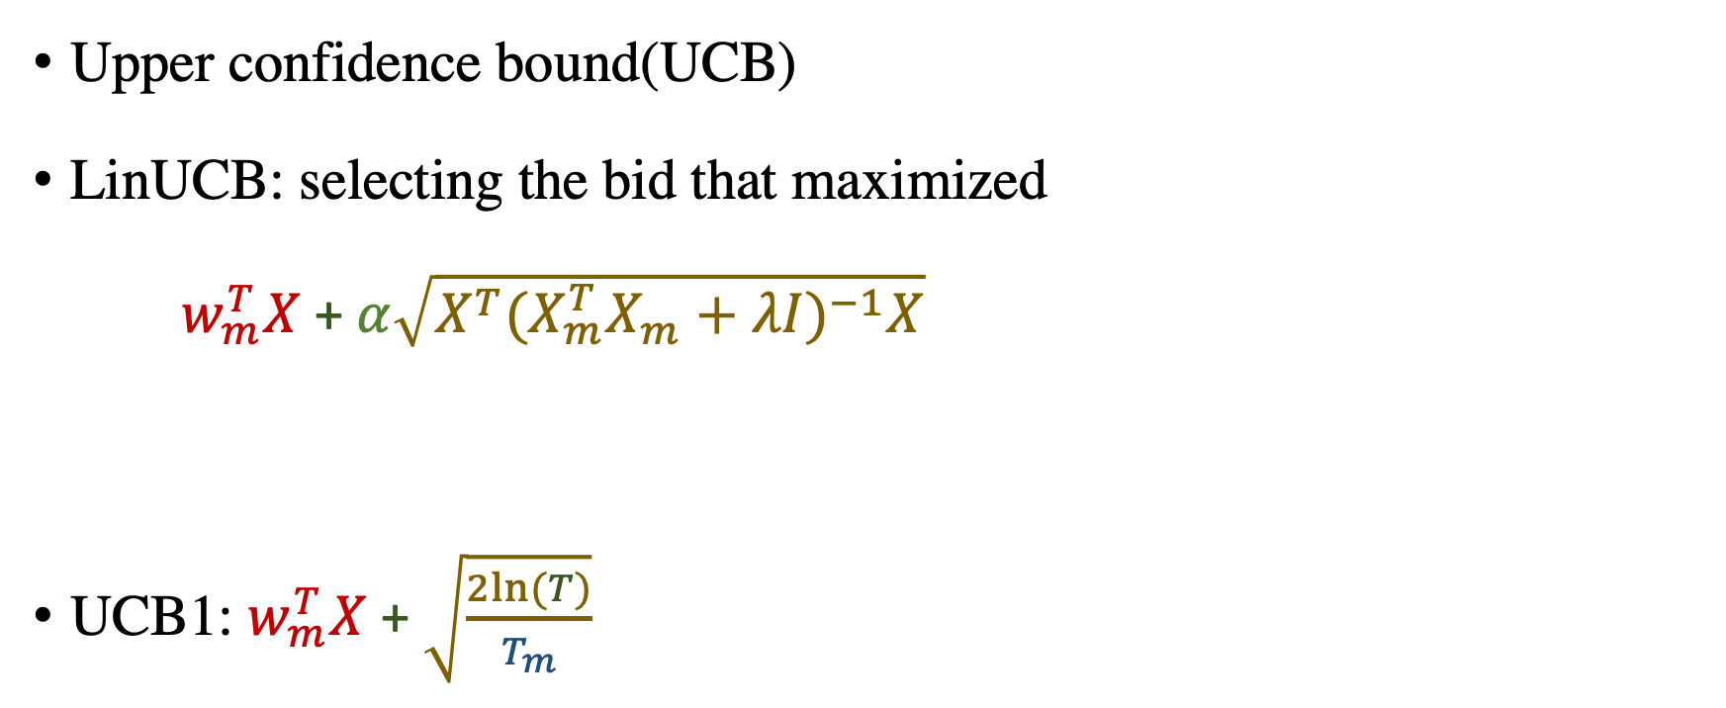


LinUCB algorithm
Upper confidence bound(UCB)
LinUCB: selecting the bid that maximized
$w_{m}^{T}X$ + $α\sqrt{X^{T}({X_{m}^{T}X_{m}+λI)}^{−1}X}$
UCB1: $w_{m}^{T}X$ + $\sqrt{\frac{2ln(T)}{T_{m}}}$
potential reward
uncertainty of X
$T:$the examples used to learn the entire g
$T_{m}:$the number of examples used to update $w_{m}$

Slide 11
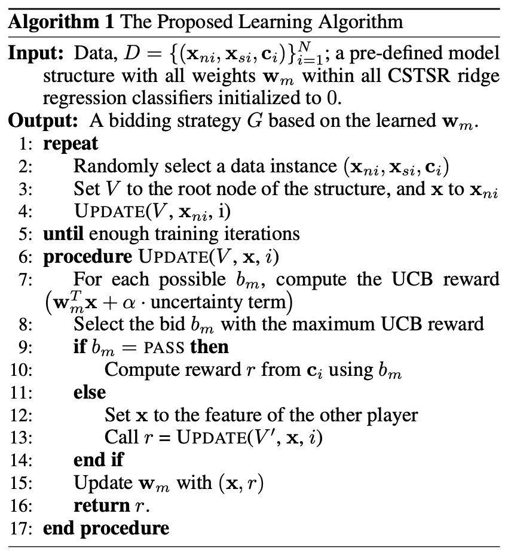
Algorithm

Slide 12
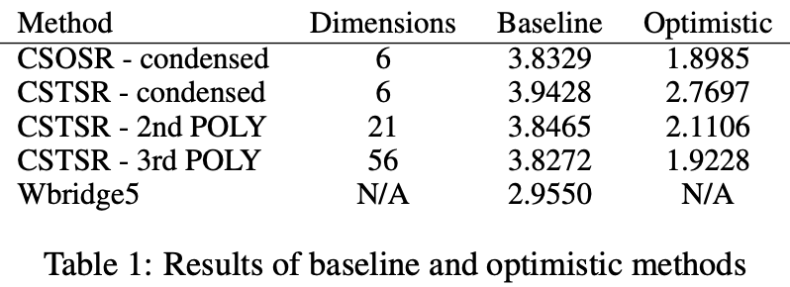


Experiments
Baseline model: $D_{base}={\{(x_{ni}, c_{i})\}}_{i=1}^{N}$
Optimistic model: $D_{cheat}={\{({[x}_{ni},x_{si}],c_{i})\}}_{i=1}^{N}$
g($X_{s}$, $b^{1}$) = PASS

Slide 13
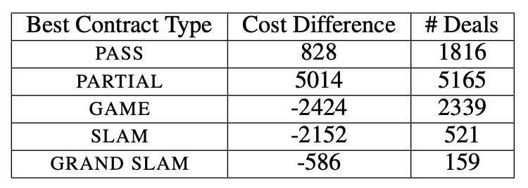
Experiments
The total cost of Wbridge5 minus the total cost of proposed model.

Slide 14
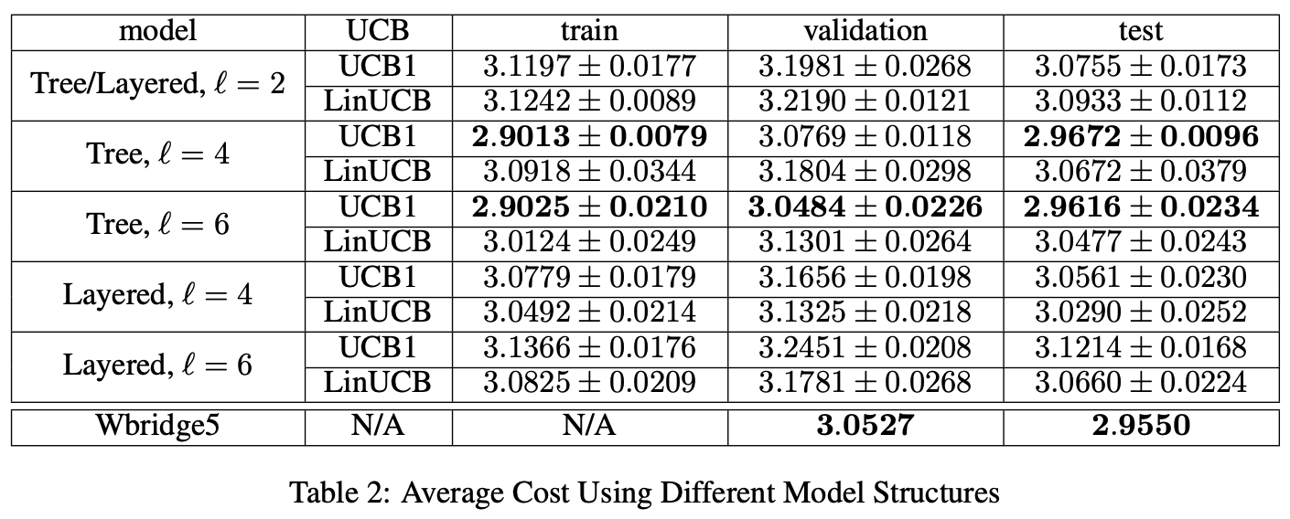
Experiments

