Slide 1
LPOD: A Local Path Based Optimized Scheduling Algorithm for Deadline-Constrained Big Data Workflows in the Cloud
Changxin Bai, Shiyong Lu, Ishtiaq Ahmed, Dunren Che and Aravind Mohan
2019 IEEE International Congress on Big Data
Presenter: Chih-Hsuan Chien​
Date: Nov. 1, 2022

Slide 2
Abstract (1/2)
List based scheduling algorithms have been proven an optimistic strategy with a shorter response time to generate feasible solutions for the workflow scheduling problem. Data-intensive and computation-intensive workflow applications have different characteristics in terms of the ratio between data transfer time and task execution time. Workflow scheduling algorithms in a cloud-based environment should adequately consider the characteristics of the underlying cloud platform such as the on-demand resource provisioning strategy, the practically unlimited compute capacities, the booting times of virtual machines, the homogeneous network and the pay-as-you-go price model to produce an optimal scheduling solution within the deadline constraint of a given workflow.

Slide 3
Abstract (2/2)
In this paper, a path based scheduling algorithm, named LPOD, is proposed to find the best workflow schedule solution with minimum monetary cost in a cloud computing environment. A series of case studies have been carefully conducted using synthetic workflows based on DATAVIEW, which is a popular open-source big data workflow management system. The experimental results show that the proposed algorithm is efficient and can generate better workflow schedules than the state-of-the-art algorithms such as IC-PCP and SGX-E2C2D.

Slide 4
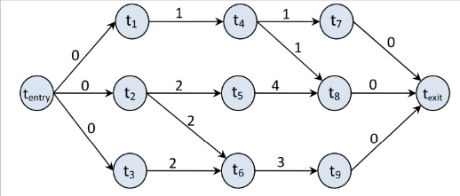
Problem
Minimize the cost with deadline δ

Slide 5
Related work
IC-PCP
SGX-E2C2D

Slide 6
Difference
Priority Rank
Path assignment

Slide 7

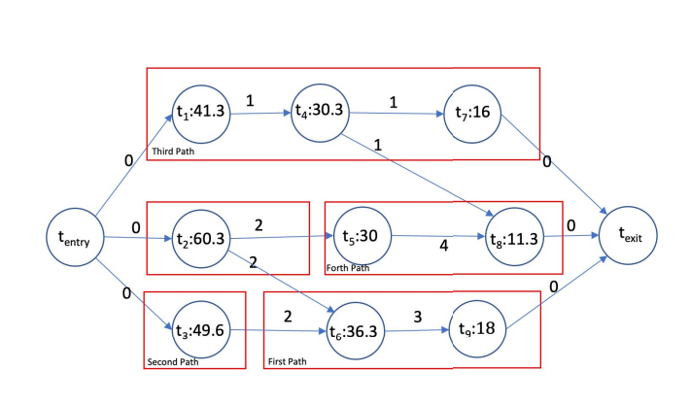
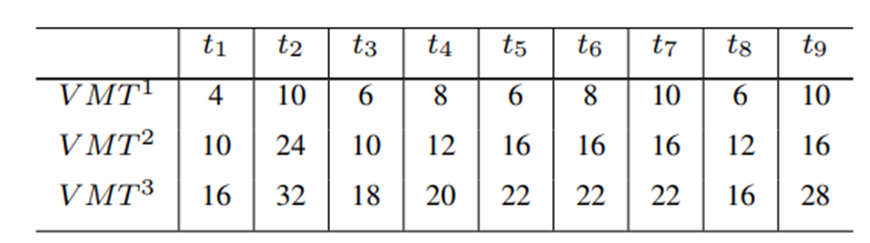
Priority Rank

Slide 8
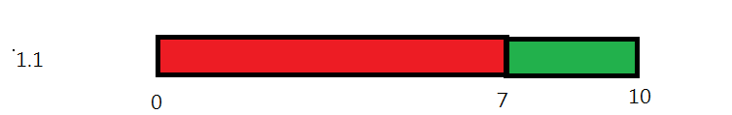
Billing cycle

Slide 9
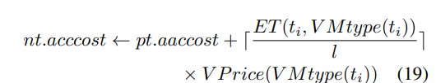
Acccost

Slide 10
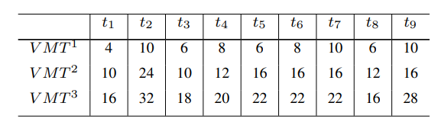
Path assignment
 | COST
VM1 | $5
VM2 | $2
VM3 | $1
TASK2 | TASK6 | TASK9 | accost
VM2 6 | VM1 11 | VM1 16 | 16
VM1 10 | VM1 10 | VM1 15 | 15

Slide 11

Performance evaluation

Slide 12
