Slide 1
A Cover-Merging-Based Algorithm for the Longest Increaing Subsequence in a Sliding Window Problem
S. Deorowicz
COMPUTING AND INFORMATICS, Vol. 31, 2013, pp. 1217~1233
Presenter: Guan-Ting Chen
Date: Nov. 29, 2022

Slide 2
Abstract
A longest increasing subsequence problem (LIS) is a well-known combinatorial problem with applications mainly in bioinformatics, where it is used in various projects on DNA sequences. Recently, a number of generalisations of this problem were proposed. One of them is to ﬁnd an LIS among all ﬁxed-size windows of the input sequence (LISW). We propose an algorithm for the LISW problem based on cover representation of the sequence that outperforms the existing methods for some class of the input sequences.

Slide 3
Longest Increasing Subsequence
A
8 | 8
3 | 3
4 | 3 | 4
1 | 1 | 4
11 | 1 | 4 | 11
2 | 1 | 2 | 11
7 | 1 | 2 | 7
9 | 1 | 2 | 7 | 9
5 | 1 | 2 | 5 | 9
12 | 1 | 2 | 5 | 9 | 12
10 | 1 | 2 | 5 | 9 | 10
6 | 1 | 2 | 5 | 6 | 10

Slide 4
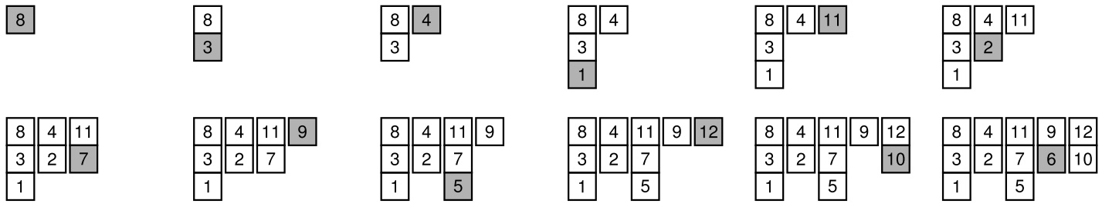
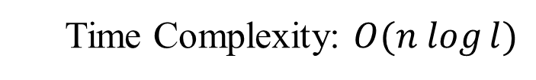
Cover-Make Algorithm
Time Complexity: $O(n log⁡l)$

Slide 5
Cover Read
Cover
8 | 4 | 11 | 9 | 12
3 | 2 | 7 | 6 | 10
1 |  | 5
Predecessor of element e
Largest element smaller than e
A = 8 3 4 1 11 2 7 9 5 12 10 6

Slide 6
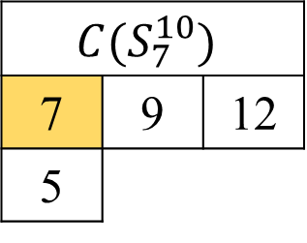
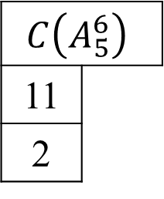
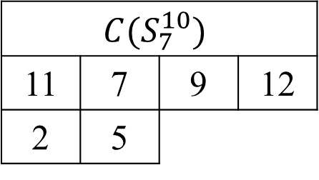
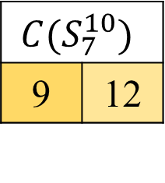
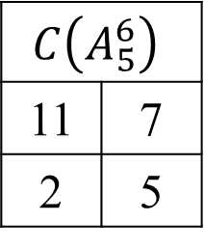
Cover-Merge
$$C\left(A_{5}^{6}\right)$$
11
2
$$C(S_{7}^{10})$$
7 | 9 | 12
5
$$C\left(A_{5}^{6}\right)$$
11 | 7
2 | 5
$$C(S_{7}^{10})$$
9 | 12
$$C(S_{7}^{10})$$
11 | 7 | 9 | 12
2 | 5

Slide 7
LIS in Sliding Windows
A | u = 6
8
3
4
1
11 | 11
2 | 2
7 | 2 | 7
9 | 2 | 7 | 9
5 | 2 | 5 | 9
12 | 2 | 5 | 9 | 12
10
6

Slide 8
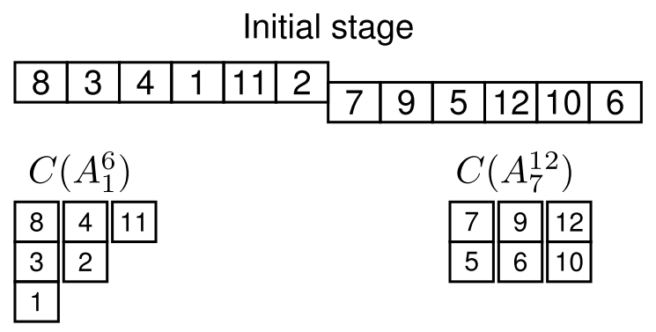
Algorithm (1 / 4)
Stop Point

Slide 9
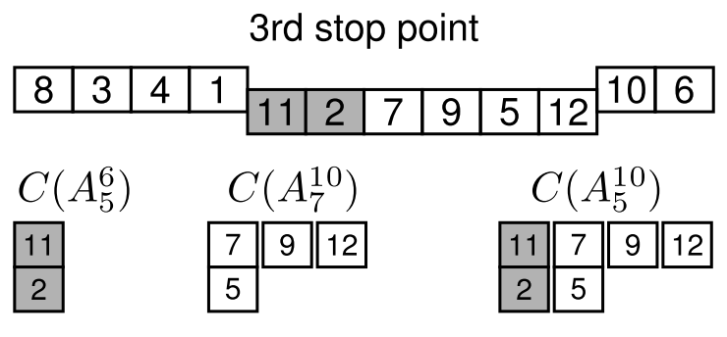
Algorithm (2 / 4)

Slide 10
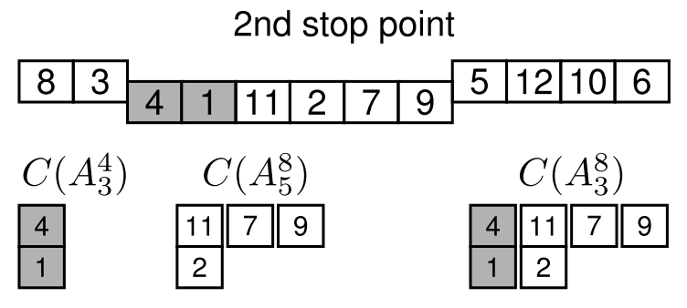
Algorithm (3 / 4)

Slide 11
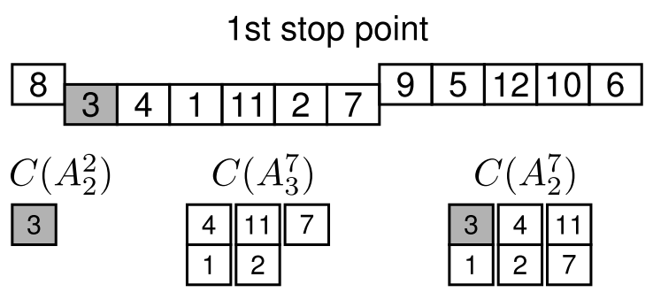
Algorithm (4 / 4)

Slide 12
General Scheme
u = 3
8 | 3 | 4 | 1 | 11 | 2 | 7 | 9 | 5 | 12 | 10 | 6

Slide 13

Conclusion
時間複雜度
$O(nl)$
限制
只能使用於兩連續子序列
優點
避免 Cover 的重複計算
適用
連續且前後相關的子序列

