Slide 1
An eﬃcient algorithm for the longest common palindromic subsequence problem
Ting-Wei Liang, Chang-Biau Yang, Kuo-Si Huang
Theoretical Computer Science 922 (2022) 475–485
Presenter: Cheng-Han Ho
Date: Nov. 28, 2022

Slide 2
Abstract (1/2)
The longest common palindromic subsequence (LCPS) problem is a variant of the longest common subsequence (LCS) problem. Given two input sequences A and B, the LCPS problem is to ﬁnd the common subsequence of A and B such that the answer is a palindrome with the maximal length. The LCPS problem was ﬁrst proposed by Chowdhury et al. (2014) , who proposed a dynamic programming algorithm with O(m²n²) time, where m and n denote the lengths of A and B, respectively.

Slide 3
Abstract (2/2)
This paper proposes a diagonal-based algorithm for solving the LCPS problem with O(L(m − L)R logn) time and O(RL) space, where R denotes the number of match pairs between A and B, and L denotes the LCPS length. In our algorithm, the 3-dimensional minima ﬁnding algorithm is invoked to overcome the domination problem. As experimental results show, our algorithm is eﬃcient practically compared with some previously published algorithms.

Slide 4


Palindrome
$w1$ = aabaa
$\tilde{w}$₁ = aabaa
$w$₁ = $\tilde{w}1$ ，w₁ is a palindrome
$w$₂ = aabbaa
$\tilde{w}$₂ = aabbaa
$w$₂ = $\tilde{w}2$ ，w₂ is a palindrome

Slide 5
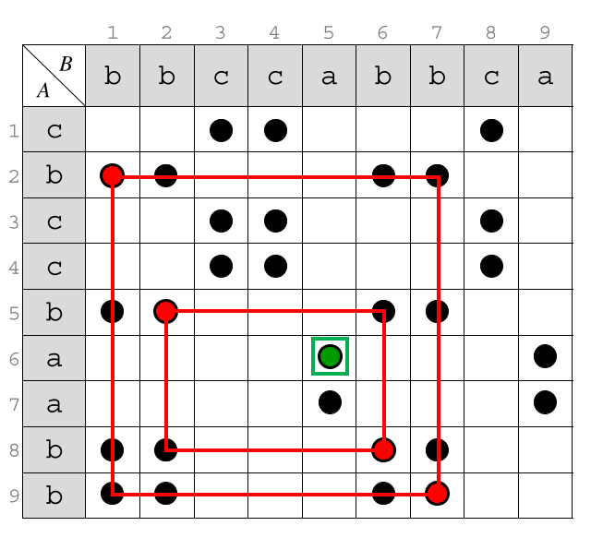
LCPS(longest common palindromic subsequence)
A = cbccbaabb
B = bbccabbca
LCPS(A, B) = bbabb

Slide 6
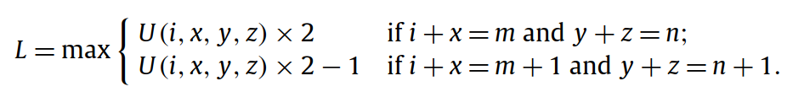

LCPS solved by FLCS (LCS with four strings)
A, $\tilde{A}$, B, $\tilde{B}$
U(i, x, y, z)
1 i x m
A
B
1 y z n

Slide 7
diagonal-based algorithm
i | 1 | 2 | 3 | 4 | 5 | 6 | 7 | 8 | 9
A | c | b | c | c | b | a | a | b | b
B | b | b | c | c | a | b | b | c | a
9-i | 9 | 8 | 7 | 6 | 5 | 4 | 3 | 2 | 1
CPS = cc
length
round
 | 0 | 1 | 2 | 3
1 | <0, 0, 0> | <6, 3, 2>
2
3
4
i <x, y, z>

Slide 8
diagonal-based algorithm
i | 1 | 2 | 3 | 4 | 5 | 6 | 7 | 8 | 9
A | c | b | c | c | b | a | a | b | b
B | b | b | c | c | a | b | b | c | a
9-i | 9 | 8 | 7 | 6 | 5 | 4 | 3 | 2 | 1
CPS = cbc
length
round
 | 0 | 1 | 2 | 3
1 | <0, 0, 0> | <6, 3, 2> | <8, 6, 3>
2
3
4

Slide 9
diagonal-based algorithm
i | 1 | 2 | 3 | 4 | 5 | 6 | 7 | 8 | 9
A | c | b | c | c | b | a | a | b | b
B | b | b | c | c | a | b | b | c | a
9-i | 9 | 8 | 7 | 6 | 5 | 4 | 3 | 2 | 1
CPS = bb
length
round
 | 0 | 1 | 2 | 3
1 | <0, 0, 0> | <6, 3, 2> | <8, 6, 3>
2 | <0, 0, 0> | <6, 3, 2> <1, 1, 3>
3
4

Slide 10
diagonal-based algorithm
i | 1 | 2 | 3 | 4 | 5 | 6 | 7 | 8 | 9
A | c | b | c | c | b | a | a | b | b
B | b | b | c | c | a | b | b | c | a
9-i | 9 | 8 | 7 | 6 | 5 | 4 | 3 | 2 | 1
CPS = ccc
length
round
 | 0 | 1 | 2 | 3
1 | <0, 0, 0> | <6, 3, 2> | <8, 6, 3>
2 | <0, 0, 0> | <6, 3, 2> <1, 1, 3> | <8, 6, 3> <7, 4, 6> <6, 3, 6>
3
4

Slide 11
diagonal-based algorithm
i | 1 | 2 | 3 | 4 | 5 | 6 | 7 | 8 | 9
A | c | b | c | c | b | a | a | b | b
B | b | b | c | c | a | b | b | c | a
9-i | 9 | 8 | 7 | 6 | 5 | 4 | 3 | 2 | 1
CPS = bccb
length
round
 | 0 | 1 | 2 | 3
1 | <0, 0, 0> | <6, 3, 2> | <8, 6, 3>
2 | <0, 0, 0> | <6, 3, 2> <1, 1, 3> | <8, 6, 3> <7, 4, 6> <6, 3, 6>
3
4

Slide 12
diagonal-based algorithm
i | 1 | 2 | 3 | 4 | 5 | 6 | 7 | 8 | 9
A | c | b | c | c | b | a | a | b | b
B | b | b | c | c | a | b | b | c | a
9-i | 9 | 8 | 7 | 6 | 5 | 4 | 3 | 2 | 1
CPS = bbbb
length
round
 | 0 | 1 | 2 | 3
1 | <0, 0, 0> | <6, 3, 2> | <8, 6, 3>
2 | <0, 0, 0> | <6, 3, 2> <1, 1, 3> | <8, 6, 3> <6, 3, 6>
3 | <0, 0, 0> | <6, 3, 2> <1, 1, 3> | <8, 6, 3> <6, 3, 6>
4 | <0, 0, 0> | <6, 3, 2> <1, 1, 3> | <8, 6, 3> <6, 3, 6> <2, 2, 4> | <3, 5, 5>

Slide 13
diagonal-based algorithm
i | 1 | 2 | 3 | 4 | 5 | 6 | 7 | 8 | 9
A | c | b | c | c | b | a | a | b | b
B | b | b | c | c | a | b | b | c | a
9-i | 9 | 8 | 7 | 6 | 5 | 4 | 3 | 2 | 1
CPS = bbabb
LCPS = bbabb
length
round
 | 0 | 1 | 2 | 3
1 | <0, 0, 0> | <6, 3, 2> | <8, 6, 3>
2 | <0, 0, 0> | <6, 3, 2> <1, 1, 3> | <8, 6, 3> <6, 3, 6>
3 | <0, 0, 0> | <6, 3, 2> <1, 1, 3> | <8, 6, 3> <6, 3, 6>
4 | <0, 0, 0> | <6, 3, 2> <1, 1, 3> | <8, 6, 3> <2, 2, 4> | <3, 5, 5>

Slide 14
Time Complexity
O(L(m − L)R logn)
length
round
 | 0 | 1 | 2 | 3
1 | <0, 0, 0> | <6, 3, 2> | <8, 6, 3>
2 | <0, 0, 0> | <6, 3, 2> <1, 1, 3> | <8, 6, 3> <6, 3, 6>
3 | <0, 0, 0> | <6, 3, 2> <1, 1, 3> | <8, 6, 3> <6, 3, 6>
4 | <0, 0, 0> | <6, 3, 2> <1, 1, 3> | <8, 6, 3> <2, 2, 4> | <3, 5, 5>

