Slide 1
Parallel Research on KMP Algorithm
Panwei Cao, Suping Wu
2011 International Conference on Consumer Electronics, Communications and Networks (CECNet),
Kirchberg, Luxembourg
Presenter: ZHI-CHENG SHEN
Date: Nov.29 , 2022

Slide 2
Abstract
The tradition pattern matching algorithm need backtrack and compare repeatedly, so that affects efficiency of algorithm . Knuth and others put forward KMP algorithm in order to promote efficiency of the pattern matching. Parallel KMP algorithm based on MPI is provided in this paper, which can get higher efficiency.

Slide 3
Introduction
Pattern matching algorithm is applied extensively in text editing, information retrieval, spell checking, dictionary-based language translation, WWW search engines, computer virus signature matching, data compression, DNA sequence matching and other computer application system.

Slide 4
MPI
大量的平行運算對電腦而言，實際上是個非常複雜及花時間的過程，因此發展了MPI(Message Passing Interface 訊息傳輸介面) ，才得以標準化平行處理計算。
MPI是一個函式庫，而不是一門語言，所以直接include進來即可使用

Slide 5
Simple Pattern Matching Algorithm
t = a b b a b a
p = a b a
Length(t) = n
Length(p) = m

Slide 6
KMP
t = a a b a a b a a f
p = a a b a a f
next[] = 0 1 0 1 2 0
When the string is very long -> behind the characters comparing of the string t need waiting -> but the front characters comparing has no irrelevant with behind the characters comparing -> means we spend a lot of time in the queue.

Slide 7
Parallel Algorithm
The consideration of solving this problem is to create ‘num’ process and divide string t into ‘num’ parts. Then each process is distributed ‘ (n/num)’ characters.
limiting conditions:
The length of the string p should be less than or equal to the length of string t.
i.e. Length(p) <= Length(t)
The length of string which is distributed to each process should be larger than
the length of p.
i.e. (n/num) >= m
Ex. t = a b b a b a num = 2
p = a b a t0 = abb, t1 = aba

Slide 8
When we disaggregate data, we encountered two problems:
After we segment the string t, we may distribute the successful matching string to the adjacent process.
Ex. t = cdefabghij, p = ab, n = 10, m = 2, num = 2
t1 = cdefa
t2 = bghij
Solution: add m-1 to the length of all processes(except last process), the length of each process is (n/num)+m-1.
new t1 = cdefab
new t2 = bghij

Slide 9
2. If n is not a multiple of num:
Ex. n = 1024, num = 10, 1024/10 = 102…4
In this paper, we first assign n/num=102 characters to each process, and then assign one more character to former four process, so now the string length of four former process is 103, and the string length of remaining process is 102.
i.e. 前四組每組有103個字元，剩下的六組每組維持102個字元

Slide 10
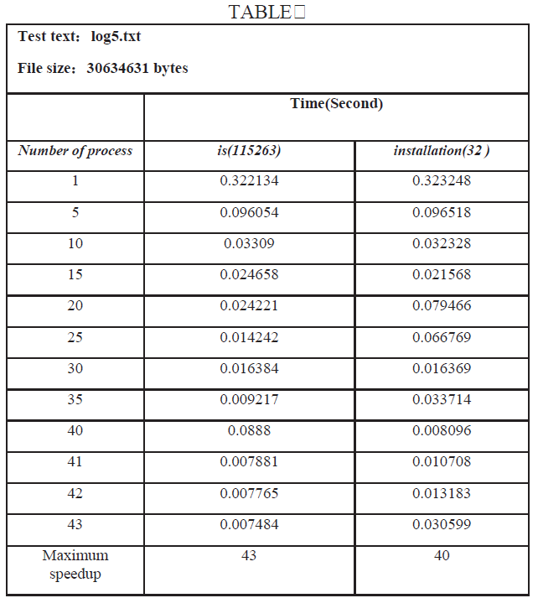
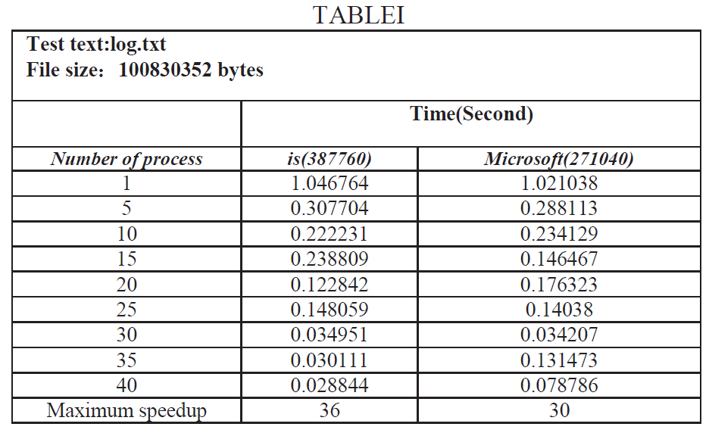
Experimental Results
Operation platform:Intel® Core™2 Quad-cores processors.4G memory.Software environment:Windows XP.

Slide 11
Results analysis
With the increasing of search process number, the time for searching the target string is reduced. Actually, the speedup is not unlimited as the process increases. Under hardware conditions of this paper, we can achieve satisfactory results within 40 processes, but if more than 50
processes,communication error will occur.

Slide 12
Conclusion
We combine with MPI and KMP algorithm in this paper, using MPI's Multi-process to parallel KMP algorithm. By reducing the time waiting for matching, to improves the string matching efficiency.

Slide 13
Thanks~

