Slide 1
Internet Packet Filter Management and Rectangle Geometry
David Eppstein, S. Muthukrishnan
12th Annual ACM-SIAM Symposium on Discrete Algorithms, Washington, D.C., USA
pp. 827–835, 2001
Presenter: Tsung-Lin Lu
Date: Dec. 7, 2022

Slide 2
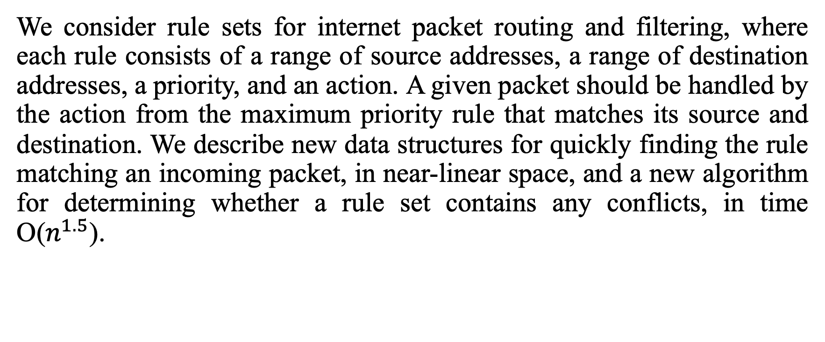
Abstract
We consider rule sets for internet packet routing and filtering, where each rule consists of a range of source addresses, a range of destination addresses, a priority, and an action. A given packet should be handled by the action from the maximum priority rule that matches its source and destination. We describe new data structures for quickly finding the rule matching an incoming packet, in near-linear space, and a new algorithm for determining whether a rule set contains any conflicts, in time O($n^{1.5}$).

Slide 3
Outline
Packet Filter Management Problem
Filter Conflict Detection Problem
Two Packet Classification
1. Persistent Interval Queries
2. Static to Dynamic Transformation
Filter Conflict Detection Problem
1. Lower Envelopes, MST Verification
2. Stripes
3. KD-Tree
Complexity

Slide 4
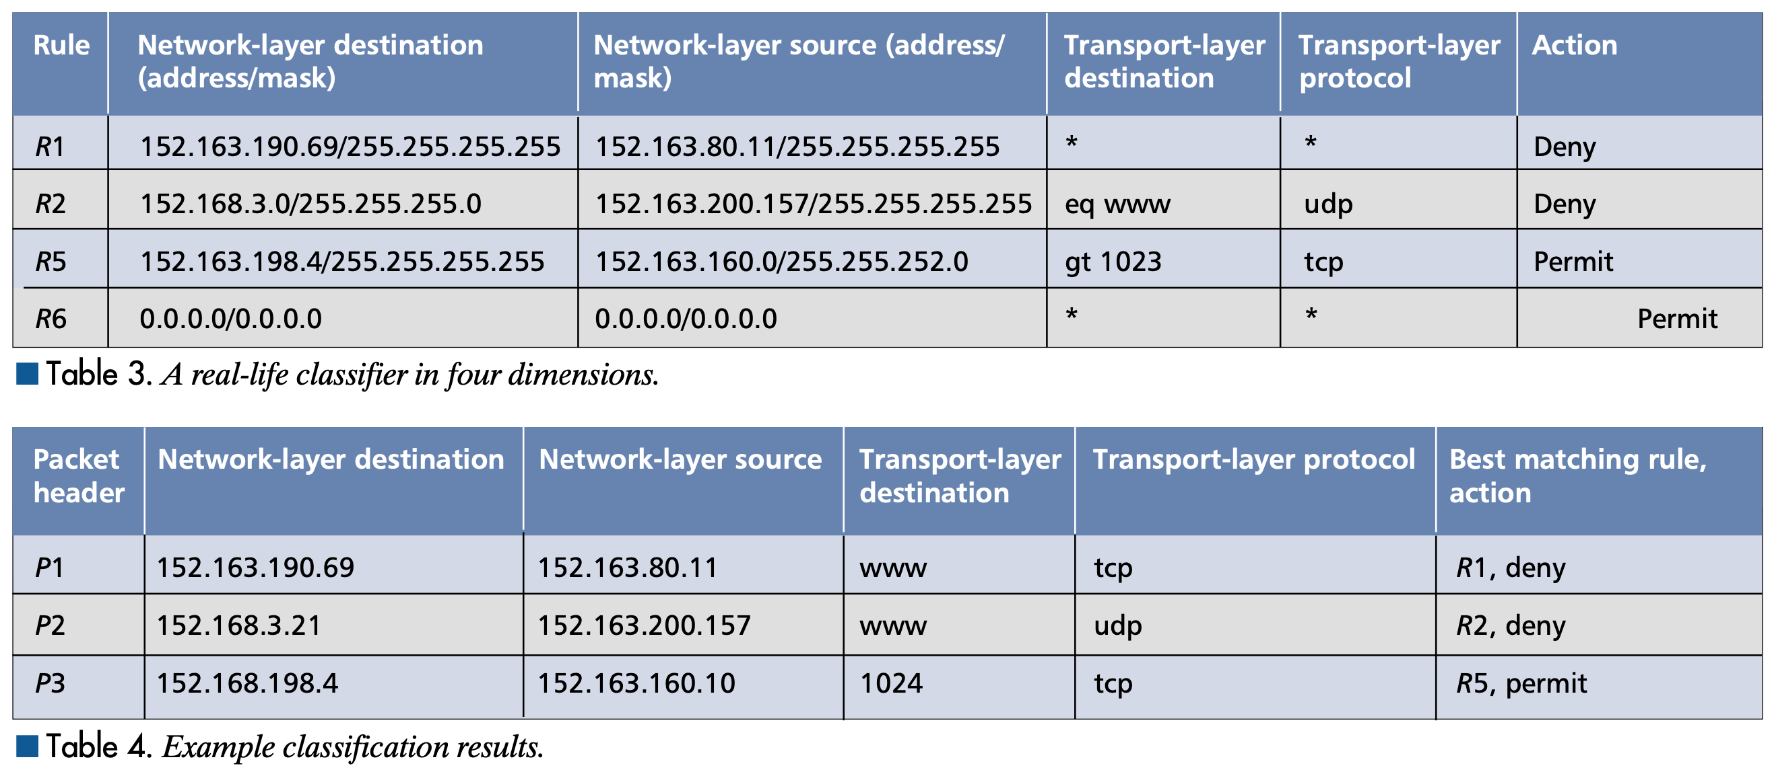
Packet Filter Management Problem (1/2)

Slide 5
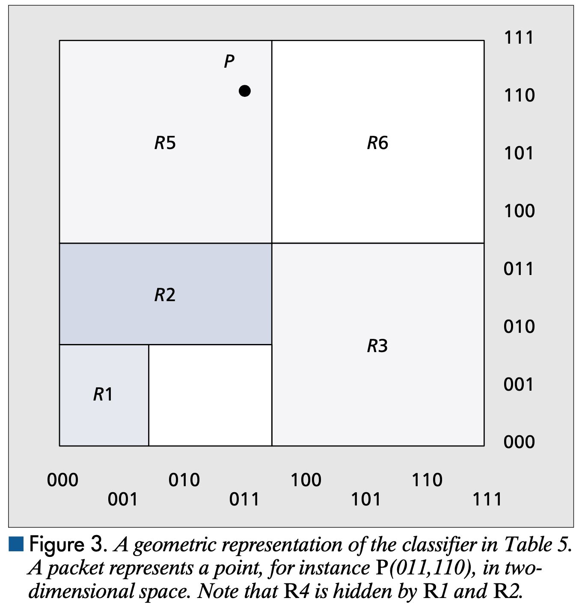
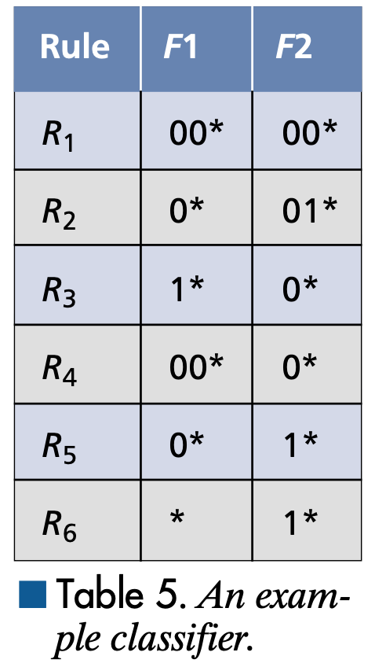
Packet Filter Management Problem (2/2)
Determine the filter of highest priority that applies to P

Slide 6
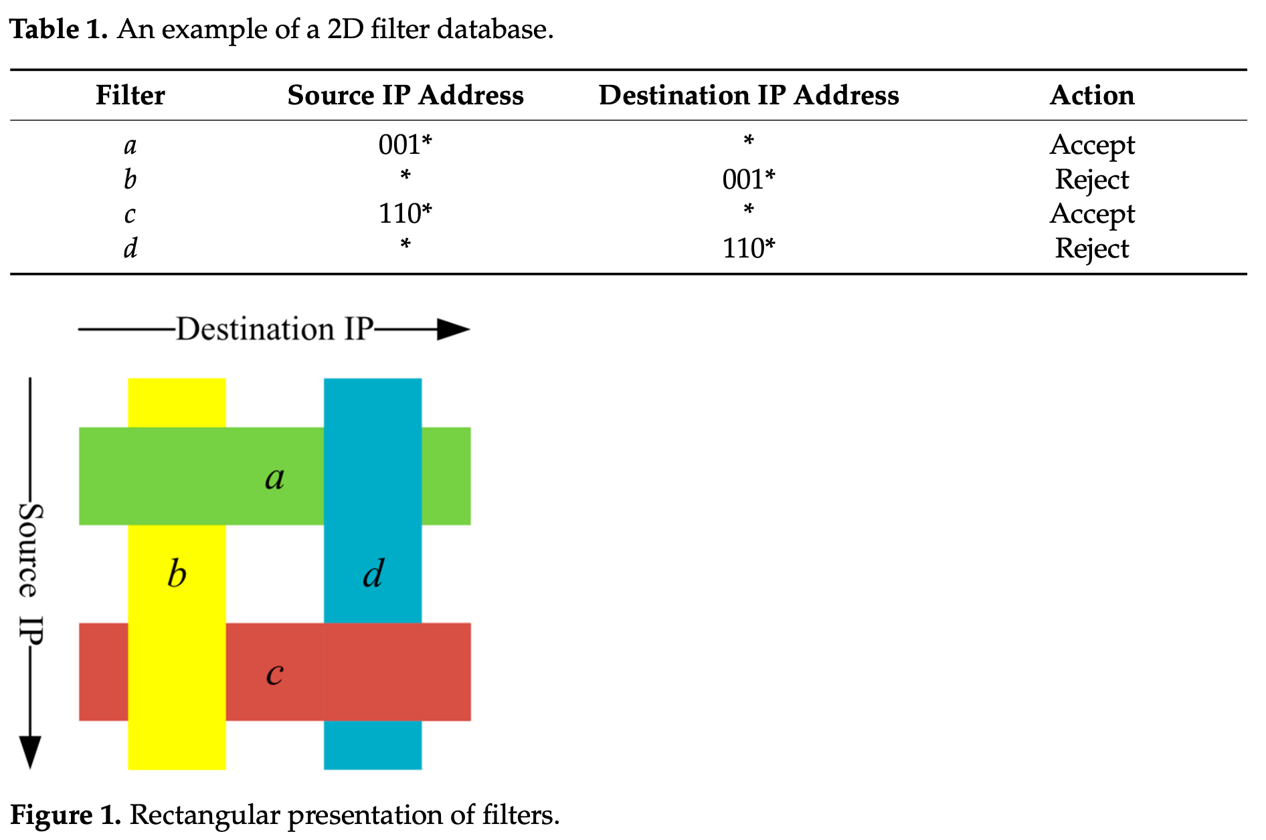
Filter Conflict Detection Problem
Given a database F of filters, determine if there exists any packet P such that of the filters of the highest priority that apply to P, any two of them specify actions that conflict.
Conflict
Conflict

Slide 7
Two Packet Classification
Our approach to solving the two packet classification relies on a standard plane-sweep approach to turn the static two-dimensional rectangle query problem into a dynamic one-dimensional problem, in which we maintain a dynamic set of intervals and must again query the maximum priority set element containing a query point.
This one-dimensional problem must be solved persistently, so we can query previous versions of the data structure after the plane sweep has occurred. We solve this persistent one-dimensional problem using a data structure combining ideas from B-trees and segment trees.

Slide 8
1. Persistent Interval Queries (1/2)
 | 0
opt | R1
pq | <R1, R2, R5>
subblock | (0,3)
(0,U) = (0,31) → 2^{k} bocks
i | 0 | 1 | 2 | 3 | 4 | 5 | 6 | 7
Block | (0,3) | (4,7) | (8,11) | (12,15) | (16,19) | (20,23) | (24,27) | (28,31)
opt | Pointers to the maximum-priority interval in the dynamic set that contains subinterval i.
pq | Pointers to priority queue data structures for the intervals containing subinterval i.
subblock | Pointers to blocks representing the subset of dynamic intervals having endpoints in subinterval i.

Slide 9
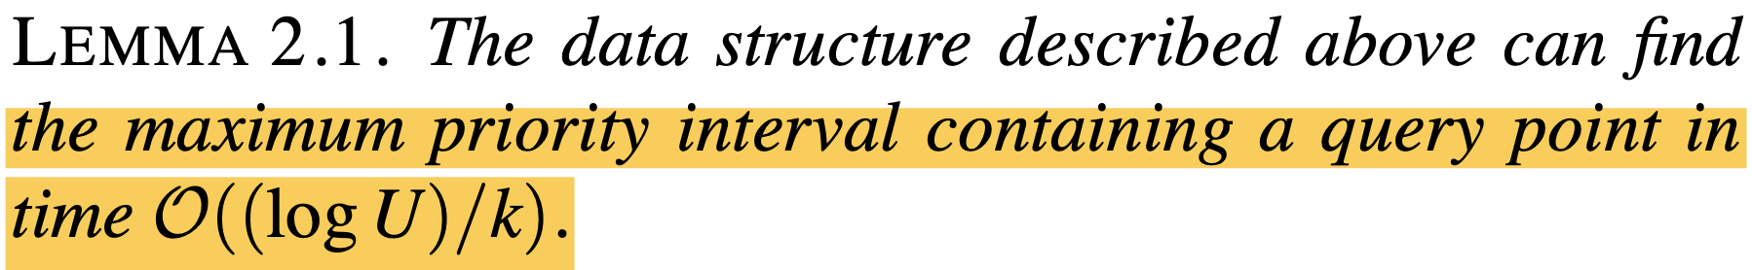
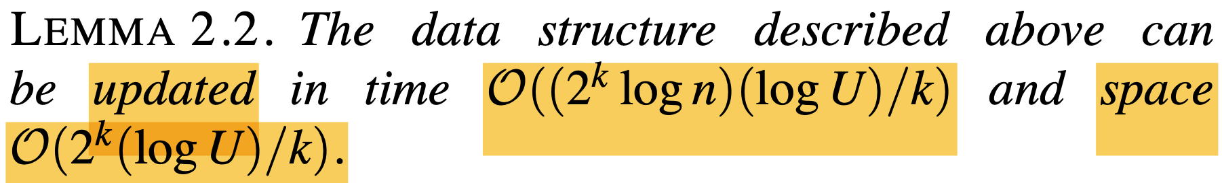
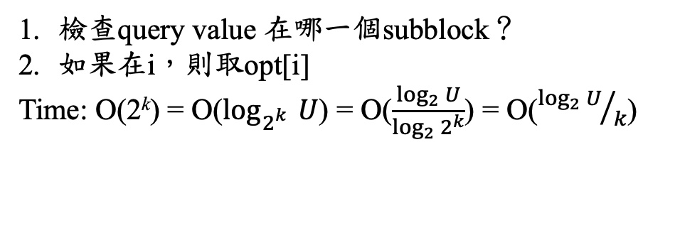
1. Persistent Interval Queries (2/2)
s
檢查query value 在哪一個subblock？
如果在i，則取opt[i]
Time: O(2^{k}) = O($\log_{2_{}^{k}}{U}$) = O($\frac{\log_{2}{U}}{\log_{2}{2^{k}}}$) = O(${\log_{2}{U}}/k$)
最多會新增O(2(log U)/k)個blocks，故會佔用O(2^{k}(log U)/k) space
會更新O(2^{k}(log U)/k)個priority queue，故會花O(log n (2^{k}(log U)/k)) time

Slide 10
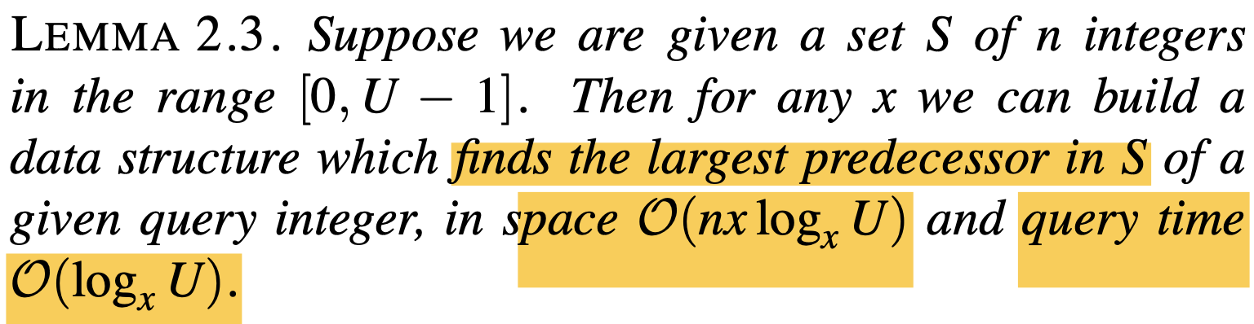
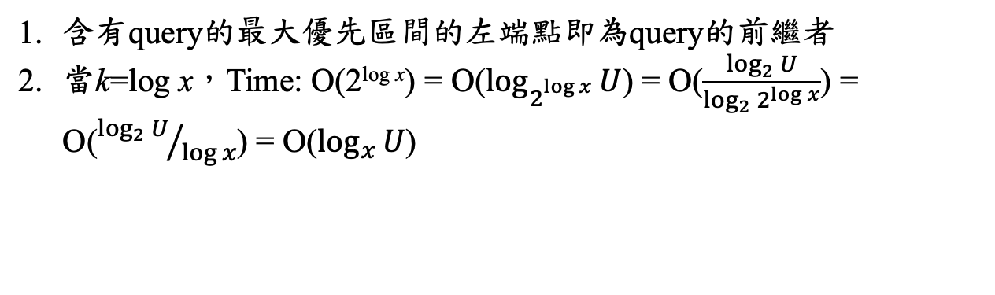
2. Static to Dynamic Transformation (1/2)
s
含有query的最大優先區間的左端點即為query的前繼者
當k=log x，Time: O(2^{log x}) = O($\log_{2_{}^{log x}}{U}$) = O($\frac{\log_{2}{U}}{\log_{2}{2^{\log{x}}}}$) = O(${\log_{2}{U}}/{\log{x}}$) = O($\log_{x}{U}$)

Slide 11
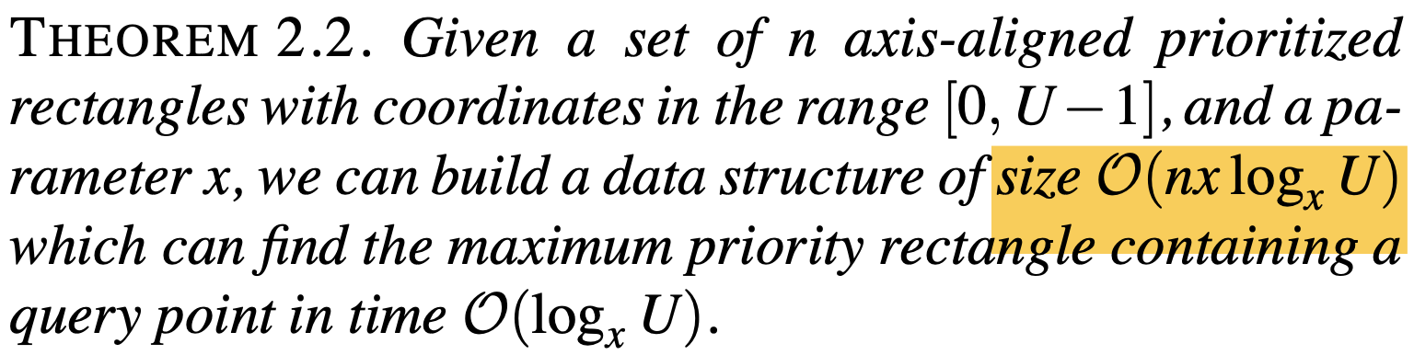
2. Static to Dynamic Transformation (2/2)
s

Slide 12
Filter Conflict Detection Problem
Our approach to the filter conflict detection problem uses a kD-tree to divide the plane into rectangular cells, not containing any rectangle vertex, so that the rectangles intersecting any cell form stripes (i.e., rectangles that are unbounded in one dimension).
The conflict detection problem can thus be reduced to determining a lower envelope of line segments, which can also be interpreted data structurally as an offline priority queue problem or graph theoretically as a minimum spanning tree verification problem. We solve this subproblem efficiently using a linear-time union-find data structure.

Slide 13
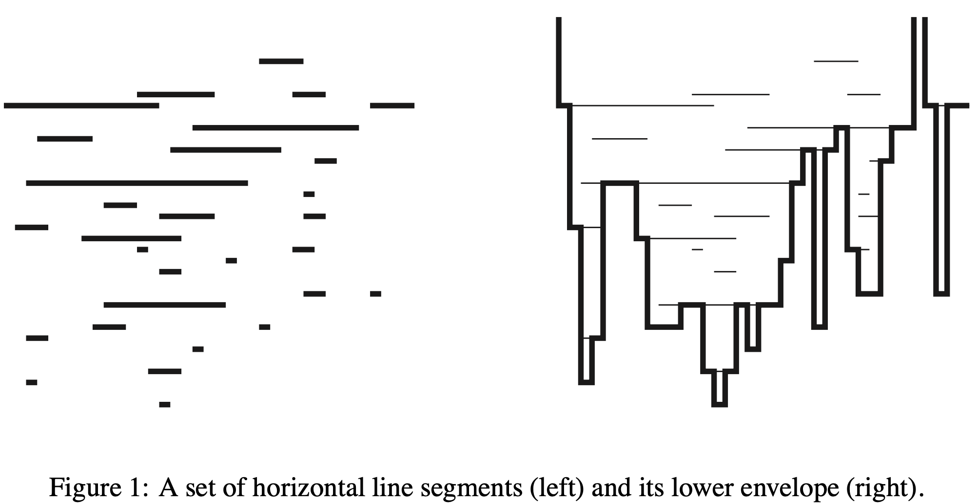
1. Lower Envelopes, MST Verification

Slide 14
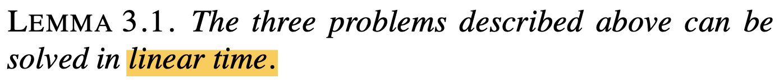
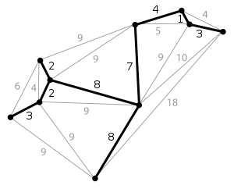
1. Lower Envelopes, MST Verification
s
Given is a graph, in which the minimum spanning tree is a given path, and in which all edges have weights in the set {0, 1, . . . n−1}.
How quickly can one determine, for each edge in the path, which edge would replace it in the MST if the path edge were deleted?
Lower Envelopes | MST Verification
x of left endpoints | 1st vertex (according to the path order)
x of right endpoints | 2nd vertex
y of line segments | weight of the non-MST edges in the graph

Slide 15
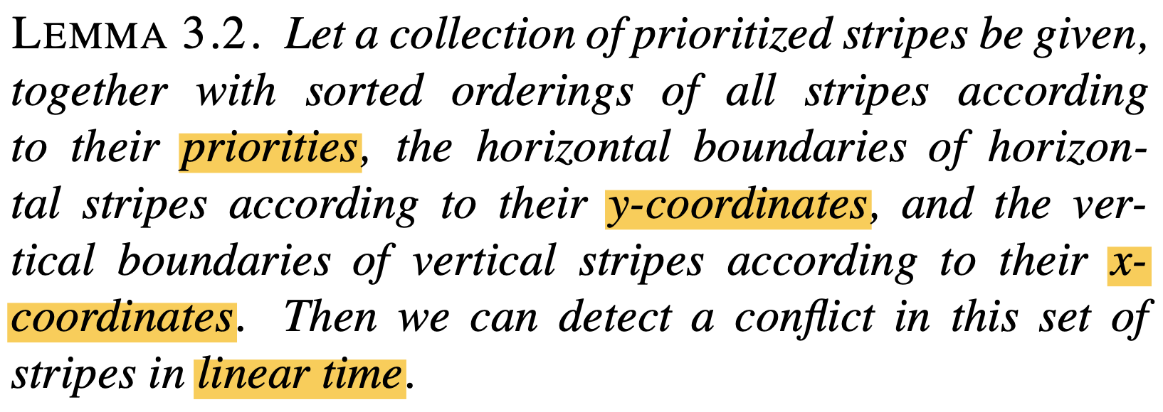
2. Stripes
s

Slide 16
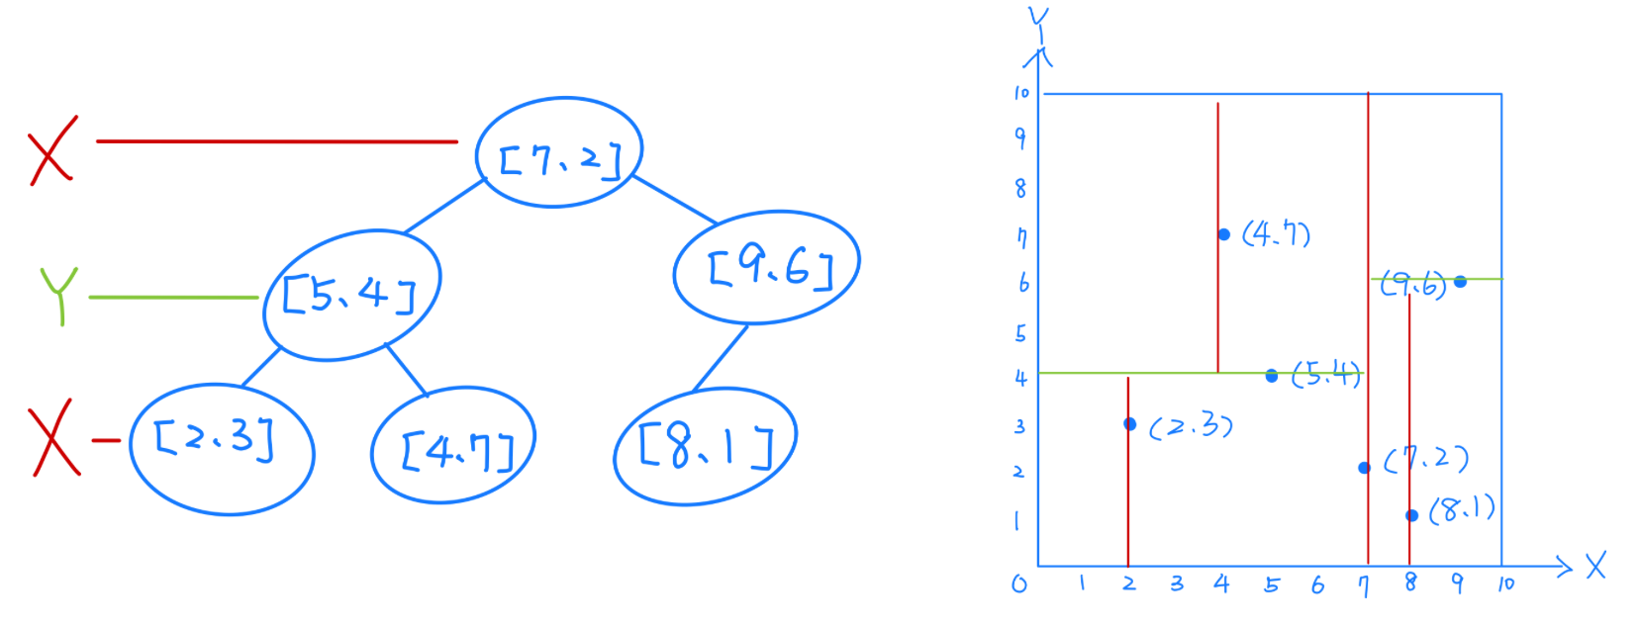
3. KD-Tree (1/4)
KD-Tree Ref.

Slide 17
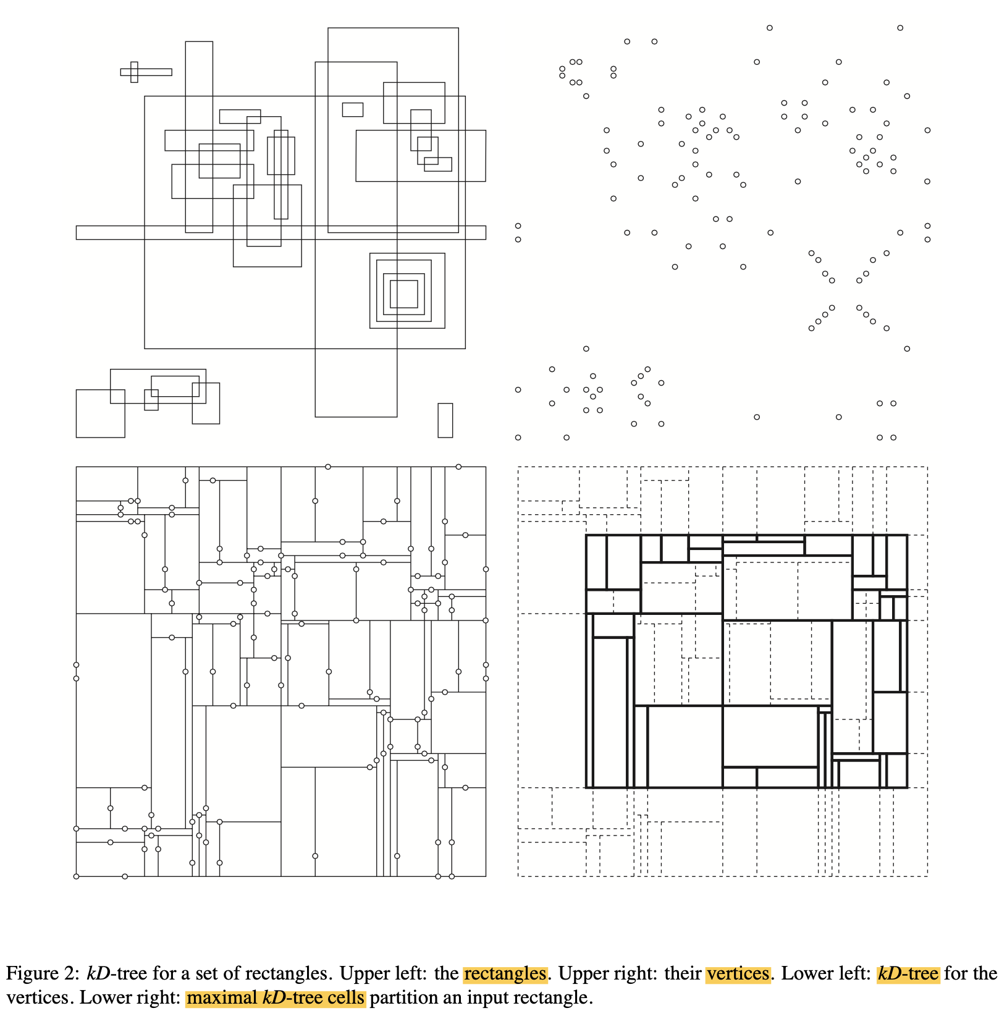
3. KD-Tree (2/4)
(a)
(b)
(a)
(b)

Slide 18
3. KD-Tree (3/4)
(c)
(d)
(c)
(d)

Slide 19
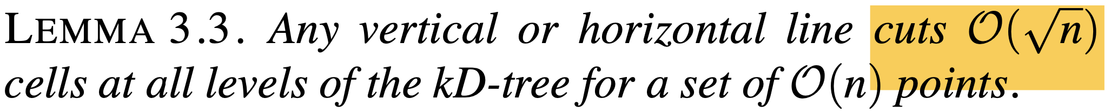
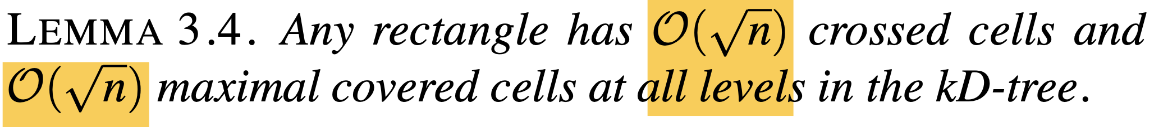
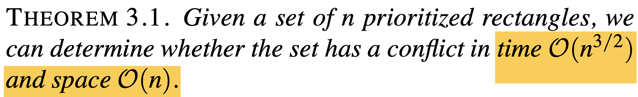
3. KD-Tree (4/4)
因為kD-tree的層數為O(log n)
The bound on the number of crossed cells follows immediately from Lemma 3.3.
Since the leaf cells contain no rectangle corners, each rectangle acts like a stripe within any such cell: it extends either the full width or the full height of the cell
遍歷格子時執行的所有操作所花費的時間與穿過格或最大覆蓋格的矩形數量成線性關係，因此根據引理 3.4，總時間為 O(n^{1.5})。

Slide 20
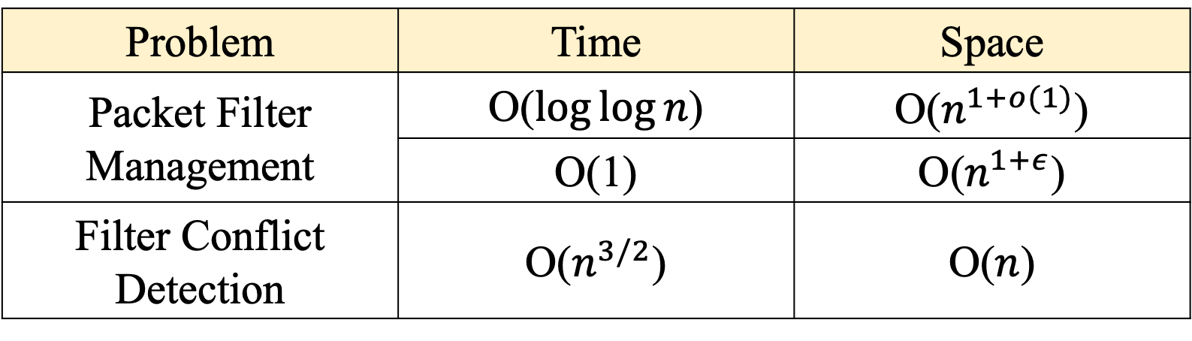
Complexity
Problem | Time | Space
Packet Filter Management | O($\log{\log{n}}$) | O($n^{1+o(1)}$)
 | O(1) | O($n^{1+ε}$)
Filter Conflict Detection | O($n^{3/2}$) | O($n$)

Slide 21
Thank you for listening

Slide 22
Abstract
s

