Slide 1
Multivariate Fine-Grained Complexity of Longest Common Subsequence
Karl Bringmann, Marvin K¨unnemann
SODA '18: Proceedings of the Twenty-Ninth Annual ACM-SIAM Symposium on Discrete Algorithms
New Orleans, Louisiana , USA, January 2018, Pages 1216–1235
Presenter: Chien-Ting Lee
Date: Dec. 15, 2022

Slide 2
Abstract(1/5)
We revisit the classic combinatorial pattern matching problem of finding a longest common subsequence (LCS). For strings x and y of length n, a textbook algorithm solves LCS in time O(n²), but although much effort has been spent, no O(n^{2−ε} )-time algorithm is known. Recent work indeed shows that such an algorithm would refute the Strong Exponential Time Hypothesis (SETH).

Slide 3
Abstract(2/5)
Despite the quadratic-time barrier, for over 40 years an enduring scientific interest continued to produce fast algorithms for LCS and its variations. Particular attention was put into identifying and exploiting input parameters that yield strongly subquadratic time algorithms for special cases of interest, e.g., differential file comparison. This line of research was successfully pursued until 1990, at which time significant improvements came to a halt. In this paper, using the lens of fine-grained complexity, our goal is to (1) justify the lack of further improvements and (2) determine whether some special cases of LCS admit faster algorithms than currently known.

Slide 4
Abstract(3/5)
To this end, we provide a systematic study of the multivariate complexity of LCS, taking into account all parameters previously discussed in the literature: the input size n := max{|x|, |y|}, the length of the shorter string m := min{|x|, |y|}, the length L of an LCS of x and y, the numbers of deletions δ := m − L and ∆ := n − L, the alphabet size, as well as the numbers of matching pairs M and dominant pairs d. For any class of instances defined by fixing each parameter individually to a polynomial in terms of the input size, we prove a SETH-based lower bound matching one of three known algorithms (up to lower order factors of the form n^{o(1)}).

Slide 5
Abstract(4/5)
Specifically, we determine the optimal running time for LCS under SETH as (n + min{d, δ∆, δm})^{1±o(1)}. Polynomial improvements over this running time must necessarily refute SETH or exploit novel input parameters. We establish the same lower bound for any constant alphabet of size at least 3. For binary alphabet, we show a SETH-based lower bound of (n + min{d, δ∆, δM/n})^{1−o(1)} and, motivated by difficulties to improve this lower bound, we design an O(n+δM/n)-time algorithm, yielding again a matching bound.

Slide 6
Abstract(5/5)
We feel that our systematic approach yields a comprehensive perspective on the well-studied multivariate complexity of LCS, and we hope to inspire similar studies of multivariate complexity landscapes for further polynomialtime problems.
Notes:
最長公共子序列的多變量細粒度複雜度是指在計算最長公共子序列時，考慮多個變量的影響，並對這些變量進行細分。這可以幫助我們更精確地估算最長公共子序列的複雜度，從而改進演算法的性能。
例如，在計算兩個字符串的最長公共子序列時，可以考慮字符 串長度、字符集大小以及字符串中相同字符的數量等變量。這些變量都會對最長公共子序列的演算法複雜度產生影響，因此我們可以通過多變量細粒度複雜度來更精確地估計演算法的性能。
這種方法可以幫助研究人員更好地理解 LCS 的複雜性，並提供更準確的複雜度預測方法

Slide 7
3-SAT
Definition:
A Boolean formula is in 3CNF if it is of the form C1 ∧ C2 ∧ · · · ∧ Cn where each Ci is an ∨ of three or less literals.
Example:
(x1 v x2 v x3 ) ^ (x4 v !x5 v x6) ^ ... ^ (x2 v !x4 v x6)
brute-force:O(2^{n})

Slide 8
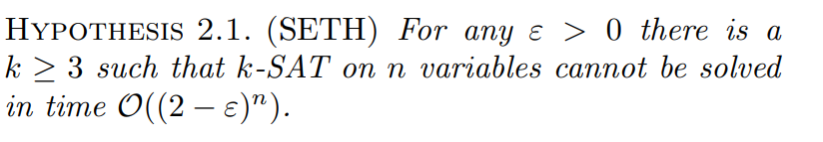
Strong Exponential Time Hypothesis (SETH)
Notes:
ep.sə.lɑːn

Slide 9
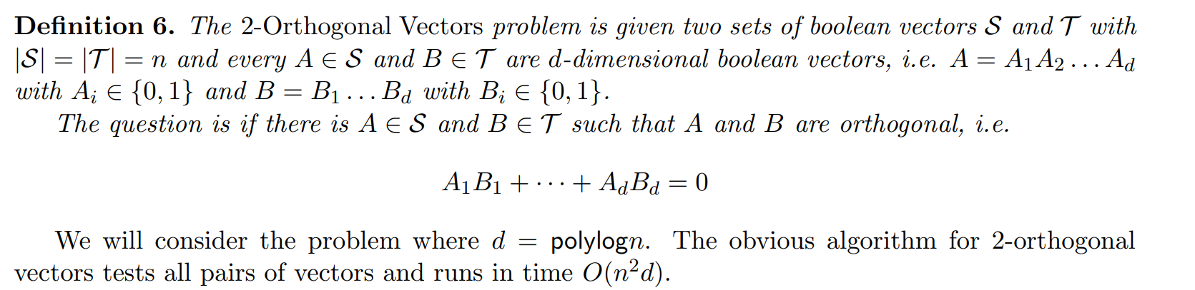
2-Orthogonal Vector Problem (OV)
Notes:
正交向量問題

Slide 10
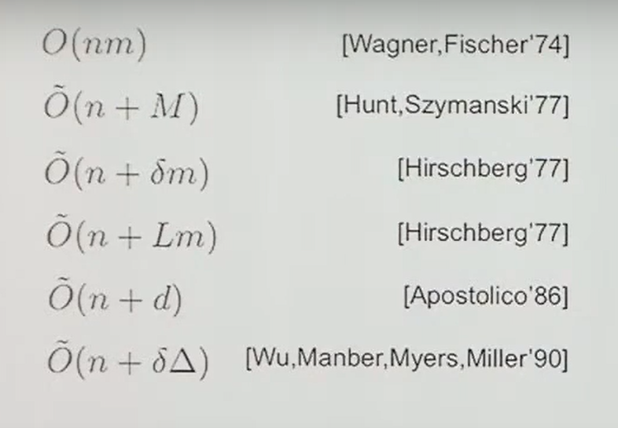
Know Algorithms

Slide 11
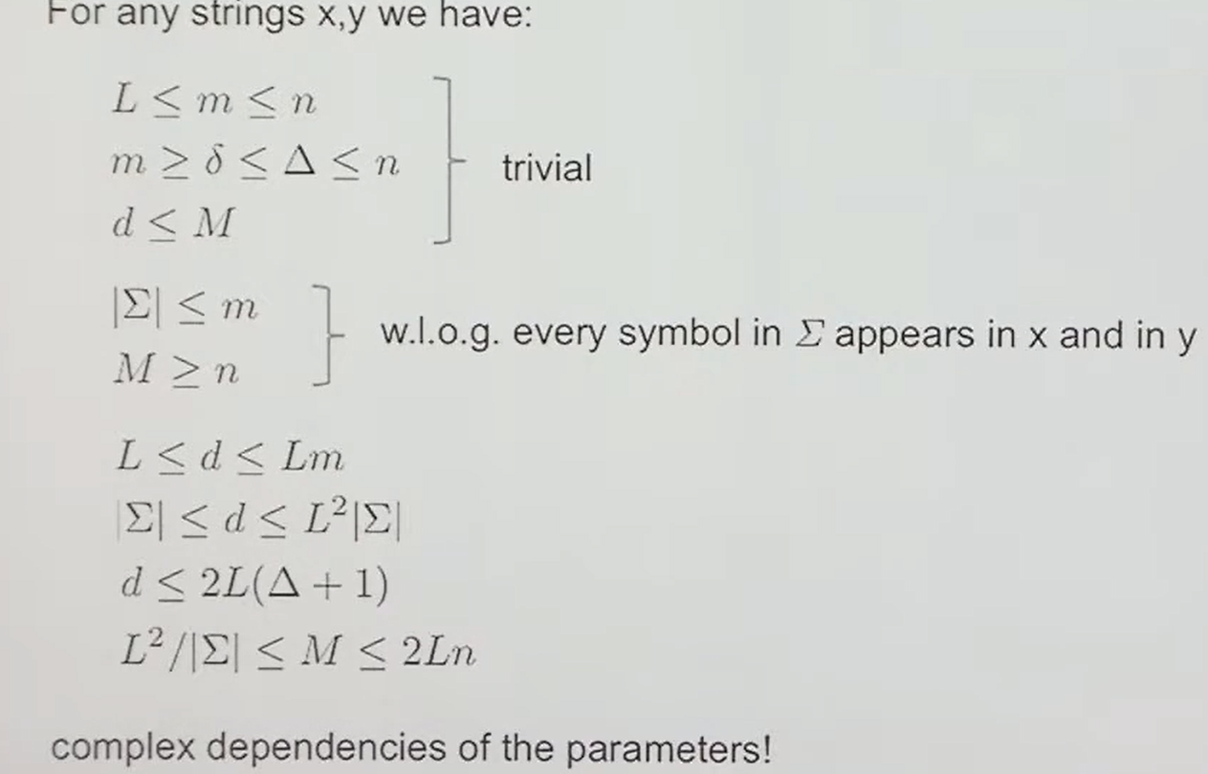
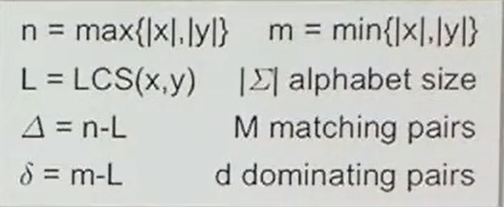
Parameter Realation

Slide 12


Know algorithms

Slide 13

Results for Alphabet Size
|Σ| = 2:$\tilde{O}\left(n+δM/n\right)$
large alphabets: $\tilde{O}\left(n+min(d,δm,δΔ)\right)$

Slide 14
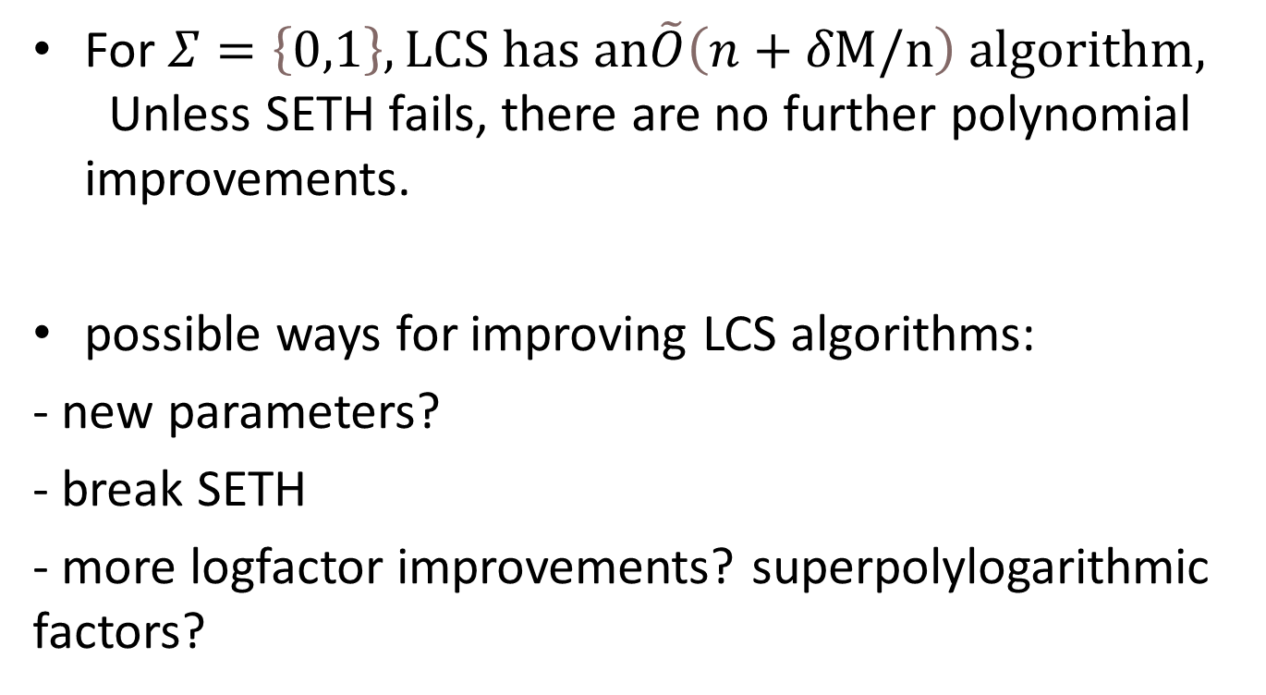
Conclusion
For $Σ=\left\{0,1\right\},LCS has an\tilde{O}\left(n+δM/n\right) algorithm,$Unless SETH fails, there are no further polynomial improvements.
possible ways for improving LCS algorithms:
- new parameters?
- break SETH
- more logfactor improvements? superpolylogarithmic factors?
Notes:
對於長度為 n 的字符串 x 和 y，經典的演算法可以在 O(n^2) 的時間內解決最長公共子序列（LCS）問題。雖然已經有很多工作致力於這個問題，但目前並沒有人知道如何構造一個時間複雜度為 O(n^2-ε) 的演算法。最近的研究表明，如果能夠構造出這樣的演算法，就會否定強指數時間假設（SETH）。

Slide 15
參考資料
https://www.youtube.com/watch?v=HN_ZV-LXZoI&ab_channel=SimonsInstitute
https://www.youtube.com/watch?v=wQWZW6oIqn8&t=410s&ab_channel=IGAFIT
https://www.youtube.com/watch?v=XCoCiXIShyk&ab_channel=SimonsInstitute

