Slide 1
MOODS: fast search for position weight matrix matches in DNA sequences
Janne Korhonen, Petri Martinmaki, Cinzia Pizzi, Pasi Rastas and Esko Ukkonen
BIOINFORMATICS Vol. 25 no. 23 2009, pages 3181–3182
Presenter: Kai-Yu Chen
Date: Mar. 9, 2010

Slide 2
ABSTRACT
Summary: MOODS (Motif Occurrence Detection Suite) is a software package for matching position weight matrices against DNA sequences. MOODS implements state-of-the-art online matching algorithms, achieving considerably faster scanning speed than with a simple brute-force search. MOODS is written in C++, with bindings for the popular BioPerl and Biopython toolkits. It can easily be adapted for different purposes and integrated into existing workflows. It can also be used as a C++ library.

Slide 3
INTRODUCTION
Position weight matrices (PWMs), also known as position-specific scoring matrices or weighted patterns are a simple, yet important model for signals in biological sequences
They are widely used to model transcription factor （轉錄因子） binding sites in the DNA.
PWM search algorithms can be roughly categorized into two groups, the index-based algorithms and the online algorithms

Slide 4
INTRODUCTION
The index-based algorithms preprocess the target sequence into an index structure, typically a suffix tree or a suffix array, and use the index structure to facilitate quick search for matrix matches.
The online algorithms perform a simple sequential search over the target sequence.
Index-based algorithms require a large amount of time and space for the construction of the index structure.

Slide 5
ALGORITHMS AND IMPLEMENTATION
The core of MOODS is formed by the search algorithms themselves , implemented in C++ and making use of the C++ Standard Template Library. The package contains the following algorithms described and experimentally compared in detail in Pizzi et al. (2009):
The naive super-alphabet algorithm (NS)
The lookahead filtration algorithm (LF) and its multi-matrix version [multi-matrix lookahead filtration algorithm (MLF)].

Slide 6
naive algorithm (NA)
The naive super-alphabet algorithm (NS), which is as the naive matching algorithm, but uses a large alphabet consisting of tuples of original alphabet symbols. It works well for very long matrices.
Ex.
ACCCG
ACCGT
S= CACTCGT
Binding
sites
k=3
ACTAT
0 0 2 0 0 =2
3 3 1 1 1 =9
3 | 0 | 0 | 1 | 0 | A
0 | 3 | 2 | 1 | 0 | C
0 | 0 | 0 | 1 | 1 | G
0 | 0 | 1 | 0 | 2 | T
0 0 2 1 2 =5
PWM

Slide 7
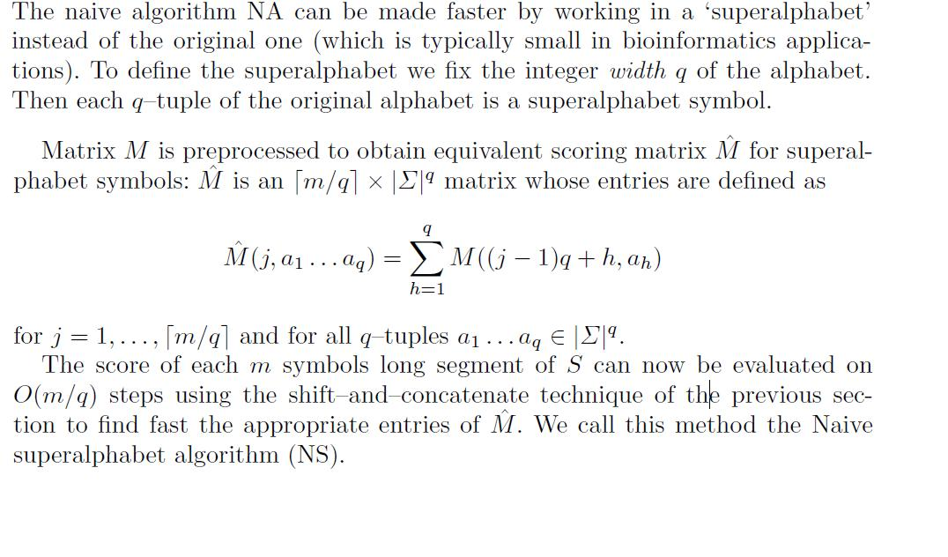
naive super-alphabet algorithm (NS)

Slide 8
lookahead filtration algorithm (LF)
The general idea of filtration algorithms is to evaluate an upper bound for the score of each m–segment of S instead of the accurate score.
Whenever the upper bound value is ≥ k, we know that also the score itself may be ≥ k.
But if the upper bound is < k, we know for sure that the score itself must be less than k, checking is not needed, and we can continue immediately to the next segment.
multi-matrix lookahead filtration algorithm (MLF)

Slide 9
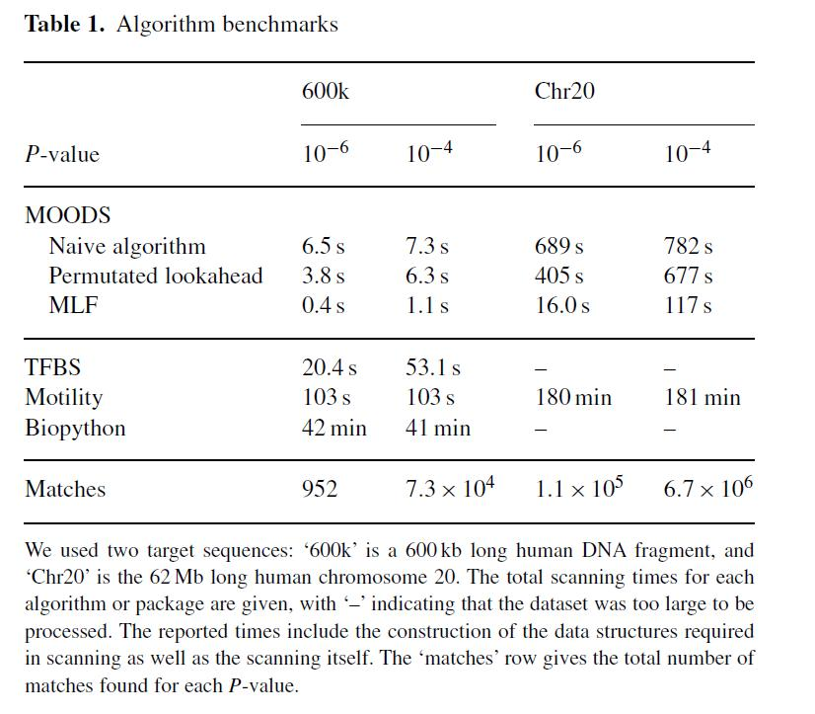
DISCUSSION

