Slide 1
A linear-time algorithm for paired-domination problem in strongly chordal graphs
Lei Chen , Changhong Lu, Zhenbing Zeng Information Processing Letters 110 (2009) 20–23
Presenter: Siao-ming Jhou
Date: Mar. 9, 2010

Slide 2
ABSTRACT
Let G = (V , E) be a simple graph without isolated vertices. A vertex set S ⊆ V is a paired-dominating set if every vertex in V − S has at least one neighbor in S and the induced subgraph G[S] has a perfect matching. In this paper, we present a linear-time algorithm to find a minimum paired-dominating set in strongly chordal graphs if the strong (elimination) ordering of the graph is given in advance.

Slide 3
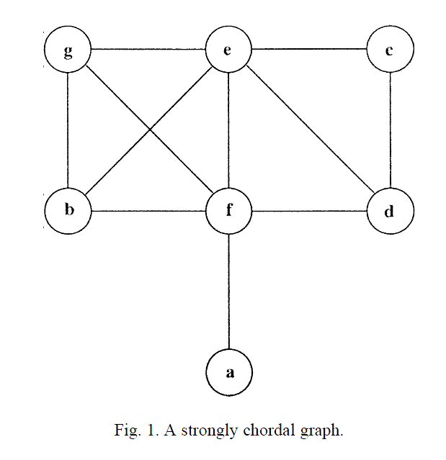
Strongly chordal graph
Def: A graph is strongly chordal if it is chordal (every cycle of length 4 or more contains a chord) and if every even cycle of length 6 or more contains a chord splitting the cycle into two odd length paths.

Slide 4
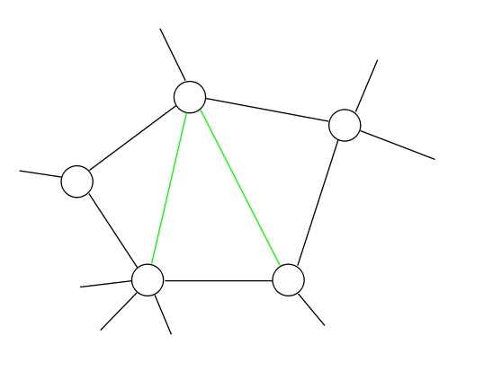
Chordal graph
In the mathematical area of graph theory, a graph is chordal if each of its cycles of four or more nodes has a chord, which is an edge joining two nodes that are not adjacent in the cycle.

Slide 5
Paired-domination
A set S ⊆ V is a paired-dominating set, denoted by PDS, of G if every vertex in V − S has at least one neighbor in S and the induced subgraph G[S] has a perfect matching M
S={A,B,C,D}
M={AC,BD}
E
F
B
A
D
C
G

Slide 6
Perfect-matching
A perfect matching M in G is a matching such that every vertex of G is incident to an edge of M.
M={AB,CG,DH,EF}
H
A
G
B
F
C
E
D

Slide 7
Matching
A matching in a graph G is a set of pairwise nonadjacent edges in G.
E
S1={AD,BC}
S2={AD,CD} X
A
D
B
C

Slide 8
SEO (strong elimination ordering)
If i≦j ≦ k and v_{j}, v_{k} ∈ N_{i} [v_{i} ], then N_{i} [v _{j}] ⊆ N_{i} [v_{k}]
where N_{i} [v _{j}] = { v_{k} | v_{k} ∈ N_{G}[v _{j} ] and k≧i}. Any vertex ordering satisfying SEO is called a strong (elimination) ordering.

Slide 9
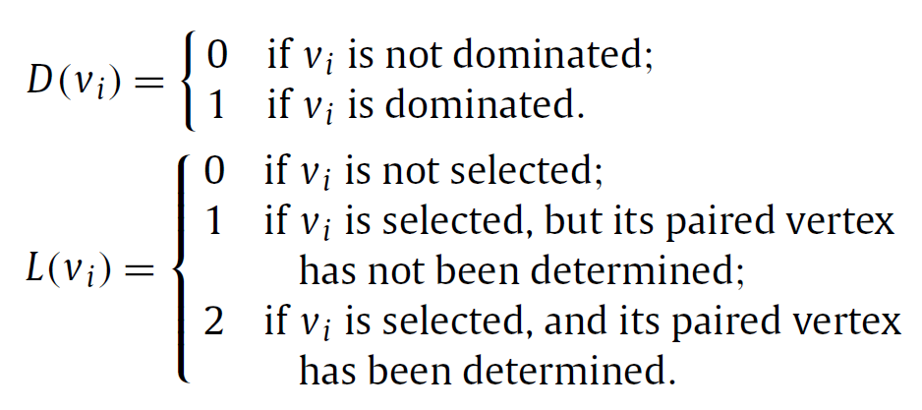
Algorithm(1/3)
Let G = (V , E) be a strongly chordal graph and v₁,v₂, . . . , v_{n} be the strong (elimination) ordering of G. For each i, define M_{i} = {k | v_{i} v_{k} ∈ E and k > i} ∪ {i} and F (v_{i}) = v _{j} such that j is the maximum integer in M_{i}.

Slide 10
Algorithm(2/3)
Input. A strongly chordal graph G = (V , E) with a strong(elimination) ordering v₁, v₂, . . . , v_{n} (n≧2). Each vertex v_{i} has labels (D(v_{i} ), L(v_{i})) = (0, 0), and F (v_{i}) = v _{j} with
j = max{k | k ∈ M_{i}}.
Output. A minimum paired-dominating set PD of G.

Slide 11
Algorithm(3/3)
Method.
For i = 1 to n do
  If (D(v_{i}) = 0 and F (v_{i}) ≠ v_{i}) then
L(F (v_{i})) = 1;
D(u) = 1 for u ∈ N[F (v_{i})];
else if (D(v_{i}) = 0 and F (v_{i}) = v_{i}) then
L(v_{i}) = 2;
L(u) = 2 for some u ∈ N(vi) such that L(u) = 0;
D(v_{i}) = 1;
else if (L(v_{i}) = 1) then
Let C = N(v_{i}) ∩ {v _{j} | L(v _{j}) = 1 and j > i};
If (C =∅ and L(F (v_{i})) = 0) then
L(v_{i}) = 2;
L(F (v_{i})) = 2;
D(u) = 1 for all u ∈ N[F (v_{i})];
else if (C =∅) then
L(v_{i}) = 2;
L(u) = 2 for some u ∈ N(v_{i}) such that L(u) = 0;
else
Take v j such that j = min{k | v_{k} ∈ C};
L(v_{i}) = 2;
L(v _{j}) = 2;
endif
endif
endfor
Output PD = {v | L(v) = 2}
end

Slide 12
3
5
4
5
2
1
1
3
6
4
6
4
5
2
1
3
6
2
7

Slide 13
End

