Slide 1
SVM-Prot: web-based support vector machine software for functional classification of a protein from its primary sequence
C.Z. Cai, L.Y. Han, Z.L. Ji, X. Chen and Y.Z. Chen
3692–3697 Nucleic Acids Research, 2003, Vol 31, No, 13
Presenter: Chu-Kai Liu
Date: Mar. 9, 2010

Slide 2
Abstract (1/3)
Prediction of protein function is of significance in studying biological processes. One approach for function prediction is to classify a protein into functional family. Support vector machine (SVM) is a useful method for such classification, which may involve proteins with diverse sequence distribution. We have developed a web-based software, SVMProt, for SVM classification of a protein into functional family from its primary sequence.

Slide 3
Abstract (2/3)
SVMProt classification system is trained from representative proteins of a number of functional families and seed proteins of Pfam curated protein families. It currently covers 54 functional families and additional families will be added in the near future. The computed accuracy for protein family classification is found to be in the range of 69.1–99.6%.

Slide 4
Abstract (3/3)
SVMProt shows a certain degree of capability for the classification of distantly related proteins and homologous proteins of different function and thus may be used as a protein function prediction tool that complements sequence alignment methods.

Slide 5
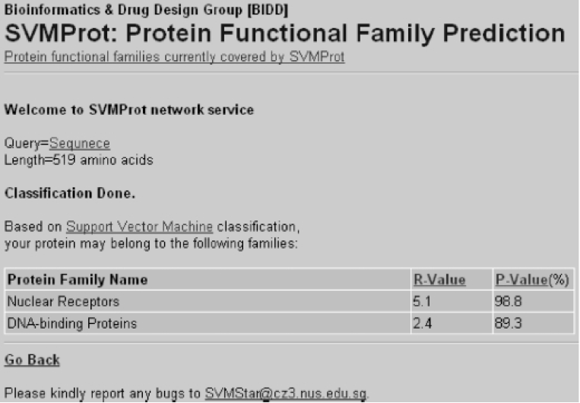
1. Software Access
SVMProt.
Database.

Slide 6
2. Methods(1/9)
Amino acid compostion.
Hydrophobicity(疏水性).
Normalized Van Der Waals volume.
Polarity.
Polarizability(極化).
Charge.
Surface tension.
Secondary structure.
  Helix(螺旋), Strand(股) and Coil(捲曲).
Solvent accessibility(溶劑可接觸性).

Slide 7
2. Methods(2/9)
Three descriptors:
Composition (C): is the percent of amino acids of certain properties.
Transition (T): is the frequency of which amino acids of a certain property is followed by amino acids of a different property.
Distribution (D): measures the percent of sequence length within which the first, 25%, 50%, 75% and 100% of the amino acids of a certain property, such as polar, is located, respectively.

Slide 8
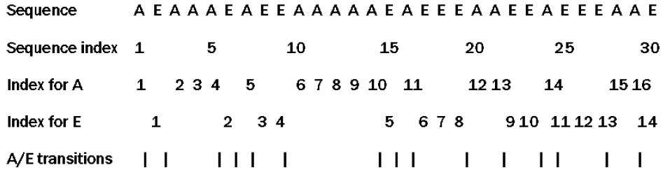
2. Methods(3/9)
Composition (C):
  As: 16/30 = 53.33.
  Es: 14/30 = 46.67.

Slide 9
2. Methods(4/9)
Transition (T):
  From A to E or from E to A: 15/29 = 51.72.

Slide 10
2. Methods(5/9)
Distribution (D) of As:
  First, 4(25%), 8(50%), 12(75%), 16(100%).
  As is 1/30 = 3.33%, 5/30 = 16.67%, 12/30 = 40.0%, 20/30 = 66.67%, 29/30 = 97.5%.
1
5
12
20
29

Slide 11
2. Methods(6/9)
Distribution (D) of Es:
  First, 3.5(25%), 7(50%), 10.5(75%), 14(100%).
  Es is 2/30 = 6.67%, 8/30 = 26.67%, 18/30 = 60.0%, 23/30 = 76.67%, 30/40 = 100.0%.
2
8
18
23
30

Slide 12
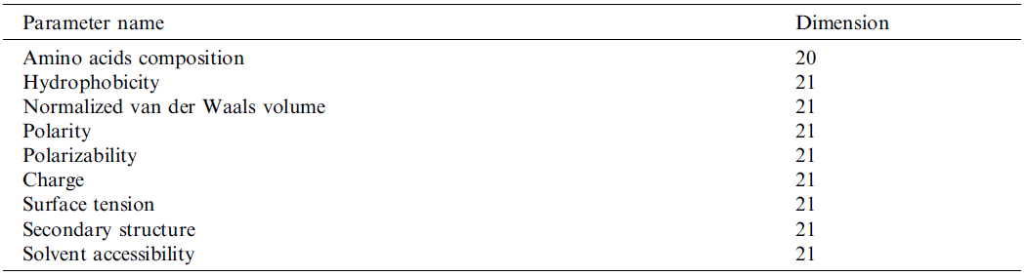
2. Methods(7/9)
A protein sequence is represented by a 188-dimensional feature vector.

Slide 13
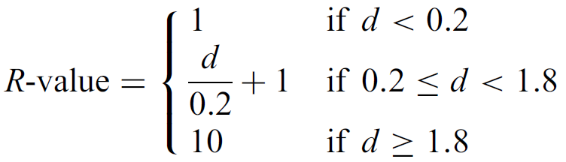
2. Methods(8/9)
A slightly modified reliability score, R-value.
Where d is the distance between the position of the vector of a classified protein and the optimal separating hyperplane in the hyperspace.

Slide 14
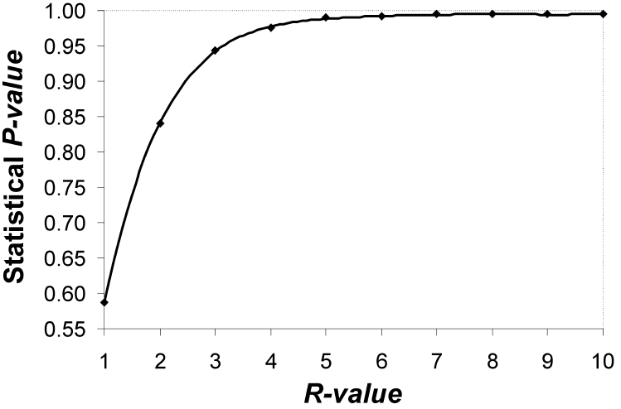
2. Methods(9/9)
Statistical relationship between the R-value and P-value (probability of correct classification) derived from analysis of 9932 positive and 45,999 negative samples of proteins.

Slide 15
3. Result
List of protein families currently covered by SVMProt.

