Slide 1
Genetic Programming for Simultaneous Feature
Selection and Classifier Design
Durga Prasad Muni, Nikhil R. Pal, and
Jyotirmoy Das
IEEE TRANSACTIONS ON SYSTEMS, MAN, AND CYBERNETICS, VOL. 36, NO. 1, FEBRUARY 2006

Slide 2
Abstract
This paper presents an online feature selection algorithm using genetic programming (GP). The proposed GP methodology simultaneously selects a good subset of features and constructs a classifier using the selected features. For a c-class problem, it provides a classifier having c trees. In this context, we introduce two new crossover operations to suit the feature selection process.

Slide 3
Abstract(Contd.)
As a byproduct, our algorithm produces a feature ranking scheme. We tested our method on several data sets having dimensions varying from 4 to 7129. We compared the performance of our method with results available in the literature and found that the proposed method produces consistently good results. To demonstrate the robustness of the scheme, we studied its effectiveness on data sets with known (synthetically added) redundant/bad features.

Slide 4
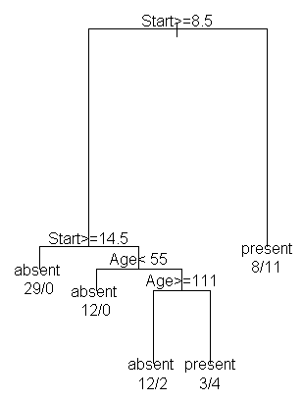
Binary decision tree classifier
(脊柱後凸症,駝背)
Kyphosis Age Number Start
1 absent 71 3 5
2 absent 158 3 14
3 present 128 4 5
4 absent 2 5 1
5 absent 1 4 15
6 absent 1 2 16
7 absent 61 2 17
8 absent 37 3 16
9 absent 113 2 16
10 present 59 6 12
11 present 82 5 14
12 absent 148 3 16
....

Slide 5
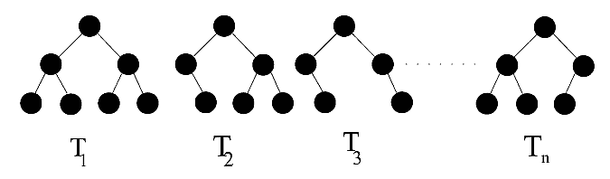
n-class Multi-tree classifier
For multi-category n-class problems,we usually require a classifier consisting of n such binary trees.
Each binary tree distinguish data between one specific class and other classes
Separating class 3 and others

Slide 6
Genetic programming procedures
Feature Subset
Selection
Fitness Evaluation
Individual Selection
Individual
Reproduction
Crossover
Mutation
1.Evaluation
2.Termination?

Slide 7


Function and terminal set
where R contains randomly generated constants in [0.0,10.0]. Trees are initialized using the ramped half-and-half method.

Slide 8
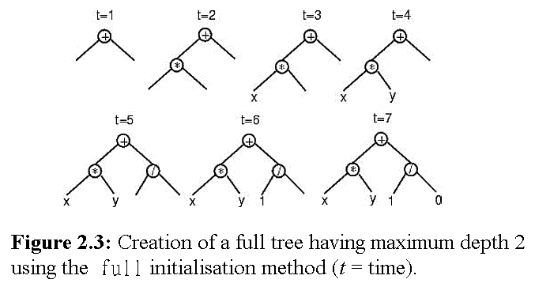
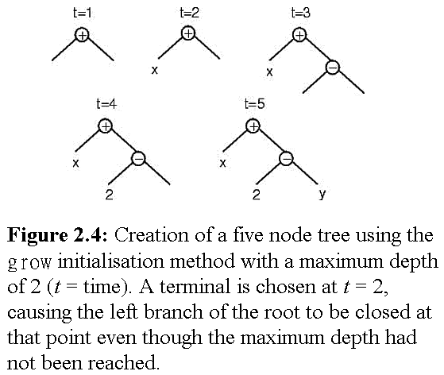
Tree initialization
The ramped half-and-half method contains full and grow methods.
Taking from Riccardo Poli’s ‘A Field Guide to Genetic Programming’

Slide 9

Selection of a feature subset for each chromosome
The probability to select r features from all available n features is:
特徵數越多，被選到機會越小
選r個特徵
總共n個特徵
可選擇特徵數r為：1,2,…,n

Slide 10
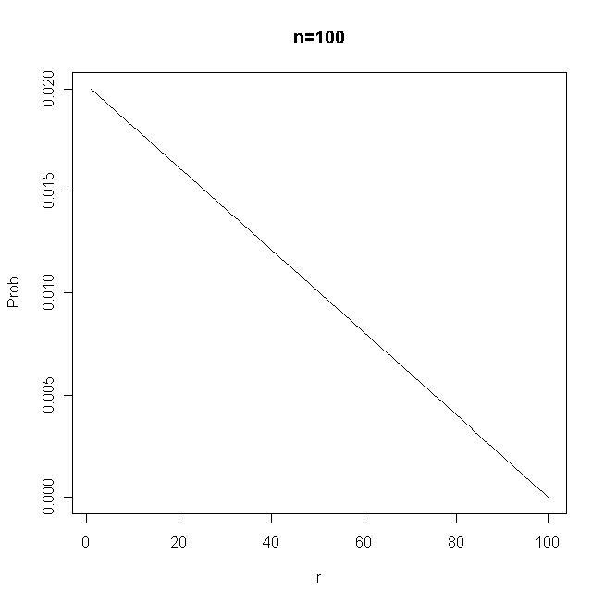
Selection of a Feature Subset for Each Chromosome
The probability to select r features from all available n features is:

Slide 11
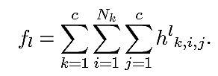
Fitness of a multi-tree classifier
The (raw) fitness function for l’th multi-tree classifier is:
第k類樣本總數
總共c類
第l個multi-tree內總共c個tree
第l個multi-tree內第j個tree所得分數
第l個multi-tree
第l個multi-tree內第j個tree
第k類別
第k類別第i筆資料

Slide 12
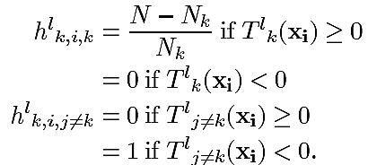
Fitness of a multi-tree classifier
The (raw) fitness function for l’th multi-tree classifier is:
第l個multi-tree內第k個tree對第k類資料回答k(答對)
答錯
第l個multi-tree內第k個tree對第j(j≠k)類資料回答k(答對)

Slide 13
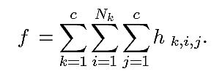


Fitness of a multi-tree classifier
The (modified) fitness function for l’th multi-tree classifier is:
常數
目前演化代數
總演化代數
選擇r個特徵

Slide 14
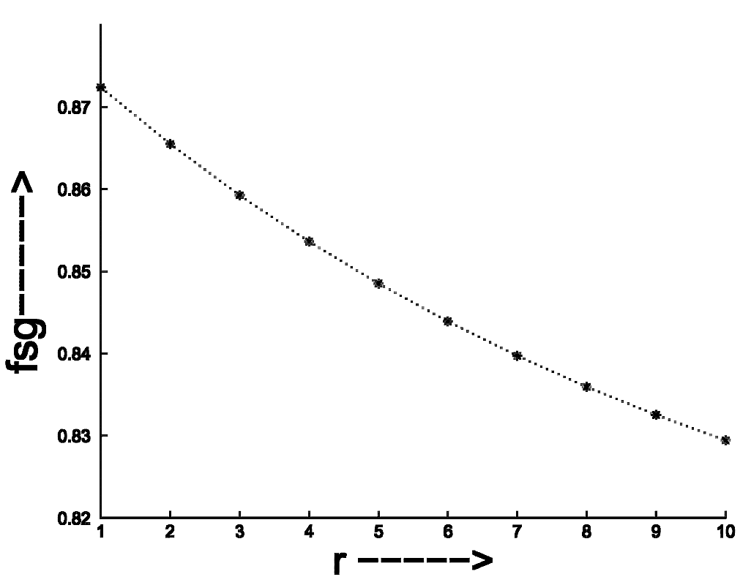
Fitness of a multi-tree classifier
The (modified) fitness function for l’th multi-tree classifier is:

Slide 15
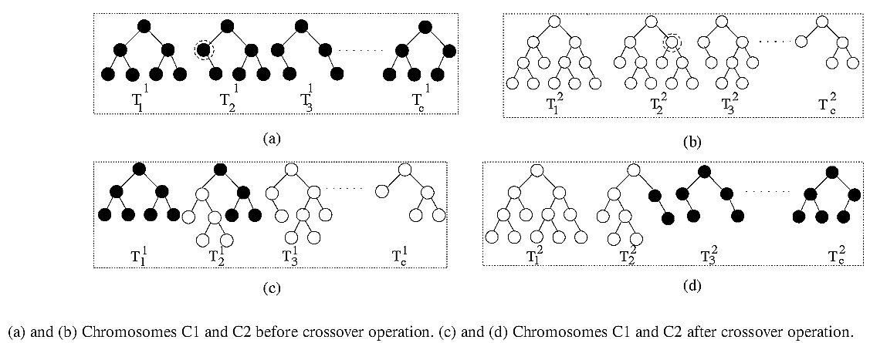
Crossover
The crossover is divided into:
Homogeneous and Heterogeneous

Slide 16
Crossover
The crossover process:
Homogeneous
  Chromosomes with a identical feature subset
Heterogeneous
  Chromosomes with a distinct feature subset
剛開始演化時，為促使更多樣特徵加入，因此heterogeneous交配機率較高。到演化即將結束時， 讓homogeneous交配機率提高，以微調演化之進步

Slide 17


Crossover
Heterogeneous crossover
  Chromosomes with distinct feature subset
  The probability is proportional to
適應性
目前最好的特徵組合:{0,1}^{n}
β=0.2
目前最好的與第j個
特徵組合相似度
第j個multi-tree特徵組合:{0,1}^{n}

Slide 18
Mutation
Unfit mutation
  Unfit (low-fitness score) trees (within the multi-tree) have more opportunity to mutate
Unfitness k₁
Unfitness k₂
Unfitness k₃
Unfitness k_{n}

Slide 19

Mutation
Unfit mutation
  Unfit (low-fitness score) trees (within the multi-tree) have more opportunity to mutate
第i顆tree誤判訓練資料數
第i顆tree突變機率

Slide 20
Mutation
A function (terminal) node is replaced by a randomly chosen new function (terminal) node (having the same arity).
突變時，須以相同型態節點替換

Slide 21
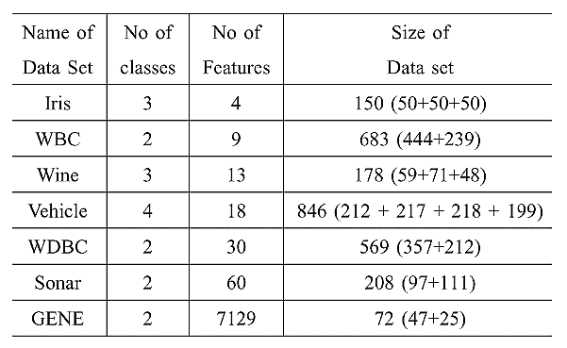
Data sets

Slide 22
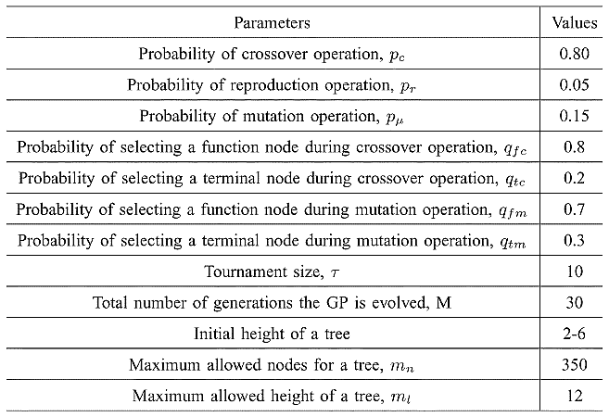
GP parameters

Slide 23


GP population & run time
Max 30 generations
10-fold CV

Slide 24
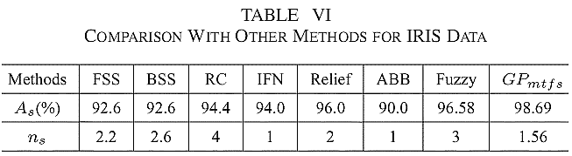
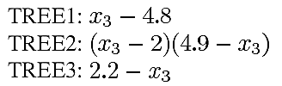

Results
R的範圍是[0.0,10.0]計100等份，要造成此4個數(4.8,2,4.9,2.2)機率只有(一億分之一)的幾倍，然此實驗只有用1000 individuals即有此結果

Slide 25
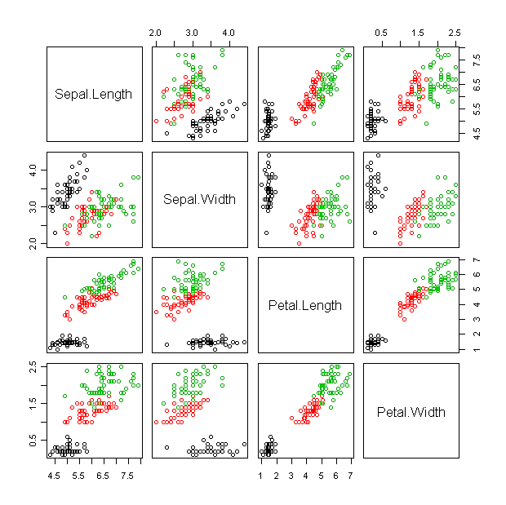
Results

Slide 26
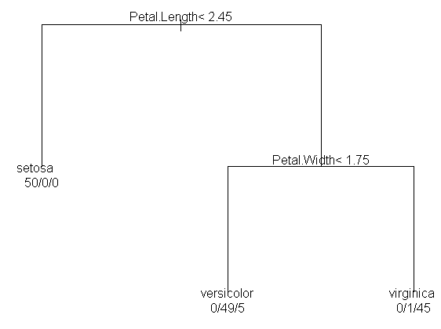
Results

Slide 27
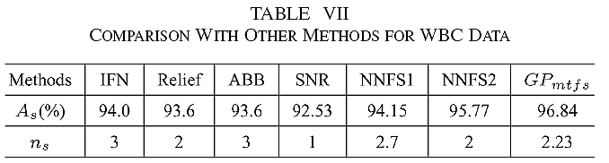
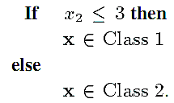

Results
Simplify (3.84 & 3.47) to 3

Slide 28
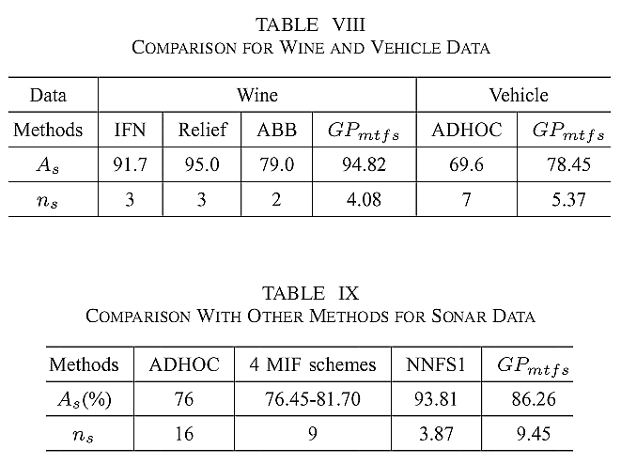
Results

Slide 29
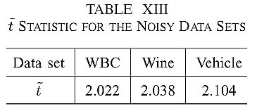
Results
Add 2 [0,1] and 2 [-1,1] random features to the WBC, wine, and vehicle data sets
Compare error rates of mt (multi-tree without FS) and mtfs (multi-tree with FS), and assume they are μ₁ and μ₂

Slide 30
Results
Cut-off t at 95% confidence level is 2.015
Null hypothesis: μ₁ = μ₂ (選特徵是無效果的)
Alternate hypothesis: μ₁ > μ₂ (選特徵誤差可降低)
Since all ť>2.015, the null hypothesis is rejected (mtfs is more robust than mt)

