Slide 1
Weighted LCS
Amihood Amir, Zvi Gotthilf , B. Riva Shalom
Journal of Discrete Algorithms 2010
Speaker: Chong-Jie Wang
Date: April 27, 2010

Slide 2
Abstract
The Longest Common Subsequence (LCS) of two strings A, B is a well studied problem having a wide range of applications. When each symbol of the input strings is assigned a positive weight the problem becomes the Heaviest Common Subsequence (HCS) problem. In this paper we consider a different version of weighted LCS on Position Weight Matrices (PWM). The Position Weight Matrix was introduced as a tool to handle a set of sequences that are not identical, yet, have many local similarities. Such a weighted sequence is a ‘statistical image’ of this set where we are given the probability of every symbol’s occurrence at every text location. We consider two possible definitions of LCS on PWM. For the first, we solve the LCS problem of z sequences in time O(zn^{z+1}). For the second, we consider the log-probability version of the problem, prove NP-hardness and provide an approximation algorithm.

Slide 3


Slide 4
EX:
DNA alphabet ∑ ={A, C, G, T},
the word =
|(A, 0.5), (C, 0.25), (G, 0.25), (T, 0)|
|(A, 0), (C, 1), (G, 0), (T, 0)|
|(A, 1), (C, 0), (G, 0), (T, 0)|

Slide 5
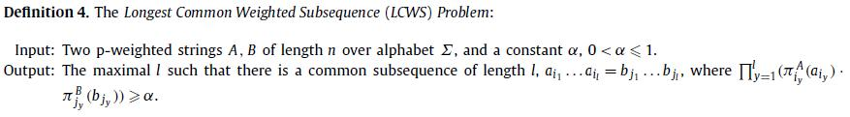
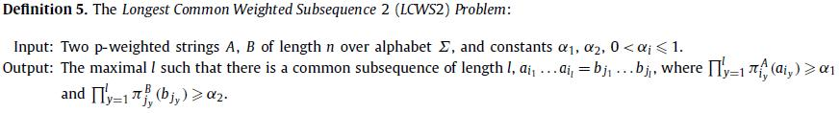
LCWS

Slide 6
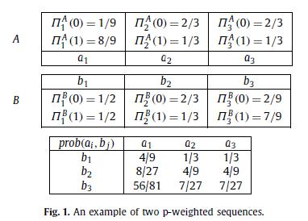

Slide 7
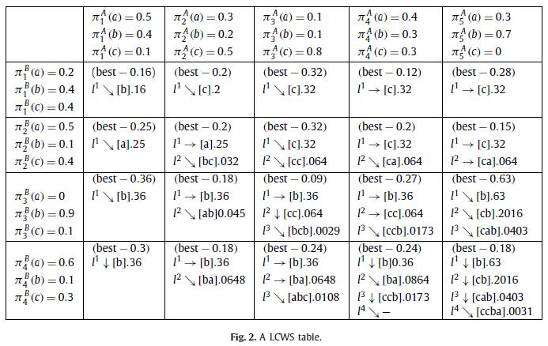

Slide 8

Filling the table in this fashion implies computing every entry of the table requires O(n + |Σ|) time for finding the best symbol and all O(n) relevant probabilities, using Lemma 1. So the time complexity is O(n³ + |Σ|n²).

Slide 9
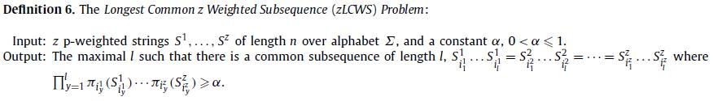
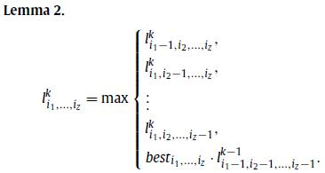
LCWS for z sequences

Slide 10
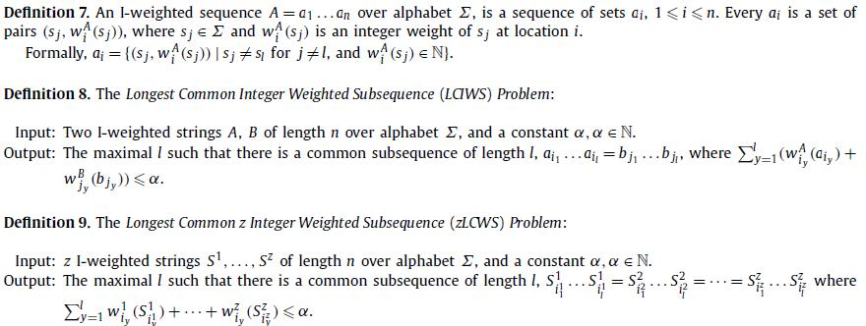
The integer model

Slide 12
Longest common integer weighted subsequence with two thresholds (LCIWS2)
LCIWS2 is NP-hard
Proved by using a Turing reduction from the Partition problem.

