Slide 1
On the Longest Common Rigid Subsequence Problem
Nikhil Bansal , Moshe Lewenstein , Bin Ma , kaizhong Zhang
Algorithmica (2010) 56 :270-280
Presenter: Siao-Ming Jhou
Date: May 25, 2010

Slide 2
Abstract
The longest common subsequence problem (LCS) and the closest substring problem (CSP) are two models for finding common patterns in strings, and have been studied extensively. Though both LCS and CSP are NP-Hard, they exhibit very different behavior with respect to polynomial time approximation algorithms. While LCS is hard to approximate within n^{δ} for some δ > 0, CSP admits a polynomial time approximation scheme. In this paper, we study the longest common rigid subsequence problem (LCRS). This problem shares similarity with both LCS and CSP and has an important application in motif finding in biological sequences. We show that it is NP-hard to approximate LCRS within ratio n^{δ}, for some constant δ > 0, where n is the maximum string length. We also show that it is NP-Hard to approximate LCRS within ratio Ω(m), where m is the number of strings.

Slide 3
the closest substring problem (CSP)
Given a set S={s₁, s₂, … , s_{n} } of strings each of length m, and an integer L, find a center string s of length L minimizing d such that for each s_{i} ∈ S there is a length L substring t_{i} of s_{i} with d(s, t_{i} ) ≦d.

Slide 4
the longest common rigid subsequence (LCRS)
Suppose s = s[1]s[2] ・ ・ ・ s[n] is a string over Σ. A rigid subsequence of s is a subsequence of s along with the relative positions of the letters. More precisely, a rigid subsequence has the form <t,P>, where t = s[i₁]s[i₂] ・ ・ ・ s[i_{k}] and P = (i₂ − i₁, i₃ − i₁, . . . , i_{k} − i₁) for 1 ≤ i₁ < i₂ < ・ ・ ・ < i_{k} ≤ n. We call P the shape of this rigid subsequence. A common rigid subsequence of several strings s₁, . . . , s_{m} is a pair<t,P >that is a rigid subsequence of every s_{i}. The longest common rigid subsequence problem (LCRS) asks for the common rigid sequence <t,P> that maximizes the length of t .

Slide 5
例子
S1:ACGAGG
S2:ACCAAG
LCS:ACAG
CSP:ACGAAC
LCRS:<ACAG,(1,3,5)>

Slide 6
Max SNP-hard
If a problem is Max SNP-hard, then there is a constant ε> 0, such that the polynomial time approximation to that problem within ratio 1 + ε will yield that NP = P.
To show the Max SNP-hardness of LCRS, we will give a gap-preserving reduction from the maximum directed cut (Max-Dicut) problem.

Slide 7
Max-Dicut Problem
Given a directed graph G = (V ,E), find a subset of vertices S such that the number of directed edges from S to V \ S is maximized.
V1
V3
V2
V4
S
V \ S

Slide 8
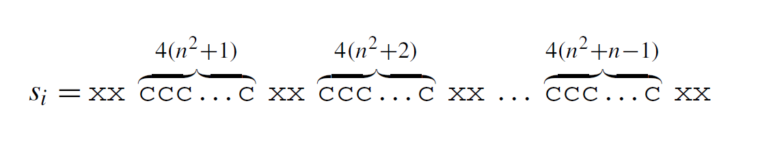
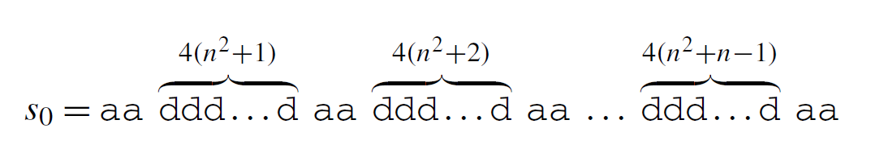
由Max-Dicut Problem reduce to LCRS Problem
Suppose the instance of Max-Dicut G = V,E has m vertices and n edges. In our construction, each vertex v_{i} ∈ V (i = 1, 2, . . . , m) corresponds to a string s_{i} of the following form:

Slide 9
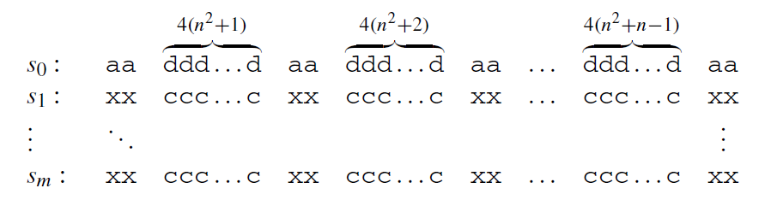
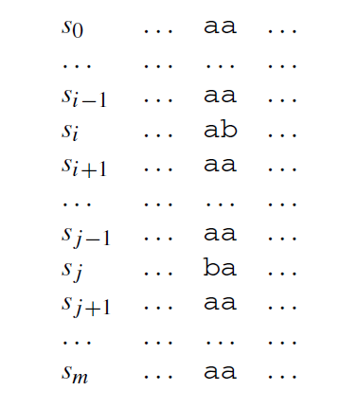

Slide 10
e5
V1
e1
V3
e2
e3
V2
e4
V4
e6
S₀ :aa aa aa aa aa aa
S1:ab ab ba
S2: ab ab ba
S3:ba ba ab
S4: ba ba ab
t t t t+1 t-1
t t t t t+1
t t t t-1 t+1
t t t t t-1

Slide 11
e1
V1
e2
V3
e3
e4
V2
e5
V4
e6
S₀ :aa aa aa aa aa aa
S1:ba ab ab
S2: ab ba ba
S3:ab ba ba
S4: ba ba ab
t-1 t t t t
t t t t t+1
t+1 t t t t
t t t t t-1

Slide 12
e1
V1
e2
V3
e3
e4
V2
e6
V4
e5
S₀ :aa aa aa aa aa aa
S1:ba ab ab
S2: ab ba ab
S3:ab ba ba
S4: ba ab ba
t-1 t t t t
t t t t+1 t-1
t+1 t t t t
t t t t-1 t+1

Slide 13
Observation 1 Any common rigid sequence of the instance constructed above can only contain the letter a.
Lemma 2 Suppose a common rigid subsequence z has length r where r ≥ 3, and the r letters are from the blocks k₁, k₂, . . . , k_{r} of s₀ respectively, where (k₁ ≤ k₂ ≤・ ・ ・≤ k_{r} ). Then z uses letters from the blocks k₁, k₂, . . . , k_{r} of s_{i} for every i = 1, . . . , m.

Slide 14
Let G = (V ,E) be a directed graph with degree at most 6, let |V| = m and |E| = n. Notice that n = O(m), and recall that finding a max-dicut of G is Max SNP-hard. Since any directed graph has a dicut of size at least m/4 (by choosing a subset S ⊆ V uniformly at random and derandomizing), it follows that there exist constants c and δ such that it is impossible to distinguish in polynomial time whether there is a dicut with of size at least cn or at most (c−δ)n. Let k be the largest integer such that (c/(c − δ))^{k} <m. Clearly, k = O(logm).

Slide 15
Corollary 1 It is impossible to distinguish in time polynomial in the size of F^{k} , whether there is k-fold dicut of (V ,F^{k}) that has size at least (cn)^{k} or at most
((c −δ)n)^{k} . Since (c/(c−δ))^{k} = Ω(m), this implies anΩ(m) approximation hardness for the max k-fold dicut problem.

Slide 16
Theorem 7 LCRS is hard to approximate within a factor of o(m) and n^{δ} for some δ > 0, unless P = NP. Here m is the number of strings and n is the length of the longest string.

Slide 17
END

