Slide 1
Algorithms for the Hybrid Constrained Longest Common
Subsequence Problem
Yi-Ching Chen
Department of Computer Science and Information Engineering,
National Taiwan University, Taipei, Taiwan 106
Presenter:Zih-Jie Yang
Date:May 25,2010

Slide 2
Abstract(1/2)
We investigate a variant of the longest common subsequence problem. Given two sequences X, Y and two constrained patterns P, Q of lengths m, n, p, and q, respectively, the hybrid constrained longest common subsequence problem is to find a longest common subsequence of X and Y such that the resulting LCS is both a supersequence of P and a nonsupersequence of Q. Without loss of generality, assume that m ≤ n.

Slide 3
Abstract(2/2)
We present a new dynamic programming algorithm for solving this problem in O(mnpq) time and space. We also propose another algorithm by restricting the computation on the positions of matches between X and Y . The latter algorithm requires
O(pqr log log n + n log n) time over an infinite alphabet and O((pqr+n) log log n)) time over a finite alphabet, and O(pq(r + n)) space for both cases,where r denotes the total number of matches between X and Y .

Slide 4
Problem (HC-LCS)
Given two sequences X, Y and two constrained patterns P, Q of lengths m, n, p, and q, respectively, the HC-LCS problem is to find an LCS of X and Y such that the resulting LCS is both a supersequence of P and a nonsupersequence of Q.

Slide 5
Example
X =BADBABD
Y =ABCBDDA
LCS of X and Y=ABBD
P = DA
Q = BA
HC-LCS of X and Y=ADA

Slide 6
HC-LCS
L(i, j, k, h) denote the length of an LCS of X[1..i] and Y [1..j] where every LCS is both a supersequence of P[1..k] and a nonsupersequence of Q[1..h].
-∞ if X[i] = Y [j] = P[k] = Q[h] and h = 1,
max {L(i – 1, j – 1, k, h), 1 + L(i – 1, j – 1, k – 1, h - 1)}
if X[i] = Y [j] = P[k] = Q[h] and h ≥2,
1 + L(i – 1, j – 1, k – 1, h)
if X[i] = Y [j] = P[k] and (h = 0 or X[i] ≠ Q[h]),
L(i – 1, j – 1, k, h)
if X[i] = Y [j] = Q[h], h = 1, and (k = 0 or X[i] ≠ P[k]),
L(i, j, k, h)
max {L(i - 1, j - 1, k, h), 1 + L(i - 1, j - 1, k, h - 1)}
if X[i] = Y [j] = Q[h], h ≥ 2, and (k = 0 or X[i] ≠ P[k],
1 + L(i – 1, j – 1, k, h)
if X[i] = Y [j], (k = 0 or X[i] ≠ P[k]), and (h = 0 or X[i] ≠ Q[h]),
max {L(i - 1, j, k, h),L(I, j - 1, k, h)}
if X[i] ≠ Y [j]:

Slide 7
Example(1/3)
k=1,h=0, P[k]=D
k=2,h=0, P[k]=A
k=0,h=0
 | - | B | A | D | B | A | B | D
- | 0 | 0 | 0 | 0 | 0 | 0 | 0 | 0
A | 0 | 0 | 1 | 1 | 1 | 1 | 1 | 1
B | 0 | 1 | 1 | 1 | 2 | 2 | 2 | 2
C | 0 | 1 | 1 | 1 | 2 | 2 | 2 | 2
B | 0 | 1 | 1 | 1 | 2 | 2 | 3 | 3
D | 0 | 1 | 1 | 2 | 2 | 2 | 3 | 4
D | 0 | 1 | 1 | 2 | 2 | 2 | 3 | 4
A | 0 | 1 | 2 | 2 | 2 | 3 | 3 | 4
 | - | B | A | D | B | A | B | D
- | N | N | N | N | N | N | N | N
A | N | N | N | N | N | N | N | N
B | N | N | N | N | N | N | N | N
C | N | N | N | N | N | N | N | N
B | N | N | N | N | N | N | N | N
D | N | N | N | 2 | 2 | 2 | 2 | 4
D | N | N | N | 2 | 2 | 2 | 2 | 4
A | N | N | N | 2 | 2 | 3 | 3 | 4
 | - | B | A | D | B | A | B | D
- | N | N | N | N | N | N | N | N
A | N | N | N | N | N | N | N | N
B | N | N | N | N | N | N | N | N
C | N | N | N | N | N | N | N | N
B | N | N | N | N | N | N | N | N
D | N | N | N | N | N | N | N | N
D | N | N | N | N | N | N | N | N
A | N | N | N | N | N | 3 | 3 | 3

Slide 8
Example(2/3)
k=1,h=1, P[k]=D,Q[h]=B
k=2,h=1, P[k]=A,Q[h]=B
k=0,h=1,Q[h]=B
 | - | B | A | D | B | A | B | D
- | 0 | 0 | 0 | 0 | 0 | 0 | 0 | 0
A | 0 | 0 | 1 | 1 | 1 | 1 | 1 | 1
B | 0 | 0 | 1 | 1 | 1 | 1 | 1 | 1
C | 0 | 0 | 1 | 1 | 1 | 1 | 1 | 1
B | 0 | 0 | 1 | 1 | 1 | 1 | 1 | 1
D | 0 | 0 | 1 | 2 | 2 | 2 | 2 | 2
D | 0 | 0 | 1 | 2 | 2 | 2 | 2 | 3
A | 0 | 0 | 1 | 2 | 2 | 3 | 3 | 3
 | - | B | A | D | B | A | B | D
- | N | N | N | N | N | N | N | N
A | N | N | N | N | N | N | N | N
B | N | N | N | N | N | N | N | N
C | N | N | N | N | N | N | N | N
B | N | N | N | N | N | N | N | N
D | N | N | N | 2 | 2 | 2 | 2 | 2
D | N | N | N | 2 | 2 | 2 | 2 | 3
A | N | N | N | 2 | 2 | 3 | 3 | 3
 | - | B | A | D | B | A | B | D
- | N | N | N | N | N | N | N | N
A | N | N | N | N | N | N | N | N
B | N | N | N | N | N | N | N | N
C | N | N | N | N | N | N | N | N
B | N | N | N | N | N | N | N | N
D | N | N | N | N | N | N | N | N
D | N | N | N | N | N | N | N | N
A | N | N | N | N | N | 3 | 3 | 3

Slide 9
Example(3/3)
k=1,h=2, P[k]=D,Q[h]=A
k=2,h=2, P[k]=A, Q[h]=A
k=0,h=2,Q[h]=A
 | - | B | A | D | B | A | B | D
- | 0 | 0 | 0 | 0 | 0 | 0 | 0 | 0
A | 0 | 0 | 1 | 1 | 1 | 1 | 1 | 1
B | 0 | 1 | 1 | 1 | 2 | 2 | 2 | 2
C | 0 | 1 | 1 | 1 | 2 | 2 | 2 | 2
B | 0 | 1 | 1 | 1 | 2 | 2 | 3 | 3
D | 0 | 1 | 1 | 2 | 2 | 2 | 3 | 4
D | 0 | 1 | 1 | 2 | 2 | 2 | 3 | 4
A | 0 | 1 | 1 | 2 | 2 | 3 | 3 | 4
 | - | B | A | D | B | A | B | D
- | N | N | N | N | N | N | N | N
A | N | N | N | N | N | N | N | N
B | N | N | N | N | N | N | N | N
C | N | N | N | N | N | N | N | N
B | N | N | N | N | N | N | N | N
D | N | N | N | 2 | 2 | 2 | 2 | 4
D | N | N | N | 2 | 2 | 2 | 2 | 4
A | N | N | N | 2 | 2 | 3 | 3 | 4
 | - | B | A | D | B | A | B | D
- | N | N | N | N | N | N | N | N
A | N | N | N | N | N | N | N | N
B | N | N | N | N | N | N | N | N
C | N | N | N | N | N | N | N | N
B | N | N | N | N | N | N | N | N
D | N | N | N | N | N | N | N | N
D | N | N | N | N | N | N | N | N
A | N | N | N | N | N | 3 | 3 | 3

Slide 10
Time complexity
If X[i] = Y [j] and L(i, j, k, h) equals to 1+L(i-1, j-1, k-1, h-1), 1+L(i-1, j-1, k-1, h), 1+L(i,-1, j-1, k, h-1), or 1 + L(i – 1, j – 1, k, h), we append the character X[ i ] to the result. Thus, delivering an HC-LCS takes O(m+n+p+q) steps.
The HC-LCS problem can be solved in O(mnpq) time and space.

Slide 11
An Improved Algorithm for the
HC-LCS Problem
The L-values might increase only when a match between X and Y is encountered.
Use a linked list M[i] to record all corresponding positions j such that X[i] = Y [j], and keep this list in increasing order.
For all 1 ≤ i ≤ m, 1 ≤ j ≤ n, 0 ≤ k ≤ p, and 0 ≤ h ≤ q, let L(I, j, k, h) = Lk,h(I, j)
L is visualized as (p + 1) * (q + 1) 2-dimensional matrices rather than one 4-dimensional matrix.

Slide 12
HC-LCS
L(i, j, k, h) denote the length of an LCS of X[1..i] and Y [1..j] where every LCS is both a supersequence of P[1..k] and a nonsupersequence of Q[1..h].
-∞ if X[i] = Y [j] = P[k] = Q[h] and h = 1,
max {L(i – 1, j – 1, k, h), 1 + L(i – 1, j – 1, k – 1, h - 1)}
if X[i] = Y [j] = P[k] = Q[h] and h ≥2,
1 + L(i – 1, j – 1, k – 1, h)
if X[i] = Y [j] = P[k] and (h = 0 or X[i] ≠ Q[h]),
L(i – 1, j – 1, k, h)
if X[i] = Y [j] = Q[h], h = 1, and (k = 0 or X[i] ≠ P[k]),
L(i, j, k, h)
max {L(i - 1, j - 1, k, h), 1 + L(i - 1, j - 1, k, h - 1)}
if X[i] = Y [j] = Q[h], h ≥ 2, and (k = 0 or X[i] ≠ P[k],
1 + L(i – 1, j – 1, k, h)
if X[i] = Y [j], (k = 0 or X[i] ≠ P[k]), and (h = 0 or X[i] ≠ Q[h]),
max {L(i - 1, j, k, h),L(I, j - 1, k, h)}
if X[i] ≠ Y [j]:

Slide 13
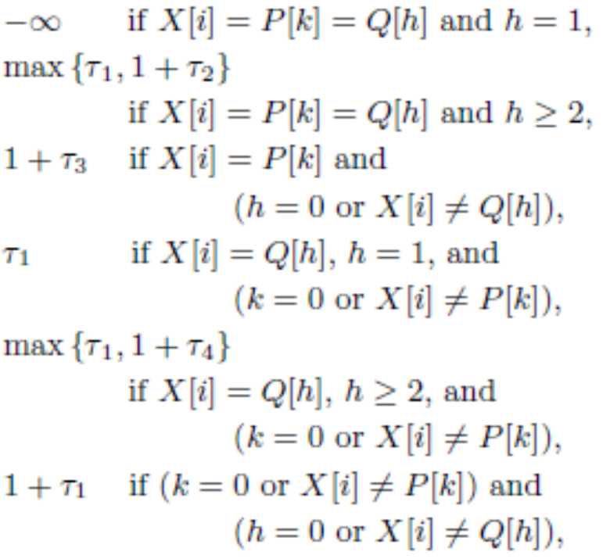
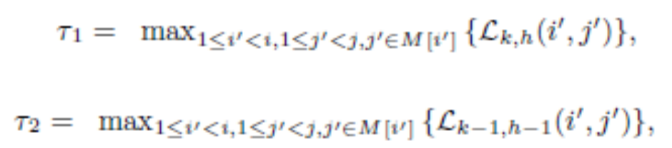
The euqation after reformulating
For any 0 < i ≤ m, j ∈ M[i], 0 ≤ k ≤ p, and 0 ≤ h ≤ q
(2)
Lk,h(i; j) =
(3)
(5)
(6)
(4)

Slide 14
The Data Structure
This algorithm need to query the element with the highest value (i.e., priority) among all the entries whose j-coordinates (i.e., key)
Bounded heap to support the following operations:
  Insert(H; j, l, pos): Insert into the bounded heap H the key j with priority l and associated position pos.
  IncreaseLength(H; j, l, pos): If the bounded heap H does not contain the key j, perform Insert(H, j, l, pos); otherwise, set the priority of this key to max {l, l’}, where l’ is its original priority.
  BoundedMax(H; j): Return the maximum priority of all items in H with key smaller than j and its associated position. If H does not contain any items with keys smaller than j, return null.
Initialization of the bounded heap takes O(n log log n) time, and each of the above operations requires
O(log log n) time.

Slide 15
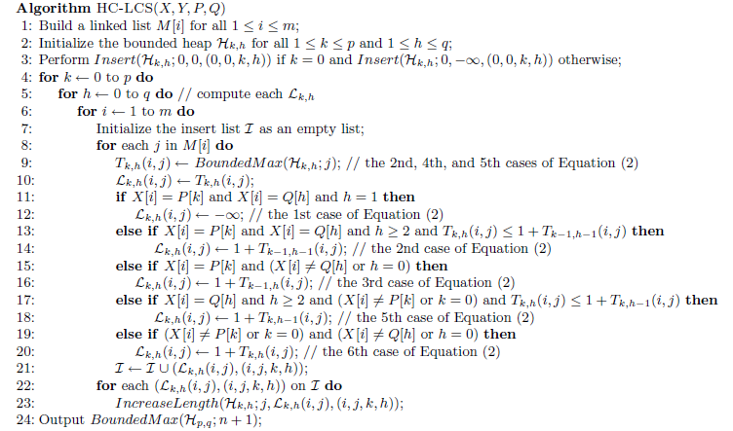
The Algorithm

Slide 16
Time complexity
First,sort X and Y, and then scan the two sorted sequences to build a linked list M[ i ], building the m linked lists in line 1 of Algorithm HC-LCS, it takes O(n log n) time over an infinite alphabet and O(n) time over a finite alphabet, and O(n) space.
The initialization of each Hk,h in line 2 takes O(n log log n) time.
Let r denote the total number of matches between X and Y .
In lines 4-23, we need to maintain an Hk,h and I for each Lk,h, and there are at most r insertions and queries on Hk,h.
Computing Lk,h takes O(r log log n)time and O(r+n) space.
The calculation of the (p+1)*(q+1) matrices requires in total
O(pqr log log n) time and O(pq(r+n)) space.
In line 24, querying on Hp,q takes O(log log n) time,

Slide 17
Time complexity
Algorithm HC-LCS runs in
O(pqr log log n +n log n) time and
O(pq(r + n)) space over an infinite alphabet.
Algorithm HC-LCS runs in
O((pqr +n) log log n)) time and
O(pq(r + n)) space over a finite alphabet.

