Slide 1

Eunseog Youn, Lars Koenig, Myong K. Jeong, Seung H. Baek
Expert Systems with Applications 37 (2010) pp.6148–6156
Presenter: Siao-ming Jhou
Date: June 14, 2010

Slide 2

The problem of feature selection is to find a subset of features for optimal classification. A critical part of feature selection is to rank features according to their importance for classification. The Support Vector Machine (SVM) has been applied to a number of applications, such as bioinformatics, face recognition, text categorization, handwritten digit recognition, and so forth. Based on the success of the SVM, several feature selection algorithms that use it have recently been proposed.

Slide 3

This paper proposes a new feature ranking algorithm based on support vectors (SVs). Support vectors refer to those sample vectors that lie around the decision boundary between two different classes. Although SV-based feature ranking can be applied to any discriminant analysis, two linear discriminants are considered here: Fisher’s linear discriminant and the Support Vector Machine. Features are ranked based on the weight associated with each feature or as determined by recursive feature elimination. The experiments show that our feature-ranking algorithms are competitive in accuracy with the existing methods and much faster.

Slide 4

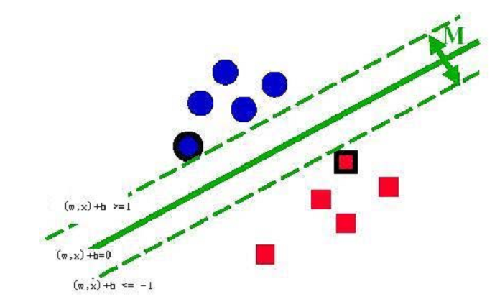
Support vectors refer to those sample vectors that lie around the decision boundary between two different classes.

Slide 5



Suppose we have n d-dimensional samples x₁, x₂, …, x_{n} belonging to c different classes with n_{i} samples in the subset Di labeled ω_{i}.
The objective of FLD is seek the direction w not only maximizing the between-class scatter of the projected samples but also minimizing the within-class scatter.

Slide 6

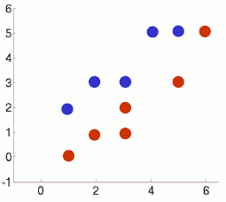
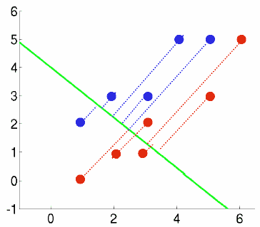
FLD分析後，兩類別分得更開，但各自類別卻縮的較近
Notes:
c1=[1 2;2 3;3 3;4 5;5 5]’
c2=[1 0;2 1;3 1;3 2;5 3;6 5]‘
m1=mean(c1,'c')
m2=mean(c2,'c')
m=(m1*5+m2*6)/11
c1_m1=c1-mtlb_repmat(m1,1,5)
S1=c1_m1*c1_m1’
c2_m2=c2-mtlb_repmat(m2,1,6)
S2=c2_m2*c2_m2’
Sw=S1+S2
Sb=5*(m1-m)*(m1-m)'+6*(m2-m)*(m2-m)‘
[V,D] = mtlb_eig(inv(Sw)*Sb)

Slide 7

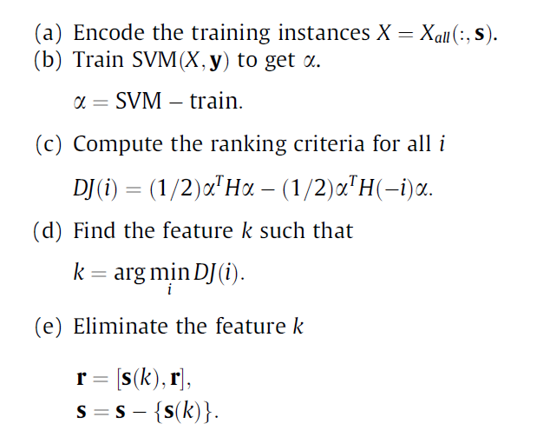
Given training instances X_{all} = [x₁, . . . , x_{l} ] ′, and class labels y=[y₁, . . . , y_{l}] ′, initialize the subset of features
s =[1, 2, . . . , n] and r = an empty array.
Repeat (a)–(e) until s becomes an empty array resulting in ranked features after the algorithm terminates.

Slide 8

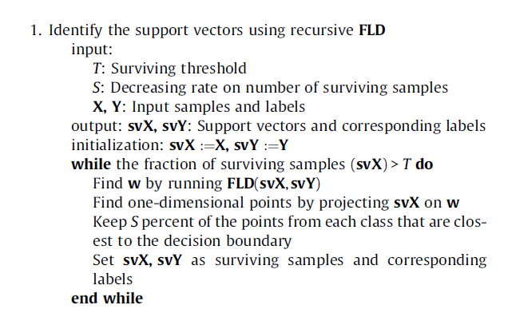

Slide 9
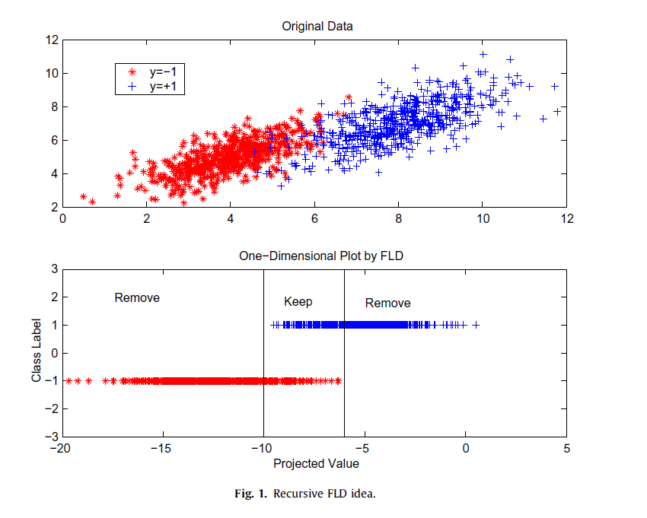

Slide 10

2. Rank the features by applying RFE on the support vectors found
input: svX, svY: Input samples and labels
output: ranking
initialization: ranking = empty list, s = (1, 2, . . ., j,. . .,dimension)
while s is not empty do
Encode instances, newX whose features contain only s from svX
Find w by applying FLD(newX,svY)
Find the feature j such that w_{j} has the minimum magnitude among w
Update s by removing the feature j from s
Update ranking by adding the feature j on top of the
ranking
end while

Slide 11

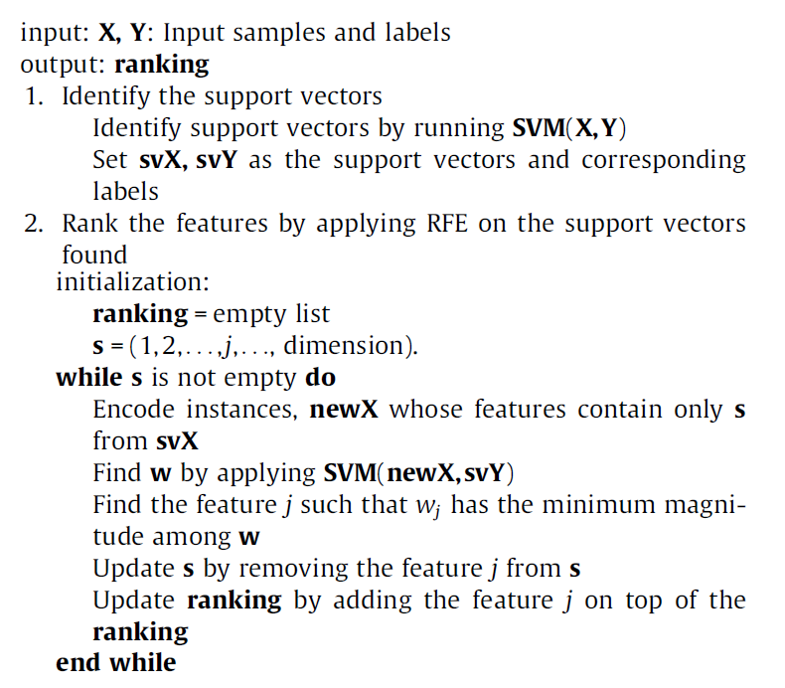

Slide 12

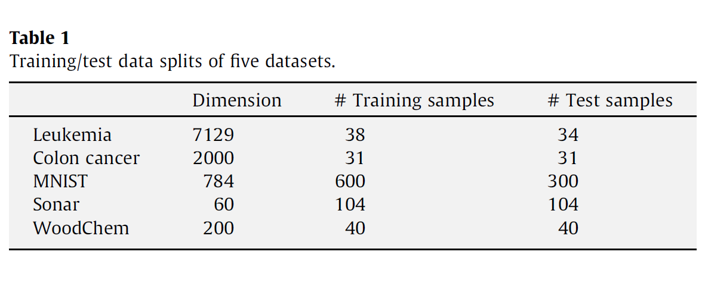

Slide 13
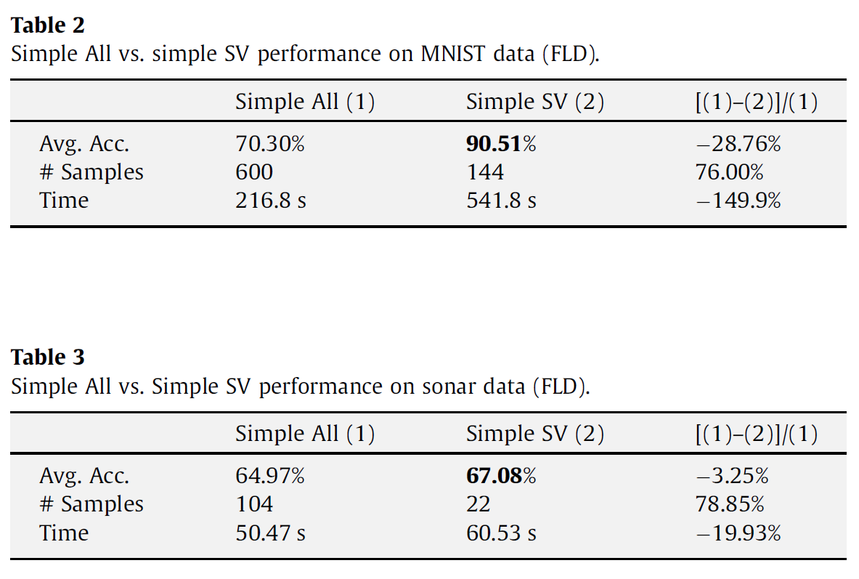

Slide 14
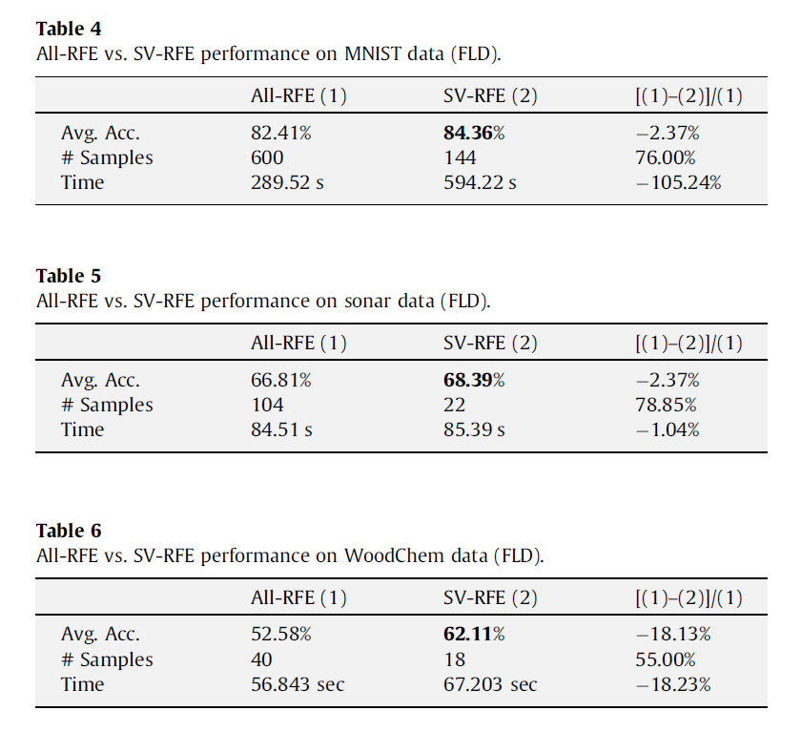

Slide 15
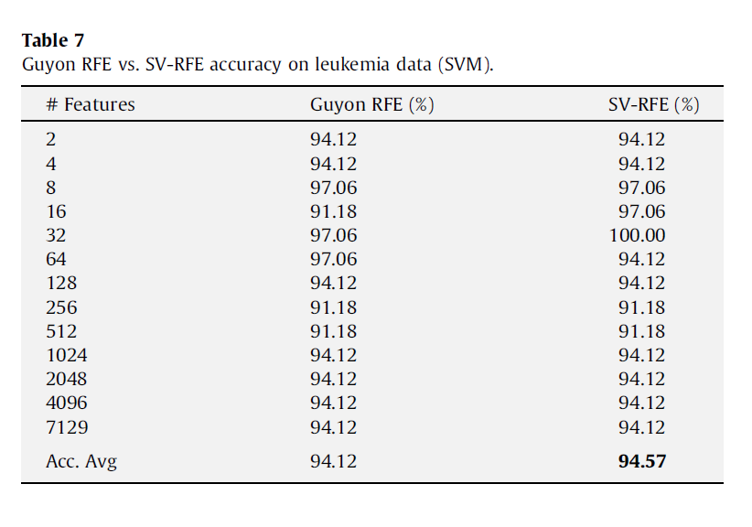

Slide 16


Slide 17
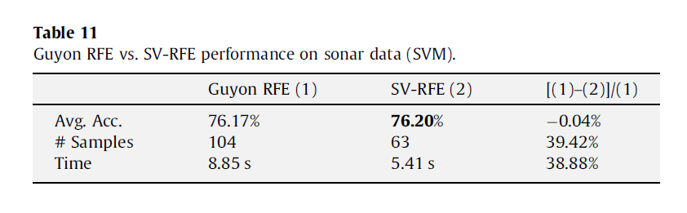
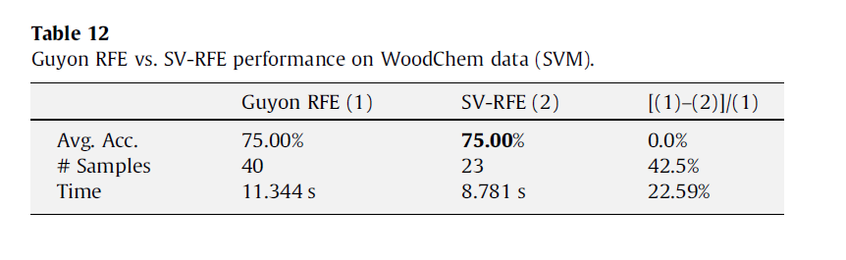

Slide 18



