Slide 1
A Progressive Strategy for DNA Resequencing Problem
Chia-Wei Lu(盧家偉), Chuan Yi Tang(唐傳一) and R. C. T. Lee
The 27th Workshop on Combinatorial Mathematics and Computation Theory.
pages 45-49
Presenter:Zih-Jie Yang
Date: June 14,2010

Slide 2
Abstract
In this paper, we are going to solve the DNA resequencing problem. We are given a set of subseuqences obtained by the next generation sequencing (NGS) technology and we are asked to assembly them into a DNA sequence with the aid of a reference sequence. In this paper, we propose a progressive strategy to solve the resequencing problem. Our algorithm allows us to map data to reference sequence efficiently. Compared with other available tools, our approach allows us to be able to map much more subsequences to the reference sequence.

Slide 3
The Resequencing Problem
Given a set S = {s1 , s2 ,…, sn} of short subsequences cut from an unknown DNA sequence T and a reference R Sequence and an error bound k, we are asked to map Si ’s to R where Si ’s appear approximately in R. For every Si, we are required to find all subsequences in R whose Hamming distance with Si are smaller than or equal to k .

Slide 4
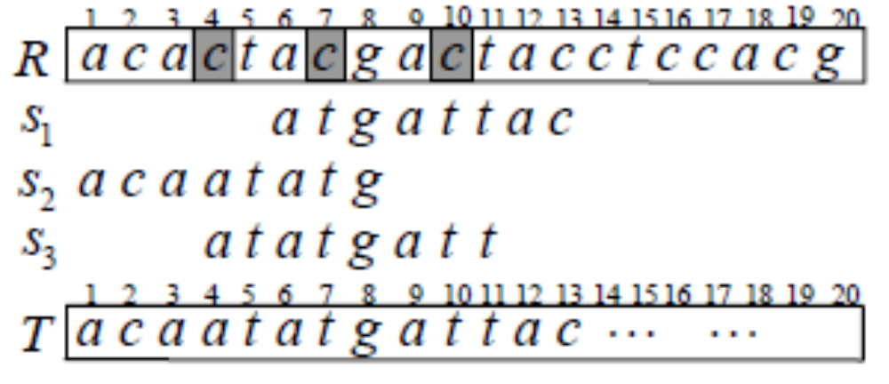
Example

Slide 5
Algorithms for the Multiple
Approximate String Matching Problem
Candidate Finding and Checking Approach
Si = aacggatat and k = 2
Divide Si into k +1 = 3 non-overlapping parts, aac , gga and tat, called seeds.
If there is a substring R(i, j) in R such that HD (R( i, j), Si ) ≤2, there must be at least one seed which is exactly equal to a part of R(i, j)

Slide 6
Example
Si = aacggatat
R(11, 19) = aaagggtat
and the 'tat‘ exactly appears in R(17, 19)
Then we check R(11, 19) and find that HD (R( 11, 19), Si ) =2
R(22, 30) = acacgtaag
We can see that none of the seeds exactly appears in it. We may now ignore this region.

Slide 7
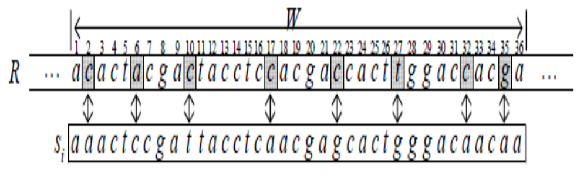
The Error Bound Setting Problem

Slide 8
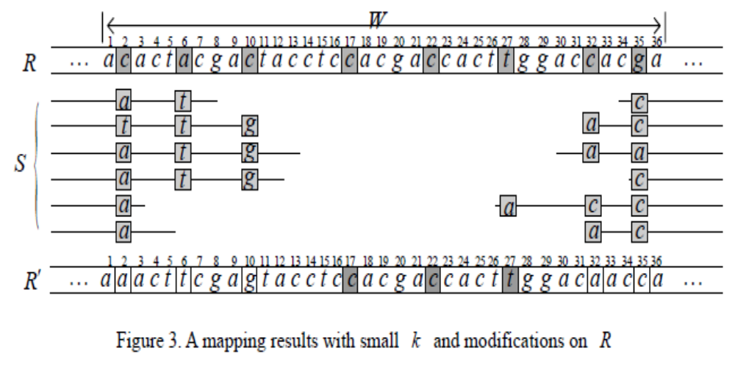
Progressive Strategy to Solve the Resequencing Problem

Slide 9
Step 1: Mapping
Let k’ be the average number of sequencing errors. We set k = k’ +1.
E.g. 5% sequencing errors in the reads with length 35.
k = 5%×35 +1 ≈ 2 +1 = 3

Slide 10
Step 2: Voting
If a read Si of length m is mapped to
R(i, i + m −1), and the quality score of si[ j ] is larger than a preset value
qual _Threshold,
we add R[i +j ].score[si [ j ]] one score.

Slide 11
Step 3: Modifying Reference Sequence
TotalScore = ΣR[i].score[q], for all q∈Σ
for every R[ i ] of R , we modify it to be x if all the following conditions are satisfied.
  Condition 1:
    R[i].score[x] ≥ depth _Threshold .
  Condition 2:
    R[i].score[x] ≥ TotalScore* Sratio ,
    where 0 ≤ Sratio ≤ 1 .

Slide 12
Step 4: Iteration
If the number of reads being successful mapped onto the modified reference sequence is large enough, terminate the process; otherwise, set R = R’ and start another round from Step 1.

Slide 13
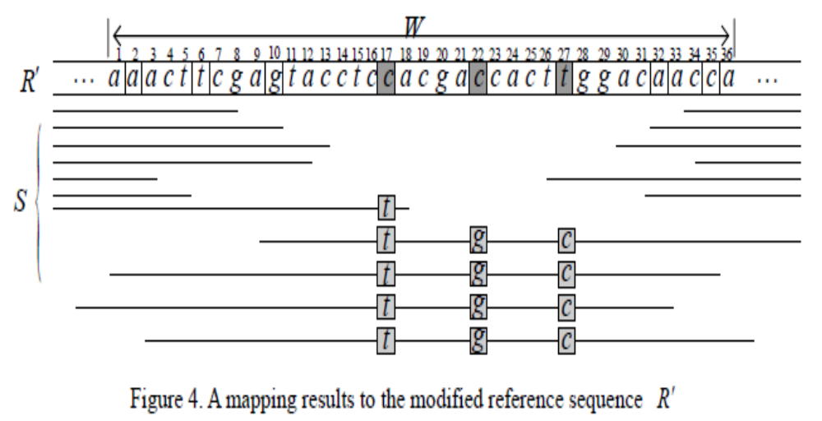

Slide 14
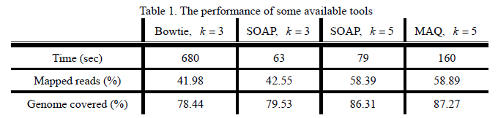
Experiments(1/2)
We used the genome sequencing data of Helicobacter pylori which were generated by Solexa system. There were 3,074,139 reads and each was of length 76. We selected the genome sequence “Helicobacter pylori 26695” to be our reference sequence R, downloaded from NCBI, and its length is around 1.6×10^{6.}

Slide 15
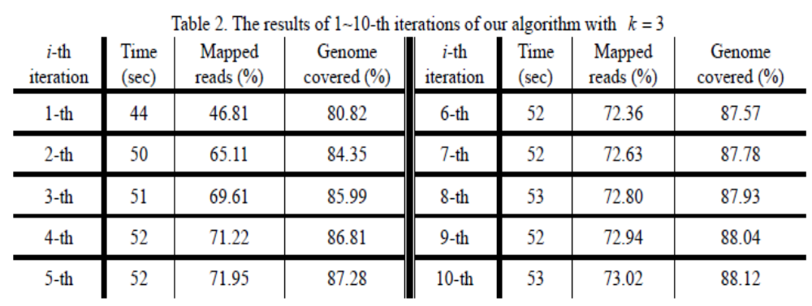
Experiments(2/2)
k = 3 , qual _Threshold = 70 ,
depth _Threshold = 3 and Sratio = 0.9 .

