Slide 1
A fast parallel algorithm for finding the longest common sequence of multiple biosequences
Yixin Chen, Andrew Wan and Wei Liu
BMC Bioinformatics 2006, 7(Suppl 4):S4
Presenter: Kai-Yu Chen
Date: July 19, 2010

Slide 2
Abstract(1/2)
Background: Searching for the longest common sequence (LCS) of multiple biosequences is one of the most fundamental tasks in bioinformatics. In this paper, we present a parallel algorithm named FAST_LCS to speedup the computation for finding LCS.
Results: A fast parallel algorithm for LCS is presented. The algorithm first constructs a novel successor table to obtain all the identical pairs and their levels. It then obtains the LCS by tracing back from the identical character pairs at the last level. Effective pruning techniques are developed to significantly reduce the computational complexity. Experimental results on gene sequences in the tigr database show that our algorithm is optimal and much more efficient than other leading LCS algorithms.

Slide 3
Abstract(2/2)
Conclusion: We have developed one of the fastest parallel LCS algorithms on an MPP parallel computing model. For two sequences X and Y with lengths n and m, respectively, the memory required is max{4*(n+1)+4*(m+1), L}, where L is the number of identical character pairs. The time complexity is O(L) for sequential execution, and O(|LCS(X, Y)|) for parallel execution, where |LCS(X, Y)| is the length of the LCS of X and Y. For n sequences X₁, X₂, ..., X_{n}, the time complexity is O(L) for sequential execution, and O(|LCS(X₁, X₂, ..., X_{n})|) for parallel execution. Experimental results support our analysis by showing significant improvement of the proposed method over other leading LCS algorithms.

Slide 4
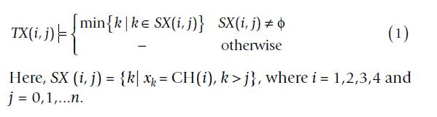
Methods
The identical character pair and its successor table
Let X = (x₁, x₂, ..., x_{n}), Y = (y₁, y₂, ..., y_{m}) be two biosequences, where x_{i}, y_{i} ∈ {A, C, G, T}. We can define an array CH of the four characters so that CH(1) = "A", CH(2)= "C", CH(3)= "G" and CH(4)= "T" .
The successor tables of the identical characters of X and Y are denoted as TX and TY, which are two dimensional arrays of size 4(n+1) × 4*(m+1). (?)
For sequence X = (x₁, x₂, ..., x_{n}), TX (i, j) in table TX is defined as follows.
It indicates the position of the next character identical to CH(i) after the jth position in sequence X, otherwise it means there is no such character after the jth position.

Slide 5
Methods
For the sequences X and Y, if x_{i} = y_{j} = CH(k), we call them an identical pair of CH(k) and denote it as (i, j). The set of all the identical character pairs of X and Y is denoted as S(X, Y).
Let (i, j) and (k, l) be two identical character pairs of X and Y. If i <k and j <l, we call (i,j) a predecessor of (k, l), or (k,l) a successor of (i, j), and denote the relationship as (i, j)< (k, l).
Let P(i, j) = {(r, s) | (i, j) < (r, s), (r, s)∈S(X,Y)} be the set of all the successors of identical pair (i, j), if (k, l)∈P(i, j) and there is no (k', l')∈ P(i, j) satisfying the condition: (k’,l') < (k, l) and x_{k'} = x_{k}, we call (k, l) the direct successor of (i, j), and denote the relationship as (i, j)>(k, l).

Slide 6
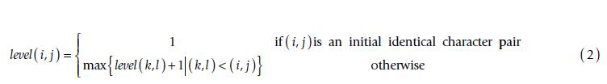
Methods
For an identical pair (i, j)∈S (X, Y), its level is defined as follows:
Theorem1. Denote the length of the LCS of X and Y as |LCS(X, Y)|, then |LCS(X, Y)| = max{level (i, j)|(i, j)∈S(X,Y)}.

Slide 7
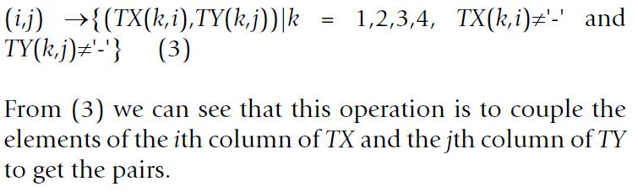
Methods
The operation of producing successors
For an identical character pair (i, j)∈S(X, Y), the operation of producing all its direct successors is as follows:
Ex. Identical character pair (2,5) can be obtained by coupling the elements of the 2nd column of TX and the 5th column of TY. There are (4,6),(3,-),(-,-) and (5,7). After discarding (3,-) and (-,-), the successors of (2,5) are just (4,6) and (5,7).
Theorem 2. For an identical character pair (i, j), the method in (3) above can produce all its direct successors.

Slide 8
Methods
The operations of pruning
Pruning Operation 1
If on the same level, there are two identical character pairs (i, j) and (k, l) satisfying (k, l)>(i, j), then (k, l) can be pruned without affecting the correctness of the algorithm in obtaining the LCS of X and Y.
Pruning Operation 2
If on the same level, there are two identical character pairs (i₁, j) and (i₂, j) satisfying i₁ <i₂, then (i₂, j) can be pruned without affecting the correctness of the algorithm in obtaining the LCS of X and Y.
Pruning Operation 3
If there are identical character pairs (i₁, j), (i₂, j), ...,(i_{r}, j) and i₁ <i₂<...<i_{r}, then we can prune(i₂, j),...,(i_{r}, j).

Slide 9
Methods
Framework of FAST_LCS
The framework of the FAST_LCS algorithm is as follows, where the phase of searching for all the identical character pairs consists of steps 1, 2, 3 and the phase of tracing back is in step 4.

Slide 10
Methods
Step 1. Build tables TX and TY;
Step 2. Find all the initial identical character pairs:(TX(k,0),TY(k, 0)), where k = 1,2,3,4, and add the records of the initial identical pairs (k, TX(k, 0), TY(k, 0), 1, Φ, active), k= 1,2,3,4 to the table pairs.
Step 3. Repeat the following until there is no record in active state in table pairs.
Step 3.1 For all active identical pairs (k, i, j, level, pred, active) in pairs parallel-do
Step 3.1.1 Produce all the direct successors of (k, i, j, level, pred, active).
Step 3.1.2 For each identical character pair (g, h) in the direct successors set of (k, i, j, level, pred, active), a new record (k', g, h, level+1, k, active) is generated and inserted into the table pairs.
Step 3.1.3 Change the state of (k, i, j, level, pred, active) into inactive.
Step 3.2 Use the pruning operations on all the successors produced on this level to remove all the redundant identical pairs from table pairs.

Slide 11
Methods
Step 4. Compute r = the maximum level in the table pairs.
For all the identical pairs (k, i, j, r,l,inactive) in pairs parallel-do
Step 4.1. pred = l; LCS(r) = x_{i}.
Step 4.2 While pred ≠ Φ do
Step 4.2.1 get the pred-th record (pred, g, h, r',l', inactive) from table pairs.
Step 4.2.2 pred = l'; LCS(r') = x_{g}.

Slide 12
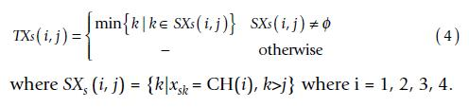
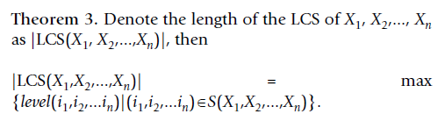

Methods
Finding the LCS of multiple sequences using FAST_LCS
Suppose there are n sequences X₁, X₂, ..., X_{n}, where X = (x_{i1}, x_{i2}, ..., x_{i,ni}), n_{i} is the length of X_{i,} x_{ij}∈ {A, C, G, T} where j = 1, 2, ..., n_{i}.

Slide 13
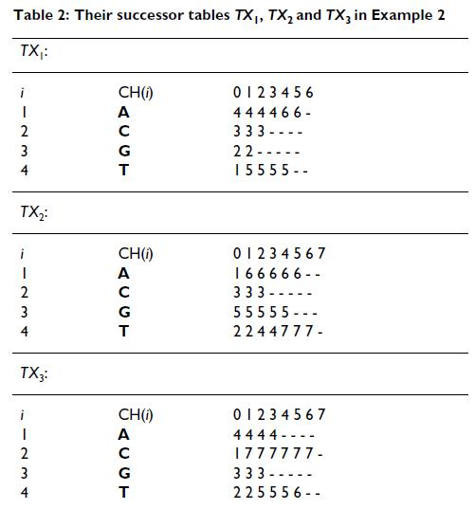
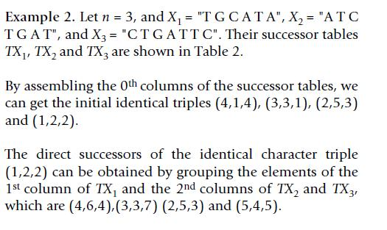
Methods

Slide 14
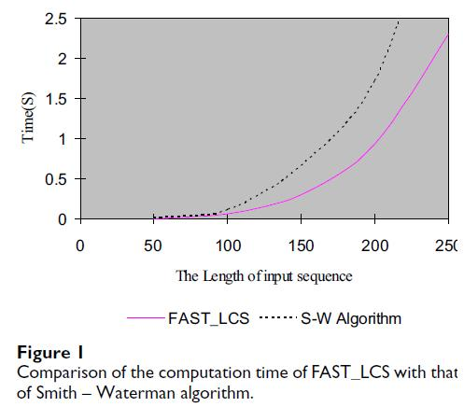
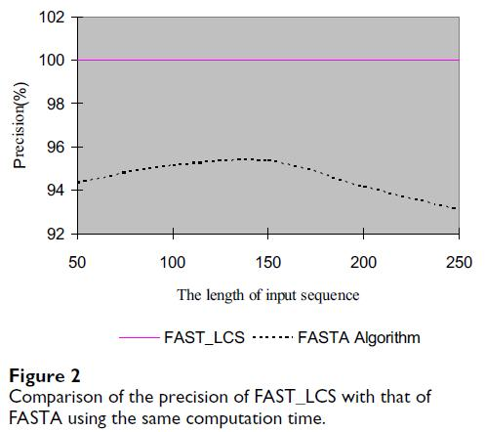
Results
The results of sequential computation on two sequences

Slide 15
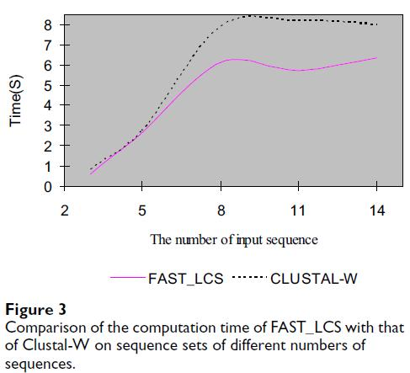
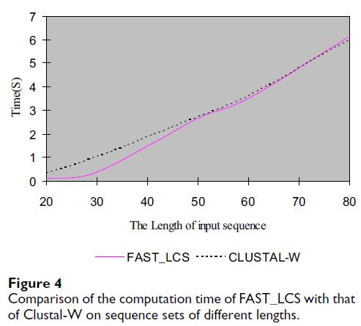
Results
The results of sequential computing on multiple sequences

Slide 16
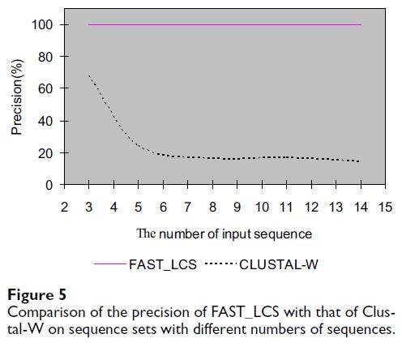
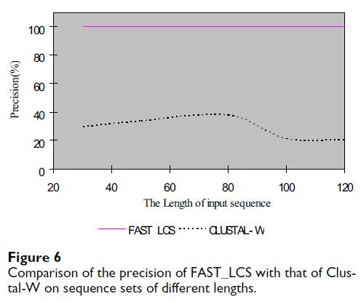
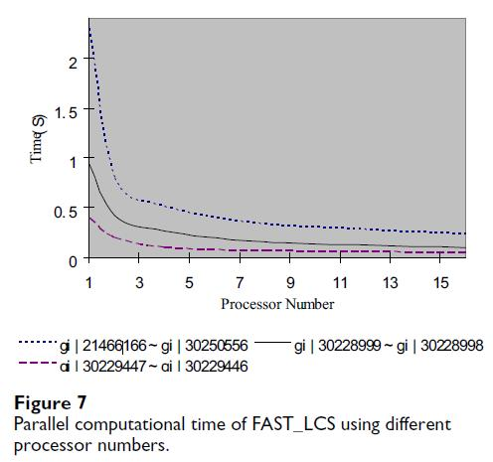
Results
The results of parallel computing

Slide 17
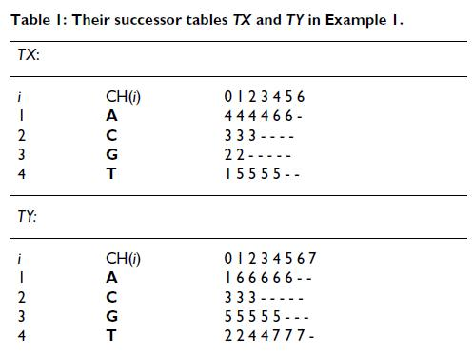
back

