Slide 1
A hierarchical Naive Bayes Model for handling sample heterogeneity in classification problems: an application to tissue microarrays
Francesca Demichelis, Paolo Magni, Paolo Piergiorgi, Mark A Rubin and Riccardo Bellazzi
BMC Bioinformatics 2006, 7:514

Slide 2
Abstract
Background: Uncertainty often affects molecular biology experiments and data for different reasons. Heterogeneity of gene or protein expression within the same tumor tissue is an example of biological uncertainty which should be taken into account when molecular markers are used in decision making. Tissue Microarray (TMA) experiments allow for large scale profiling of tissue biopsies, investigating protein patterns characterizing specific disease states. TMA studies deal with multiple sampling of the same patient, and therefore with multiple measurements of same protein target, to account for possible biological heterogeneity. The aim of this paper is to provide and validate a classification model taking into consideration the uncertainty associated with measuring replicate samples.

Slide 3
Abstract
Results: We propose an extension of the well-known Naive Bayes classifier, which accounts for biological heterogeneity in a probabilistic framework, relying on Bayesian hierarchical models. The model, which can be efficiently learned from the training dataset, exploits a closed-form of classification equation, thus providing no additional computational cost with respect to the standard Naive Bayes classifier. We validated the approach on several simulated datasets comparing its performances with the Naive Bayes classifier. Moreover, we demonstrated that explicitly dealing with heterogeneity can improve classification accuracy on a TMA prostate cancer dataset.

Slide 4
Abstract
Conclusion: The proposed Hierarchical Naive Bayes classifier can be conveniently applied in problems where within sample heterogeneity must be taken into account, such as TMA experiments and biological contexts where several measurements (replicates) are available for the same biological sample. The performance of the new approach is better than the standard Naive Bayes model, in particular when the within sample heterogeneity is different in the different classes.

Slide 5
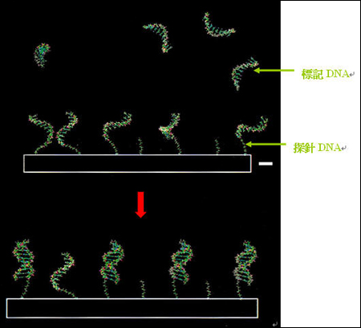
微陣列系統(microarray)
微陣列系統(microarray)，俗稱生物晶片，主要是透過DNA-DNA雜合反應或是蛋白質之間的特異性結合，可同時偵測數千至數萬個基因，右圖顯示DNA陣列晶片利用雜合反應(Hybridization)產生雙股的互補性結合。
http://life.nctu.edu.tw/~mb/c70201.htm

Slide 6
微陣列系統(microarray)
一般來說，陣列晶片材質可分為尼龍薄膜(Nylon membrane)或載玻片(Slide)，上面固定並排列大量DNA或蛋白質探針，利用可見光顯色方式(Colorimetric Development method)或螢光顯色方式(Fluorescent method)來分析檢驗生物樣本。
微陣列系統可分為DNA晶片(DNA microarray)，蛋白質晶片(Protein microarray)，細胞晶片(Cell micro array)，組織晶片(tissue microarray)。
http://life.nctu.edu.tw/~mb/c70201.htm

Slide 7
微陣列系統實驗流程
一般標準microarray實驗流程如下圖所示，在實驗樣本蒐集完以後，接下來就是進行樣本標定，將樣本的mRNA經反轉錄成cDNA或是試管外轉錄(in vitro transcription)時，以螢光物質(Cy3 or/and Cy5)或是生物素(biotin)進行標定。為了區分微陣列上的cDNA以及樣本標定後的cDNA，我們定義點在微陣列上的DNA定義為探針(probe)，而欲進行實驗的樣本(DNA或是RNA)則稱為標的(target)，以避免混淆。標定好的target與probe進行雜合以及後續清洗處理後，再以適當的偵測方法獲得雜合後的影像。接下來的訊號分析以及群組分類，則必須仰賴適當的軟體以及分類運算，將微陣列所得到的大量基因訊號，轉換成有生物意義的訊息，提供生物學家進行更進一步的研究。
http://life.nctu.edu.tw/~mb/c70201.htm

Slide 8
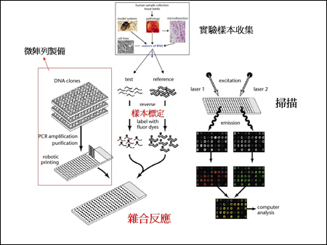
微陣列系統實驗流程
http://life.nctu.edu.tw/~mb/c70201.htm

Slide 9
微陣列系統的優點
微陣列系統最主要的優點就是能在短時間之內得到大量基因表現的結果，透過這些實驗，許多先前未被發現的訊息傳導路徑的基因，也已經獲得證實，如MYC、WT1、p53等。目前有許多不錯的分析軟體，利用數學演算法來分析微陣列系統上的基因訊號。
http://life.nctu.edu.tw/~mb/c70201.htm

Slide 10

The Brier score
Commonly used verification measure for assessing the accuracy of probability forecasts
The score is the mean squared error of the probability forecasts over the verification sample.
Assuming that p_{i} is the probability that was forecast, o_{i} the actual outcome of the event at instance i (0 if it doesn't happen and 1 if it happens) and N is the number of forecasting instances
http://en.wikipedia.org/wiki/Brier_score

Slide 11
The Brier score
Suppose it is required to give a probability P forecast of a binary event – such as a forecast of rain. The forecast issued says that there is a probability P that the event will occur. Let X = 1 if the event occurs and X = 0 if it doesn’t.
  If you forecast P = 1 and there is rain => BS = 0
  If you forecast P = 0.7 and there is rain => BS = (0.7-1)^2=0.09
  If you forecast P = 0.3 and there is rain => BS = (0.3-1)^2=0.49
  If you forecast P = 0 and there is rain => BS = 1
http://en.wikipedia.org/wiki/Brier_score

Slide 12
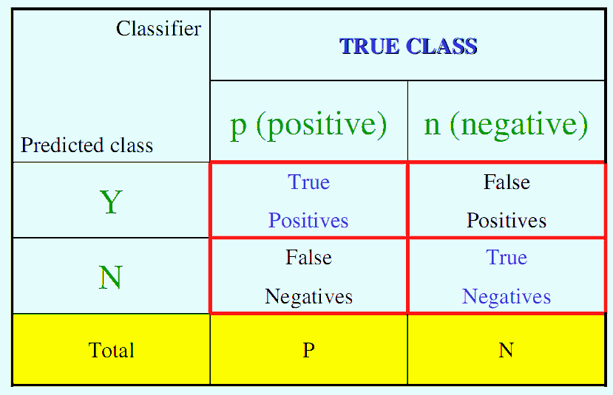
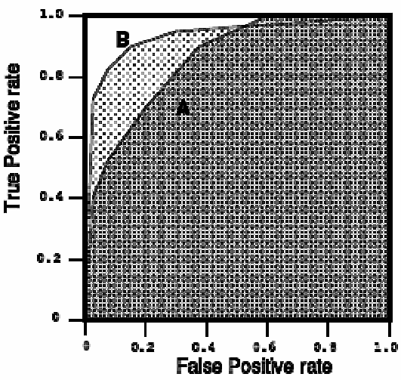
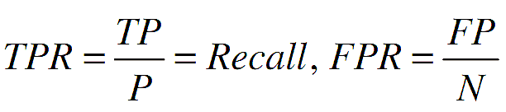
Receiver Operating Characteristic (ROC)
AUC
http://www.anaesthetist.com/mnm/stats/roc/Findex.htm

Slide 13
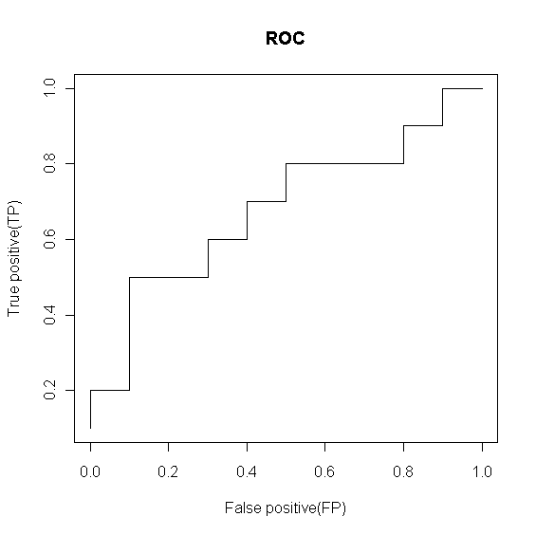
Receiver Operating Characteristic (ROC)
Use thresholds to create ROC curve
Score Class
------------------
0.9 P
0.8 P
0.7 N
0.6 P
0.55 P
0.54 P
0.53 N
0.52 N
0.51 P
0.505 N
0.4 P
0.39 N
0.38 P
0.37 N
0.36 N
0.35 N
0.34 P
0.33 N
0.30 P
0.1 N
threshold=0.900000
N P
N 10 9
P 0* 1*
TP FP
0.1 0.0
------------------
threshold=0.800000
N P
N 10 8
P 0* 2*
TP FP
0.2 0.0
------------------
threshold=0.300000
N P
N 1 0
P 9* 10*
TP FP
1.0 0.9
http://www.anaesthetist.com/mnm/stats/roc/Findex.htm
Notes:
tb <- read.table('roct.txt',header=T)
tn <- table(tb[,2]); x<- NULL
for(thr in tb[,1]){
print(sprintf('threshold=%f',thr),quote=F)
print(ttb <- table(ifelse(tb[,1]>=thr,"P","N"),tb[,2]))
dttb <- c(ttb['P','P'],ttb['P','N'])
x <- rbind(x, dttb/tn); dttbxy <- dttb/tn; names(dttbxy) <- c('TP','FP')
print(dttbxy)
}
plot(x[,2],x[,1],xlab='False positive(FP)',ylab='True positive(TP)',type='l',main='ROC')

Slide 14
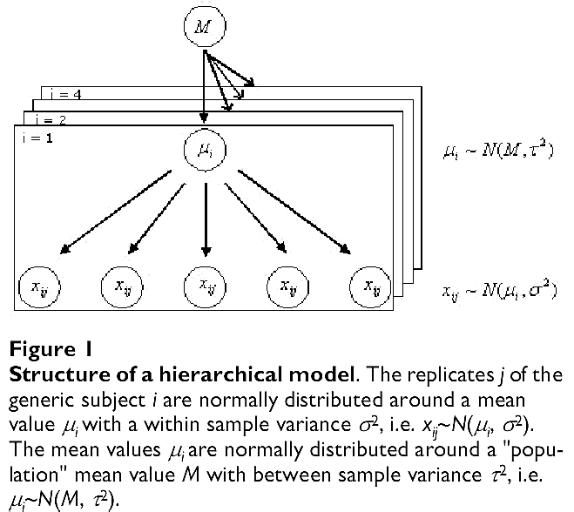
The hierarchical Bayesian model
範例一：假設μ₁,...μ_{i}... μ_{k}為k所學校學生平均數學成績，我們可以假設μ₁,...μ_{i}... μ_{k}為可由常態分佈N(M,τ²)描述，另外，在第i所學校學生數學成績x_{i1},x_{i2},…,x_{ij},...可由常態分佈N(μ_{i},σ²)描述，其中M與μ均為平均數，τ及σ為標準差

Slide 15
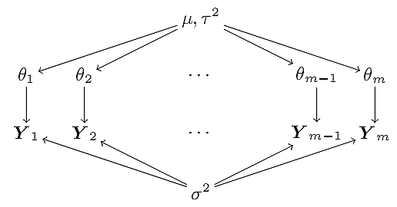
The hierarchical Bayesian model
同上範例不過M→μ、 μ→θ 、 x→Y假設θ₁,...θ_{i},... ,θ_{k}為k所學校學生平均數學成績，假設可由常態分佈N(μ,τ²)描述，另外，在第i所學校學生數學成績Y₁,Y₂,…,Y_{m}可由常態分佈N(θ_{i},σ²)描述，此種描述方式更易了解變數相依關係
P.D. Hoff, A First Course in Bayesian Statistical Methods

Slide 16
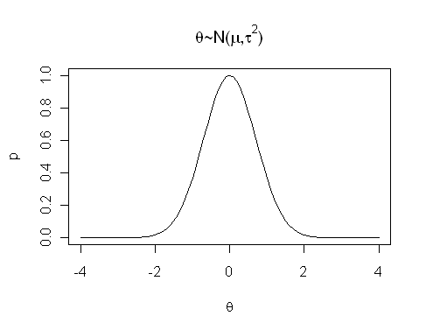

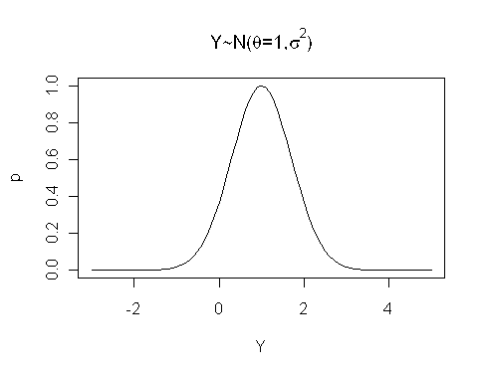
The hierarchical Bayesian model
P.D. Hoff, A First Course in Bayesian Statistical Methods
Notes:
x<-seq(-4,4,0.1)
x11()
plot(x,exp(-x^2),type='l',xlab=expression(theta),ylab='p',main=expression(paste(theta,'~N(',mu,',',tau^2,')',sep='')))
x<-seq(-3,5,0.1)
x11()
plot(x,exp(-(x-1)^2),type='l',xlab='Y',ylab='p',main=expression(paste(Y,'~N(',theta,'=1,',sigma^2,')',sep='')))
x<-seq(-6,2,0.1)
x11()
plot(x,exp(-(x+2)^2),type='l',xlab='Y',ylab='p',main=expression(paste(Y,'~N(',theta,'=-2,',sigma^2,')',sep='')))

Slide 17

Bayes theorem
P(h): prior probability of hypothesis h, may reflect any background knowledge that h holds
P(D): prior probability of training data D is observed
P(D|h): the probability of observing D given that h holds
P(h|D): posterior probability that h holds after observing D
Tom M. Mitchell, "Machine Learning"

Slide 18
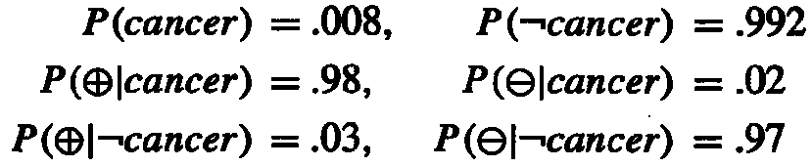
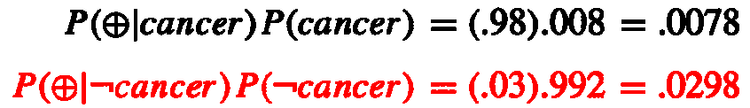
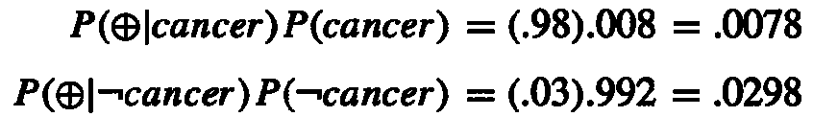
Bayes theorem example
P(cancer): the probability of the entire population that have cancer
P(⊕): the probability of laboratory test that shows positive outcome
Question: suppose we observe a person whose laboratory test is positive, should we diagnose him as have cancer or not?
Tom M. Mitchell, "Machine Learning"

Slide 19
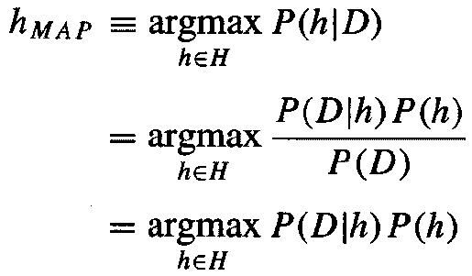
Maximum a posterior (MAP)
P(h|D): maximum posterior probability that h holds after observing D
Tom M. Mitchell, "Machine Learning"

Slide 20

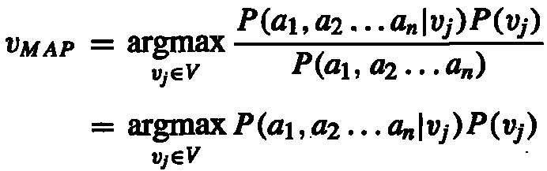
Navie Bayes classifier
Maximum a posterior (MAP)
Rewritten MAP
Tom M. Mitchell, "Machine Learning"

Slide 21
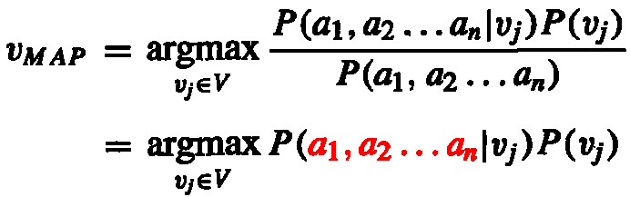
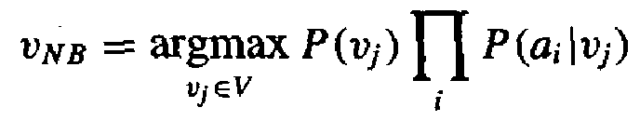
Navie Bayes classifier
It is impossible to enumerate all possible (a₁,a₂,...,a_{n}) combinations. Hence, we assume each attribute (feature) is independent. That is
The Navie Bayes classifier is
Tom M. Mitchell, "Machine Learning"

Slide 22
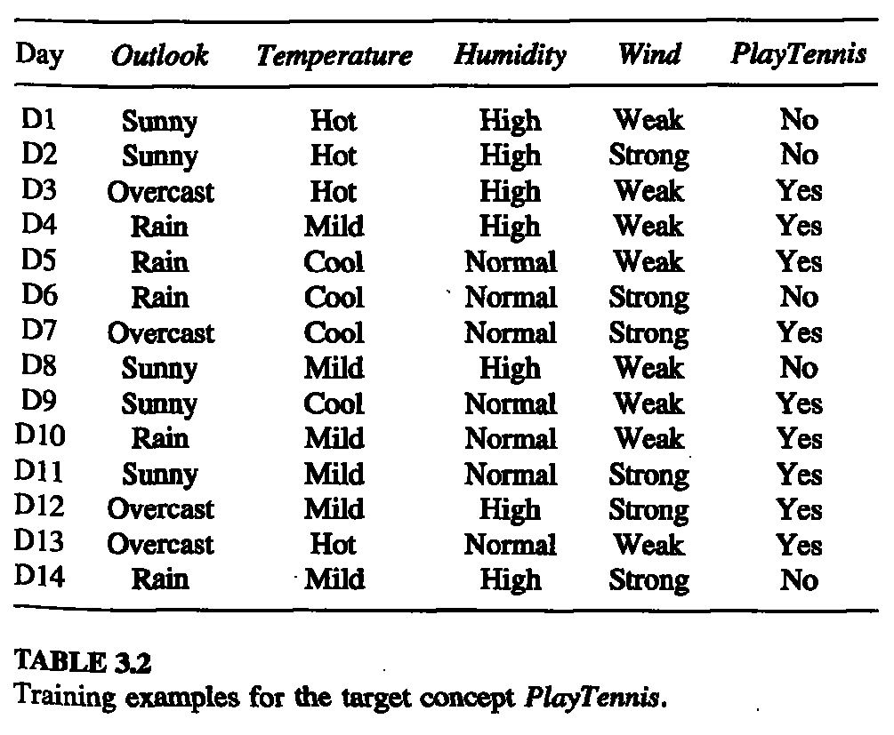
Navie Bayes classifier example
--Features, --Labels

Slide 23
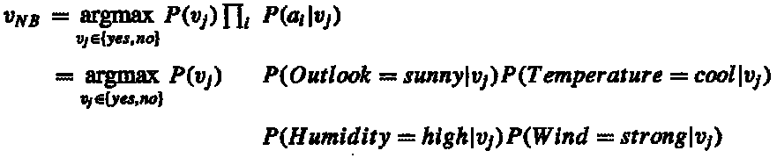
Navie Bayes classifier example
What we want to predict is: whether someone will play tennisthe given the following condition?
According to NB rule, the target value v_{NB} is:
Tom M. Mitchell, "Machine Learning"

Slide 24



Navie Bayes classifier example
P(Humidity=high|PlayTennis=yes)=3/9
P(Humidity=high|PlayTennis=no)=4/5
P(Temperature=cool|PlayTennis=yes)=3/9
P(Temperature=cool|PlayTennis=no)=1/5
P(Outlook=sunny|PlayTennis=yes)=2/9
P(Outlook=sunny|PlayTennis=no)=3/5
Tom M. Mitchell, "Machine Learning"

Slide 25
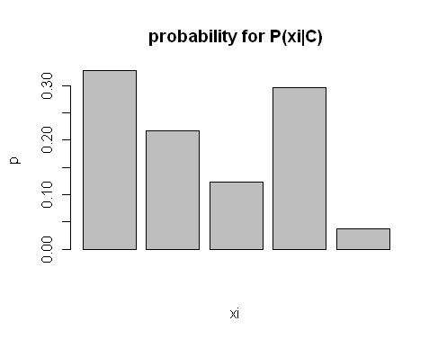
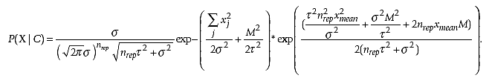
The difference betwwen hierarchical and conventional Navie Bayes (NB) classifier
For a single feature X
Conventional NB
Hierarchical NB(推導過程省略，怪怪的)
Notes:
x<-runif(5)
x <- x/ sum(x)
barplot(x,ylab='p',xlab='xi',main='probability for P(xi|C)')

Slide 26
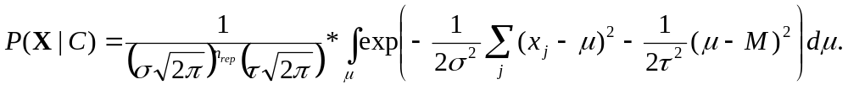
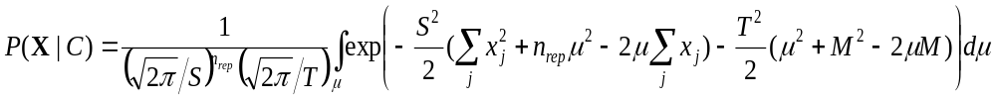
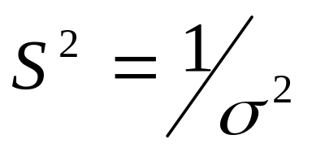
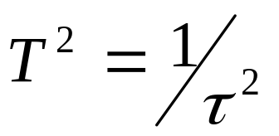
The marginal likelihood P(X | C_{k}, σ², M, τ²) computed exploiting the conditional independence assumption of the Hierarchical Naïve Bayes Model can be written as:
For simplicity, we can write:
where

Slide 27
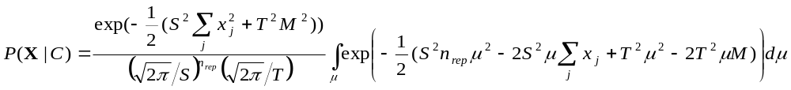
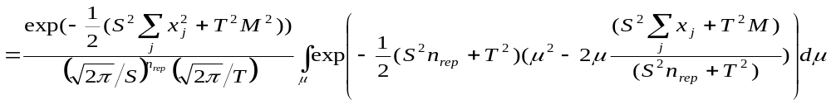
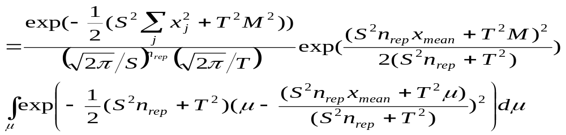
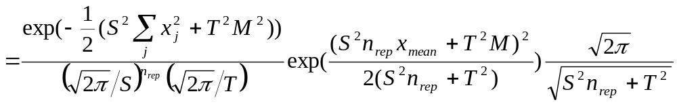

Slide 28
Hierirchical NB on TMA
在同一類試驗者中，假設他們的平均(或期望)TMA資料是程常態分佈
在個別試驗者取TMA資料時，通常會進行很多次。多次數據並不會一模一樣，因此，每一病人之數筆TMA資料可視為一Cluster

Slide 29
Learning the Hierarchical Naive Bayes Model
由上面公式可知，HNB學習重點為以下參數估計
  M與μ_{i} ：為平均數(μ_{i}必須由個別試驗者數據估算)
  τ及σ：為標準差
  n_{rep}為在個別試驗者重複實驗次數

Slide 30
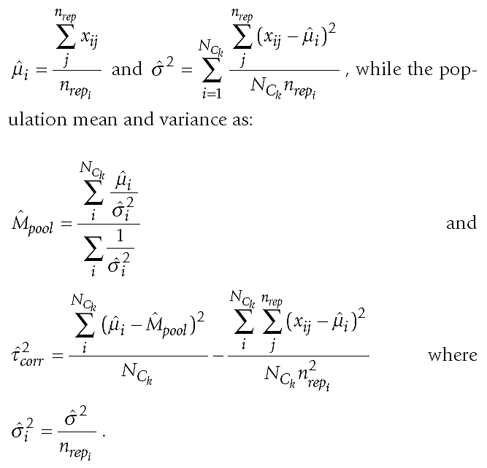

Slide 31
Real data experiments
兩類
  Class 1: EZH2, negative, non aggressive tumor
  Class 2: AMACR, positive, aggressive tumor
數據
  Class 1: 35 (重複4次取樣)
  Class 2: 34 (重複4次取樣)
特徵：15?
10 fold cross-validation

Slide 32
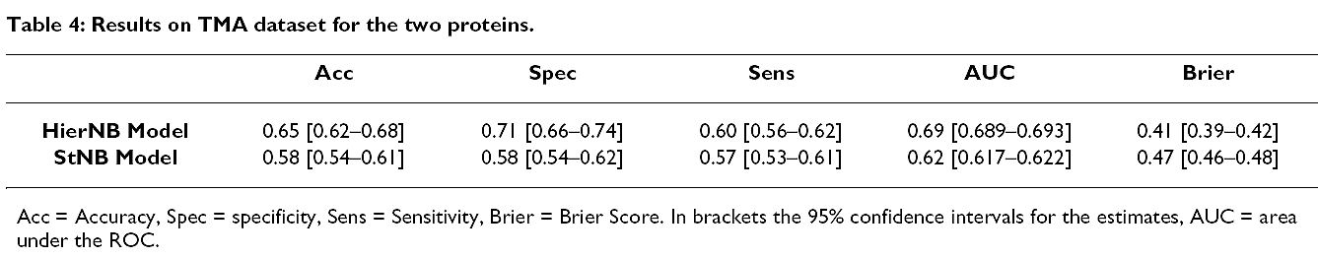
Real data experiments

Slide 33
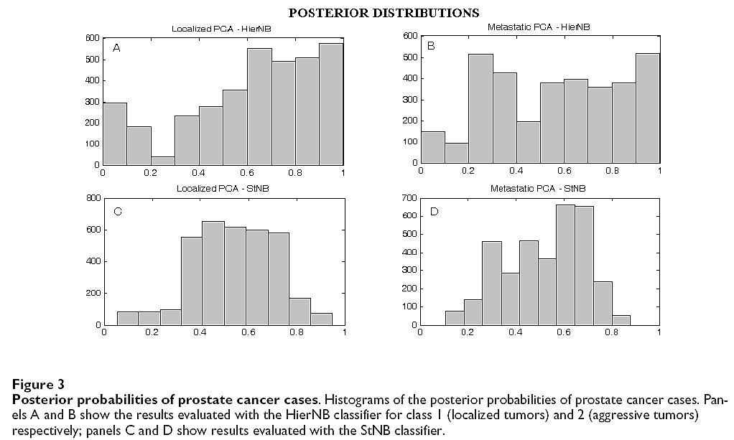
Real data experiments
Hierarchical NB算出來的機率均較高

