Slide 1
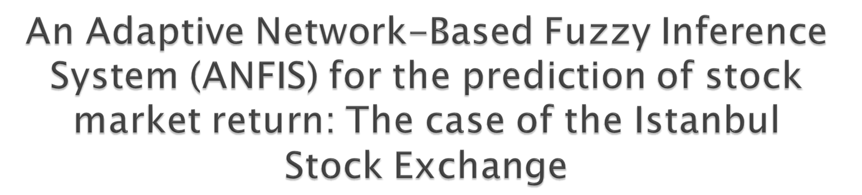
Melek Acar Boyacioglu , Derya Avci
Expert Systems with Applications xxx (2010) xxx–xxx
Presenter: Siao-ming Jhou
Date: July 19, 2010

Slide 2

Stock market prediction is important and of great interest because successful prediction of stock prices may promise attractive benefits. These tasks are highly complicated and very difficult. In this paper, we investigate the predictability of stock market return with Adaptive Network-Based Fuzzy Inference System (ANFIS). The objective of this study is to determine whether an ANFIS algorithm is capable of accurately predicting stock market return. We attempt to model and predict the return on stock price index of the Istanbul Stock Exchange (ISE) with ANFIS.

Slide 3

We use six macroeconomic variables and three indices as input variables. The experimental results reveal that the model successfully forecasts the monthly return of ISE National 100 Index with an accuracy rate of 98.3%. ANFIS provides a promising alternative for stock market prediction. ANFIS can be a useful tool for economists and practitioners dealing with the forecasting of the stock price index return.

Slide 4


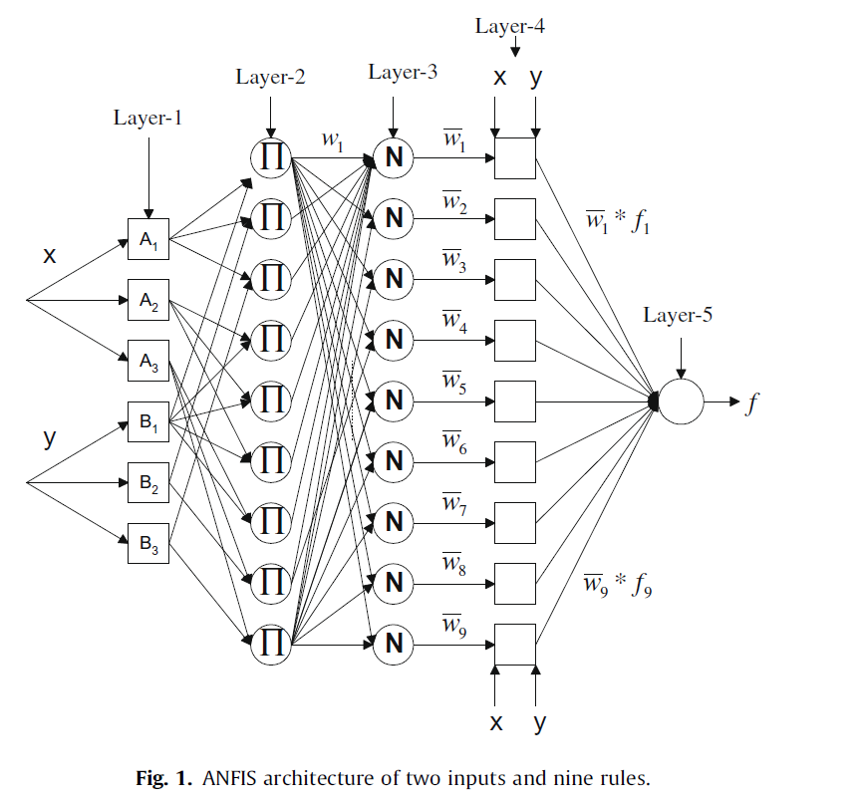
ANFIS將模糊推論系統與類神經網路兩種演算法結合，也就是將模糊推論系統架構於類神經網路上，使其充分發揮模式對於系統不確定性與不精確性的處理能力，同時具有自我學習與組織能力，能夠調整模式的參數。

Slide 5

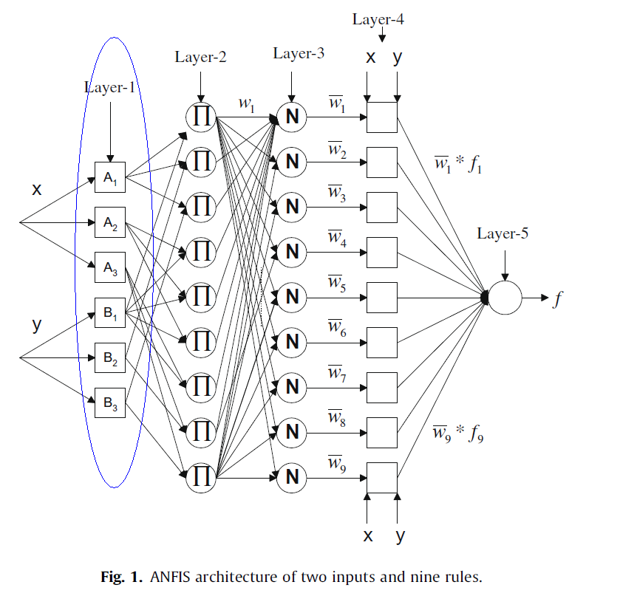


Slide 6

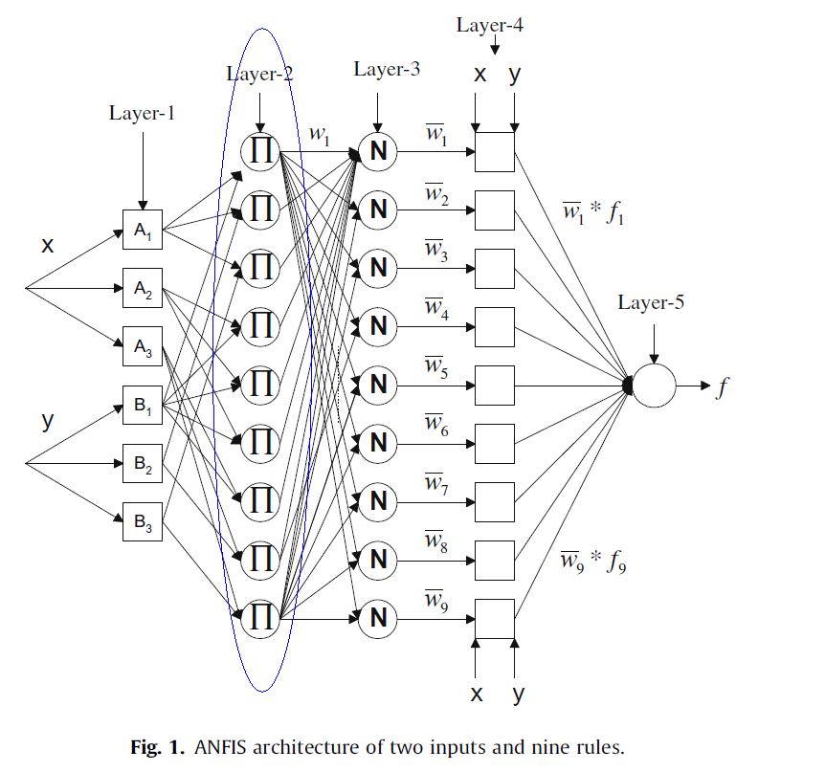


Slide 7

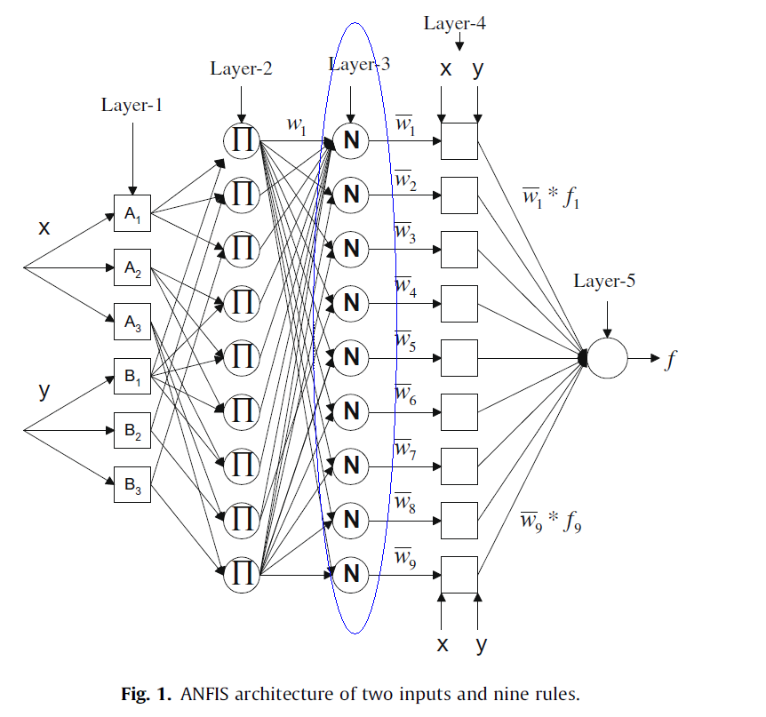

Slide 8

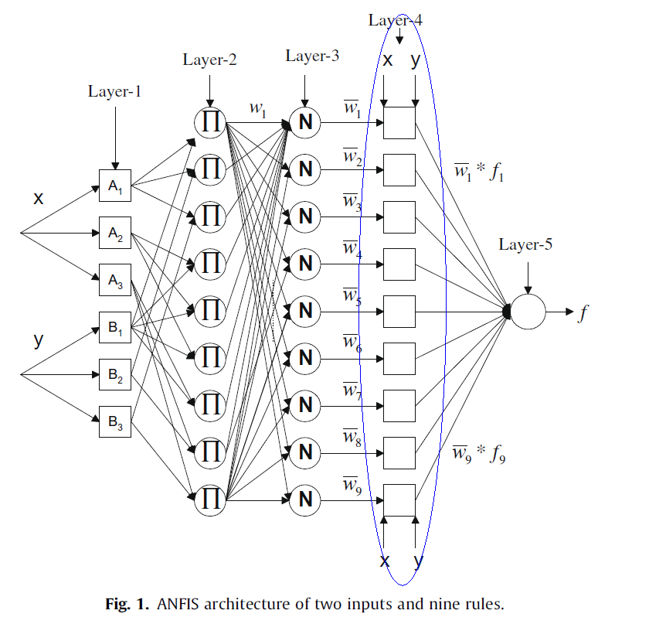

Slide 9

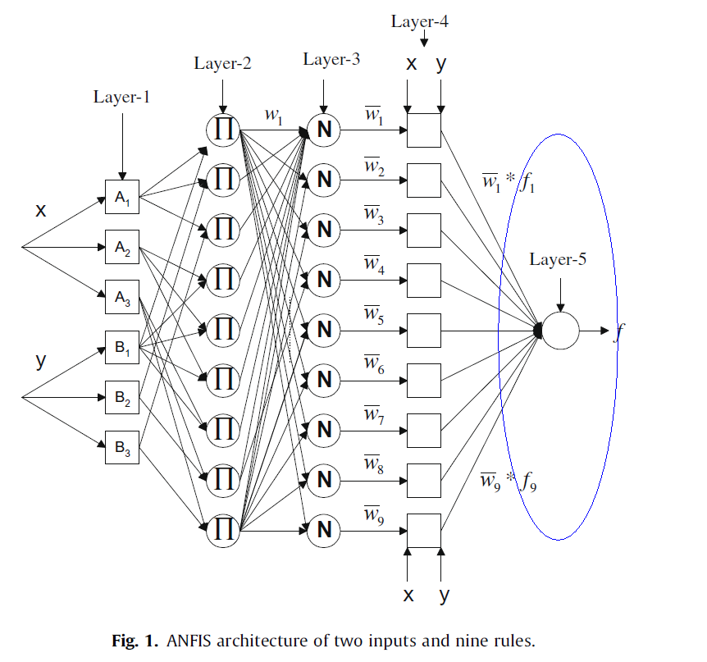
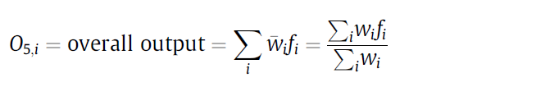

Slide 10
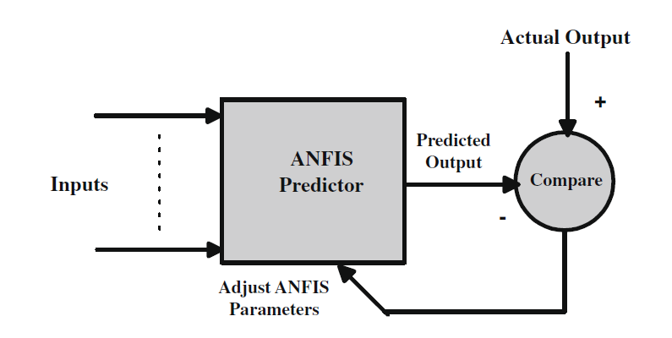

Slide 11
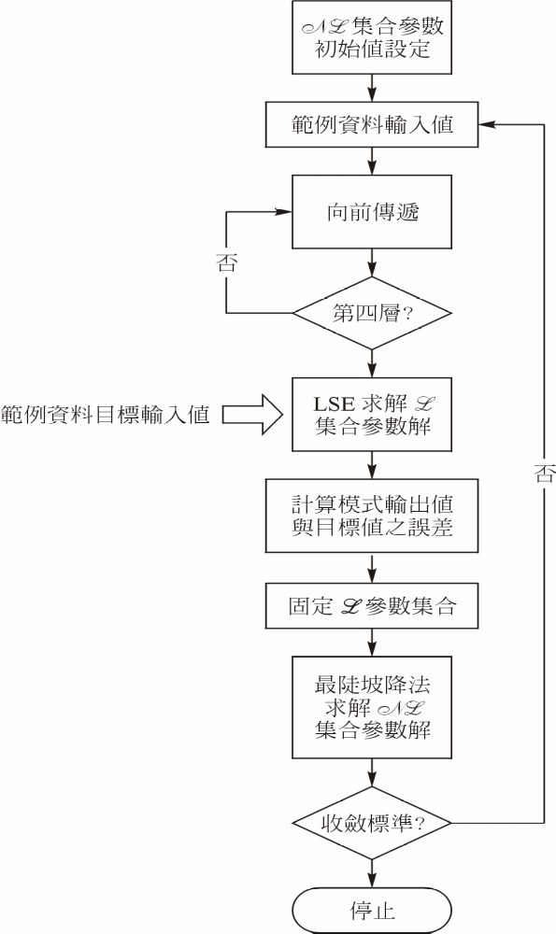

❖ 複合型學習演算法流程
台大生工系水資源資訊系統研究室

Slide 12

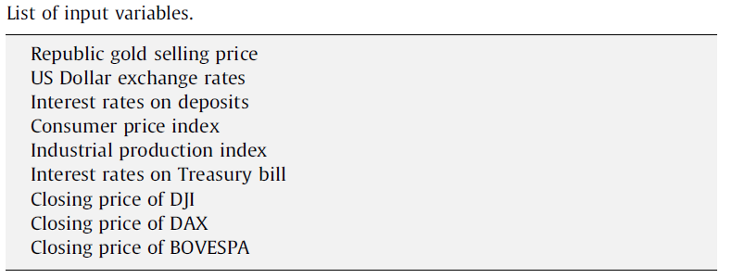
The research data used in this study are monthly macroeconomic
indicators, the DJI, DAX, BOVESPA Indices and the return
of the ISE National 100 Index.
The whole data set covers the period from January 1990 to December 2008, a total of 228 pairs of observations. The data set is divided into two parts. The first group of the data (122 pairs of
observations) is utilized for training the model. The second group
of the data (106 pairs of observations) is utilized for testing the
model.

Slide 13

道瓊工業平均指數（Dow Jones Industrial Average，DJIA）是由華爾街日報和道瓊公司創建者查爾斯·道創造的幾種股票市場指數之一。他把這個指數作為測量美國股票市場上工業構成的發展，是最悠久的美國市場指數之一。
時至今日，平均指數包括美國30間最大、最知名的上市公司。

Slide 14

德國DAX指數 是德國重要的股票指數。由德意志交易所集團（Deutsche Börse Group）推出的一個藍籌股指數。該指數中包含有30家主要的德國公司。DAX指數是全歐洲與英國金融時報指數齊名的重要證券指數，也是世界證券市場中的重要指數之一

Slide 15

是 聖保羅的 股票和期貨交易。 它是第四大交流在 美洲 的條款市值，僅次於 紐約證券交易所， 納斯達克和 多倫多證券交易所上市。

Slide 16
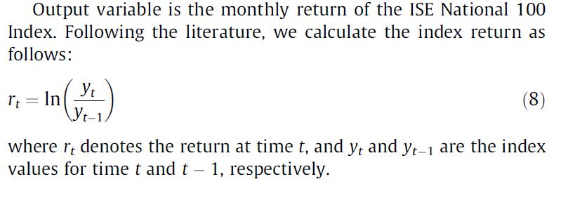

Slide 17

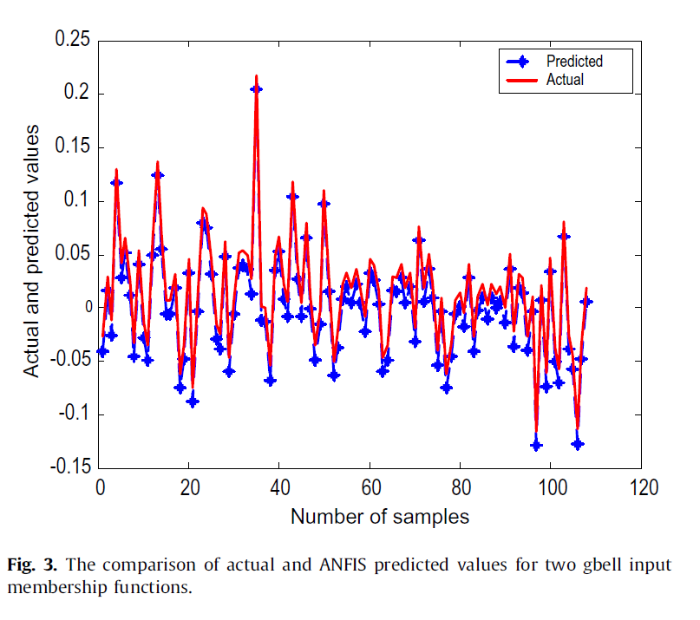

Slide 18

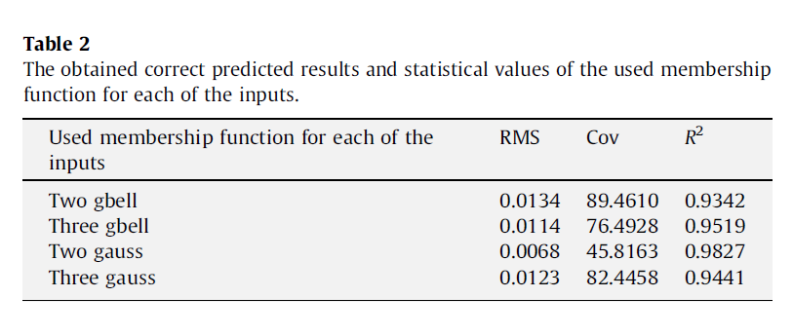
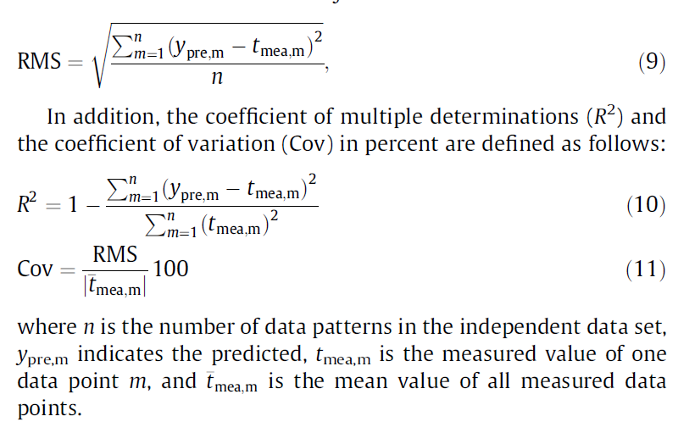

Slide 19


