Slide 1
Scaling Up Support Vector Machines Using Nearest
Neighbor Condensation
Fabrizio Angiulli and Annabella Astorino
IEEE TRANSACTIONS ON NEURAL NETWORKS, VOL. 21, NO. 2, FEBRUARY 2010, pp.351-357

Slide 2
Abstract
In this brief, we describe the FCNN-SVM classifier, which combines the support vector machine (SVM) approach and the fast nearest neighbor condensation classification rule (FCNN) in order to make SVMs practical on large collections of data. As a main contribution, it is experimentally shown that, on very large and multidimensional data sets, the FCNN-SVM is one or two orders of magnitude faster than SVM, and that the number of support vectors (SVs) is more than halved with respect to SVM. Thus, a drastic reduction of both training and testing time is achieved by using the FCNN-SVM. This result is obtained at the expense of a little loss of accuracy. The FCNN-SVM is proposed as a viable alternative to the standard SVM in applications where a fast response time is a fundamental requirement.

Slide 3
Training-Set-Consistent Subset
T: a labelled training set
p: an element of T
l(p): the label of p
nn(p,T): the point belonging to T with p as its nearest neighbor
A subset S of T is a training-set-consistent subset if for each p∈(T-S), if l(p)= l(nn(p,T))

Slide 4
Training-Set-Consistent Subset
: Class 1
: Class 2
: All training set (T)
: Training-Set-Consistent Subset (S)
: (T-S)

Slide 5
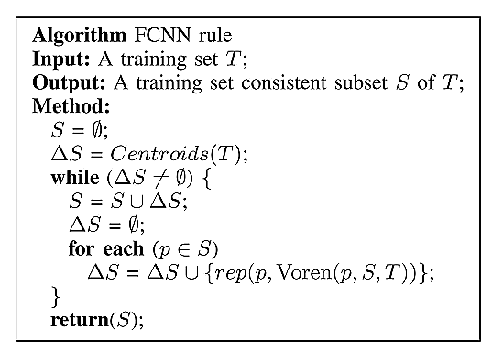
Fast Condensation Nearest Neighbor (FCNN)
訓練資料
分錯的點

Slide 6
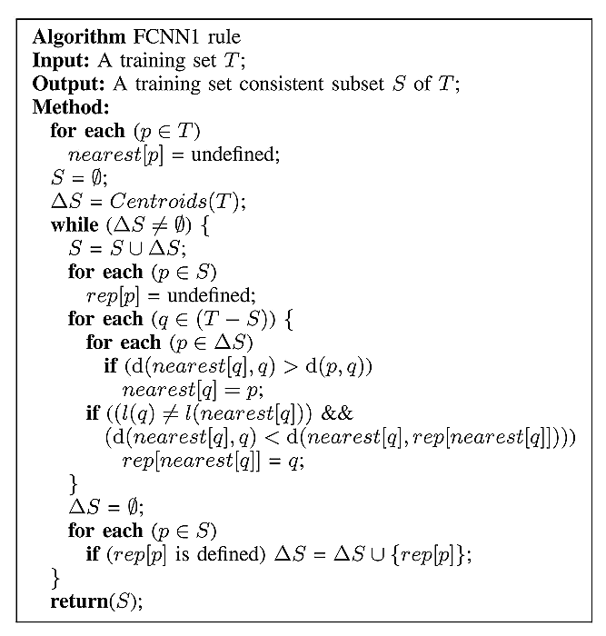
FCNN properties
FCNN terminates in a finite iteration.
FCNN is order independent.
FCNN1 requires at most |T|*|S| distance computations and O(|T|) space.

Slide 7
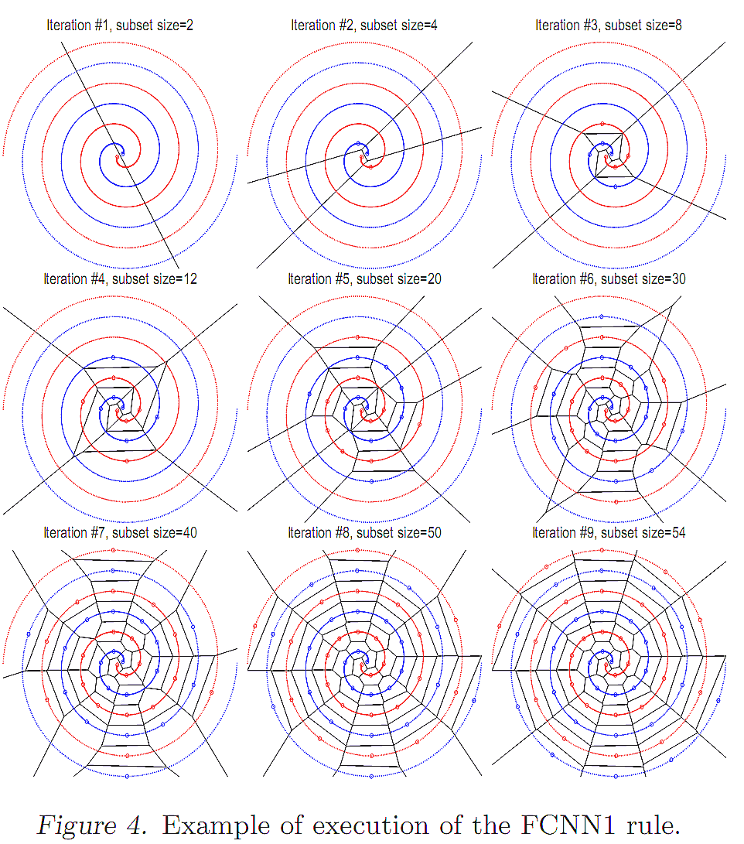
FCNN Experiments

Slide 8
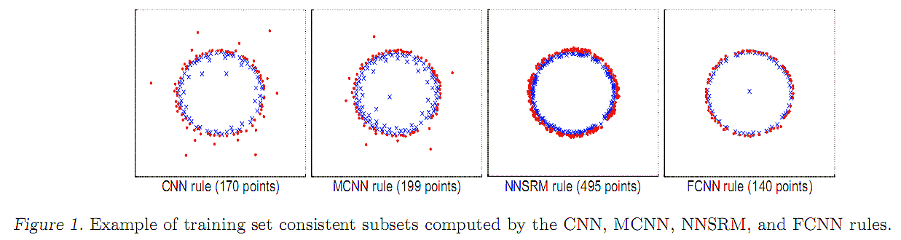
FCNN Experiments

Slide 9
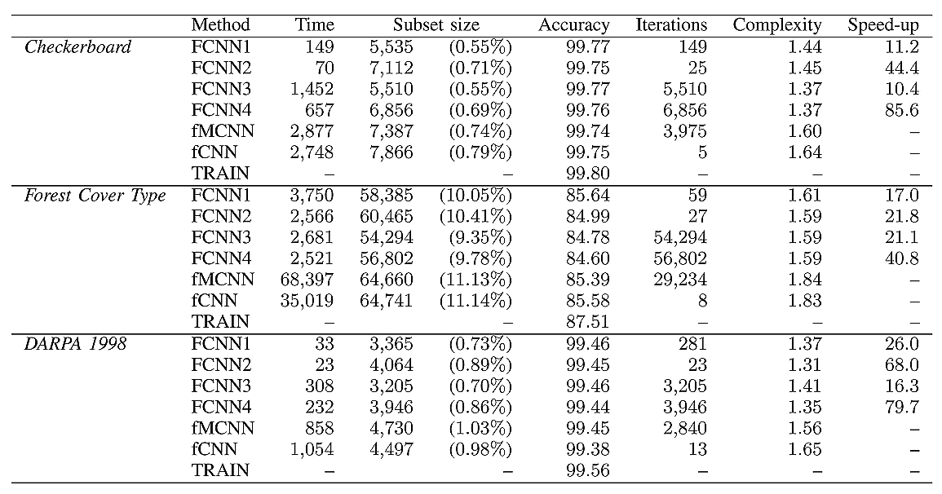
FCNN Experiments
10⁶ ,2D
581012,54D
458301,23D

Slide 10
FCNN exploits the triangle inequality
The FCNN rule takes advantage of the triangle inequality in order to avoid the comparison of each point in (T-S) with each point in ΔS.
d₁∈ΔS
r
q∈(T-S)
r
d₂∈ΔS
d₃∈ΔS
p∈S_{i-1}

Slide 11
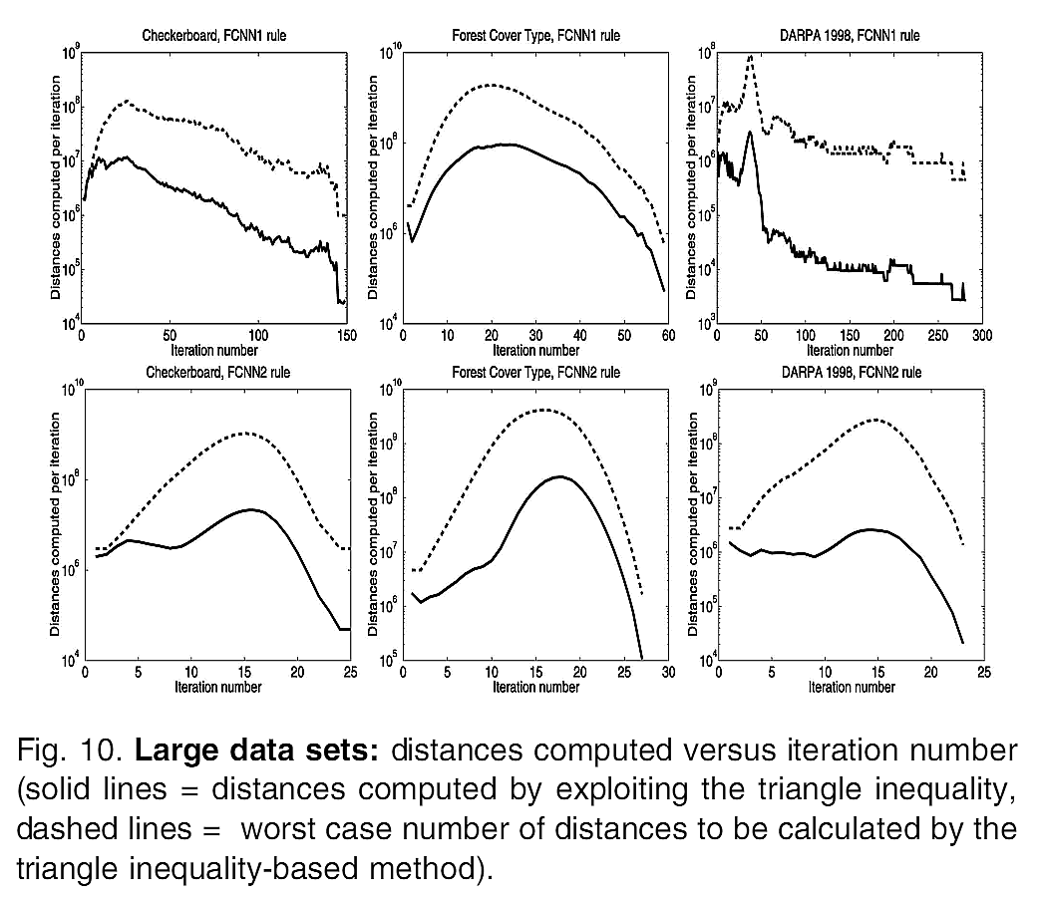
FCNN exploits the triangle inequality

Slide 12
FCNN SVM
Compute a training set consistent subset S of T
Train an SVM on the consistent subset S.
Time complexity
  SVM: O(N³)
  FCNN: O(Nn)
  FCNN SVM: O(Nn+n³)

Slide 13
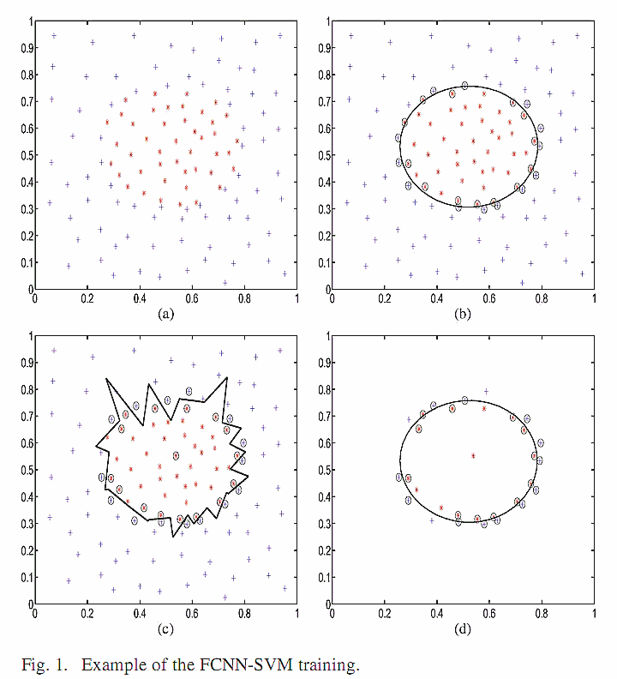
FCNN SVM
ORIGINAL DATA, 121 PTS
FULL DATA➔SVM, 26 SVS
FULL DATA➔FCNN, 31 PTS
FULL DATA➔FCNN ➔SVM, 24 SVS

Slide 14
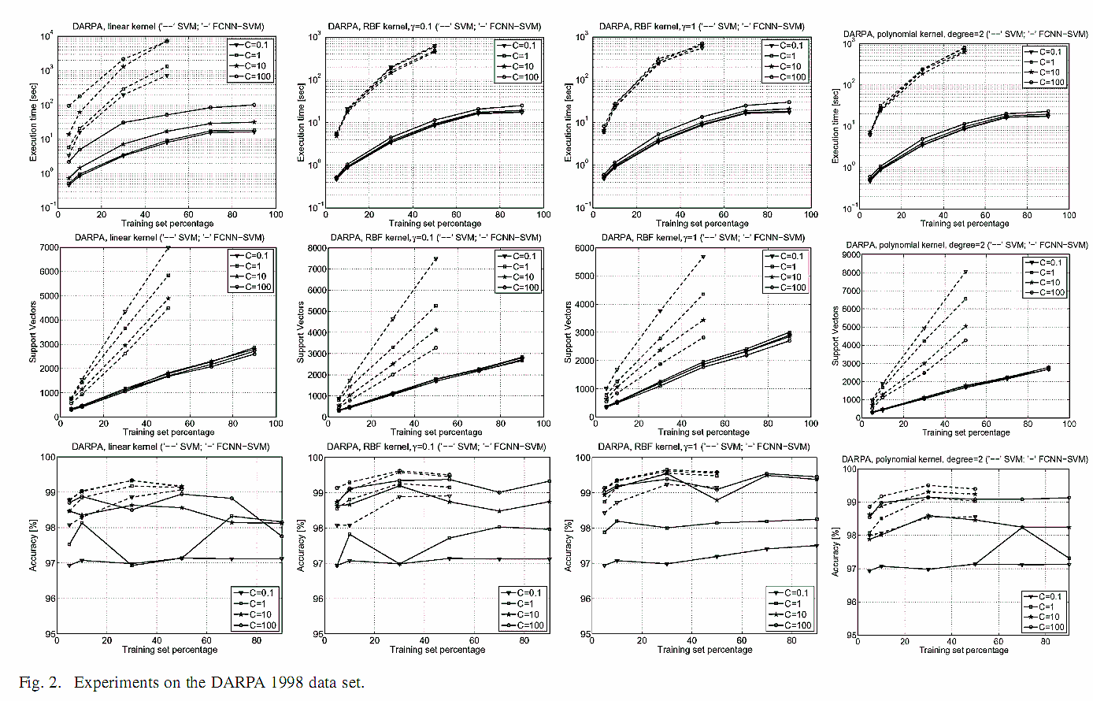
458301,23D

Slide 15
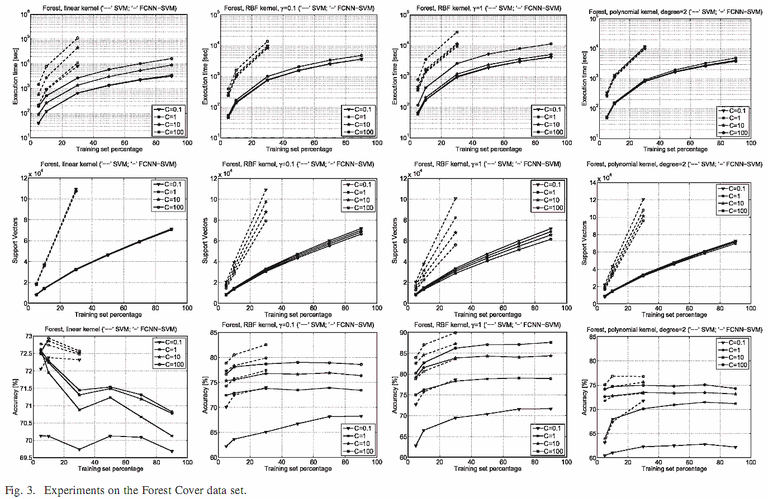
581012,54D

Slide 16
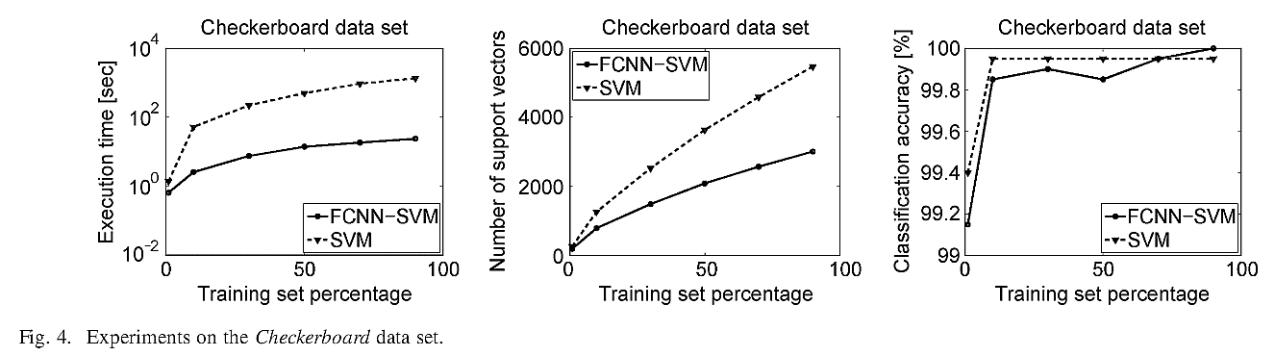
10⁶ ,2D

