Slide 1
Protein Contact Prediction Using Patterns of Correlation
Nicholas Hamilton, Kevin Burrage, Mark A. Ragan, and Thomas Huber
BIOINFORMATICS, Vol. 56, pp. 679–684, 2004
Presenter: Dong-Jian Lin
Date: Aug. 16, 2010

Slide 2
Abstract(1/2)
We describe a new method for using neural networks to
predict residue contact pairs in a protein. The main inputs
to the neural network are a set of 25 measures of
correlated mutation between all pairs of residues in two
“windows” of size 5 centered on the residues of interest.
While the individual pair-wise correlations are a relatively
weak predictor of contact, by training the network on
windows of correlation the accuracy of prediction is
significantly improved. The neural network is trained on a
set of 100 proteins and then tested on a disjoint set of 1033
proteins of known structure.

Slide 3
Abstract(2/2)
An average predictive accuracy of 21.7% is obtained taking
the best L/2 predictions for each protein, where L is the
sequence length. Taking the best L/10 predictions gives an
average accuracy of 30.7%. The predictor is also tested on
a set of 59 proteins from the CASP5 experiment. The
accuracy is found to be relatively consistent across
different sequence lengths, but to vary widely according to
the secondary structure. Predictive accuracy is also found
to improve by using multiple sequence alignments
containing many sequences to calculate the correlations.

Slide 4
Definition of a Contact
In the following we consider two residues to be in contact
if the distance between their CA atoms is less than 8 A˚ .
We chose only those pairs that areseparated by at least
four residues.

Slide 5
Generation of a Multiple Sequence Alignment and Predicted Secondary Structure
The Psipred version 2.3 software by D. Jones is used
to generate a prediction for the secondary structure as well
as giving a pair-wise multiple sequence alignment for the
proteins sequence.
For each pair of residues in the protein sequence we
generate a pattern of inputs for a neural network.

Slide 6
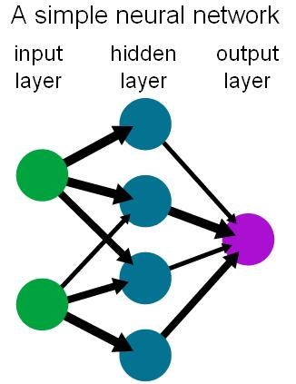
Neural Network
透過一組dataset讓
它學習其中的規則，
然後靠著這個規則來
判斷我們想要知的答
案。

Slide 7
Neural Network Inputs for Protein Contact
Prediction
Pairwise correlations (25 inputs)
Residue classes (10 inputs)
Predicted secondary structure (18 inputs)
Affinity score
Length of input sequence and residue separation(2 inputs)
Total 56 inputs

Slide 8
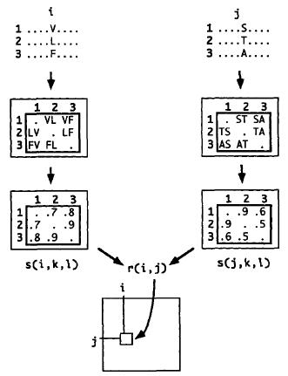


Slide 9
Network Architecture and Training
with 56 inputs, ten hidden units, and a single output.
The expected output is 1 for contacts and 0 for non-contacts.
1133 proteins were chosen from a representative set of proteins (pdb_select Sept 2001) of the Protein Data Bank.
100 proteins were randomly chosen for training.
The Stuttgart Neural Network Simulator(SNNS) version 4.2 was used to train the neural network.
Of the 739,753 patterns used for training, 17,996 were
contacts.

Slide 10
Testing the Trained Network
Once a “best” network was found, its performance was
tested on a set of 1033 proteins from the Protein Data
Bank

Slide 11
For a given target protein, we define the prediction
accuracy A_{N} on N predicted contacts to be
A_{N} = N_{c}/N
where N_{c} is the number of the predicted contacts that are indeed contacts. In the following, N will typically be one of L, L/2, L/5, or L/10 where L is the length of the sequence.

Slide 12
For a given protein, the random prediction accuracy, A_{R}, is defined to be the fraction of the patterns generated that are contacts. The improvement of a set of predictions is then given by
Improvement = A_{N}/A_{R}.

Slide 13
The coverage (fraction of observed contacts predicted) is
given as
Coverage = N_{c}/N_{obs},
where N_{obs} is the observed number of contacts.

Slide 14
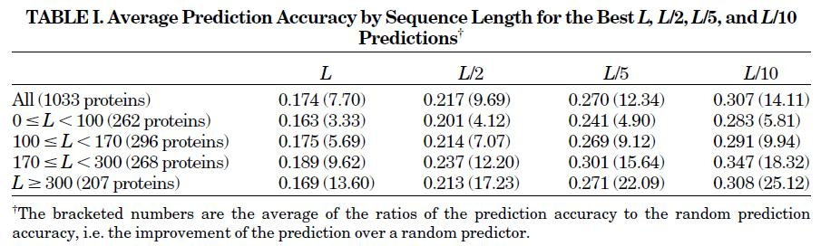
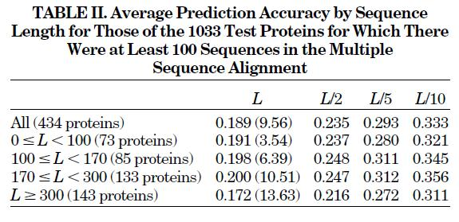
Results

Slide 15
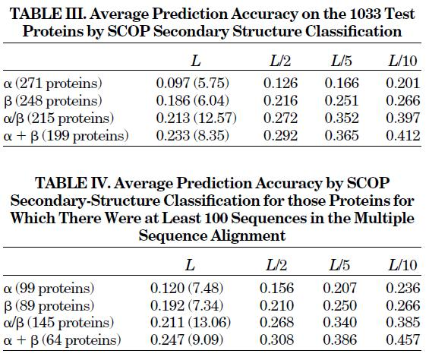

Slide 16
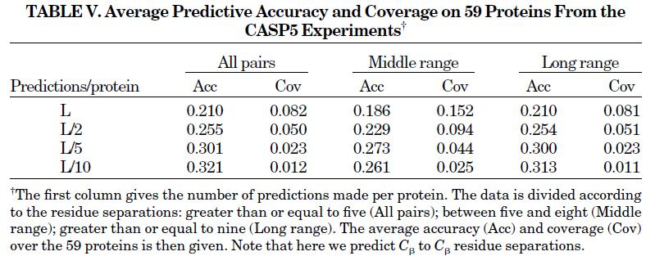

Slide 17
Thanks for your listening!

