Slide 1
Predicting disulfide connectivity from protein sequence using multiple sequence feature vectors and secondary structure
Jiangning Song, Zheng Yuan, Hao Tan, Thomas Huber and Kevin Burrage
Bioinformatics original paper, Vol. 23 no. 23 2007, pages 3147–3154
Speaker: Chong-Jie Wang
Date: August 16, 2010

Slide 2
Abstract(1/3)
Motivation: Disulfide bonds are primary covalent crosslinks between two cysteine residues in proteins that play critical roles in stabilizing the protein structures and are commonly found in extracy-toplasmatic or secreted proteins. In protein folding prediction, the localization of disulfide bonds can greatly reduce the search in conformational space. Therefore, there is a great need to develop computational methods capable of accurately predicting disulfide connectivity patterns in proteins that could have potentially important applications.

Slide 3
Abstract(2/3)
Results: We have developed a novel method to predict disulfide connectivity patterns from protein primary sequence, using a support vector regression (SVR) approach based on multiple sequence feature vectors and predicted secondary structure by the PSIPRED program. The results indicate that our method could achieve a prediction accuracy of 74.4% and 77.9%, respectively, when averaged on proteins with two to five disulfide bridges using 4-fold cross-validation, measured on the protein and cysteine pair on a well-defined non-homologous dataset. We assessed the effects of different sequence encoding schemes on the prediction performance of disulfide connectivity.

Slide 4
Abstract(3/3)
It has been shown that the sequence encoding scheme based on multiple sequence feature vectors coupled with predicted secondary structure can significantly improve the prediction accuracy, thus enabling our method to outperform most of other currently available predictors. Our work provides a complementary approach to the current algorithms that should be useful in computationally assigning disulfide connectivity patterns and helps in the annotation of protein sequences generated by large-scale whole-genome projects.

Slide 5
SVR(Support vector regression)
The objective of the regression problem is to estimate an unknown continuous-valued functionx y = f(x), which is based on a finite number of samples.

Slide 6
Sequence encoding schemes
Cysteine–cysteine coupling pair:
PSSM + SS
Amino acid compositions(A)
AA_{i}: percentage of residue type i
Cysteine separation distance(D)
DOC(i, j) = |i - j|

Slide 7
Sequence encoding schemes
Cysteine ordering(O):
the sequential order difference between each cysteine pair
Protein molecular weight (W)
Protein sequence length (L)

Slide 8
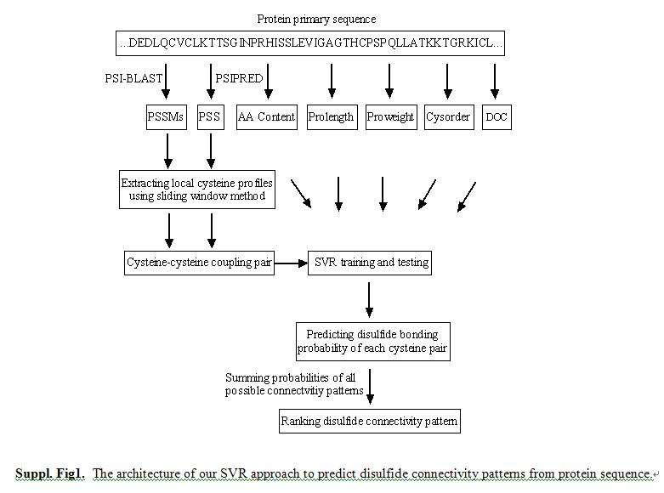

Slide 9
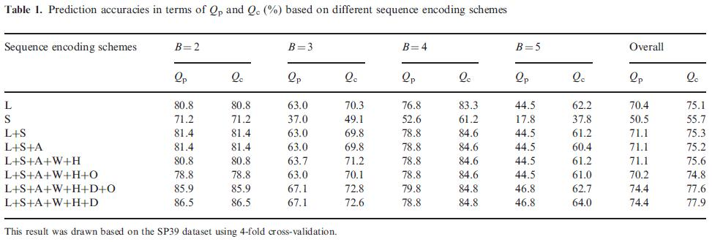
Results

Slide 10
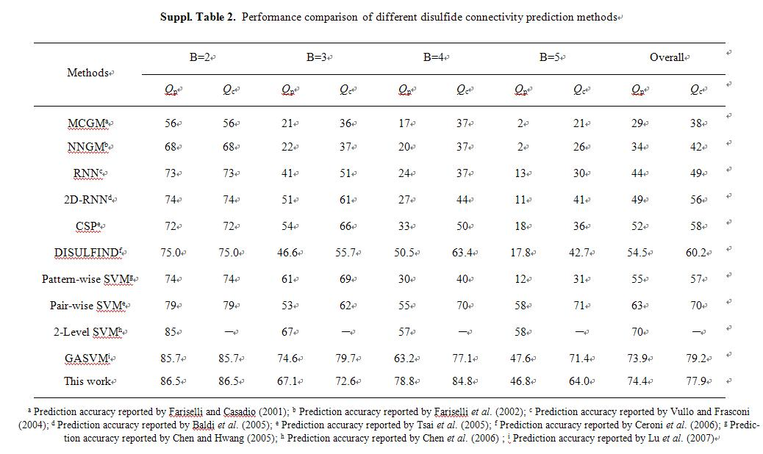

Slide 11
Thank you!

