Slide 1
Using Pseudo Amino Acid Composition to Predict Protein Subnuclear Localization: Approached with PSSM
Piyushkumar Mundra, Madhan Kumar, K. Krishna Kumar, Valadi K. Jayaramaan, Bhaskar D. Kulkarni
Chemical Engineering and Process Development Division, National Chemical Laboratory, Dr. Homi Bhabha Rad, Pune 411 008, India
Pattern Recognition Letters 28 (2007) 1610-1615
Presenter: Yen, Hsin-Wei
Date: 2008.6.18

Slide 2
Abstract
Identification of nuclear protein localization assumes significance as it can provide in depth insight for genome regulation and function annotation of novel proteins. A multiclass SVM classifier with various input features was employed for nuclear protein compartment identification.

Slide 3
Abstract (cont’)
The input features include factor solution scores and evolutionary information (position specific scoring matrix (PSSM) score) apart from conventional dipeptide composition and pseudo amino acid composition. All the SVM classifiers with different sets of input features performed better than the previously available prediction classfiers.

Slide 4
Abstract (cont’)
The jack-knife success rate thus obtained on the benchmark dataset constructed by Shen and Chou is 71.23%, indicating that the novel pseudo amino acid composition approach with PSSM and SVM classifier is very promising and may at least play a complimentary role to the existing methods.

Slide 5
Datasets
The sequences were retrieved from the SWISS-PROT and TREMBL databanks
The working dataset consists of 368 protein sequences grouped into nine classes
CAJAL body [10], Chromatin [59], Heterochromatin [31], Nuclear Diffuse [64], Nuclear Pore [24], Nuclear Speckle [15], Nucleolus [115], PcG [10], PML body [40]

Slide 6
Statistical Factors
Factor 1: polarity index
Factor 2: secondary structure factor
Factor 3: molecular size
Factor 4: amino acid composition
Factor 5: electrostatic charge

Slide 7
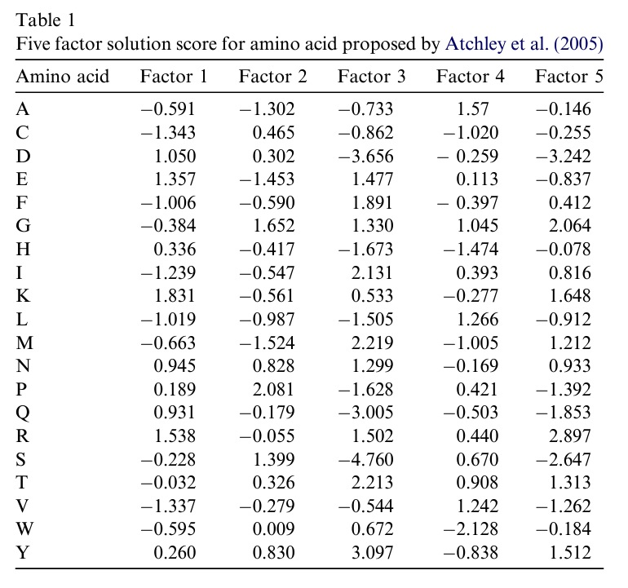

Slide 8
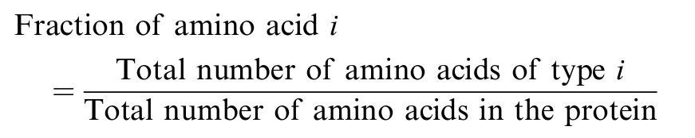
Statistical Factors - Fraction

Slide 9
Example
“ACEAE”
Fraction of ‘A’ = 0.4
Fraction of ‘C’ = 0.2
Fraction of ‘E’ = 0.4
Score of ‘A’ = [-0.2364, -0.5208, -0.2932, 0.628, -0.0584]
Score of ‘C’ = [-0.2686, 0.093, -0.1724, -0.204, -0.051]
Score of ‘E’ = [0.5428, -0.5812, 0.5908, 0.0425, -0.3348]

Slide 10
Example
[ -0.2364, -0.5208, -0.2932, 0.628, -0.0584, -0.2686, 0.093, -0.1724, -0.204, -0.051, 0, 0, 0, 0, 0, 0.5428, -0.5812, 0.5908, 0.0452, -0.3348, 0, 0, 0, 0, 0, 0, 0, 0, ……., 0, 0, 0]
Length of input feature vector was varied from 20 to 100

Slide 11
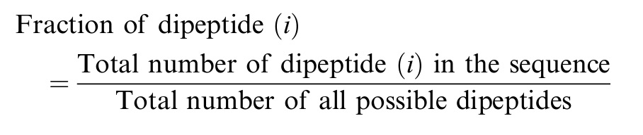
Dipeptide Composition
400 dimensional input vector

Slide 12
Pseudo Amino Acid Composition
(20 + λ) features
First 20 features are derived from the composition of the 20 amino acid
Remaining features can be calculated by using physical properties – hydrophobicity, hydrophilicity, and side chain mass

Slide 13
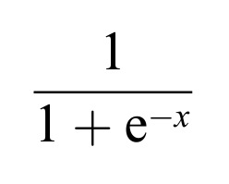
Position Specific Scoring Matrix
PSI-BLAST profile was used to generate a 400 dimensional input vector
Every element was scaled to the range of 0-1 by using the standard sigmoid function

Slide 14
Multiclass SVM
There are K classes, a total of K(K-1)/2 classifiers will be constructed
A
B
C
B
C
A
A
B
B
C
C
A

Slide 15
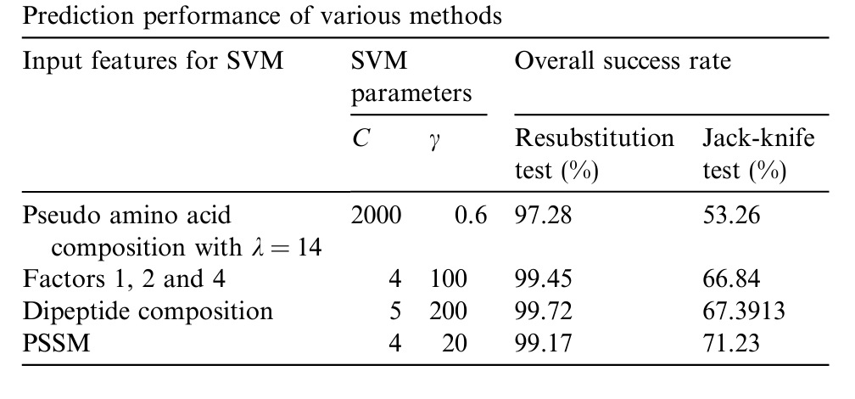
Results

Slide 16
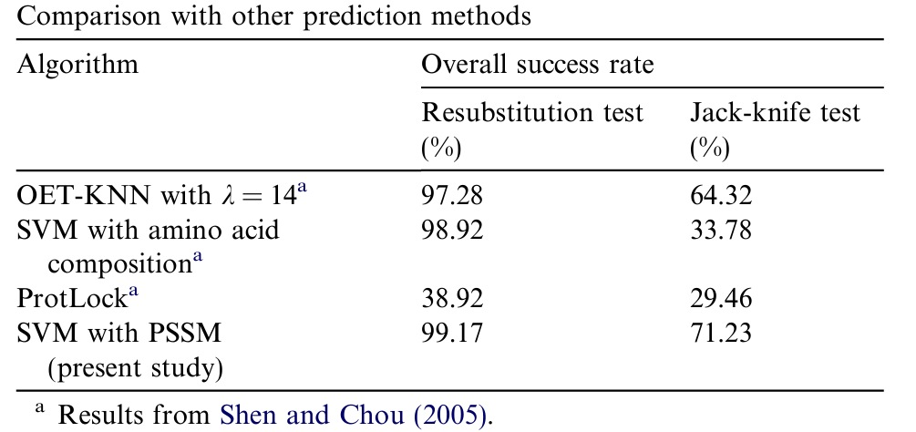
Results (cont’)

Slide 17
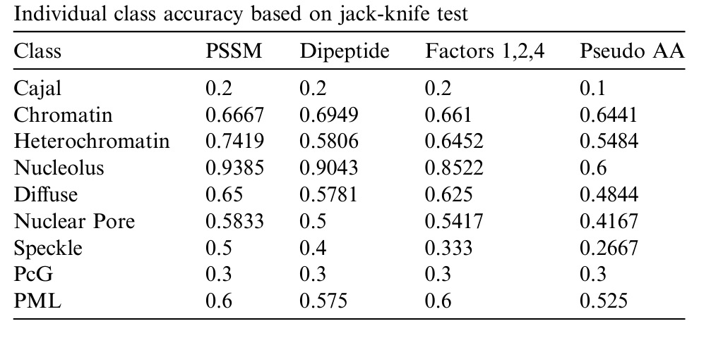
Results (cont’)

Slide 18
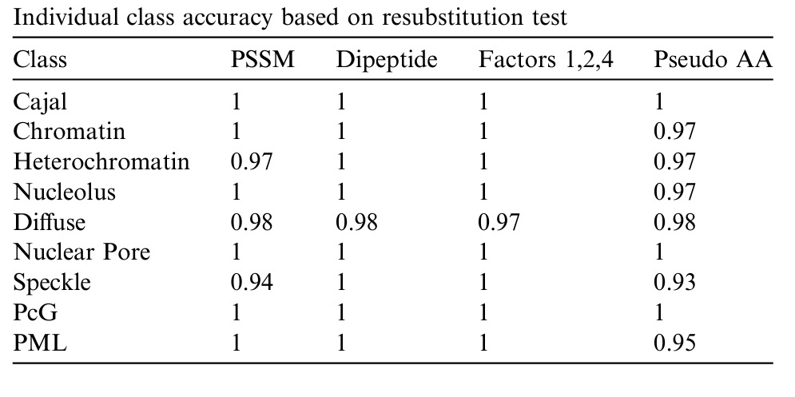
Results (cont’)

