Slide 1
Efficient Sparse Dynamic Programming for the Merged LCS Problem
Yung-Hsing Peng, Chang-Biau Yang, Chiou-Ting Tseng and Chiou-Yi Hor
National Sun Yat-sen University, Kaohsiung, Taiwan
Presenter: Yung-Hsing Peng
Date: July 16, 2008

Slide 2
Comparison of Sequences
S₁ = t c a t c g a, S₂ = a c t t c t g
How to measure the similarity between S₁ and S₂?
The longest common subsequence (LCS) is a classic approach, which can be extended to sequence alignment.

Slide 3
The Traditional LCS Problem
S₁ = t c a t c g a, S₂ = a c t t c t g
S₁ = t c a t c g a
S₂ = a c t t c t g
LCS(S₁, S₂) = 4 (c t c g)
LCS(S₁, S₂) can be determined in O(|S₁||S₂|) time.
Here we omit the detailed algorithm for finding the LCS.

Slide 4
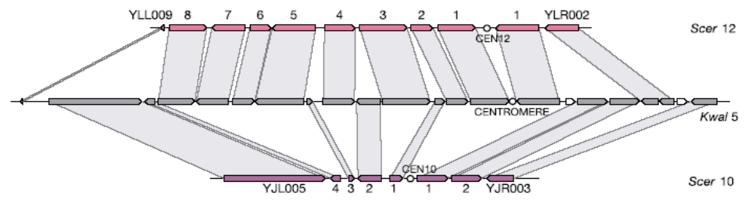
Doubly Conserved Synteny Block
Two yeast species
  Kluyveromyces waltii
  Saccharomyces cerevisiae
[Kellis et al., Nature 428(6983), 2004]
Character? Block ?
Notes:
Symbol A is the long run symbol, select and remove the suffix sequence.
Symbol G is the long run symbol, select and remove the suffix sequence.
So, the common subsequence of our algorithm is GAGG, which is better than the long run algorithm. The common subsequence of long run algorithm is GGG.
It is easy to show that our algorithm Enhanced Long Run is also a 1/4 approximation algorithm for the LCS problem in DNA sequences.
And the time complexity is order sigma times k times n, where sigma is the number of symbols and k is the number of sequences and n is the length of sequences.
Why the time complexity is not order n square?
Because we can store the relative information, we can get the run of each symbol quickly by subtracting the suffix part. It is a simple programming trick.

Slide 5
Example for the Merged LCS Problem
T = t c a t c g a, A = a c t t, B = c t g
C₁ = a c c t t t g LCS(T,C₁) = 3 (c t g)
C₂ = a c t t c t g LCS(T,C₂) = 4 (c t c g)
C₃ = c a t c g t t LCS(T,C₃) = 5 (c a t c g)
Let C = A⊕B be an interleaving sequence of A and B.
Goal: Determine the best C such that LCS(T,C) is maximized.
In this example, C₃ is one of the optimal solutions.

Slide 6
Example for the Merged LCS with Blocks
T = tcatcga, A = X₁X₂ = ac#tt#, B = Y₁Y₂ = ct#g#
C₁ = X₁X₂Y₁Y₂ = ac tt ct g LCS(T,C₁) = 4
C₂ = X₁Y₁X₂Y₂ = ac ct tt g LCS(T,C₂) = 3
C₃ = Y₁X₁Y₂X₂ = ct ac g tt LCS(T,C₃) = 4
Goal: Determine the best C such that LCS(T,C) is maximized.
In this example, C₁ and C₃ are both optimal solutions.

Slide 7
Algorithm for the Merged LCS Problem

Slide 8
The Dominating Candidates
T = tcatcga, A = a c t t (1234 for i), B = c t g (123 for j)
LCS(T[1, 3], A[1, 3] ⊕B[1, 1]) = LCS( t c a, a c t ⊕ c) = 2 (tc)
LCS(T[1, 3], A[1, 2] ⊕B[1, 2]) = LCS( t c a, a c ⊕ c t) = 2 (tc, ca)
LCS(T[1, 3], A[1, 1] ⊕B[1, 1]) = LCS( t c a, a ⊕ c ) = 2 (ca)
To buy an LCS of length 2 in T[1, 3], the least cost is one character in A and one character in B.
We say that (1, 1) is a dominating candidate in H_{2,3}.
These candidates can be obtained with sparse dynamic programming.

Slide 9
Table of Dominating Candidates
T = tcatcga, A = actt (1234 for i), B = ctg (123 for j)
 | T[0]=‘’ | T[1] = t | T[2] = c | T[3] = a | T[4] = t | T[5] = c | T[6] = g | T[6] = a
l = 0 | (0,0) | (0,0) | (0,0) | (0,0) | (0,0) | (0,0) | (0,0) | (0,0)
l = 1 |  | (3,0) (0,2) | (2,0) (0,1) | (1,0) (0,1) | (1,0) (0,1) | (1,0) (0,1) | (1,0) (0,1) | (1,0) (0,1)
l = 2 |  |  | (3,1) (2,2) | (1,1) | (3,0) (1,1) (0,2) | (2,0) (1,1) (0,2) | (2,0) (1,1) (0,2) | (2,0) (1,1) (0,2)
l = 3 |  |  |  |  | (3,1) (1,2) | (2,1) (1,2) | (2,1) (1,2) (0,3) | (2,1) (1,2) (0,3)
l = 4 |  |  |  |  |  | (2,2) | (2,2) (1,3) | (2,2) (1,3)
l = 5 |  |  |  |  |  |  | (2,3) | (2,3)

Slide 10
The Construction of H_{2,3}
T = tc a tcga, A = a c t t (1234 for i), B = c t g (123 for j)
H_{1,2}
H_{2,3}
(2, 0)
(0, 1)
(∞,0)
(2,∞)
(1, 1)
(0,∞)
Buy T[3]
H_{2,3}
Thrift
(1, 1)
H_{2,2}
H_{2,3}
(3, 1)
(2, 2)
(3, 1)
(2, 2)
Skip T[3]
H_{2,3} must be 2D minima.

Slide 11
Example of Our Algorithm
T = tcatcga, A = actt (1234 for i), B = ctg (123 for j)
T[0]=‘’
T[1] = t
T[2] = c
T[3] = a
T[4] = t
T[5] = c
T[6] = g
T[6] = a
l = 0
(0,0)
(0,0)
(0,0)
(0,0)
(0,0)
(0,0)
(0,0)
(0,0)
l = 1
(3,0)
(0,2)
(2,0)
(0,1)
(1,0)
(0,1)
(1,0)
(0,1)
(1,0)
(0,1)
(1,0)
(0,1)
(1,0)
(0,1)
l = 2
(3,1)
(2,2)
(1,1)
(3,0)
(1,1)
(0,2)
(2,0)
(1,1)
(0,2)
(2,0)
(1,1)
(0,2)
(2,0)
(1,1)
(0,2)
l = 3
(3,1)
(1,2)
(2,1)
(1,2)
(2,1)
(1,2)
(0,3)
(2,1)
(1,2)
(0,3)
l = 4
(2,2)
(2,2)
(1,3)
(2,2)
(1,3)
l = 5
(2,3)
(2,3)
C₃ = c a t c g t t
(2,3)→ (2,2) → (1,2) → (1,1) → (0,1) → (0,0)
B[3] A[2] B[2] A[1] B[1] → Order: B[1], A[1], B[2], A[2], B[3]

Slide 12
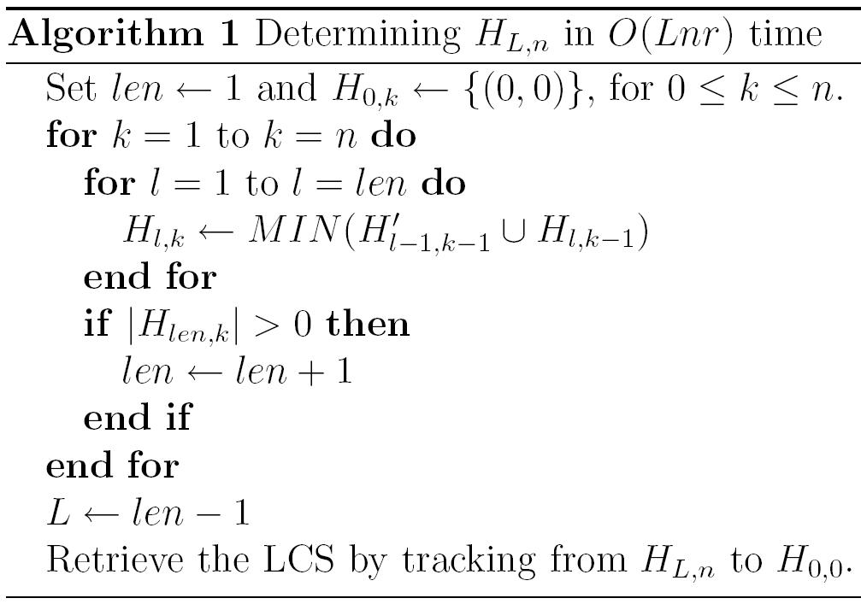
Our On-line Algorithm
O(r) time
MIN(Q): The 2D mimima of Q
n = |T|, r = min{|A|, |B|}

Slide 13
Analysis of Our Algorithm
There are no more than r + 1 pairs in each grid, and no more than mr pairs in each column.
We have obtained an O(Lnr)-time algorithm which is on-line with respect to T. (Space: O(min{Lnr, Lmr})
With Hirschberg’s idea, the space complexity can be reduced to O(m+Lr).
n = |T|, m = max{|A|, |B|}, r = min{|A|, |B|}

Slide 14
Extended Algorithm with Blocks
T = tcatcga, A = ac#tt# (123456), B = ct#g# (12345)
 | T[0]=‘’ | T[1] = t | T[2] = c | T[3] = a | T[4] = t | T[5] = c | T[6] = t | T[7] = a
l = 0 | (0,0) | (0,0) | (0,0) | (0,0) | (0,0) | (0,0) | (0,0) | (0,0)
l = 1 |  | (3,0) (0,2) | (2,0) (0,1) | (1,0) (0,1) | (1,0) (0,1) | (1,0) (0,1) | (1,0) (0,1) | (1,0) (0,1)
l = 2 |  |  | (6,1) (2,3) | (1,3) | (4,0) (0,2) | (2,0) (0,2) | (2,0) (0,2) | (2,0) (0,2)
l = 3 |  |  |  |  | (4,3) | (6,1) (2,3) | (4,0) (3,2) (2,3) | (4,0) (3,2) (1,3)
l = 4 |  |  |  |  |  |  | (6,2) (4,3) | (6,2) (4,3)
l = 5
g c t c
C₃ = ct ac g tt
(4,3)→ (2,3) → (0,2) → (0,1) → (0,0)
B[4] A[2] B[2] B[1] → Order: B[1], B[2], A[2], B[4]

Slide 15
Summary
For the merged LCS problem on biosequences, we improve the previous O(nmr)-time and O(mr)-space result by giving an on-line O(Lnr)-time algorithm, whose off-line implementation takes O(m+Lr) space.
This algorithm can be extended to solve the merged LCS problem with blocks. (please refer to the full version of this paper)
Remaining problems:
How much space do we need on average?

