Slide 1
CARVE—A Constructive Algorithm for Real-Valued Examples
Steven Young and Tom Downs
IEEE TRANSACTIONS ON NEURAL NETWORKS,
VOL. 9, NO. 6, NOVEMBER 1998, pp. 1180-1190
Reporter: Chiou-Yi Hor
Date: July 23, 2008

Slide 2
Abstract
A constructive neural-network algorithm is presented. For any consistent classification task on real-valued training vectors, the algorithm constructs a feed-forward network with a single hidden layer of threshold units which implements the task. The algorithm, which we call CARVE, extends the “sequential learning” algorithm of Marchand et al. from Boolean inputs to the real-valued input case, and uses convex hull methods for the determination of the network weights.

Slide 3
Abstract
The algorithm is an efficient training scheme for producing near-minimal network solutions for arbitrary classification tasks. The algorithm is applied to a number of benchmark problems including Gorman and Sejnowski’s sonar data, the Monks problems and Fisher’s iris data. A significant application of the constructive algorithm is in providing an initial network topology and initial weights for other neural-network training schemes and this is demonstrated by application to back-propagation.

Slide 4
Linear programming
Linear programming (LP) problems involve the optimization of a linear objective function, subject to linear equality and inequality constraints.
Can be expressed in the form:
  Maximize c^{T}x (or c₁*x₁+c₂*x₂+…+c_{n}*x_{n})
  Subject to Ax≤b (or a_{i1}*x₁+a_{i2}*x₂+…+a_{in}*x_{n} ≤b_{i} where i=1~m)
There are various approaches to LP or linear reparability problem, such as simplex, interior-point, perceptron, IncLP and multiple cuts algorithm.

Slide 5
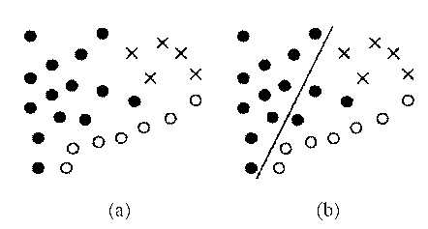
Finding the half-space consistent with the largest subset
According to [14], finding the half-space consistent with the largest subset of negative examples (denoted by •) is NP-hard (may be wrong, see [Meg83] & [Meg84]).
Can be converted to a linear programming problem.

Slide 6
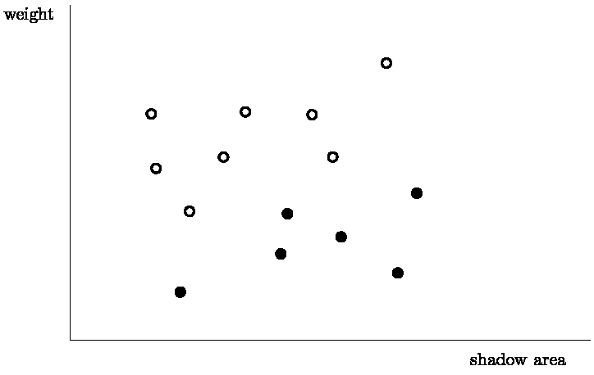
Learning the half-space vs. LP
Assume two parameters were collected for a number of specimens of rabbits and weasels [鼬鼠], as depicted in the following graph

Slide 7
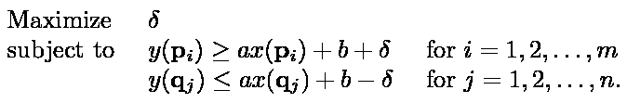
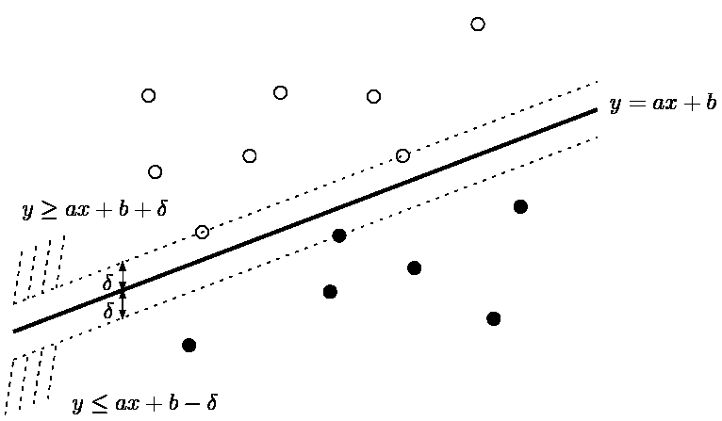
Learning the half-space vs. LP
We introduce a new variable δ, which stands for the “gap” between these two classes.

Slide 8
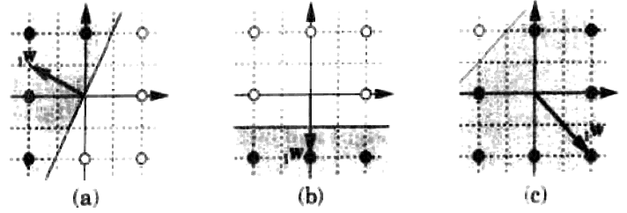
Learning the half-space vs. LP
For a 2-class (ω₁ & ω₂) problem, to find a separating hyper-plane is equivalent to find discriminant function g(x) such that
  x∈ ω₁ if g(x) ≥ 0
  x∈ ω₂ if g(x) < 0
The separating hyper-plane g(x) = 0 can be expressed as g(x) = w^{T}x + b = 0 (w:平面之法向量)

Slide 9
Learning the half-space vs. LP
Defining a = (w^{T},b)^{T} = (w₁,w₂,…,w_{k})^{T}, and a = (x^{T},1)^{T} = (x₁,x₂,…,x_{k},1)^{T} , then we can get
Replacing all samples labeled ω₂ by their negatives (加負號), we obtain

Slide 10
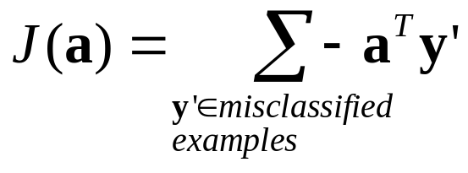
Learning the half-space vs. LP
The cost function (or perceptron criterion function) that we want to minimize is

Slide 11
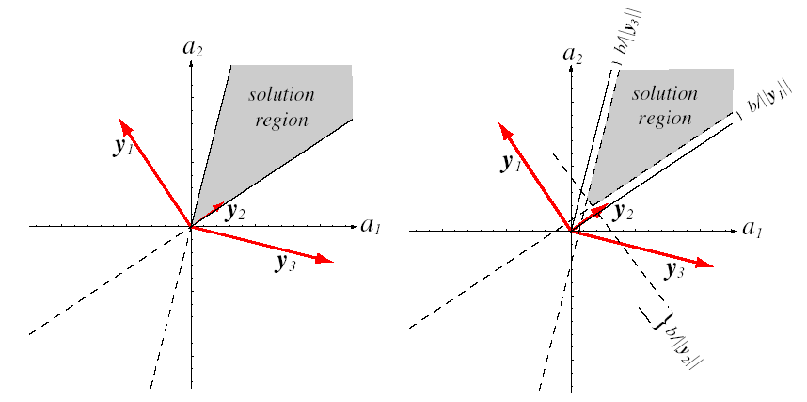
Learning the half-space vs. LP
Since a = 0 is a obvious but useless solution, to avoid this, we introduce a positive vector b.
Another reason to introduce a positive vector b is that we want our final solution have a margin toward the feasible solution region.
The decision hyper-plane can be from nearest data point with a^{T} y’ ≥ b. For a particular point y’_{i}, this distance is b/⎜⎜y_{i}⎜⎜.

Slide 12
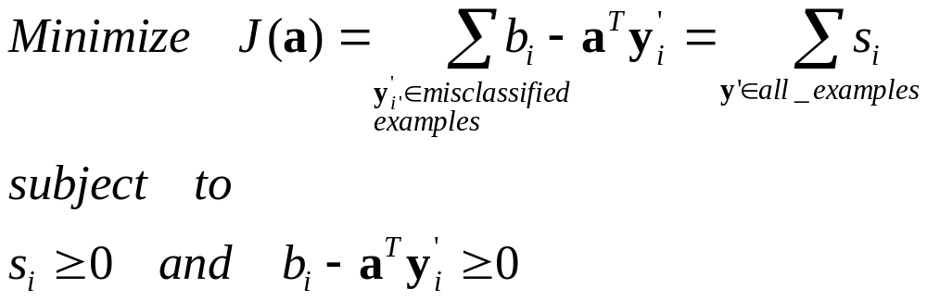
Learning the half-space vs. LP
If we define s_{i} = max(0,b_{i} – a^{T}y’_{i}), then the problem become a linear programming problem
Thus we can use linear programming solvers to learning the half-space.

Slide 13
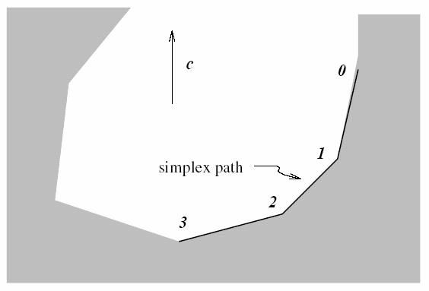
Simplex approach to LP
持續檢視鄰近可用解，直到得到最佳解為止
It converges in expected polynomial time for certain distributions of random inputs However, its worst-case complexity is exponential [Kle72] , where n is the number of the constrain. From http://mathworld.wolfram.com/SimplexMethod.html
Simplex:單一的, 單純的, 簡單的

Slide 14
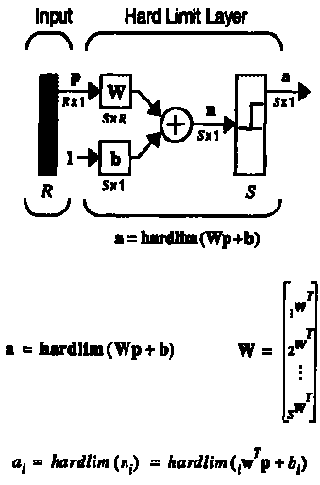
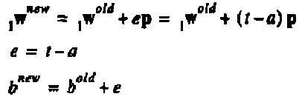
Perceptron(感知機) learning rule to a linearly separable problem
Define p: input, a: perceptron output, t: desired output
If the decision boundary is g(x) = w^{T}p + b = 0, then the approach to learning the separating hyper-plane is

Slide 15
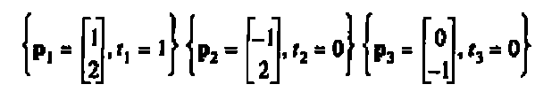
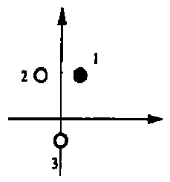
Perceptron learning example
We have three examples to learning the separating plane.
Assume the initial plane is: w = (1,-0.8) and fix b = 0.

Slide 16
Perceptron learning example
For p1(1,2), the output is:
a=hardlim((1,-0.8)•((1,2)+0)
=hardlim(-0.6)=0 ≠ 1 (wrong), so
w_{new}=w_{old}+(1-0)*(1,2)=
=(1,-0.8)+(1,2)=(2,1.2)
Test p1 again, we get
a_{new}=hardlim((2,1.2)•((1,2)+0)=1 (correct!)
For p3(0,-1), the output is:
a=hardlim((3,-0.8)•((0,-1)+0)
=hardlim(3.8)=1 ≠ 0 (wrong), so
w_{new}=w_{old}+(0-1)*(0,-1)=
=(3,-0.8)-(0,-1)=(3,0.2)
Test p3 again, we get
a_{new}=hardlim((3,0.2)•((0,-1)+0)=0 (correct!)
For p1(-1,2), the output is:
a=hardlim((2,1.2)•((-1,2)+0)
=hardlim(0.4)=1 ≠ 0 (wrong), so
w_{new}=w_{old}+(0-1)*(-1,2)=
=(2,1.2)-(-1,2)=(3,-0.8)
Test p2 again, we get
a_{new}=hardlim((3,-0.8)•((-1,2)+0)=0 (correct!)

Slide 17
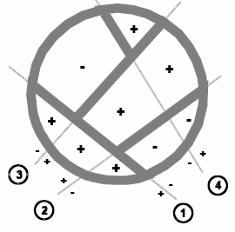
Perceptron learning example
Test p1 again, we get
a_{new}=hardlim((3,0.2)•((1,2)+0)=1 (correct!)
Test p2 again, we get
a_{new}=hardlim((3,0.2)•((-1,2)+0)=0 (correct!)
Test p3 again, we get
a_{new}=hardlim((3,0.2)•((0,-1)+0)=0 (correct!)
A s-neuron perceptron can totally separate 2^{s} categories. We can again encode these 2^{s} categories into 2 classes.
W=(3,0.2)

Slide 18
Pocket Algorithm
The pocket algorithm with ratchet (Gallant, 1990) solves the stability problem of perceptron learning by keeping the best solution seen so far "in its pocket". The pocket algorithm then returns the solution in the pocket, rather than the last solution.

Slide 19
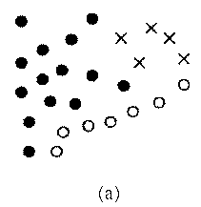
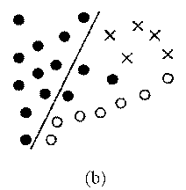
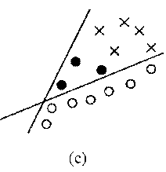
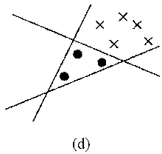
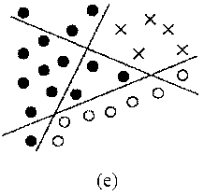
Sequential learning algorithm
At each step, examples pertaining (從屬于) to the same class are sequentially separated from the rest by successively adding hidden units (separating hyper-plane) until the remaining patterns are all in the same class.
The question is: Is each set of sequentially separated examples is big enough?

Slide 20
Incremental linear programming
An incremental linear programming (IncLP) algorithm [14] is introduced to make sure that each set of sequentially separated examples is big enough.

Slide 21
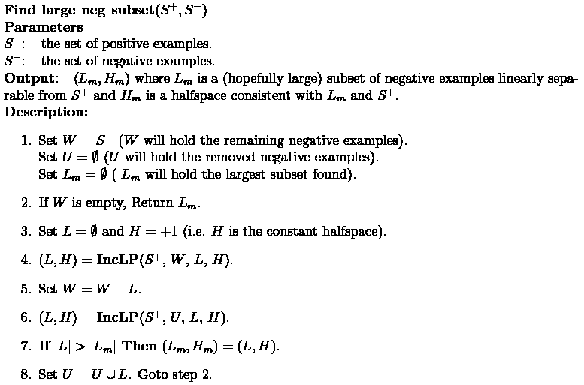
Incremental linear programming

Slide 22
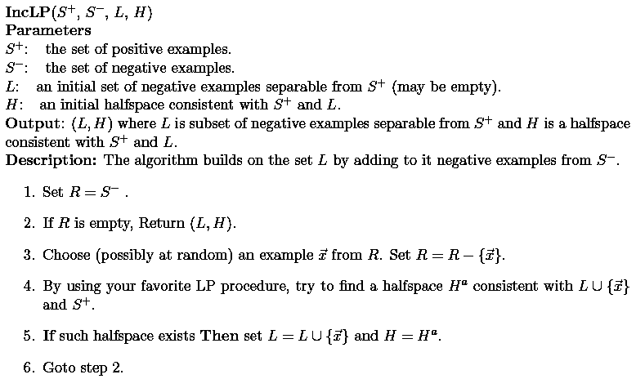
Incremental linear programming
一個一個的增加example，觀察這些example是否可以和另外一類examples分離。

Slide 23
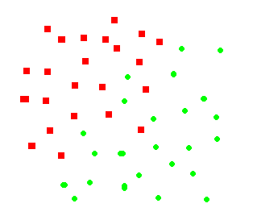
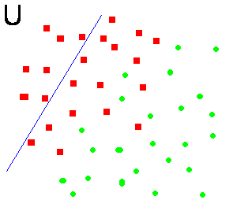
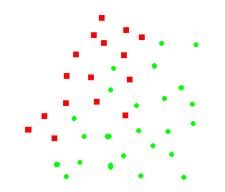
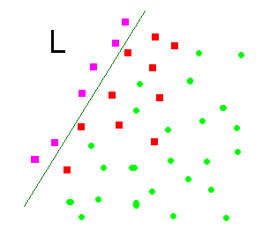
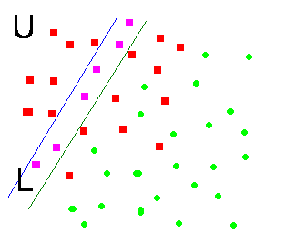
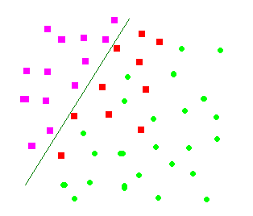
Incremental linear programming

Slide 24
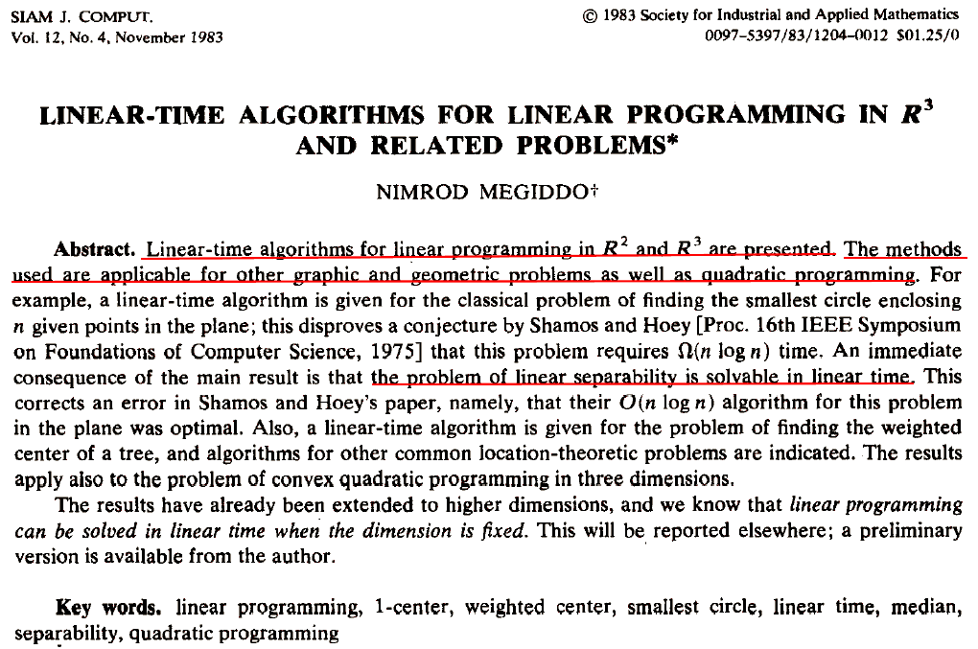
[Meg83]

Slide 25
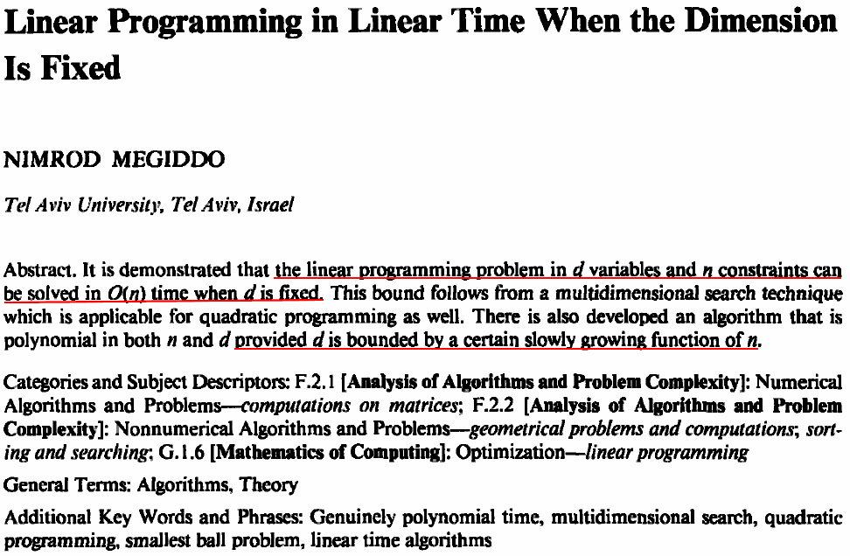
[Meg84]

Slide 26
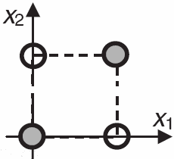
Multiple-hyperplane approaches to linearly inseparable problem
XOR problem
  (0,0)→0,(1,0)→1,(0,1)→1,(1,1)→0
  No single hyperplane can separate these two classes, and thus is a linearly inseparable case

Slide 27
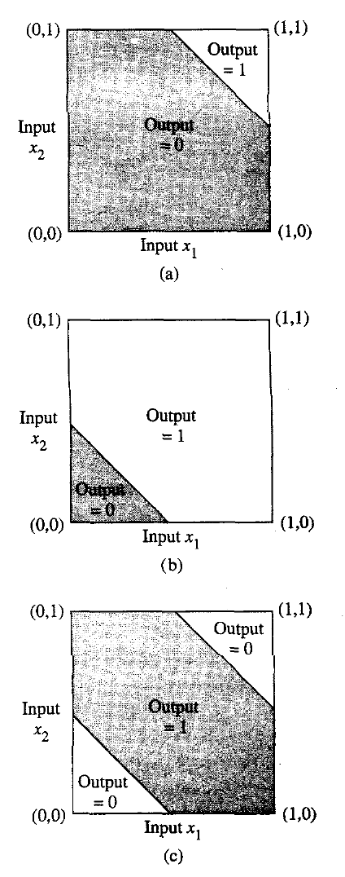
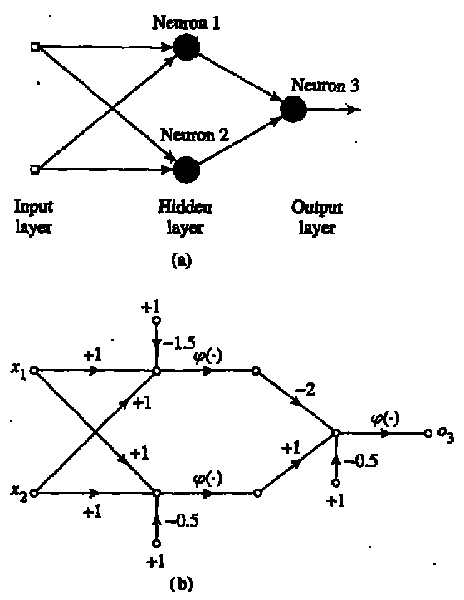
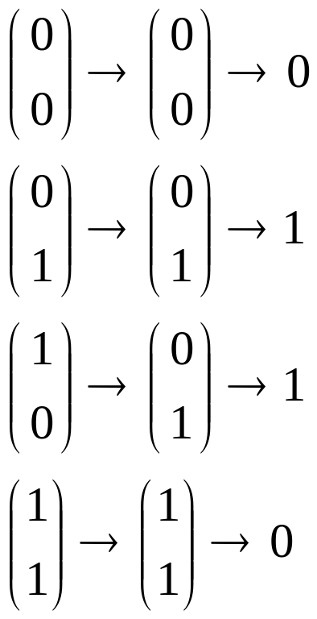
Multiple-hyperplane approaches to linearly inseparable problem

Slide 28
CARVE
The abbreviation of constructive algorithm for real-valued examples
As an extension of the sequential learning algorithm, it allows hyperplanes to be found which separate substantial sets of points (all of one class) from the remaining training examples. (每一步驟都儘量把大部份的點抽離 ⇒ carve sets)
Instead of using perceptron learning rule, CARVE uses a convex hull search method.

Slide 29
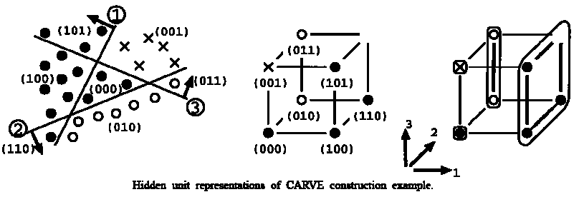
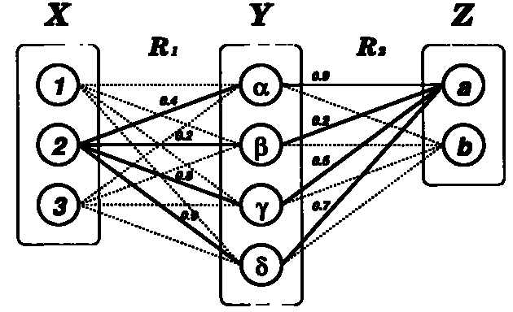
CARVE
X: input, Y: hidden unit representation, Z: output

Slide 30
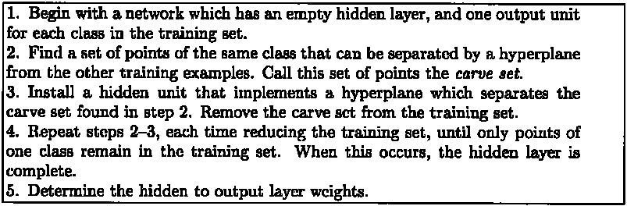
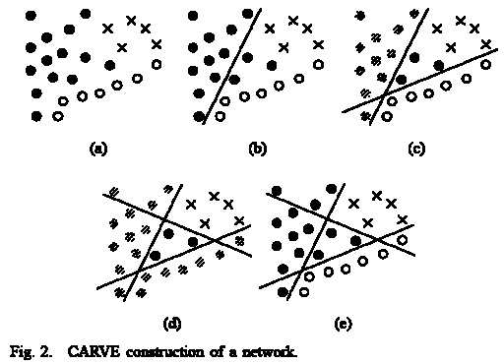
CARVE algorithm

Slide 31
Hidden unit representations of CARVE construction example
The hidden unit is equivalent to the separating hyper-plane.
By encoding the output (or assigning appropriate weights) of the hidden units, we can classify all examples into 2 classes.

Slide 32
m-Hidden unit & m-cube
The first hidden unit separates the m-cube into two (m-1)-cubes.
The second hidden unit then splits the other (m-1)-cube into two (m-2)-cubes and so on for subsequent units.

Slide 33
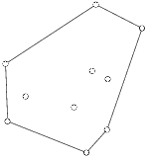

Convex Hull
The convex hull of a set of points S in d dimensions is the intersection of all convex sets containing S. For N points p1,...,pN the convex hull C is then given by the expression
In d dimensions, the "gift wrapping" algorithm, which has complexity O(n^{[d/2]+1}), where [] is the floor function, can be used. [32]
In 2 & 3 dimensions, however, specialized algorithms exist with complexity O(nlogn). [32]
http://mathworld.wolfram.com/ConvexHull.html

Slide 34
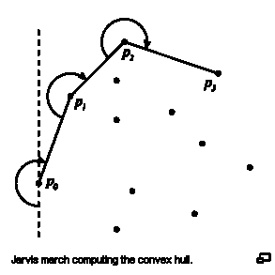
Gift wrapping algorithm
The gift wrapping algorithm is a simple algorithm for computing the convex hull of a given set of points.
In the 2D case, the algorithm is also known as Jarvis march, after R. A. Jarvis. It has O(nh) time complexity, where n is the number of points and h is the number of points on the convex hull.
http://en.wikipedia.org/wiki/Gift_wrapping_algorithm

Slide 35
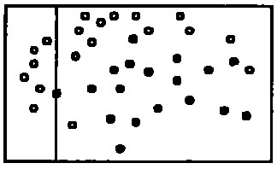
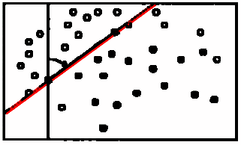
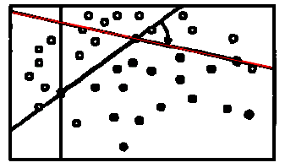
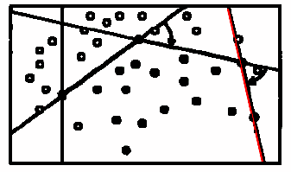
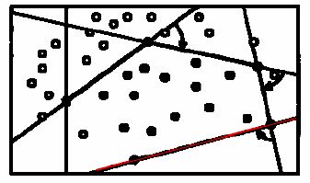
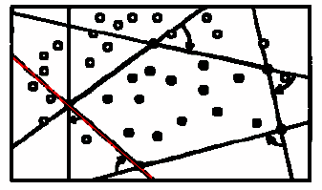
Gift wrapping to find carve set
Since polynomial time algorithms exist for determining the convex hull of a set of 2-D points, then, in the 2-D case, it is always possible to find the largest CARVE set in polynomial time.

Slide 36
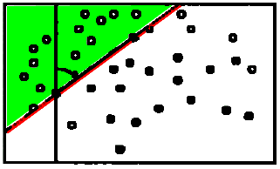
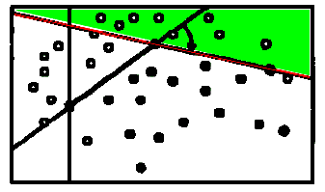
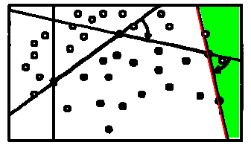
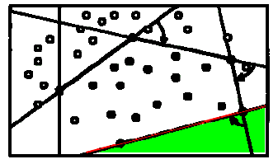
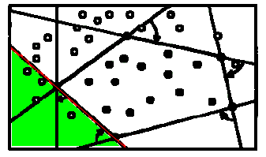
Gift wrapping to find carve set
°:18,•:17
°:13/18 (max)
°:8/18
°:2/18
°:0/18
°:4/18

Slide 37
Gift wrapping to find carve set
???Total Time Complexity: O(n²(logn+d)×NInit ×NRot)
(可能不含找Convex Hull)
n: samples, d: dimension
Ninit: #Initial hyperplanes (with (d-1) dimensions)
NRot: #Rotations

Slide 38
Extension: Higher Order CARVE
The CARVE can be extended to higher order threshold unit. For example (x₁,x₂,…,x_{d})→ (x₁,x₂,…,x_{d},x₁²,…,x₁x₂,…)
There is totally _{n+d}C_{n} terms for d-input & n-order data.
To avoid the explosion in the dimensionality of the transformed data points is to use only a (suitably selected) subset of the polynomial terms.
Think about SVM classifier.

Slide 39
Application: CARVE-BP
By applying CARVE , the minimal network size that CARVE produces can be found. The resulting network structure can then be trained using back-propagation (BP) or some other training scheme.
The network weights that CARVE finds can be used as initial network weight vectors for BP training.
Note that the CARVE procedure depends upon randomly-generated hyper-planes, multiple applications of the procedure to the same learning task will normally lead to the production of different networks.

Slide 40
Experiment 1: Parity Problem
The problem is to classify Boolean input vectors according to whether or not the input vector has an odd number of elements with value one.
  (1,0,1,1,1) : four 1 → Yes
  (1,0,1,0,1) : three 1 → No
The training set for the -bit problem consists of all 2^{n} Boolean inputs and it is well-known that a single hidden layer solution exists with n hidden units. (因為n個hidden uint共可表示2^{n}個狀態)
The experiments we carried out with CARVE indicate that it is capable of finding the hidden unit solution so long as the search parameters (NInit, NRot) are given sufficiently large values.

Slide 41

Experiment 2: Network Size for
Random Boolean Functions
A random n-bit Boolean function is a training problem consisting of all 2^{n} Boolean vectors with each training vector being randomly assigned to one of two classes with equal probability.
進行100實驗結果，平均network size較其他方法小

Slide 42

Experiment 3: 2 spiral problem
The two spirals problem is a classification task which is highly nonlinearly separable. Single hidden layer networks trained by back-propagation generally fail to produce solutions to this problem

Slide 43


Experiment 3: 2 spiral problem
Ignore x₁x₂ terms

Slide 44

Experiment 4: Monks problem
Monk: 修道士, 僧侶, 和尚
Being a classification task in an artificial robot domain, with robots described by 6 attributes, totally 432 status (3x3x2x3x4x2)
The attributes are treated as a 17-input Boolean (NO/OFF) vector
(a₁,a₂,…,a₁₇)
where a_{i}=ON or OFF

Slide 45


Experiment 4: Monks problem
Three problems: M1~M3

Slide 46

Experiment 4: Monks problem
Result comparison
  “Cascade” ones have smaller network sizes.
  Larger values of (NInit, NRot) produce near-minimal network sizes.
  CARVE-BP produces equivalent test set performance to that reported elsewhere for BP and Cascade Correlation.

Slide 47
Experiment 5: Sonar (聲納) data
208 training examples classified into two classes (Mines/Rocks). Each training vector consists of 60 real-valued variables.
Two generalization tests

Slide 48

Experiment 5: Sonar (聲納) data
Two generalization tests
  Using cross validation to split the 208 training examples into 13 sets of 16 examples each. Each set, in turn, is left out of the training set and is used as the test set. 10 trials on each training set are performed, and test set performance is measured. This experiment ignores the fact that sonar returns with different aspect angles.

Slide 49

Experiment 5: Sonar (聲納) data
Two generalization tests
  Splitting the training examples into 2 equal-size sets of examples. Each set is in turn left as the training set and test set performance is measured. This experiment takes into account different aspect angles.

Slide 50
References
[14] M. Marchand and M. Golea, “On learning simple neural concepts: From halfspace intersections to neural decision lists,” Newtork, vol. 4, pp. 67–85, 1993.
[18] G. Swart, “Finding the convex hull facet by facet,” J. Algorithms, vol. 6, pp. 17–48, 1985.
[32] Skiena, S. S. "Convex Hull." §8.6.2 in The Algorithm Design Manual. New York: Springer-Verlag, pp. 351-354, 1997.
[Meg83] Megiddo, N., ‘‘Linear-time algorithms for linear programming in R3 and related problems’’, SIAM J. Comp. 12, pp. 759-776, 1983.
[Meg84] Megiddo, N., ‘‘Linear programming in linear time when the dimension is fixed’’, J. Association for Computing Machinery (JACM) 31, pp. 114-127, 1984.
[Kle72] Klee, V.; Minty, G. J.; and Shisha, O. (Eds.) "How Good is the Simplex Algorithm?" In Inequalities 3. New York: Academic Press, 159-175, 1972.

