Slide 1
van Emde Boas (vEB) Tree Revisited
Date: Oct. 1, 2008
Introducer: Hsing-Yen Ann

Slide 2
van Emde Boas (vEB) Tree
vEB Tree Version 1:
“Design and implementation of an efficient priority queue”,
P. van Emde Boas, R. Kaas and E. Zijlstra, Theory of Computing Systems, Vol. 10, pp. 99-127, 1977.
vEB Tree Version 2:
“Preserving order in a forest in less than logarithmic time”,
P. van Emde Boas, Information Processing Letters, Vol. 6, No. 3, pp. 80-82, 1977.
vEB Tree Version 3 (Erik Demaine Tree ??) :
MIT Course 6.897: Advanced Data Structures (Spring 2003),
Prof. Erik Demaine.

Slide 3






The Goal of vEB Tree
Maintain a sorted set , s.t. the following operations can be executed in time:
  INSERT(j):
  DELETE(j):
  MEMBER(j): Find whether
  PREDECESSOR(j): Find the largest x, s.t. x < j and
  SUCCESSOR(j): Find the smallest x, s.t. x > j and
  ( j may not belong to S)

Slide 4
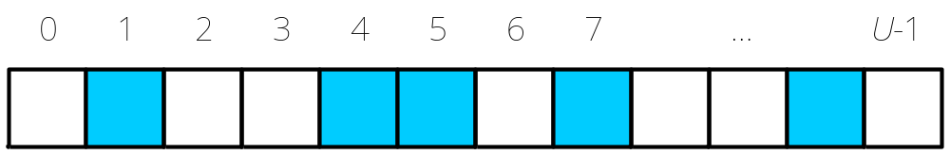


How Difficult Is It? (1/3)
Implemented by an Array
  INSERT / DELETE:
  MEMBER:
  PREDECESSOR / SUCCESSOR:
  Initial space:

Slide 5
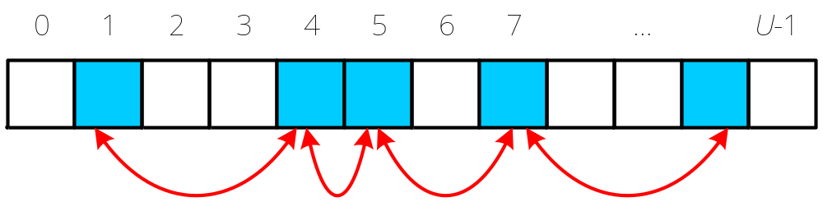

How Difficult Is It? (2/3)
Implemented by an Array and additional Pointers
  INSERT / DELETE:
  MEMBER:
  PREDECESSOR / SUCCESSOR:
  Initial space:

Slide 6
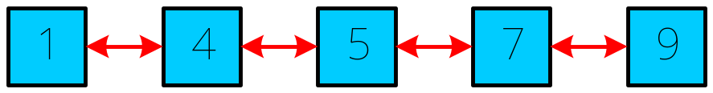

How Difficult Is It? (3/3)
Implemented by a Doubly Linked-list
  INSERT / DELETE:
  MEMBER:
  PREDECESSOR / SUCCESSOR:
  Initial space:

Slide 7
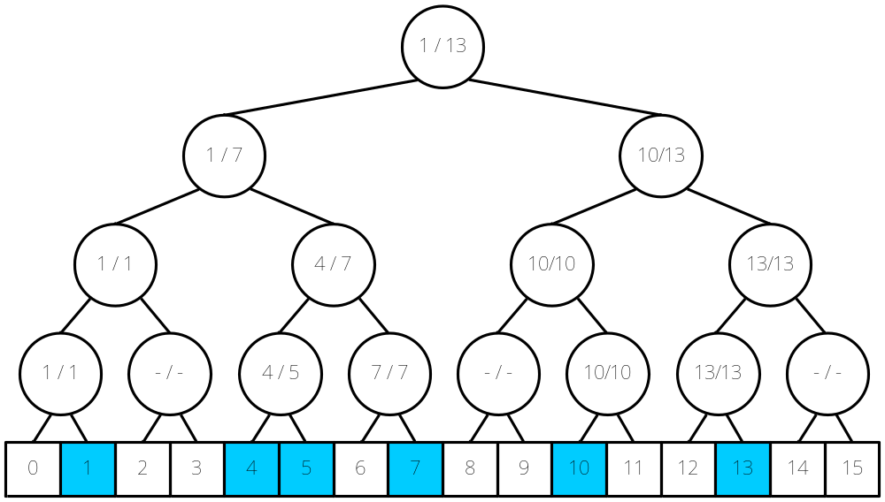
A Better Data Structure (1/4)
Implemented by a Complete Binary Tree
Record the min/max of the sub-tree for each internal nodes

Slide 8
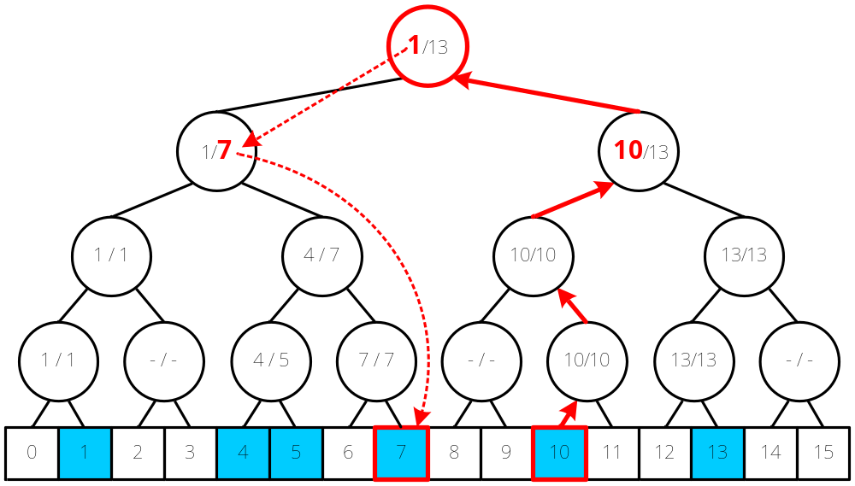
A Better Data Structure (2/4)
Finding PREDECESSOR(10)

Slide 9
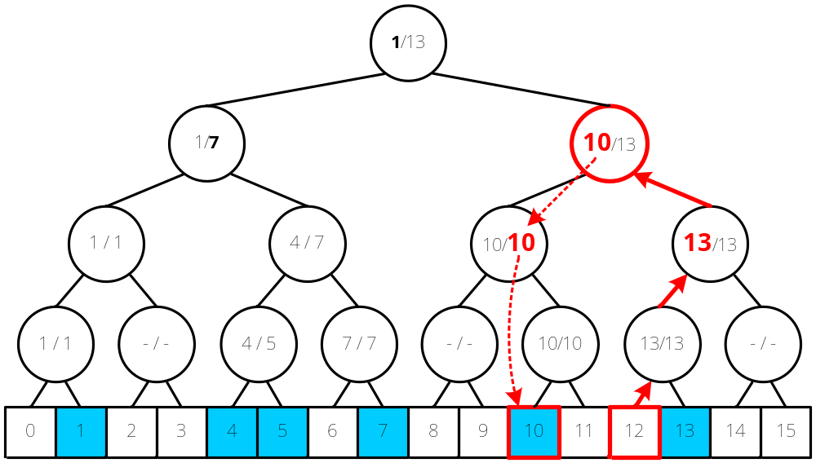
A Better Data Structure (3/4)
Finding PREDECESSOR(12)

Slide 10

A Better Data Structure (4/4)
Implemented by a Complete Binary Tree
  INSERT / DELETE:
  MEMBER:
  PREDECESSOR / SUCCESSOR:
  Initial space:

Slide 11

Other Better Data Structures
Implemented by Balanced Binary Search Trees
  for example: 2-3 tree, AVL-tree, Red-Black tree
  INSERT / DELETE:
  MEMBER:
  PREDECESSOR / SUCCESSOR:
  Initial space:

Slide 12
vEB Tree v1:
Design and implementation of an efficient priority queue
P. van Emde Boas, R. Kaas and E. Zijlstra, Theory of Computing Systems, Vol. 10,
pp. 99-127, 1977.

Slide 13



vEB Tree Version 1
Modified from a Complete Binary Tree
  INSERT / DELETE:
  MEMBER:
  PREDECESSOR / SUCCESSOR:
  Initial space :

Slide 14
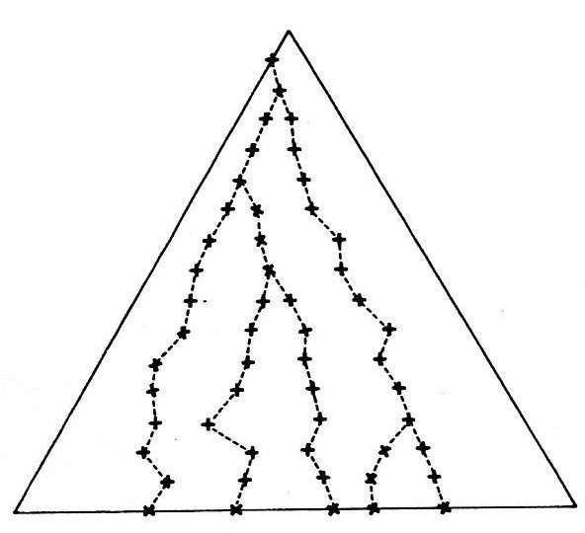
Key Point: How to Locate the Lowest Branch Faster?

Slide 15
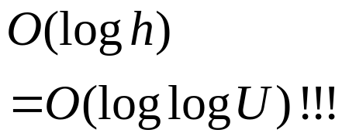
Idea: Binary Search on the Levels
Level
16
15
14
13
12
11
10
9
8
7
6
5
4
3
2
1
0
2
4
3
1

Slide 16
Assign the Rank to Each Level (1/2)
Level | Rank
16 | 4
15 | 0
14 | 1
13 | 0
12 | 2
11 | 0
10 | 1
9 | 0
8 | 3
7 | 0
6 | 1
5 | 0
4 | 2
3 | 0
2 | 1
1 | 0
0 | 5

Slide 17
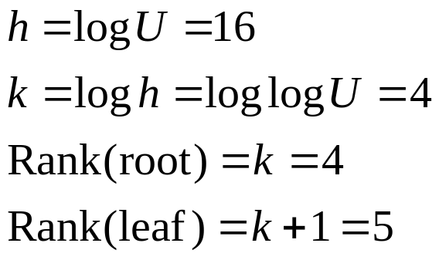
Assign the Rank to Each Level (2/2)
Level
16
15
14
13
12
11
10
9
8
7
6
5
4
3
2
1
0
4 | 4 | 4 | 4 | 4
 |  |  |  | 0
 |  |  | 1 | 1
 |  |  |  | 0
 |  | 2 | 2 | 2
 |  |  |  | 0
 |  |  | 1 | 1
 |  |  |  | 0
 | 3 | 3 | 3 | 3
 |  |  |  | 0
 |  |  | 1 | 1
 |  |  |  | 0
 |  | 2 | 2 | 2
 |  |  |  | 0
 |  |  | 1 | 1
 |  |  |  | 0
5 | 5 | 5 | 5 | 5
Rank
4
0
1
0
2
0
1
0
3
0
1
0
2
0
1
0
5

Slide 18
The k+1 Lowest Proper Fathers (Ancestors) of a Node (1/2)
v.father[4]
Level | Rank
16 | 4
15 | 0
14 | 1
13 | 0
12 | 2
11 | 0
10 | 1
9 | 0
8 | 3
7 | 0
6 | 1
5 | 0
4 | 2
3 | 0
2 | 1
1 | 0
0 | 5
father[0..k]: k+1 pointers
v.father[3]
v.father[2]
v.father[1]
v.father[0]
v

Slide 19
The k+1 Lowest Proper Fathers (Ancestors) of a Node (2/2)
v.father[4]
Level | Rank
16 | 4
15 | 0
14 | 1
13 | 0
12 | 2
11 | 0
10 | 1
9 | 0
8 | 3
7 | 0
6 | 1
5 | 0
4 | 2
3 | 0
2 | 1
1 | 0
0 | 5
father[0..k]: k+1 pointers
v.father[2] = v.father[3]
v.father[0] = v.father[1]
v

Slide 20
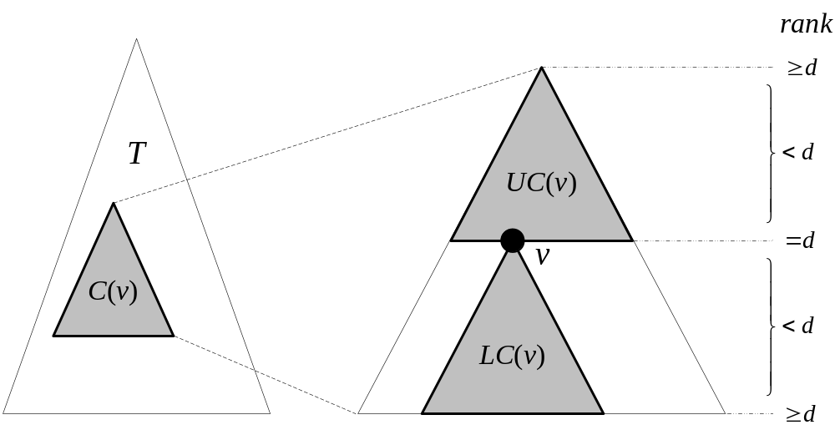
Canonical Subtree and Reach (1/2)
Rank-d Canonical Subtree C(v) of T:
  a node v with rank d is called center
  min{Rank(top), Rank(leaf)} = d+1
  the ranks of internal nodes in other levels < d
  a reach R(v) = UC(v) + LC(v)

Slide 21
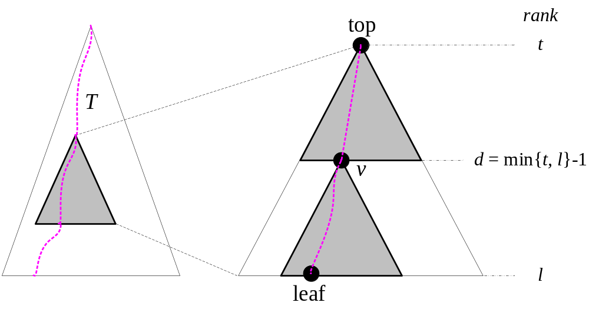
Canonical Subtree and Reach (2/2)
Given the top and a leaf of C(v), the center node v can be identified in O(1) time.
  rank d = min{Rank(top), Rank(leaf)} - 1
  node v = leaf.father[d]

Slide 22
Predecessor / Successor
Level | Rank
16 | 4
15 | 0
14 | 1
13 | 0
12 | 2
11 | 0
10 | 1
9 | 0
8 | 3
7 | 0
6 | 1
5 | 0
4 | 2
3 | 0
2 | 1
1 | 0
0 | 5
root
u.father[3]
u

Slide 23
Predecessor / Successor
Level | Rank
16 | 4
15 | 0
14 | 1
13 | 0
12 | 2
11 | 0
10 | 1
9 | 0
8 | 3
7 | 0
6 | 1
5 | 0
4 | 2
3 | 0
2 | 1
1 | 0
0 | 5
root
u.father[2]
u

Slide 24
Predecessor / Successor
Level | Rank
16 | 4
15 | 0
14 | 1
13 | 0
12 | 2
11 | 0
10 | 1
9 | 0
8 | 3
7 | 0
6 | 1
5 | 0
4 | 2
3 | 0
2 | 1
1 | 0
0 | 5
root
u.father[1]
u

Slide 25
Predecessor / Successor
Level | Rank
16 | 4
15 | 0
14 | 1
13 | 0
12 | 2
11 | 0
10 | 1
9 | 0
8 | 3
7 | 0
6 | 1
5 | 0
4 | 2
3 | 0
2 | 1
1 | 0
0 | 5
root
u.father[0]
u

Slide 26
Predecessor / Successor
Level | Rank
16 | 4
15 | 0
14 | 1
13 | 0
12 | 2
11 | 0
10 | 1
9 | 0
8 | 3
7 | 0
6 | 1
5 | 0
4 | 2
3 | 0
2 | 1
1 | 0
0 | 5
u

Slide 27
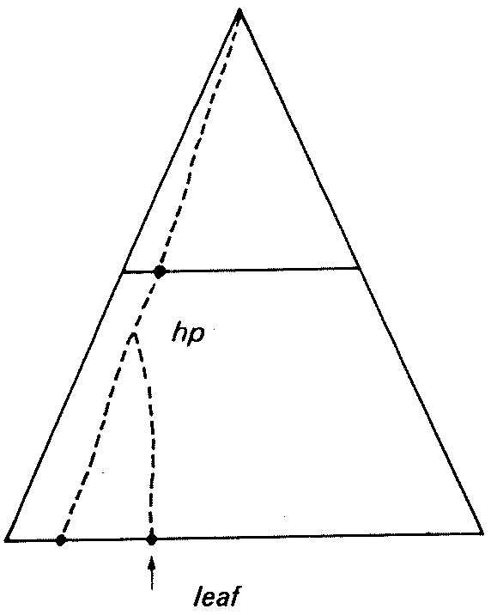
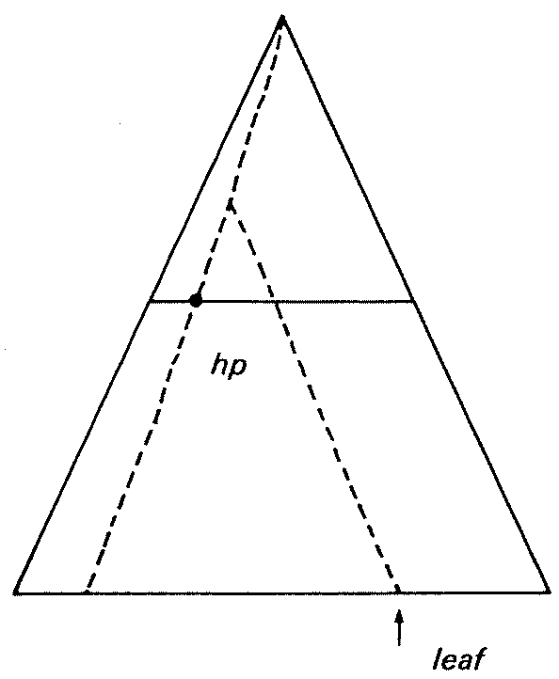
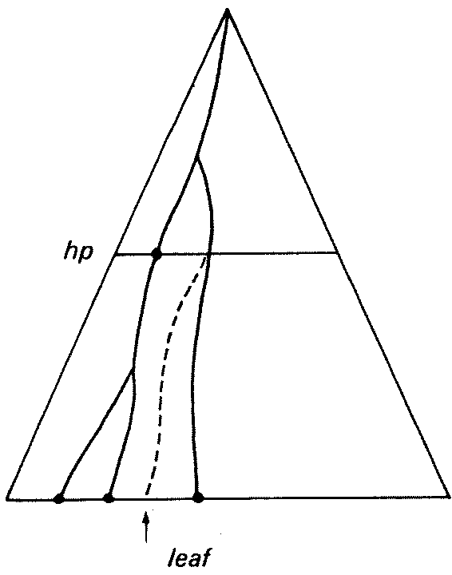
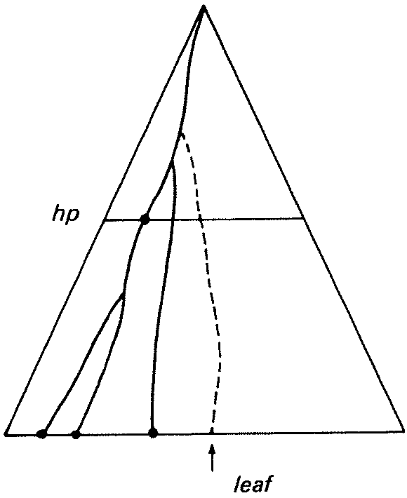
Insertion (1/3)
Four types of Canonical Subtrees to be considered recursively

Slide 28
Insertion (2/3)
Current Canonical Subtree is present but not active
(exactly one path before this insertion)

Slide 29
Insertion (3/3)
Current Canonical Subtree is active
(at least two paths before this insertion)

Slide 30
Deletion
Similar to insertion
The neighbors (predecessor / successor) should be prepared before the deletion.

Slide 31
vEB Tree v2:
Preserving order in a forest in less than logarithmic time
P. van Emde Boas,
Information Processing Letters,
Vol. 6, No. 3, pp. 80-82, 1977.

Slide 32
vEB Tree Version 2
Modified from a vEB Tree v1 + Balanced Binary Search Trees
  INSERT / DELETE:
  MEMBER:
  PREDECESSOR / SUCCESSOR:
  Initial space:

Slide 33
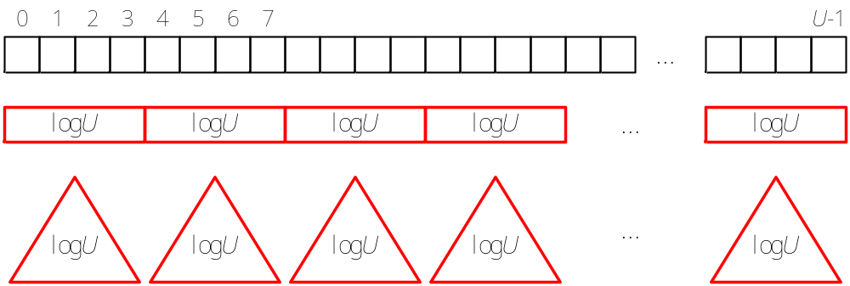
Divide the Universe (1/2)
Divide the universe of size U into segments of size logU
There are U / logU segments
Each segment is implemented by a balanced binary search tree

Slide 34
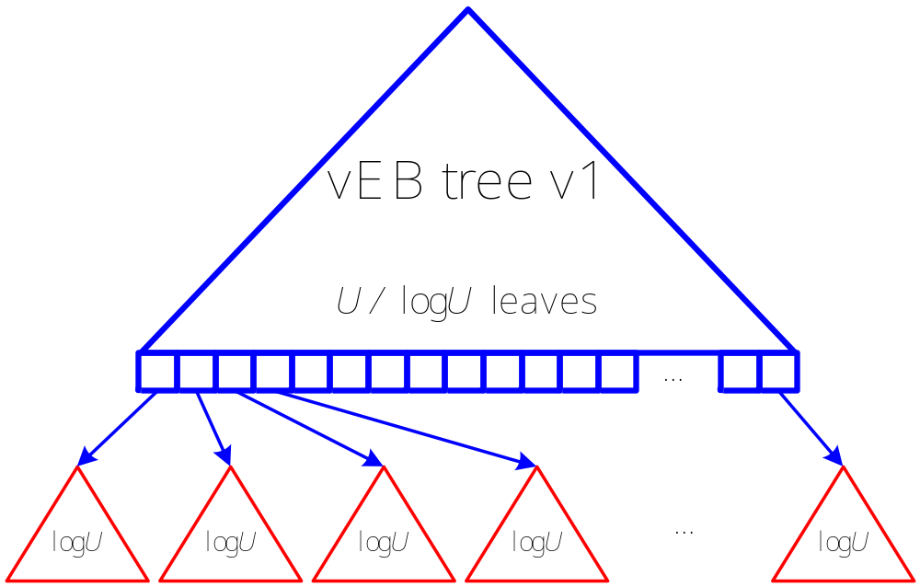
Divide the Universe (2/2)
The summary of segments is implemented by a vEB tree version 1

Slide 35
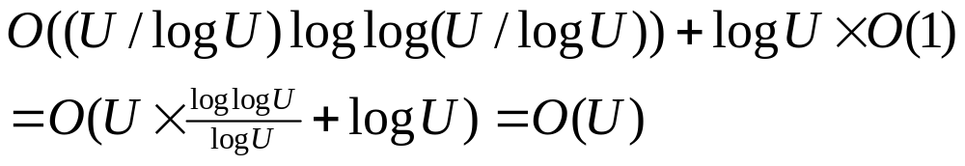
Analysis of vEB Tree v2
Size of the upper vEB tree v1: U / logU
Max size of a balanced binary search tree: logU
INSERT / DELETE:
MEMBER:
PREDECESSOR / SUCCESSOR:
Initial space:

Slide 36
vEB Tree v3:
Erik Demaine Tree
MIT Course 6.897:
Advanced Data Structures (Spring 2003),
Prof. Erik Demaine

Slide 37
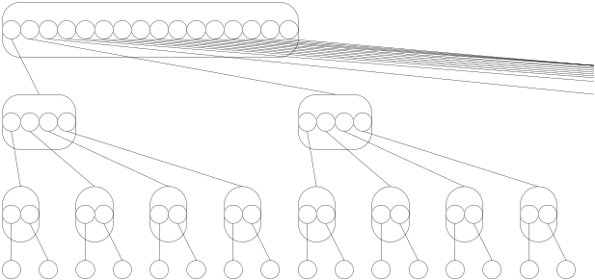
vEB Tree v3:
Erik Demaine Tree
Like an Exponential Search Tree
  INSERT / DELETE:
  MEMBER:
  PREDECESSOR / SUCCESSOR:
  Initial space :

Slide 38

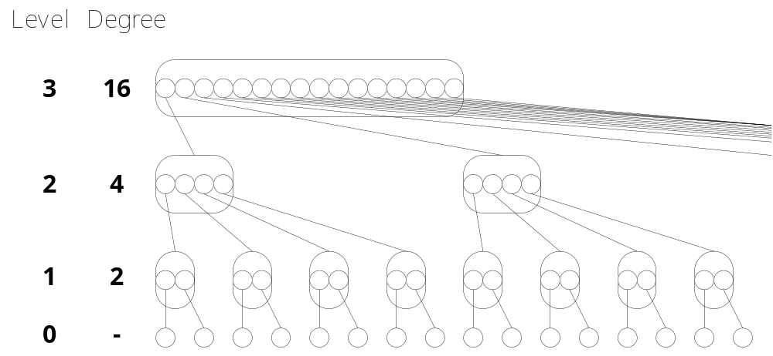
Exponential Search Tree
Shallow tree with degrees increasing doubly-exponentially towards the root.
Tree height:

Slide 39

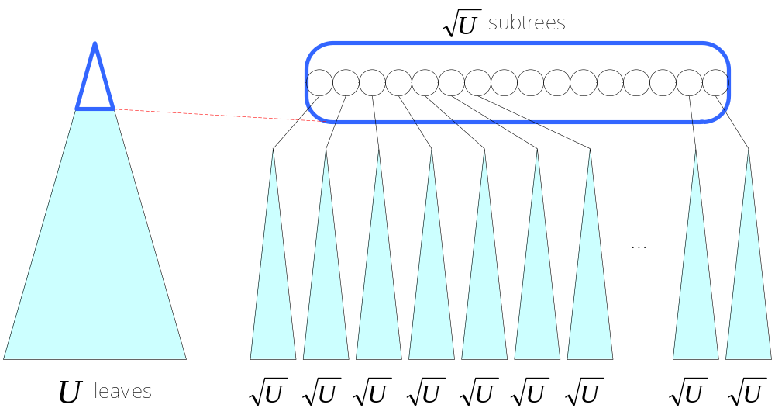
Another Point of View
A tree T of U leaves is divided into subtrees of leaves.
Use an array to store the points of subtrees.

Slide 40
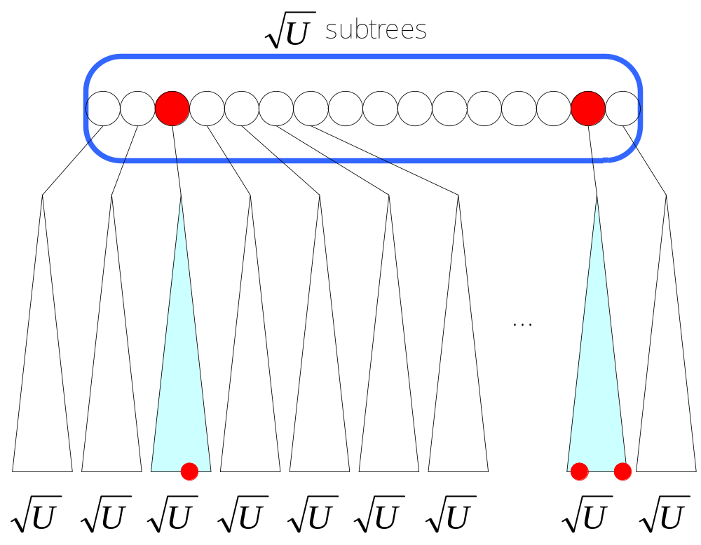
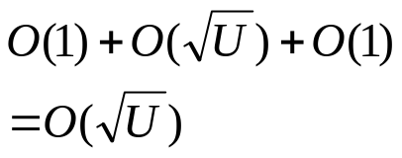
How to Find Predecessors / Successors
Inner-subtree search or inter-subtree search

Slide 41
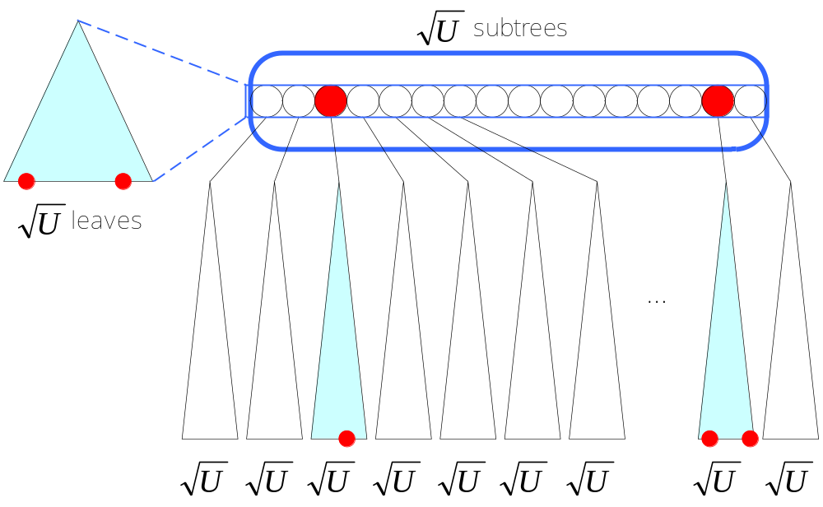
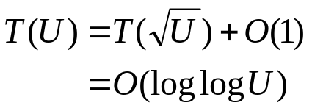
Add a Additional Summary Tree to Each Node
Search the summary tree recursively.

Slide 42
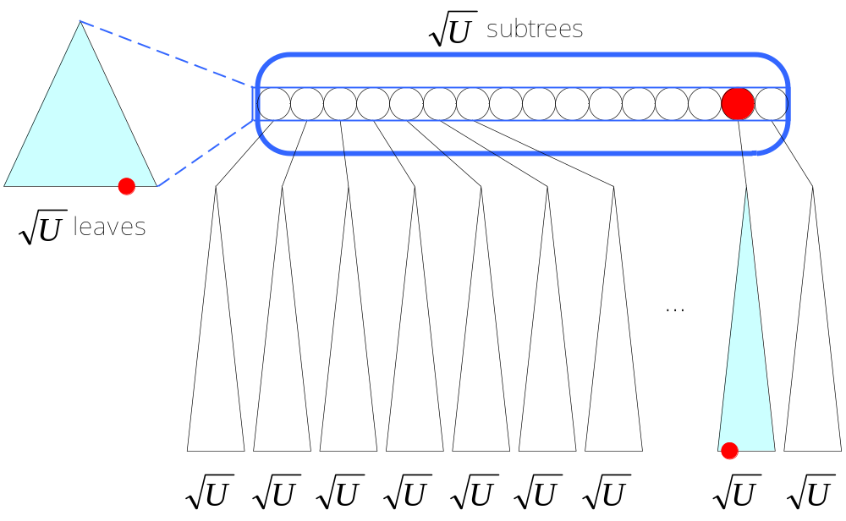
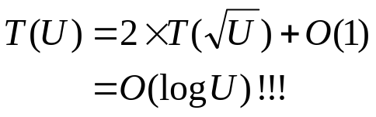
Problem on INSERT
If the leaves on both the summary tree and the corresponding subtree are inserted recursively.

Slide 43
INSERT on Summary Tree Exactly Once
The first INSERT to a subtree:
  Recursively INSERT to the summary tree
  Set (min = max) in the subtree
The second INSERT to a subtree:
  Update min and max in the subtree
The third INSERT to a subtree:
  Update min and max in the subtree
  Recursively INSERT to the subtree

Slide 44
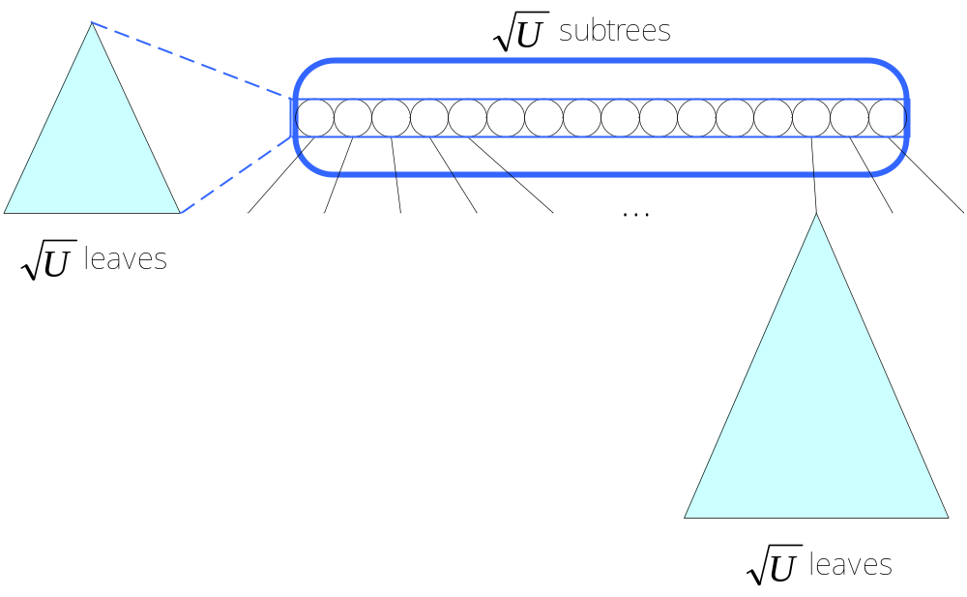

Reduce the Recursion of INSERT
3
2
1

Slide 45
DELETE on Summary Tree Exactly Once
The steps of DELETE are exact in the reverse order of the steps of INSERT.
The DELETE occurs in summary tree only if the corresponding subtree becomes empty.

Slide 46
Conclusion
Erik Demaine tree achieves the same time and space complexities as van Emde Boas tree v2 does.
These two tree structures are of similar concepts, but the structures are really different.
To see is to believe. (眼見為憑)

