Slide 1
An O(n log n) Algorithm for Finding All Repetitions in a String
MICHAEL G. MAIN
Department of Computer Science, University of Colorado, Boulder, Colorado 80309
RICHARD J. LORRNTZ
Computer Science Group, Harvey Mudd College, Claremont, California 91711
Journal of Algorithms Volume 5, Issue 3, pp. 422-432, September 1984
Presenter: Shih-jhan Huang
Date:2016/2/1

Slide 2
Abstract
Any nonempty string of the form xx is called a repetition. An O(nlogn) algorithm is presented to find all repetitions in a string of length n. The algorithm is based on a linear algorithm to find all the new repetitions formed when two strings are concatenated. This linear algorithm is possible because new repetitions of equal length must occur in blocks with consecutive starting positions. The linear algorithm uses a variation of the Knuth-Morris-Pratt algorithm to find all partial occurrences of a pattern within a text string. It is also shown that no algorithm based on comparisons of symbols can improve O(nlogn). Finally, some open problems and applications are suggested.

Slide 3
Introduction
A repetition is an immediately repeated nonempty string, e.g., aa, abab,wallawalla.
Any string which contains a repetition as a substring is called repetition-containing.
A string which is not repetition-containing is repetition-free.
This paper is to find the longest repetition in a string, or just to determine when a string is repetition-free.

Slide 4
Finding all partial matches of a pattern
Let pattern and text be strings of length m and n, respectively.
This section shows how to find all partial matches of text with the beginning of pattern in O(n) time.
The algorithm is a variation of the Knuth-Morris-Pratt pattern matching algorithm.

Slide 5
Compute the following arrays
lppattern:
Ippatern[i] is the length of the longest substring of pattern which begins at position i and is a prefix of pattern (1 < i ≤ m). O(m)
lptext:
lptext[i] is the length of the longest substring of text which begins at position i and is a prefix of pattern (1 ≤ i ≤ n). O(n)
( 註：The variation of the KMP algorithm which we use to calculate lppattern was suggested by a referee. Simplify the presentation of algorithm 3. )

Slide 6
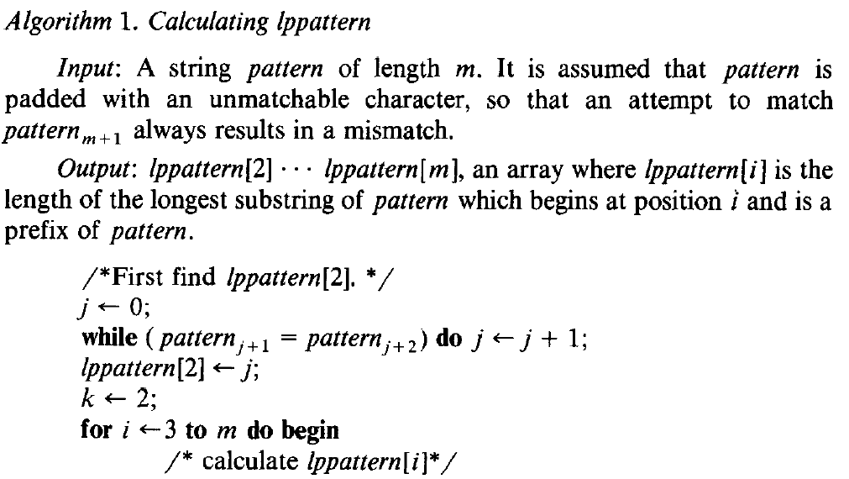
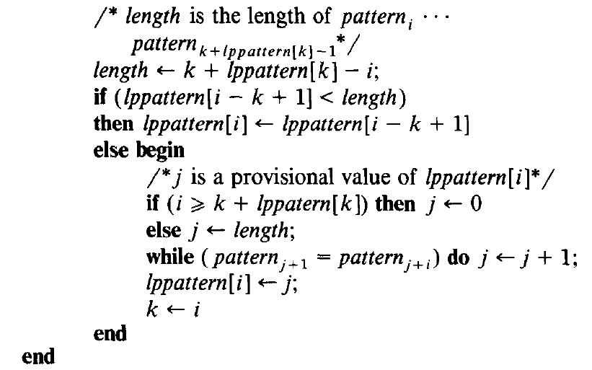

Slide 7
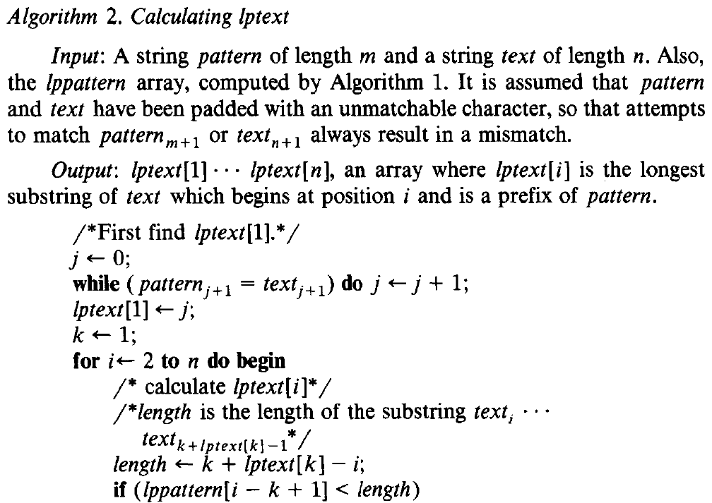
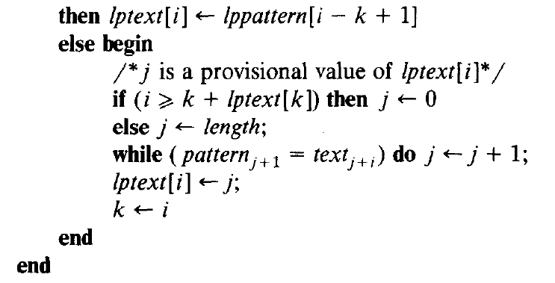

Slide 8
Example
Give two string following : Text : ACBACAACA
Pattern : ACAACAB
Compute lppattern[i] : (1 < i ≤ m)
ACAACAB
lppattern[2] = 0
ACAACAB
lppattern[5] = 1
ACAACAB
lppattern[3] = 1
ACAACAB
lppattern[6] = 0
ACAACAB
lppattern[4] = 3
ACAACAB
lppattern[5] = 0

Slide 9
Example
Give two string following : Text : ACBACAACA
Pattern : ACAACAB
Compute lptext[i] : (1 ≤ i ≤ n)
ACBACAACA
lptext[1] = 2
ACBACAACA
lptext[5] = 0
ACBACAACA
lptext[9] = 1
ACBACAACA
lptext[6] = 1
ACBACAACA
lptext[2] = 0
ACBACAACA
lptext[3] = 0
ACBACAACA
lptext[7] = 3
ACBACAACA
lptext[4] = 6
ACBACAACA
lptext[8] = 0

Slide 10
Detecting formation of repetition
u and v are any strings.
Give an O(|uv|) algorithm to find all the new repetitions that are formed when u is concatenated to v.
The new repetitions in uv are classified into two groups, according to where their centers lie.
A right repetition has its center at or to the right of the boundary between u and v.
A left repetition has its center at or to the left of this boundary.
To find all new repetitions in uv, we need only find all new right repetitions and all new left repetitions.

Slide 11
The procedure newright(u, v) makes use of the following information:
ls[i] (1≤ i ≤|v|) is the length of the longest suffix of u which occurs in v,ending at position i.
lp[i] (2≤ I ≤|v|+1) is the length of the longest prefix of v which occurs in v, beginning at position i (lp[|v|+1] ≡ 0).

Slide 12
Repetition Lemma :
Let n and i be integers with 1≤ n ≤|v| and n≤ i <2n. There is a repetition of length 2n in uv ending at position i of v iff 2n-ls[n] ≤ i ≤ n + lp[n+1].
Proof: Let n and i be integers in the given ranges. A repetition of length 2n in uv, that ends at v_{i}, must begin at u_{|u|-2n+i+1}.
The beginning of its second half must be at v_{i-n+1}. Thus, a necessary and sufficient condition for such a repetition to occur is that the substring u_{|u|-2n+i+1} . . . u_{|u|}v₁ . . . v_{i-n} matches v_{i-n+1} . . . v_{i}. Equivalently:
(1) u_{|u|-2n+i+1} . . . u_{|u|} = v_{i-n+1} . . . v_{n} , and
(2) v₁ . . . v_{i-n} = v_{n+1} . . . v_{i} (This second condition is vacuous if i = n.)
The first condition is exactly the statement that the string v_{i-n+1} . . . v_{n} of length 2n - i is a suffix of u, which is true iff ls[n] ≥ 2n - i.
This may be rewritten as 2n - ls[n] ≤ i. Similarly, the second condition reduces to i ≤ n+lp[n+1].

Slide 13
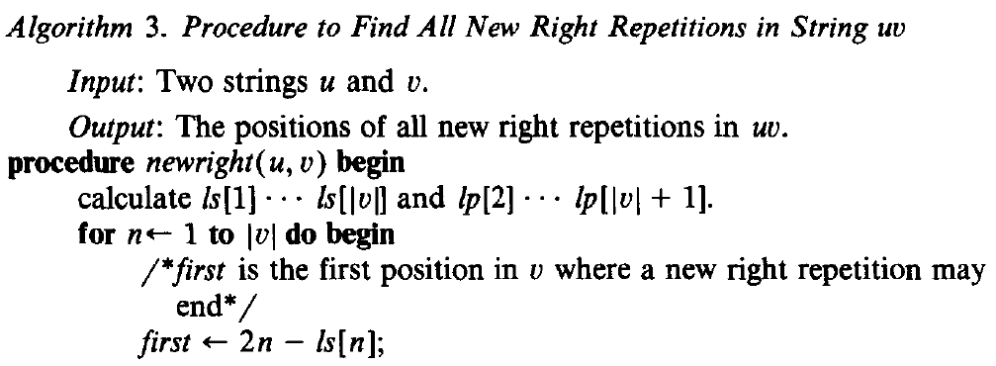
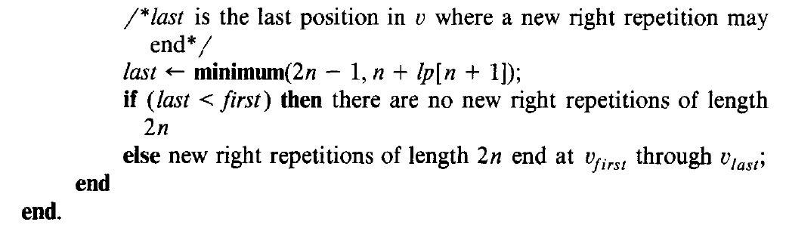

Slide 14
Finding all repetitions in a string
This section describes an algorithm to find all repetitions in a string of length n, in time O(nlogn). It uses the procedure new of the last section.
Let w be the string of length n. The repetitions in w are of these three sorts:
(1) The repetitions which end at or before the ┌n/2┐th position of w.
(2) The repetitions which start after the ┌ n/2 ┐th position of w.
(3) The repetitions which start at or before the ┌ n/2 ┐th position of w, and end after it.

Slide 15
In Algorithm 4, the procedure findreps( w) finds repetitions of the third kind with a call to new(w₁ . . . w┌_{n/2}┐, w┌_{n/2}┐₊₁. . . w_{n}). (Recall that new(u,v) finds all repetitions which span the border between u and v.)
Repetitions of the first two sorts are found with recursive calls findreps(w₁ . . . w┌_{n/2}┐),and findreps(w┌_{n/2}┐₊₁. . . w_{n})

Slide 16
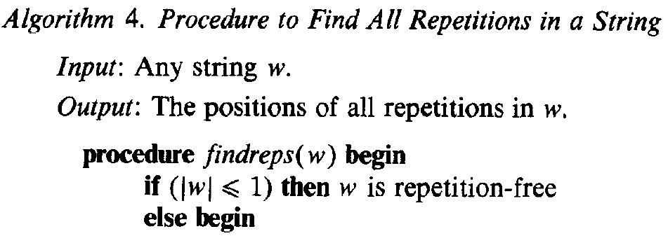
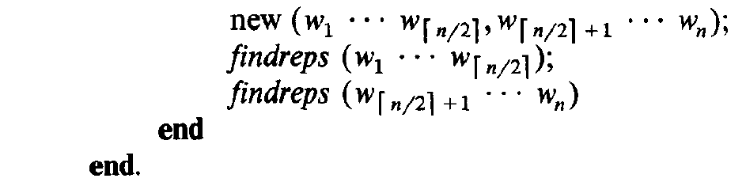

Slide 17
Let T(n) be the time findreps takes on an input of length n. The function T(n) gives rise to the recurrence:
T(1) = d
T(n) = cn + 2T( n/2)
for some constants c and d. The cn comes from the call to new, which takes linear time.
The 2T(n/2) arises from the two recursive calls to findreps. The solution to this recurrence is O(nlogn).

Slide 18
Conclusion
Given a string w, of length n, the algorithm of the previous section finds all repetitions in w in time O(n logn). If we know nothing about the size of the alphabet, then this is optimal for algorithms based on comparisons of symbols.
In fact, it is optimal for any algorithm which determines if w is repetition-free.

