Slide 1
Computational complexity of similarity retrieval in a pictorial database
D.J. Guan
Department of Computer Science, National Sun-Yat-Sen University, Kaohsiung 80424, Taiwan
Chun-Yen Chou
Chiou-Wei Chen
Department of Applied Mathematics, National Sun-Yat-Sen University, Kaohsiung 80424, Taiwan
Information Processing Letters 75, pp.113-117, 2000
Presenter: Shiou-Zong Chiou
Date:2016/02/16

Slide 2
Abstract
Three types of similarity are commonly used in similarity retrieval of a pictorial database. Only one of them is isometric hence transitive. We present polynomial time algorithms to find the maximum similar subpicture of two given pictures when the similarity is isometric. For nonisometric types, we show that finding a maximum similar subpicture in two given pictures is NP-complete, even then all symbols are distinct, by reducing the satisfiability problem to it.

Slide 3

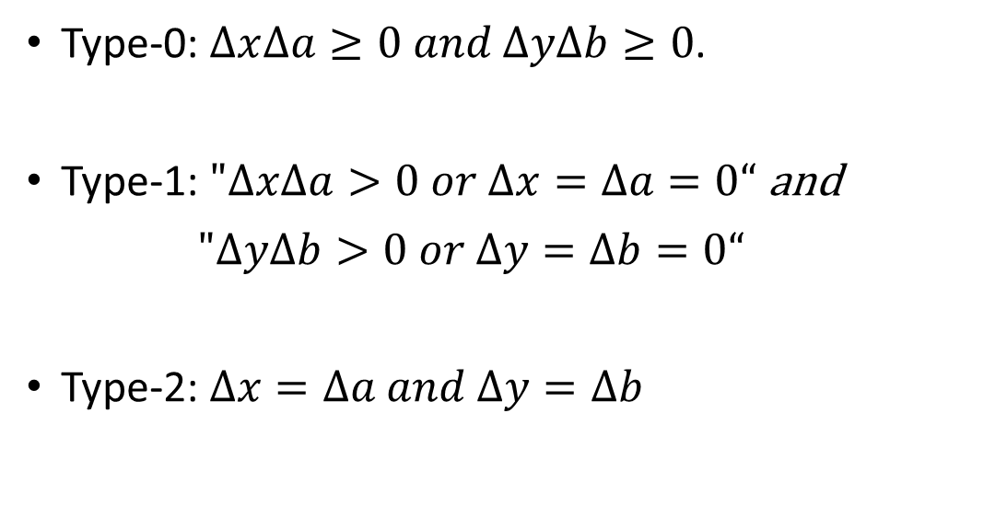

Introduction
$$P_{1}$$
$$P_{2}$$
Type-0: $∆x∆a≥0 and ∆y∆b≥0$.
Type-1: $"∆x∆a>0 or ∆x=∆a=0“$ and
$"∆y∆b>0 or ∆y=∆b=0“$
Type-2: $∆x=∆a and ∆y=∆b$
 | A
 |  | B
A
A
 | A
 | A
 | B
A
 | A

Slide 4
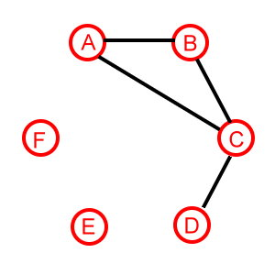


$$Maximum similar subpicture ∝clique problem$$
Let the vertex set V be the set of symbols appearing in both $P_{1}$ and $P_{2}$.
There is a edge between A and B iff A,B in $P_{1}$ and $P_{2}$ have the spatial relation of type-i,i=0,1,2.
 |  | G |  | F
 | A
 |  |  |  | B
 | E | C
D
 | A
E |  |  |  | B
 |  | C
 | D
 | F
Type-1

Slide 5
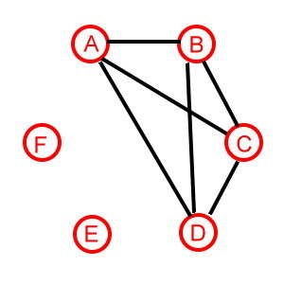

Type-2
When all symbols are distinct, it can be solved in $O(n^{2})$.
If A and B have a relation of type-2,and B and C have a relation of type-2, then A and C have a relation of type-2.
 |  | G |  | F
 | A
 |  |  |  | B
 | E | C
D
 | A
E |  |  |  | B
 |  | C
D
 | F

Slide 6
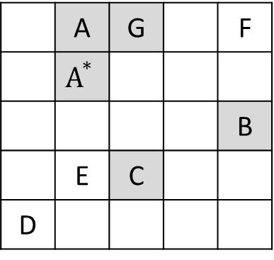



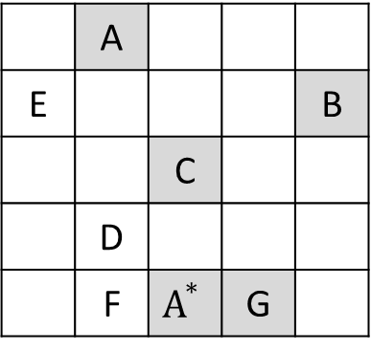
Type-2
When symbols are not all distinct, can be solved in $O\left(n^{3}\right).$
D
E
C
$$A^{∗}$$
A
G
B
F
D
$$A^{∗}$$
E
G
C
A
B
 | A | G |  | F
 | $$A^{∗}$$
 |  |  |  | B
 | E | C
D
 | A
E |  |  |  | B
 |  | C
 | D
 | F | $$A^{∗}$$ | G

Slide 7


Type-0 and type-1
$SAT∝maximun similar subpicture$.
$$P_{1}:[l_{i}^{r},(g_{1}\left(i,r\right),h_{1}(i,r))]$$
$$P_{2}:[l_{i}^{r},(g_{2}\left(i,r\right),h_{2}(i,r))]$$
$$g_{1}\left(i,r\right)=\left\{\begin{matrix}3r−2 \\ 3r−1 \\ 3r\end{matrix} \begin{matrix}if i=1 \\ if i=2 \\ if i=3\end{matrix}\right.$$
$$g_{2}\left(i,r\right)=\left\{\begin{matrix}3r \\ 3r−1 \\ 3r−2\end{matrix} \right. \begin{matrix}if i=1 \\ if i=2 \\ if i=3\end{matrix}$$
$$h_{1}\left(i,r\right)=\left\{\begin{matrix}2j \\ 2j−1\end{matrix} \begin{matrix}if l_{i}^{r}is the Boolean variable\overline{x_{j}} \\ if l_{i}^{r}is the Boolean variablex_{j}\end{matrix}\right.$$
$$h_{2}\left(i,r\right)=\left\{\begin{matrix}2j−1 \\ 2j\end{matrix}\right. \begin{matrix}if l_{i}^{r}is the Boolean variable\overline{x_{j}} \\ if l_{i}^{r}is the Boolean variablex_{j}\end{matrix}$$

Slide 8
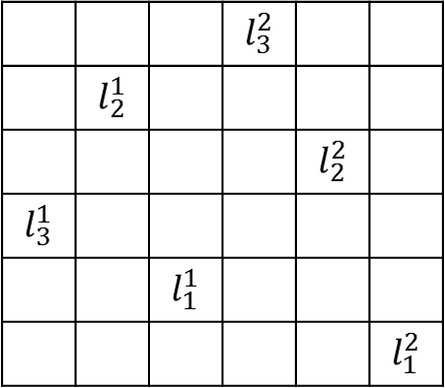
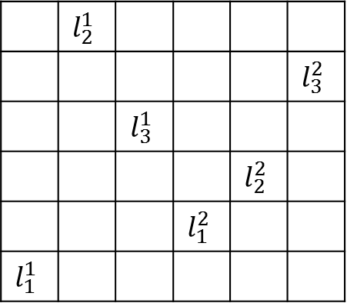



Type-0 and type-1
Ex:if $Φ=(x_{1}∨\overline{x_{3}}∨\overline{x_{2}})∧(\overline{x_{1}}∨x_{2}∨x_{3})$
 | $$l_{2}^{1}$$
 |  |  |  |  | $$l_{3}^{2}$$
 |  | $$l_{3}^{1}$$
 |  |  |  | $$l_{2}^{2}$$
 |  |  | $$l_{1}^{2}$$
$$l_{1}^{1}$$
 |  |  | $$l_{3}^{2}$$
 | $$l_{2}^{1}$$
 |  |  |  | $$l_{2}^{2}$$
$$l_{3}^{1}$$
 |  | $$l_{1}^{1}$$
 |  |  |  |  | $$l_{1}^{2}$$
$$P_{1}$$
$$P_{2}$$

