Slide 1
On the Common Substring Alignment Problem
Gad M. Landau, Michal Ziv-Ukelson
Journal of Algorithms 41, pp. 338-359, 2001
Presenter: Bi-Shiang Lin
Date:2016/2/23

Slide 2
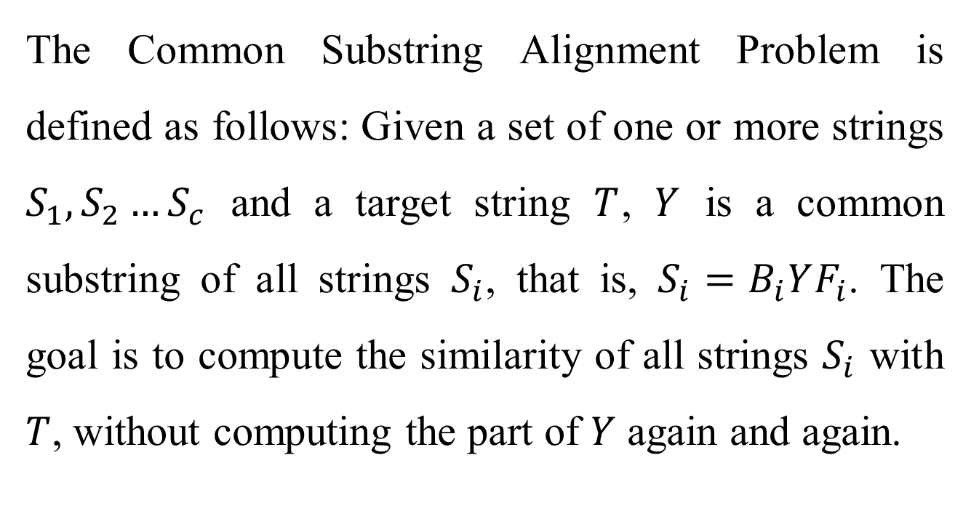
Abstract(1/4)
The Common Substring Alignment Problem is defined as follows: Given a set of one or more strings $S_{1},S_{2}…S_{c}$ and a target string $T$, $Y$ is a common substring of all strings $S_{i}$, that is, $S_{i}=B_{i}YF_{i}$. The goal is to compute the similarity of all strings $S_{i}$ with $T$, without computing the part of $Y$ again and again.

Slide 3
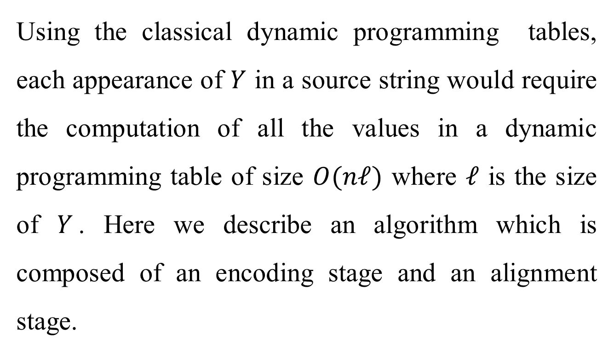
Abstract(2/4)
Using the classical dynamic programming tables, each appearance of $Y$ in a source string would require the computation of all the values in a dynamic programming table of size $O(nℓ)$ where $ℓ$ is the size of $Y$. Here we describe an algorithm which is composed of an encoding stage and an alignment stage.

Slide 4
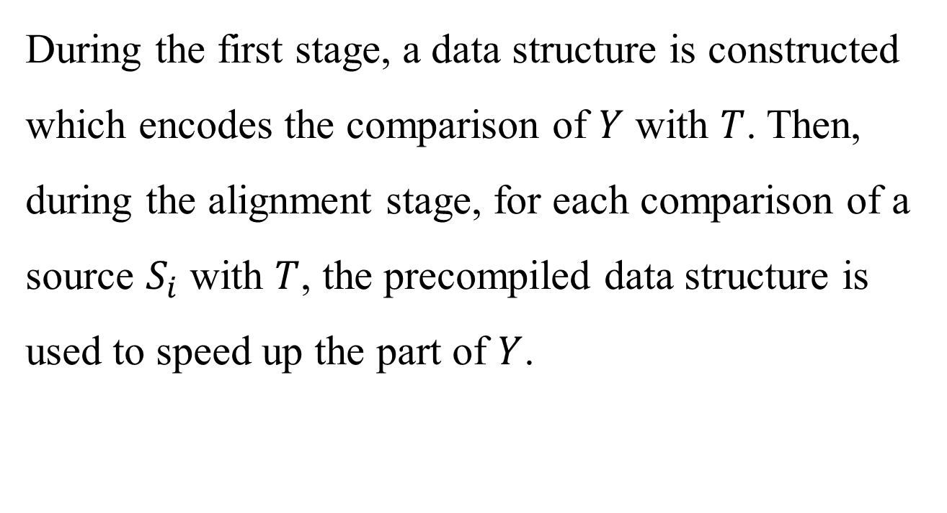
Abstract(3/4)
During the first stage, a data structure is constructed which encodes the comparison of $Y$ with $T$. Then, during the alignment stage, for each comparison of a source $S_{i}$ with $T$, the precompiled data structure is used to speed up the part of $Y$.

Slide 5
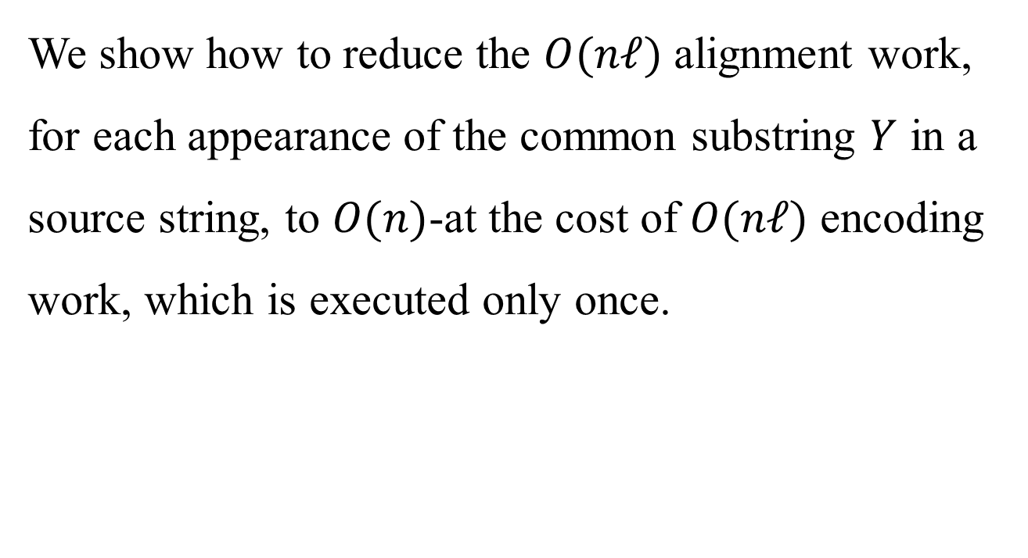
Abstract(4/4)
We show how to reduce the $O(nℓ)$ alignment work, for each appearance of the common substring $Y$ in a source string, to $O(n)$-at the cost of $O(nℓ)$ encoding work, which is executed only once.

Slide 6
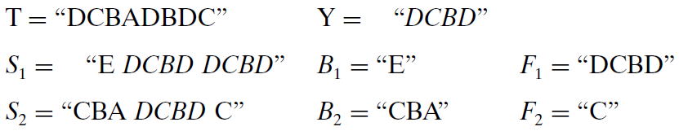
Problem
Input : a set of strings , a common substring Y, a target T
Output : find the similarity of any string and the target T without computing Y and T again and again

Slide 7
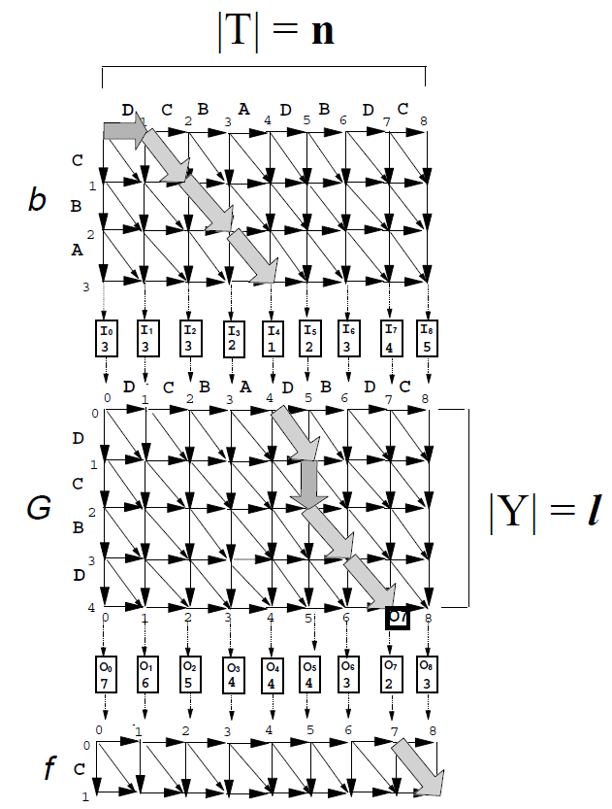
Edit distance, Score:
Mismatched aligned pair = 1
Unaligned symbol = 1
Matched pair = 0
Two Stage :
Encoding stage
Alignment stage

Slide 8
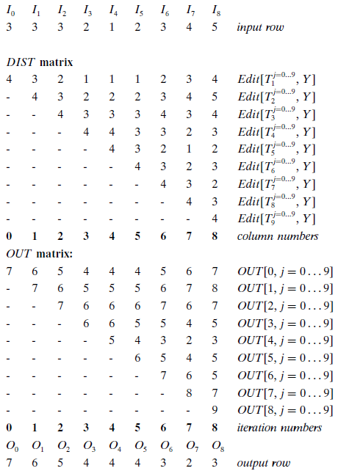
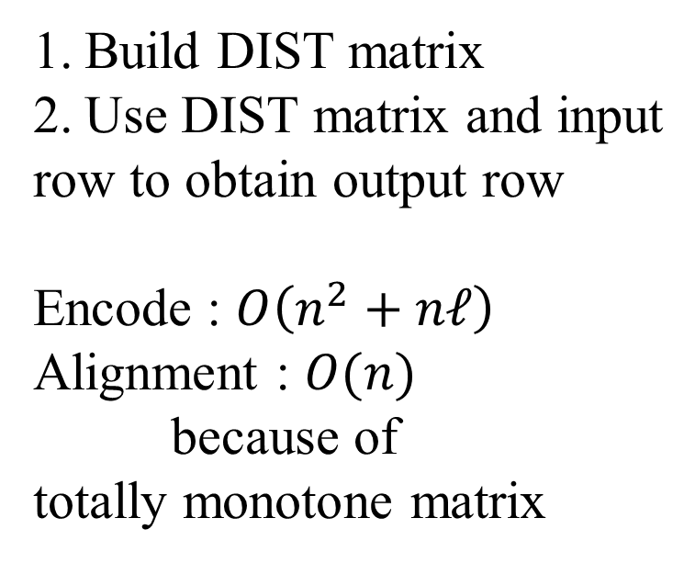
First Algorithm
Build DIST matrix
Use DIST matrix and input
row to obtain output row
Encode : $O\left(n^{2}+nℓ\right)$
Alignment : $O(n)$
because of
totally monotone matrix

Slide 9
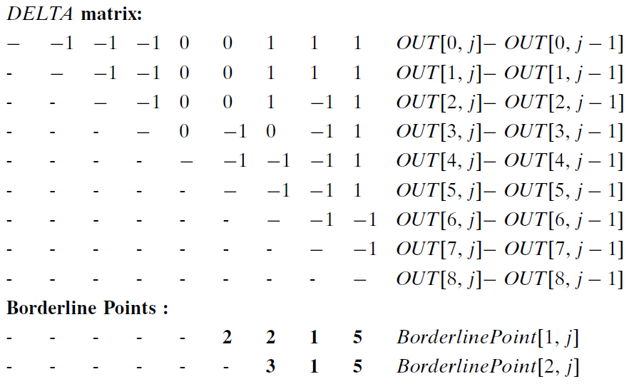
Second Algorithm

Slide 10
 | O0 | O1 | O2 | O3 | O4 | O5 | O6 | O7 | O8
I0 | 7 | 6 | 5 | 4 | 4 | 4 | 5 | 6 | 7
I1 |  | 7 | 6 | 5 | 5 | 5 | 6 | 7 | 8
I2 |  |  | 7 | 6 | 6 | 6 | 7 | 6 | 7
I3 |  |  |  | 6 | 6 | 5 | 5 | 4 | 5
I4 |  |  |  |  | 5 | 4 | 3 | 2 | 3
I5 |  |  |  |  |  | 6 | 5 | 4 | 5
I6 |  |  |  |  |  |  | 7 | 6 | 5
I7 |  |  |  |  |  |  |  | 8 | 7
I8 |  |  |  |  |  |  |  |  | 9

Slide 11
 | O0 | O1 | O2 | O3 | O4 | O5 | O6 | O7 | O8
I0 | 7/0 | 6 | 5 | 4 | 4 | 4 | 5 | 6 | 7
I1 |  | 7 | 6 | 5 | 5 | 5 | 6 | 7 | 8
I2 |  |  | 7 | 6 | 6 | 6 | 7 | 6 | 7
I3 |  |  |  | 6 | 6 | 5 | 5 | 4 | 5
I4 |  |  |  |  | 5 | 4 | 3 | 2 | 3
I5 |  |  |  |  |  | 6 | 5 | 4 | 5
I6 |  |  |  |  |  |  | 7 | 6 | 5
I7 |  |  |  |  |  |  |  | 8 | 7
I8 |  |  |  |  |  |  |  |  | 9

Slide 12
 | O0 | O1 | O2 | O3 | O4 | O5 | O6 | O7 | O8
I0 | 7 | 6/1 | 5 | 4 | 4 | 4 | 5 | 6 | 7
I1 |  | 7/0 | 6 | 5 | 5 | 5 | 6 | 7 | 8
I2 |  |  | 7 | 6 | 6 | 6 | 7 | 6 | 7
I3 |  |  |  | 6 | 6 | 5 | 5 | 4 | 5
I4 |  |  |  |  | 5 | 4 | 3 | 2 | 3
I5 |  |  |  |  |  | 6 | 5 | 4 | 5
I6 |  |  |  |  |  |  | 7 | 6 | 5
I7 |  |  |  |  |  |  |  | 8 | 7
I8 |  |  |  |  |  |  |  |  | 9

Slide 13
 | O0 | O1 | O2 | O3 | O4 | O5 | O6 | O7 | O8
I0 | 7 | 6 | 5/1 | 4 | 4 | 4 | 5 | 6 | 7
I1 |  | 7 | 6/1 | 5 | 5 | 5 | 6 | 7 | 8
I2 |  |  | 7/0 | 6 | 6 | 6 | 7 | 6 | 7
I3 |  |  |  | 6 | 6 | 5 | 5 | 4 | 5
I4 |  |  |  |  | 5 | 4 | 3 | 2 | 3
I5 |  |  |  |  |  | 6 | 5 | 4 | 5
I6 |  |  |  |  |  |  | 7 | 6 | 5
I7 |  |  |  |  |  |  |  | 8 | 7
I8 |  |  |  |  |  |  |  |  | 9

Slide 14
 | O0 | O1 | O2 | O3 | O4 | O5 | O6 | O7 | O8
I0 | 7 | 6 | 5 | 4/1 | 4 | 4 | 5 | 6 | 7
I1 |  | 7 | 6 | 5/1 | 5 | 5 | 6 | 7 | 8
I2 |  |  | 7 | 6/0 | 6 | 6 | 7 | 6 | 7
I3 |  |  |  | 6/0 | 6 | 5 | 5 | 4 | 5
I4 |  |  |  |  | 5 | 4 | 3 | 2 | 3
I5 |  |  |  |  |  | 6 | 5 | 4 | 5
I6 |  |  |  |  |  |  | 7 | 6 | 5
I7 |  |  |  |  |  |  |  | 8 | 7
I8 |  |  |  |  |  |  |  |  | 9

Slide 15
 | O0 | O1 | O2 | O3 | O4 | O5 | O6 | O7 | O8
I0 | 7 | 6 | 5 | 4/1 | 4 | 4 | 5 | 6 | 7
I1 |  | 7 | 6 | 5/1 | 5 | 5 | 6 | 7 | 8
I2 |  |  | 7 | 6 | 6 | 6 | 7 | 6 | 7
I3 |  |  |  | 6/0 | 6 | 5 | 5 | 4 | 5
I4 |  |  |  |  | 5 | 4 | 3 | 2 | 3
I5 |  |  |  |  |  | 6 | 5 | 4 | 5
I6 |  |  |  |  |  |  | 7 | 6 | 5
I7 |  |  |  |  |  |  |  | 8 | 7
I8 |  |  |  |  |  |  |  |  | 9

Slide 16
 | O0 | O1 | O2 | O3 | O4 | O5 | O6 | O7 | O8
I0 | 7 | 6 | 5 | 4 | 4/1 | 4 | 5 | 6 | 7
I1 |  | 7 | 6 | 5 | 5/1 | 5 | 6 | 7 | 8
I2 |  |  | 7 | 6 | 6 | 6 | 7 | 6 | 7
I3 |  |  |  | 6 | 6/-1 | 5 | 5 | 4 | 5
I4 |  |  |  |  | 5/0 | 4 | 3 | 2 | 3
I5 |  |  |  |  |  | 6 | 5 | 4 | 5
I6 |  |  |  |  |  |  | 7 | 6 | 5
I7 |  |  |  |  |  |  |  | 8 | 7
I8 |  |  |  |  |  |  |  |  | 9

Slide 17
 | O0 | O1 | O2 | O3 | O4 | O5 | O6 | O7 | O8
I0 | 7 | 6 | 5 | 4 | 4/1 | 4 | 5 | 6 | 7
I1 |  | 7 | 6 | 5 | 5 | 5 | 6 | 7 | 8
I2 |  |  | 7 | 6 | 6 | 6 | 7 | 6 | 7
I3 |  |  |  | 6 | 6 | 5 | 5 | 4 | 5
I4 |  |  |  |  | 5/0 | 4 | 3 | 2 | 3
I5 |  |  |  |  |  | 6 | 5 | 4 | 5
I6 |  |  |  |  |  |  | 7 | 6 | 5
I7 |  |  |  |  |  |  |  | 8 | 7
I8 |  |  |  |  |  |  |  |  | 9

Slide 18
 | O0 | O1 | O2 | O3 | O4 | O5 | O6 | O7 | O8
I0 | 7 | 6 | 5 | 4 | 4 | 4/1 | 5 | 6 | 7
I1 |  | 7 | 6 | 5 | 5 | 5 | 6 | 7 | 8
I2 |  |  | 7 | 6 | 6 | 6 | 7 | 6 | 7
I3 |  |  |  | 6 | 6 | 5 | 5 | 4 | 5
I4 |  |  |  |  | 5 | 4/2 | 3 | 2 | 3
I5 |  |  |  |  |  | 6/0 | 5 | 4 | 5
I6 |  |  |  |  |  |  | 7 | 6 | 5
I7 |  |  |  |  |  |  |  | 8 | 7
I8 |  |  |  |  |  |  |  |  | 9

Slide 19
 | O0 | O1 | O2 | O3 | O4 | O5 | O6 | O7 | O8
I0 | 7 | 6 | 5 | 4 | 4 | 4/0 | 5 | 6 | 7
I1 |  | 7 | 6 | 5 | 5 | 5 | 6 | 7 | 8
I2 |  |  | 7 | 6 | 6 | 6 | 7 | 6 | 7
I3 |  |  |  | 6 | 6 | 5 | 5 | 4 | 5
I4 |  |  |  |  | 5 | 4/2 | 3 | 2 | 3
I5 |  |  |  |  |  | 6/0 | 5 | 4 | 5
I6 |  |  |  |  |  |  | 7 | 6 | 5
I7 |  |  |  |  |  |  |  | 8 | 7
I8 |  |  |  |  |  |  |  |  | 9

Slide 20
 | O0 | O1 | O2 | O3 | O4 | O5 | O6 | O7 | O8
I0 | 7 | 6 | 5 | 4 | 4 | 4 | 5 | 6 | 7
I1 |  | 7 | 6 | 5 | 5 | 5 | 6 | 7 | 8
I2 |  |  | 7 | 6 | 6 | 6 | 7 | 6 | 7
I3 |  |  |  | 6 | 6 | 5 | 5 | 4 | 5
I4 |  |  |  |  | 5 | 4/2 | 3 | 2 | 3
I5 |  |  |  |  |  | 6/0 | 5 | 4 | 5
I6 |  |  |  |  |  |  | 7 | 6 | 5
I7 |  |  |  |  |  |  |  | 8 | 7
I8 |  |  |  |  |  |  |  |  | 9

Slide 21
 | O0 | O1 | O2 | O3 | O4 | O5 | O6 | O7 | O8
I0 | 7 | 6 | 5 | 4 | 4 | 4 | 5 | 6 | 7
I1 |  | 7 | 6 | 5 | 5 | 5 | 6 | 7 | 8
I2 |  |  | 7 | 6 | 6 | 6 | 7 | 6 | 7
I3 |  |  |  | 6 | 6 | 5 | 5 | 4 | 5
I4 |  |  |  |  | 5 | 4 | 3/2 | 2 | 3
I5 |  |  |  |  |  | 6 | 5/2 | 4 | 5
I6 |  |  |  |  |  |  | 7/0 | 6 | 5
I7 |  |  |  |  |  |  |  | 8 | 7
I8 |  |  |  |  |  |  |  |  | 9

Slide 22
 | O0 | O1 | O2 | O3 | O4 | O5 | O6 | O7 | O8
I0 | 7 | 6 | 5 | 4 | 4 | 4 | 5 | 6 | 7
I1 |  | 7 | 6 | 5 | 5 | 5 | 6 | 7 | 8
I2 |  |  | 7 | 6 | 6 | 6 | 7 | 6 | 7
I3 |  |  |  | 6 | 6 | 5 | 5 | 4 | 5
I4 |  |  |  |  | 5 | 4 | 3 | 2/2 | 3
I5 |  |  |  |  |  | 6 | 5 | 4/2 | 5
I6 |  |  |  |  |  |  | 7 | 6/2 | 5
I7 |  |  |  |  |  |  |  | 8/0 | 7
I8 |  |  |  |  |  |  |  |  | 9

Slide 23
 | O0 | O1 | O2 | O3 | O4 | O5 | O6 | O7 | O8
I0 | 7 | 6 | 5 | 4 | 4 | 4 | 5 | 6 | 7
I1 |  | 7 | 6 | 5 | 5 | 5 | 6 | 7 | 8
I2 |  |  | 7 | 6 | 6 | 6 | 7 | 6 | 7
I3 |  |  |  | 6 | 6 | 5 | 5 | 4 | 5
I4 |  |  |  |  | 5 | 4 | 3 | 2 | 3/2
I5 |  |  |  |  |  | 6 | 5 | 4 | 5/2
I6 |  |  |  |  |  |  | 7 | 6 | 5/2
I7 |  |  |  |  |  |  |  | 8 | 7/2
I8 |  |  |  |  |  |  |  |  | 9/0

Slide 24
 | O0 | O1 | O2 | O3 | O4 | O5 | O6 | O7 | O8
I0 | 7 | 6 | 5 | 4 | 4 | 4 | 5 | 6 | 7
I1 |  | 7 | 6 | 5 | 5 | 5 | 6 | 7 | 8
I2 |  |  | 7 | 6 | 6 | 6 | 7 | 6 | 7
I3 |  |  |  | 6 | 6 | 5 | 5 | 4 | 5
I4 |  |  |  |  | 5 | 4 | 3 | 2 | 3/2
I5 |  |  |  |  |  | 6 | 5 | 4 | 5/0
I6 |  |  |  |  |  |  | 7 | 6 | 5/2
I7 |  |  |  |  |  |  |  | 8 | 7/2
I8 |  |  |  |  |  |  |  |  | 9/0

Slide 25
 | O0 | O1 | O2 | O3 | O4 | O5 | O6 | O7 | O8
I0 | 7 | 6 | 5 | 4 | 4 | 4 | 5 | 6 | 7
I1 |  | 7 | 6 | 5 | 5 | 5 | 6 | 7 | 8
I2 |  |  | 7 | 6 | 6 | 6 | 7 | 6 | 7
I3 |  |  |  | 6 | 6 | 5 | 5 | 4 | 5
I4 |  |  |  |  | 5 | 4 | 3 | 2 | 3/2
I5 |  |  |  |  |  | 6 | 5 | 4 | 5
I6 |  |  |  |  |  |  | 7 | 6 | 5/2
I7 |  |  |  |  |  |  |  | 8 | 7/2
I8 |  |  |  |  |  |  |  |  | 9/0

Slide 26
 | O0 | O1 | O2 | O3 | O4 | O5 | O6 | O7 | O8
I0 | 7 | 6 | 5 | 4 | 4 | 4 | 5 | 6 | 7
I1 |  | 7 | 6 | 5 | 5 | 5 | 6 | 7 | 8
I2 |  |  | 7 | 6 | 6 | 6 | 7 | 6 | 7
I3 |  |  |  | 6 | 6 | 5 | 5 | 4 | 5
I4 |  |  |  |  | 5 | 4 | 3 | 2 | 3
I5 |  |  |  |  |  | 6 | 5 | 4 | 5
I6 |  |  |  |  |  |  | 7 | 6 | 5
I7 |  |  |  |  |  |  |  | 8 | 7
I8 |  |  |  |  |  |  |  |  | 9

Slide 27
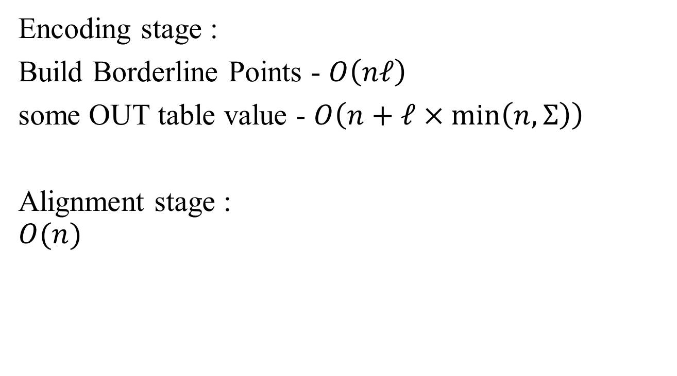
Analysis
Encoding stage :
Build Borderline Points - $O\left(nℓ\right)$
some OUT table value - $O\left(n+ℓ×\min\left(n,Σ\right)\right)$
Alignment stage :
$$O(n)$$

