Slide 1
Classification of time series by shapelet transformation
Jon Hills ·
Jason Lines ·
Edgaras Baranauskas ·
James Mapp ·
Anthony Bagnall
Data Mining and Knowledge
Discover 2013
Presenter: Shu-Kai Hung Date:2016/3/29
Notes:
http://link.springer.com/journal/10618

Slide 2
Abstract(1/3)
Time-series classification (TSC) problems present a specific challenge for classification algorithms: how to measure similarity between series. A shapelet is a time-series subsequence that allows for TSC based on local, phase-independent similarity in shape. Shapelet-based classification uses the similarity between a shapelet and a series as a discriminatory feature. One benefit of the shapelet approach is that shapelets are comprehensibe, and can offer insight into the problem domain. The original shapelet-based classifier embeds the shapelet-discovery algorithm in a decision tree, and uses information gain to assess the quality of candidates, finding a new shapelet at each node of the tree through an enumerative search. Subsequent research has focused mainly on techniques to speed up the search. We examine how best to use the shapelet primitive to construct classifiers.

Slide 3
Abstract(2/3)
We propose a single-scan shapelet algorithm that finds the best k shapelets, which are used to produce a transformed dataset, where each of the k features represent the distance between a time series and a shapelet. The primary advantages over the embedded approach are that the transformed Subsequent research has focused mainly on techniques to speed up the search. We examine how best to use the shapelet primitive to construct classifiers. We propose a single-scan shapelet algorithm that finds the best k shapelets, which are used to produce a transformed dataset, where each of the k features represent the distance between a time series and a shapelet. The primary advantages over the embedded approach are that the transformed data can be used in conjunction with any classifier, and that there is no recursive search for shapelets.

Slide 4
Abstract(3/3)
We demonstrate that the transformed data, in conjunction with more complex classifiers, gives greater accuracy than the embedded shapelet tree. We also evaluate three similarity measures that produce equivalent results to information gain in less time. Finally, we show that by conducting post-transform clustering of shapelets, we can enhance the interpretability of the transformed data. We conduct our experiments on 29 datasets: 17 from the UCR repository, and 12 we provide ourselves.

Slide 5
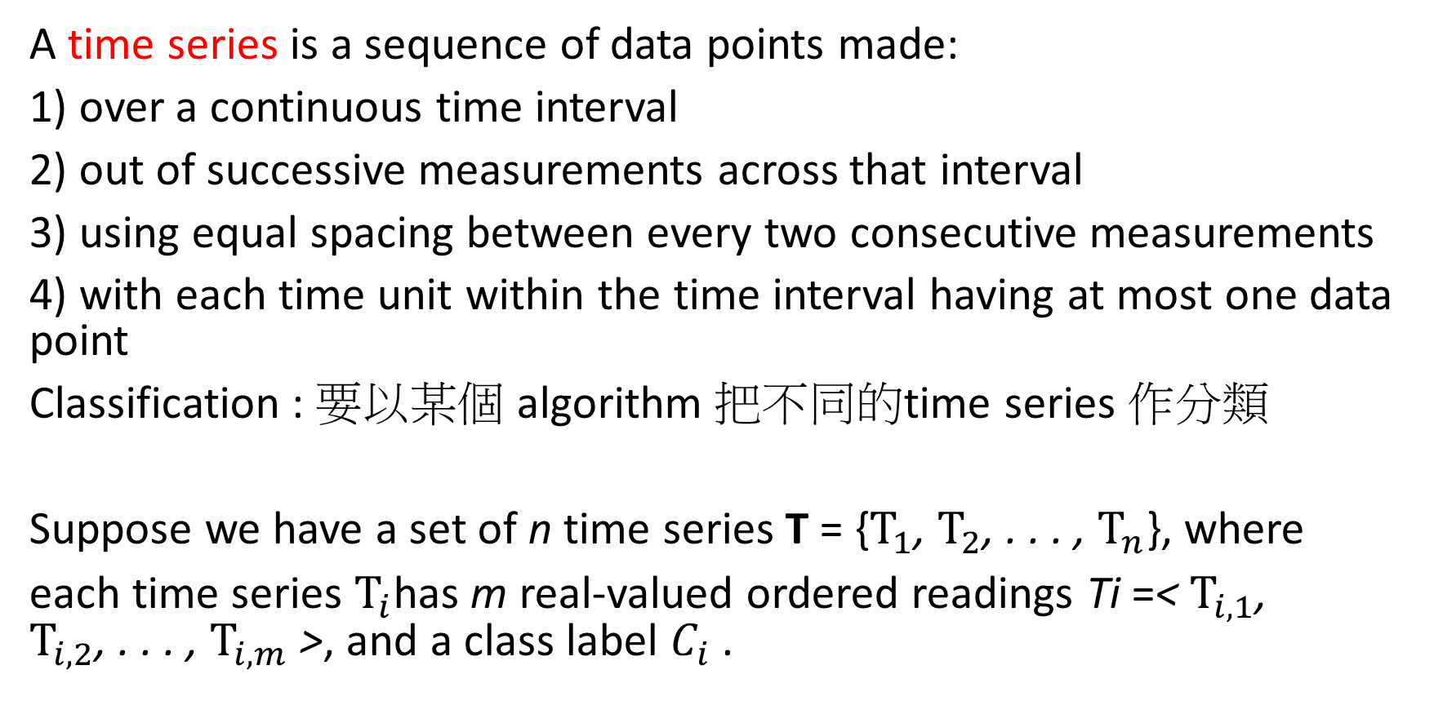
Time-series classification (TSC) problems
A time series is a sequence of data points made:
1) over a continuous time interval
2) out of successive measurements across that interval
3) using equal spacing between every two consecutive measurements
4) with each time unit within the time interval having at most one data point
Classification : 要以某個 algorithm 把不同的time series 作分類
Suppose we have a set of n time series T = {$T_{1}$, $T_{2}$, . . . , $T_{n}$}, where
each time series $T_{i}$has m real-valued ordered readings Ti =< $T_{i,1}$, $T_{i,2}$, . . . , $T_{i,m}$ >, and a class label $C_{i}$ .
Notes:
1）在連續的時間間隔
2）出跨間隔連續測量
3）採用每兩個連續測量之間的間距相等
4）具有至多一個數據點的時間間隔內的每個時間單元

Slide 6
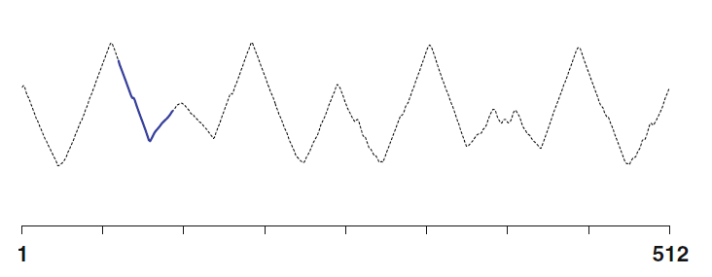
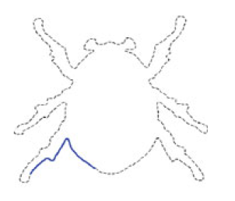
Shapelet-based classification
Shapelet : a time-series subsequence that can be used as a primitive for TSC based on local, phase-independent similarity in shape.

Slide 7
ShapeletCachedSelection
process to extract the best k shapelets
Step 1 : Generating candidates
Step 2 : Shapelet distance calculations
Step 3 : Shapelet assessment(quality)
Step 4 : remove Self Similar
Step 5 : Select k Shapelets

Slide 8
My dataset
HUNG(n=3 m=10)
Hand(H) = (1,5,4,3,7,6,2,8,9,10)
Leg(L) = (4,5,8,7,6,10,9,3,2,1)
Eye(E) = (1,2,3,4,5,6,7,8,9,10)

Slide 9


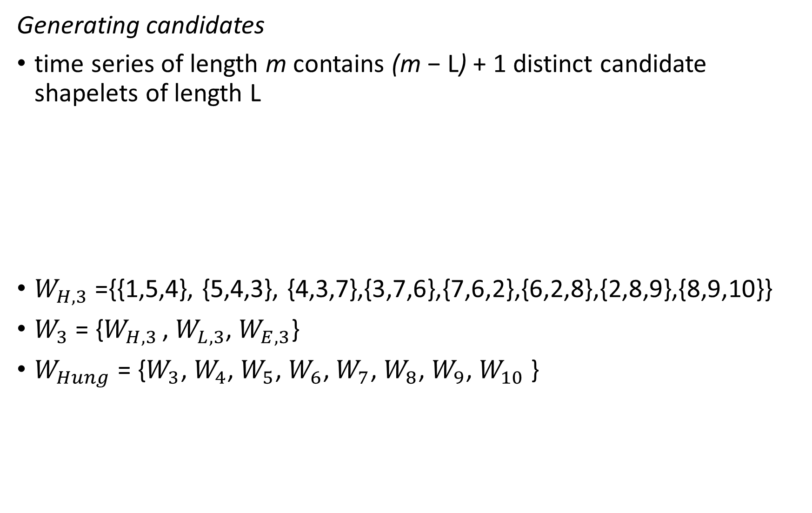
Generating candidates
time series of length m contains (m − L) + 1 distinct candidate shapelets of length L
$W_{H,3}$ ={{1,5,4}, {5,4,3}, {4,3,7},{3,7,6},{7,6,2},{6,2,8},{2,8,9},{8,9,10}}
$W_{3}$ = {$W_{H,3 }$, $W_{L,3}$, $W_{E,3}$}
$W_{Hung}$ = {$W_{3}$, $W_{4}$, $W_{5}$, $W_{6}$, $W_{7}$, $W_{8}$, $W_{9}$, $W_{10}$ }
Notes:
Hand(H) = (1,5,4,3,7,6,2,8,9,10)
Leg(L) = (4,5,8,7,6,10,9,3,2,1)
Eye(E) = (1,2,3,4,5,6,7,8,9,10

Slide 10


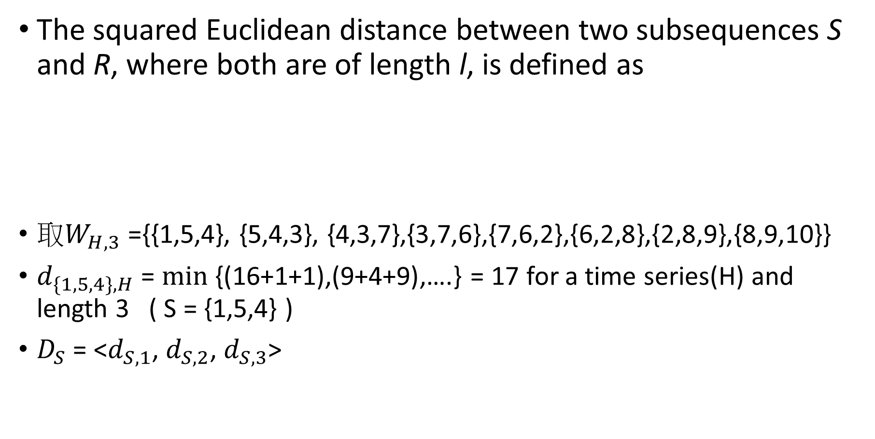
Shapelet distance calculations
The squared Euclidean distance between two subsequences S and R, where both are of length l, is defined as
取$W_{H,3}$ ={{1,5,4}, {5,4,3}, {4,3,7},{3,7,6},{7,6,2},{6,2,8},{2,8,9},{8,9,10}}
$d_{\{1,5,4\},H}$ = $min$ {(16+1+1),(9+4+9),….} = 17 for a time series(H) and length 3 ( S = {1,5,4} )
$D_{S}$ = <$d_{S,1}$, $d_{S,2}$, $d_{S,3}$>

Slide 11
Shapelet assessment
information gain (IG)
Kruskal-Wallis
Analysis of variance F-statistic
Mood’s median

Slide 12

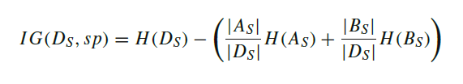
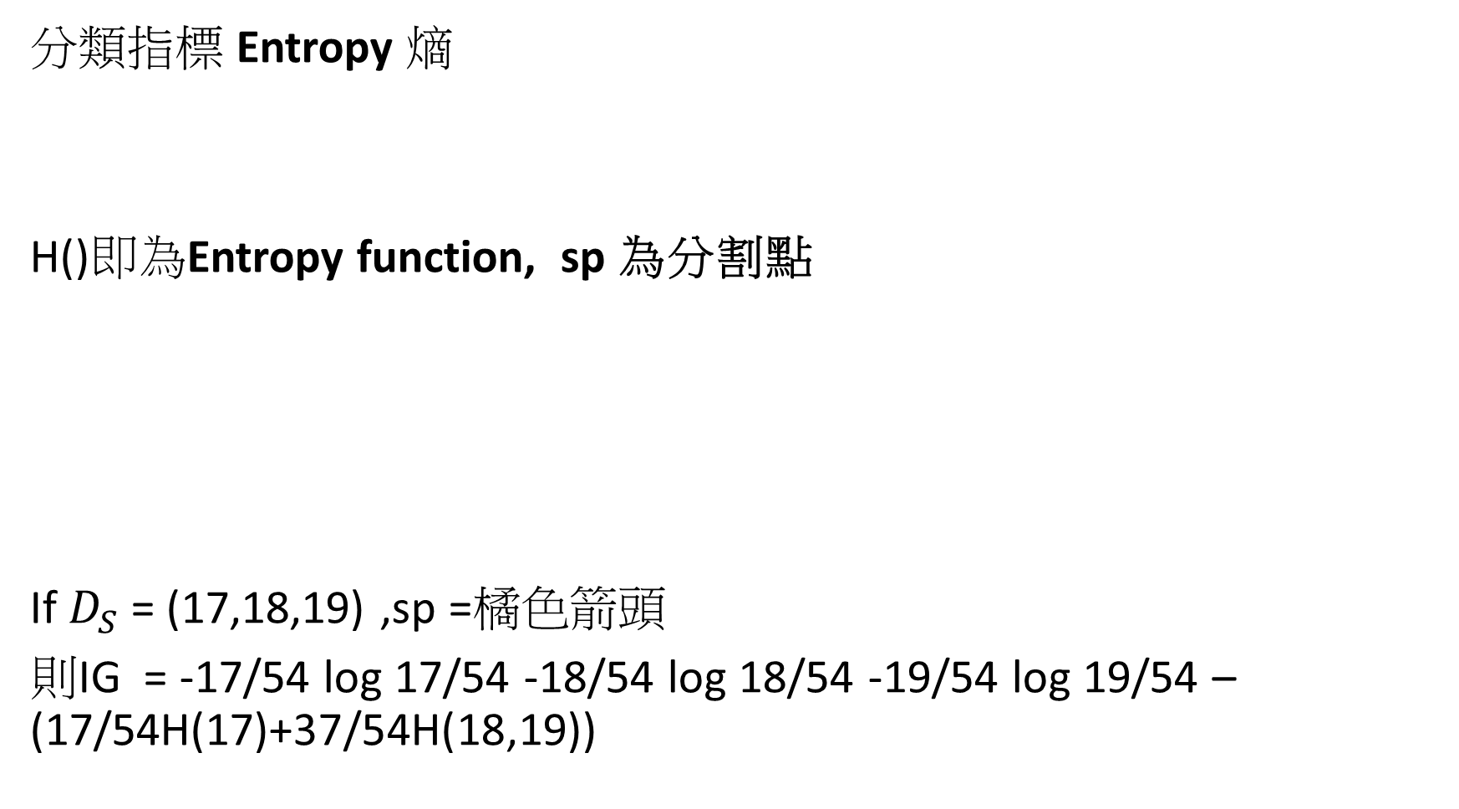
information gain (IG)
分類指標 Entropy 熵
H()即為Entropy function, sp 為分割點
If $D_{S}$ = (17,18,19) ,sp =橘色箭頭
則IG = -17/54 log 17/54 -18/54 log 18/54 -19/54 log 19/54 –(17/54H(17)+37/54H(18,19))

Slide 13
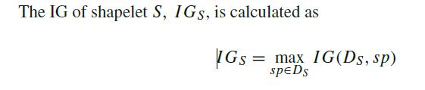
處理所有分割點後 取最大值

Slide 14
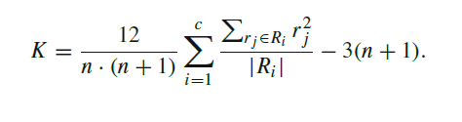
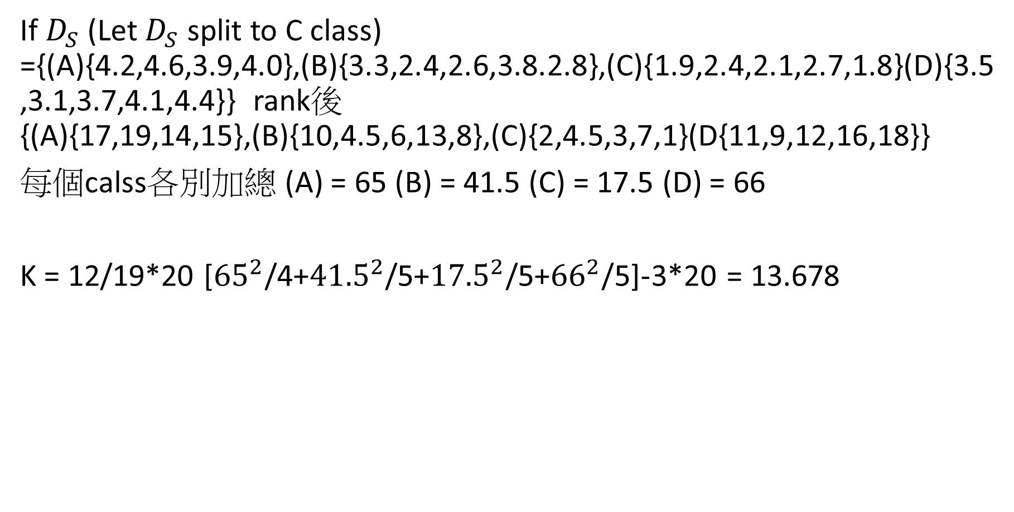
Kruskal-Wallis
If $D_{S}$ (Let $D_{S}$ split to C class) ={(A){4.2,4.6,3.9,4.0},(B){3.3,2.4,2.6,3.8.2.8},(C){1.9,2.4,2.1,2.7,1.8}(D){3.5,3.1,3.7,4.1,4.4}} rank後 {(A){17,19,14,15},(B){10,4.5,6,13,8},(C){2,4.5,3,7,1}(D{11,9,12,16,18}}
每個calss各別加總 (A) = 65 (B) = 41.5 (C) = 17.5 (D) = 66
K = 12/19*20 [${65}^{2}$/4+${41.5}^{2}$/5+${17.5}^{2}$/5+${66}^{2}$/5]-3*20 = 13.678

Slide 15


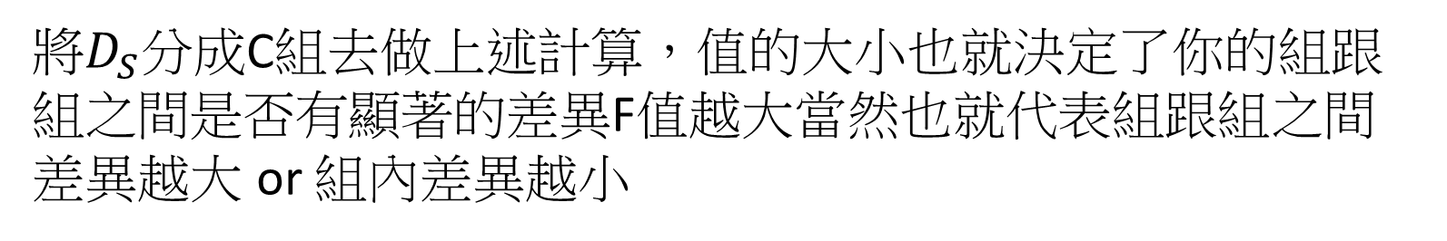
Analysis of variance (ANOVA)F-statistic
F = (組間變異/組數-1)/(組內變異/樣本數-組數)
將$D_{S}$分成C組去做上述計算，值的大小也就決定了你的組跟組之間是否有顯著的差異F值越大當然也就代表組跟組之間差異越大 or 組內差異越小

Slide 16
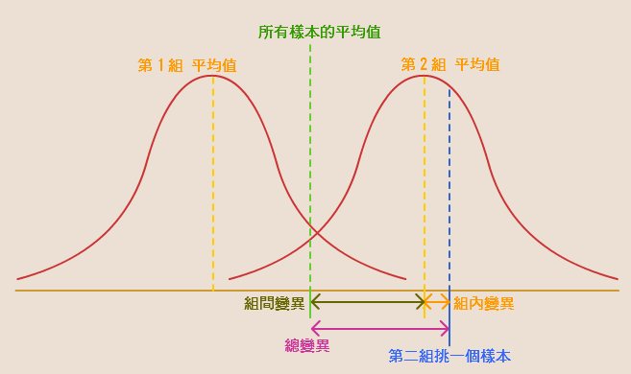
Notes:
http://belleaya.pixnet.net/blog/post/30754486-%5B%E6%95%99%E5%AD%B8%5D-%5B%E7%B5%B1%E8%A8%88%5D-anova%E8%AE%8A%E7%95%B0%E6%95%B8%E5%88%86%E6%9E%90-%E5%B0%8F%E7%AD%86%E8%A8%98

Slide 17
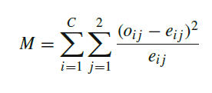
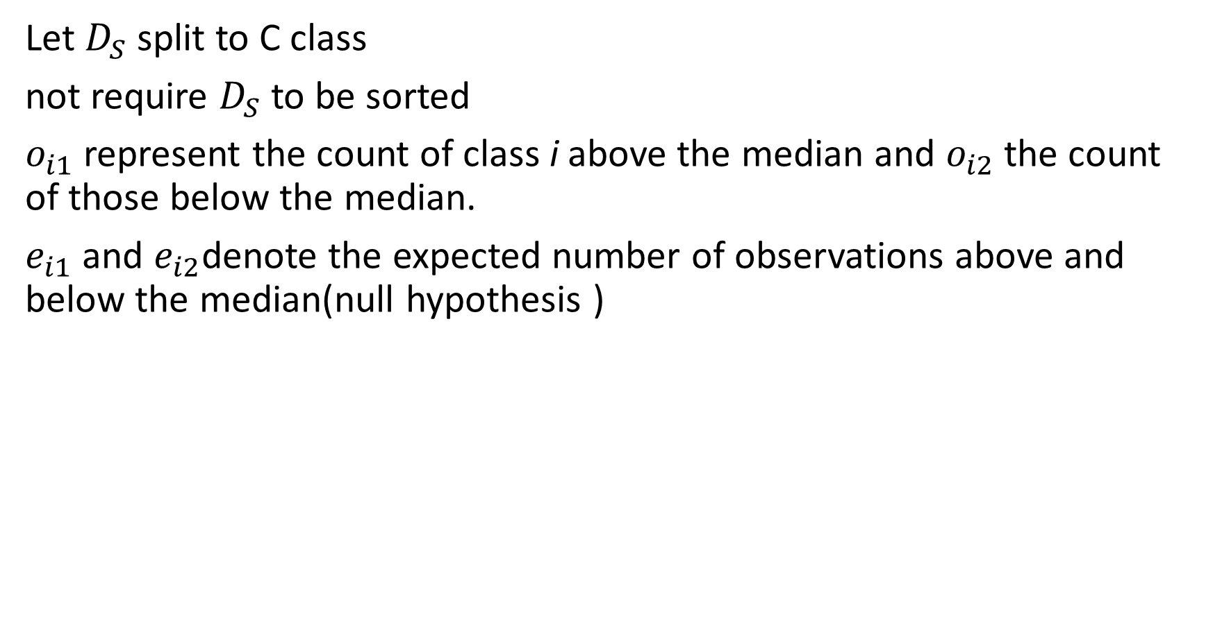
Mood’s median(MM)
Let $D_{S}$ split to C class
not require $D_{S}$ to be sorted
$o_{i1}$ represent the count of class i above the median and $o_{i2}$ the count of those below the median.
$e_{i1}$ and $e_{i2}$denote the expected number of observations above and below the median(null hypothesis )

Slide 18
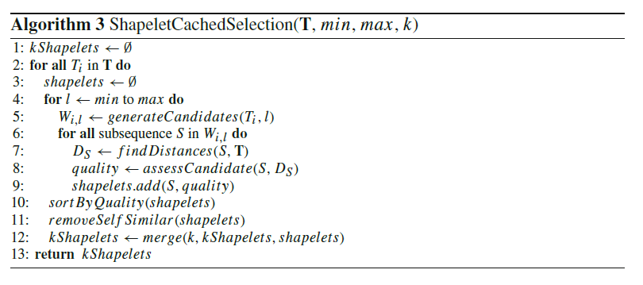

Slide 19
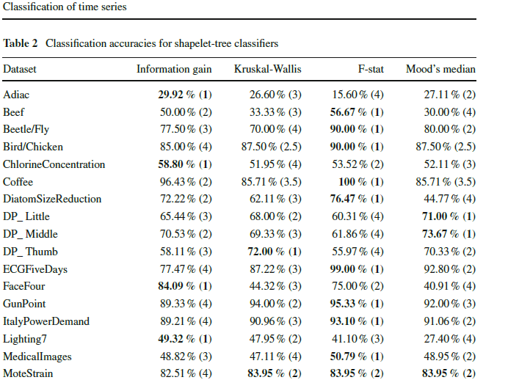

Slide 20
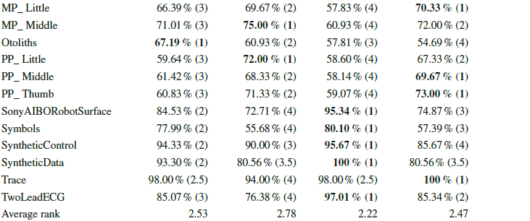
Average rank of time 3.72 2.64 1.62 2.02

Slide 21
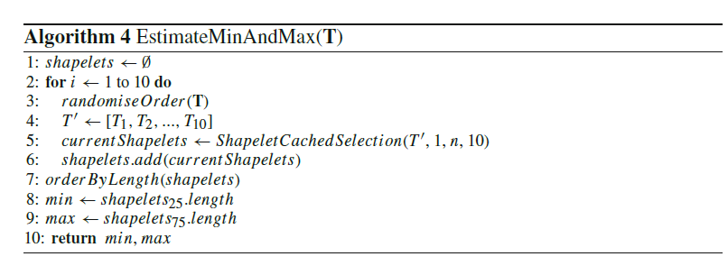

Slide 22
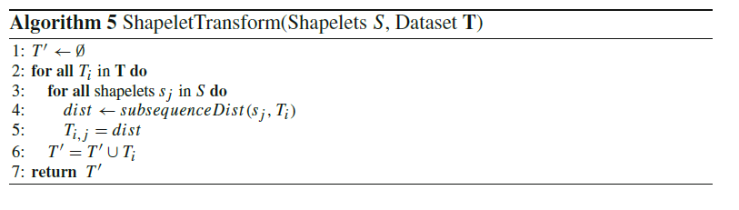
The main motivation for our shapelet transformation is to allow shapelets to be used
with a diverse range of classification algorithms

