Slide 1
IEEE Conference on Computer Vision and Pattern Recognition, Oregon, USA, 2013 Anelia Angelova, Shenghuo Zhu
Efficient object detection and segmentation for fine-grained recognition
Presenter：Wei-Hao Fu
Date：2016/ 12/ 27
Notes:
1

Slide 2
Abstract(1/3)
We propose a detection and segmentation algorithm for the purposes of fine-grained recognition. The algorithm first detects low-level regions that could potentially belong to the object and then performs a full-object segmentation through propagation. Apart from segmenting the object, we can also ‘zoom in’ on the object, i.e. center it, normalize it for scale, and thus discount the effects of the background.
We then show that combining this with a state-of-the-art classification algorithm leads to significant improvements in performance especially for datasets which are considered particularly hard for recognition, e.g. birds species.

Slide 3
Abstract(2/3)
The proposed algorithm is much more efficient than other known methods in similar scenarios [4, 21]. Our method is also simpler and we apply it here to different classes of objects, e.g. birds, flowers, cats and dogs.

Slide 4
Abstract(3/3)
We tested the algorithm on a number of benchmark datasets for fine-grained categorization. It outperforms all the known state-of-the-art methods on these datasets, sometimes by as much as 11%. It improves the performance of our baseline algorithm by 3-4%, consistently on all datasets. We also observed more than a 4% improvement in the recognition performance on a challenging largescale flower dataset, containing 578 species flowers and 250,000 images.

Slide 5
Algorithm(1/5)
Step 1: Detection object (low-level)
Step 2: Full-object segmentation
Step 3: Training and classification

Slide 6
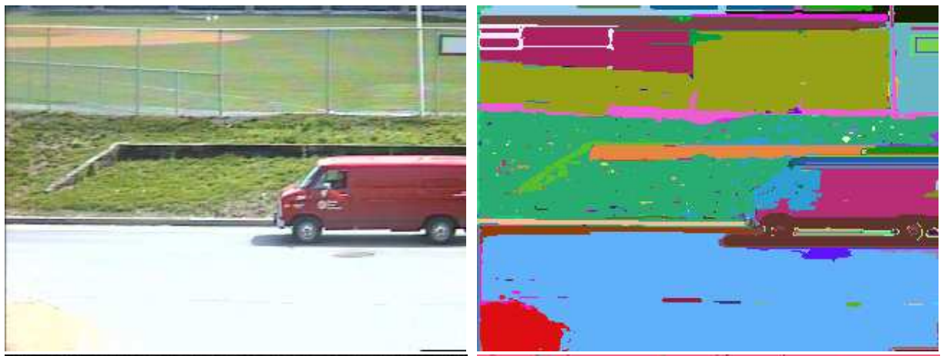
Algorithm(2/5)
Step 1: Detection object (low-level)
First, use the super-pixel segmentation method to over-segment the image into small coherent regions.
Second, each super-pixel region is described by average color and HOG feature.
Last, train a classification model to decide if a region belongs to a super-class or the background.
Notes:
有ground truth就用ground truth去訓練。
沒有就用approximate segmentation，一直反覆訓練直到沒有變化。

Slide 7
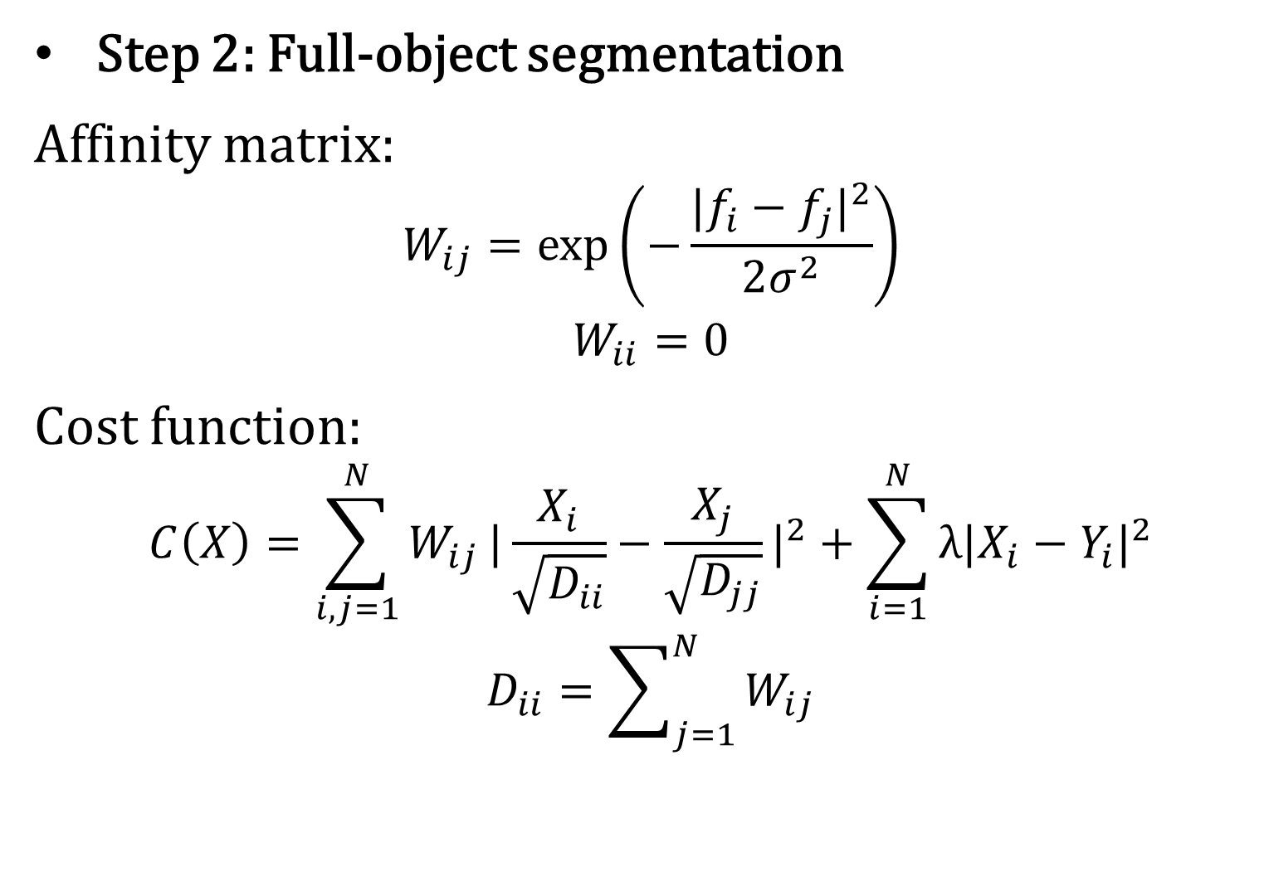
Algorithm(3/5)
Step 2: Full-object segmentation
Affinity matrix:
$$W_{ij}=\exp\left(−\frac{|f_{i}−f_{j}|^{2}}{2σ^{2}}\right)$$
$$W_{ii}=0$$
Cost function:
$$C\left(X\right)=\sum_{i, j=1}^{N}{W_{ij}}|\frac{X_{i}}{\sqrt{D_{ii}}}−\frac{X_{j}}{\sqrt{D_{jj}}}|^{2}+\sum_{i=1}^{N}{λ|X_{i}−Y_{i}|^{2}}$$
$$D_{ii}=\sum_{j=1}^{N}{W_{ij}}$$

Slide 8
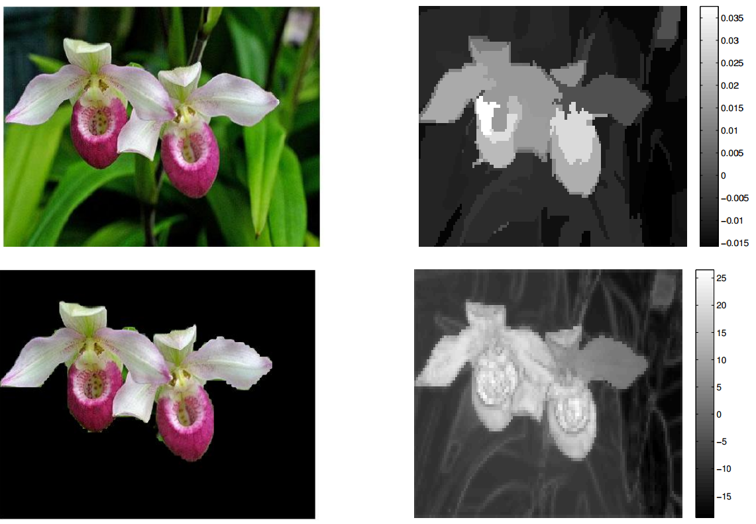
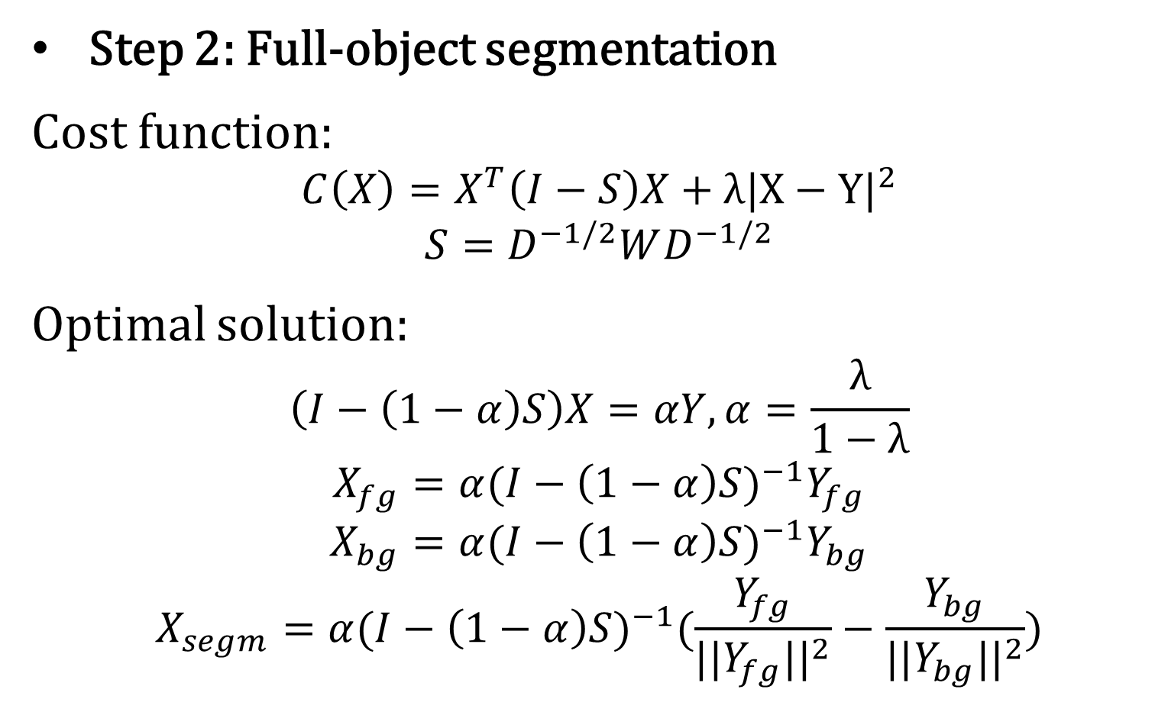
Algorithm(4/5)
Step 2: Full-object segmentation
Cost function:
$$C\left(X\right)=X^{T}\left(I−S\right)X+λ|X−Y|^{2}$$
$$S=D^{−1/2}WD^{−1/2}$$
Optimal solution:
$$\left(I−\left(1−α\right)S\right)X=αY, α=\frac{λ}{1−λ}$$
$$X_{fg}=α(I−\left(1−α\right)S)^{−1}Y_{fg}$$
$$X_{bg}=α(I−\left(1−α\right)S)^{−1}Y_{bg}$$
$$X_{segm}=α(I−\left(1−α\right)S)^{−1}(\frac{Y_{fg}}{||Y_{fg}||^{2}}−\frac{Y_{bg}}{||Y_{bg}||^{2}})$$

Slide 9
Algorithm(5/5)
Step 3: Training and classification
Baseline:
Feature: HOG features
Classifier: LibSVM
This paper: Segmentation + Baseline
Notes:
HOG features at 4 different scales, then those features are encoded in 8K dimensional global feature dictionary using the LLC method.

Slide 10
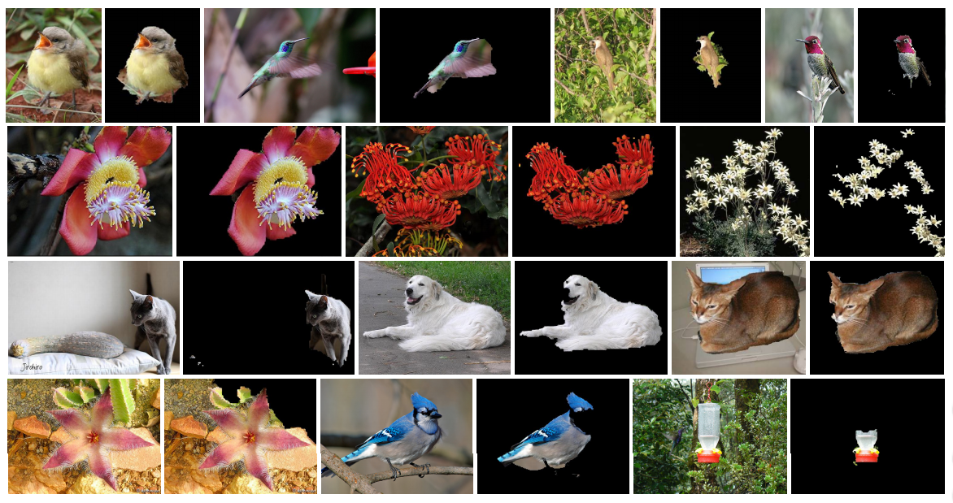
Result(1/3)

Slide 11
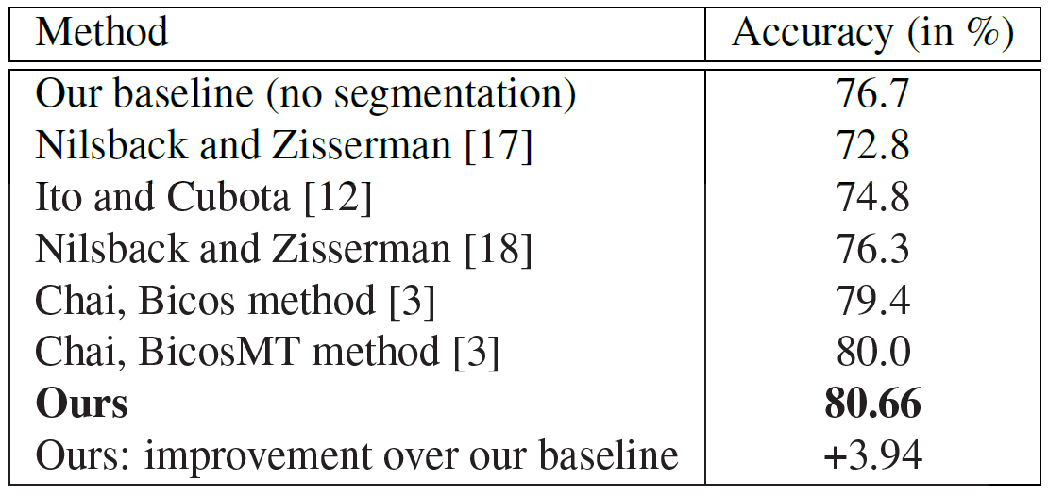
Result(2/3)
Oxford 102 flower species dataset

Slide 12
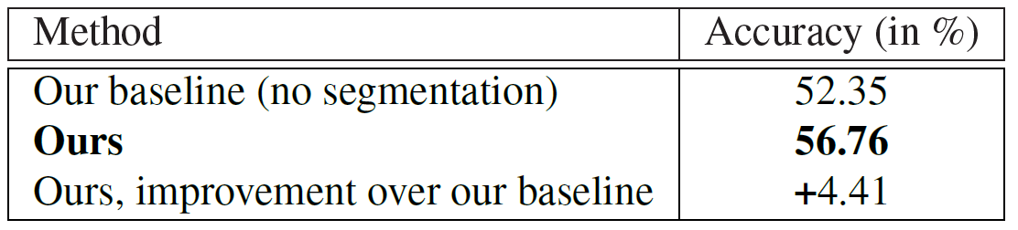
Result(3/3)
Large-scale 578 flower species dataset

