Slide 1
Support vector regression with chaos-based firefly algorithm for stock market price forecasting
Applied Soft Computing 13 (2013) 947–958
Ahmad Kazem, Ebrahim Sharifi, Farookh Khadeer Hussain, Morteza Saberi, Omar Khadeer Hussain
Presentor : Shih-jhan Huang
Date : 2016/12/27

Slide 2
Abstract(1/3)
Due to the inherent non-linearity and non-stationary characteristics of financial stock market price time series, conventional modeling techniques such as the Box–Jenkins autoregressive integrated moving average (ARIMA) are not adequate for stock market price forecasting. In this paper, a forecasting model based on chaotic mapping, firefly algorithm, and support vector regression (SVR) is proposed to predict stock market price. The forecasting model has three stages. In the first stage, a delay coordinate embedding method is used to reconstruct unseen phase space dynamics. In the second stage, a chaotic firefly algorithm is employed to optimize SVR hyperparameters. Finally in the third stage, the optimized SVR is used to forecast stock market price. The significance of the proposed algorithm is 3-fold.

Slide 3
Abstract(2/3)
First, it integrates both chaos theory and the firefly algorithm to optimize SVR hyperparameters, whereas previous studies employ a genetic algorithm (GA) to optimize these parameters. Second, it uses a delay coordinate embedding method to reconstruct phase space dynamics. Third, it has high prediction accuracy due to its implementation of structural risk minimization (SRM). To show the applicability and superiority of the proposed algorithm, we selected the three most challenging stock market time series data from NASDAQ historical quotes, namely Intel, National Bank shares and Microsoft daily closed (last) stock price, and applied the proposed algorithm to these data.

Slide 4
Abstract(3/3)
Compared with genetic algorithm-based SVR (SVR-GA), chaotic genetic algorithm-based SVR (SVR-CGA), firefly-based SVR (SVR-FA), artificial neural networks (ANNs) and adaptive neuro-fuzzy inference systems (ANFIS), the proposed model performs best based on two error measures, namely mean squared error (MSE) and mean absolute percent error (MAPE).

Slide 5
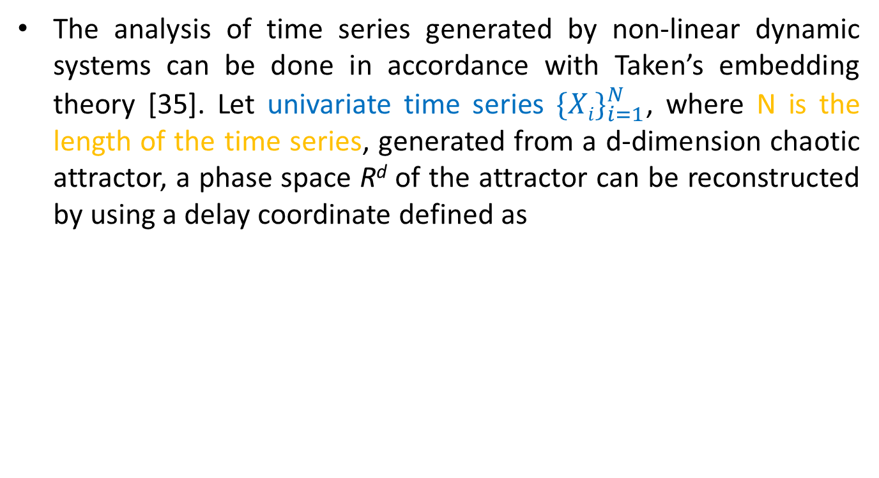

Delay coordinate
m : the embedding dimension of reconstructed phase space
τ : the time delay constant.

Slide 6
embedding dimension
too large：Noise and other unwanted inputs will be highly embedded with the real source input information, which may corrupt(損壞) the underlying system dynamic information.
According to [37]：
m = 2d + 1 → adequate for reconstructing the attractor
m：embedding dimension
d：the dimension of the original attractor

Slide 7
FNN
false nearest neighbor(FNN)：在重建的相空間中兩點相近，但在原始的空間卻相離甚遠，即稱為FNN。
Such a phenomenon occurs if we select an embedding dimension lower than the minimal sufficient value and the reconstructed attractor therefore does not preserve the topological properties of the real phase space.

Slide 8


(用來判斷是否為FNN)
If R_{i} exceeds a given threshold R_{tol} (say, 10 or 15), the point X_{j} is considered as a false nearest neighbor in dimension m.
Use the first minimum of mutual information (MI) function [39] to determine τ . (決定τ)

Slide 9

Chaotic mapping operator(CMO)
The simplest chaotic mapping operator (CMO is logistic mapping.
where x_{n} is the nth chaotic number, n denotes the iteration number and μ = 4.
Diversity in the initial solution of optimization algorithm is vital for preventing premature phenomena.
Logistic mapping：
provide more diversity than randomly selected initial solutions
decrease the probability of premature occurrence

Slide 10
Support vector regression
SVM：在找能將資料一分為二的平面，即所謂的分類。
SVR：在找能準確預測資料分佈的平面(hyperlane)

Slide 11
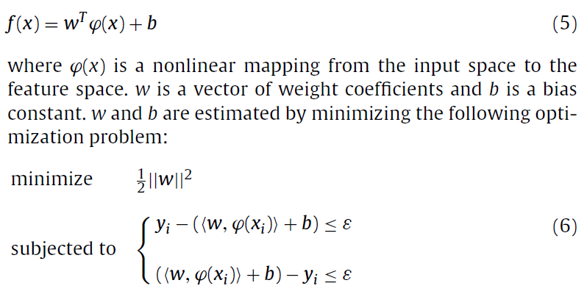
Support vector regression
Suppose we are given a set of training patterns (x₁, y₁), . . . , (x_{l}, y_{l}), where x_{i} ∈ R^{n}, I =1, 2, . . . , l and y_{i} ∈ R is the target value for each input vector x_{i}. A regression model is trained by these patterns and used to predict the future target values.
又稱ε-SVR

Slide 12
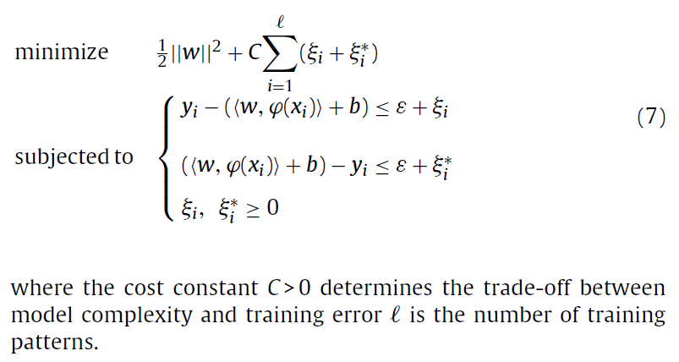
feasibility of SVR
在做迴歸時，實際上可能會有雜訊、誤差…等，通常使用原始SVR不會是feasible的，因此額外加入ξ變數，以容許某些instances落在ε之外的情況。

Slide 13
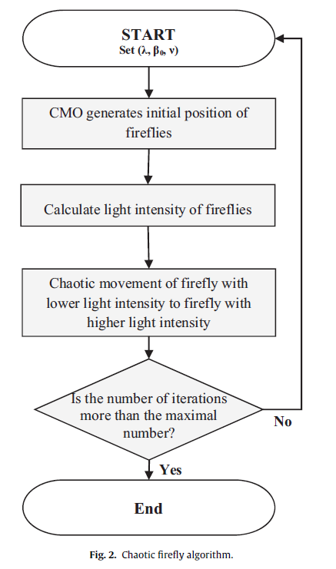
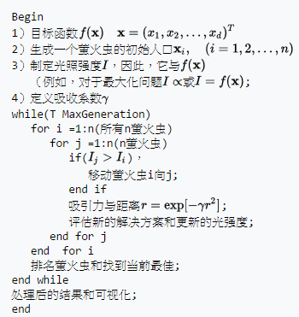
Firefly algorithm(FA)
三項假設：
螢火蟲不分性別，這樣一個螢火蟲將會吸引到所有其他的螢火蟲;
吸引力與它們的亮度成正比，對於任何兩個螢火蟲，不那麼明亮的螢火蟲被吸引，因此移動到更亮的一個，然而，亮度又隨著其距離的增加而減少;
如果沒有比一個給定的螢火蟲更亮的螢火蟲，它會隨機移動。
此篇論文的chaotic firefly algorithm
pseudo code

Slide 14
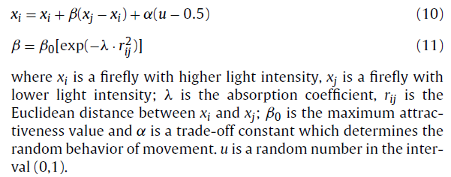
螢火蟲狀態更新公式：

Slide 15
Proposed integrated algorithm
Data preprocessing
First：
對時間序列使用MI function做計算
Second：
first delay time，即MI function最小值，被認為最佳的time delay value
Third：
FNN方法用來找minimum sufficient embedding dimension
Fourth：
time series phase space is reconstructed
normalize
Finally：分成訓練集和測試集

Slide 16
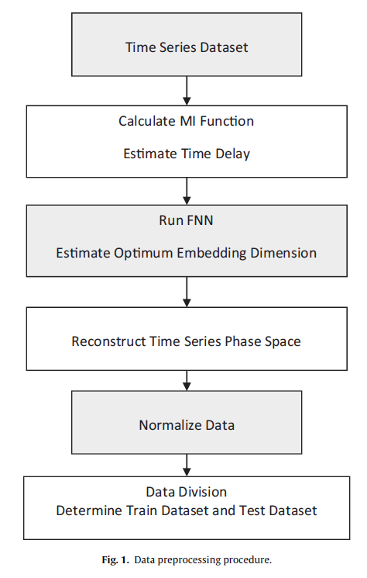

Slide 17
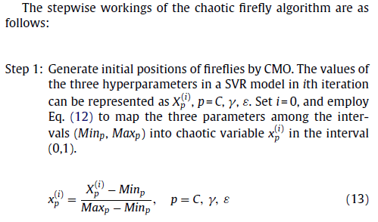
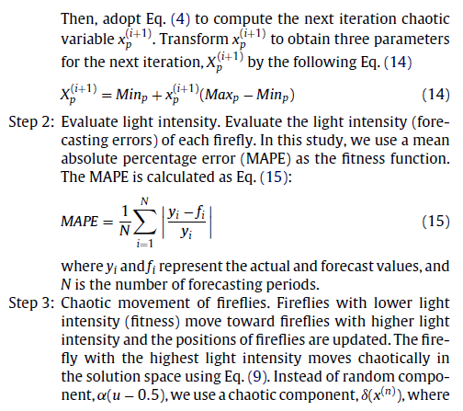
Chaotic firefly algorithm
最佳化參數值

Slide 19
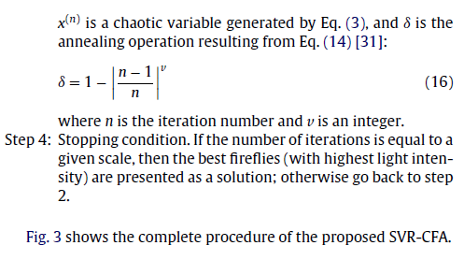

Slide 20
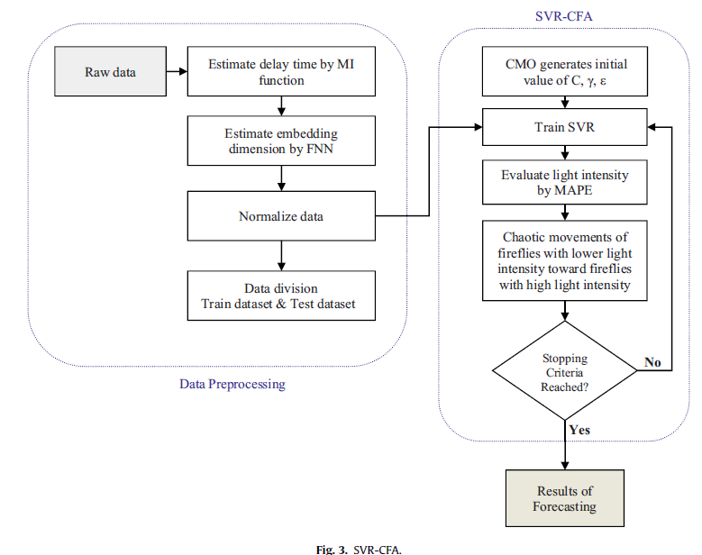

Slide 21
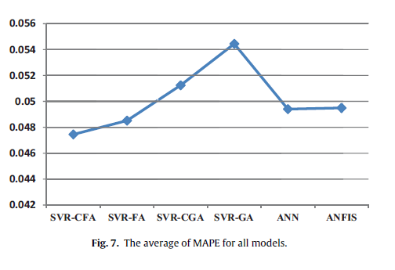

Slide 22
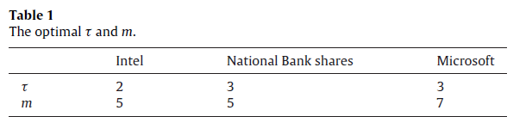
m : the embedding dimension of reconstructed phase space
τ : the time delay constant.

Slide 23
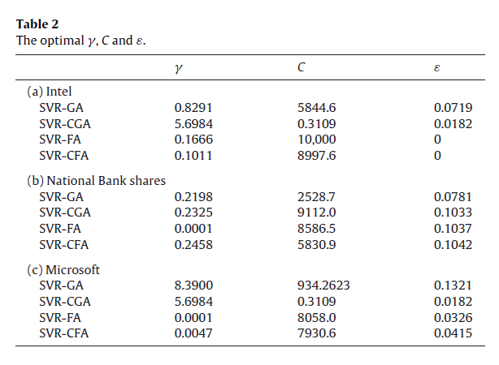
參數最佳化

Slide 24
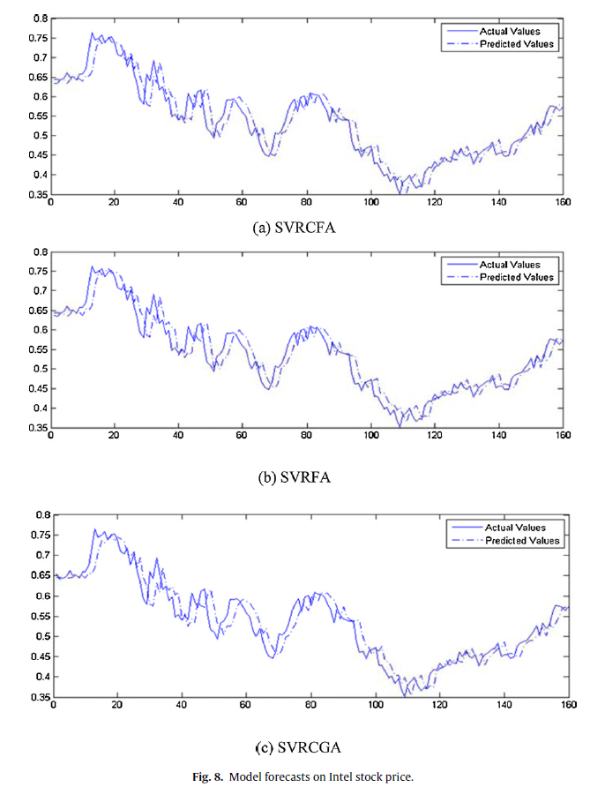
Intel

Slide 25
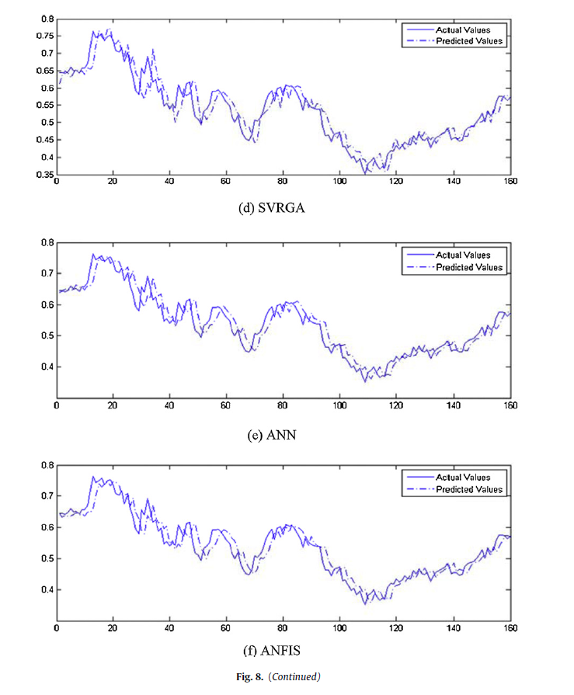

Slide 26
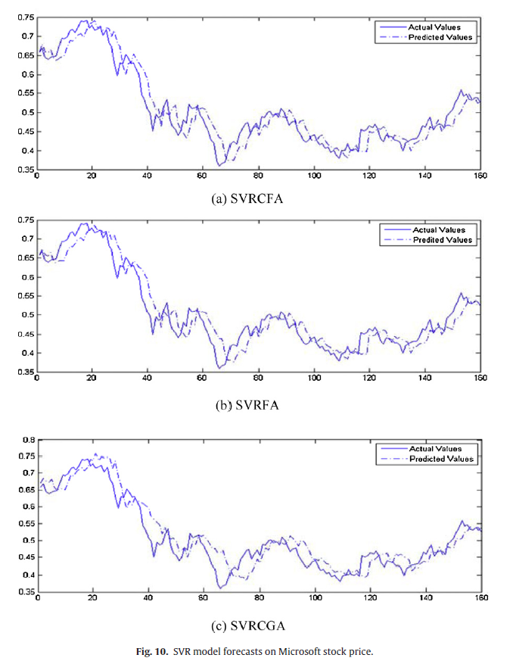
Microsoft

Slide 27
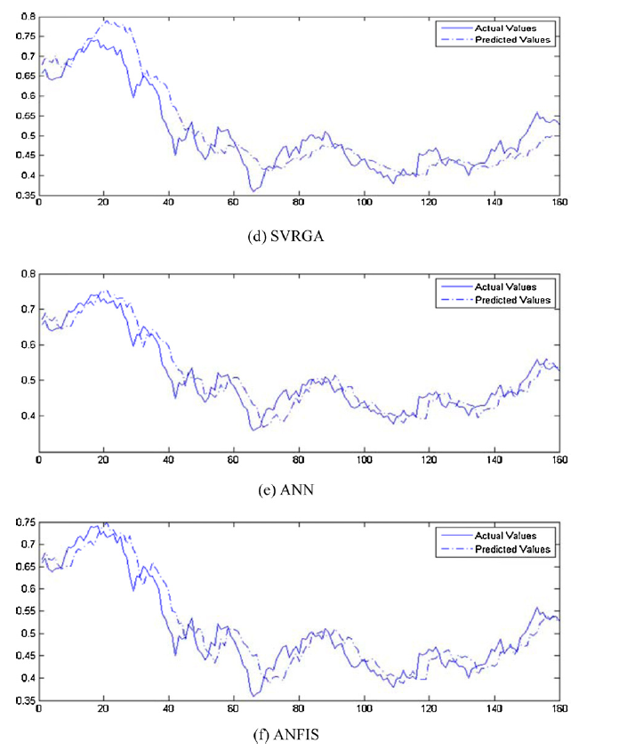

Slide 28
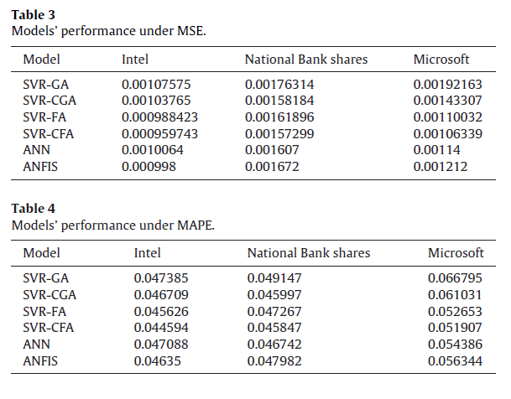
6
5
2
1
3
4
6
5
2
1
3
4

