Slide 1
pknotsRG: RNA pseudoknot folding including near-optimal structures and sliding windows
Jens Reeder, Peter Steffen and Robert Giegerich
Faculty of Technology, Bielefeld University, Bielefeld, Germany
Nucleic Acids Research, 2007, 1–5
Speak: Chia-Hung Chang
Date: 2008/03/19

Slide 2
Abstract
RNA pseudoknots are an important structural feature of RNAs, but often neglected in computer predictions for reasons of efficiency. Here, we present the pknotsRG Web Server for single sequence RNA secondary structure prediction including pseudoknots. pknotsRG employs the newest Turner energy rules for finding the structure of minimal free energy. The algorithm has been improved in several ways recently. First, it has been reimplemented in the C programming language, resulting in a 60-fold increase in speed. Second, all suboptimal foldings up to a user-defined threshold can be enumerated. For large scale analysis, a fast sliding window mode is available. Further improvements of the Web Server are a new output visualization using the PseudoViewer Web Service or RNAmovies for a movie like animation of several suboptimal foldings.
The tool is available as source code, binary executable, online tool or as Web Service. The latter alternative allows for an easy integration into bioinformatics pipelines. pknotsRG is available at the Bielefeld Bioinformatics Server (http://bibiserv.techfak.uni-bielefeld.de/pknotsrg).

Slide 3
Input & Output
Input:
  An RNA sequence with FASTA format (or not).
Output:
  The sequence with arc-annotation.

Slide 4
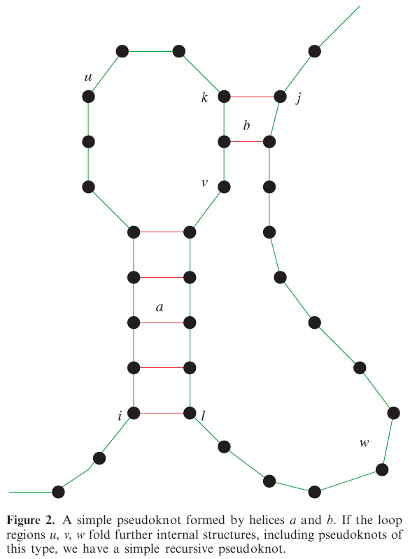
Introduction
General pseudoknot prediction is a NP-complete problem.
Most of the structure looks like the shape left.
  Canonization simple recursive pseudoknots
Solution?
  Impose some restrictions.

Slide 5
Restrictions
Rule 1:
  The 5’ and 3’ part of each pseudoknot helix must have the same length and must not have an interruption. This disallows bulges and internal loops inside pseudoknot stems.
Rule 2:
  The pseudoknot helices must have maximal length, i.e. if there is a possible base pair at either end, it must be closed.
Rule 3:
  If due to Rule 2 the helices would overlap, the first helix (a) is prioritized and the second one is shortened.

Slide 6
Implementation
Loop over all possible knots: O(n⁴).
Firstly, Fix i & j. then, search for k, l.
The maximal length of a helix is pre-computed and stored in a 2D array.
Total sum is the MFE. Should be compared with the unknotted foldings.

Slide 7


Slide 8
Web server
A maximum of 800 nucleotides is allowed for one submission. This guarantees the computation to finish within a few minutes. Note that smaller requests usually are answered instantly.
The suboptimal folding space of an RNA sequence grows exponentially with the energy threshold and sequence length. We prevent the Web service of returning too much data, by limiting the number of returned structures to the first 100, respectively, 1000 lines for the window mode.

Slide 9
Services
Standard MFE folding with pseudoknots: This method returns the structure of minimum free energy (MFE), containing a pseudoknot or not. In the latter case, this structure is identical to the MFE structure computed by RNAfold from the Vienna RNA package.
Enforced folding: The best structure in the folding space that contains at least one pseudoknot is reported. This is especially useful, when a pseudoknot is suspected, but not computed in the MFE folding.
Local folding: The pseudoknot with the best energy to length ratio is predicted. This mode helps to identify promising pseudoknot candidates in otherwise misfolded structures.

