Slide 1
A fast learning algorithm for deep belief nets
Geoffrey E. Hintonª, Simon Osinderoª, and Yee-Whye Teh^{b}
ªDepartment of Computer Science, University of Toronto
^{b}Department of Computer Science, National University of Singapore
Neural Computation, Vo. 18, Issue 7, pp. 1527-1554, 2006
Presenter: Hung-Hsin Chen (陳紘昕)
Date: Feb. 5, 2013

Slide 2
Abstract (1/2)
We show how to use “complementary priors” to eliminate the explaining away effects that make inference difﬁcult in densely-connected belief nets that have many hidden layers. Using complementary priors, we derive a fast, greedy algorithm that can learn deep, directed belief networks one layer at a time, provided the top two layers form an undirected associative memory. The fast, greedy algorithm is used to initialize a slower learning procedure that ﬁne-tunes the weights using a contrastive version of the wake-sleep algorithm. After ﬁne-tuning, a network with three hidden layers forms a very good generative model of the joint distribution of handwritten digit images and their labels.

Slide 3
Abstract (2/2)
This generative model gives better digit classiﬁcation than the best discriminative learning algorithms. The low-dimensional manifolds on which the digits lie are modeled by long ravines in the free-energy landscape of the top-level associative memory and it is easy to explore these ravines by using the directed connections to display what the associative memory has in mind.

Slide 4

Deep learning resources
http://deeplearning.net/
Coursera: probabilistic graphical models (Daphine Koller)
Coursera: neural networks for machine learning (Geoffrey Hinton)
Geoffrey Hinton website (Univ. of Toronto)
Yosuha Bergio website (Univ. of Montreal)

Slide 5
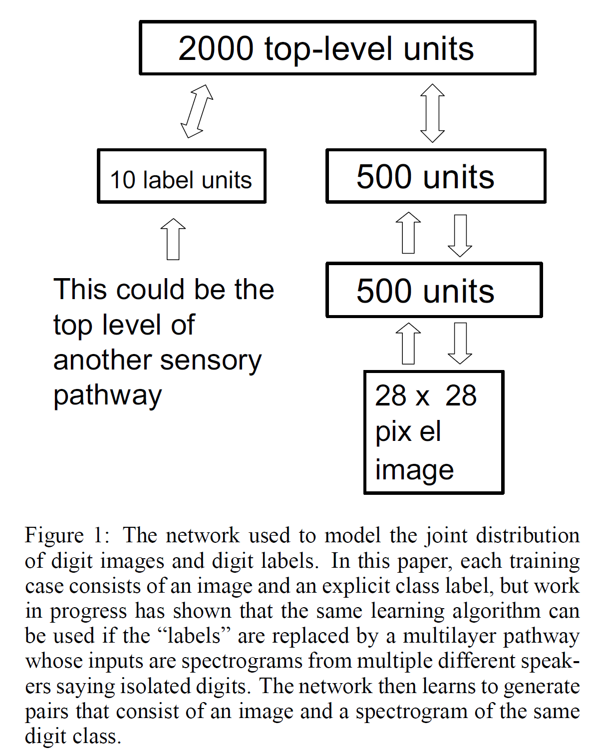
Deep belief net (DBN)
Goal: to learn the weight matrix of each layer

Slide 6
Deep Networks
Why go deep??
Insufficient depth can require more computational elements, than architectures whose depth is matches to the task.
Provide simpler more descriptive model of many problems.
Problem with deep?
Many cases, deep nets are hard to optimize.
Neural Networks
Deep Networks
Deep Belief Nets.

Slide 7
Why it is usually very hard to learn belief nets one layer at a time
To learn W, we need the posterior distribution in the first hidden layer.
Problem 1: The posterior is typically intractable because of “explaining away”.
Problem 2: The posterior depends on the prior as well as the likelihood.
So to learn W, we need to know the weights in higher layers, even if we are only approximating the posterior. All the weights interact.
Problem 3: We need to integrate over all possible configurations of the higher variables to get the prior for first hidden layer.
hidden variables
hidden variables
prior
hidden variables
likelihood
W
data

Slide 8
Generative v.s. discriminant models
Given random variables X (features) and Y(labels)
Generative models:
to learn joint distribution P(x,y)
Mixtures of Gaussian or experts, HMM, Bayesian network, Markov network, etc.
Discriminant models:
to learn conditional probability P(y|x)
logistic regression, SVM, LDA, etc.

Slide 9
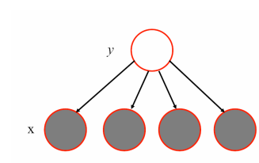
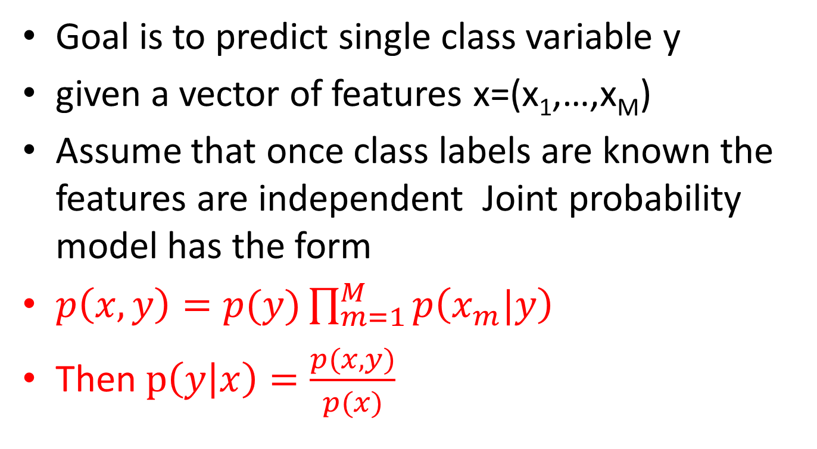
Naïve Baye’s classifier
Goal is to predict single class variable y
given a vector of features x=(x₁,…,x_{M})
Assume that once class labels are known the features are independent Joint probability model has the form
$p\left(x,y\right)=p(y)\prod_{m=1}^{M}{p\left(x_{m}|y\right) }$
Then $p\left(y | x\right)=\frac{p(x,y)}{p(x)}$

Slide 10
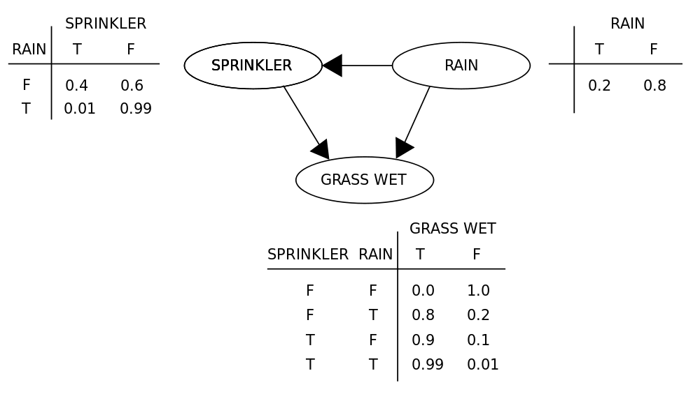
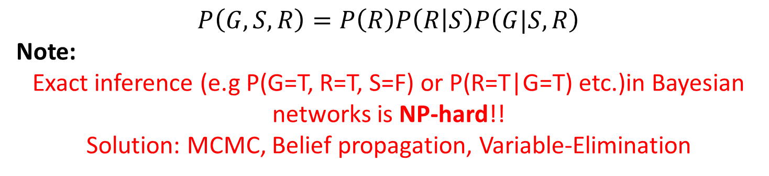
Bayesian (belief) network (BN)
Directed acyclic graph
Inference problem
Parameter learning
Structure learning
$$P\left(G, S, R\right)=P\left(R\right)P\left(R | S\right)P\left(G|S,R\right)$$
Note:
Exact inference (e.g P(G=T, R=T, S=F) or P(R=T|G=T) etc.)in Bayesian networks is NP-hard!!
Solution: MCMC, Belief propagation, Variable-Elimination

Slide 11
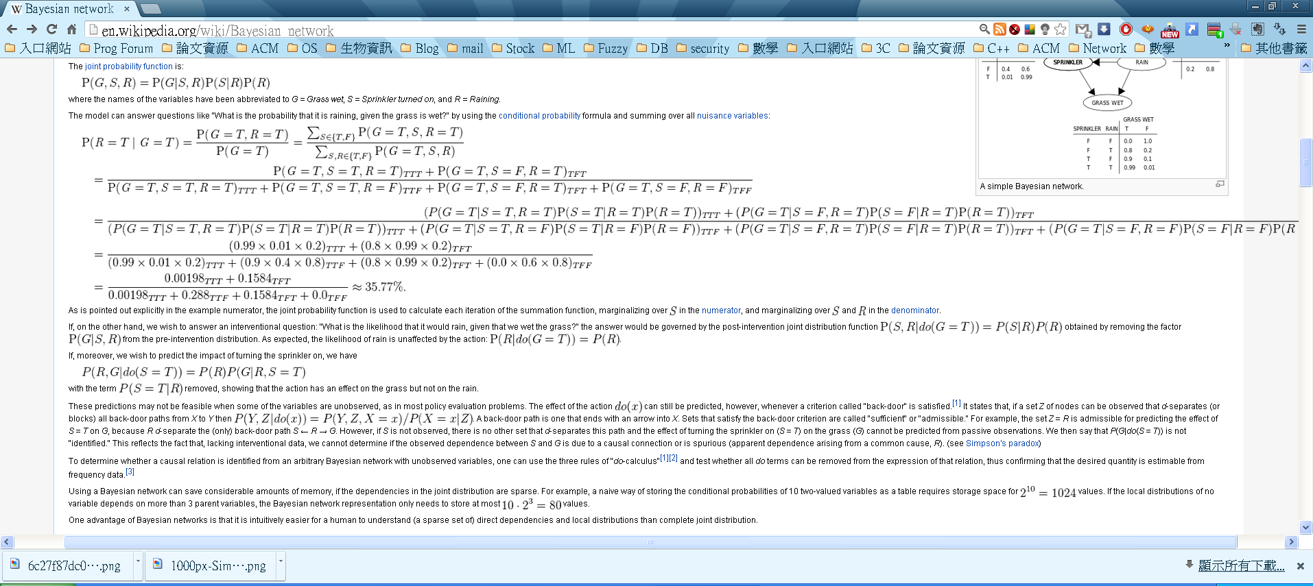
Example of inference of BN
http://en.wikipedia.org/wiki/Bayesian_network

Slide 12
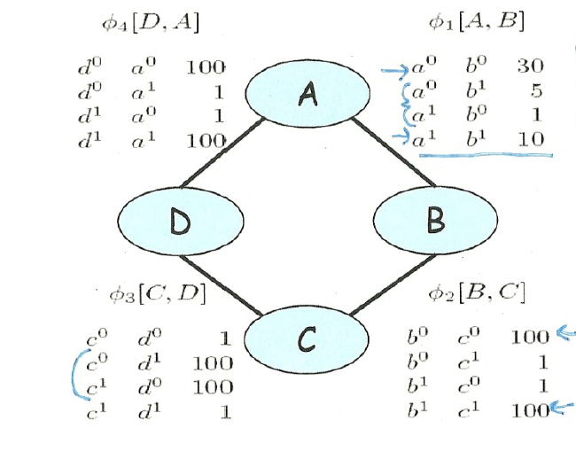
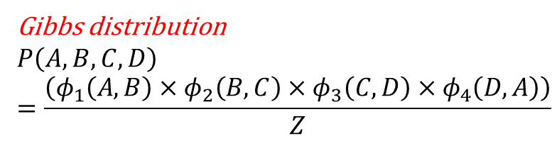
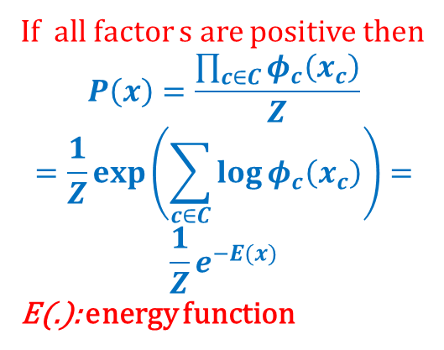
Markov random field (MRF)
undirected graphical model , 即無法確定是A->B或是B->A時，以A-B表示
factor
Gibbs distribution
$$P\left(A,B,C,D\right)=\frac{\left(φ_{1}\left(A,B\right)×φ_{2}\left(B,C\right)×φ_{3}\left(C,D\right)×φ_{4}\left(D,A\right)\right)}{Z}$$
If all factor s are positive then
$$P\left(x\right)=\frac{\prod_{c∈C}{φ_{c}\left(x_{c}\right)}}{Z}$$
$$=\frac{1}{Z}\exp\left(\sum_{c∈C}{\log{φ_{c}\left(x_{c}\right)}}\right)=$$
$$\frac{1}{Z}e^{−E(x)}$$
E(.): energy function

Slide 13
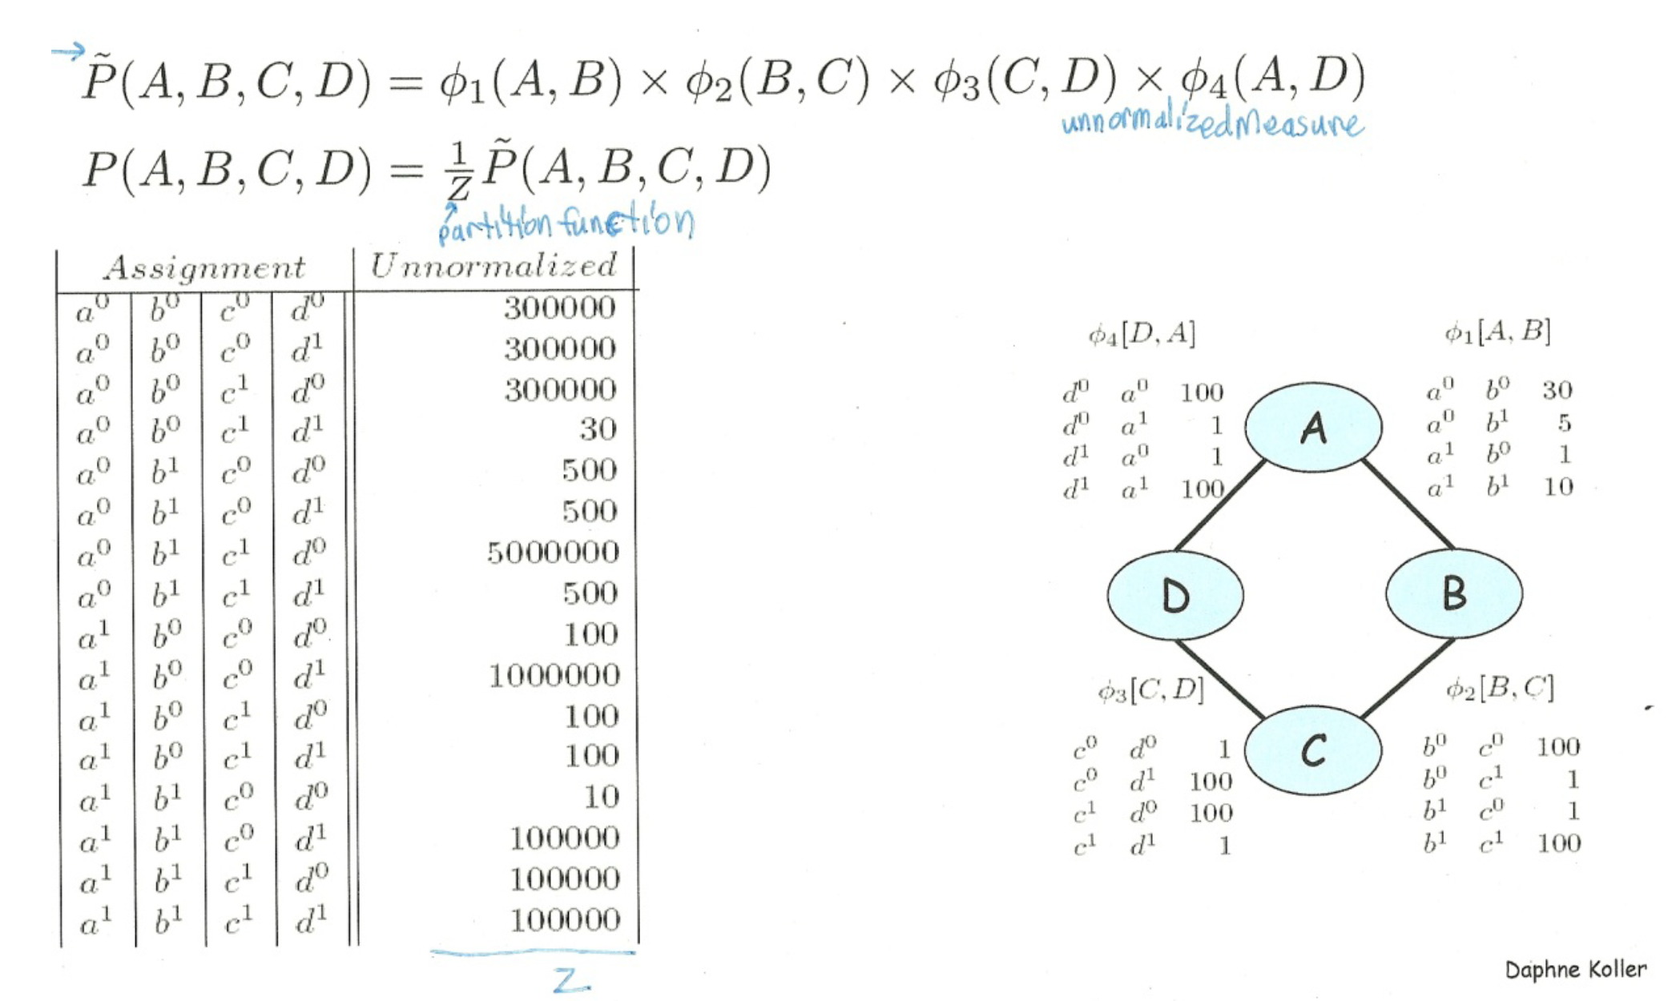

Slide 14
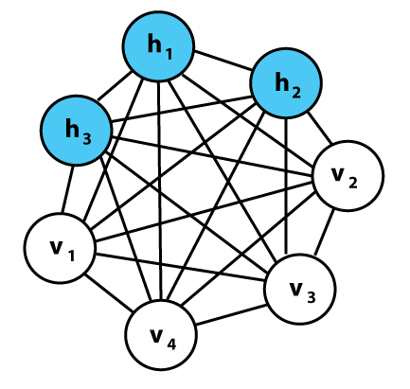
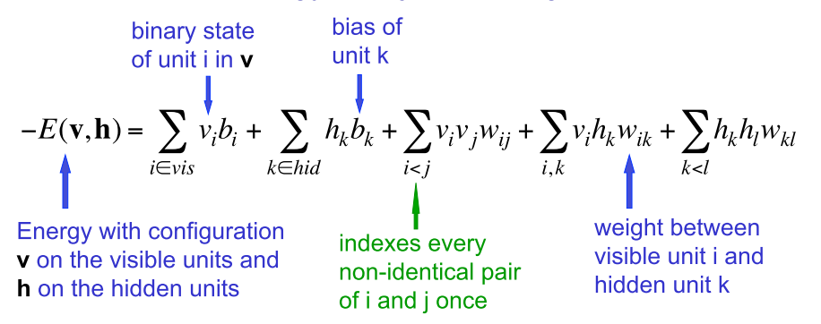
Boltzmann machine (BM)
Ackley, D. H., Hinton, G. E., and Sejnowski, T. J. “A learning algorithm for Boltzmann machines,” Cognitive Science, Vol. 9, pp. 147-169, 1985.
Hidden variables and observed variables are dependent, hence the model is hard to learn.

Slide 15
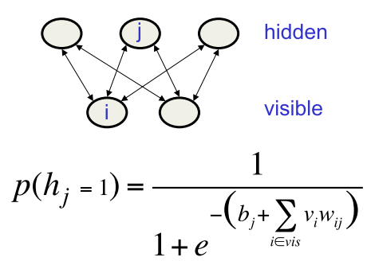
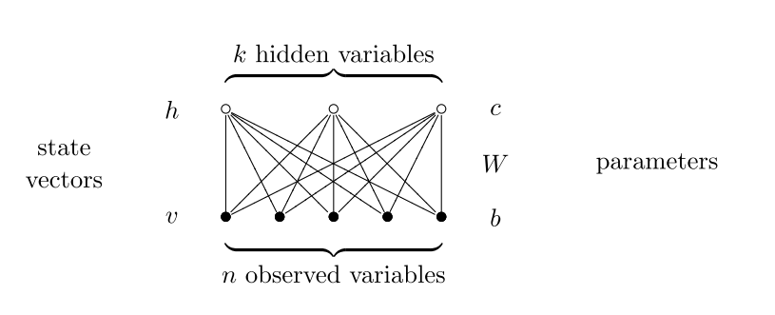
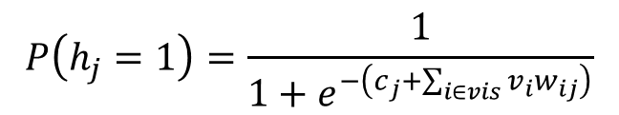
Restricted Boltzmann machine (RBM)
Hinton, G. E. ,”Training Products of Experts by Minimizing Contrastive Divergence,” Neural Computation, Vol. 14, pp. 1771-1800, 2002.
Product of Experts (PoE) + Boltzmann machine (BM)= Restricted Boltzmann machine (RBM)
each hidden unit is conditionally
independent given the data
c: bias
b: bias
$$P\left(h_{j}=1\right)=\frac{1}{1+e^{−\left(c_{j}+\sum_{i∈vis}{v_{i}w_{ij}}\right)}}$$
$$E\left(v,h\right)=−b^{T}v−c^{T}h−h^{T}Wv$$

Slide 16
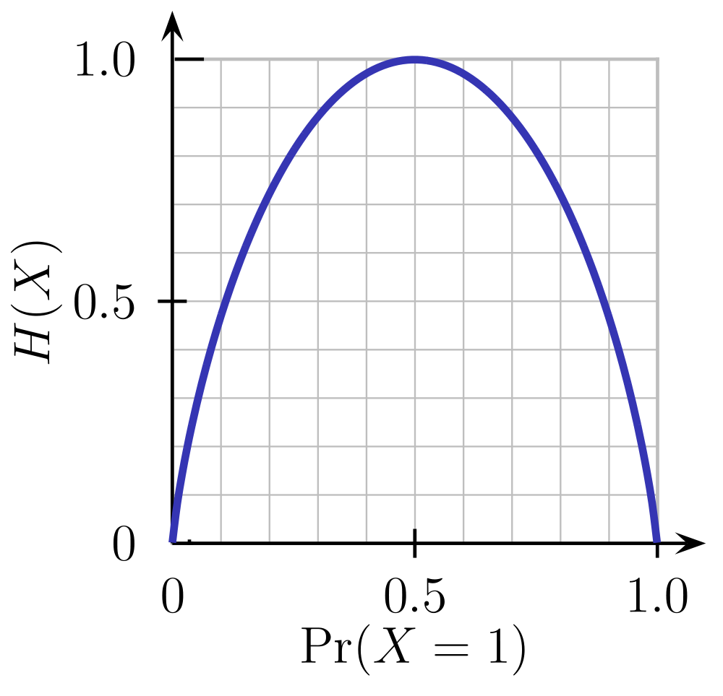
Entropy
A coin X,
P(X=head) = 0.5, P(X=tail)=0.5
H(X)=-(0.5*log₂(0.5)+ 0.5*log₂(0.5))=1

Slide 17

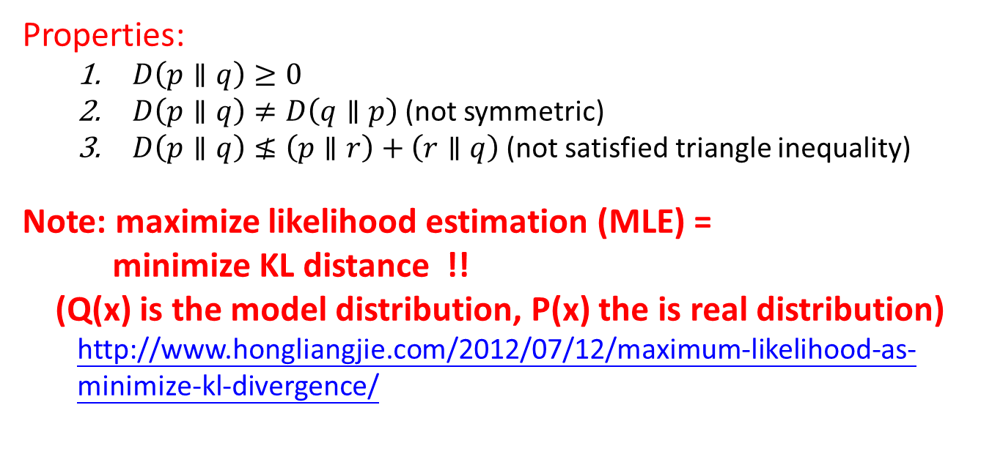
Kullback–Leibler divergence (Relative entropy)
The KL-divergence from P to Q
Properties:
$D\left(p∥q\right)≥0$
$D\left(p∥q\right)≠D\left(q∥p\right)$ (not symmetric)
$D\left(p∥q\right)≰\left(p∥r\right)+\left(r∥q\right)$ (not satisfied triangle inequality)
Note: maximize likelihood estimation (MLE) =
minimize KL distance !! (Q(x) is the model distribution, P(x) the is real distribution)
http://www.hongliangjie.com/2012/07/12/maximum-likelihood-as-minimize-kl-divergence/

Slide 18
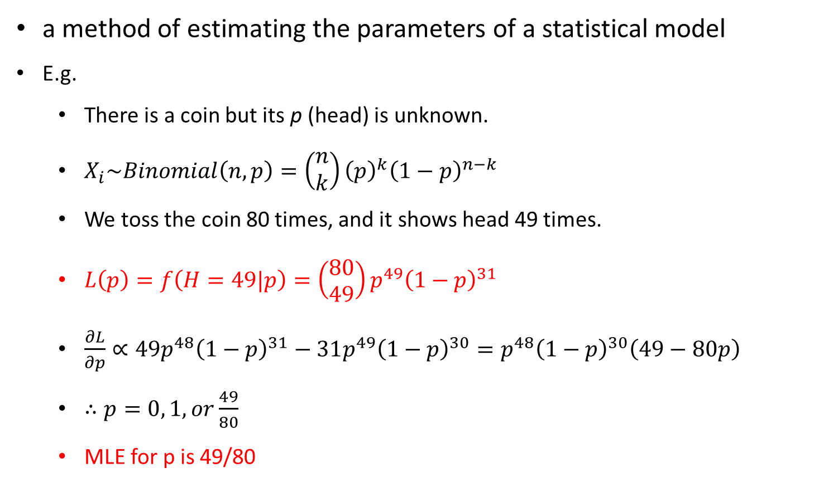
Maximum likelihood estimation (MLE)
a method of estimating the parameters of a statistical model
E.g.
There is a coin but its p (head) is unknown.
$X_{i}\sim Binomial\left(n, p\right)=\left(\begin{matrix}n \\ k\end{matrix}\right){\left(p\right)}^{k}{\left(1−p\right)}^{n−k}$
We toss the coin 80 times, and it shows head 49 times.
$L\left(p\right)=f\left(H=49|p\right)=\left(\begin{matrix}80 \\ 49\end{matrix}\right)p^{49}{\left(1−p\right)}^{31}$
$\frac{∂L}{∂p}∝49p^{48}{\left(1−p\right)}^{31}−31p^{49}{\left(1−p\right)}^{30}=p^{48}{\left(1−p\right)}^{30}\left(49−80p\right)$
$∴p=0, 1, or\frac{49}{80}$
MLE for p is 49/80

Slide 19
Gibbs sampling
A special case of MCMC (Monte Carlo Markov Chain)
To get joint distribution of (X₁,…,X_{k})
Algorithm GibbsSampling(X₁,...,X_{k}) for i = 1 to N #num. of examples for j = 1 to K X_{j} = generate sample from P(X_{i}|X₁,...,X_{j−1},X_{j+1},...,X_{k}) calculate P(X₁,...,X_{k}) End Algorithms

Slide 20
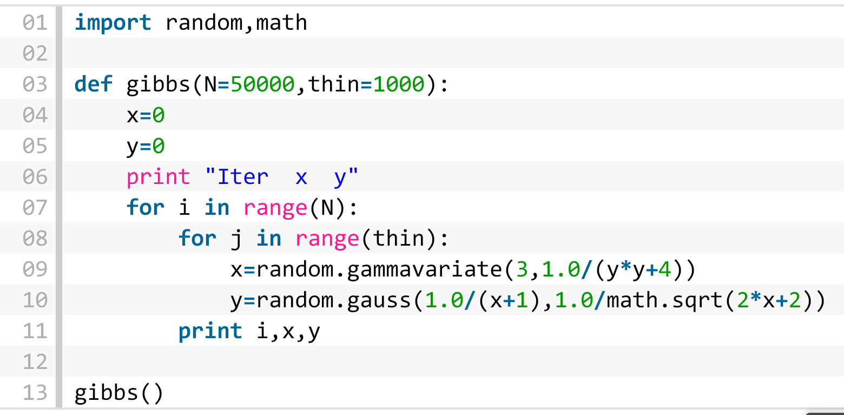
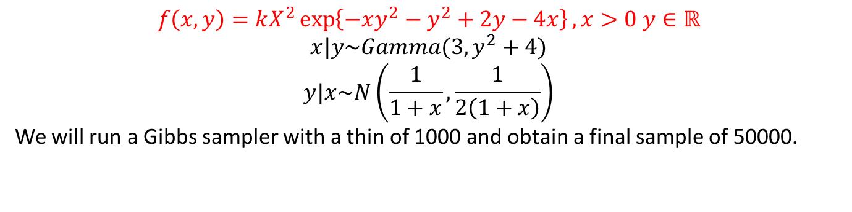
$$f\left(x,y\right)=kX^{2}\exp\left\{−xy^{2}−y^{2}+2y−4x\right\}, x>0 y∈ℝ$$
$$x|y\sim Gamma(3, y^{2}+4)$$
$$y|x\sim N\left(\frac{1}{1+x},\frac{1}{2\left(1+x\right)}\right)$$
We will run a Gibbs sampler with a thin of 1000 and obtain a final sample of 50000.
http://darrenjw.wordpress.com/2011/07/16/gibbs-sampler-in-various-languages-revisited/

Slide 21
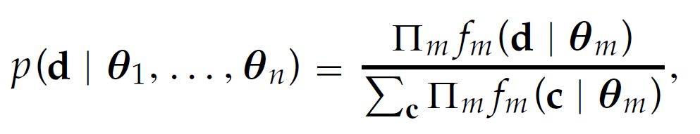
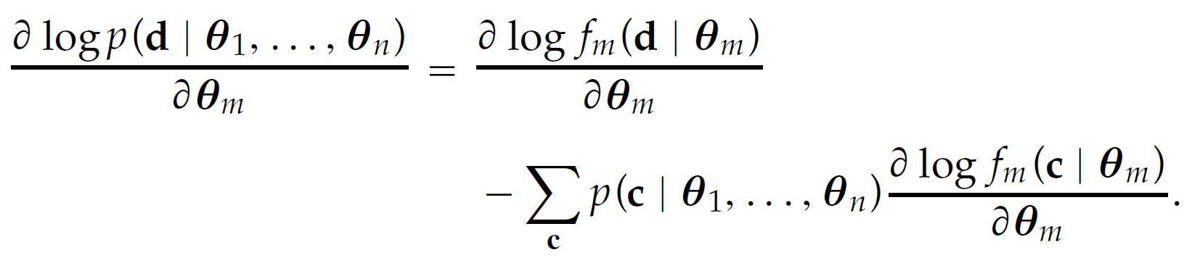
Contrastive divergence (CD-k)
Hinton, G. E. ,”Training Products of Experts by Minimizing Contrastive Divergence,” Neural Computation, Vol. 14, pp. 1771-1800, 2002.
有n個experts (hidden units)，第 i個pert的參數為Ө_{i}. c為在data space中所有的組合。
Log-likelihood for i.i.d. observed data vector d:
Easily get from energy function
Unknown, but we can get it by Gibbs sampling.

Slide 22
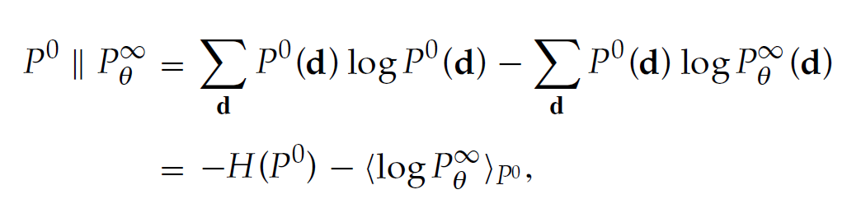
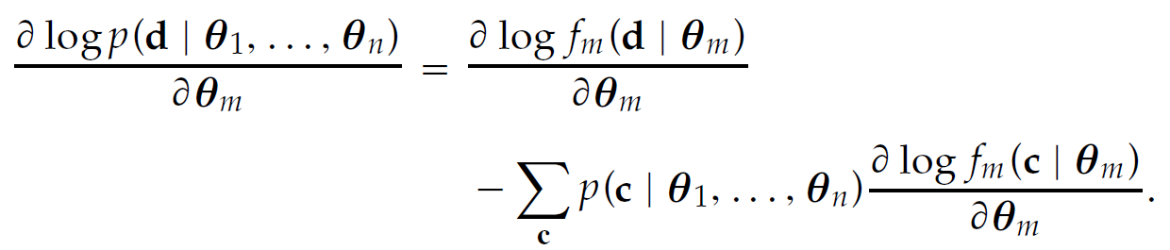
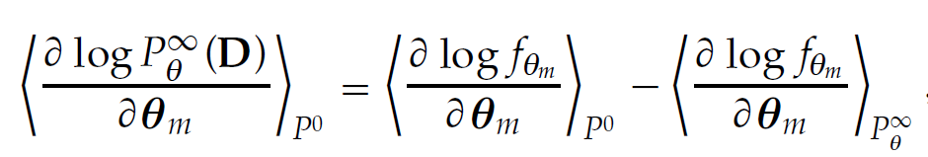

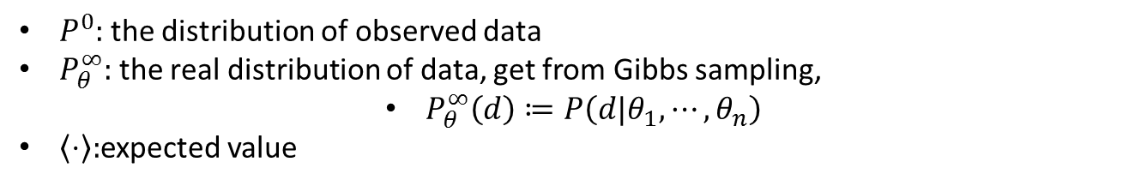
MLE = minimize KL divergence
與Ө無關，最佳化時不需考慮entropy
$P^{0}:$ the distribution of observed data
$P_{θ}^{∞}:$ the real distribution of data, get from Gibbs sampling,
$P_{θ}^{∞}\left(d\right)≔P\left(d|θ_{1},⋯,θ_{n}\right)$
$\left\langle ⋅\right\rangle :$expected value
$$f_{θm} ≔logf_{m}\left(D|θ_{m}\right)$$
Expectation is linear operator.

Slide 23
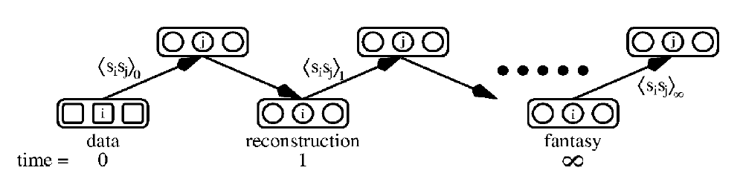
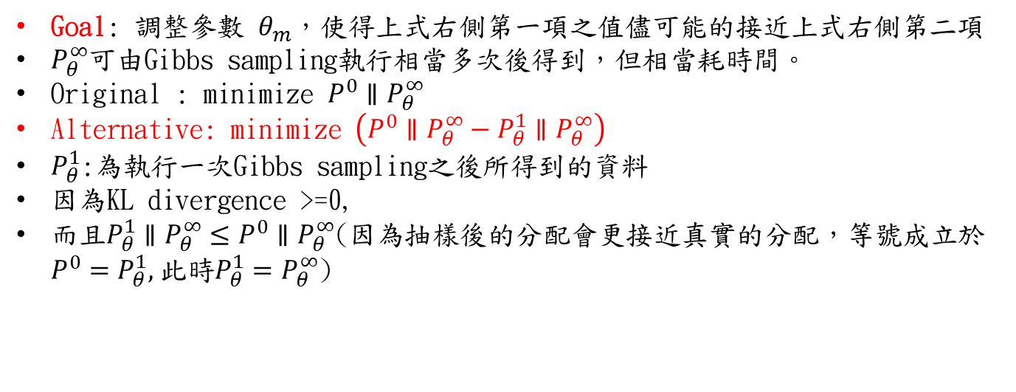
資料D之分佈的Log-likelihood對參數Ө_{m} 的期望變化量
資料D之在第m個模型使用參數Ө_{m} 時之log-likelihood 對參數Ө_{m}的(empirical)期望變化量
資料D之在第m個模型使用參數Ө_{m} 時之log-likelihood 對參數Ө_{m}的(real)期望變化量
Goal: 調整參數 $θ_{m}$，使得上式右側第一項之值儘可能的接近上式右側第二項
$P_{θ}^{∞}$可由Gibbs sampling執行相當多次後得到，但相當耗時間。
Original : minimize $P^{0}∥P_{θ}^{∞}$
Alternative: minimize $\left(P^{0}∥P_{θ}^{∞}−P_{θ}^{1}∥P_{θ}^{∞}\right)$
$P_{θ}^{1}$:為執行一次Gibbs sampling之後所得到的資料
因為KL divergence >=0,
而且$P_{θ}^{1}∥P_{θ}^{∞}≤P^{0}∥P_{θ}^{∞}$(因為抽樣後的分配會更接近真實的分配，等號成立於$P^{0}=P_{θ}^{1},$此時$P_{θ}^{1}=P_{θ}^{∞}$)

Slide 24
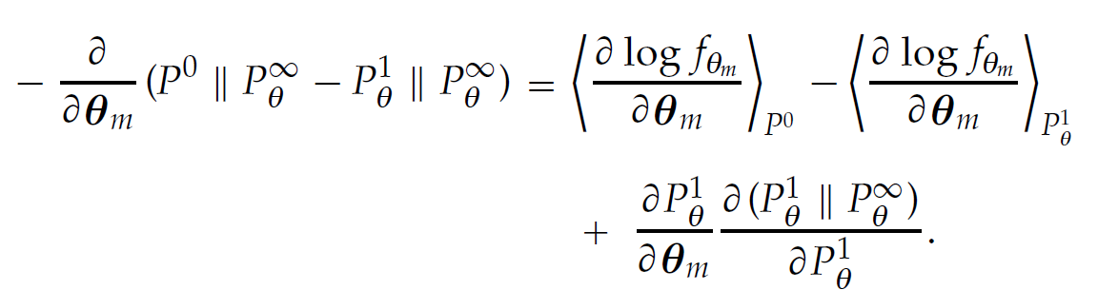
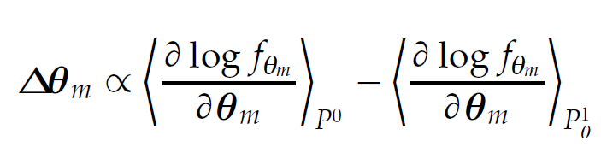
此項之值相當小，可忽略
the following procedure produces an unbiased sample from $P_{θ}^{1}$ :
Pick a data vector, d, from the distribution of the data P₀.
Compute, for each expert separately, the posterior probability distribution over its latent (i.e., hidden) variables given the data vector, d.
Pick a value for each latent variable from its posterior distribution.
Given the chosen values of all the latent variables, compute the conditional distribution over all the visible variables by multiplying together the conditional distributions specified by each expert and renormalizing.
Pick a value for each visible variable from the conditional distribution. These values constitute the reconstructed data vector, ˆd.

Slide 25
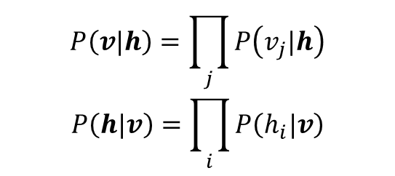
CD-k (k=1) on RBM
Separate initialization of the experts seems like a sensible idea, but simulations
indicate that the PoE is far more likely to become trapped in poor local optima if the experts are allowed to specialize separately.
Better solution:
simply initializing the experts randomly with very vague distributions
$$P\left(v|h\right)=\prod_{j}{P\left(v_{j}|h\right)}$$
$$P\left(h|v\right)=\prod_{i}{P\left(h_{i}|v\right)}$$
$$E\left(v,h\right)=−b^{T}v−c^{T}h−h^{T}Wv, θ=\left\{b,c,W\right\}$$
Fischer, Asja, and Christian Igel. "An Introduction to Restricted Boltzmann Machines," Progress in Pattern Recognition, Image Analysis, Computer Vision, and Applications, pp. 14-36, 2012.

Slide 26
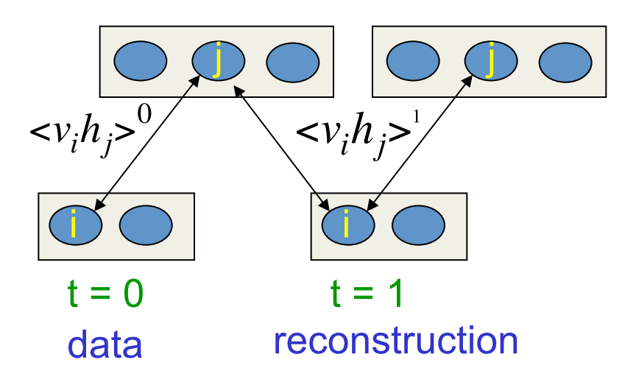
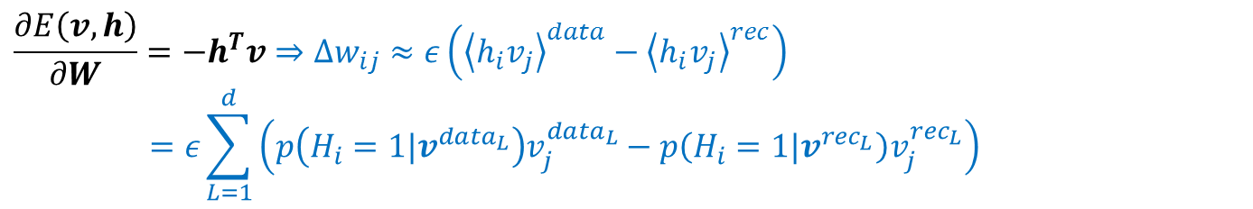

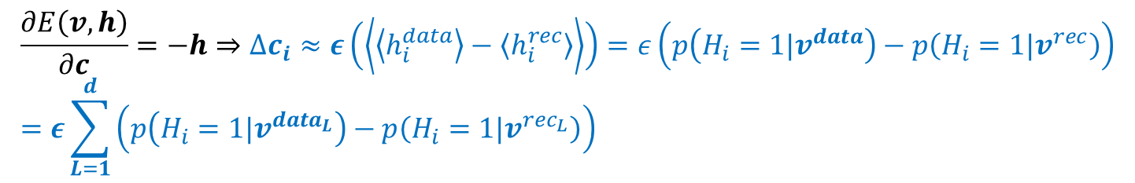
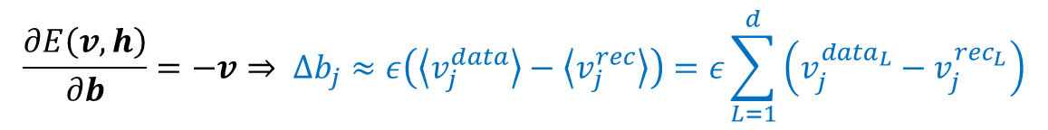

$$E\left(v,h\right)=−b^{T}v−c^{T}h−h^{T}Wv, θ=\left\{b,c,W\right\}$$
1. $θ_{m}=W (weight matrix)$
$$\frac{∂E\left(v,h\right)}{∂W}={−h}^{T}v⇒∆w_{ij}≈ε\left({\left\langle h_{i}v_{j}\right\rangle }^{data}−{\left\langle h_{i}v_{j}\right\rangle }^{rec}\right)=ε\sum_{L=1}^{d}{\left(p\left(H_{i}=1|v^{data_{L}}\right)v_{j}^{data_{L}}−p\left(H_{i}=1|v^{rec_{L}}\right)v_{j}^{rec_{L}}\right)}$$
2. $θ_{m}=b (bias vector of the visual units)$
$$\frac{∂E\left(v,h\right)}{∂b}=−v⇒ ∆b_{j}≈ε\left(\left\langle v_{j}^{data}\right\rangle −\left\langle v_{j}^{rec}\right\rangle \right)=ε\sum_{L=1}^{d}{\left(v_{j}^{data_{L}}−v_{j}^{rec_{L}}\right)}$$
3. $θ_{m}=c \text{(}\text{bias} \text{vector} \text{of} \text{the} \text{hidden} \text{units}\text{)}$
$$\frac{∂E\left(v,h\right)}{∂c}=−h⇒∆c_{i}≈ε\left(\left\langle \left\langle h_{i}^{data}\right\rangle −\left\langle h_{i}^{rec}\right\rangle \right\rangle \right)=ε\left(p\left(H_{i}=1|v^{data}\right)−p\left(H_{i}=1|v^{rec}\right)\right) \\ =ε\sum_{L=1}^{d}{\left(p\left(H_{i}=1|v^{data_{L}}\right)−p\left(H_{i}=1|v^{rec_{L}}\right)\right)}$$

Slide 27
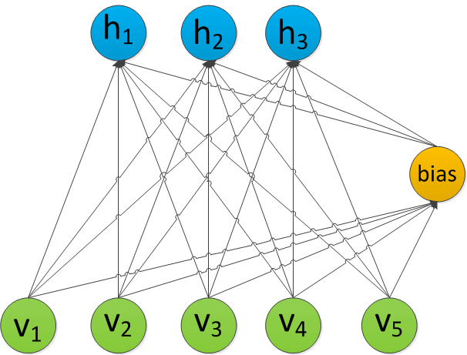
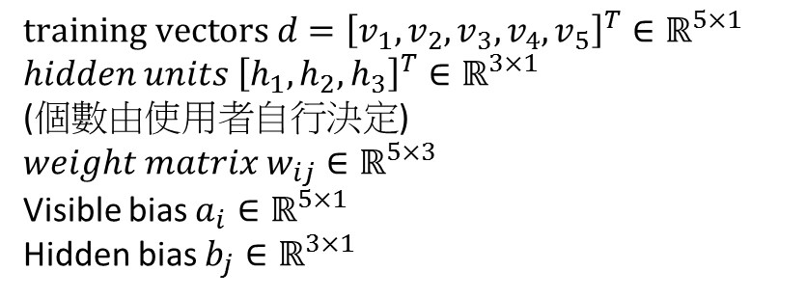
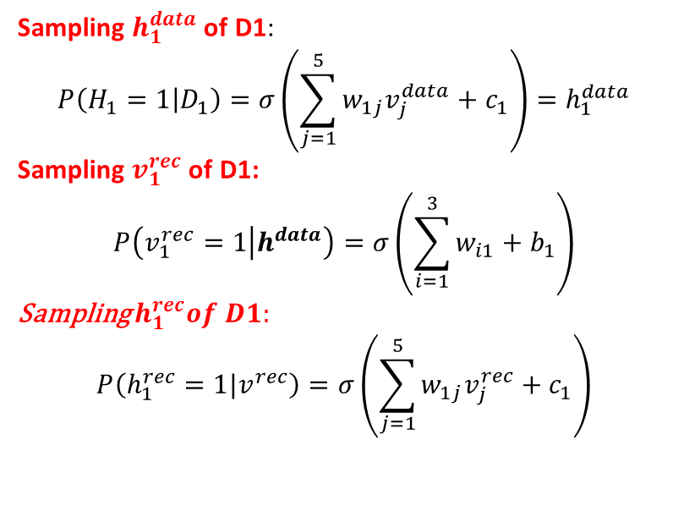
Example of CD-1
Idx | V1 | V2 | V3 | V4 | v5
D1 | 1 | 0 | 1 | 0 | 1
D2 | 1 | 1 | 0 | 0 | 0
D3 | 0 | 0 | 1 | 1 | 1
Sampling $h_{1}^{data}$ of D1:
$$P\left(H_{1}=1 | D_{1}\right)=σ\left(\sum_{j=1}^{5}{w_{1j}v_{j}^{data}+c_{1}}\right)=h_{1}^{data}$$
Sampling $v_{1}^{rec}$ of D1:
$$P\left(v_{1}^{rec}=1 | h^{data}\right)=σ\left(\sum_{i=1}^{3}{w_{i1}+b_{1}}\right)$$
Sampling $h_{1}^{rec}of D1:$
$$P\left(h_{1}^{rec}=1|v^{rec}\right)=σ\left(\sum_{j=1}^{5}{w_{1j}v_{j}^{rec}+c_{1}}\right)$$
$$training vectors d={\left[v_{1}, v_{2}, v_{3}, v_{4}, v_{5}\right]}^{T}∈ℝ^{5×1}$$
$hidden units {\left[h_{1}, h_{2}, h_{3}\right]}^{T}∈ℝ^{3×1}$ (個數由使用者自行決定)
$$weight matrix w_{ij}∈ℝ^{5×3}$$
Visible bias $a_{i}∈ℝ^{5×1}$
Hidden bias $b_{j}∈ℝ^{3×1}$

Slide 28
Deep belief net, layer-wise pre-training
1. RBM for first layer
3. RBM for top layer
500 units
W₁
2000 units
28*28 units (input)
W₄
W₃
10 label units
500 units
2. RBM for second layer
W₂ freeze
500 units
500 units
W₂
W₁ freeze
500 units
28*28 units (input)
W₁ freeze
28*28 units (input)

Slide 29
Deep belief net, fine tuning (wake sleeping algorithm)
Hinton, G. E., Dayan, P., Frey, B. J. and Neal, R. “The wake-sleep algorithm for unsupervised Neural Networks,” Science, Vol. 268, pp. 1158-1161, 1995.
2000 units
2000 units
W₄
W₃
W₄’
W₃’
10 label units
500 units
10 label units
500 units
W₂^{recon}
W₂^{gen}
500 units
500 units
W₁^{recon}
W₁^{gen}
28*28 units (input)
28*28 units (input)

Slide 30
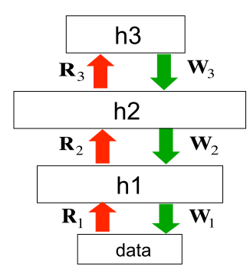
Wake-sleeping algorithm
unsupervised learning for multilayer neural networks
Wake phase:
Use recognition weights to perform a bottom-up pass.
Train the generative weights to reconstruct activities in each layer from the layer above.
Sleep phase:
Use generative weights to generate samples from the model.
Train the recognition weights to reconstruct activities in each layer from the layer below.

Slide 31
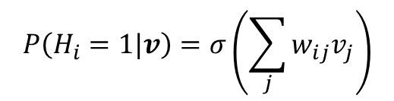
Wake phase (bottom up)
4.wakeTopStates
top
labtop
pentop
lab
pen
3.targets
3.wakePenStates
5.Penhid+= ε(wakePenStates^{T}*(wakehidStates-wakeReconHidProbs))
hidpen
hid
2.wakeHidStates
6.Hidvis+=ε(wakeHidStates^{T}*(data-wakeReconVisProbs))
$$P\left(H_{i}=1|v\right)=σ\left(\sum_{j}{w_{ij}v_{j}}\right)$$
vishid
1.data
vis

Slide 32
Contrastive divergence on top layer(CD-1)
2.negTopStates = wakeTopStates
4.negTopStates
1.posPenTopStatistics = wakePenStates.T* wakeTopStates
5. negPenTopStatistics = negPenStates.T * negTopStates
1.posLabTopStatistics = target.T* wakeTopStates
5.negLabTopStatistics= negLabProbs.T * negTopStates
top
labtop
pentop
lab
pen
targets
3.negLabProbs
wakePenStates
3.negPenStates
Weight matrices labtop and pentop are updated according to CD-1

Slide 33
Sleeping phase (top-down)
top
sleepPenStates=negPenStates
lab
pen
4.Hidpen+= ε(sleepHidStates^{T}*(sleepPenStates-sleepReconPenProbs))
penhid
hid
1.sleepHidStates
3.vishid+=ε((sleepVisProbs^{T}*(sleepHidStates-sleepReconHidProbs))
hidvis
vis
2. sleepVisProbs

Slide 34
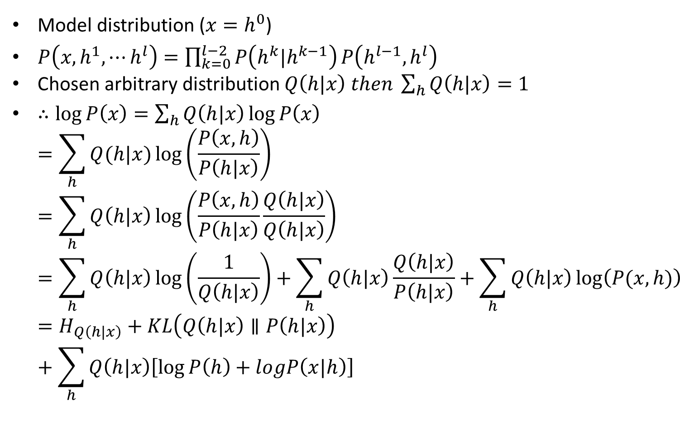
Why DBN works?
Model distribution ($x=h^{0}$)
$P\left(x,h^{1},⋯h^{l}\right)=\prod_{k=0}^{l−2}{P\left(h^{k}|h^{k−1}\right)}P\left(h^{l−1},h^{l}\right)$
Chosen arbitrary distribution $Q\left(h|x\right) then \sum_{h}{Q\left(h|x\right)=1}$
$∴\log{P\left(x\right)}=\sum_{h}{Q\left(h|x\right)}\log{P\left(x\right)}$ $=\sum_{h}{Q(h|x)}\log\left(\frac{P\left(x,h\right)}{P\left(h|x\right)}\right)$ $=\sum_{h}{Q\left(h|x\right)}\log\left(\frac{P\left(x,h\right)}{P\left(h|x\right)}\frac{Q\left(h|x\right)}{Q\left(h|x\right)}\right)=\sum_{h}{Q\left(h|x\right)\log\left(\frac{1}{Q\left(h|x\right)}\right)+\sum_{h}{Q\left(h|x\right)\frac{Q\left(h|x\right)}{P\left(h|x\right)}}+\sum_{h}{Q\left(h|x\right)\log\left(P(x,h)\right)}}=H_{Q\left(h|x\right)}+KL\left(Q\left(h|x\right)∥P\left(h|x\right)\right)+\sum_{h}{Q\left(h|x\right)\left[\log{P\left(h\right)}+logP\left(x|h\right)\right]}$

Slide 35
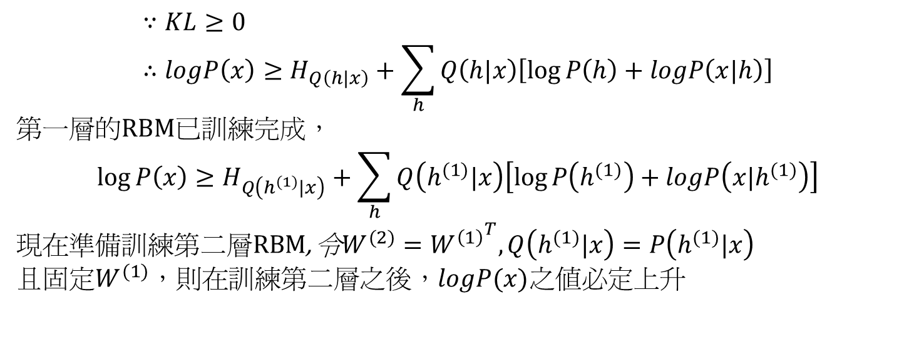
$$∵KL≥0 \\ ∴logP\left(x\right)≥H_{Q\left(h|x\right)}+\sum_{h}{Q\left(h|x\right)\left[\log{P\left(h\right)}+logP\left(x|h\right)\right]}$$
第一層的RBM已訓練完成，
$$\log{P\left(x\right)}≥H_{Q\left(h^{(1)}|x\right)}+\sum_{h}{Q\left(h^{(1)}|x\right)\left[\log{P\left(h^{(1)}\right)}+logP\left(x|h^{(1)}\right)\right]}$$
現在準備訓練第二層RBM, 令$W^{(2)}={W^{\left(1\right)}}^{T},Q\left(h^{(1)}|x\right)=P\left(h^{(1)}|x\right)$
且固定$W^{(1)}$，則在訓練第二層之後，$logP(x)$之值必定上升

Slide 36
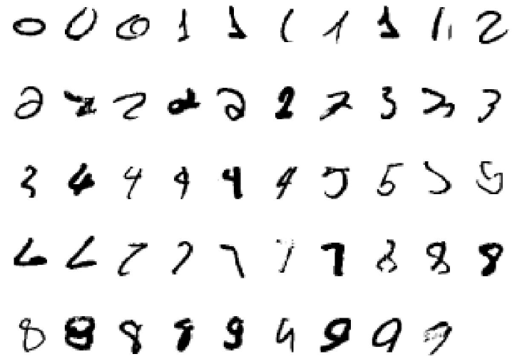
Experiments
Dataset: MNIST (handwritten digits)
http://yann.lecun.com/exdb/mnist/

Slide 37
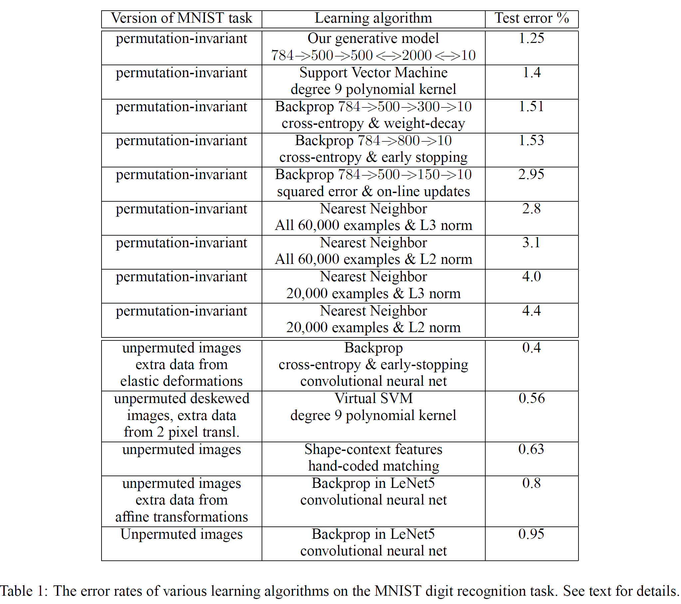

Slide 38
Parameters for DBN
Structure:
Num. of layers
Num. of units of each layer
Type of the RBM (standard, Gaussian, or others)
Learning:
Num. of epoch (generation)
Size of mini-batch
Num. of Gibbs sampling (CD-k)
Learning rate
Momentum

Slide 39
Related deep models
Stacked autoencoder Hinton, G. E. and Salakhutdinov, R. R , “Reducing the dimensionality of data with neural networks,” Science, Vol. 313. no. 5786, pp. 504 - 507, 28 July 2006.
Denoising autoencoder Vincent, H. Larochelle Y. Bengio and P.A. Manzagol, “Extracting and Composing Robust Features with Denoising Autoencoders,” Proceedings of the Twenty-fifth International Conference on Machine Learning (ICML‘08), pp. 1096 - 1103, ACM, 2008.
Deep Boltzmann machine
Salakhutdinov, R. R. and Hinton, G. E., “An Efficient Learning Procedure for Deep Boltzmann Machines,” Neural Computation, 2012.

Slide 40
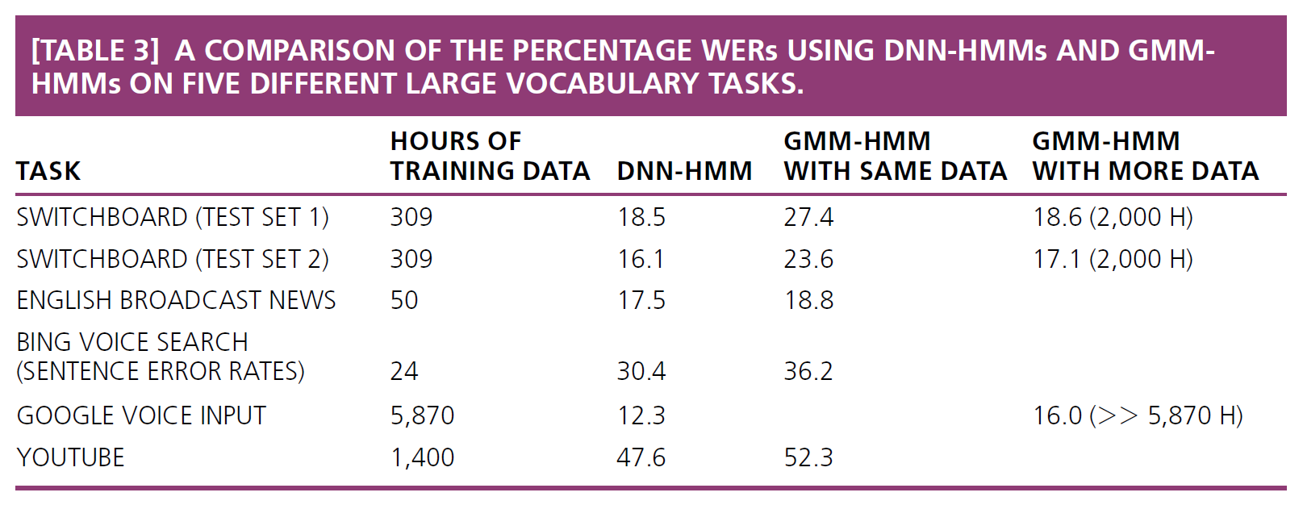
Application in time series
Geoffrey Hinton, Li Deng, Dong Yu, George Dahl, Abdel-rahman Mohamed, Navdeep Jaitly, Andrew Senior, Vincent Vanhoucke, Patrick Nguyen, Tara Sainath, and Brian Kingsbury, “Deep Neural Networks for Acoustic Modeling in Speech Recognition,” IEEE Signal Processing Magazine, November 2012 (in press)
Experiment: word recognition from the voice
WERs: word error rate

Slide 41
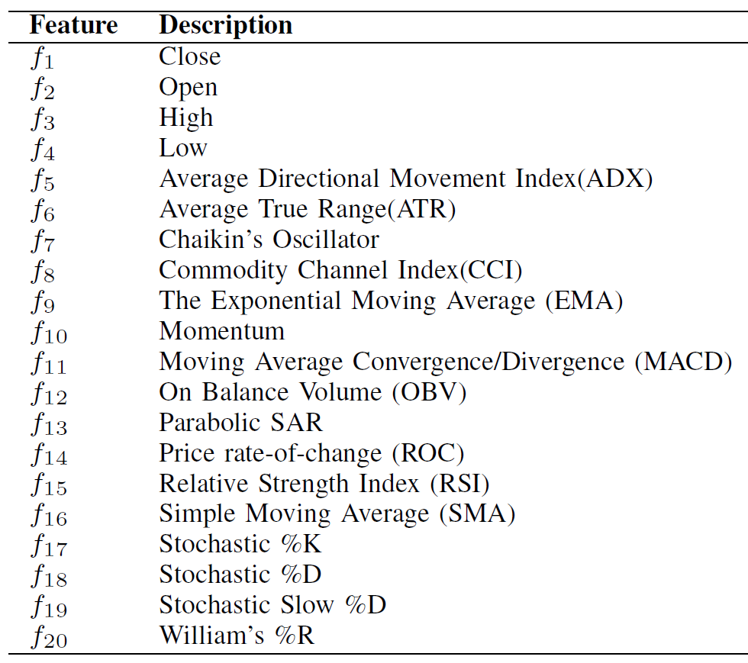
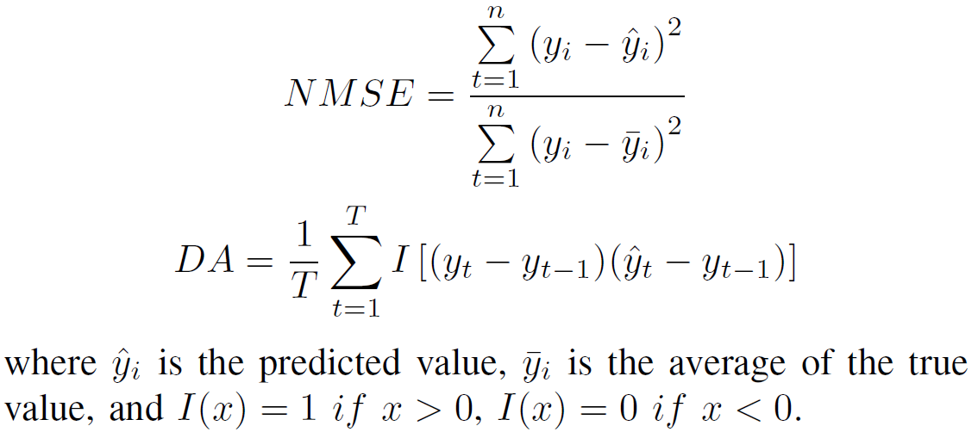
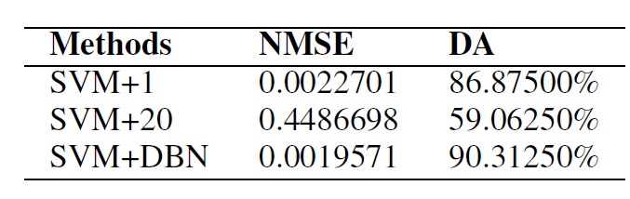
Xianggao Cai, Su Hu, and Xiaola Lin, ”Feature extraction using Restricted Boltzmann Machine for stock price prediction, ” Computer Science and Automation Engineering (CSAE), 2012 IEEE International Conference on, pp. 80-82, 2012.
Using DBN to do feature extraction for SVR
S&P500 daily close price prediction
2000/1/3~2011/2/22
(2800 points, 2500 for training, 300 for testing)
SVR for S&P500 and f₁~f₂₀
SVR for S&P500 with f₁~f₄ and 20 stocks with f₄~f₂₀
SVR for S&P500 with f₁~f₄ and 20 stocks with trained (DBN) f₄~f₂₀

Slide 42

Thank you!!

