Slide 1
Dynamic Signature Verification through the Longest Common Subsequence Problem and Genetic Algorithms
Alejandro Flores-Mendez and Manuel Bernal-Urbina Evolutionary Computation (CEC), 2010 IEEE Congress on, Pages 1-6
Presenter: Guo Yi-Pu 2013-02-05

Slide 2
Abstract
The following paper includes an automated system that shows the use of signature data for biometric verification. The verification uses the dynamic distinctiveness of the signature, thus this method lies within those referred as dynamic or on-line signature verification. This proposal makes use of a variation of the Longest Common Subsequence Problem together with Genetic Algorithm for this purpose.

Slide 3

The Problem to Solve
Learning: original signature $S_{1},S_{2},…,S_{k}$ of a person
Input: any signature $S^{′}$
Output: accept/reject

Slide 4
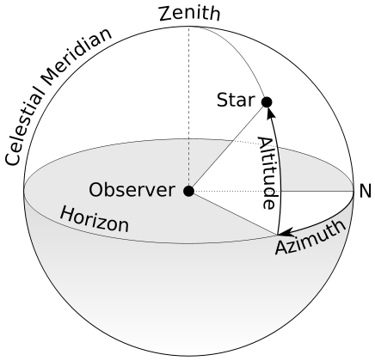
Dynamic Signature
Captured by a PDA, a digitizer, etc.
A number of events:
current position x, y
time t
button status bs
azimuth degree a
altitude degree h
pressure p
distance dist
derivatives of x, y, a, h and p
Notes:
簽名一定有筆劃順序，故可視為時間序列。 http://en.wikipedia.org/wiki/Azimuth

Slide 5
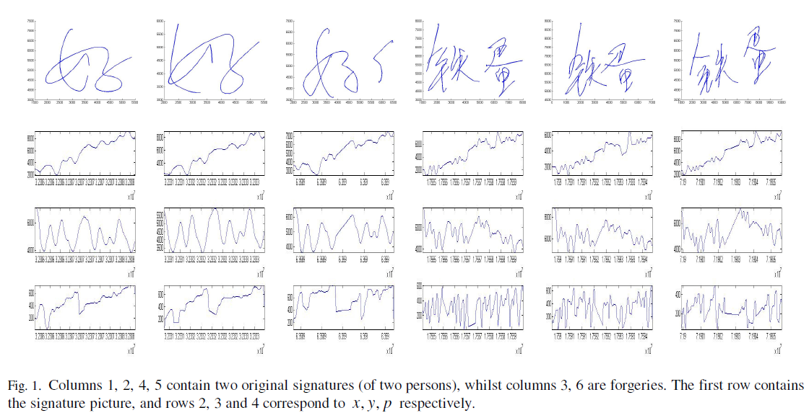

Slide 6
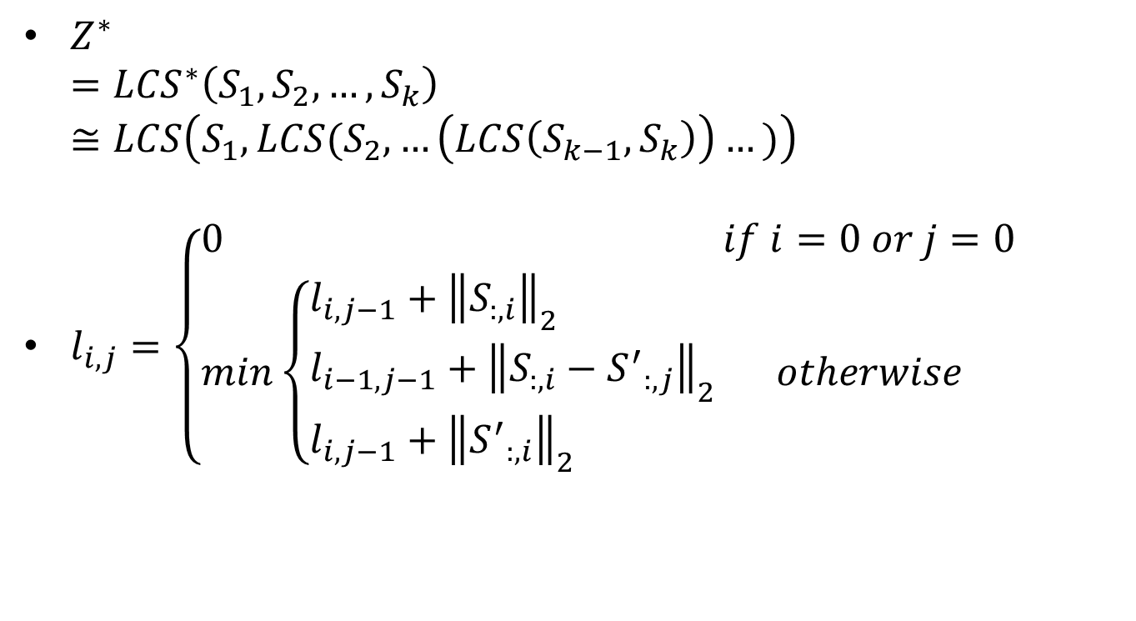
Learning
$Z^{∗}$ $={LCS}^{∗}\left(S_{1},S_{2},…,S_{k}\right)$ $≅LCS\left(S_{1},LCS(S_{2},…\left(LCS\left(S_{k−1},S_{k}\right)\right)…)\right)$
$l_{i,j}=\left\{\begin{aligned}&0&if i=0 or j=0 \\ &min\left\{\begin{aligned}&l_{i,j−1}+{\left\|S_{:,i}\right\|}_{2} \\ &l_{i−1,j−1}+{\left\|S_{:,i}−{S^{′}}_{:,j}\right\|}_{2} \\ &l_{i,j−1}+{\left\|{S^{′}}_{:,i}\right\|}_{2}\end{aligned}\right.&otherwise\end{aligned}\right.$
Notes:
因為 Σ 是值而非字元，故算距離，似 DTW。

Slide 7
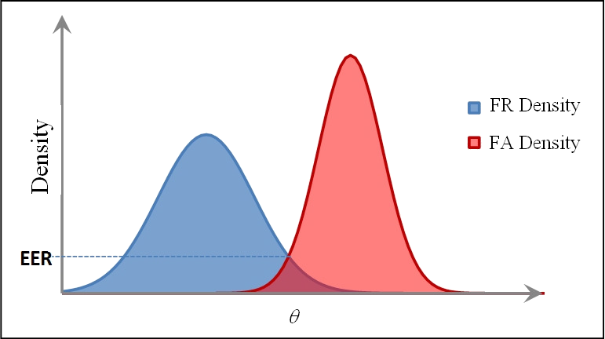

Verification
$d^{∗}=LCS\left(S^{′},Z^{∗}\right)$
$d^{∗}≤θ$
The threshold: θ
Θ↓；False Rejection (FR)↑
Θ↑；False Acceptance (FA)↑
Equal Error Rate (EER)
Notes:
Θ 在最大或最小 FA 與 FR 會下降至 0？

Slide 8
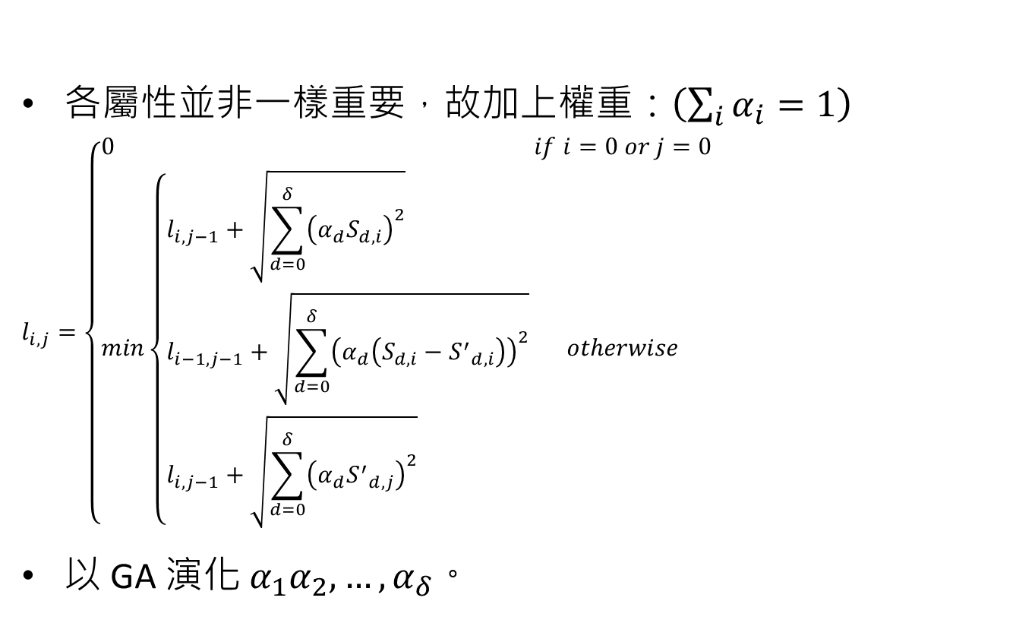
Genetic Algorithm
各屬性並非一樣重要，故加上權重：$\left(\sum_{i}{α_{i}}=1\right)$
$$l_{i,j}=\left\{\begin{aligned}&0&if i=0 or j=0 \\ &min\left\{\begin{aligned}&l_{i,j−1}+\sqrt{\sum_{d=0}^{δ}{{\left(α_{d}S_{d,i}\right)}^{2}}} \\ &l_{i−1,j−1}+\sqrt{\sum_{d=0}^{δ}{{\left(α_{d}\left(S_{d,i}−{S^{′}}_{d,i}\right)\right)}^{2}}} \\ &l_{i,j−1}+\sqrt{\sum_{d=0}^{δ}{{\left(α_{d}{S^{′}}_{d,j}\right)}^{2}}}\end{aligned}\right.&otherwise\end{aligned}\right.$$
以 GA 演化 $α_{1}α_{2},…,α_{δ}$。

Slide 9
Database: SVC04
Signature Verification Competition 2004
40 persons × (20 originals + 20 forgeries)
Original signatures were taken in 2 session (10 in each session).
Forgeries were informed on how good was faked. (practicing is allowed)
To calculate EER:
Randomly choose k signatures from 10 originals (k=2, 3, 5).

Slide 10
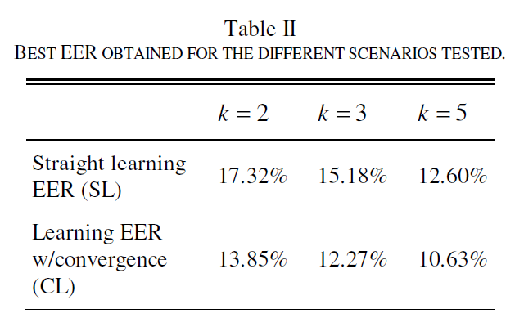
Result

Slide 11
